Slide 1
O Sacred Head
PASSION CHORALE
7.6.7.6.D
Words: | Attr. to Bernard of Clairvaux (12th Century), Tr. James W. Alexander (1830)
Music: | Hans L. Hassler (1601), Arr. J. S. Bach (1729)
4/2
C/E - MI
Verses: 3
Lead - | MI
Alto - | DO
Tenor - | SOL
Bass - | DO
PDHymns.com

Slide 2
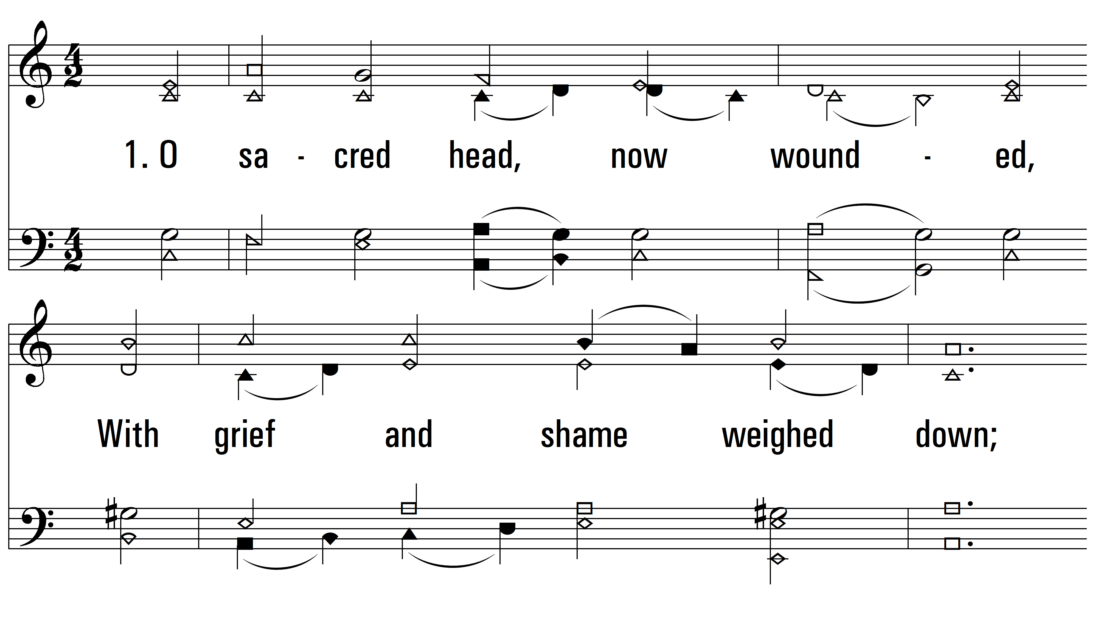
vs. 1 ~ O Sacred Head

Slide 3
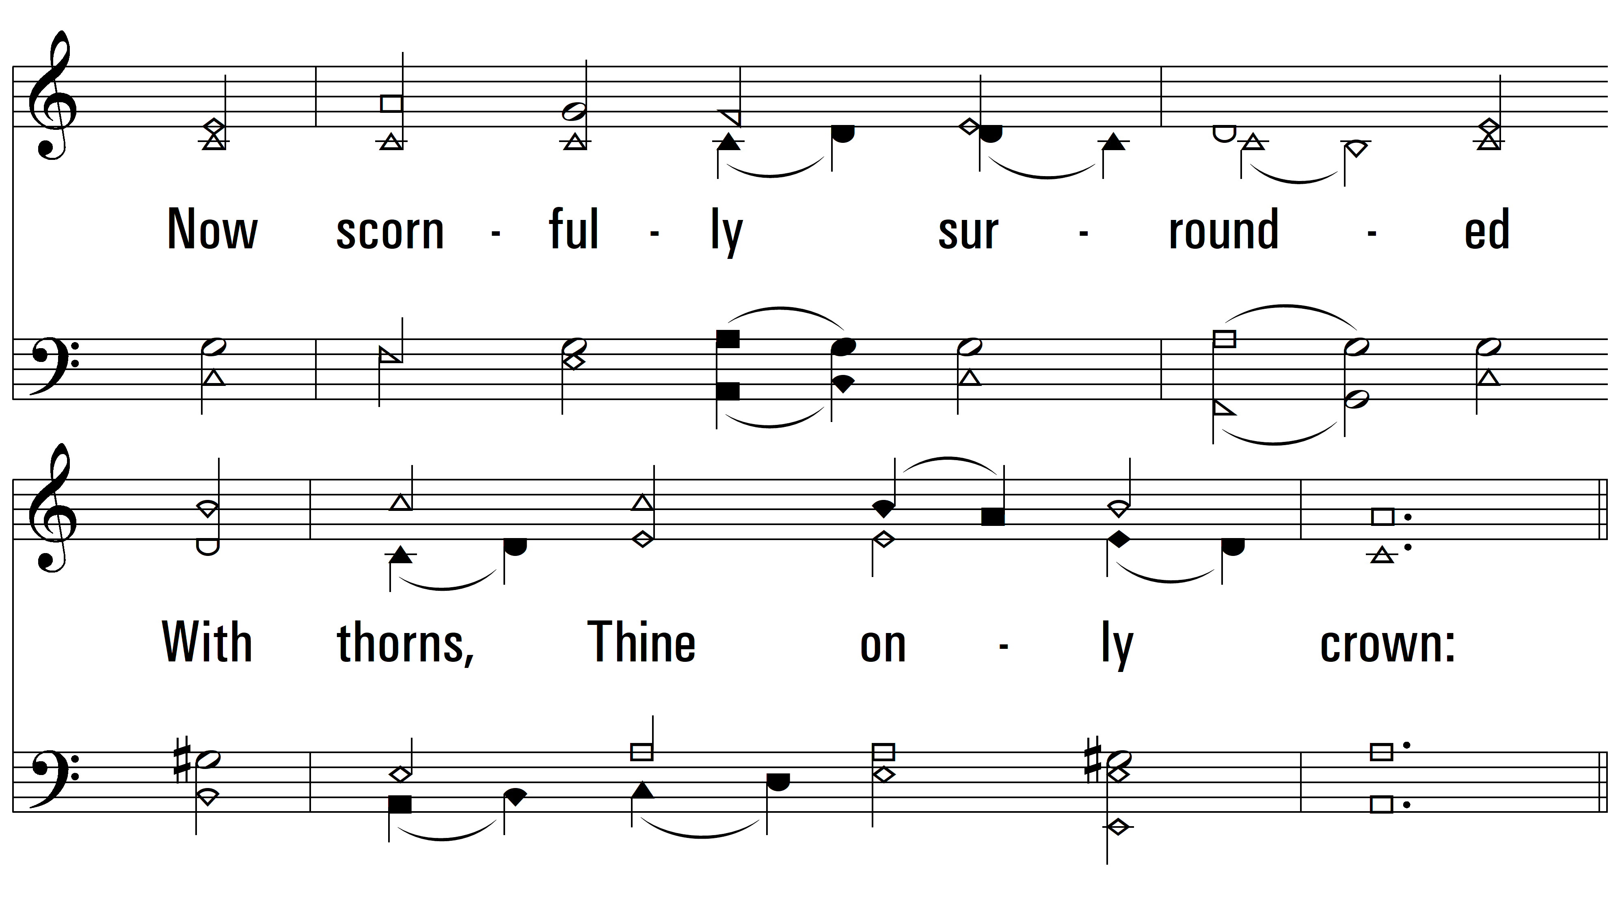
vs. 1

Slide 4
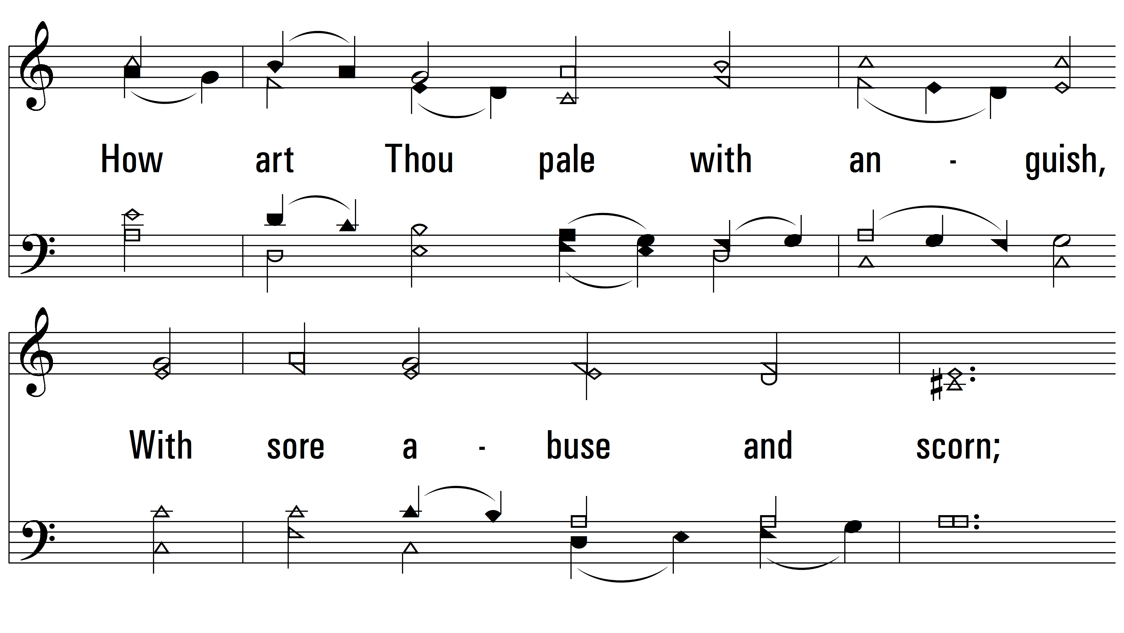
vs. 1

Slide 5
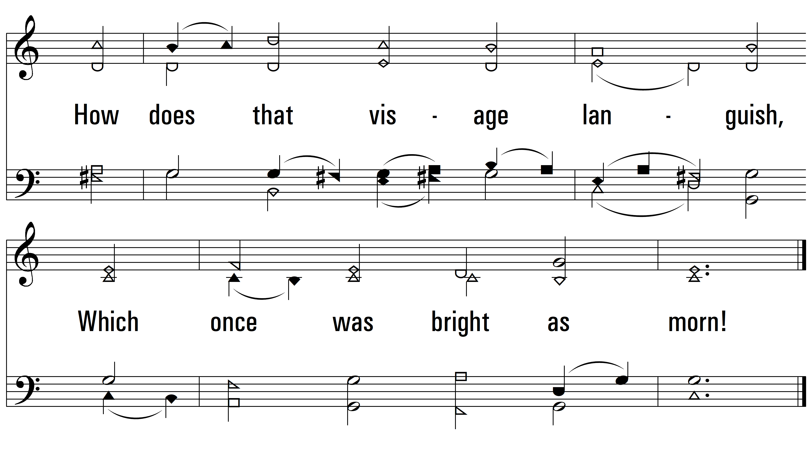
vs. 1

Slide 6
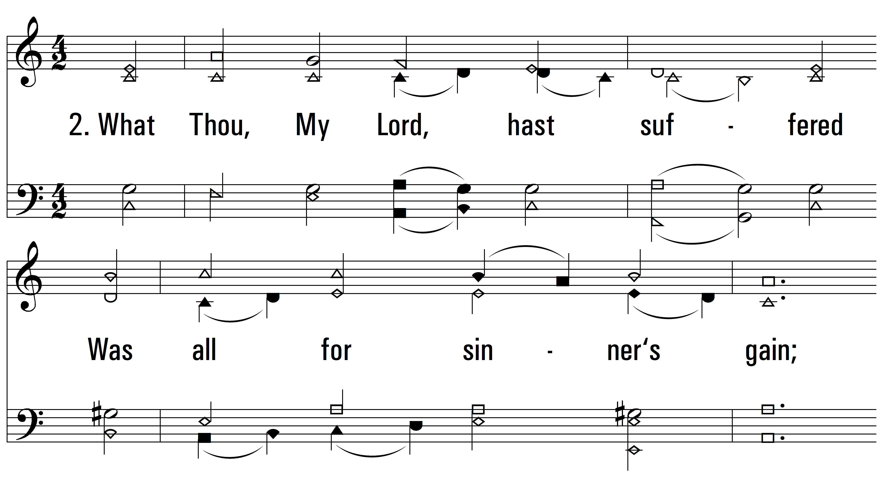
vs. 2 ~ O Sacred Head

Slide 7
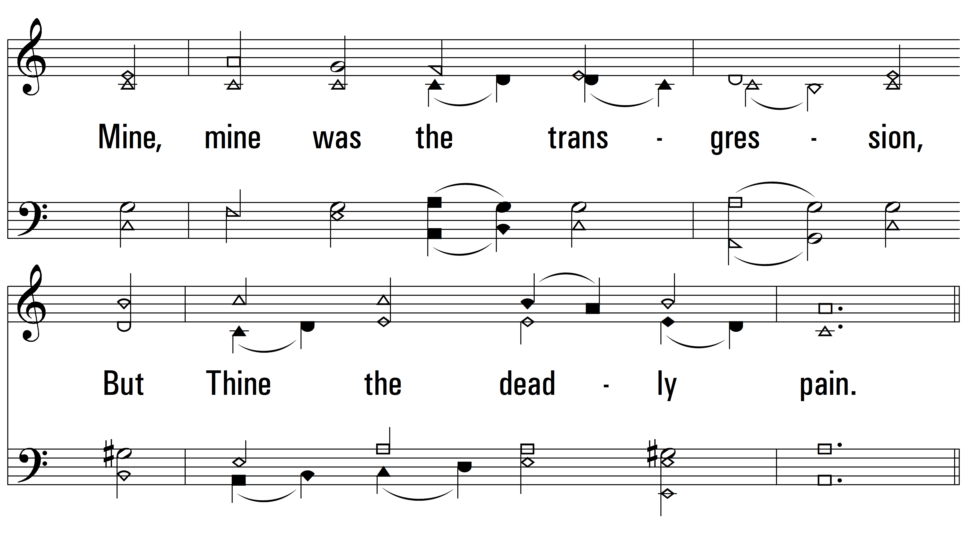
vs. 2

Slide 8
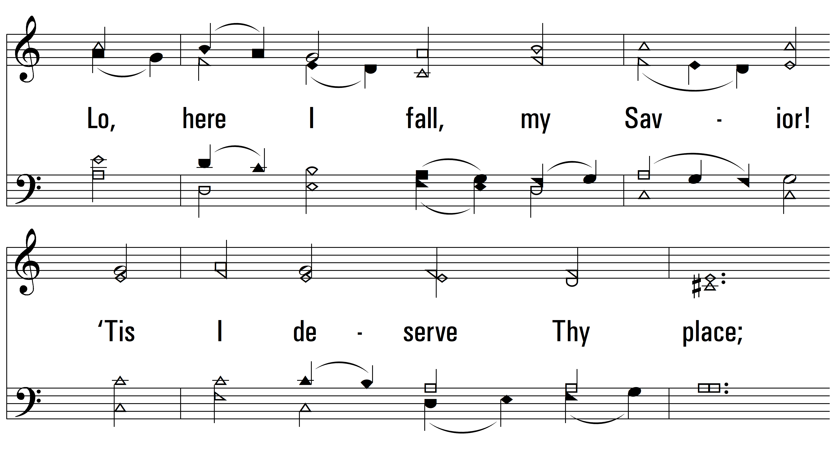
vs. 2

Slide 9
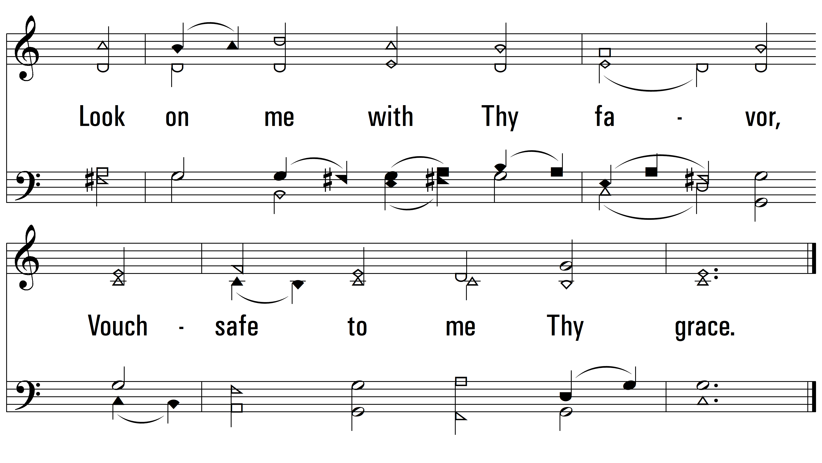
vs. 2

Slide 10
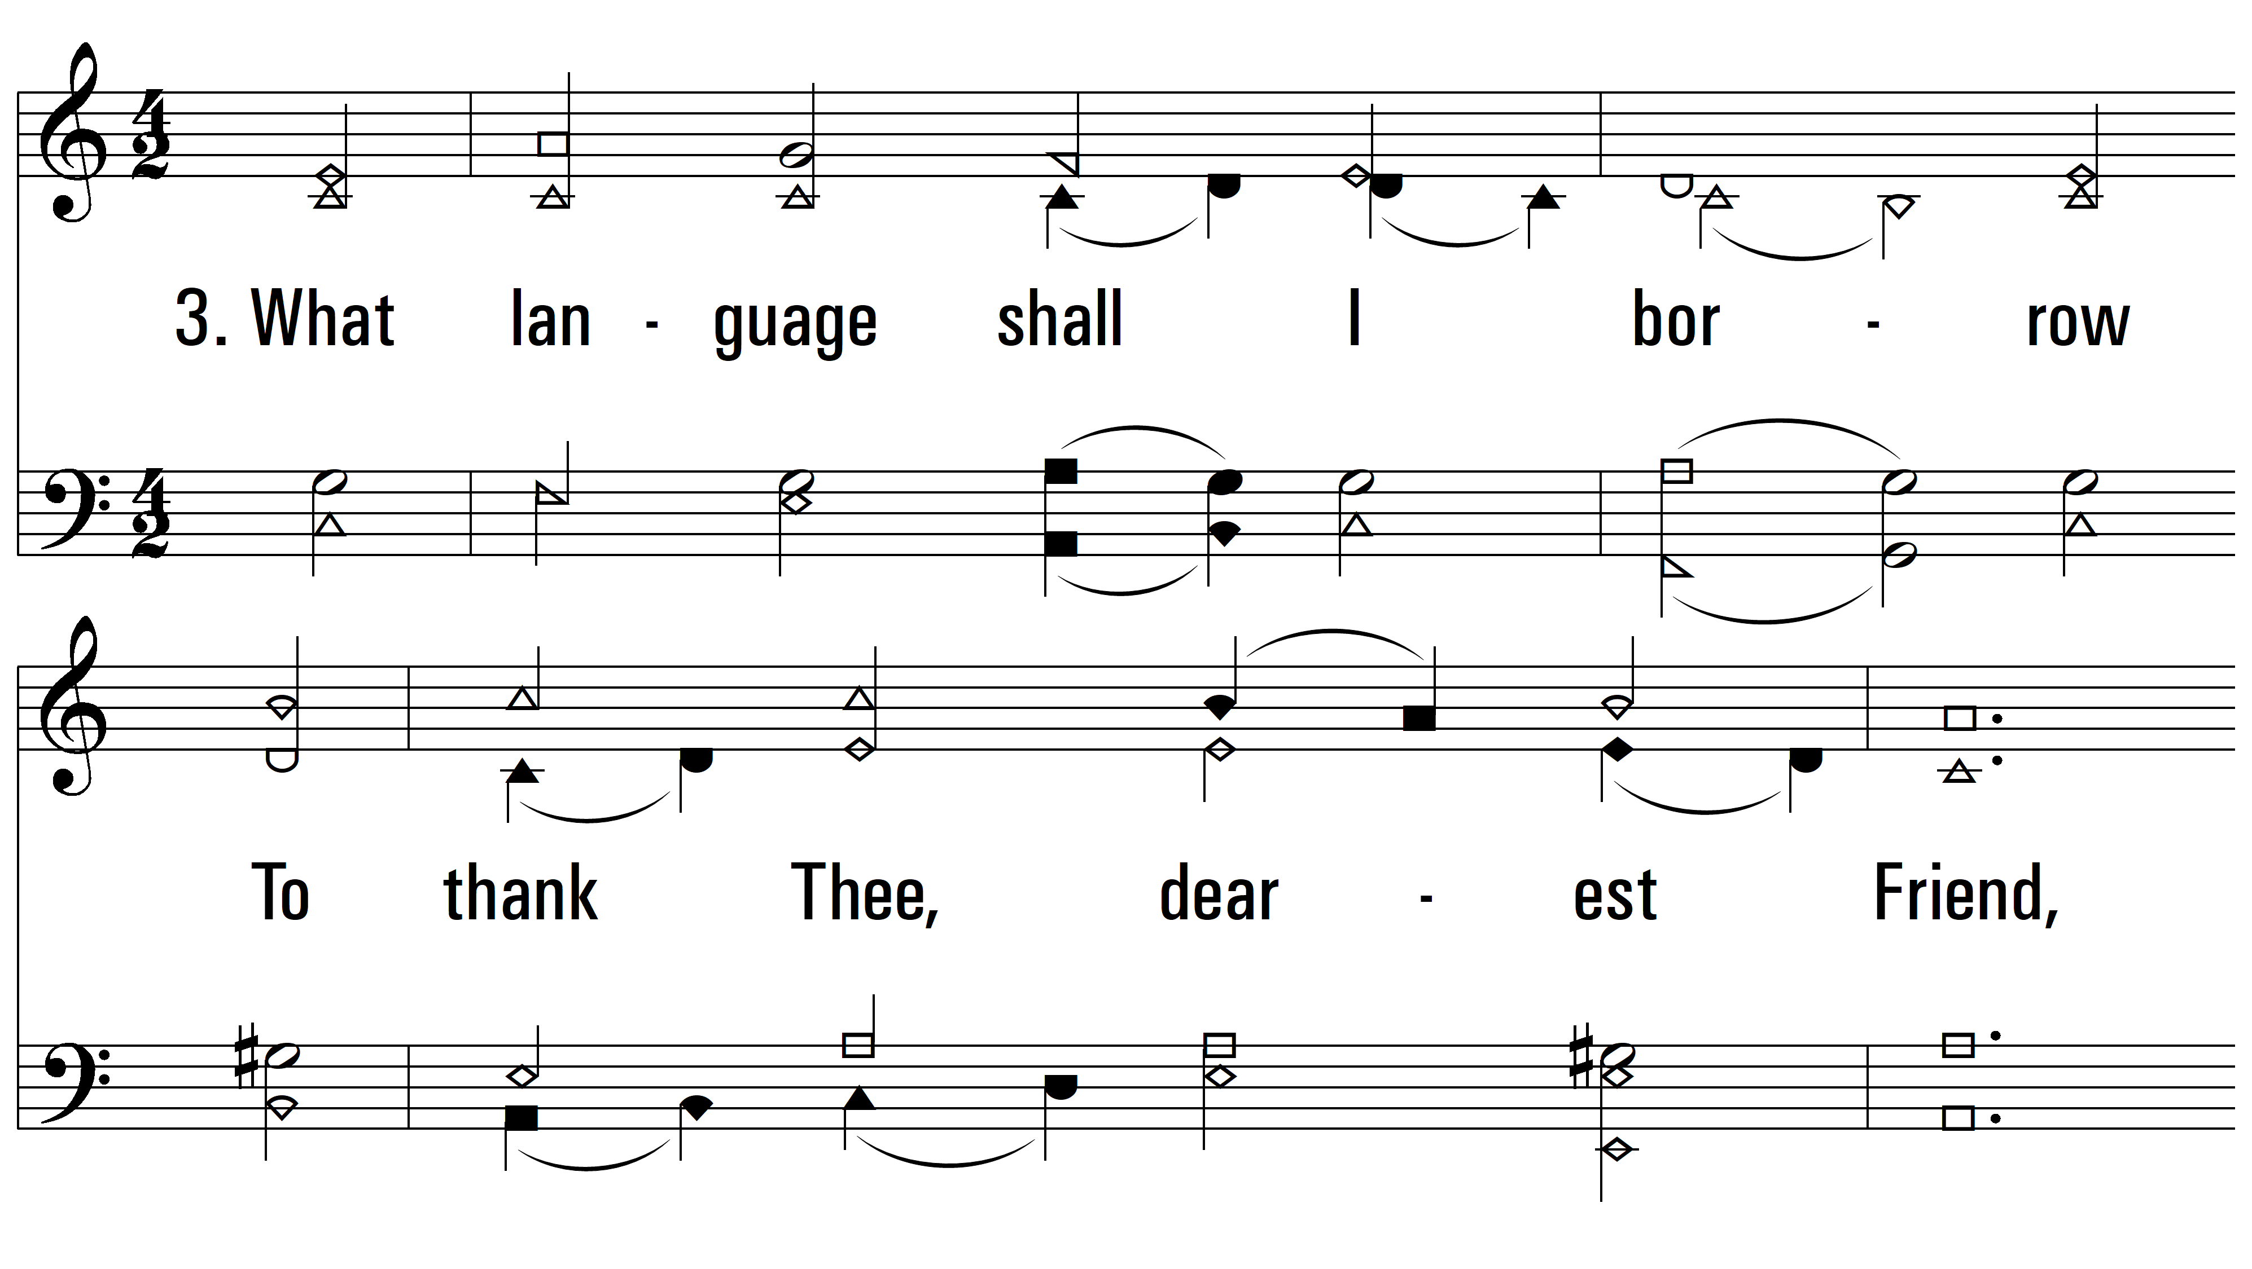
vs. 3 ~ O Sacred Head

Slide 11
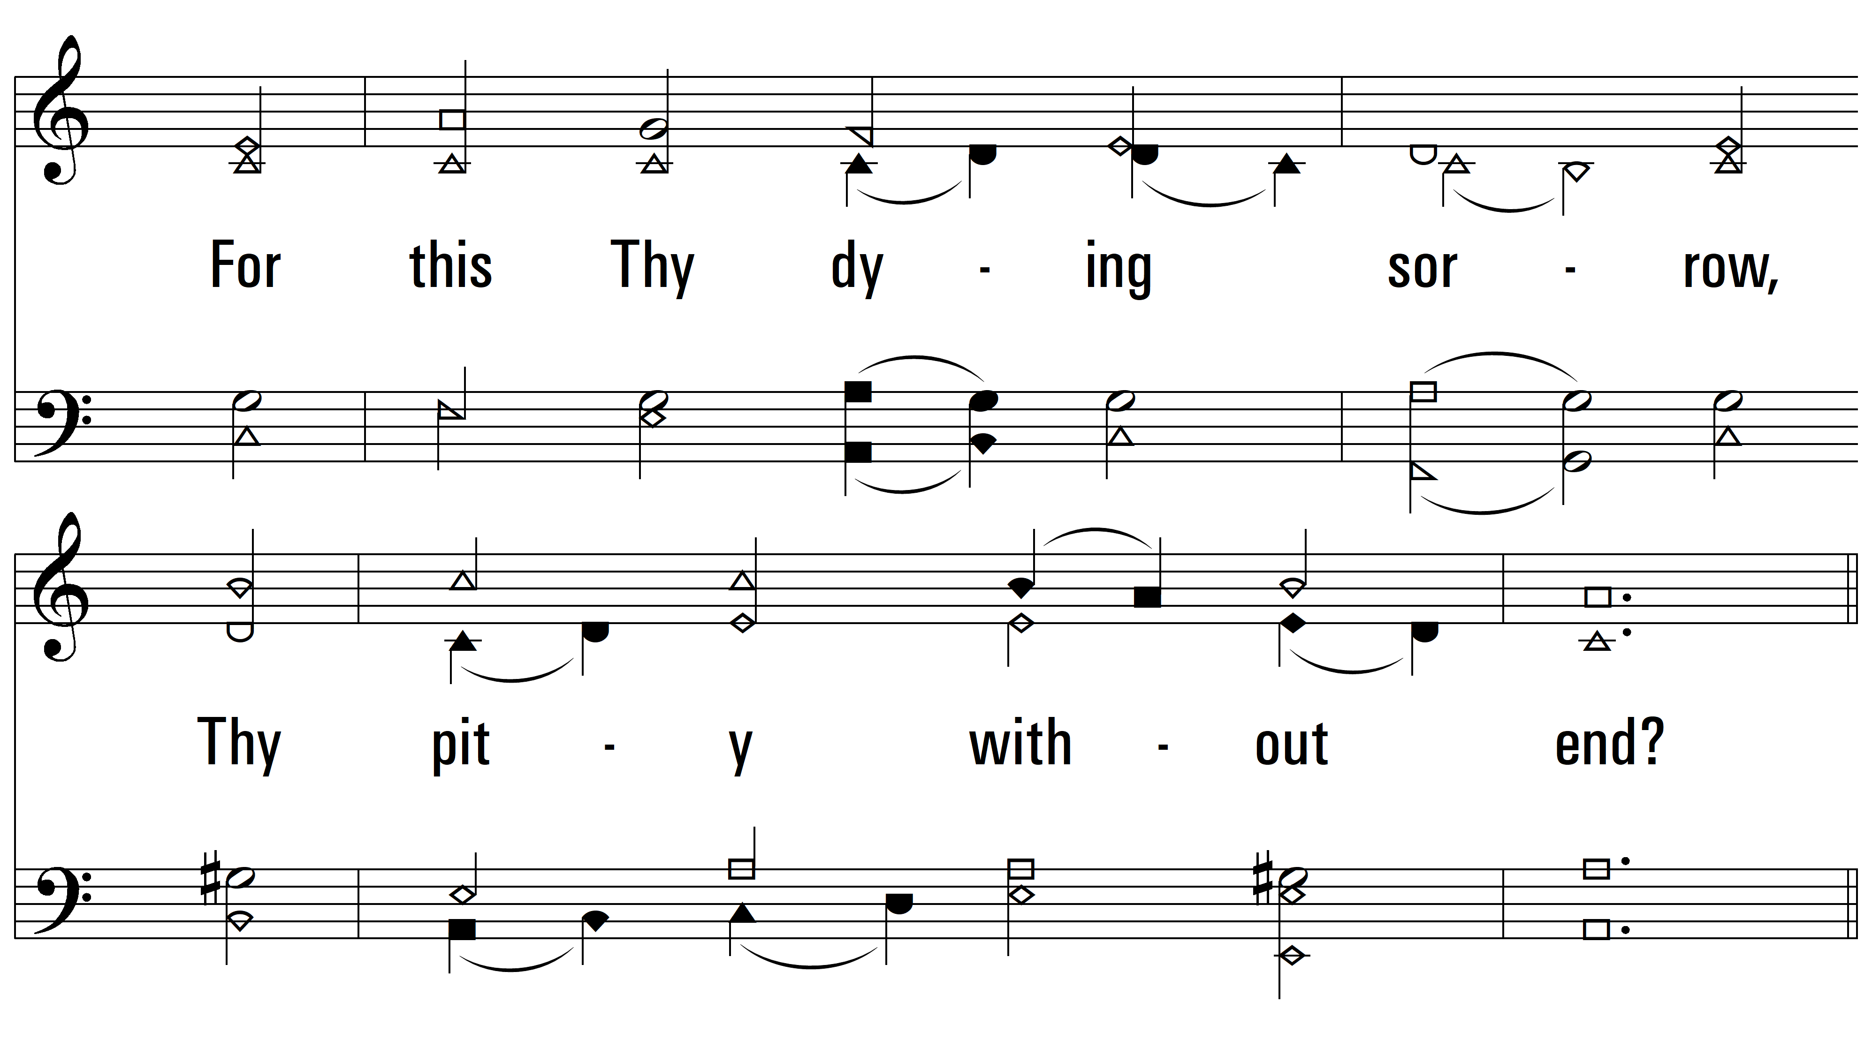
vs. 3

Slide 12
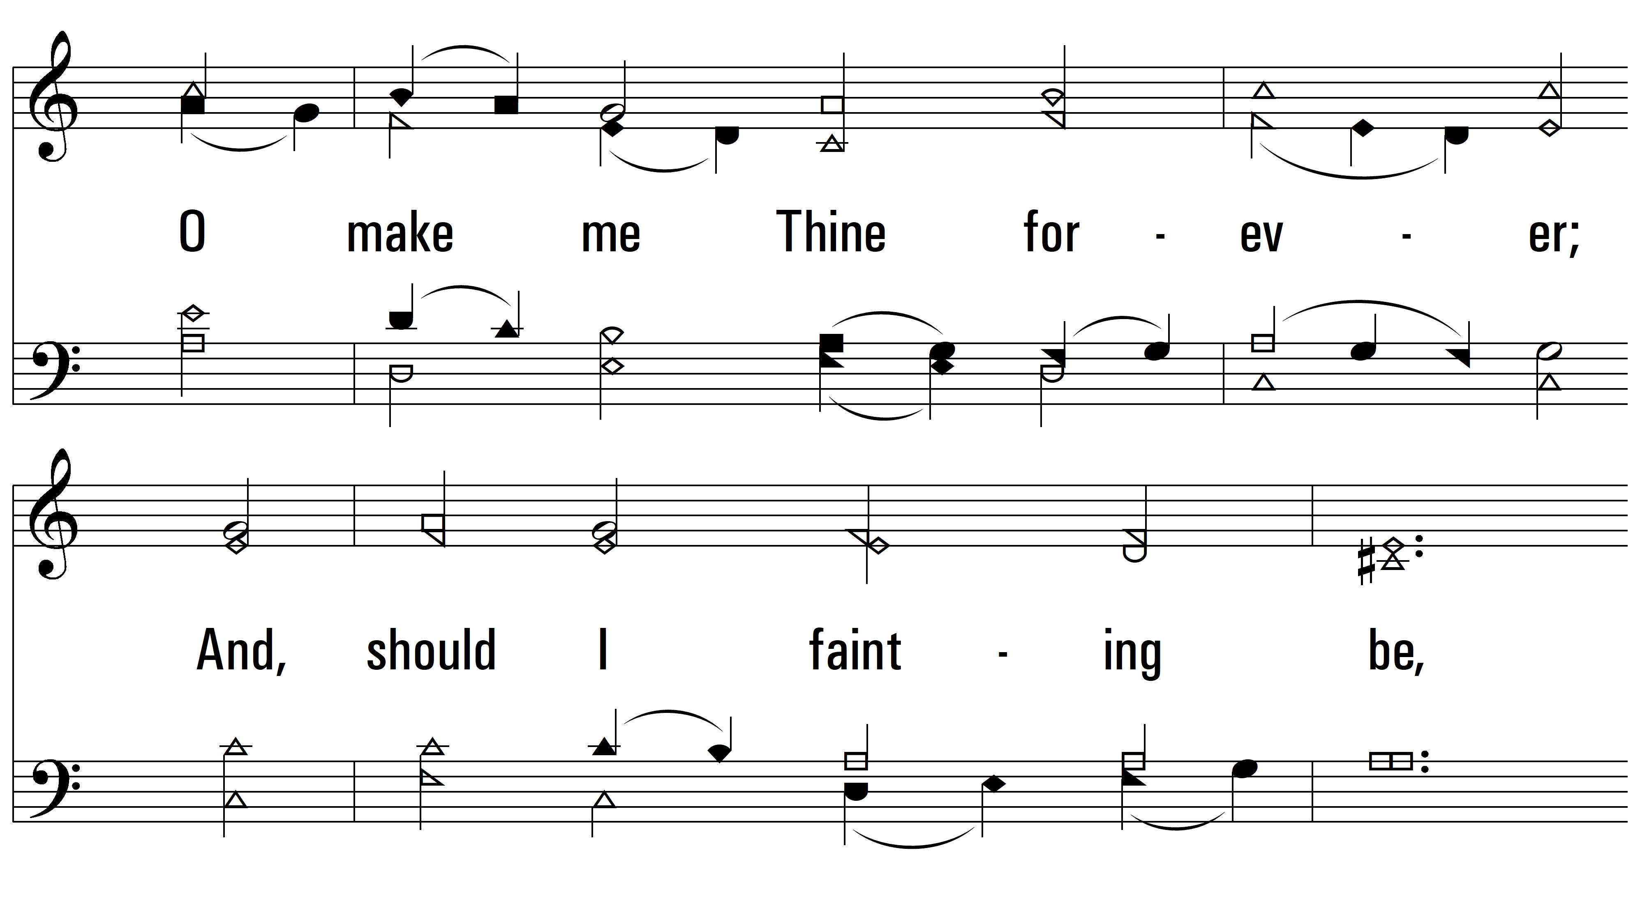
vs. 3

Slide 13
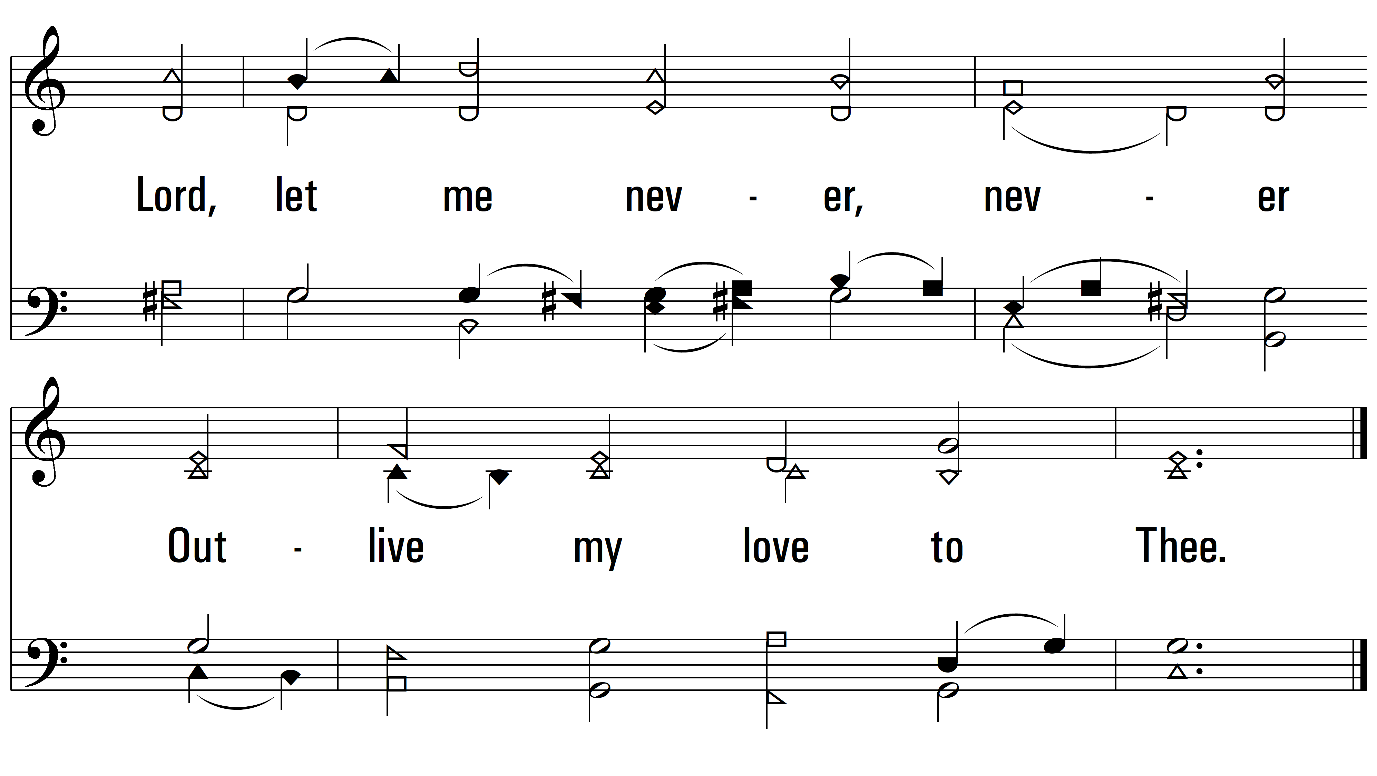
vs. 3
PDHymns.com
END

