Slide 1
O Praise The Lord
Words: | Psalm 117
Music: | Will Hill (c. 1921)
3/4
C/C - DO
Verses: 1
Lead - | DO
Alto - | MI
Tenor - | SOL
Bass - | DO
PDHymns.com

Slide 2
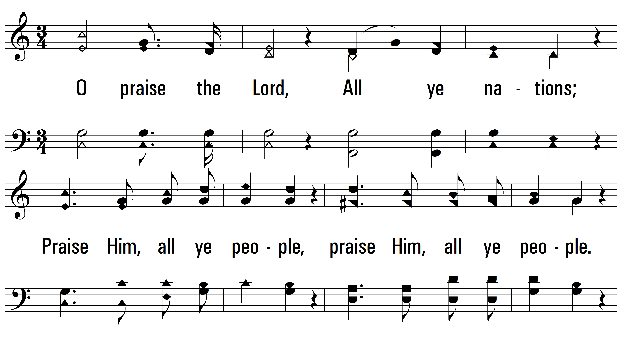
vs. 1 ~ O Praise The Lord

Slide 3
vs. 1

Slide 4
vs. 1
PDHymns.com
END

