Slide 1
O Perfect Love
SANDRINGHAM
11.10.11.10
Words: | Dorothy B. Gurney (1884)
Music: | John Barnby (1889), Arr. John Stainer (1893)
4/4
E^{b}/E^{b} - DO
Verses: 3
Lead - | DO
Alto - | DO
Tenor - | MI
Bass - | DO
PDHymns.com

Slide 2
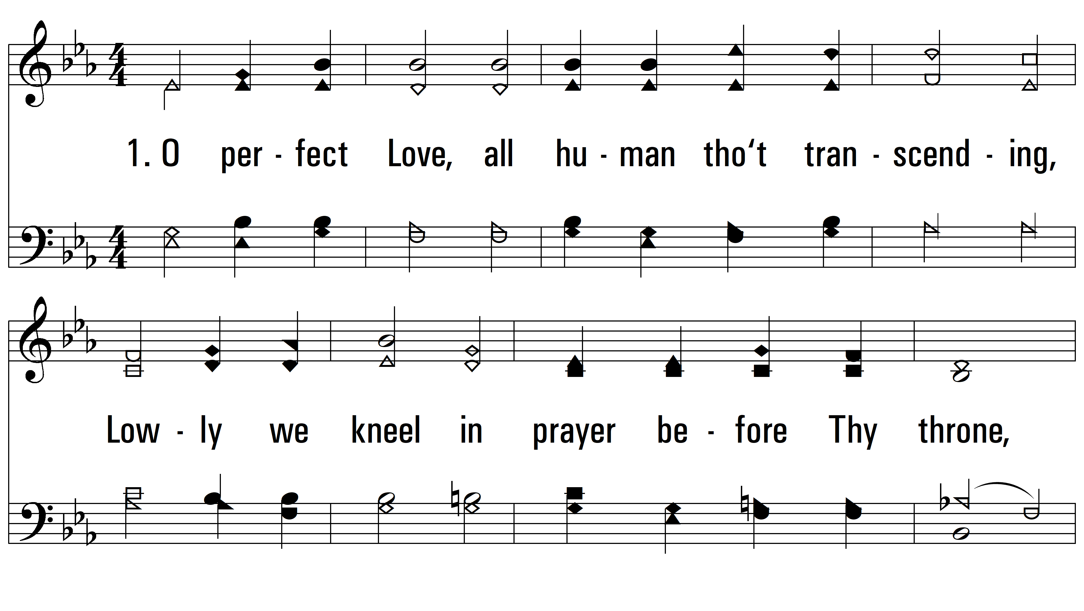
vs. 1 ~ O Perfect Love

Slide 3
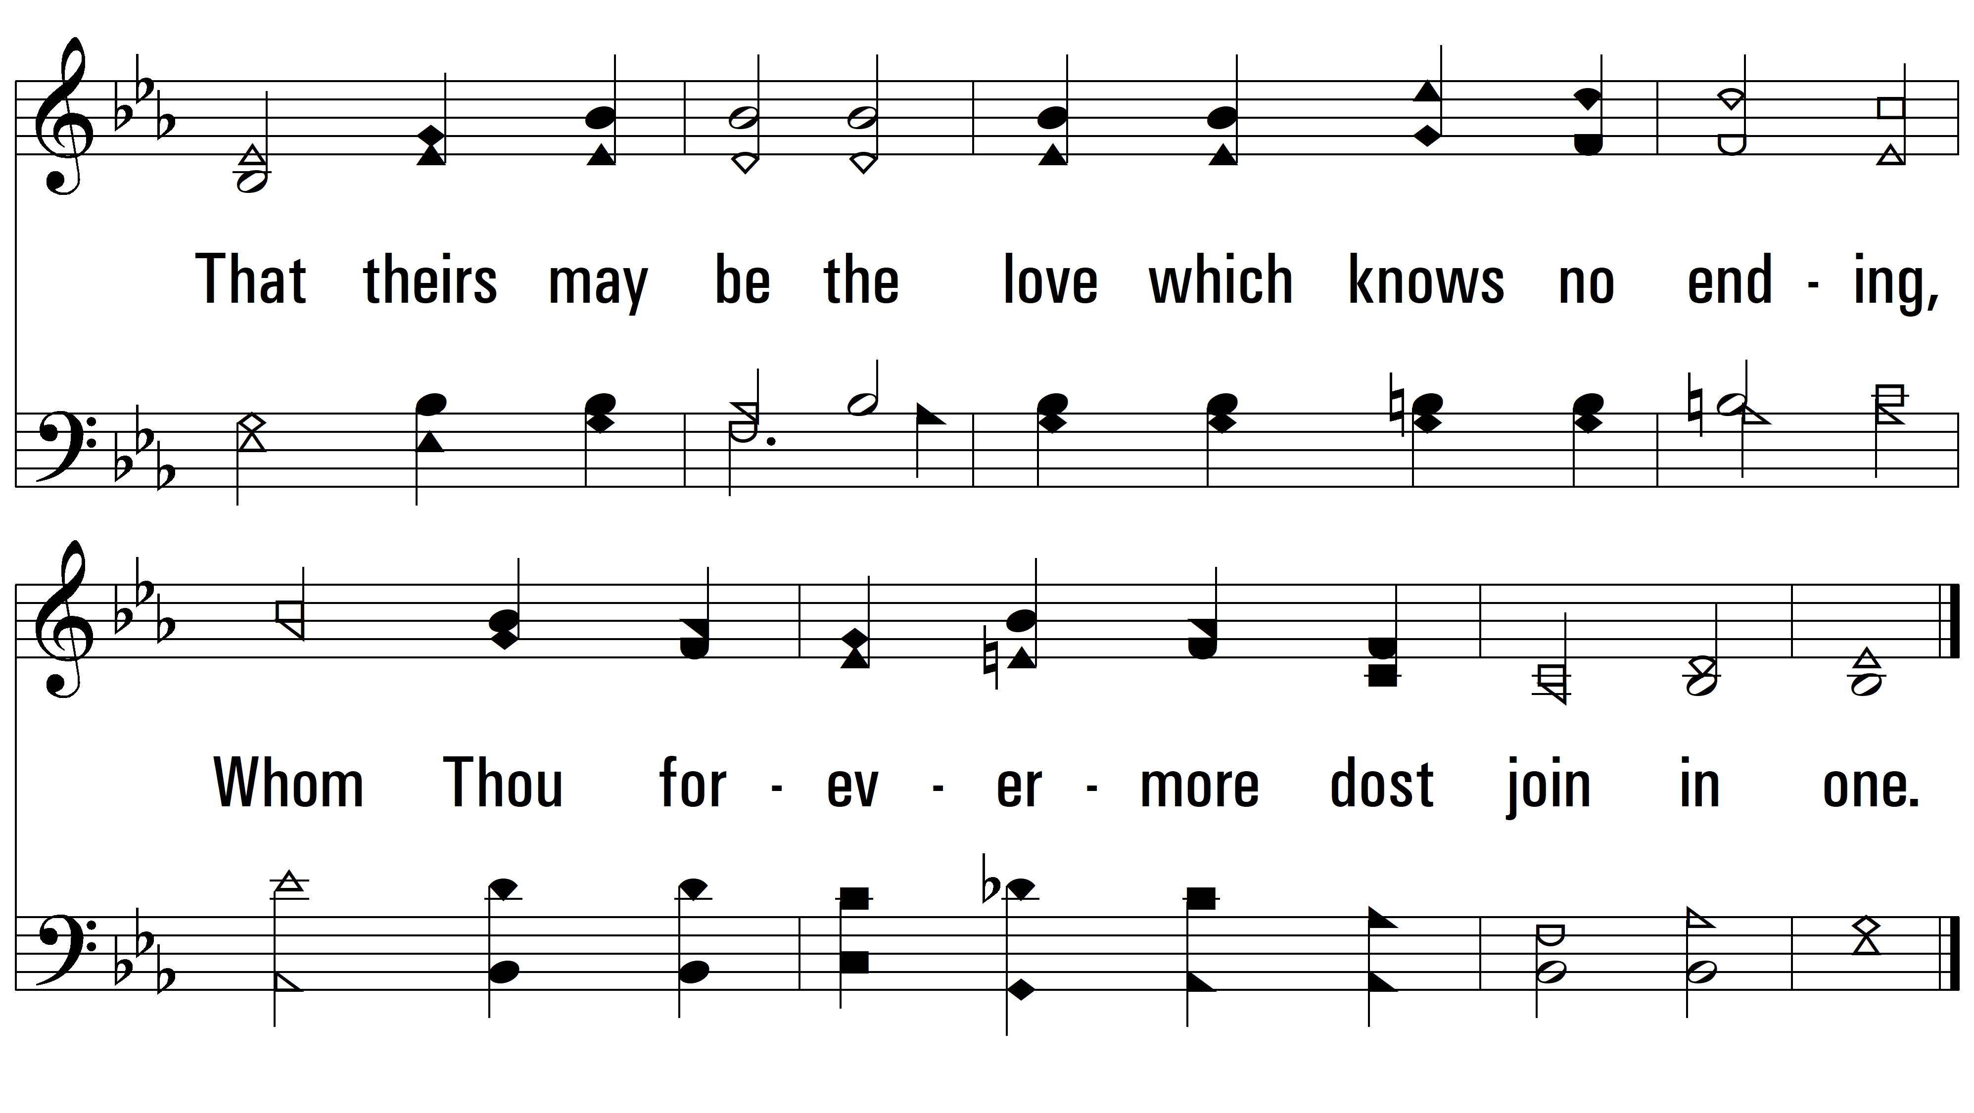
vs. 1

Slide 4
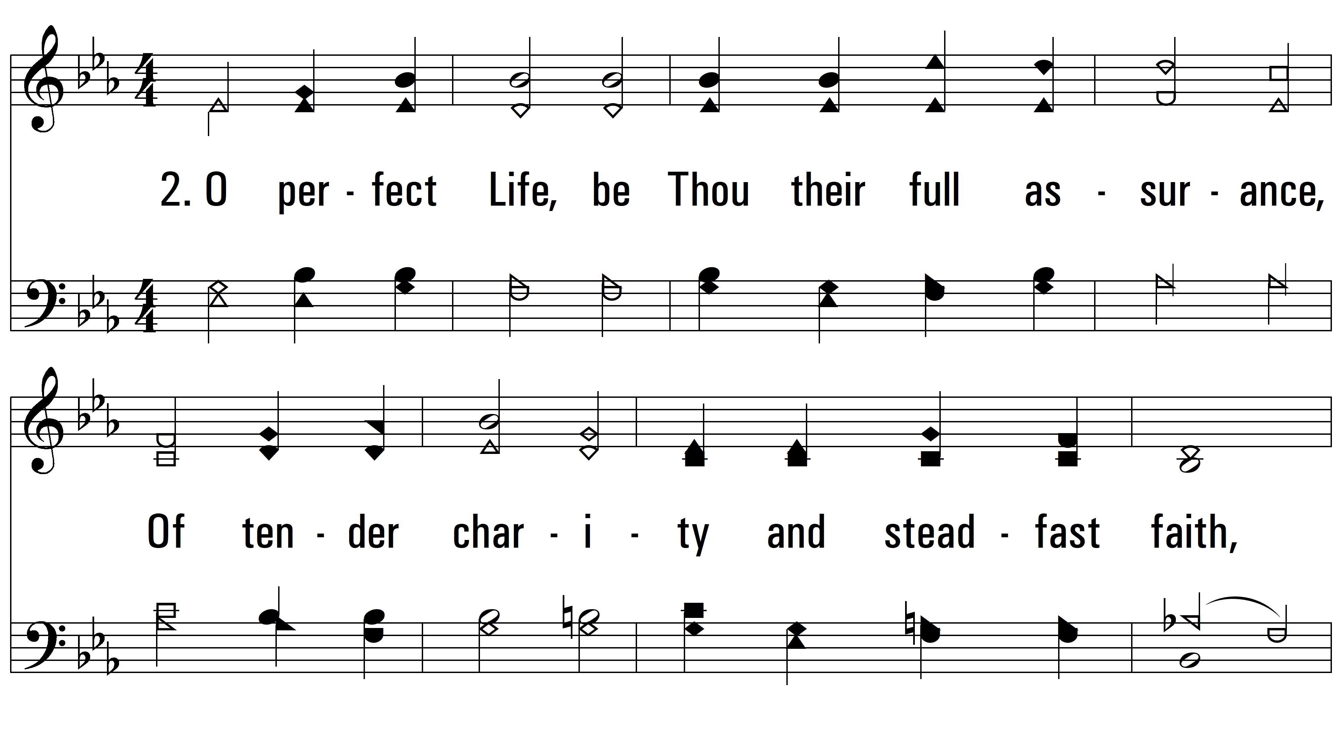
vs. 2 ~ O Perfect Love

Slide 5
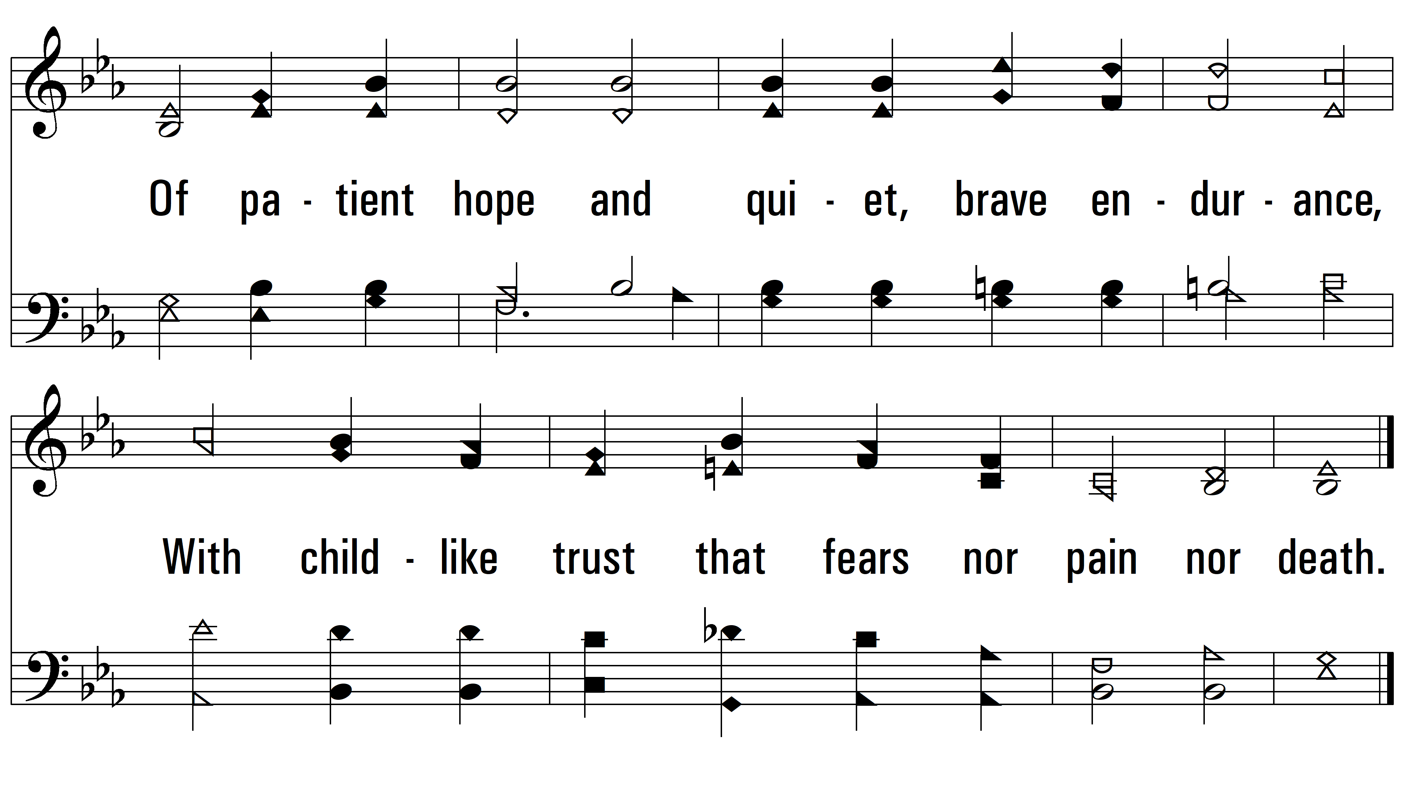
vs. 2

Slide 6
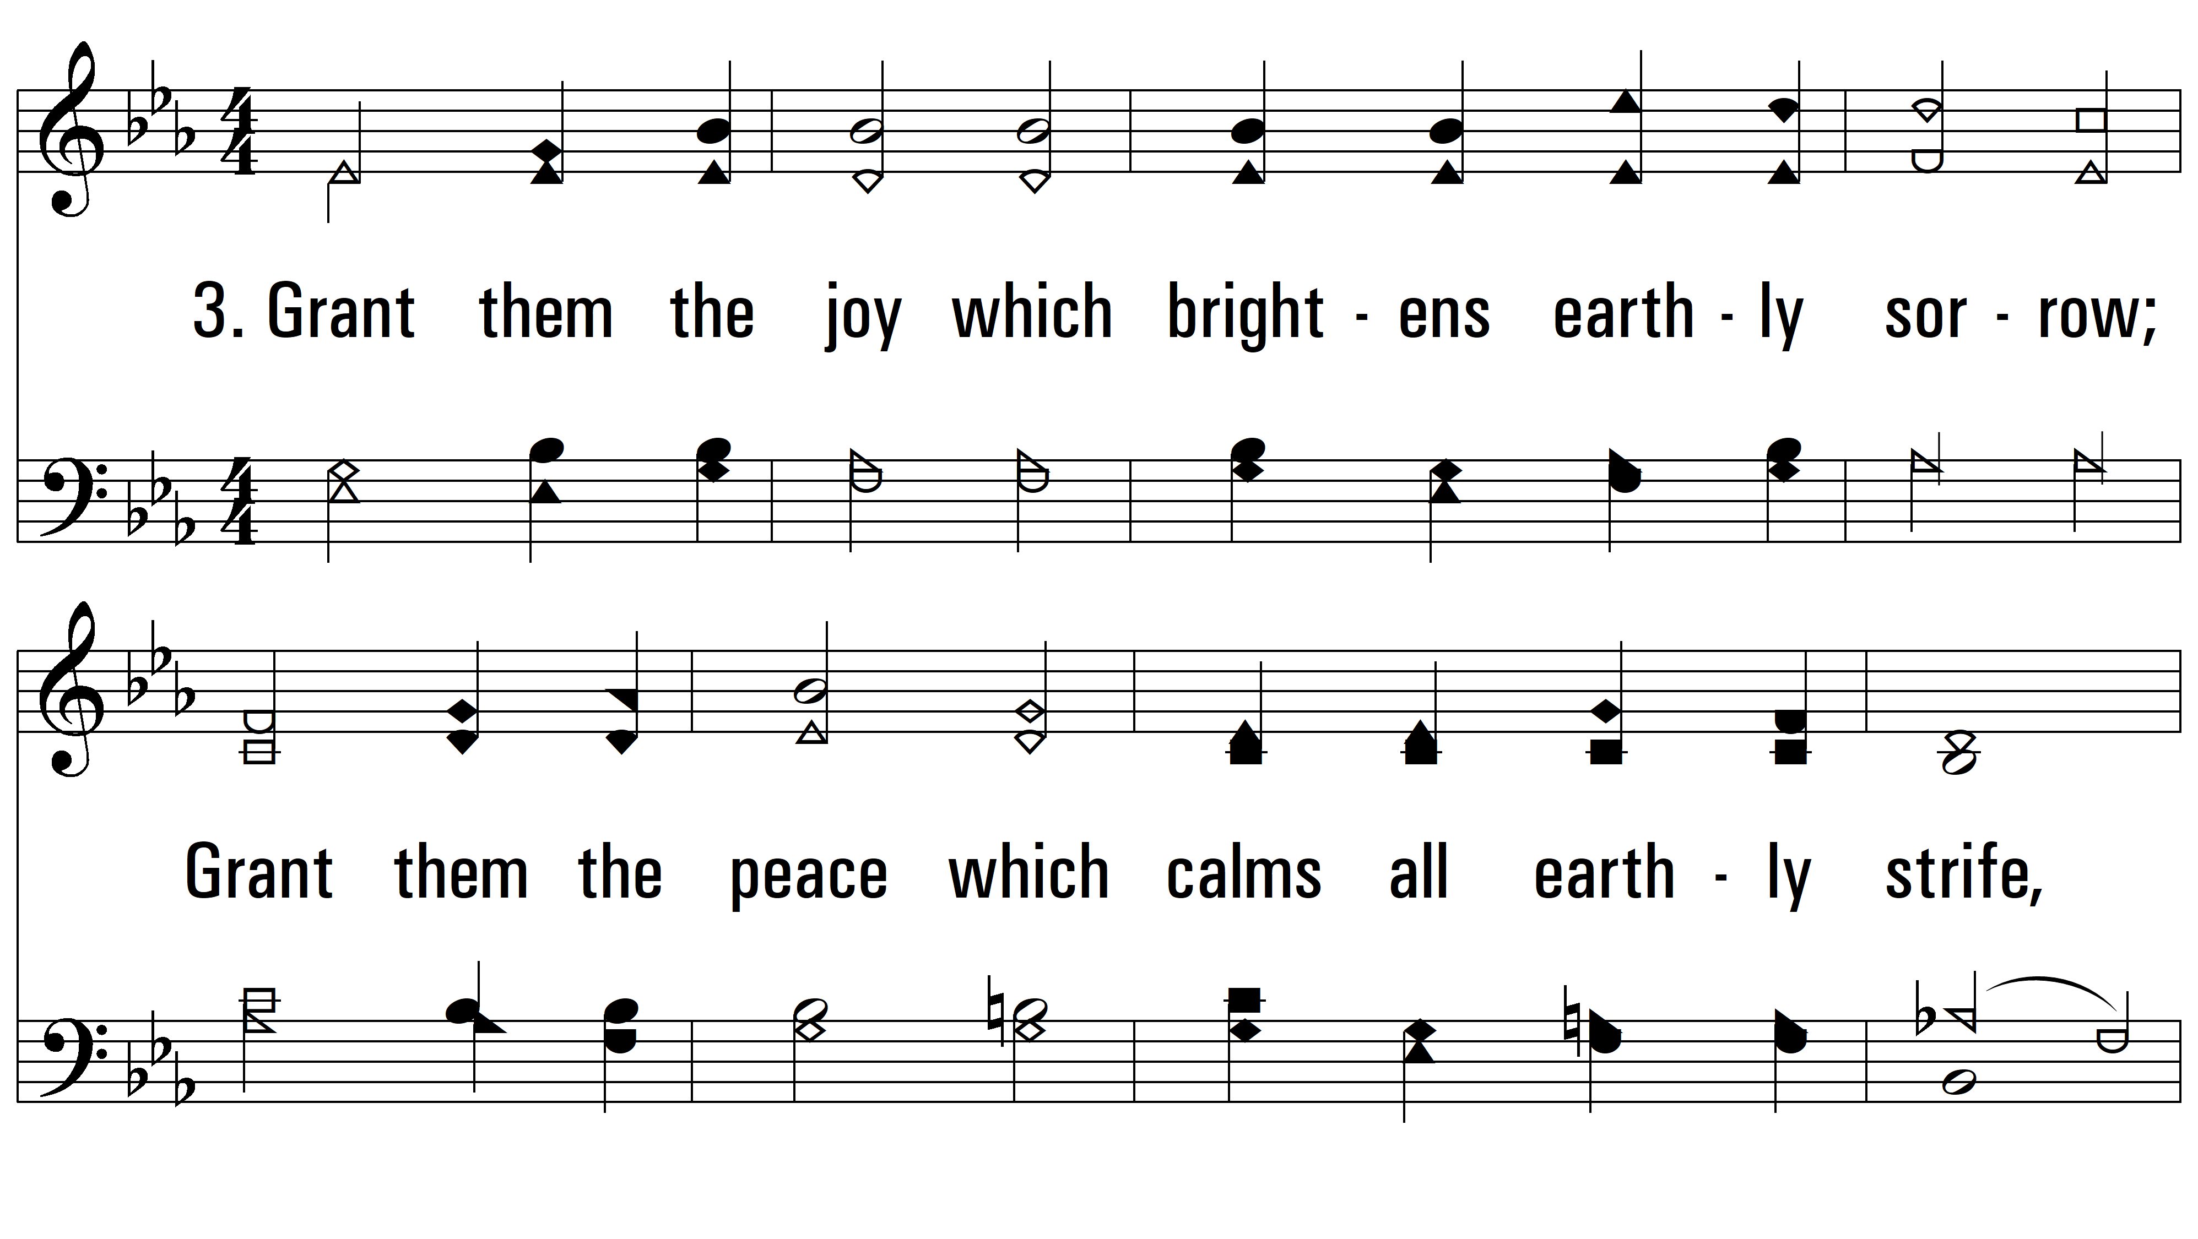
vs. 3 ~ O Perfect Love

Slide 7
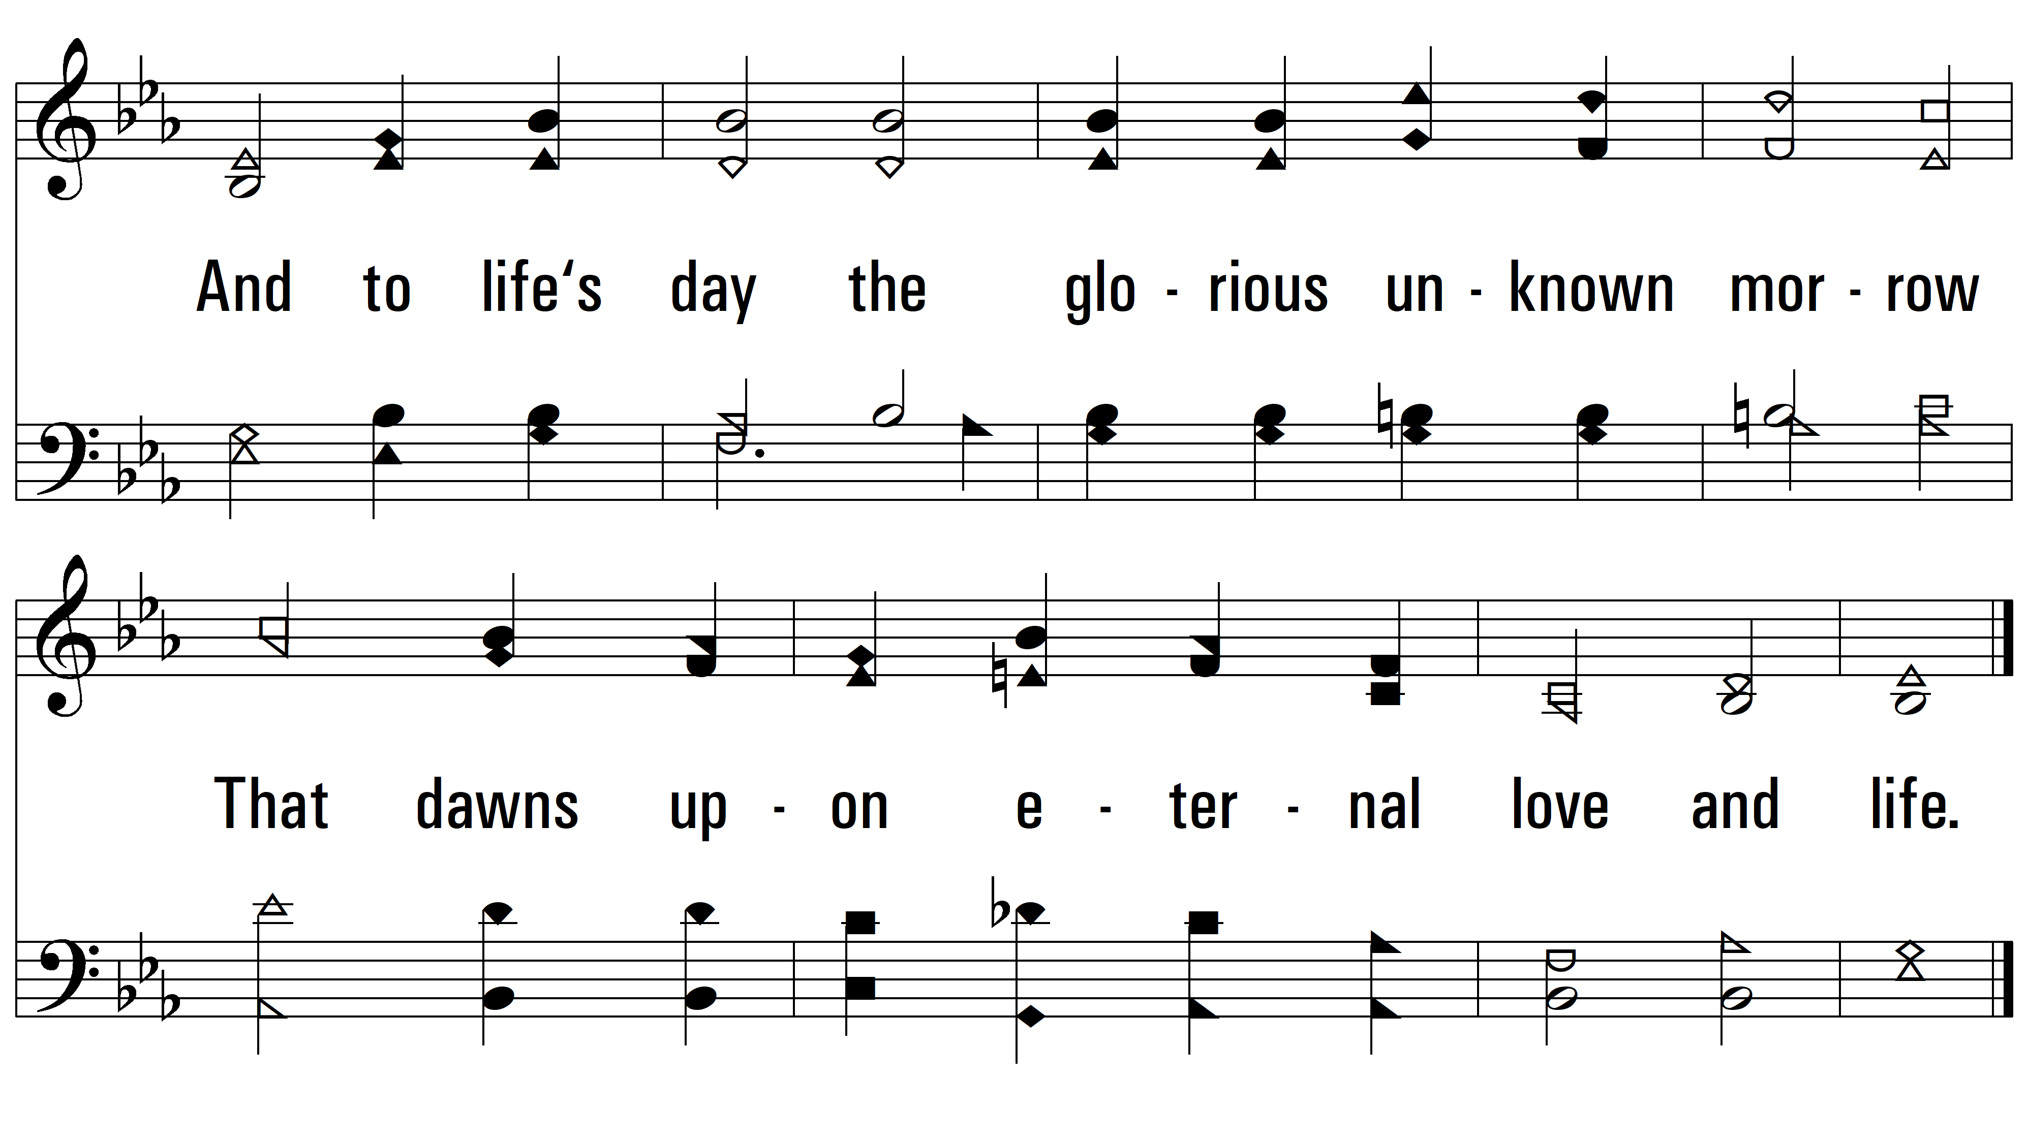
vs. 3
PDHymns.com
END

