Slide 1
O Master, Let Me Walk With Thee
MARYTON
8.8.8.8
Words: | Washington Gladden (1879)
Music: | Henry Percy Smith (1874)
3/4
E/G# - MI
Verses: 4
Lead - | MI
Alto - | DO
Tenor - | SOL
Bass - | DO
PDHymns.com

Slide 2
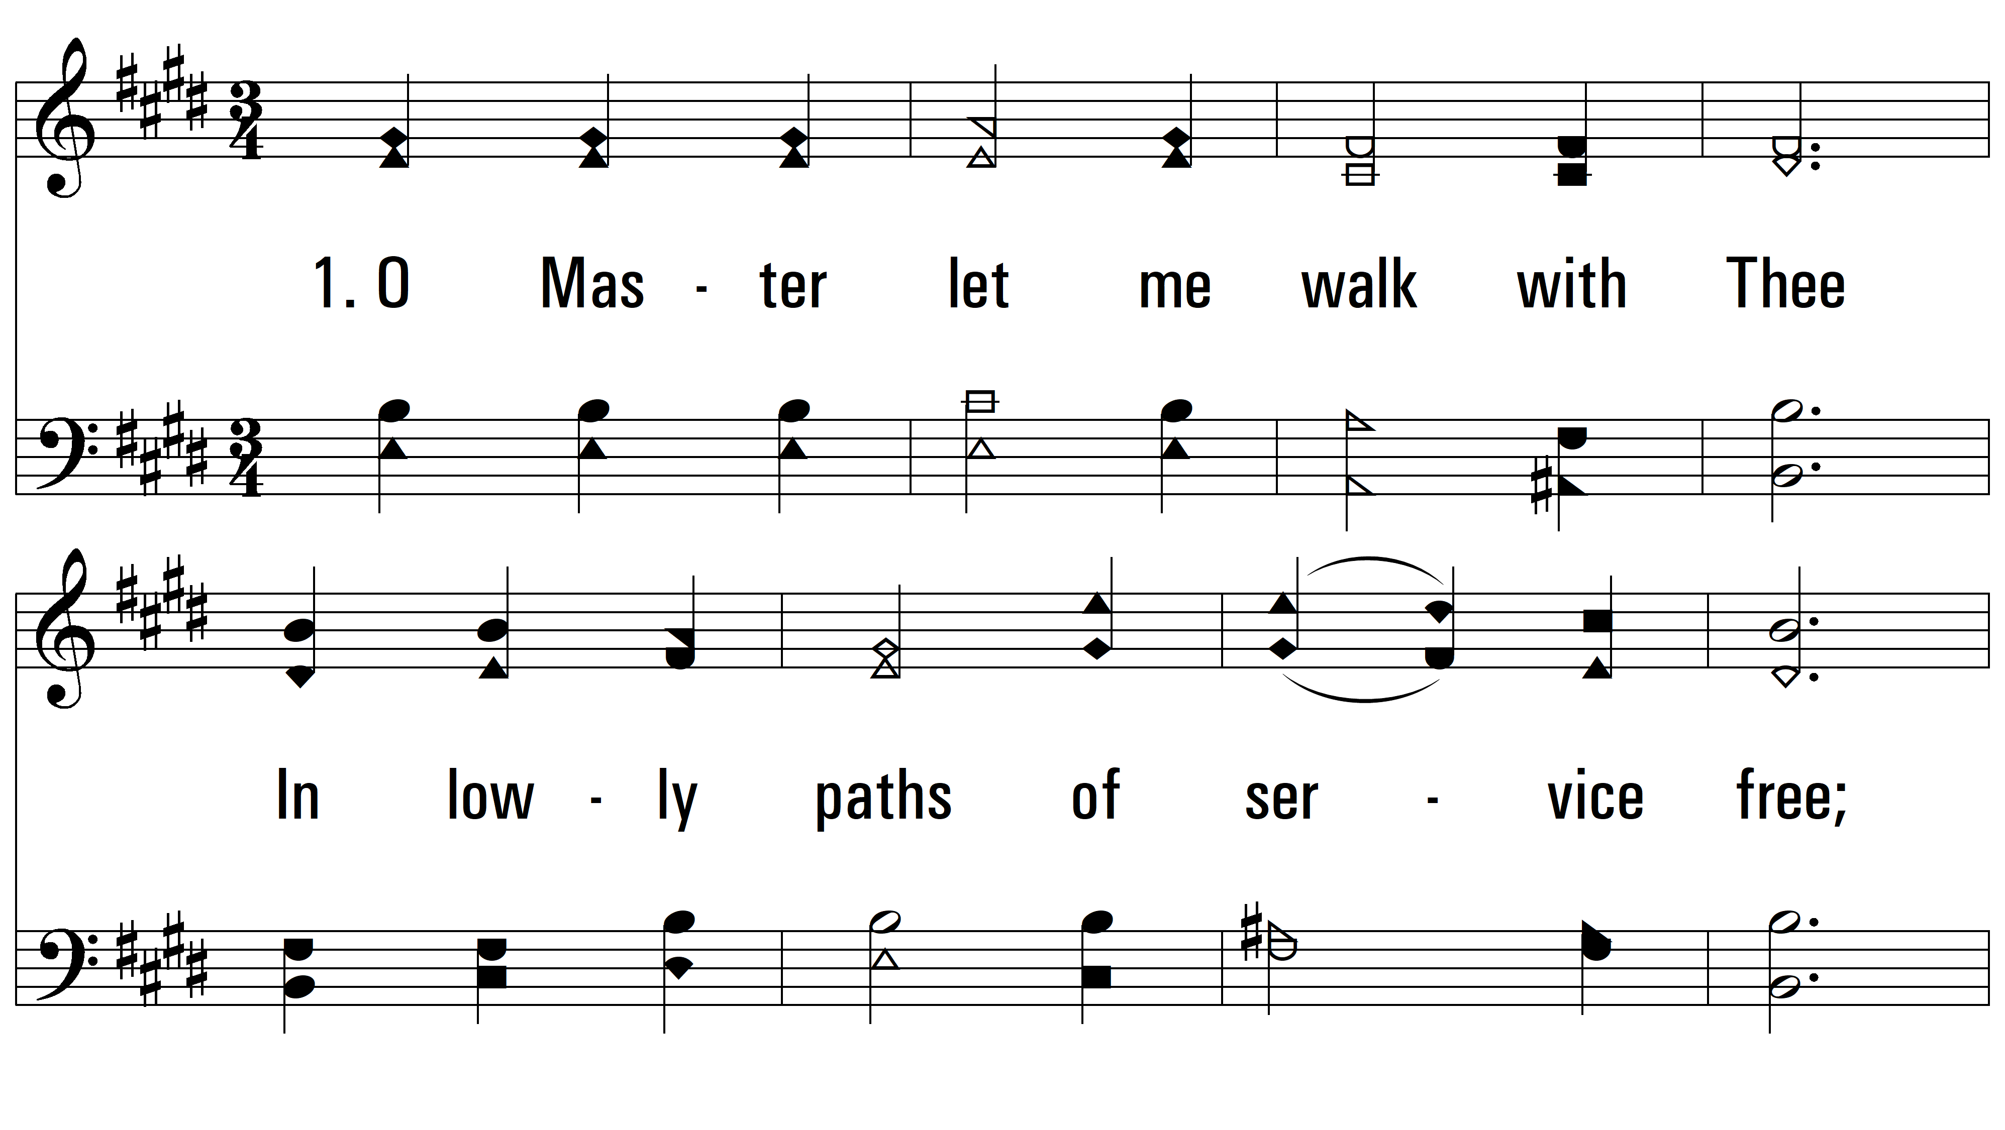
vs. 1 ~ O Master, Let Me Walk With Thee

Slide 3
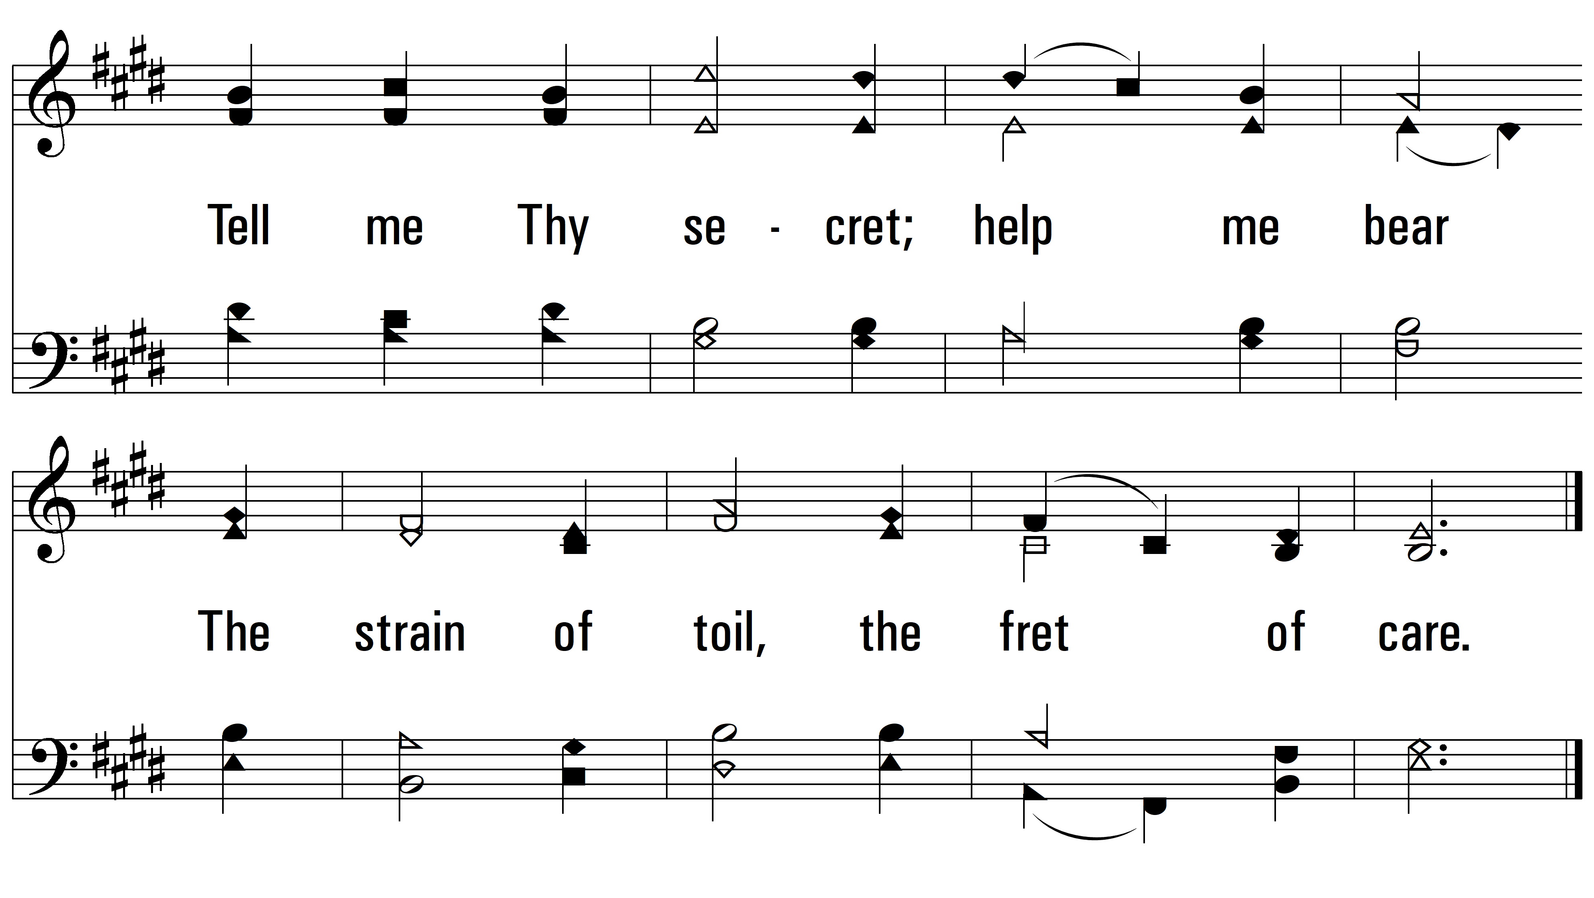
vs. 1

Slide 4
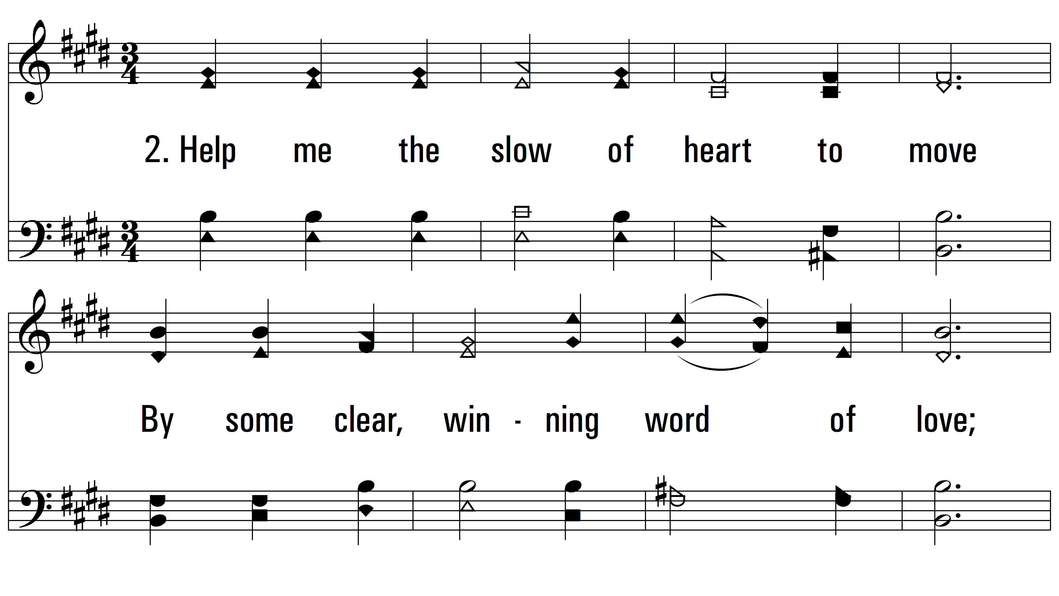
vs. 2 ~ O Master, Let Me Walk With Thee

Slide 5
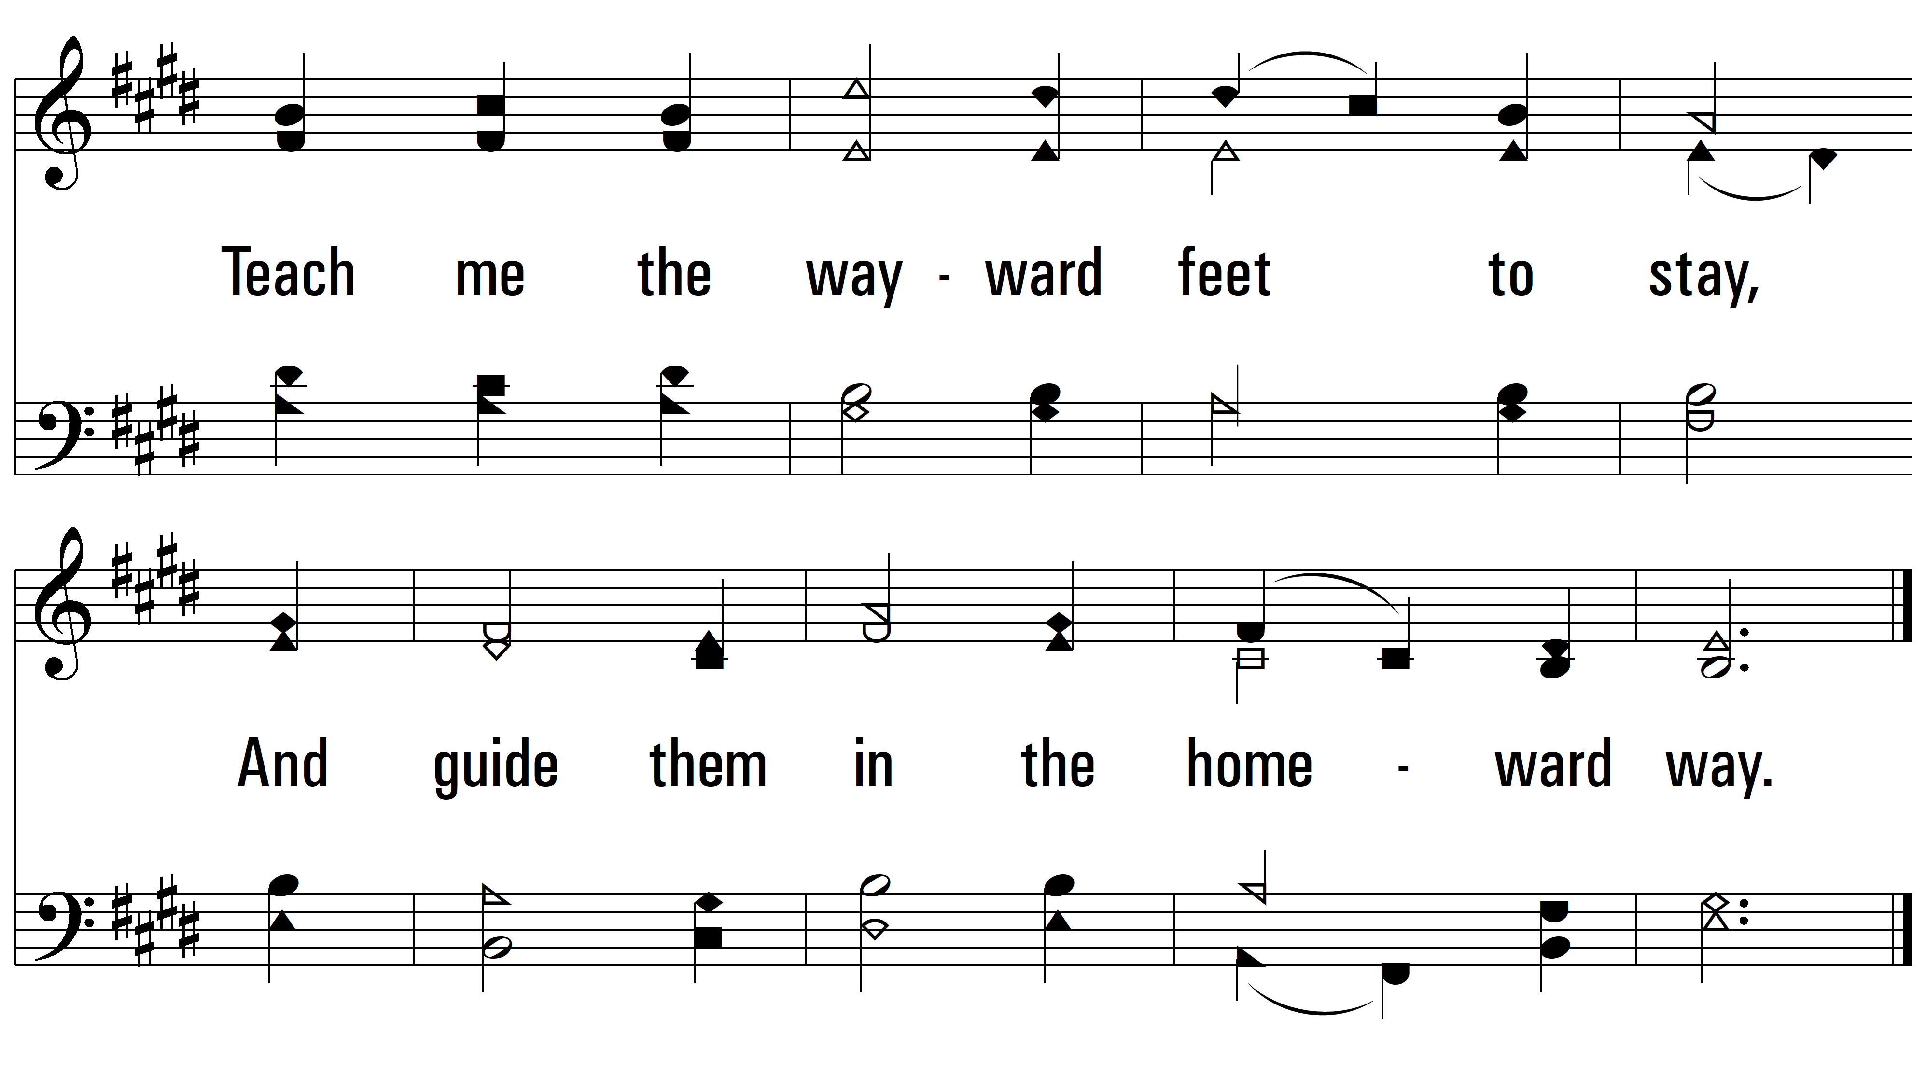
vs. 2

Slide 6
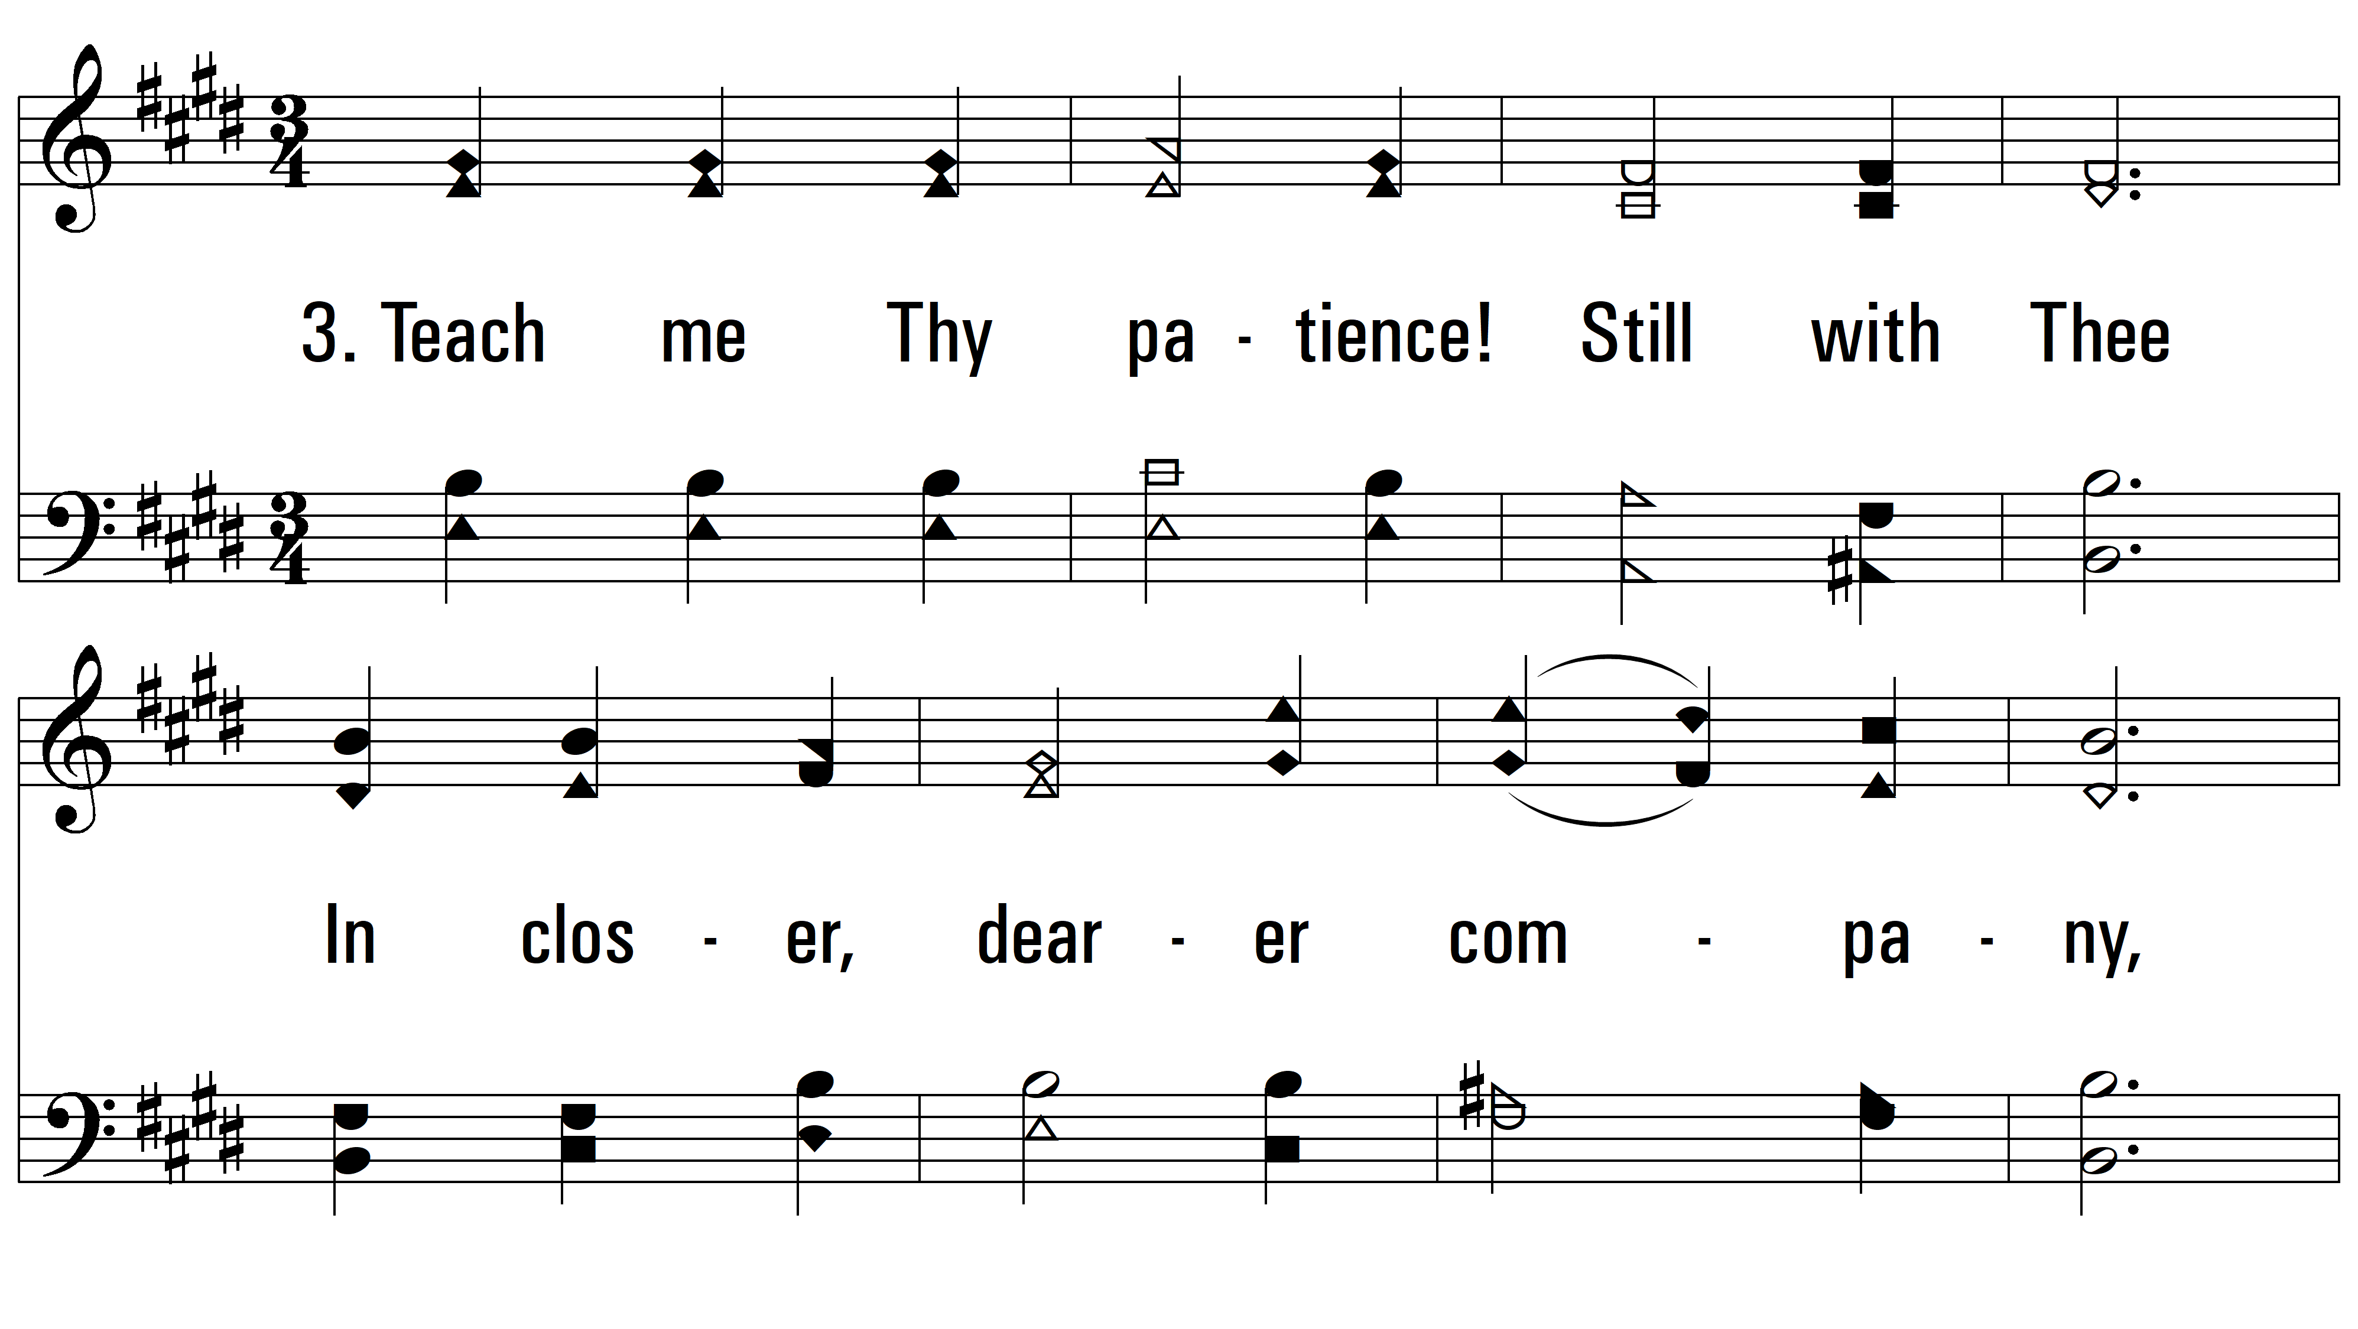
vs. 3 ~ O Master, Let Me Walk With Thee

Slide 7
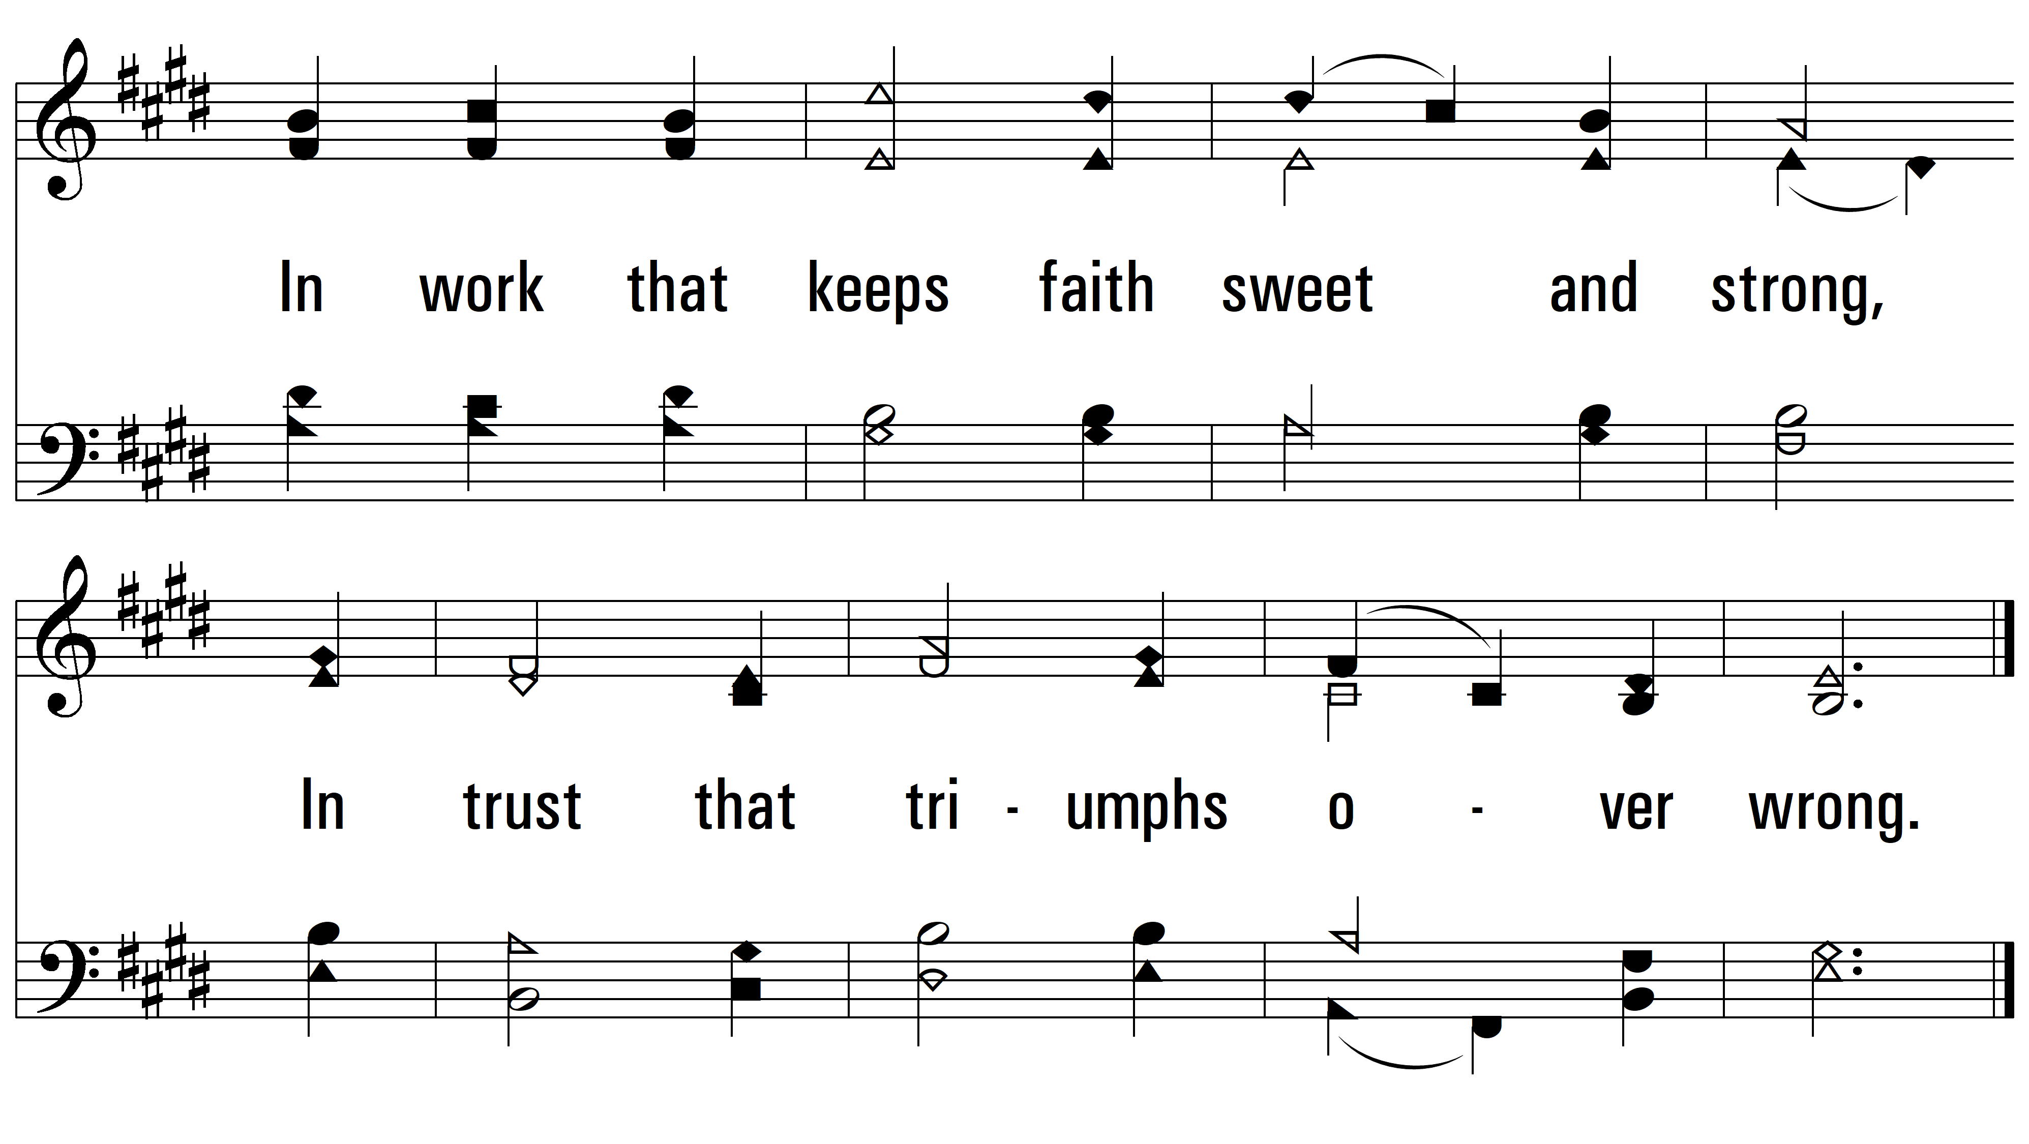
vs. 3

Slide 8
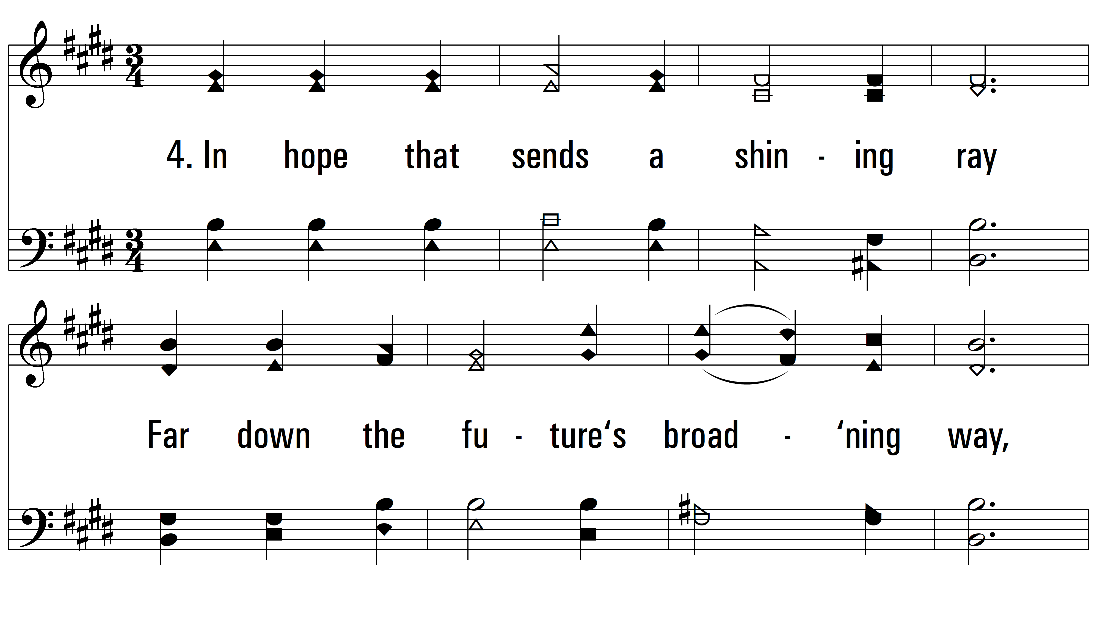
vs. 4 ~ O Master, Let Me Walk With Thee

Slide 9
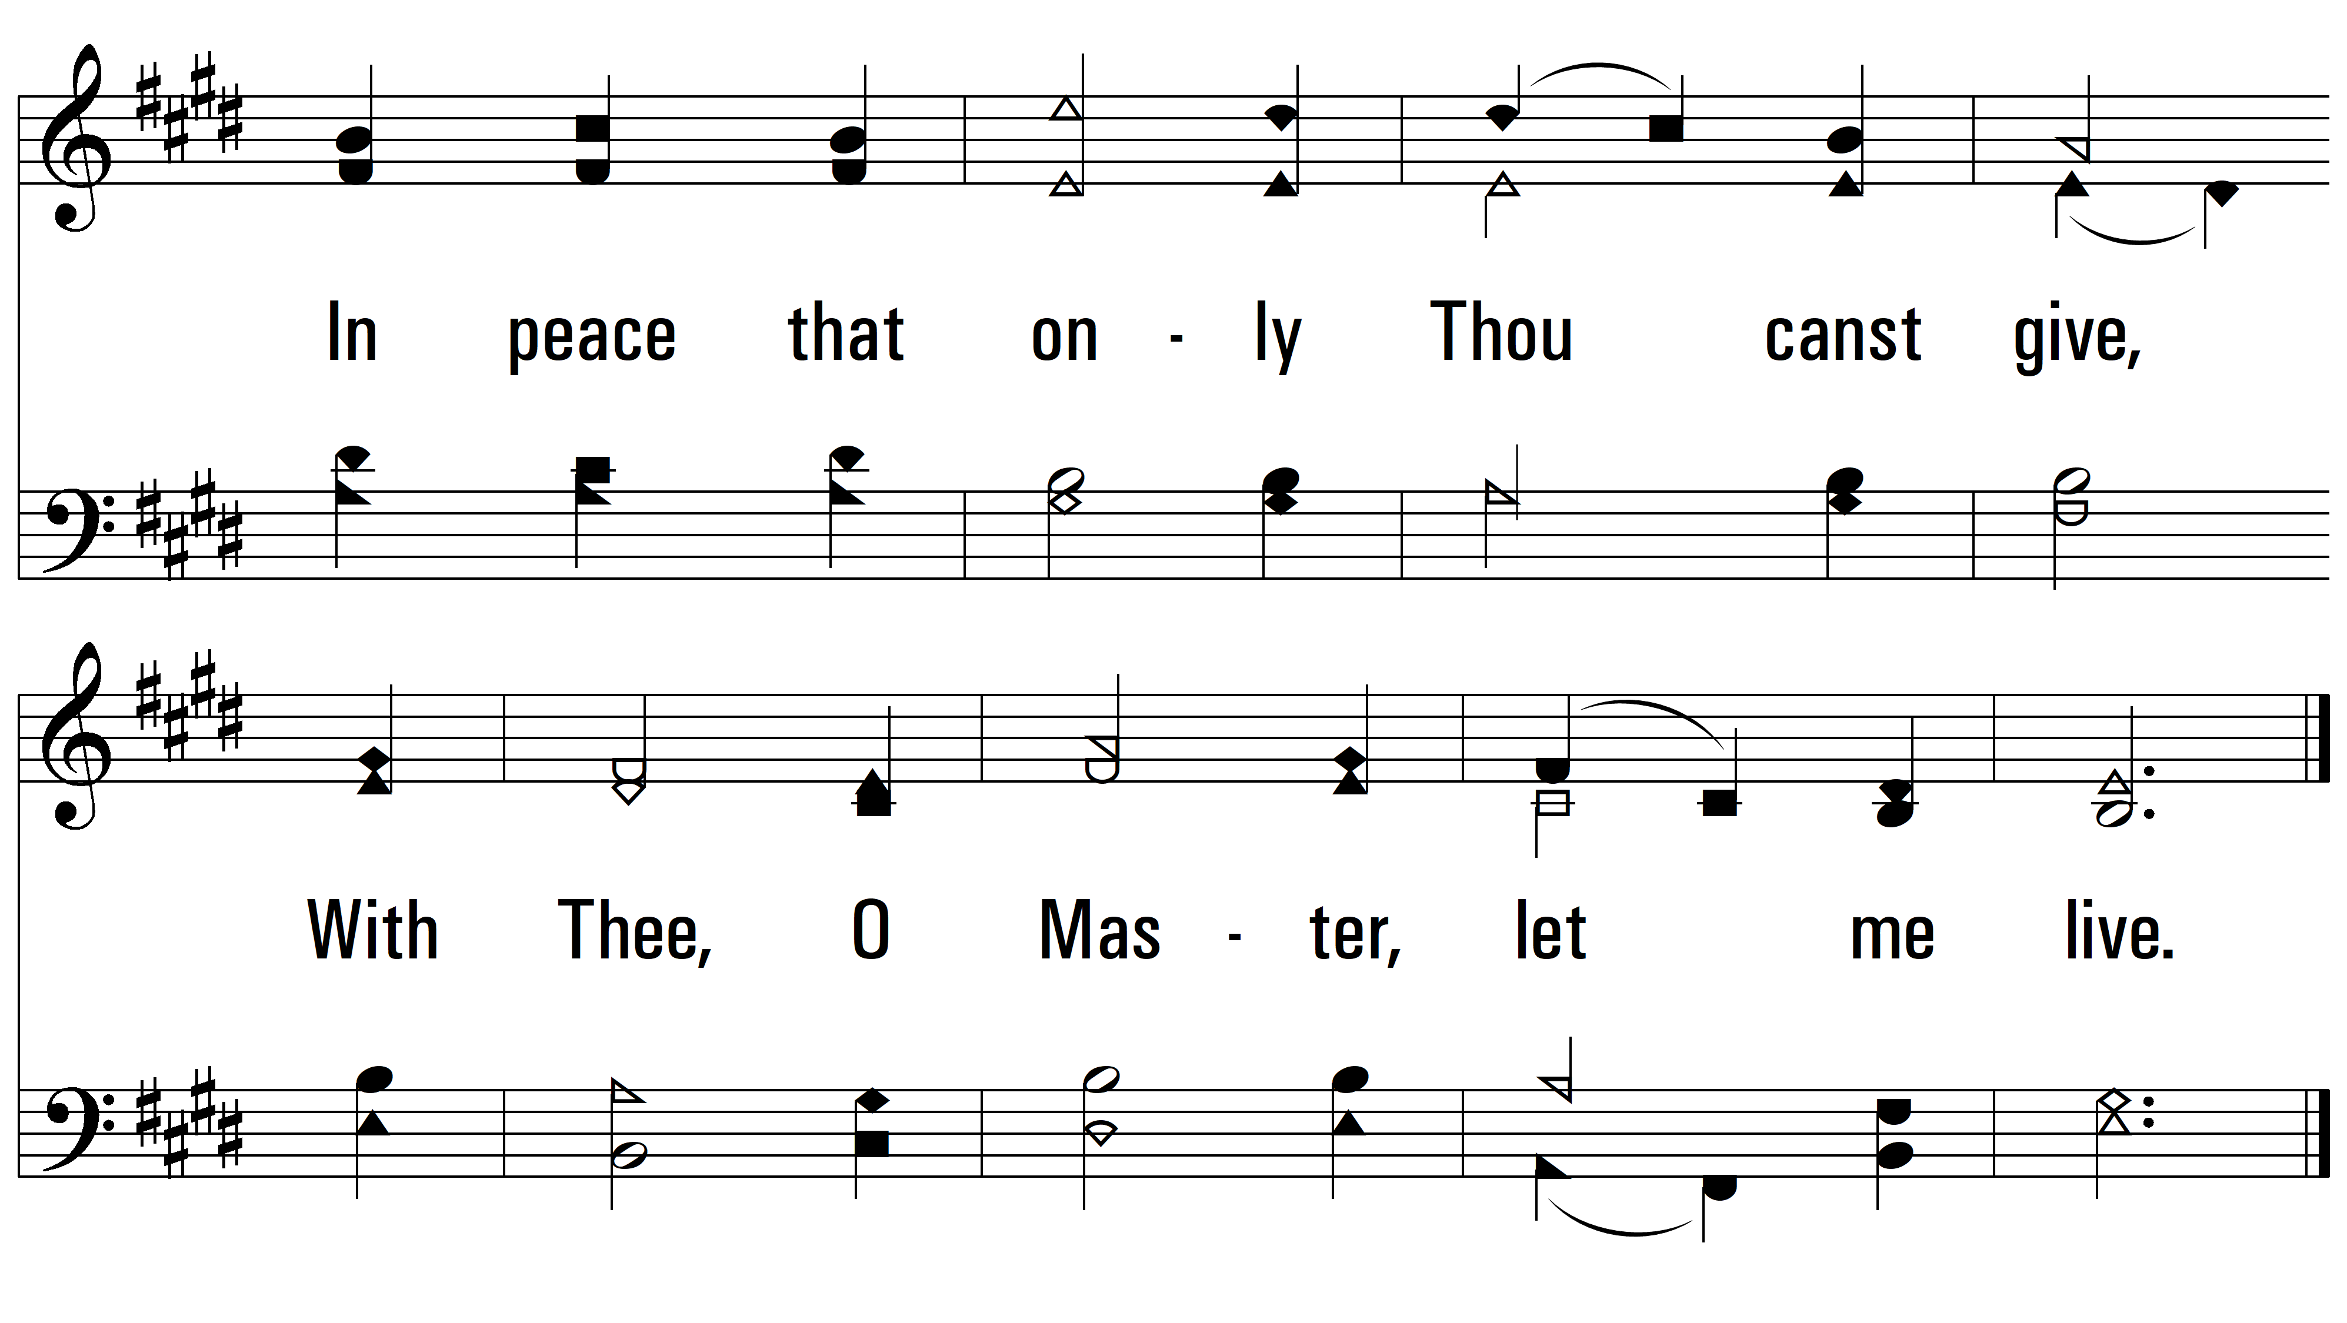
vs. 4
PDHymns.com
END

