Slide 1
O Love That Wilt Not Let Me Go
ST. MARGARET
8.8.8.8.6
Words: | George Matheson (1842)
Music: | Albert L. Peace (1884)
4/4
A^{b}/E^{b} - SOL
Verses: 4
Lead - | SOL
Alto - | MI
Tenor - | DO
Bass - | DO
PDHymns.com

Slide 2
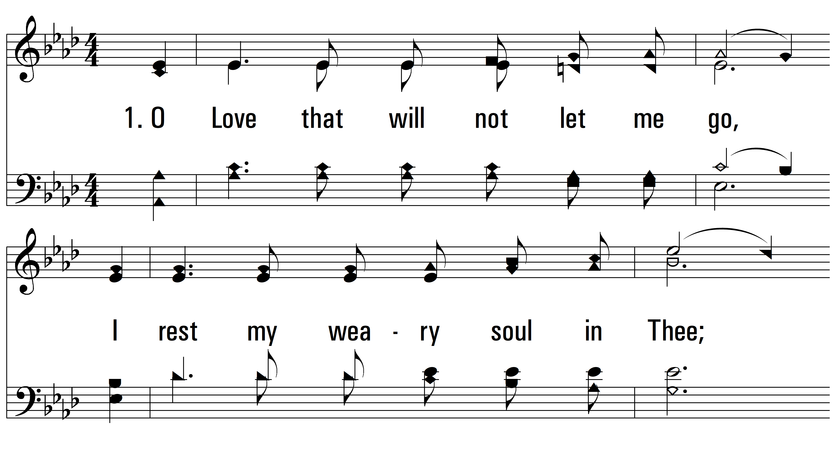
vs. 1 ~ O Love That Wilt Not Let Me Go

Slide 3
vs. 1

Slide 4
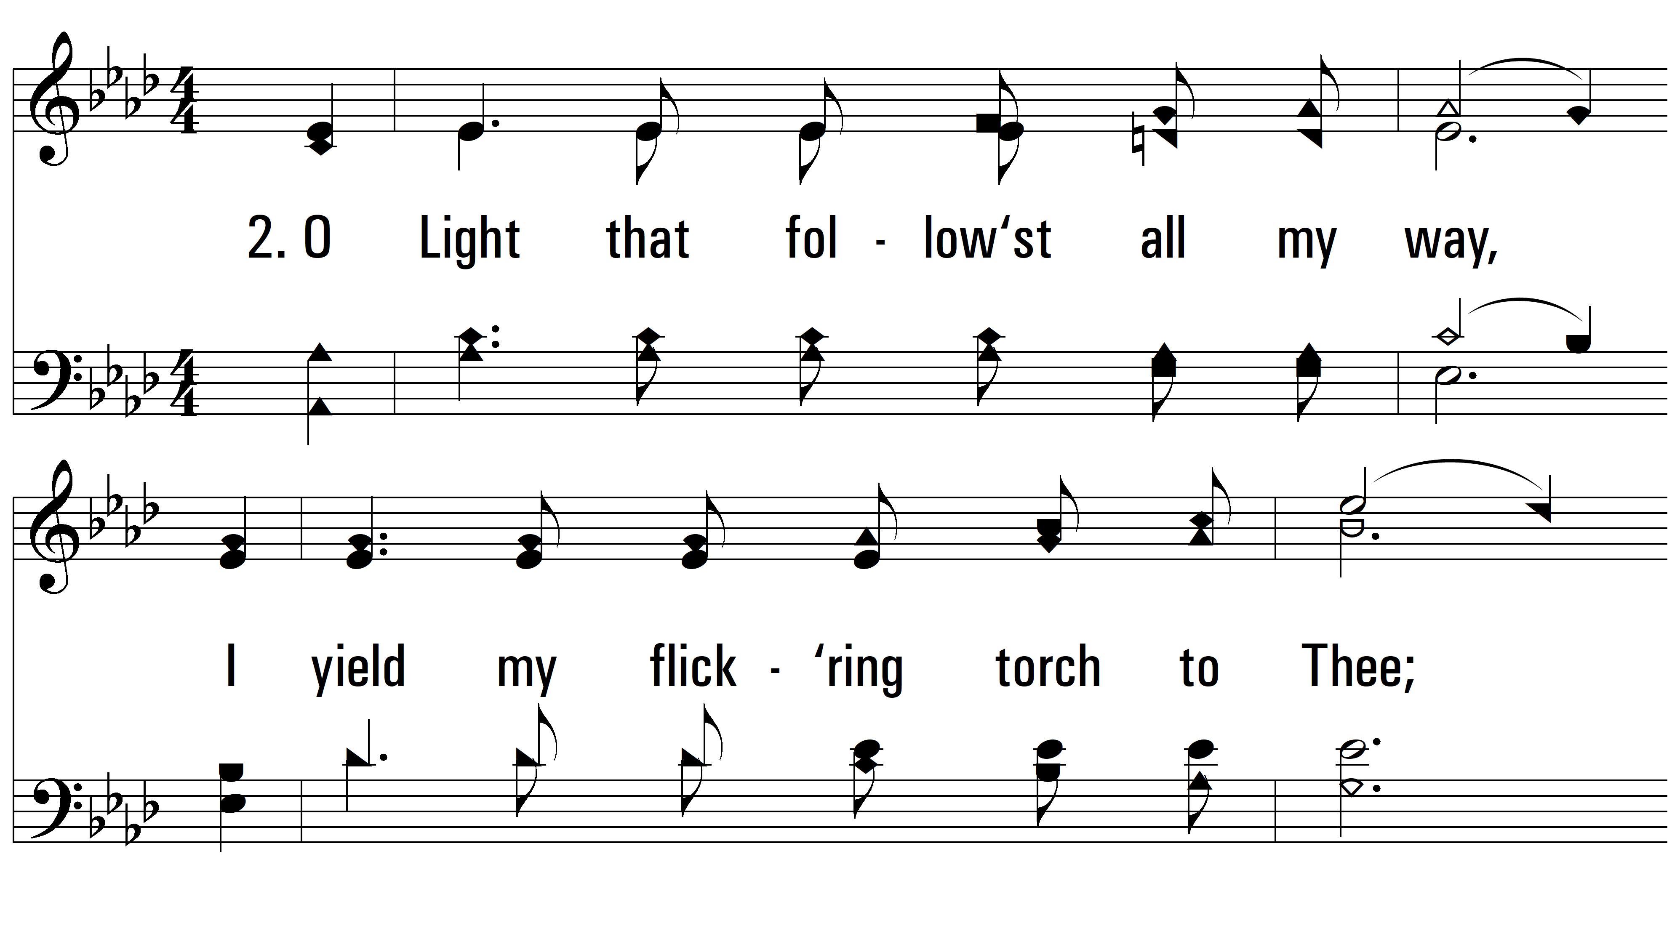
vs. 2 ~ O Love That Wilt Not Let Me Go

Slide 5
vs. 2

Slide 6
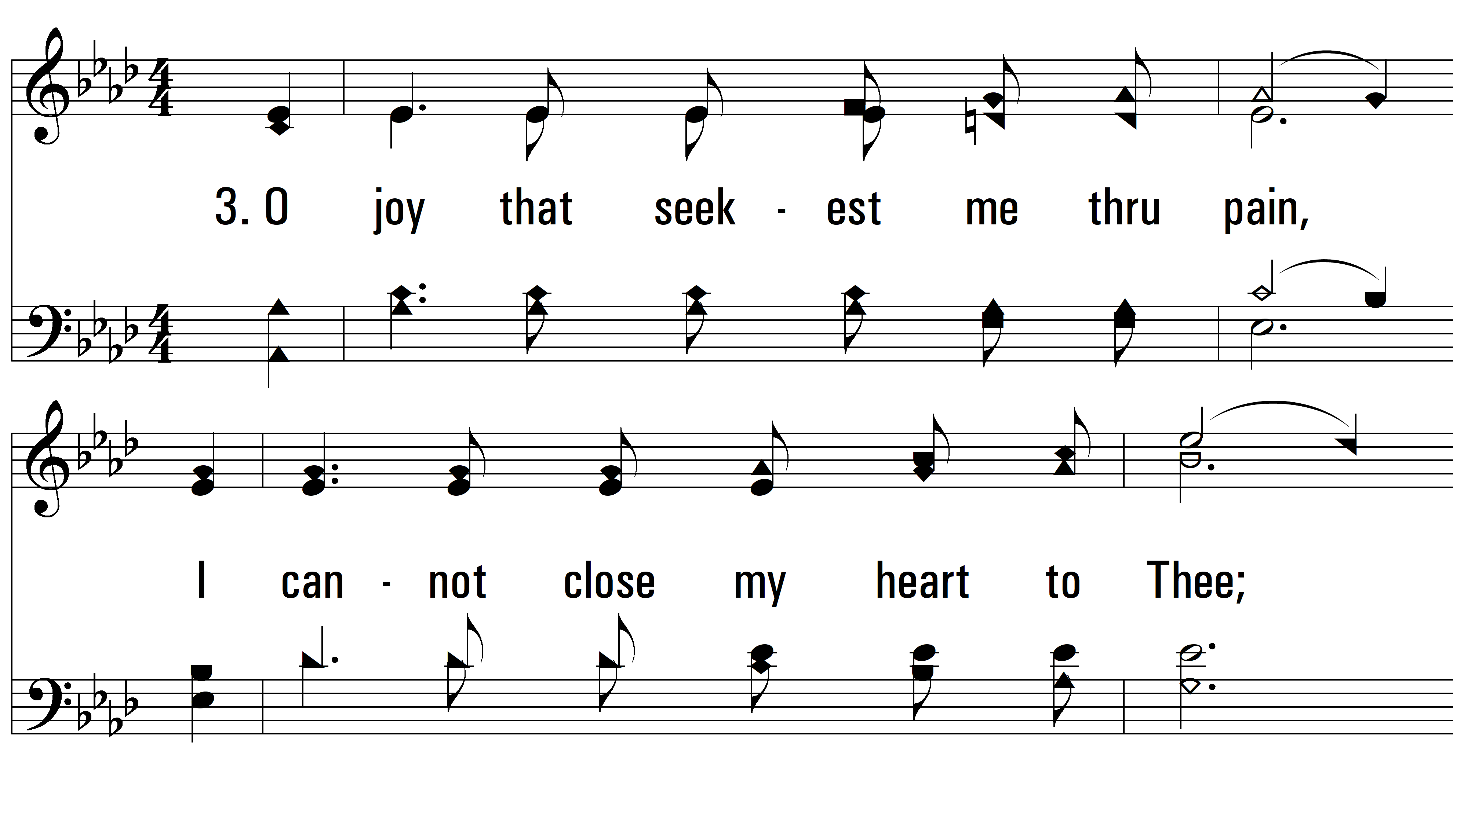
vs. 3 ~ O Love That Wilt Not Let Me Go

Slide 7
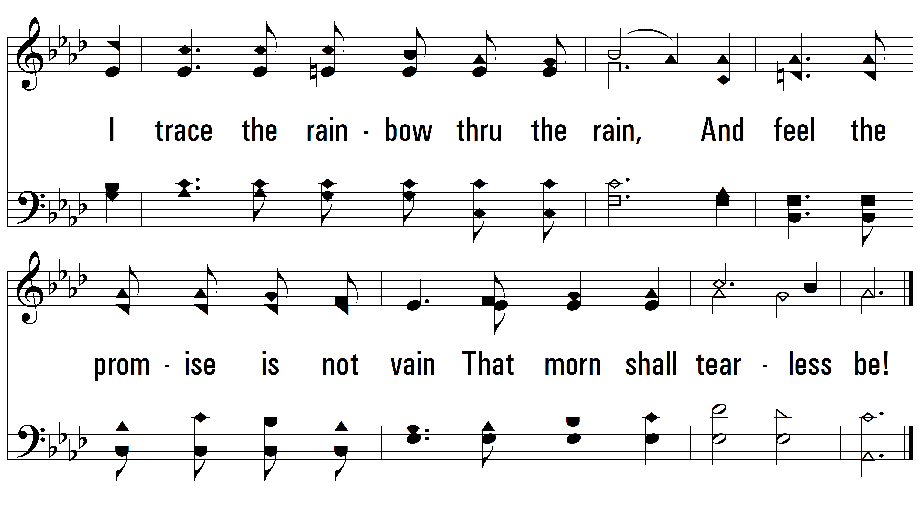
vs. 3

Slide 8
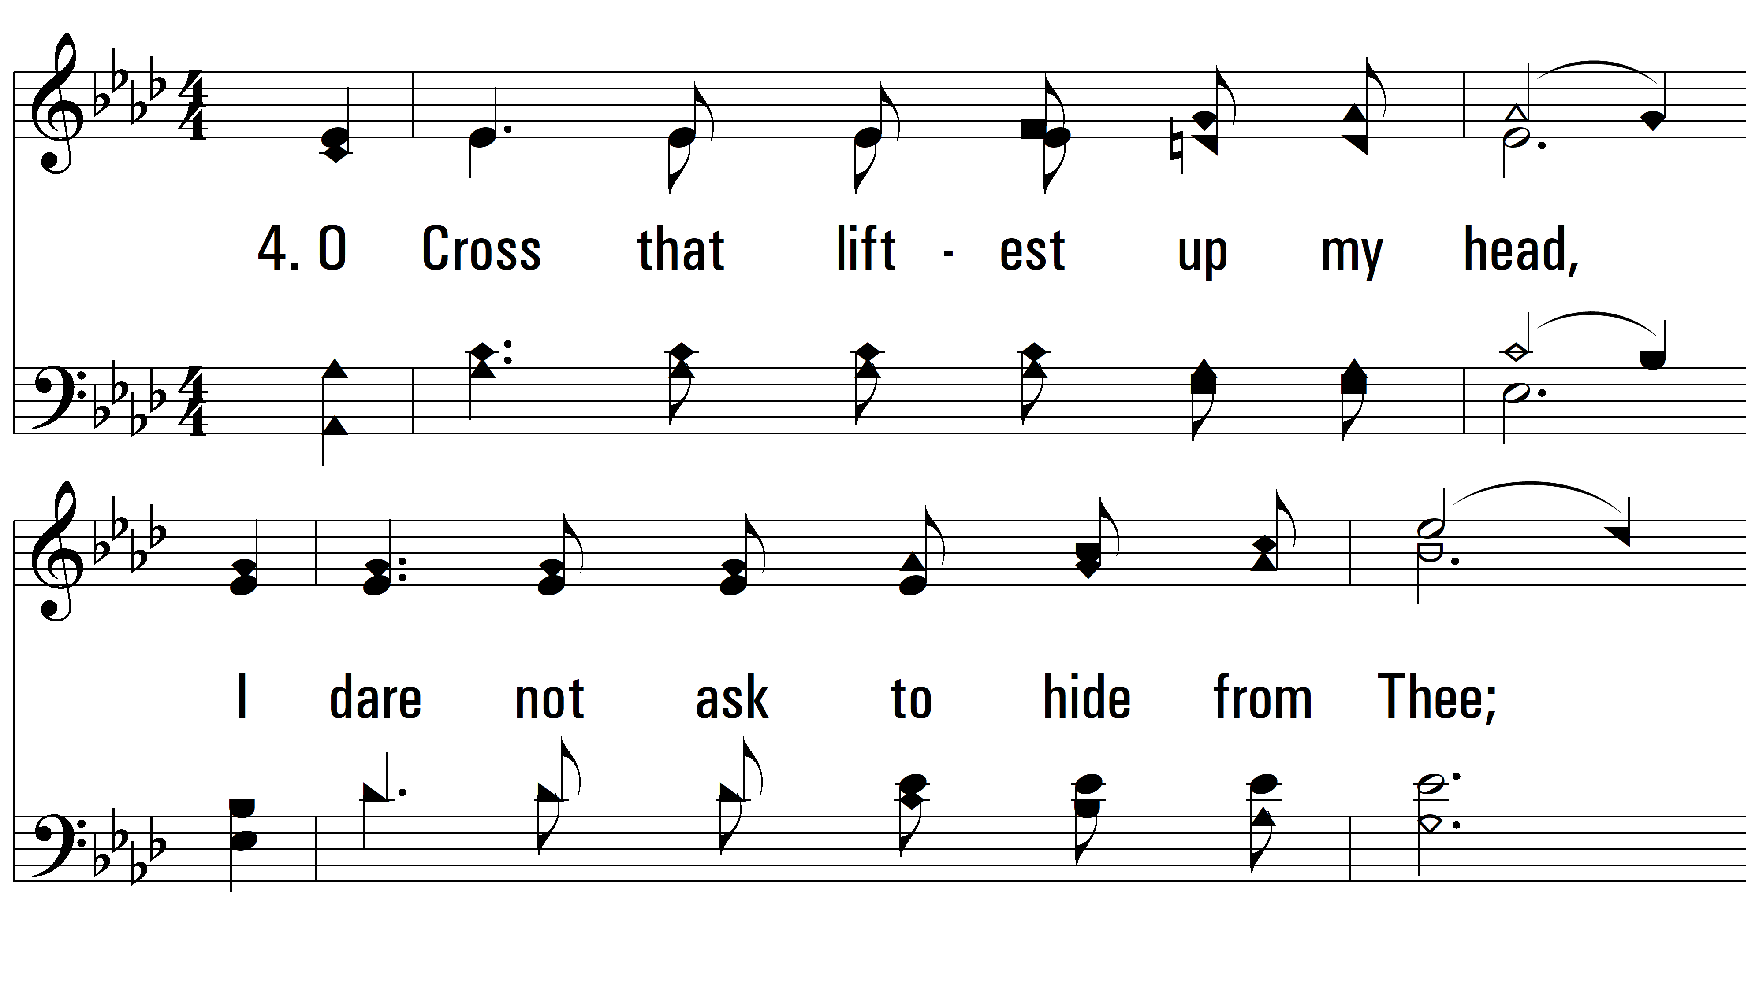
vs. 4 ~ O Love That Wilt Not Let Me Go

Slide 9
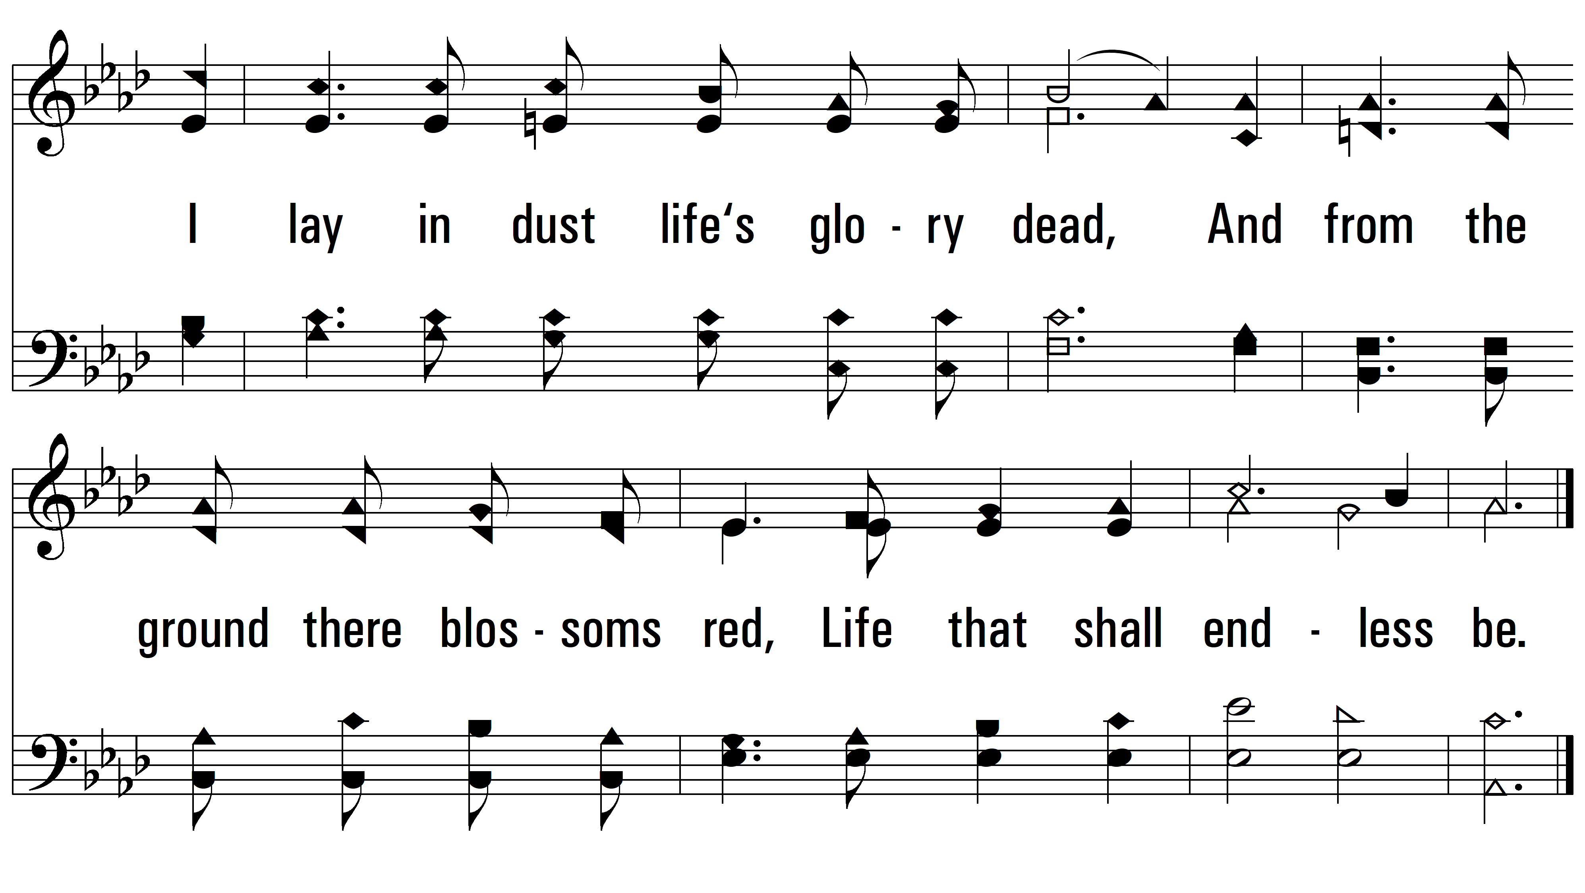
vs. 4
PDHymns.com
END

