Slide 1
O Lord, Our Lord
Words: | Psalm 8:1, Arr. H. R. Palmer (1874)
Music: | H. R. Palmer (1874)
3/4
E^{b}/B^{b} - SOL
Verses: 1
Lead - | SOL
Alto - | SOL
Tenor - | FA
Bass - | SOL
PDHymns.com

Slide 2
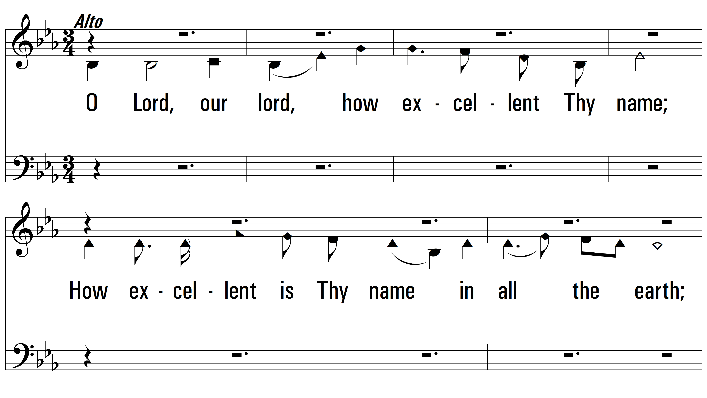
vs. 1 ~ O Lord, Our Lord

Slide 3
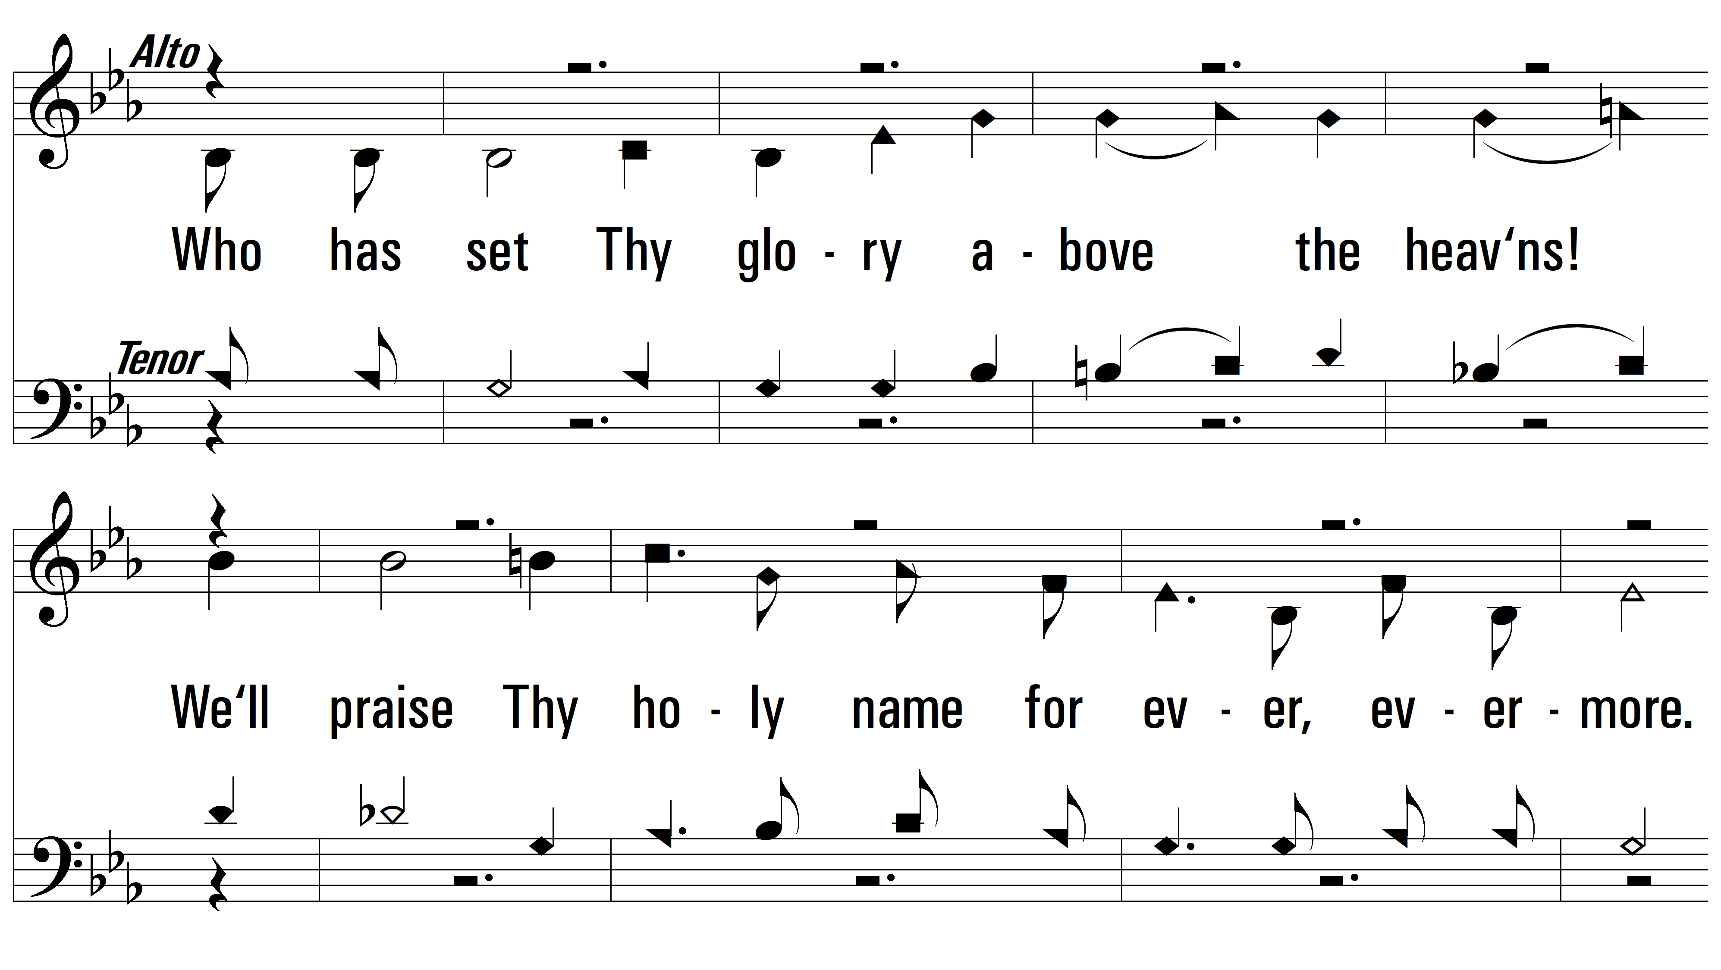
vs. 1

Slide 4
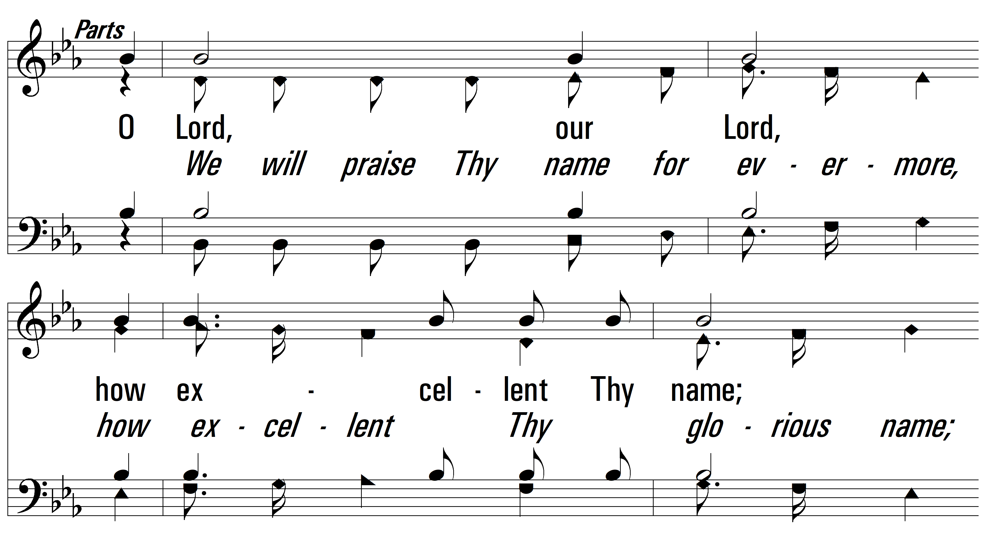
vs. 1

Slide 5
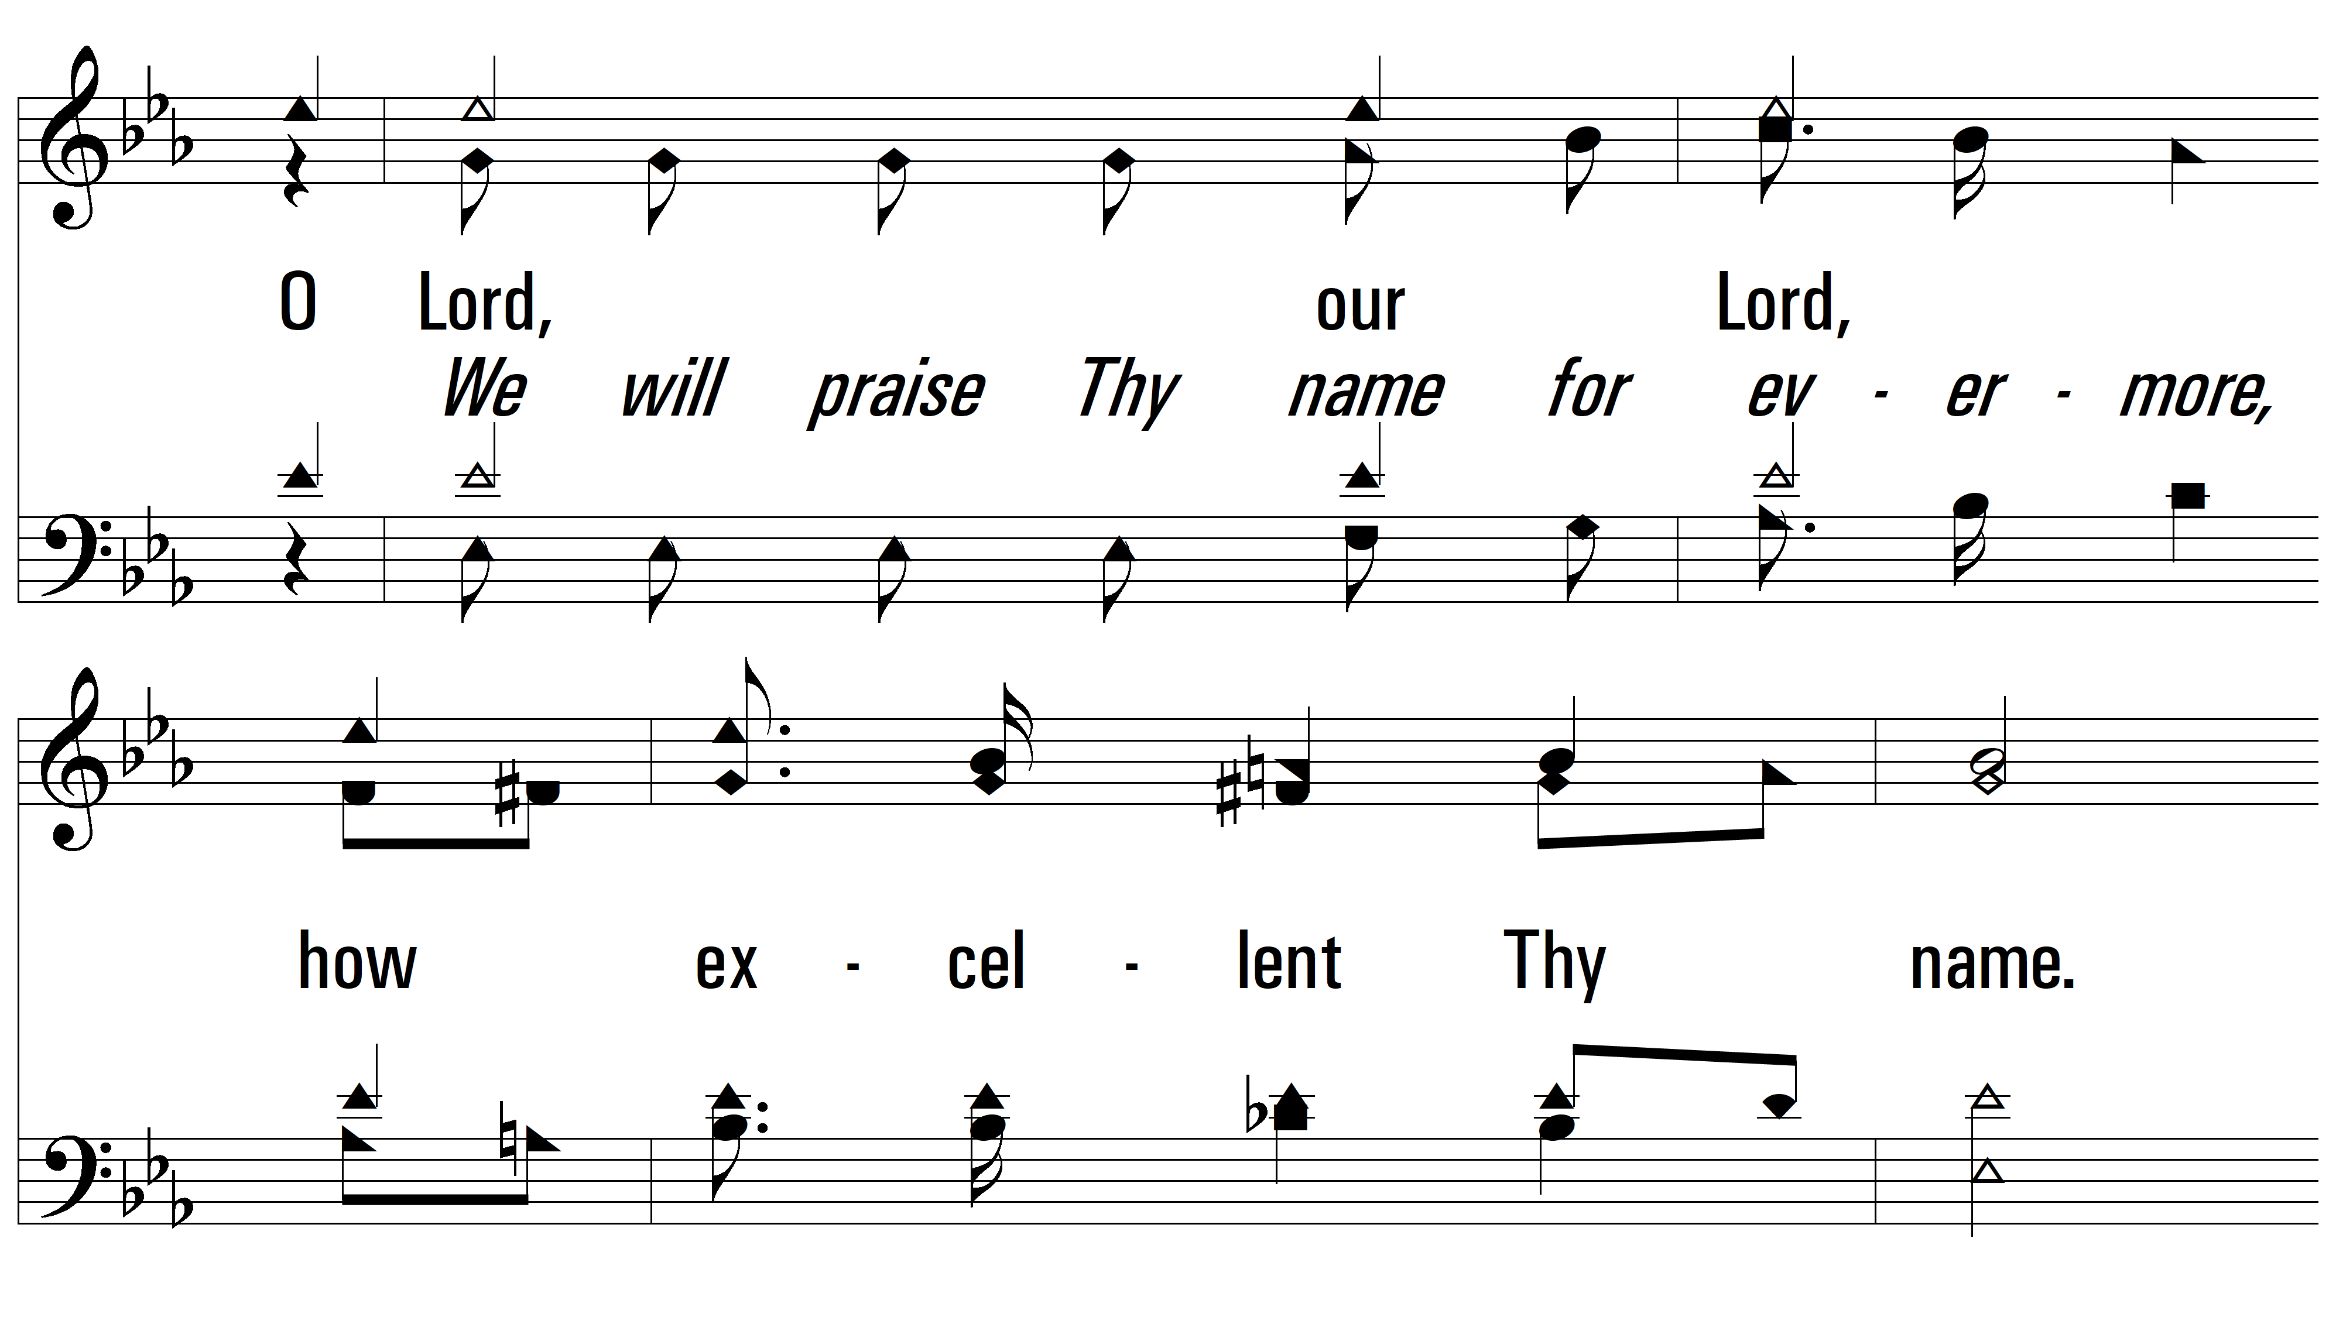
vs. 1

Slide 6
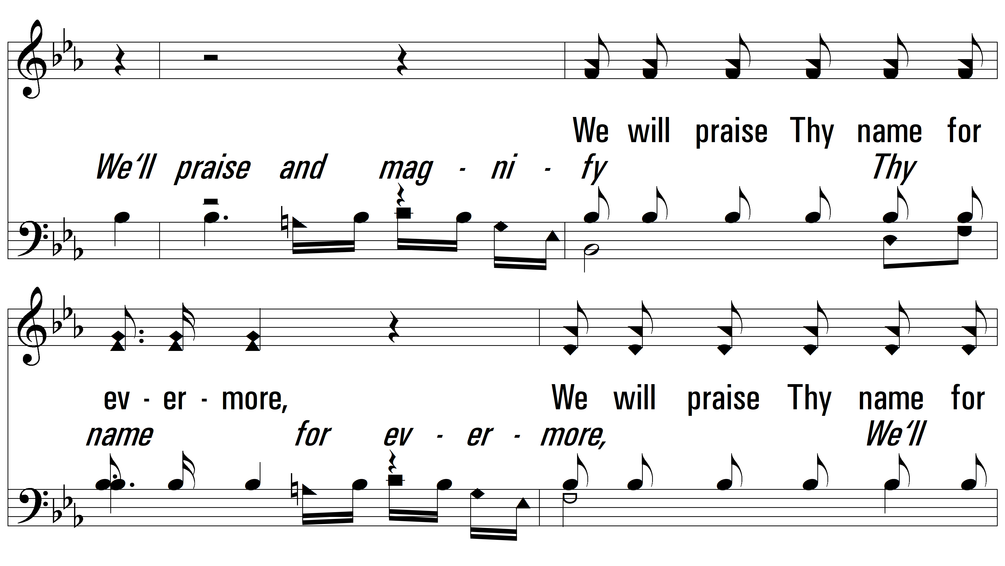
vs. 1

Slide 7
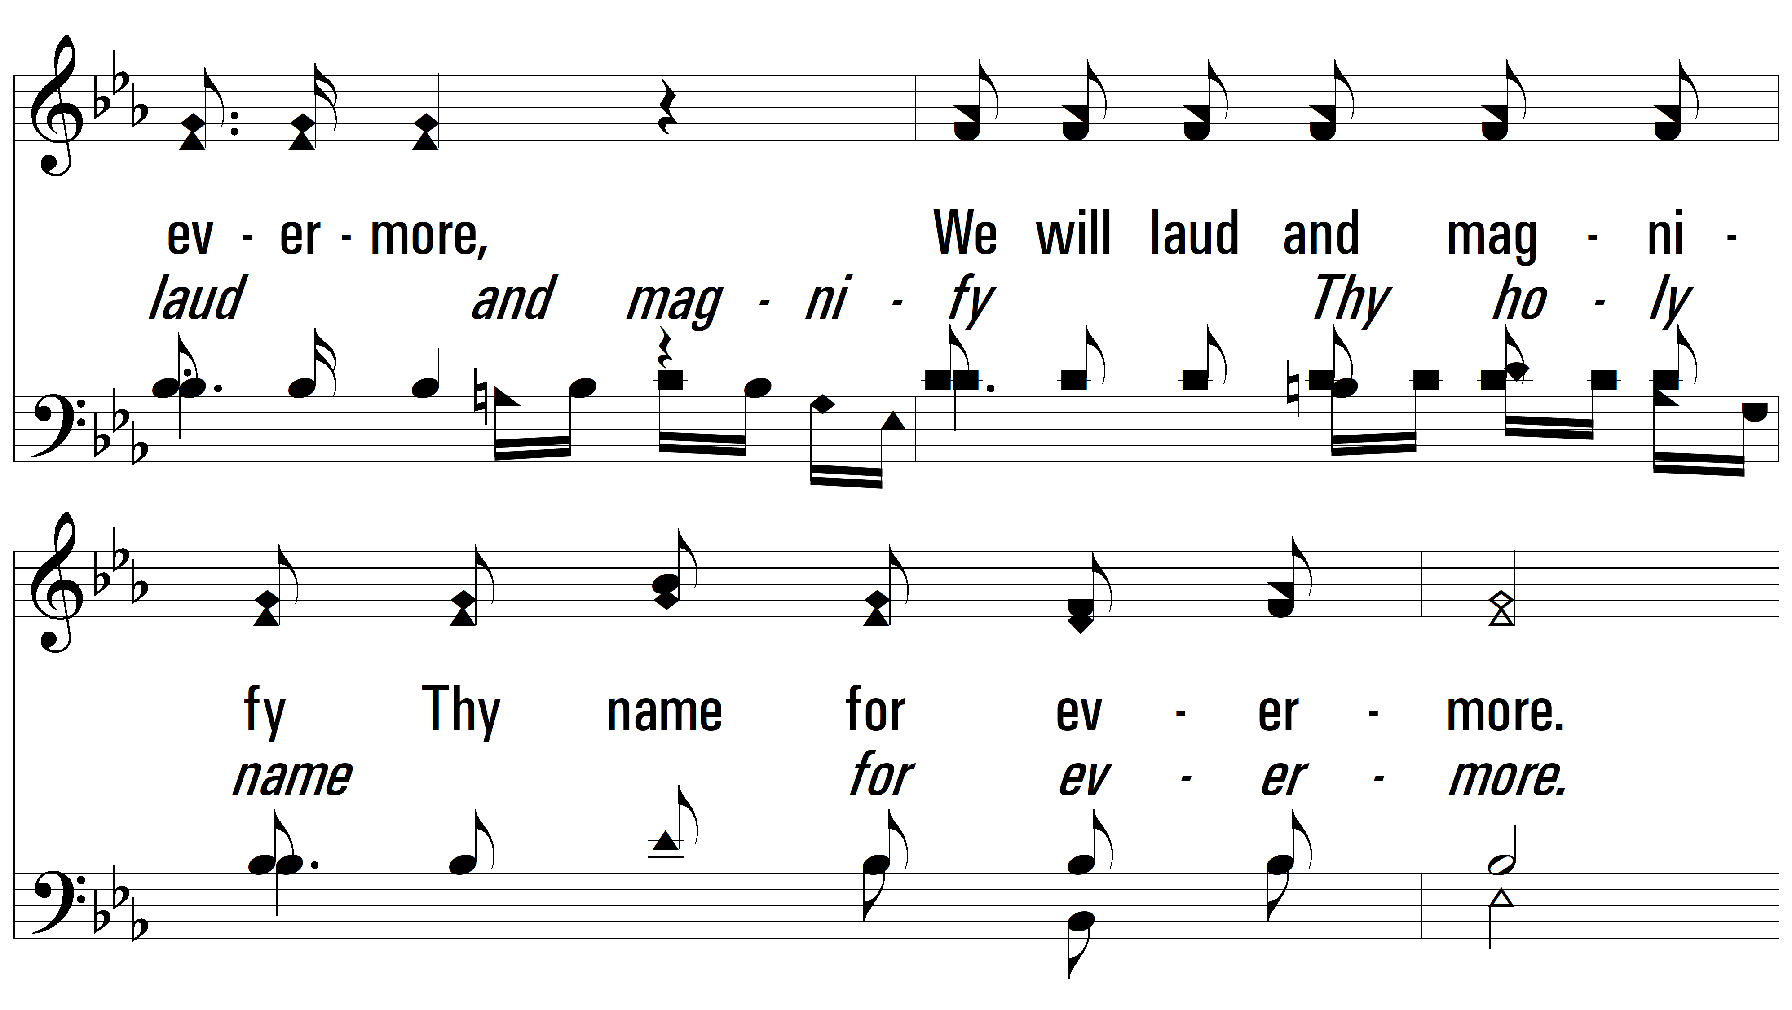
vs. 1

Slide 8
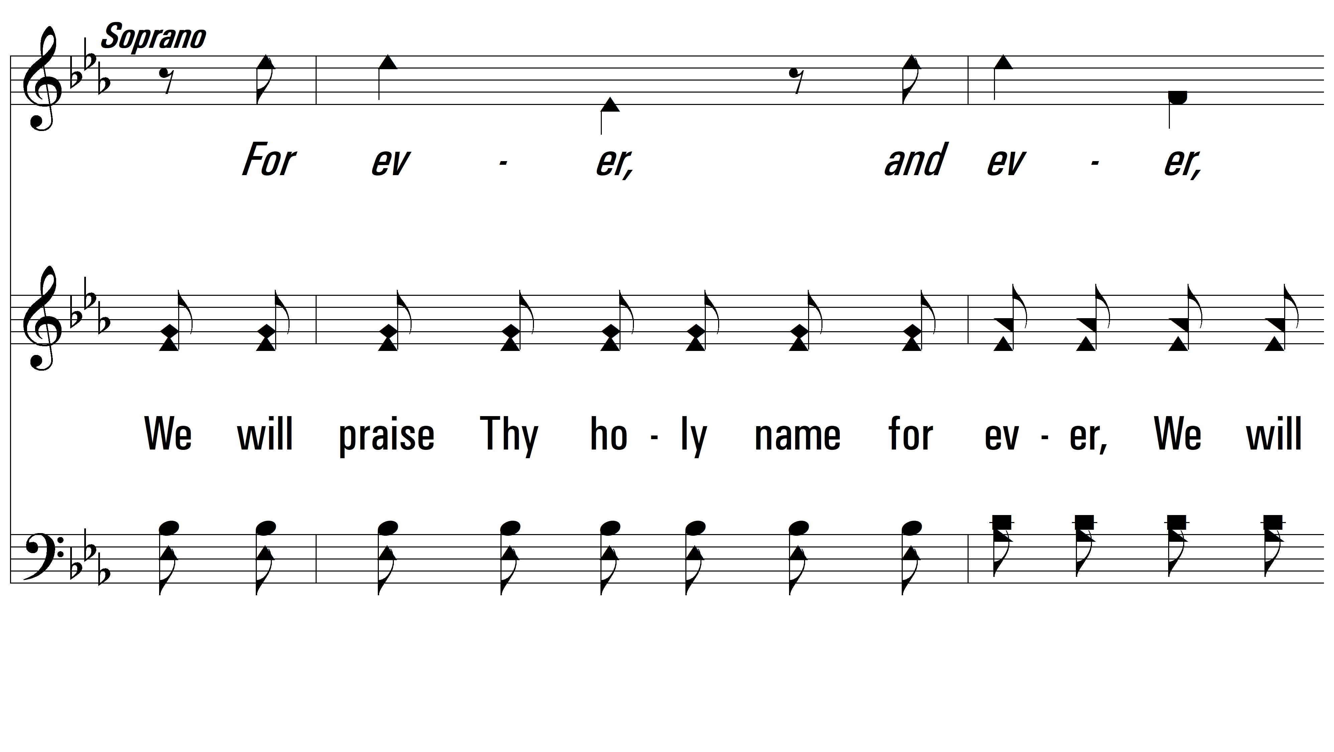
vs. 1

Slide 9
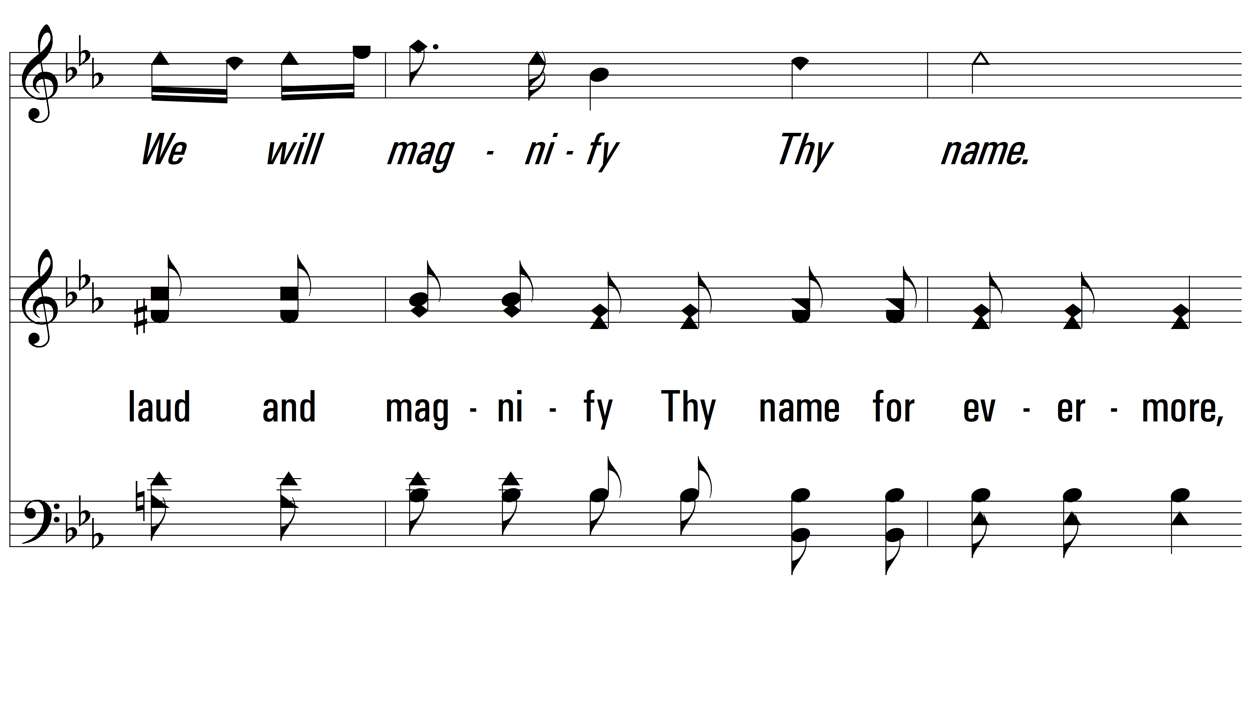
vs. 1

Slide 10
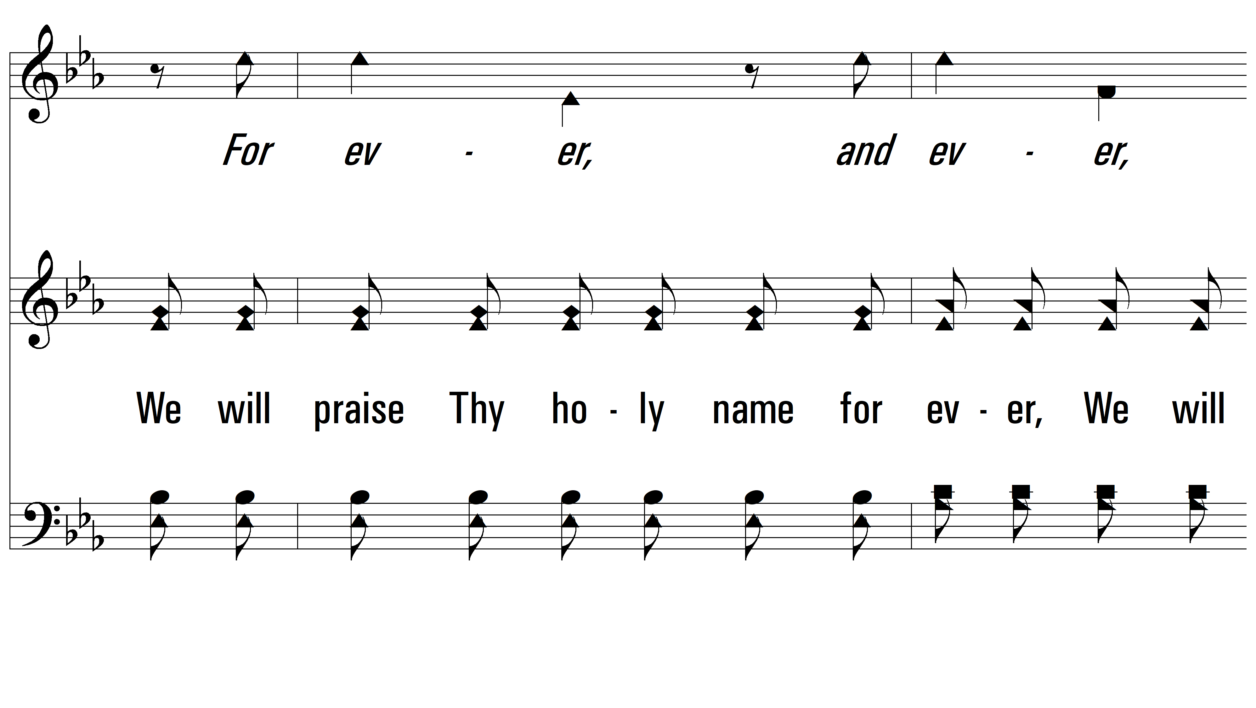
vs. 1

Slide 11
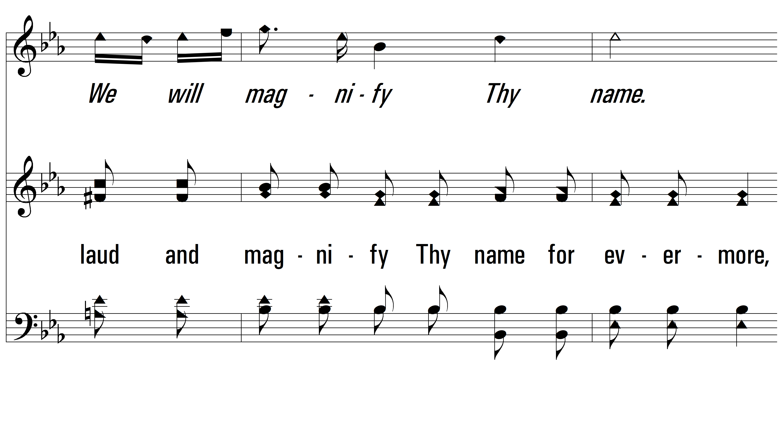
vs. 1

Slide 12
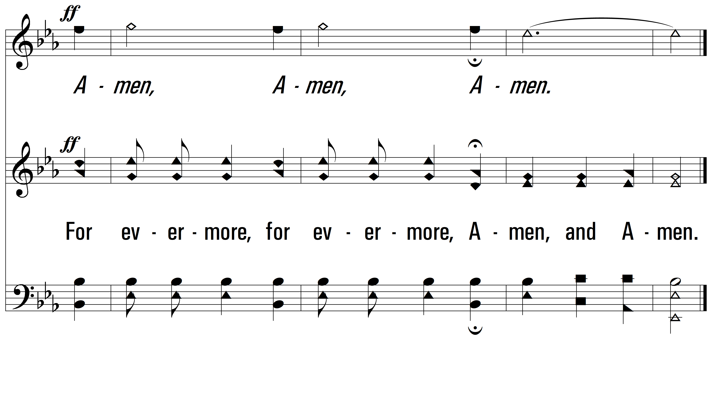
vs. 1
PDHymns.com
END

