Slide 1
O Jesus, My Savior
I LOVE THEE
11.11.11.11
Words: | Anonymous
Music: | Jeremiah Ingall’s Christian Harmony (1805)
3/4
E^{b}/B^{b} - SOL
Verses: 3
Lead - | SOL
Alto - | SOL
Tenor - | MI
Bass - | DO
PDHymns.com

Slide 2
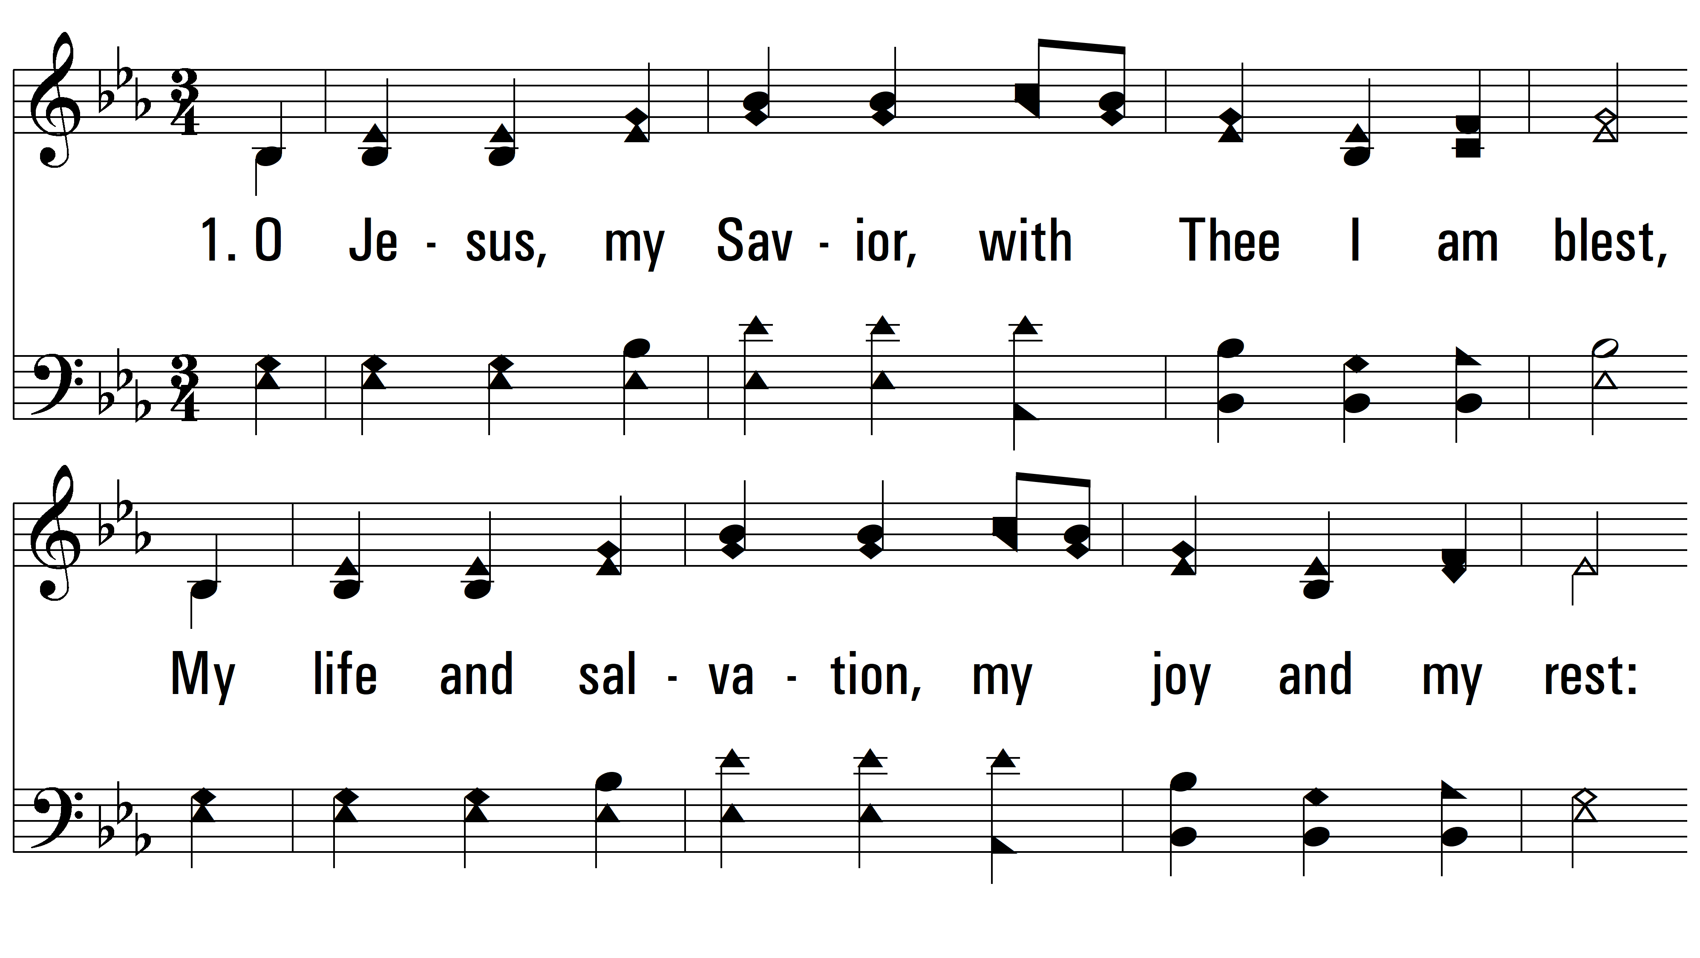
vs. 1 ~ O Jesus, My Savior

Slide 3
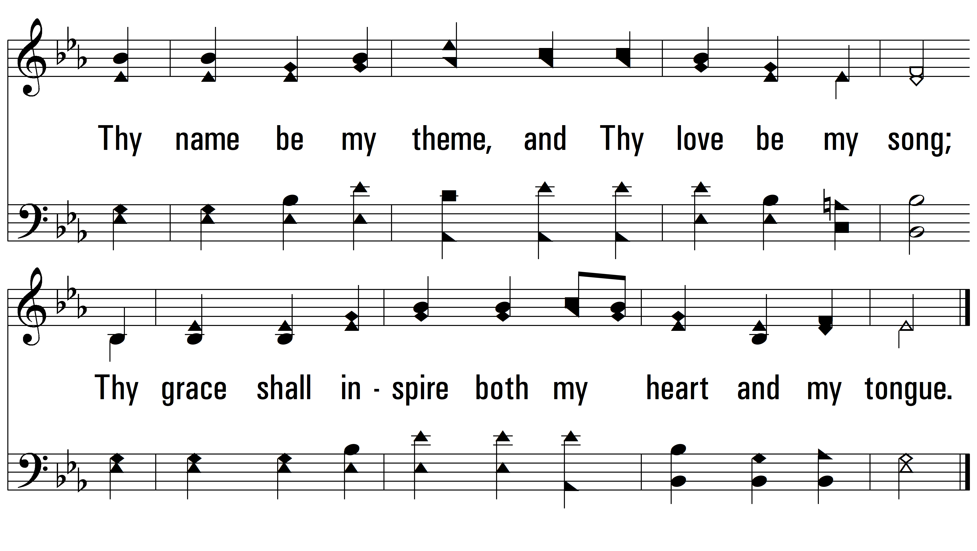
vs. 1

Slide 4
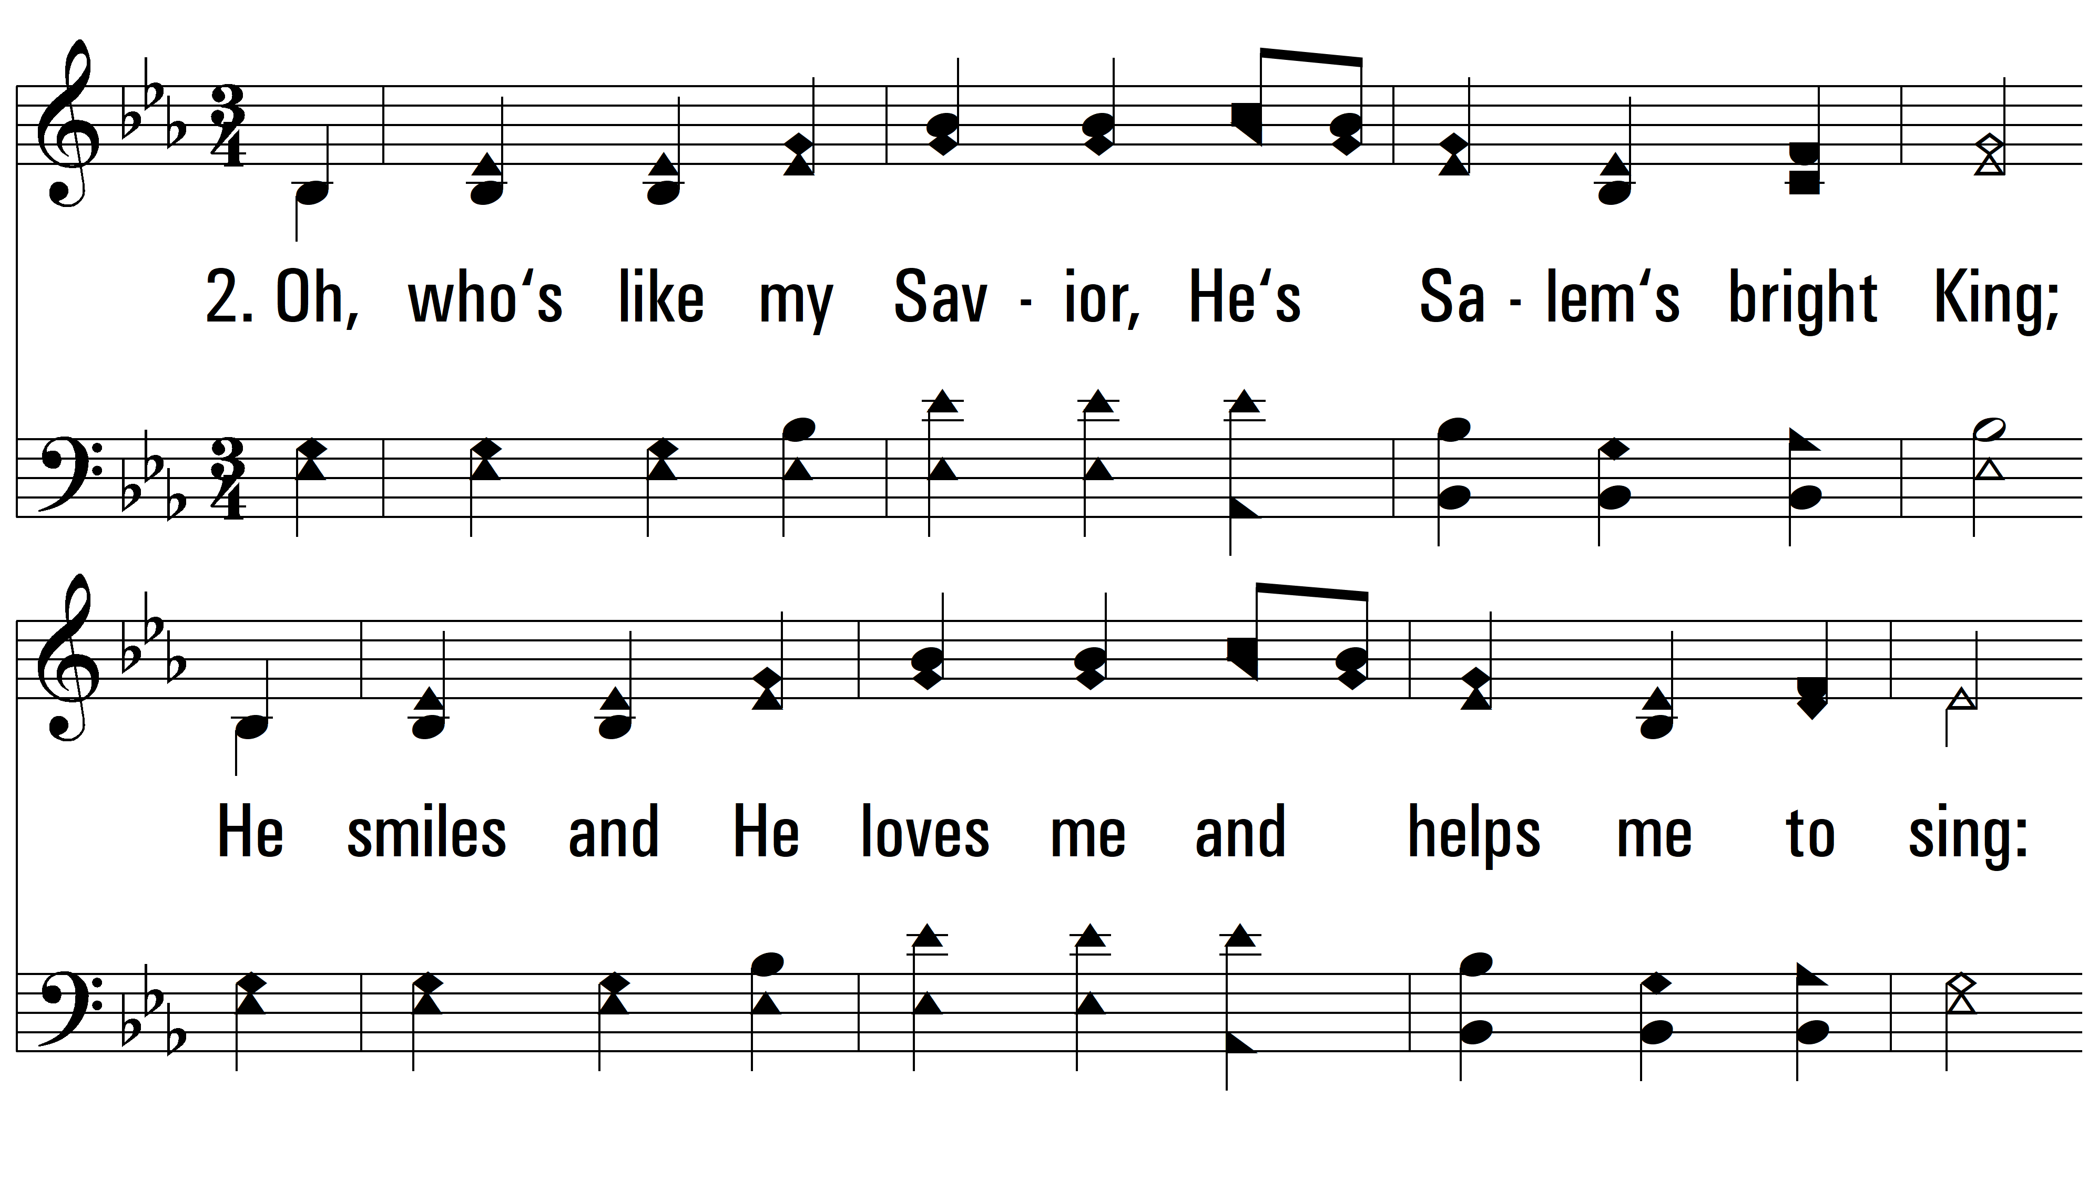
vs. 2 ~ O Jesus, My Savior

Slide 5
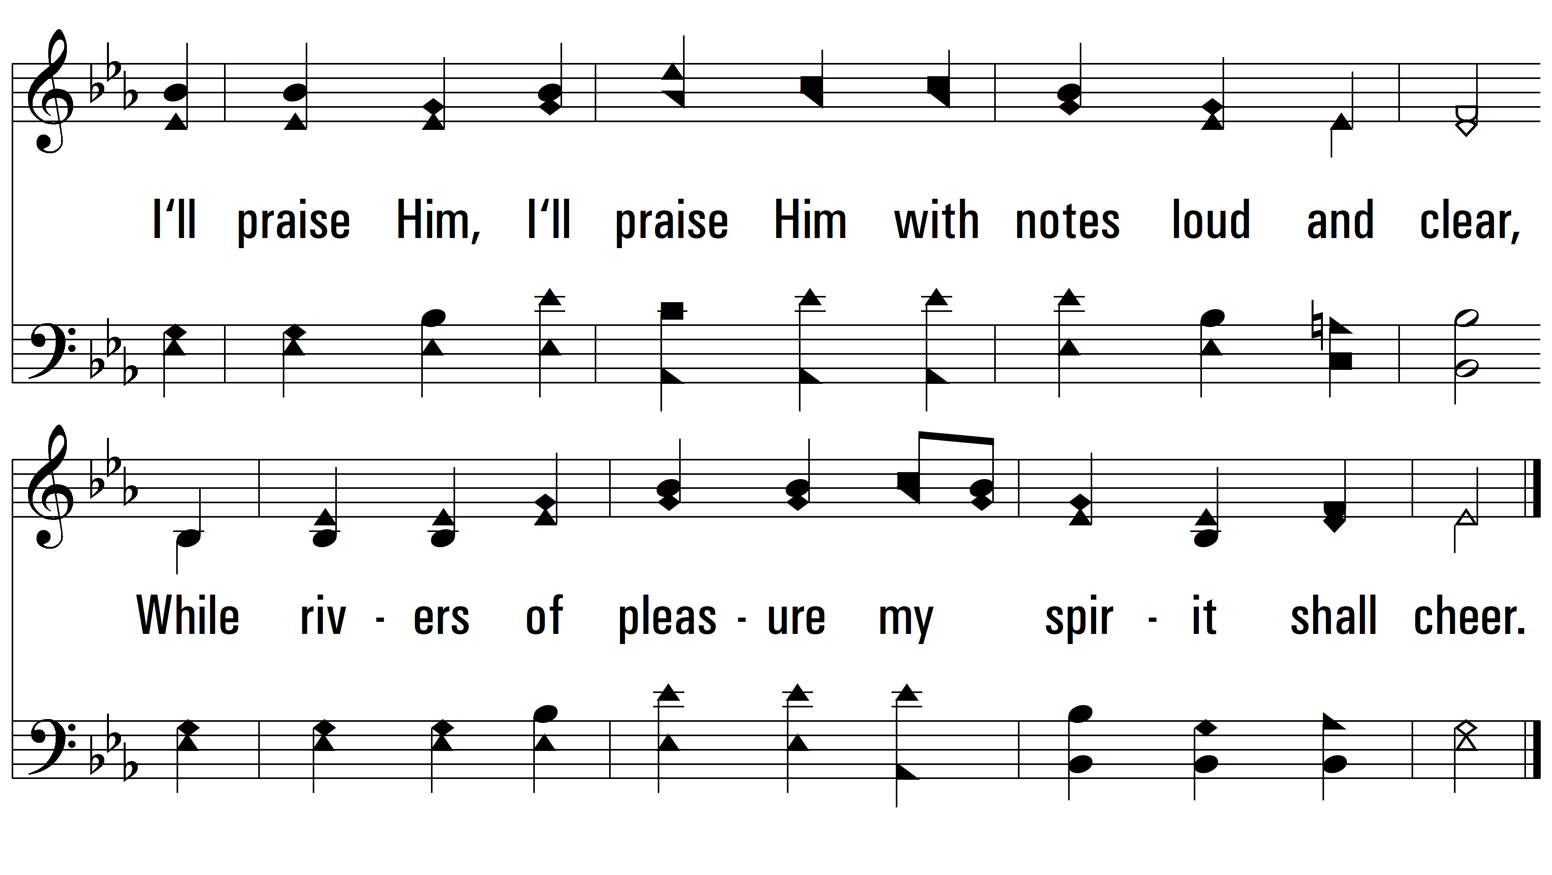
vs. 2

Slide 6
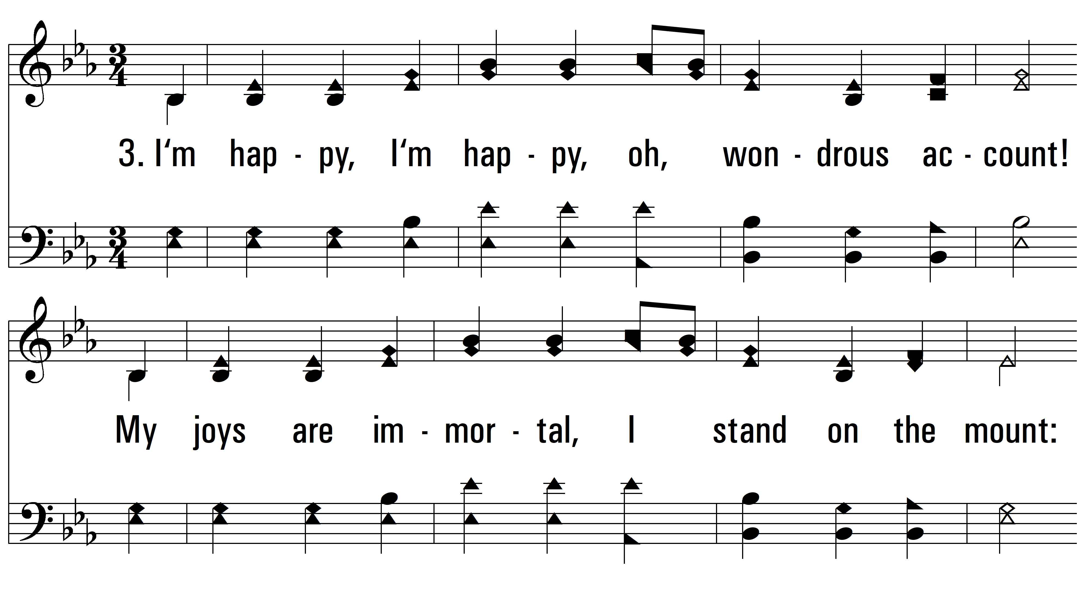
vs. 3 ~ O Jesus, My Savior

Slide 7
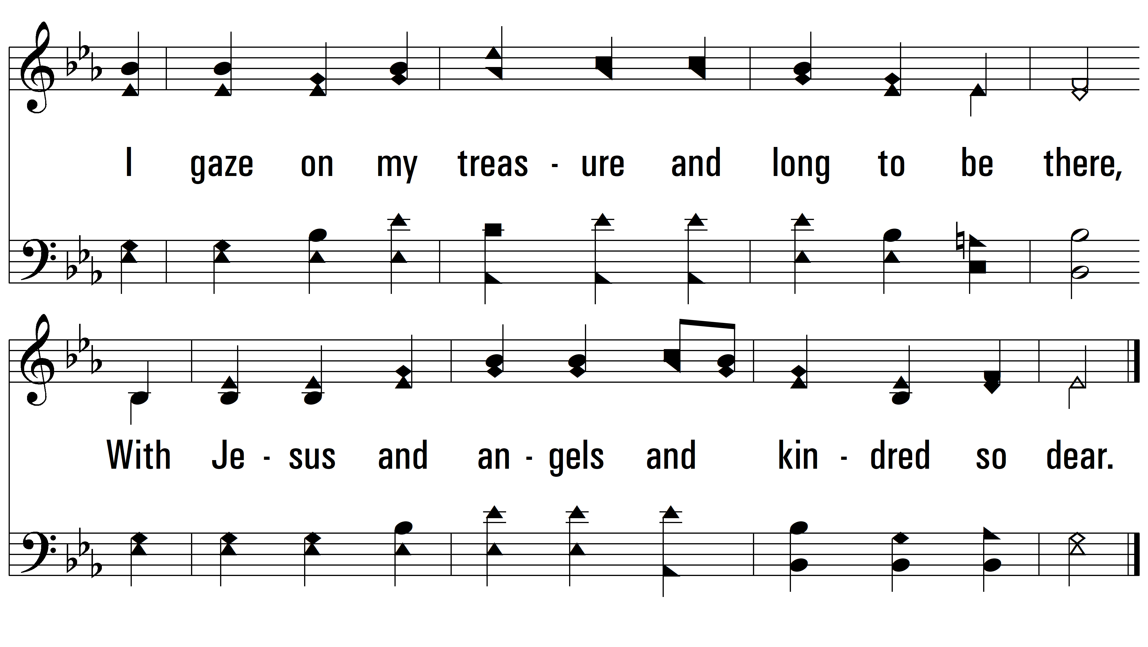
vs. 3
PDHymns.com
END

