Slide 1
O Jesus, I Have Promised
ANGEL’S STORY
7.6.7.6.D
Words: | John E. Bode (1868)
Music: | Arthur H. Mann (1881)
4/4
G/B - MI
Verses: 5
Lead - | MI
Alto - | SOL
Tenor - | DO
Bass - | DO
PDHymns.com

Slide 2
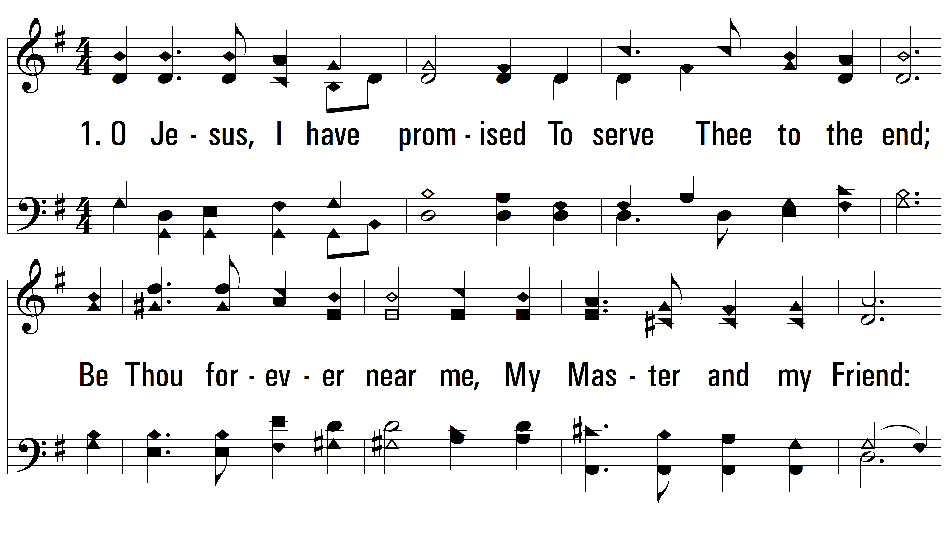
vs. 1 ~ O Jesus, I Have Promised

Slide 3
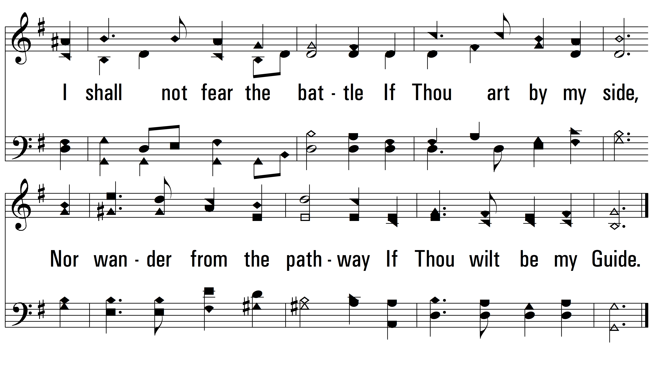
vs. 1

Slide 4
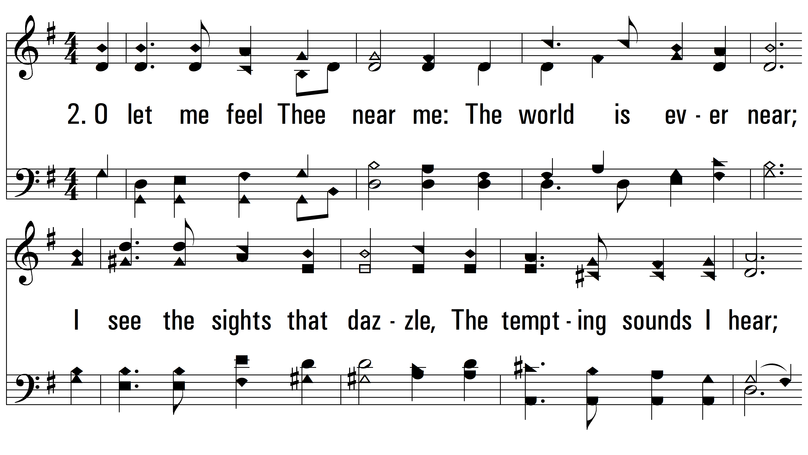
vs. 2 ~ O Jesus, I Have Promised

Slide 5
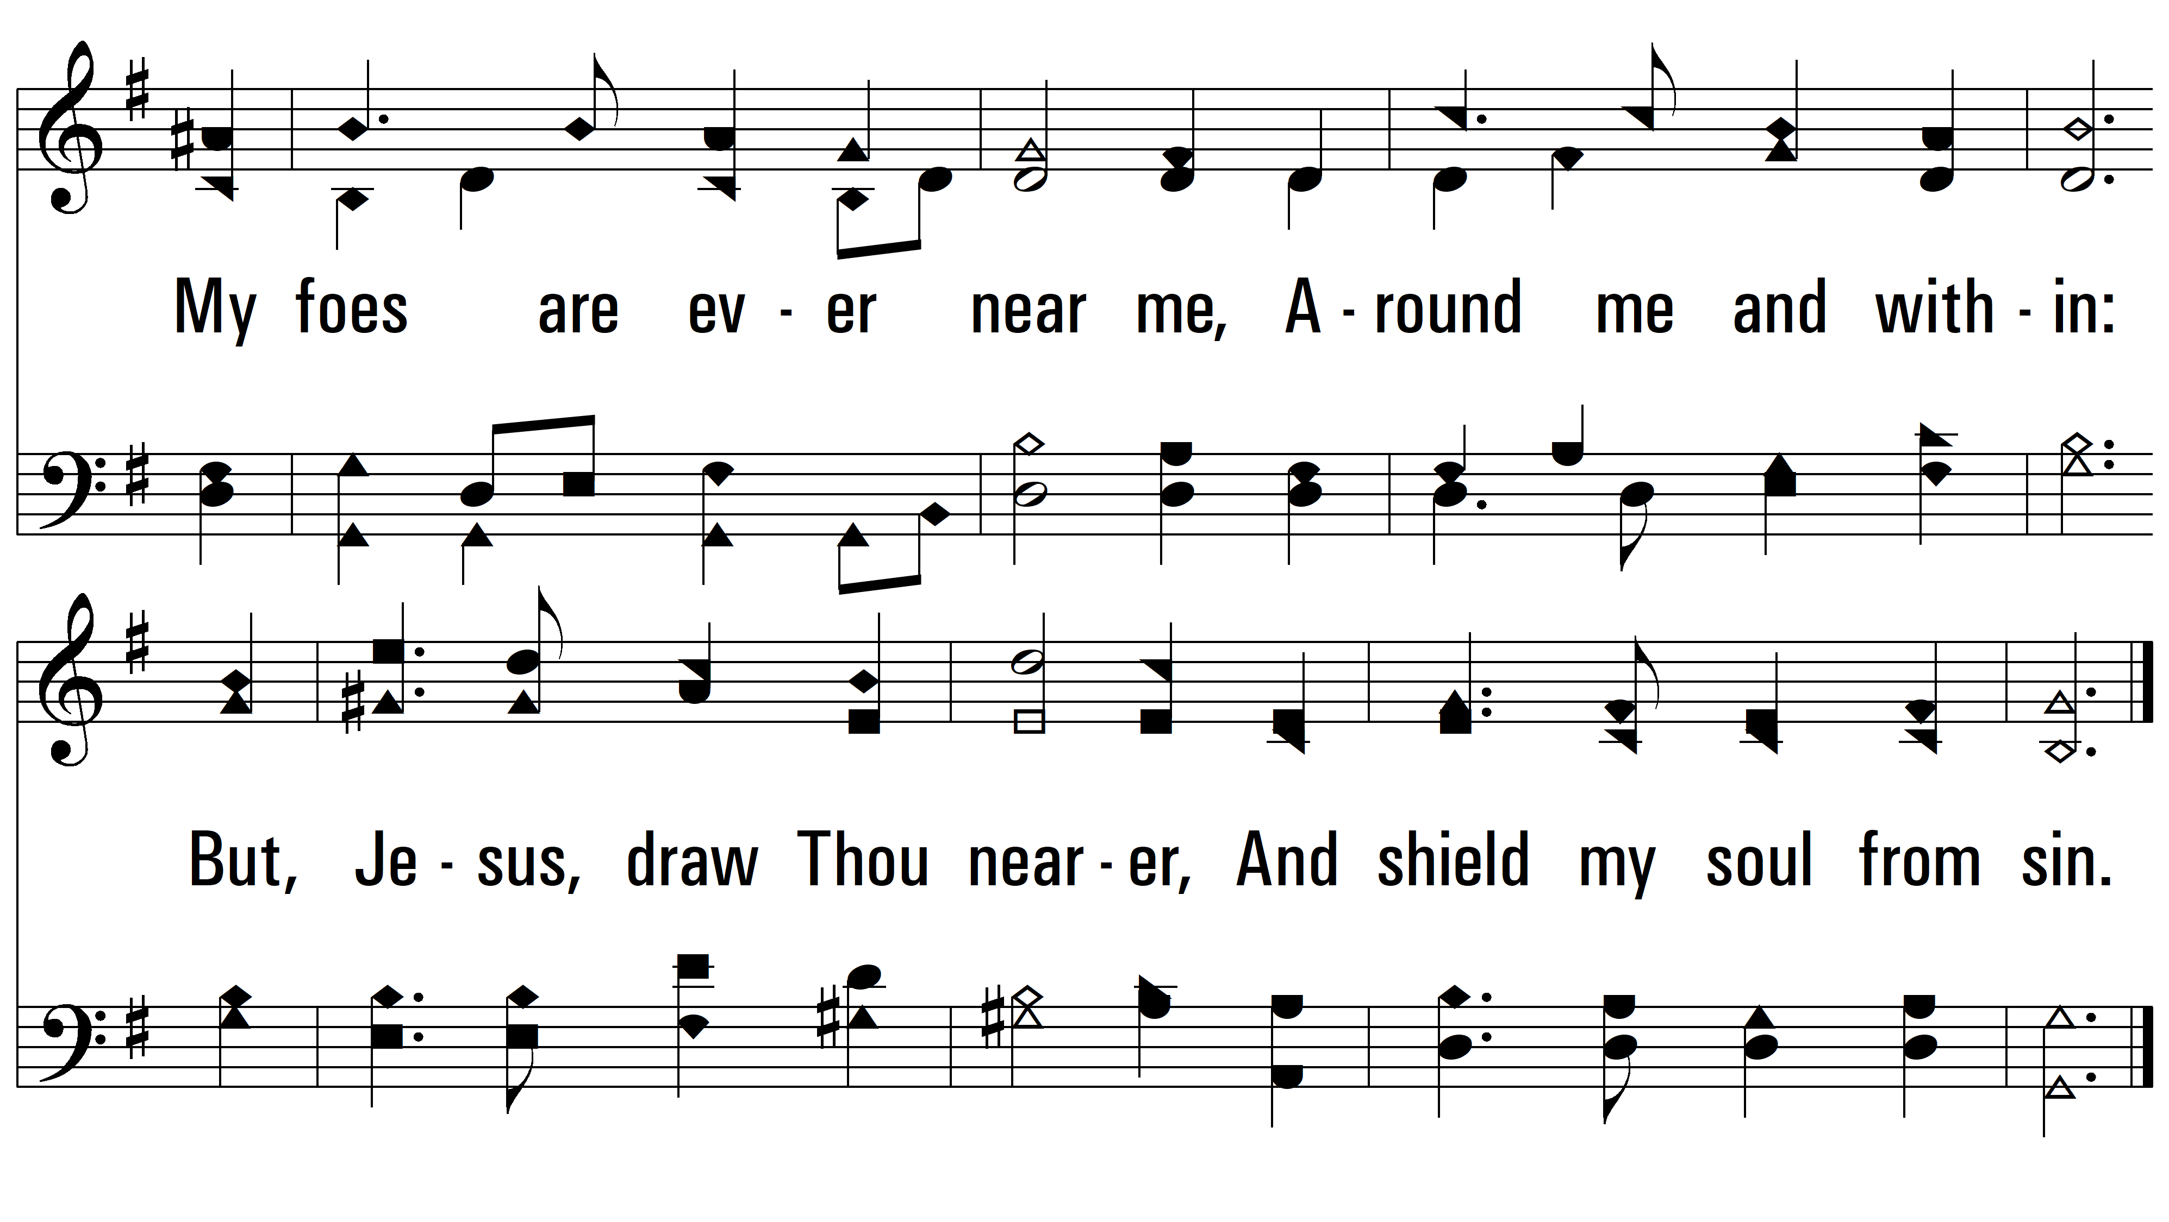
vs. 2

Slide 6
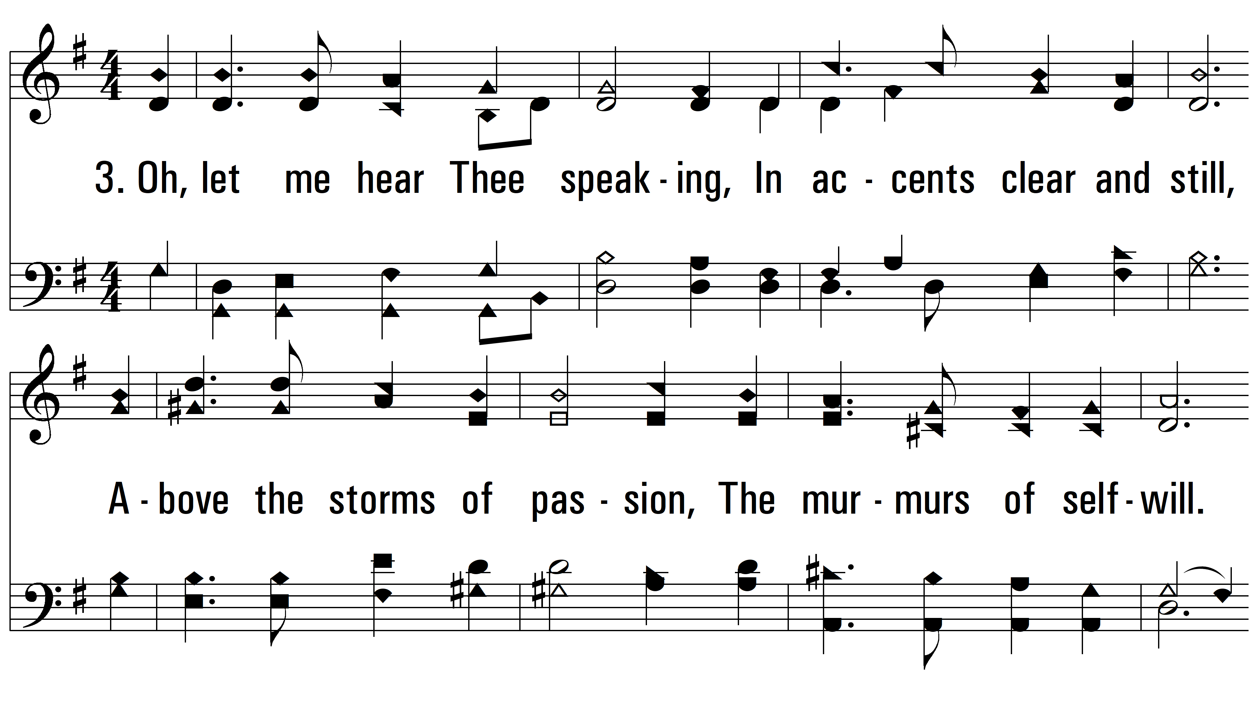
vs. 3 ~ O Jesus, I Have Promised

Slide 7
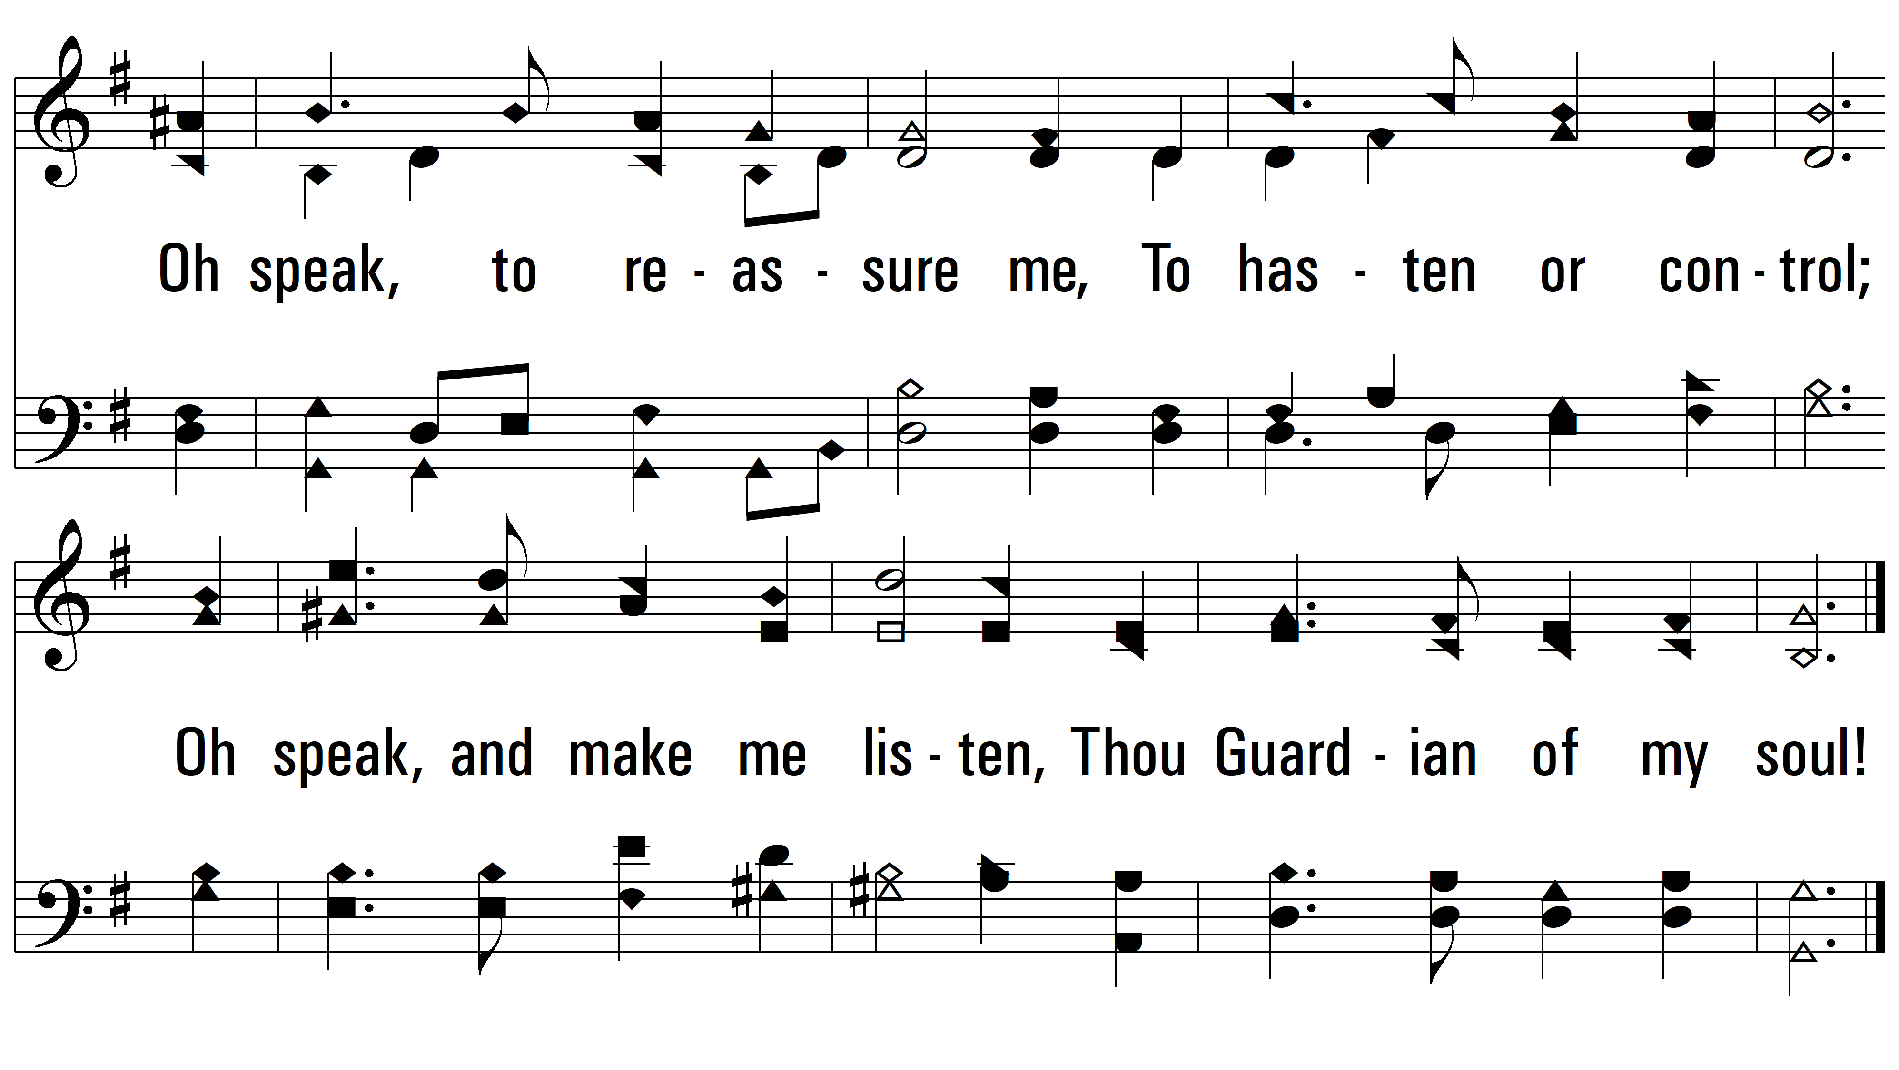
vs. 3

Slide 8
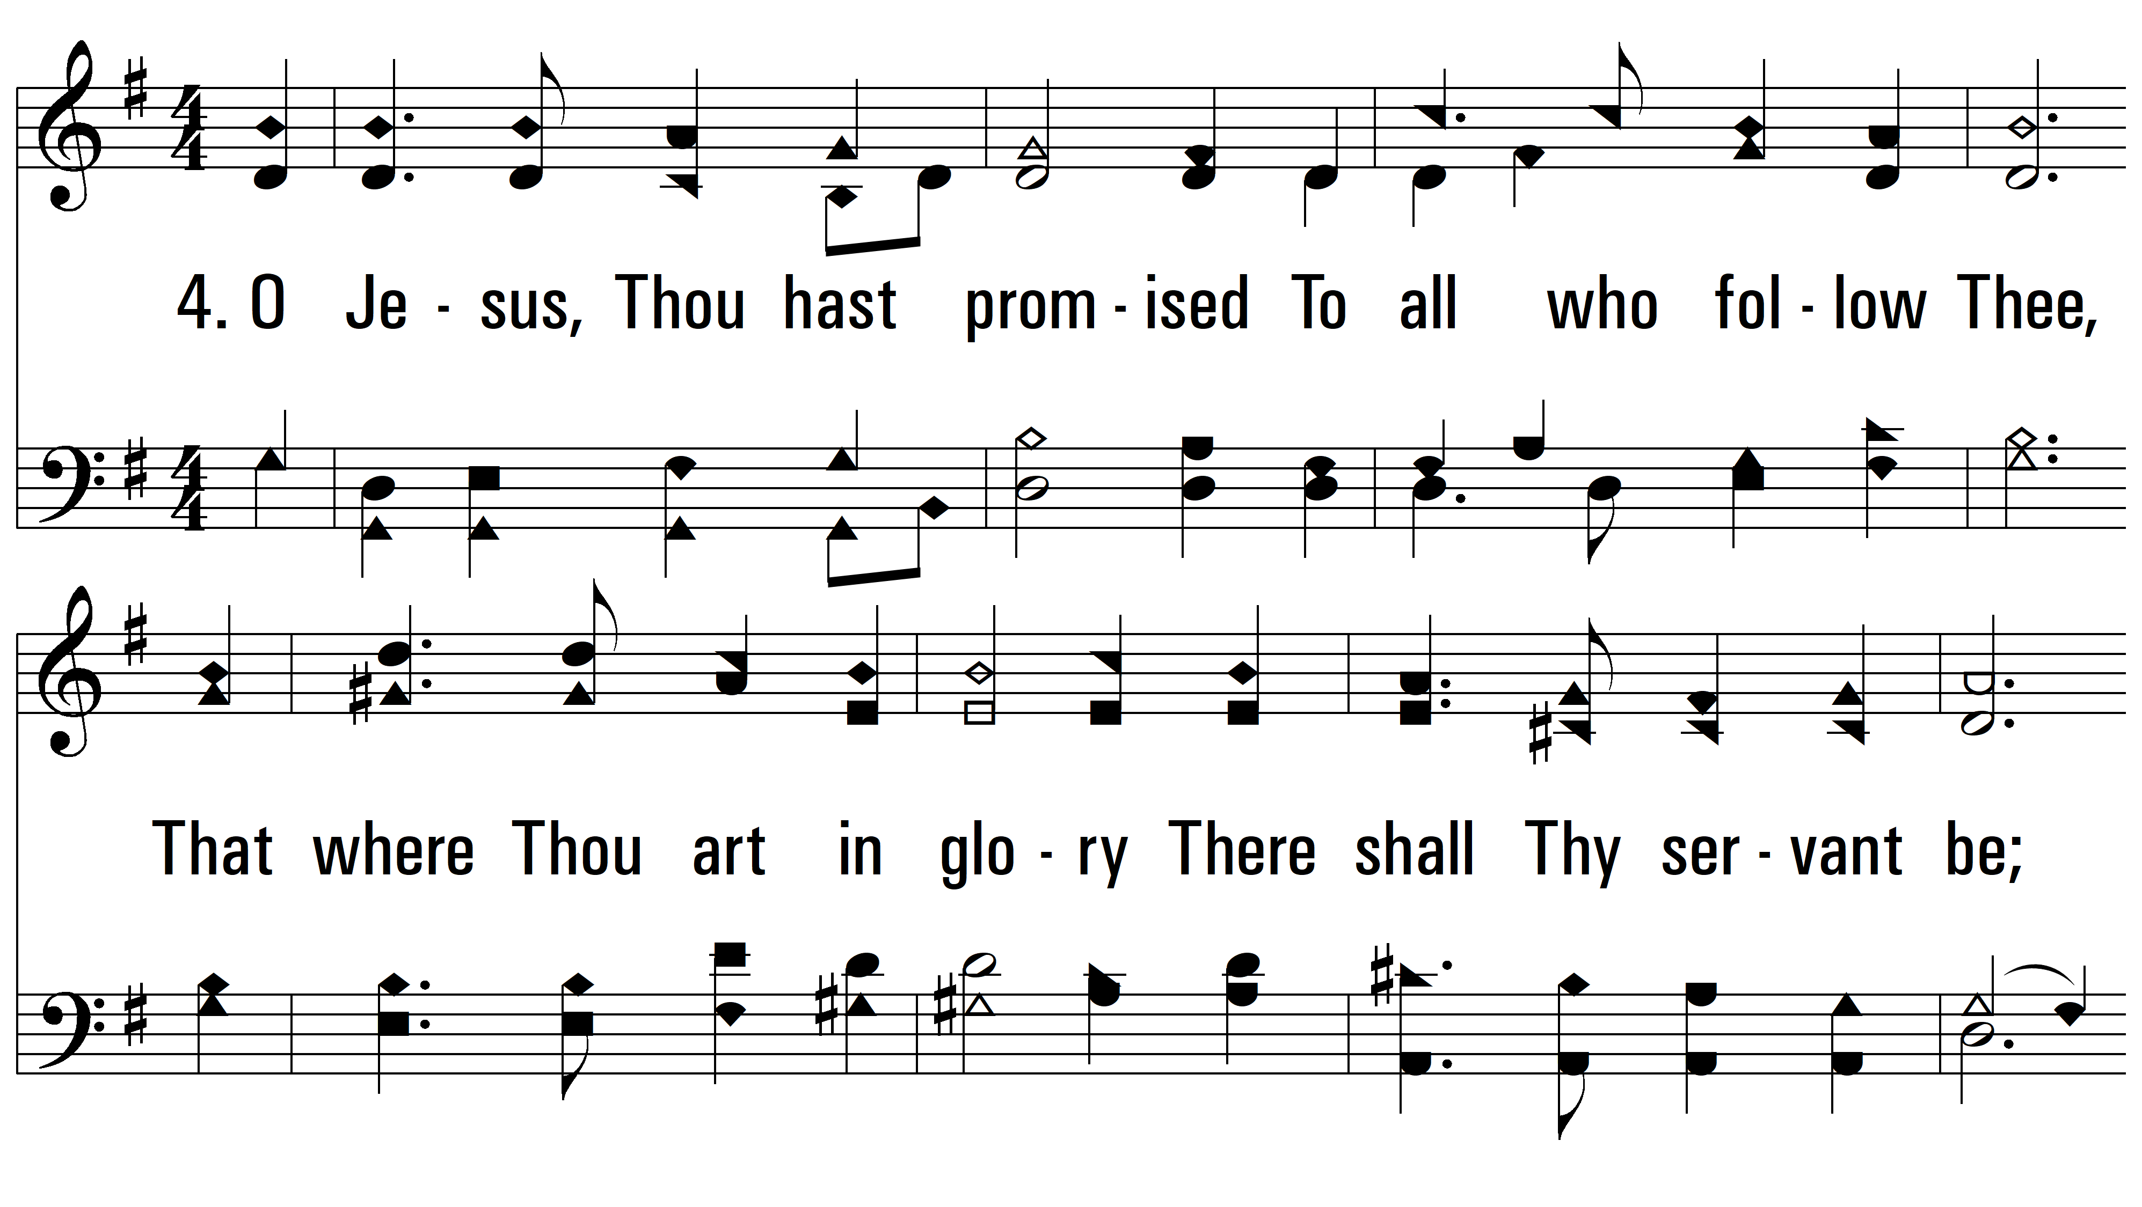
vs. 4 ~ O Jesus, I Have Promised

Slide 9
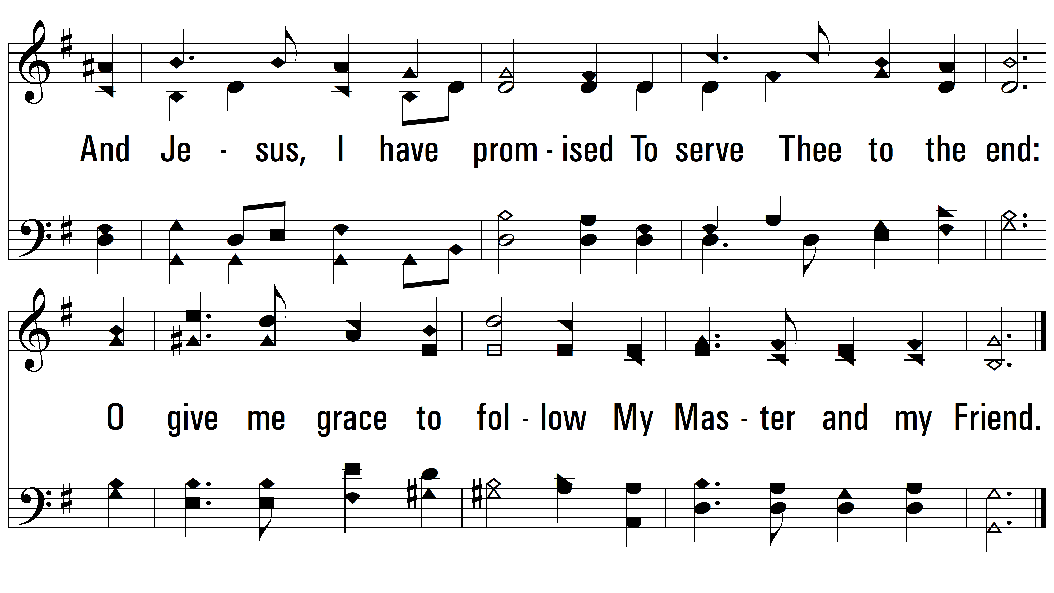
vs. 4

Slide 10
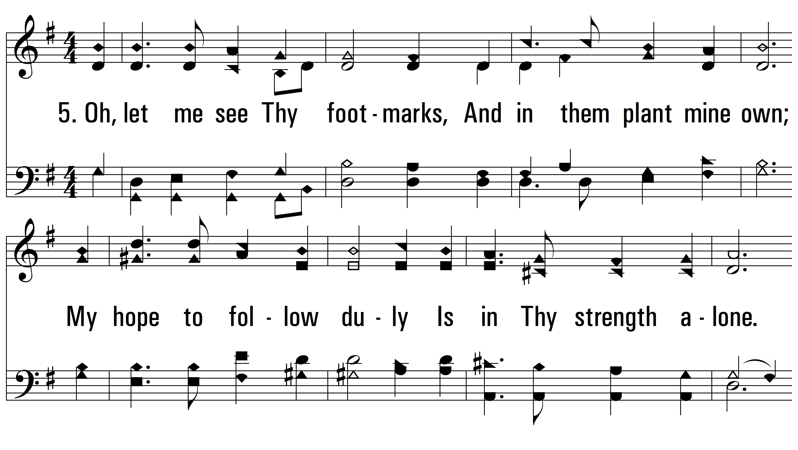
vs. 5 ~ O Jesus, I Have Promised

Slide 11
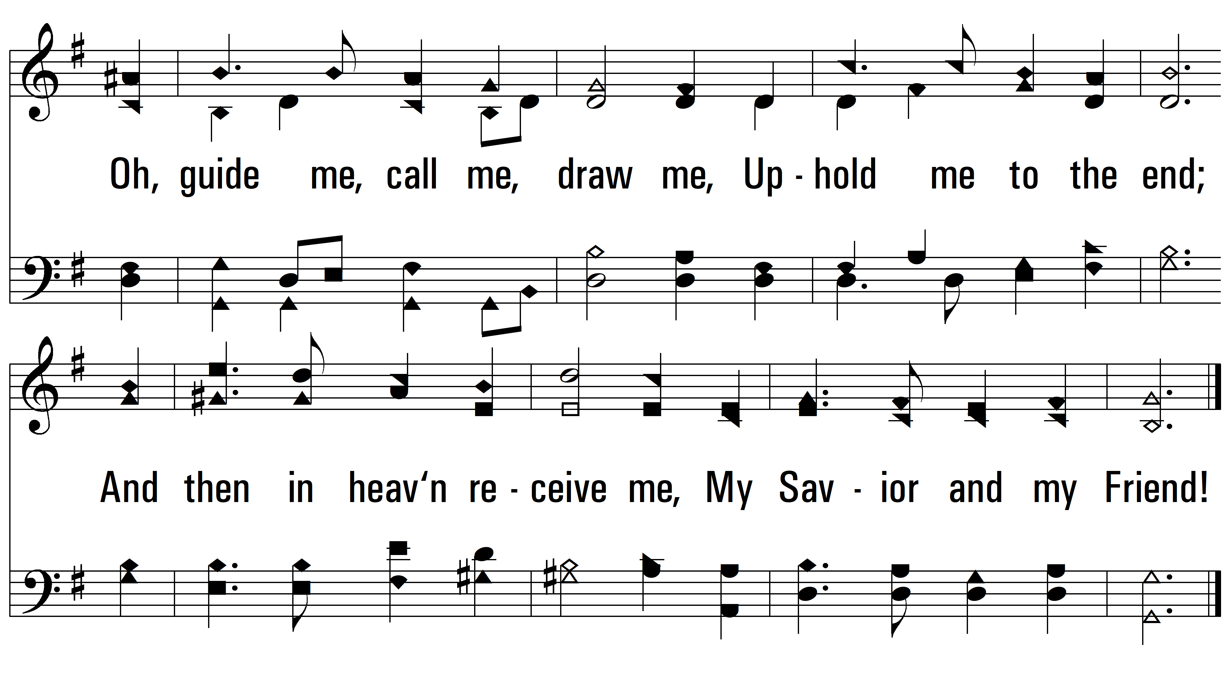
vs. 5
PDHymns.com
END

