Slide 1
O Heart Bowed Down With Sorrow
(Come Unto Me)
Words: | F. E. Belden (1895)
Music: | F. E. Belden (1895)
3/4 - 4/4
C/G - SOL
Verses: 3/Chorus
Lead - | SOL
Alto - | MI
Tenor - | DO
Bass - | DO
PDHymns.com

Slide 2
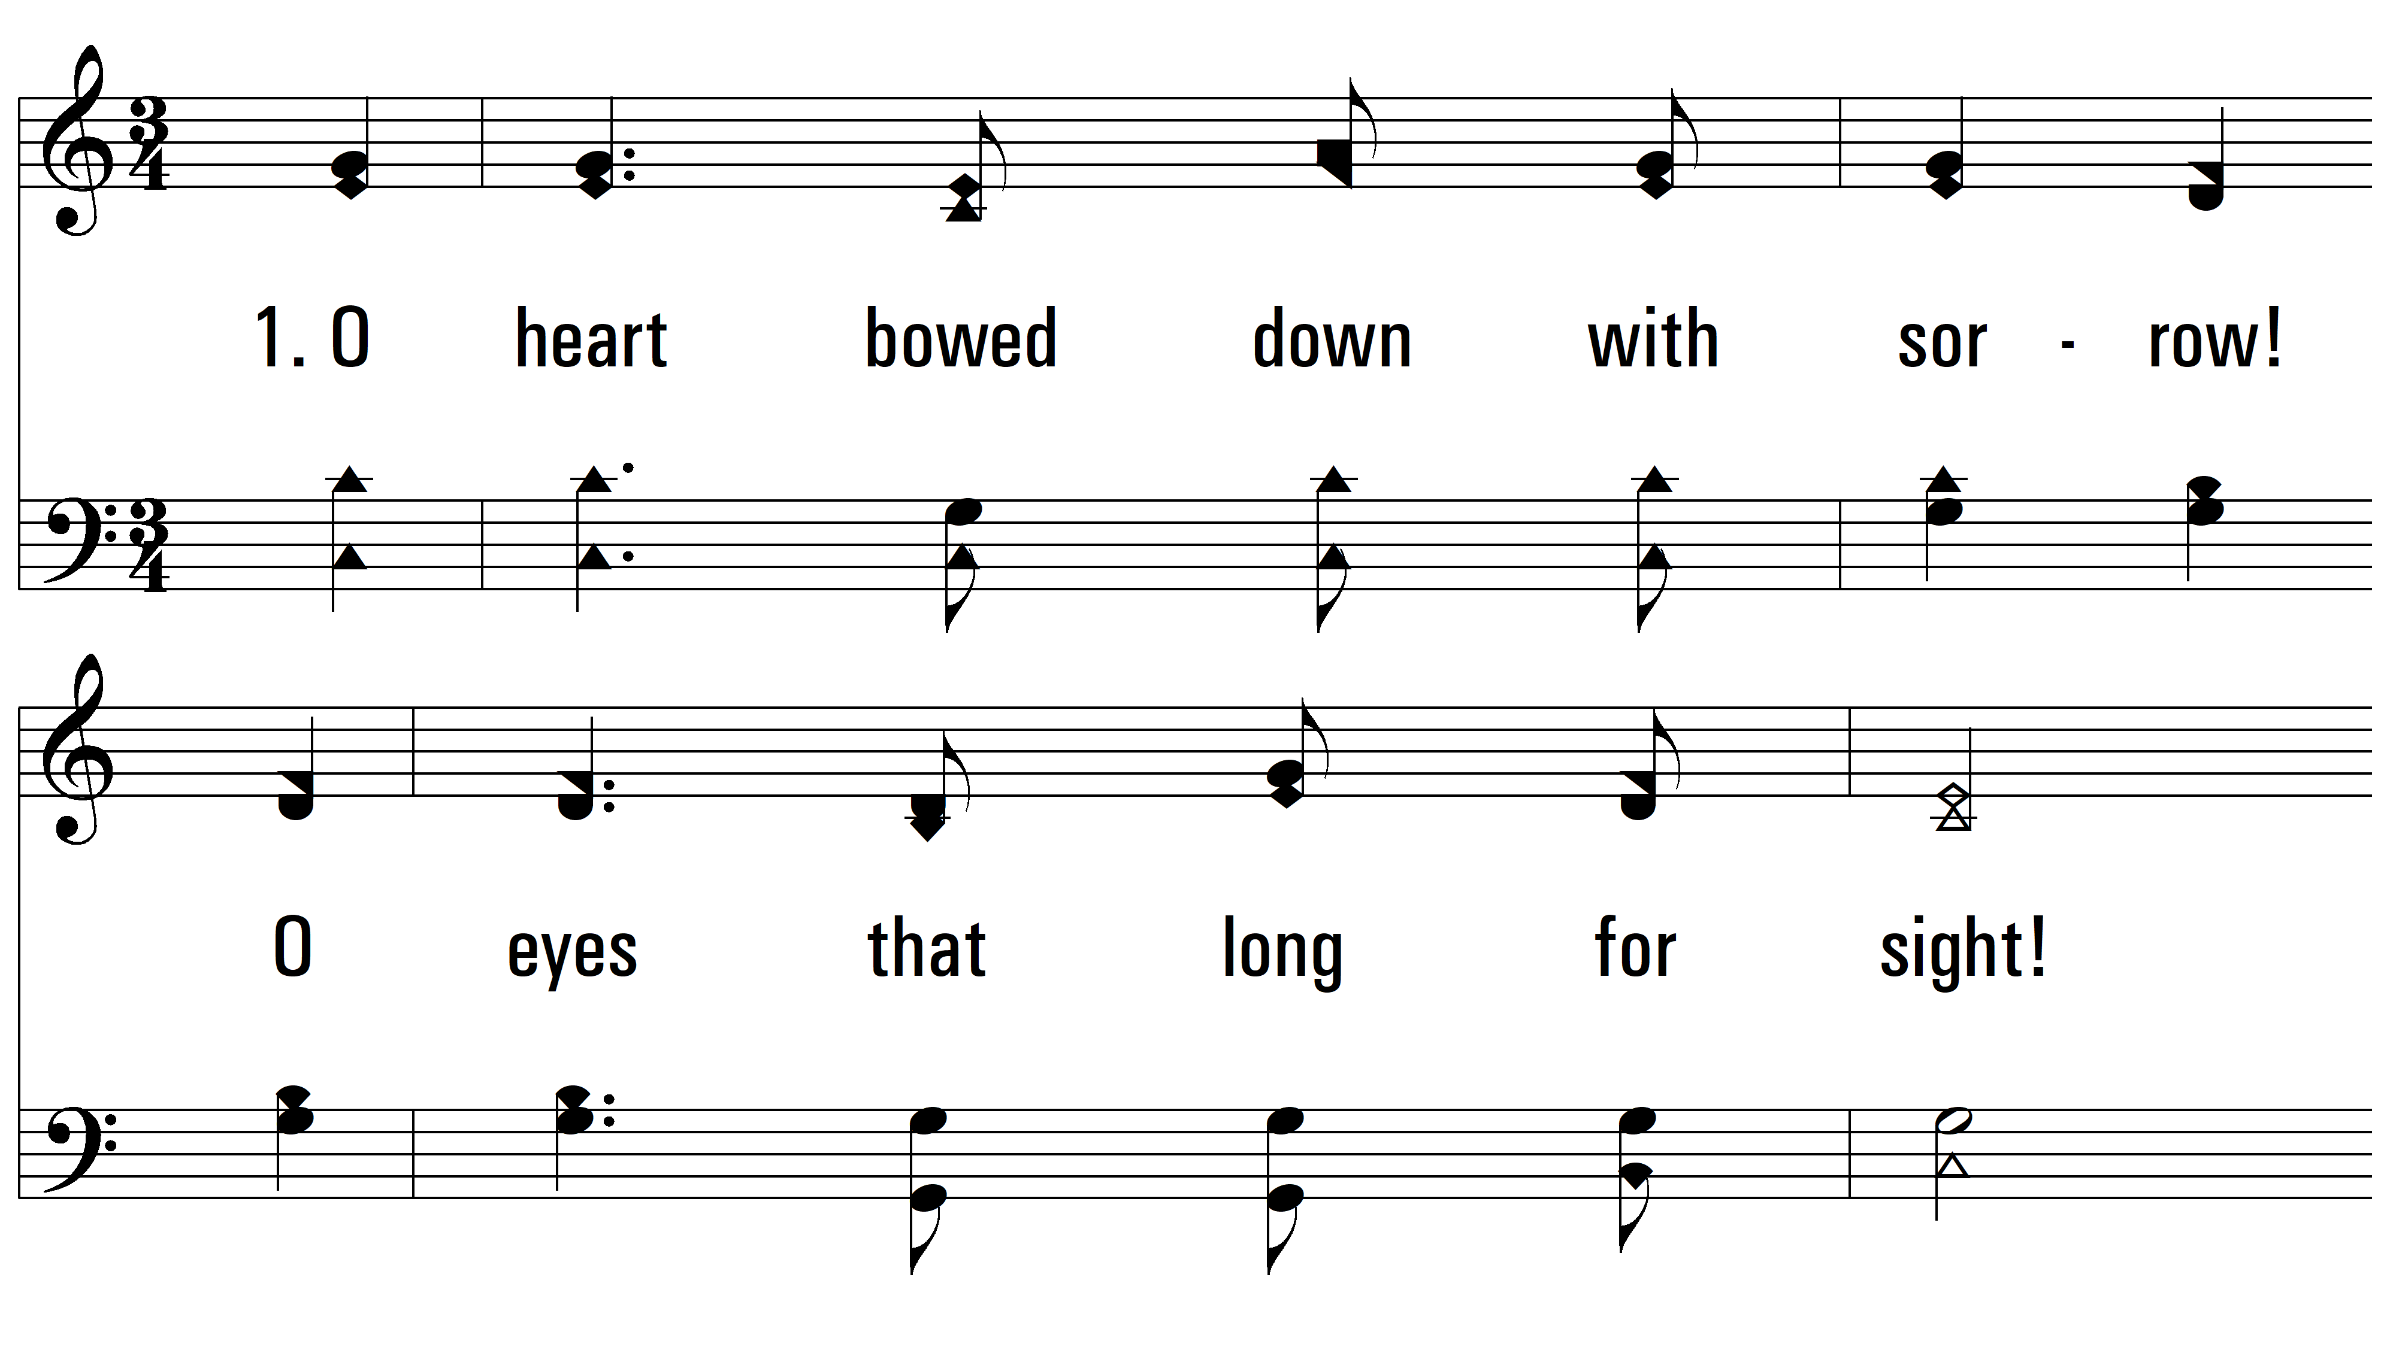
vs. 1 ~ O Heart Bowed Down With Sorrow

Slide 3
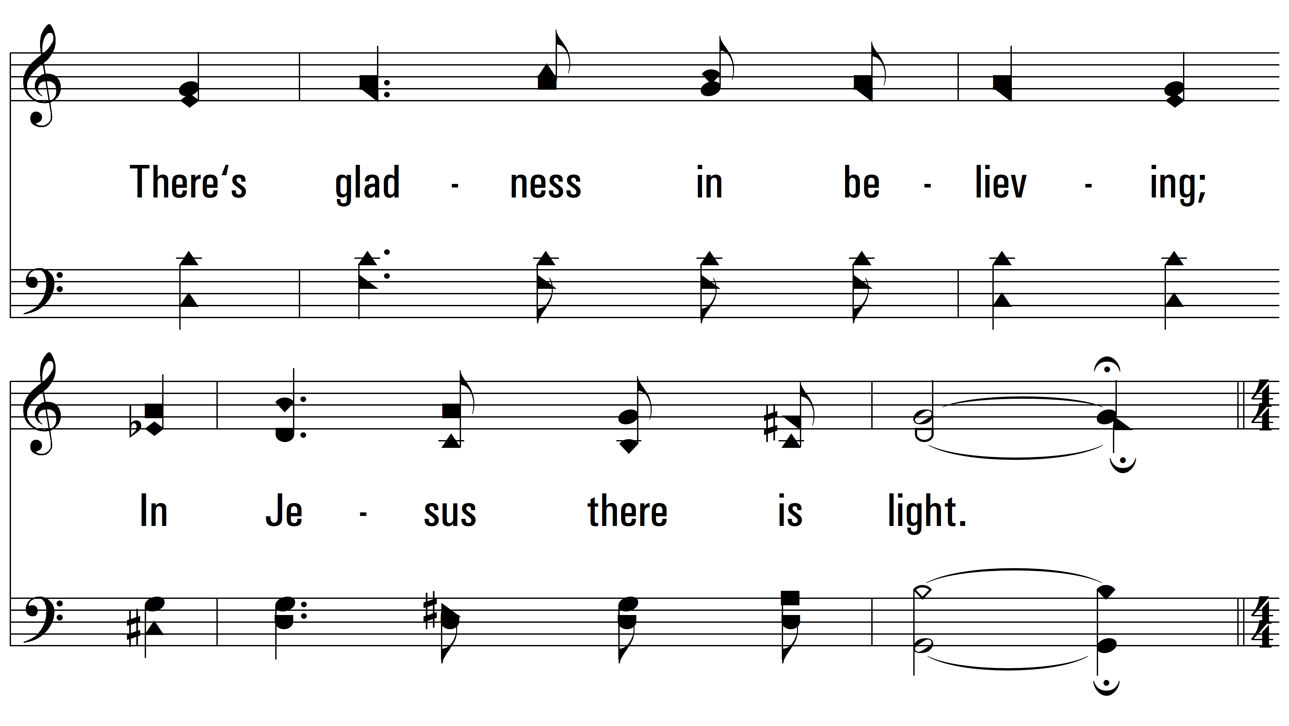
vs. 1

Slide 4
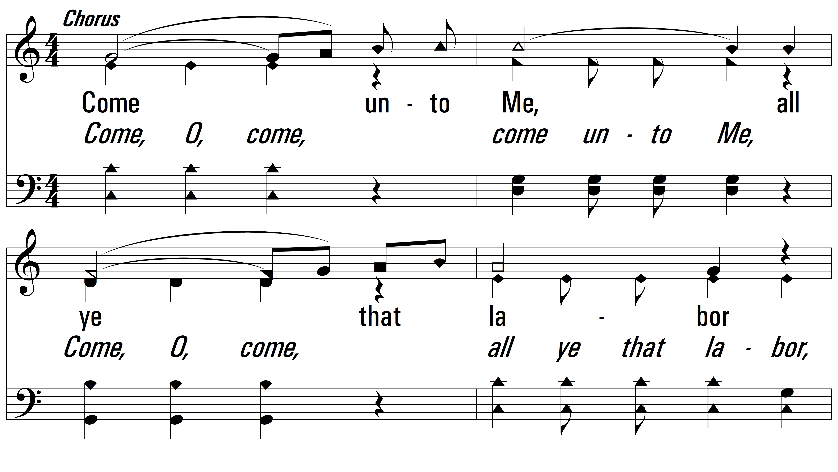
vs. 1

Slide 5
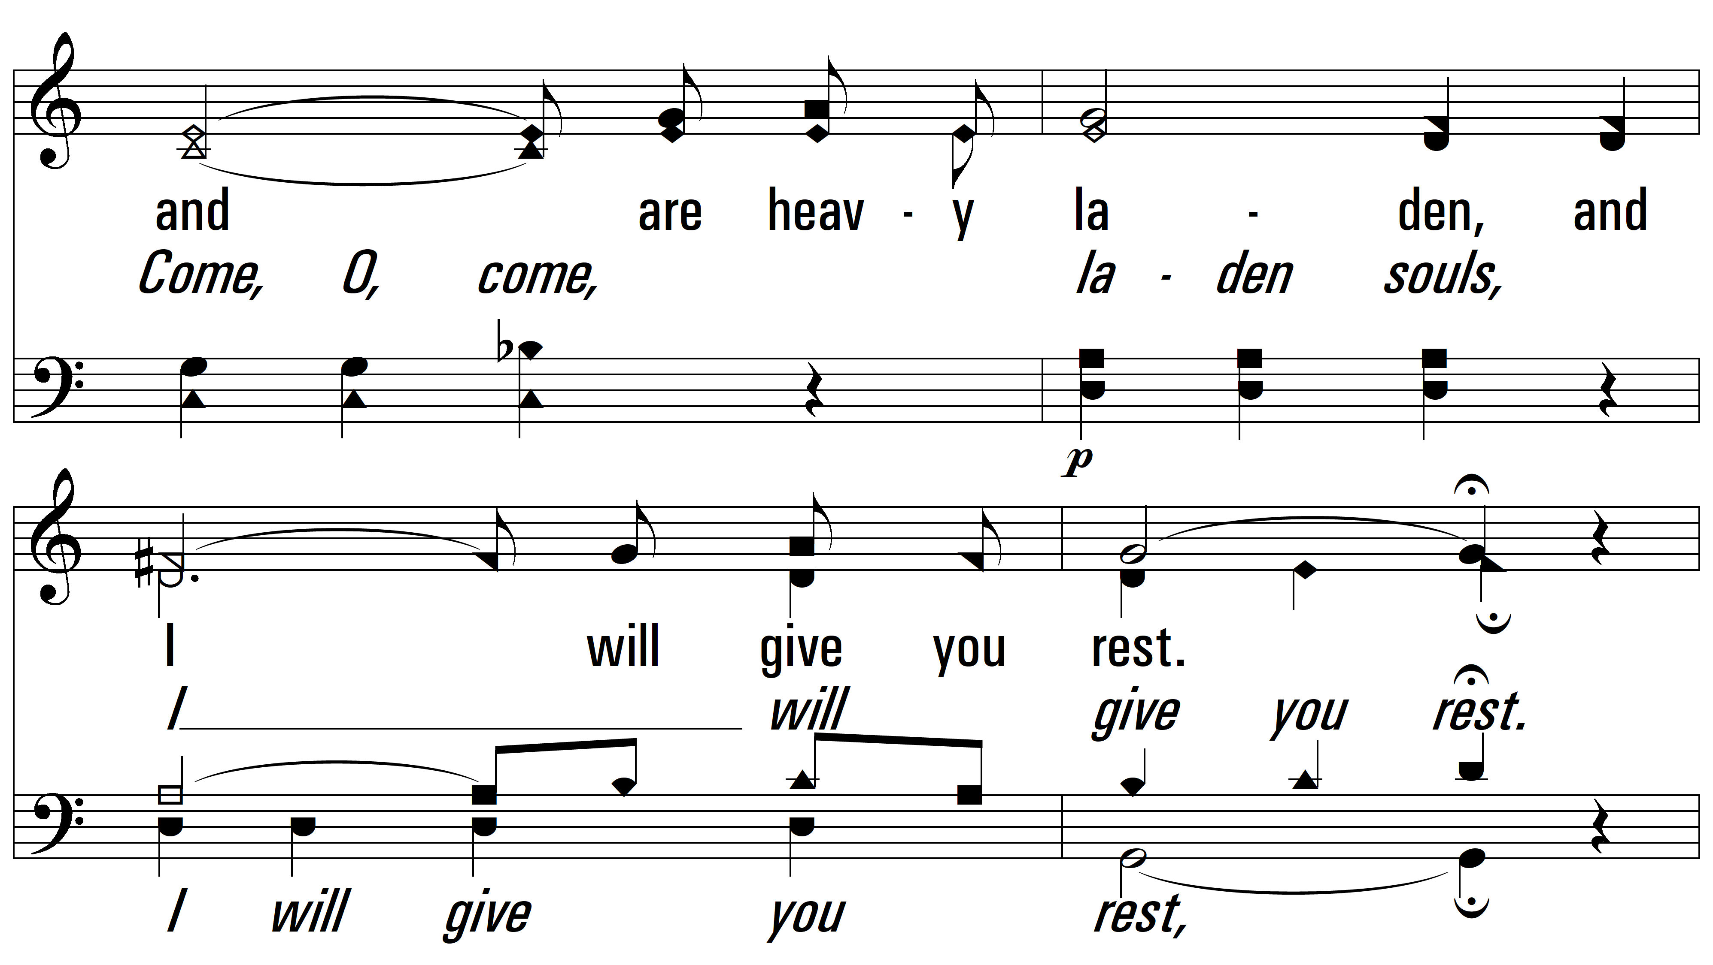
vs. 1

Slide 6
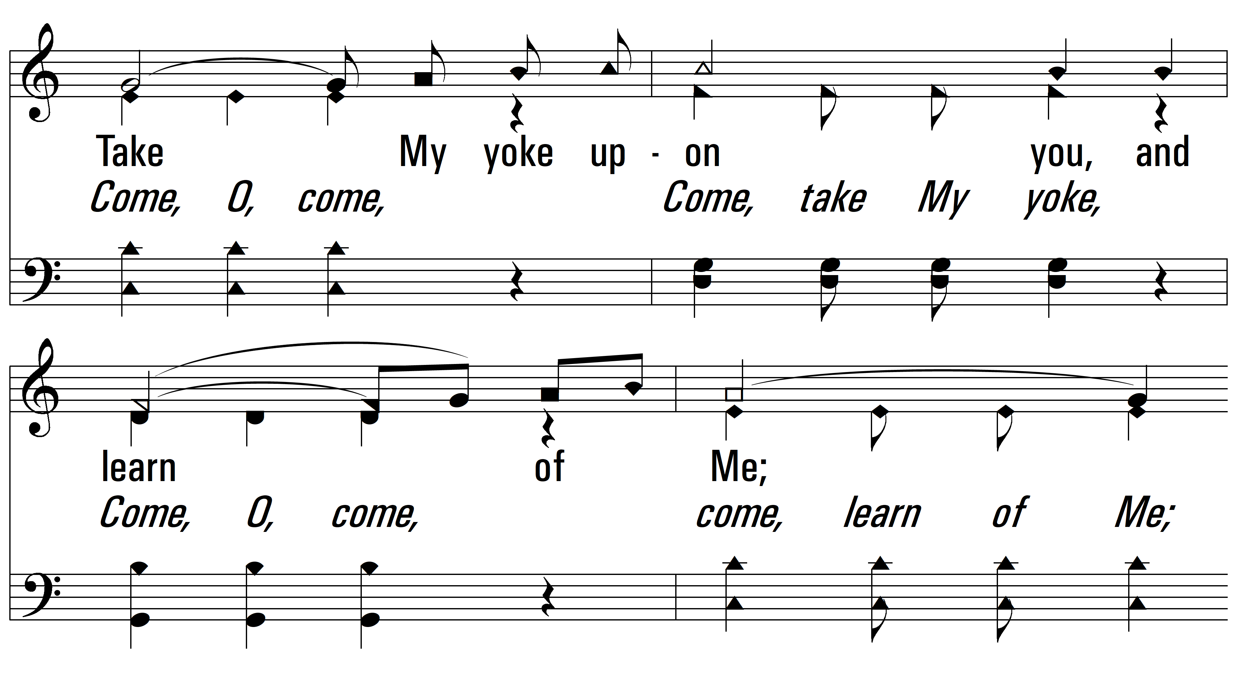
vs. 1

Slide 7
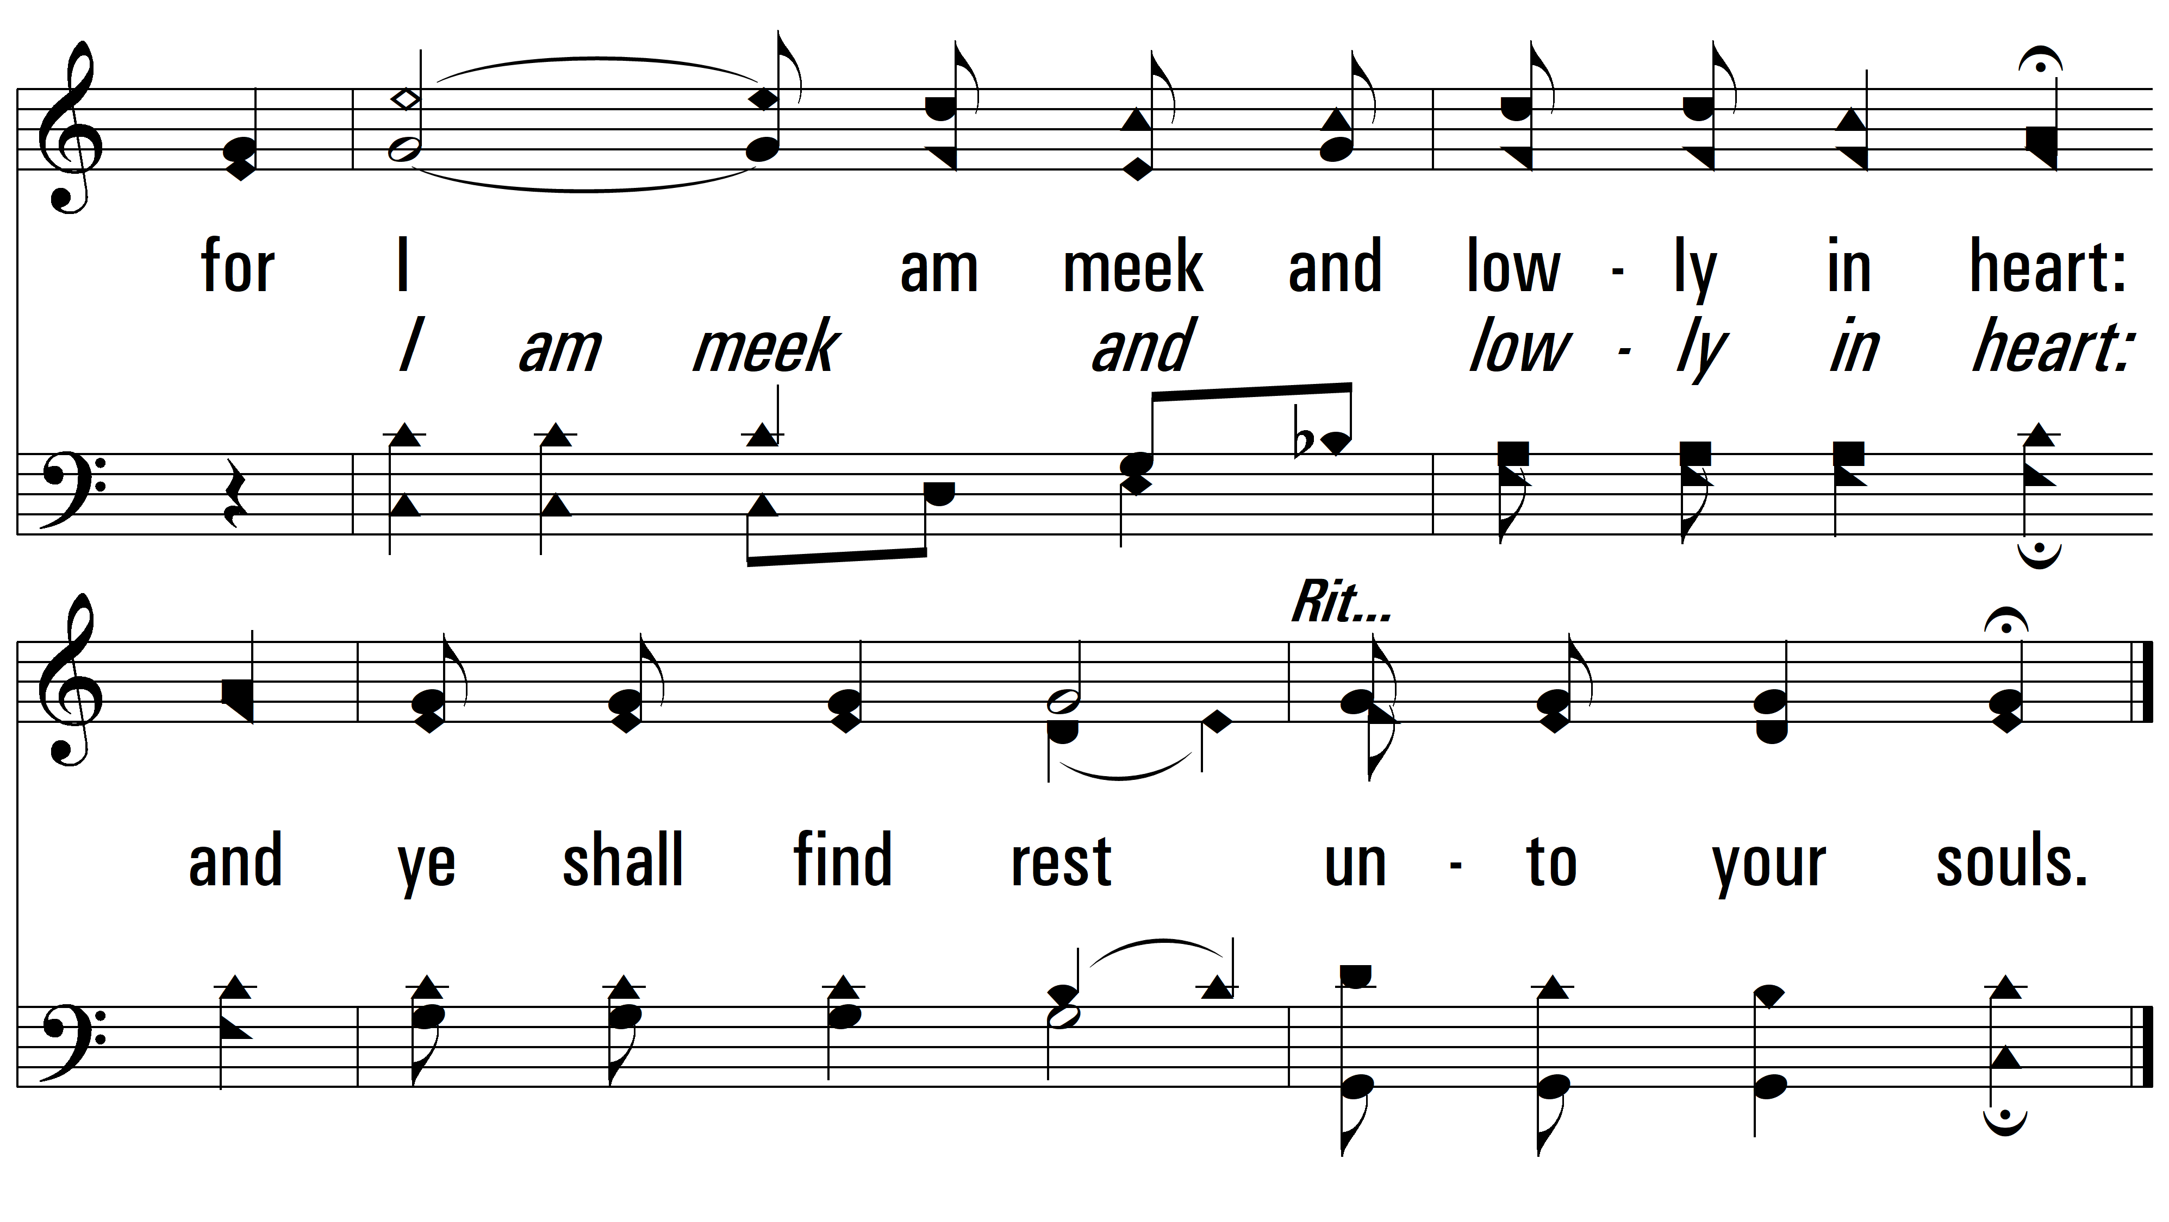
vs. 1

Slide 8
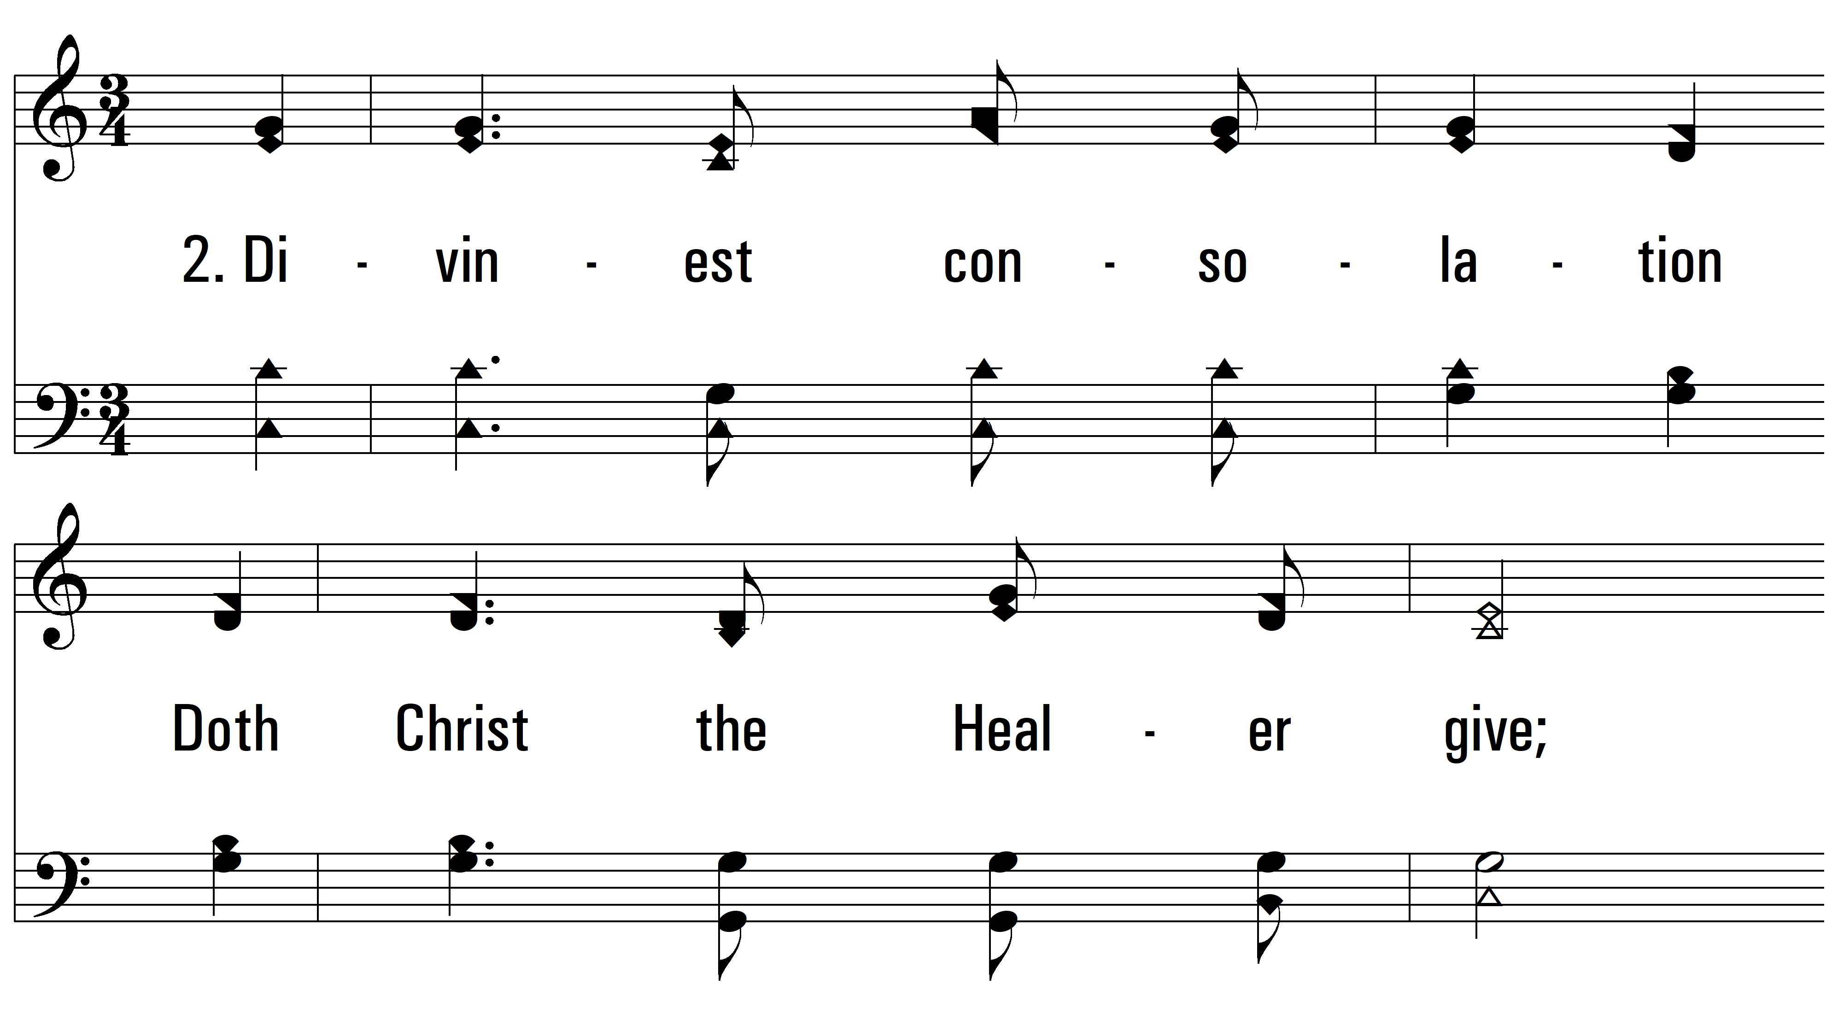
vs. 2 ~ O Heart Bowed Down With Sorrow

Slide 9
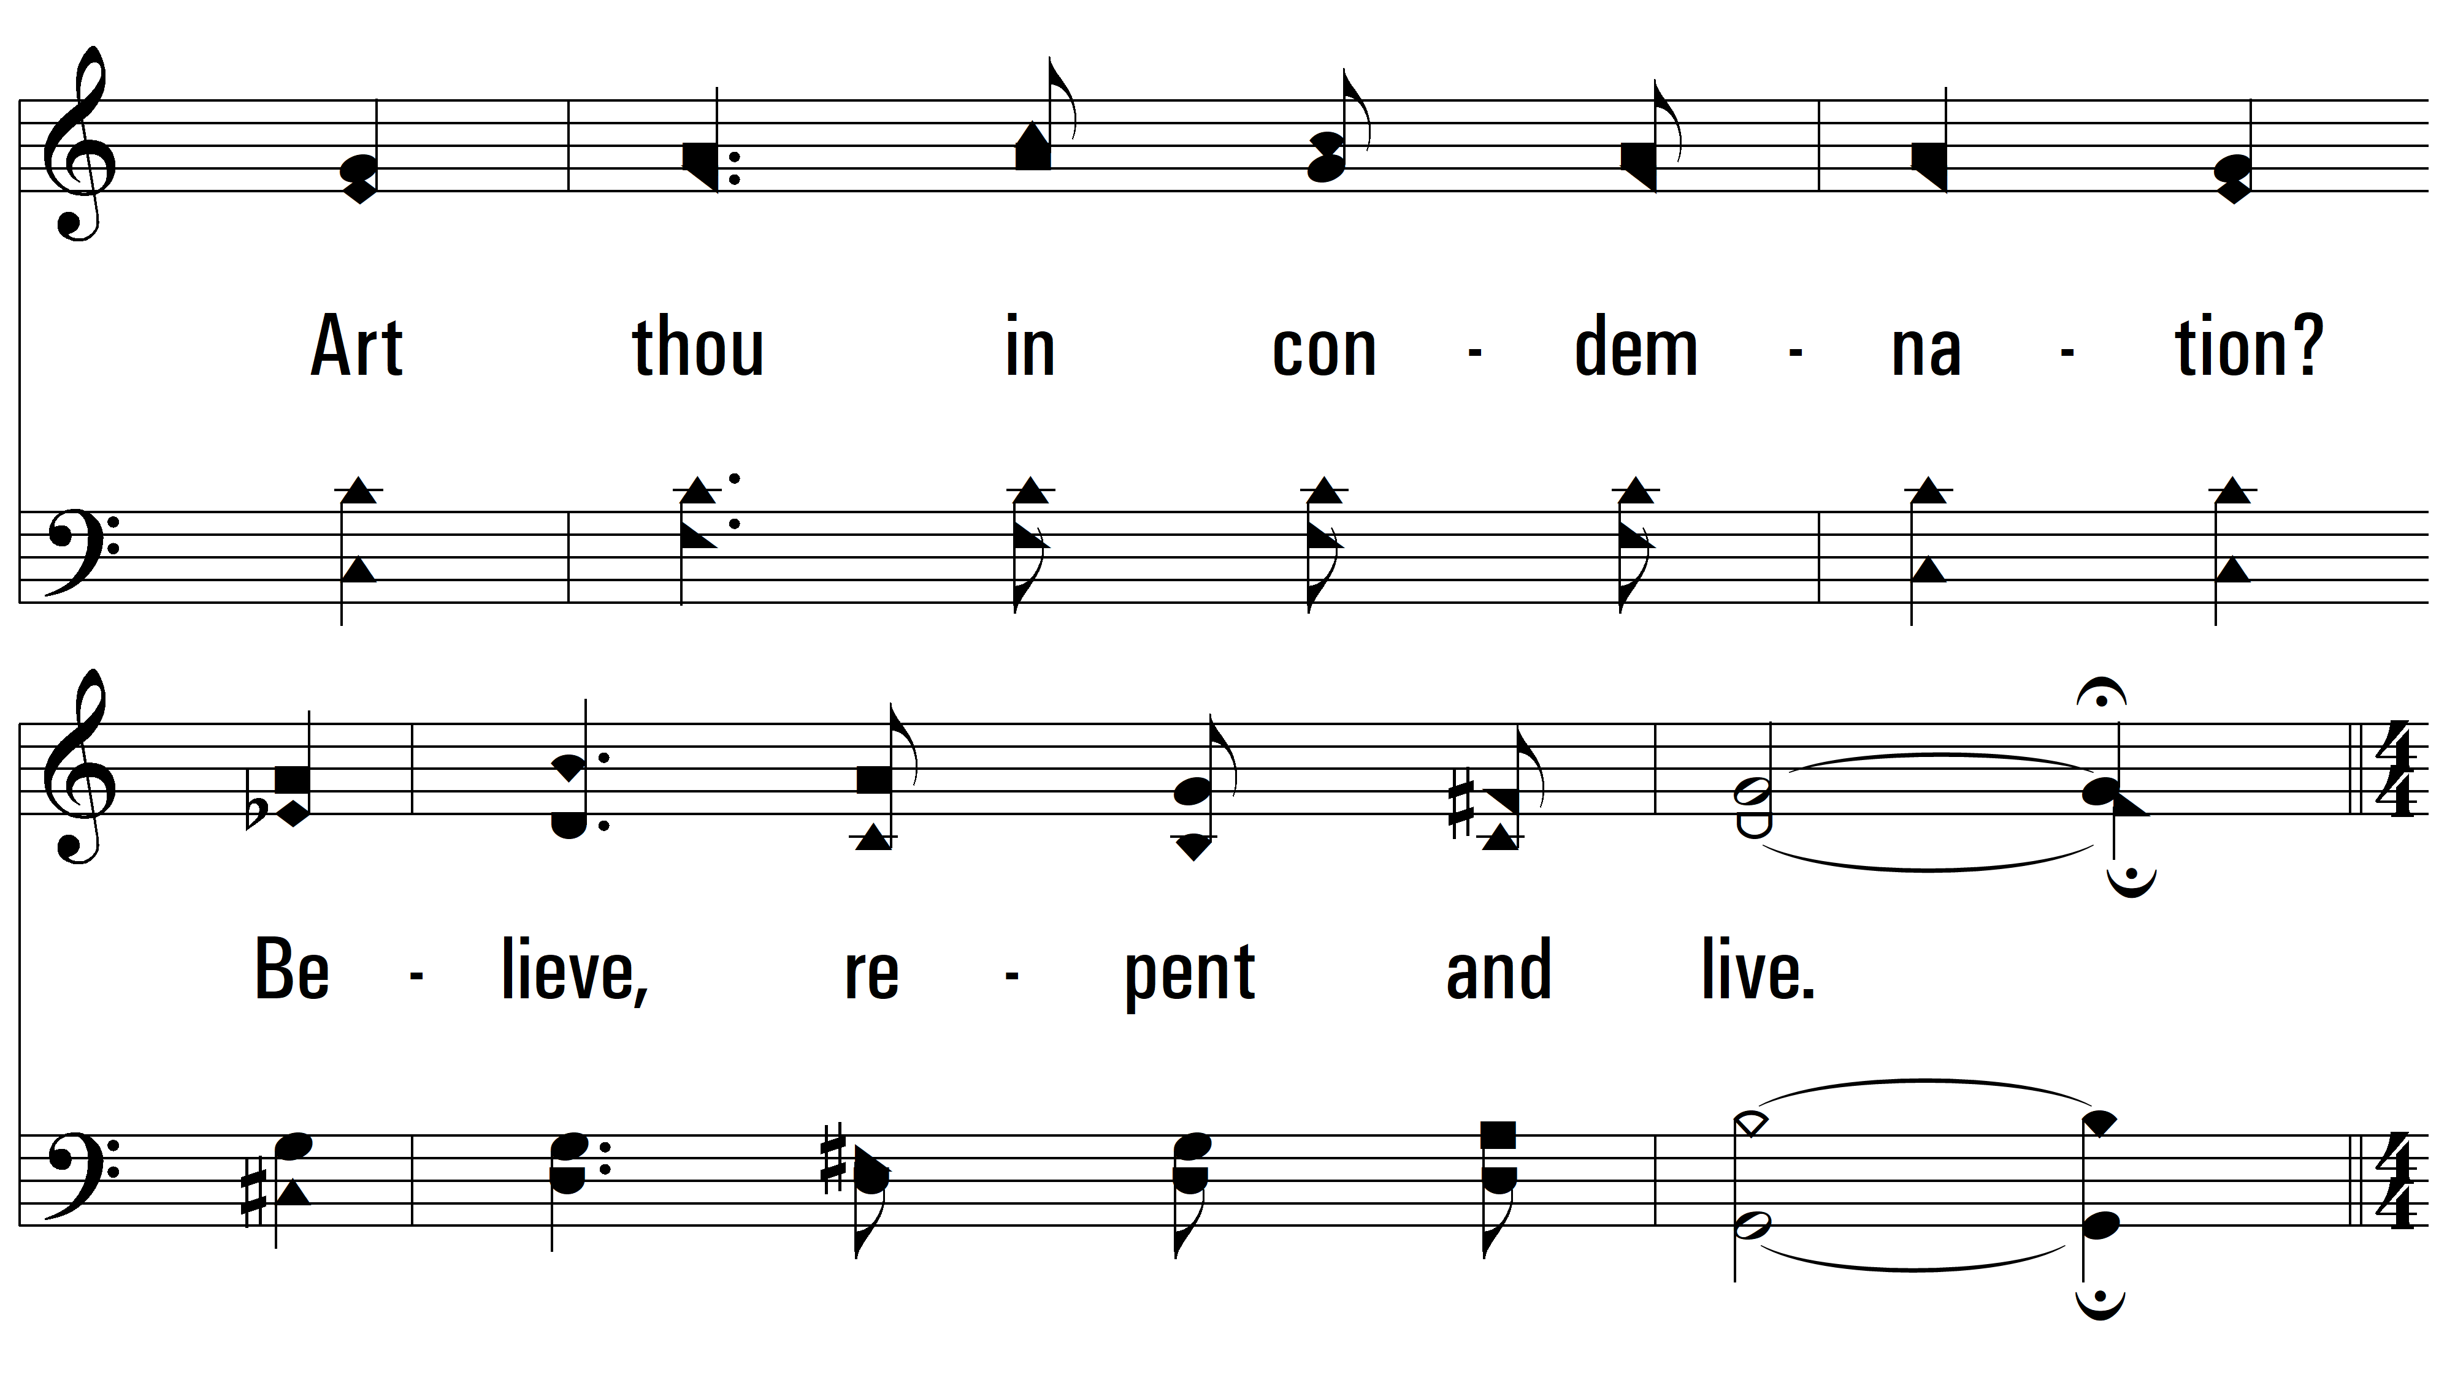
vs. 2

Slide 10
vs. 2

Slide 11
vs. 2

Slide 12
vs. 2

Slide 13
vs. 2

Slide 14
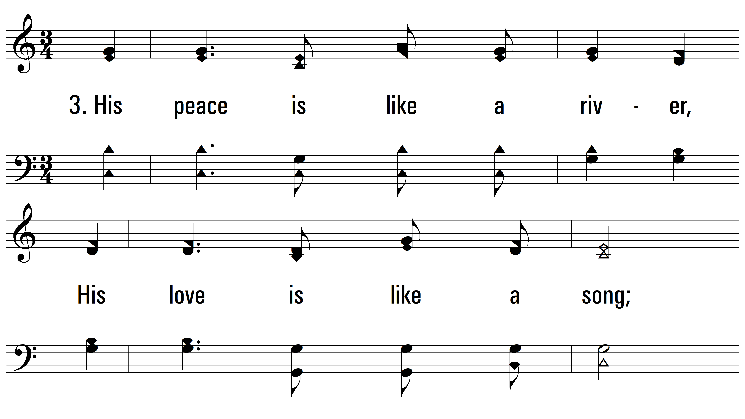
vs. 3 ~ O Heart Bowed Down With Sorrow

Slide 15
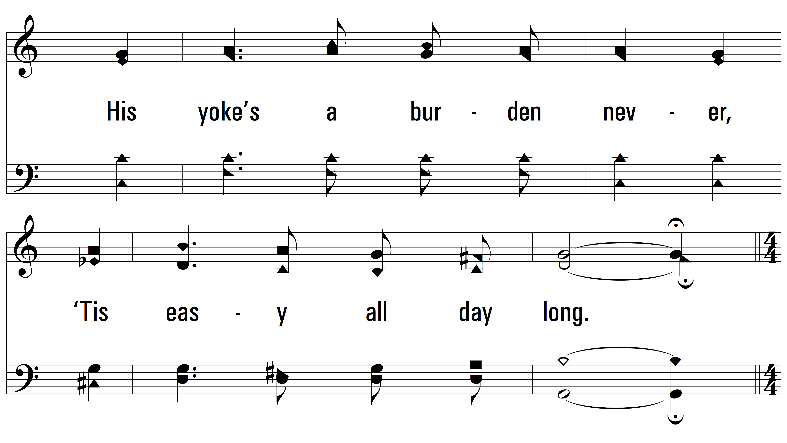
vs. 3

Slide 16
vs. 3

Slide 17
vs. 3

Slide 18
vs. 3

Slide 19
vs. 3
PDHymns.com
END

