Slide 1
O Happy Day
Words: | Philip Doddridge (1755)
Music: | Edward F. Rimbault (1854)
3/2
G/D - SOL
Verses: 5/Chorus
Lead - | SOL
Alto - | SOL
Tenor - | SOL
Bass - | SOL
PDHymns.com

Slide 2
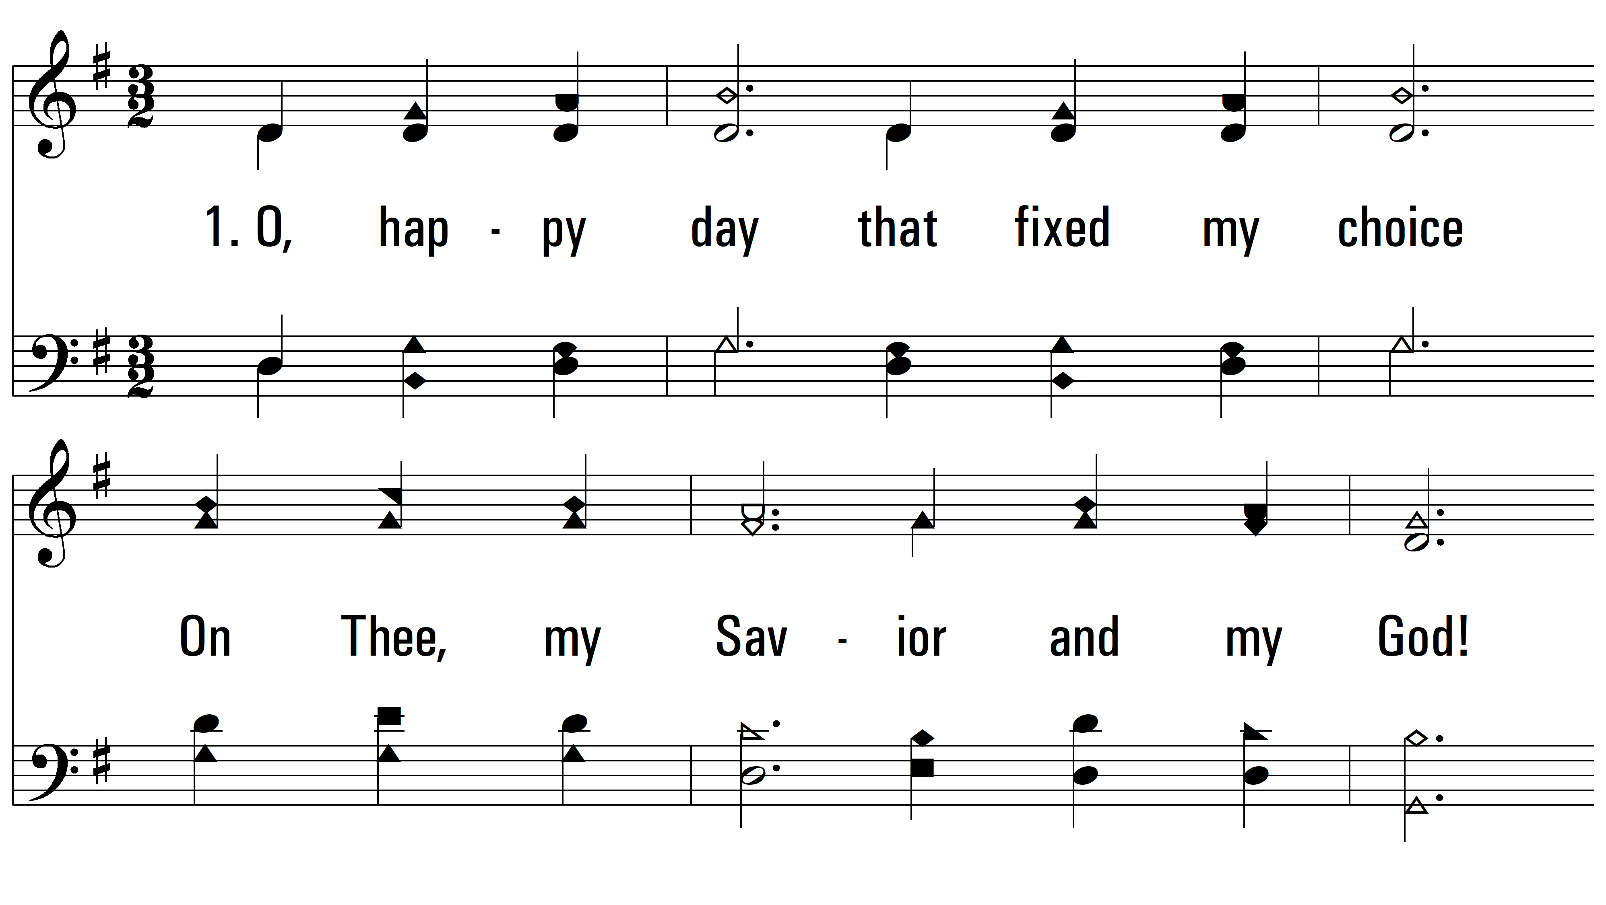
vs. 1 ~ O Happy Day

Slide 3
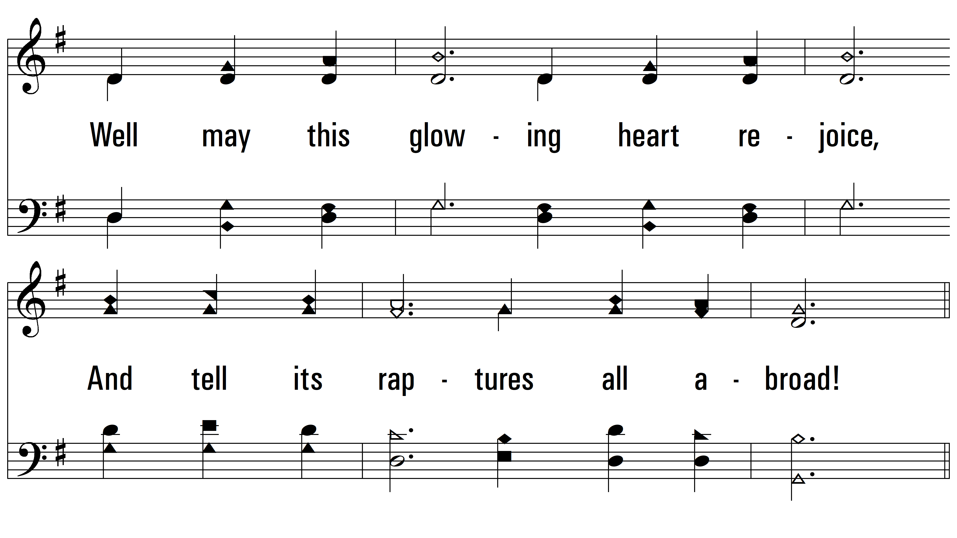
vs. 1

Slide 4
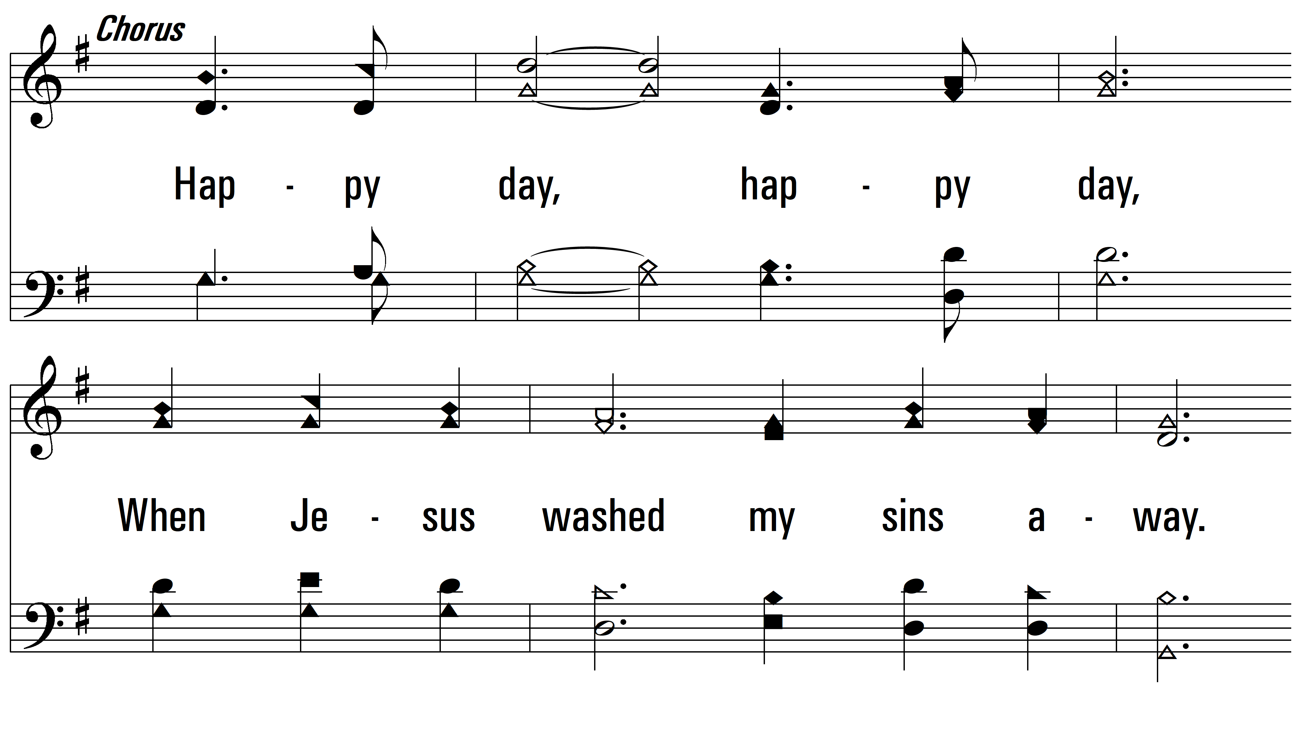
vs. 1

Slide 5
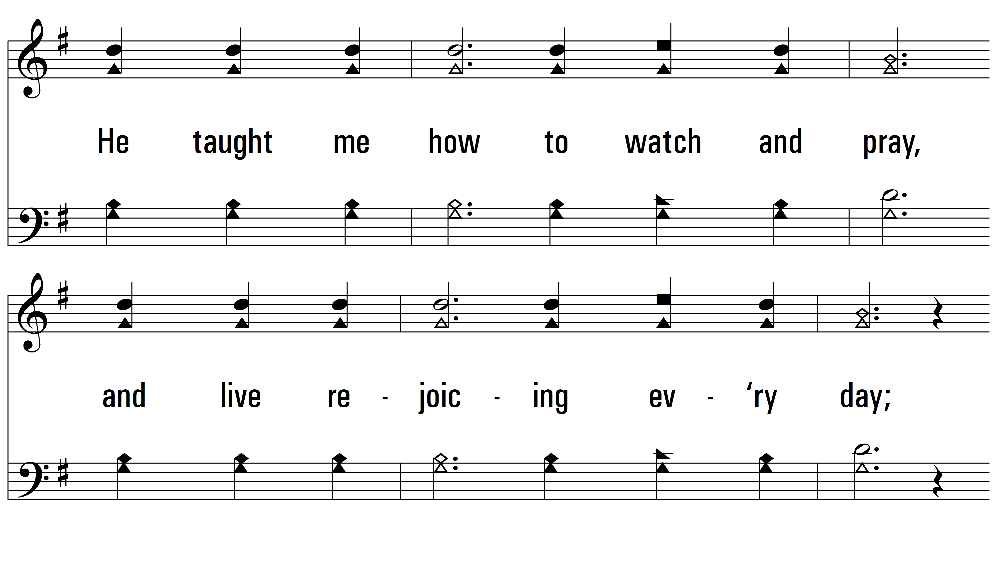
vs. 1

Slide 6
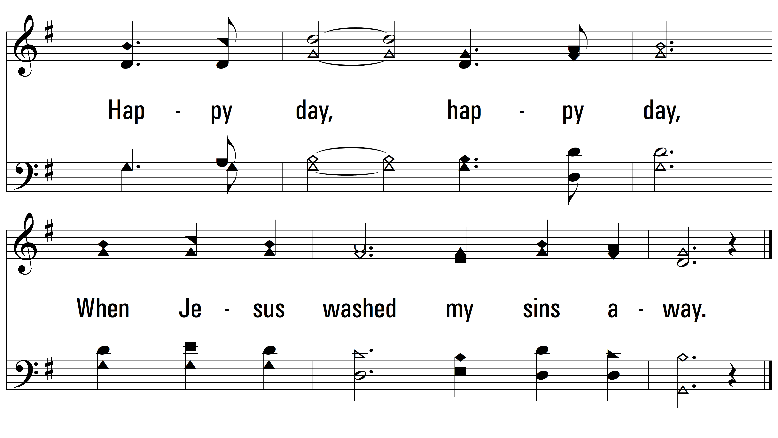
vs. 1

Slide 7
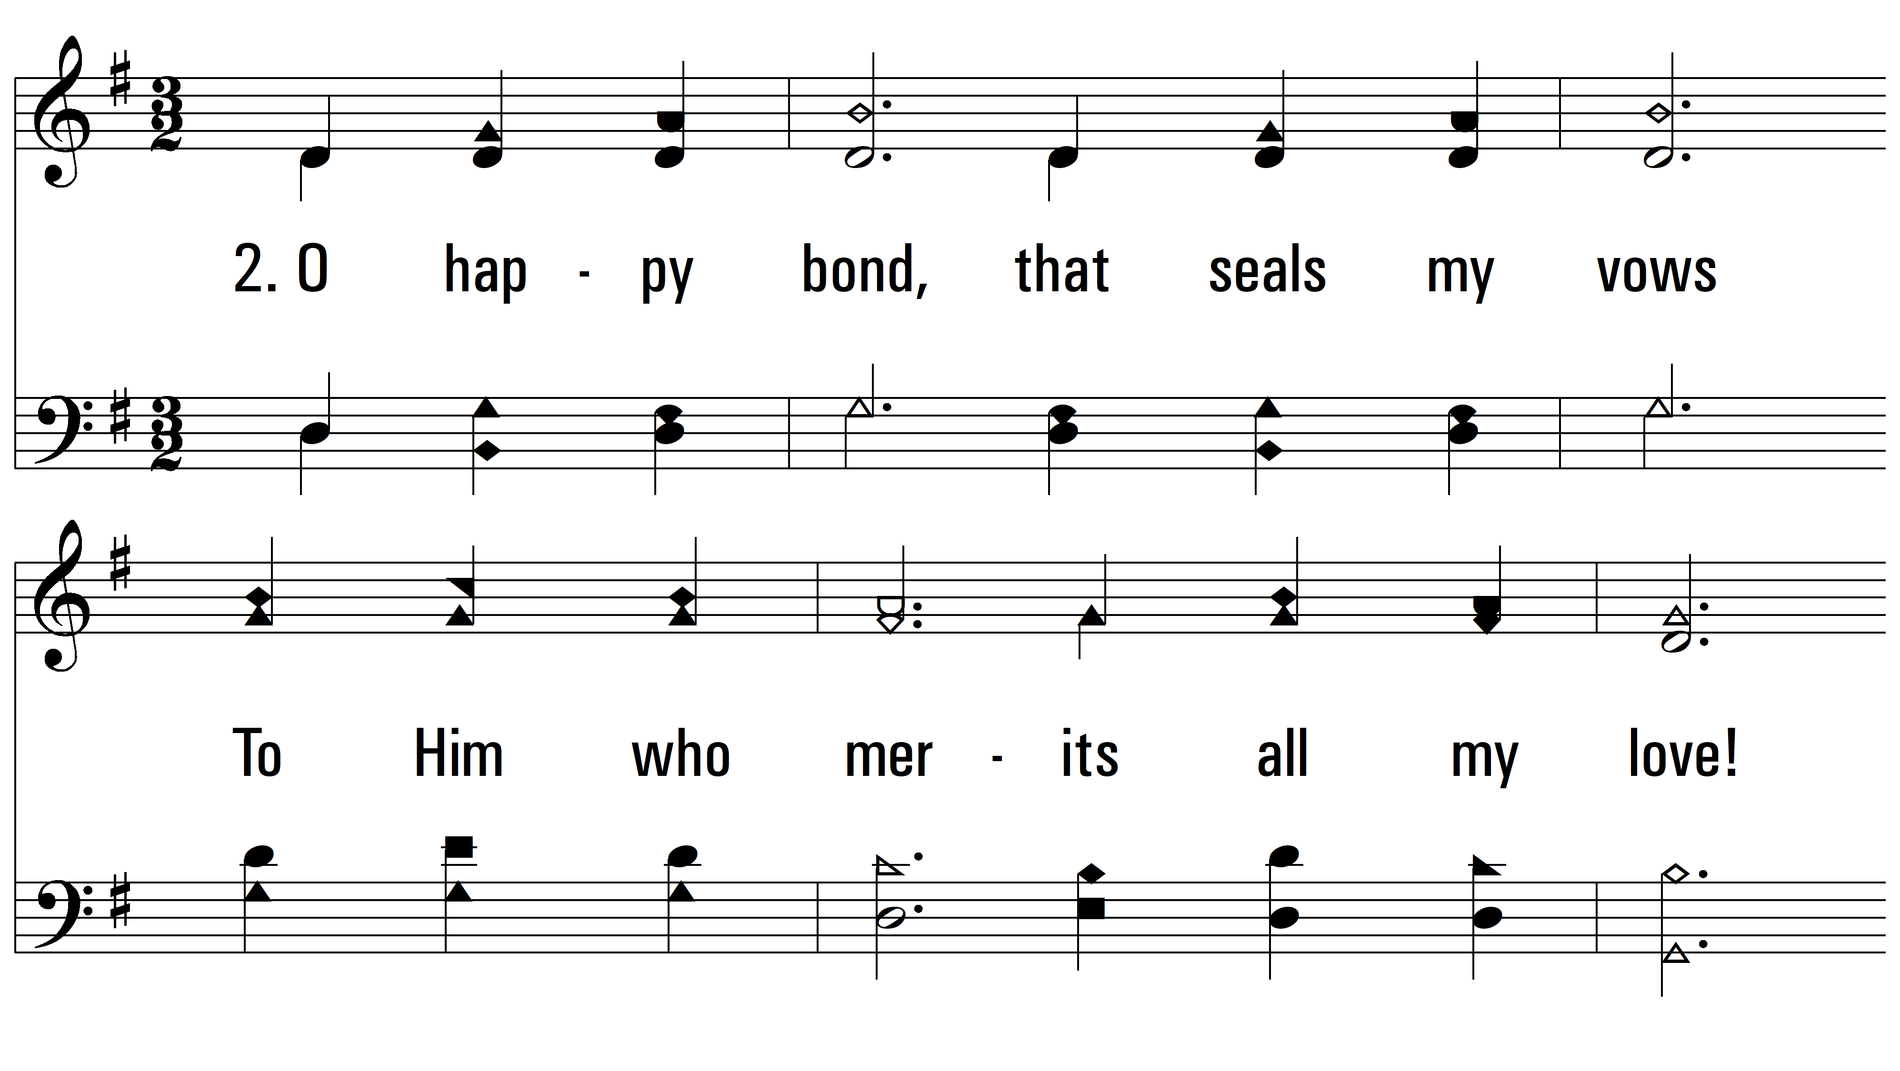
vs. 2 ~ O Happy Day

Slide 8
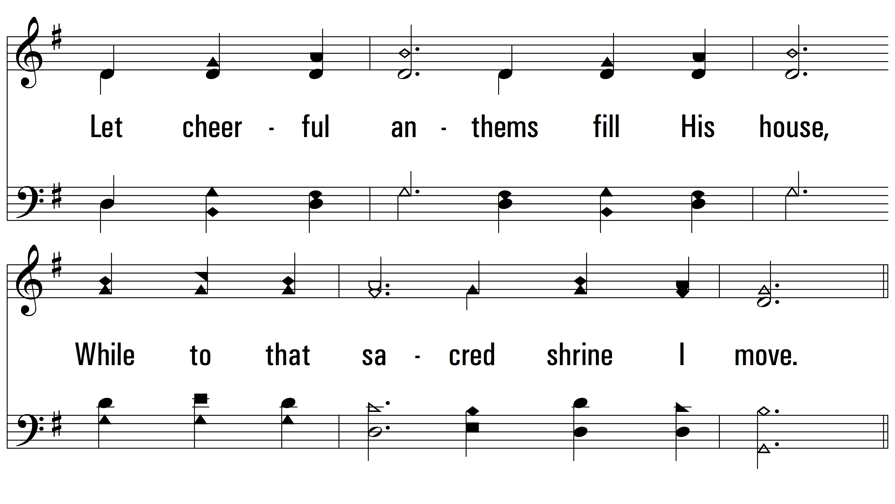
vs. 2

Slide 9
vs. 2

Slide 10
vs. 2

Slide 11
vs. 2

Slide 12
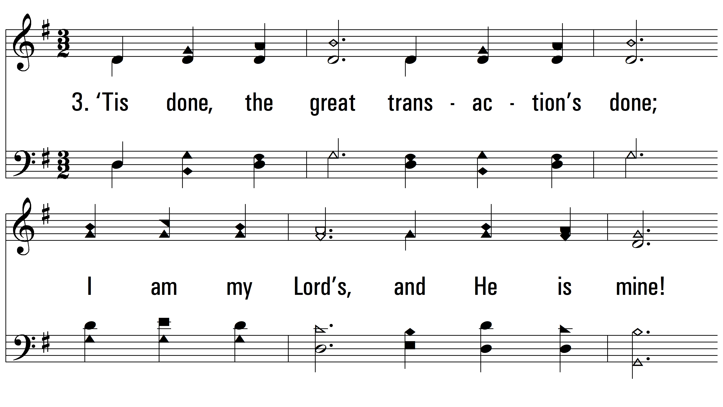
vs. 3 ~ O Happy Day

Slide 13
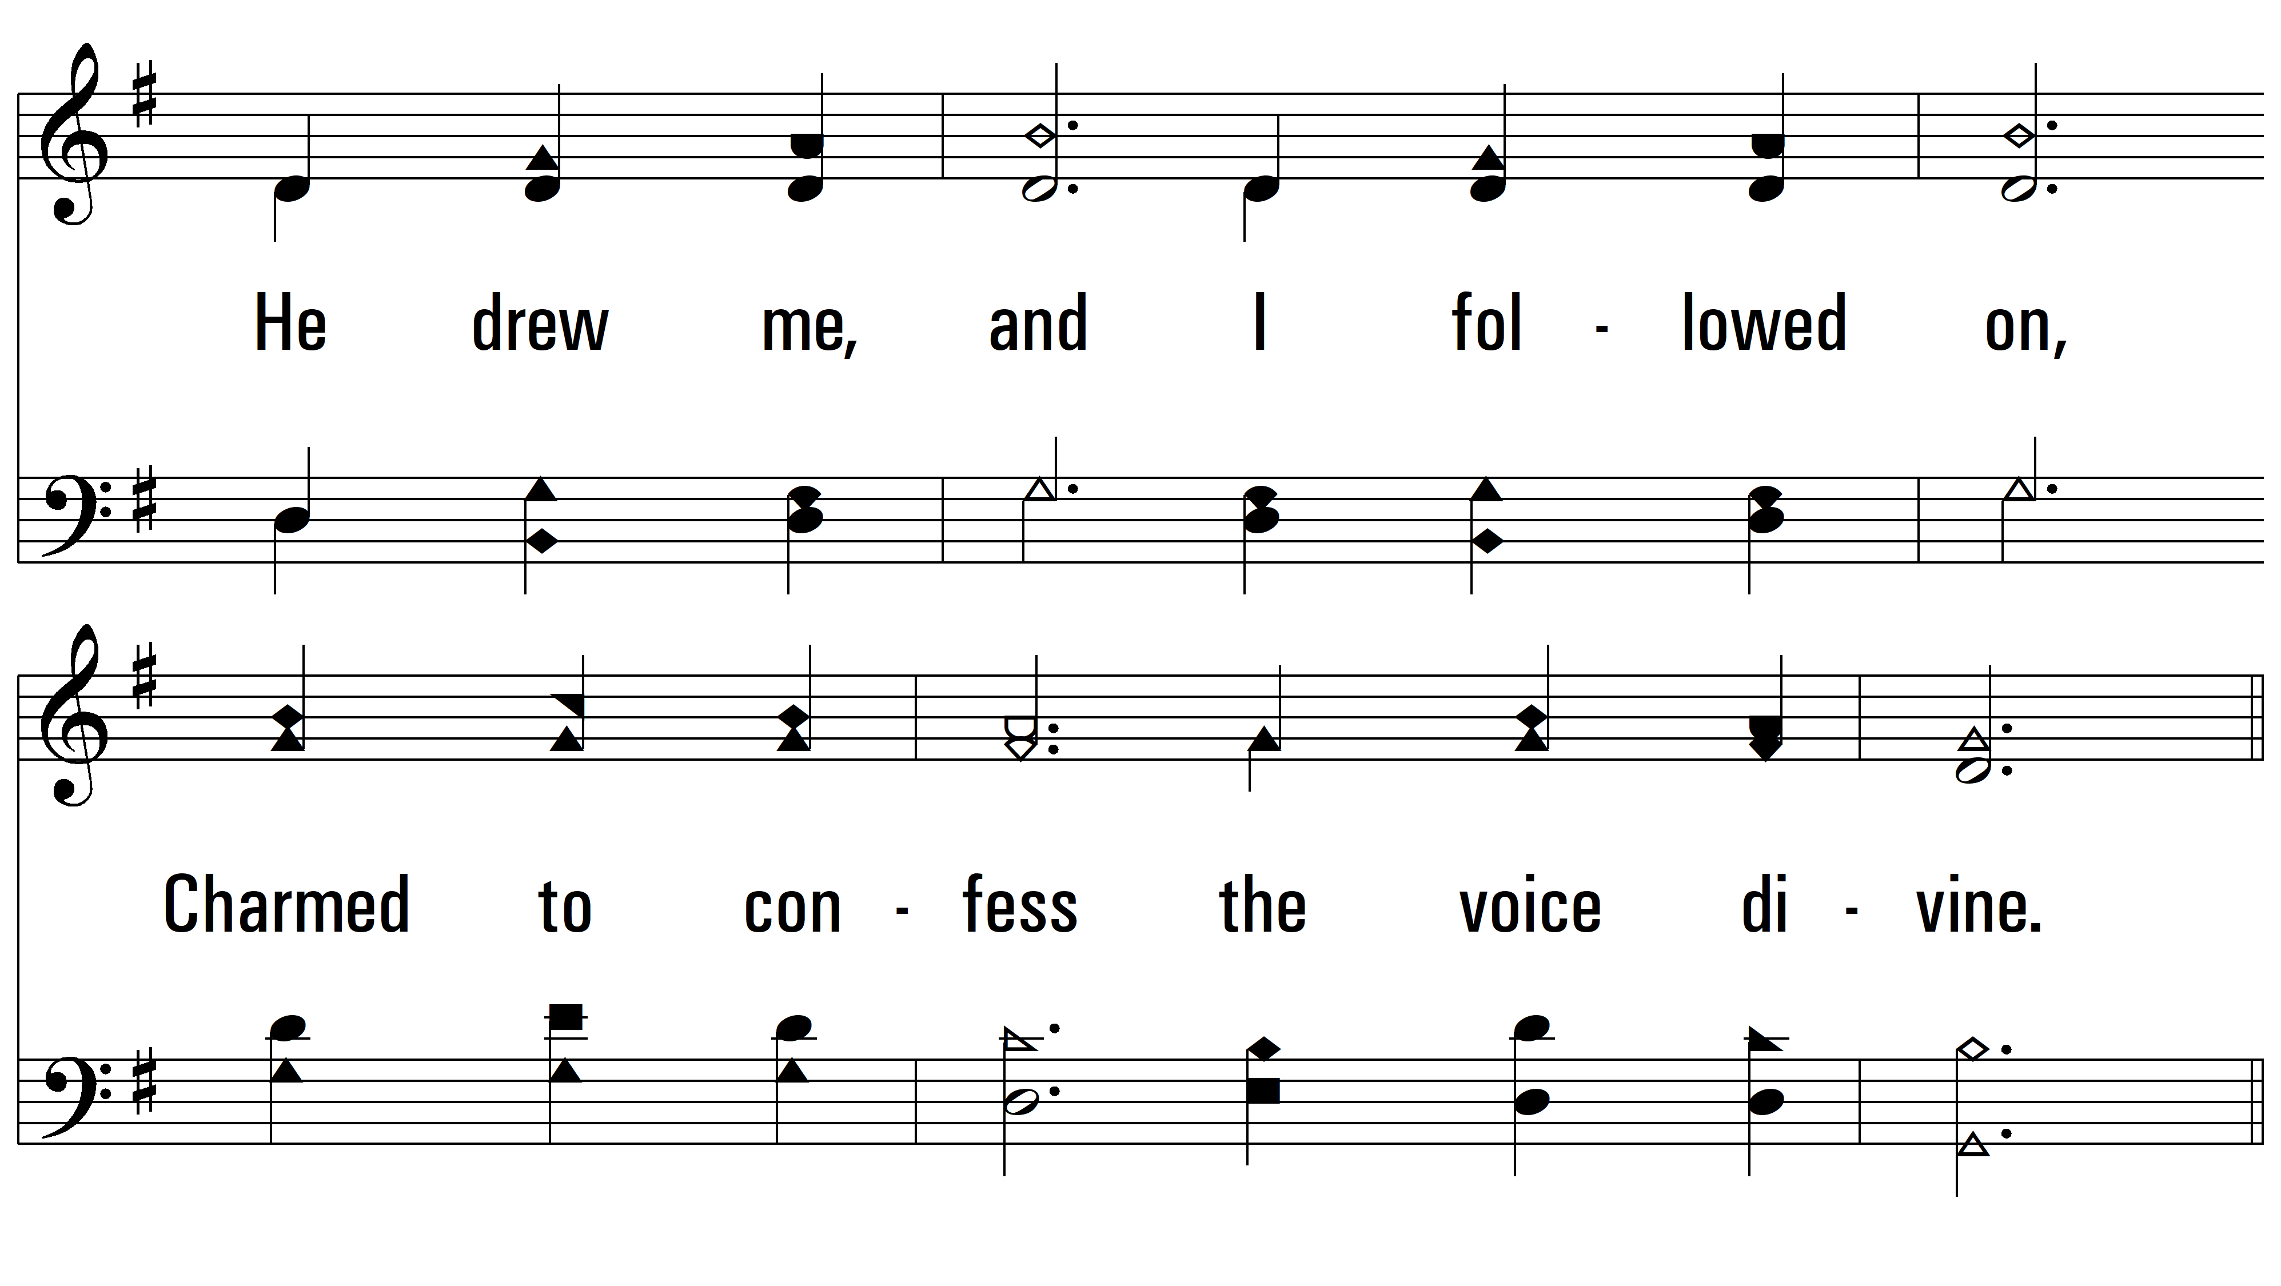
vs. 3

Slide 14
vs. 3

Slide 15
vs. 3

Slide 16
vs. 3

Slide 17
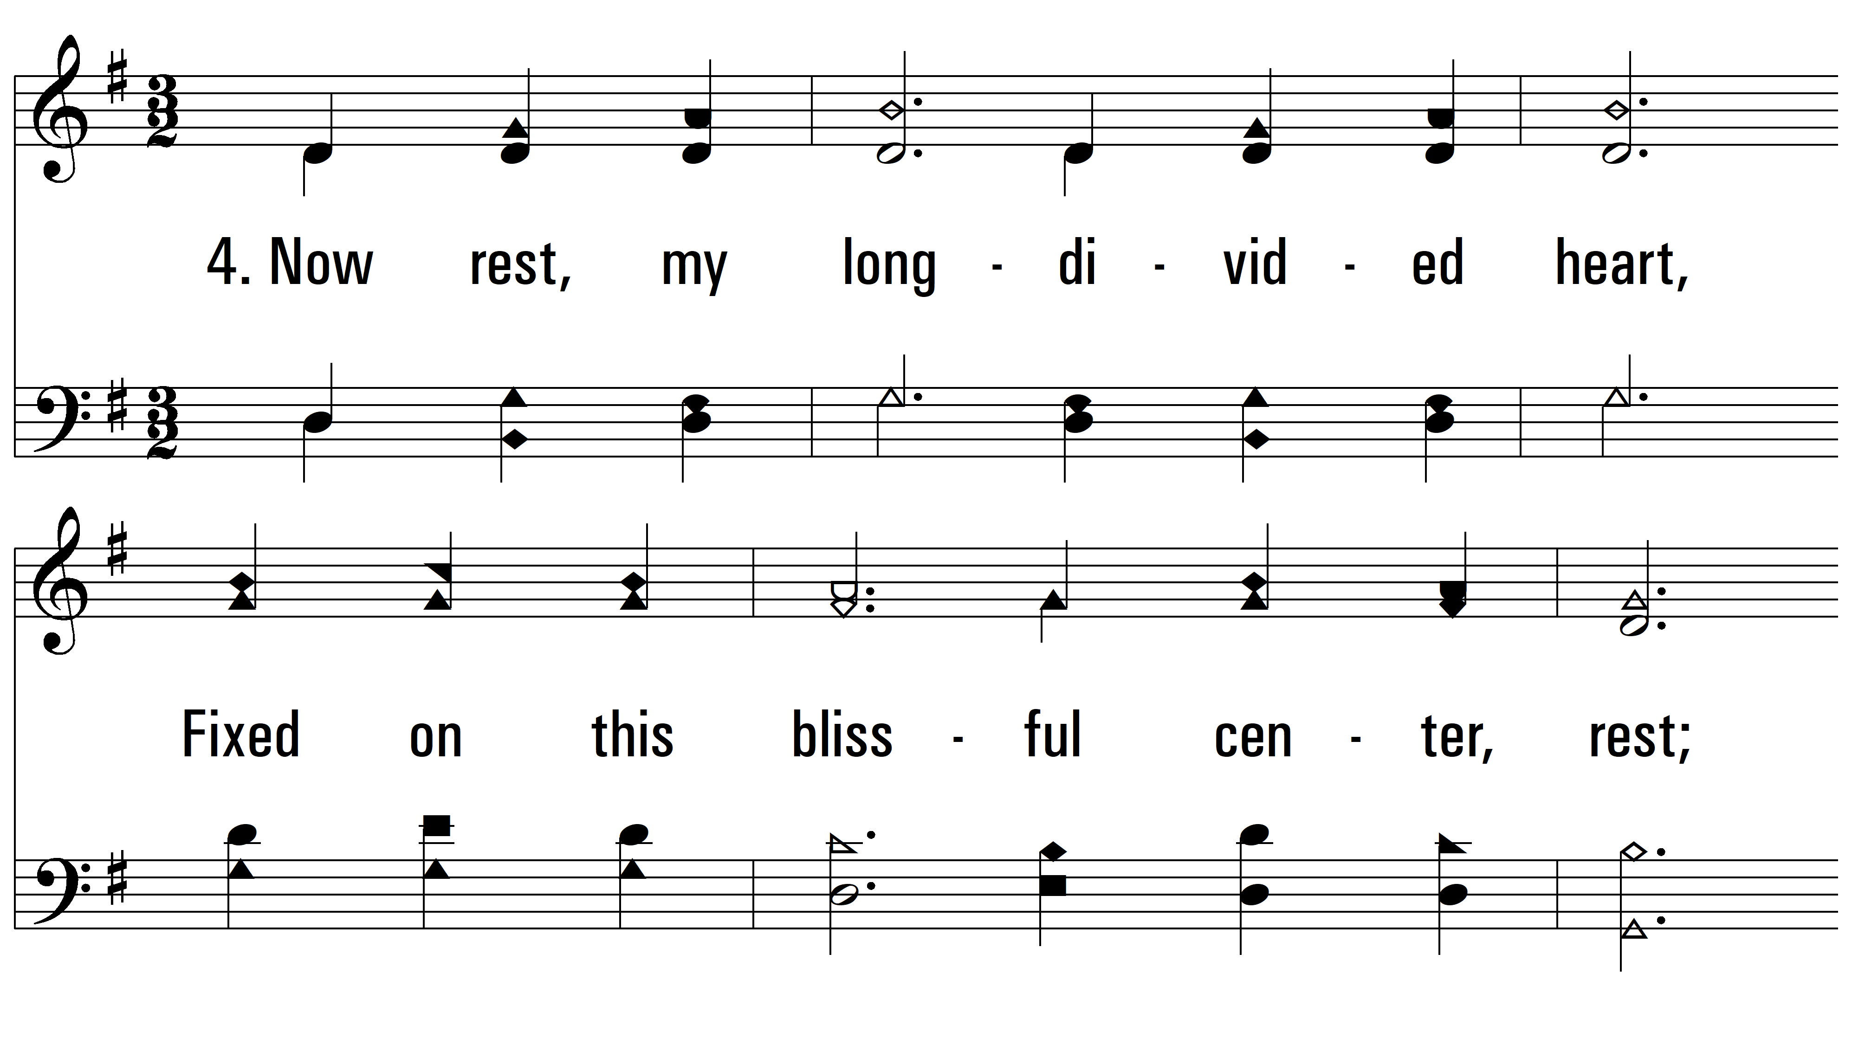
vs. 4 ~ O Happy Day

Slide 18
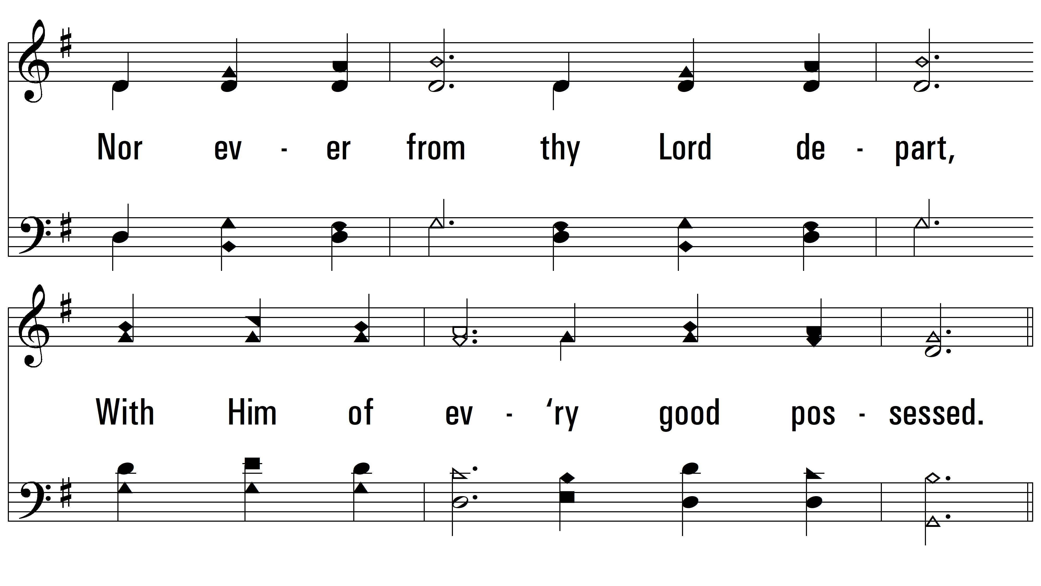
vs. 4

Slide 19
vs. 4

Slide 20
vs. 4

Slide 21
vs. 4

Slide 22
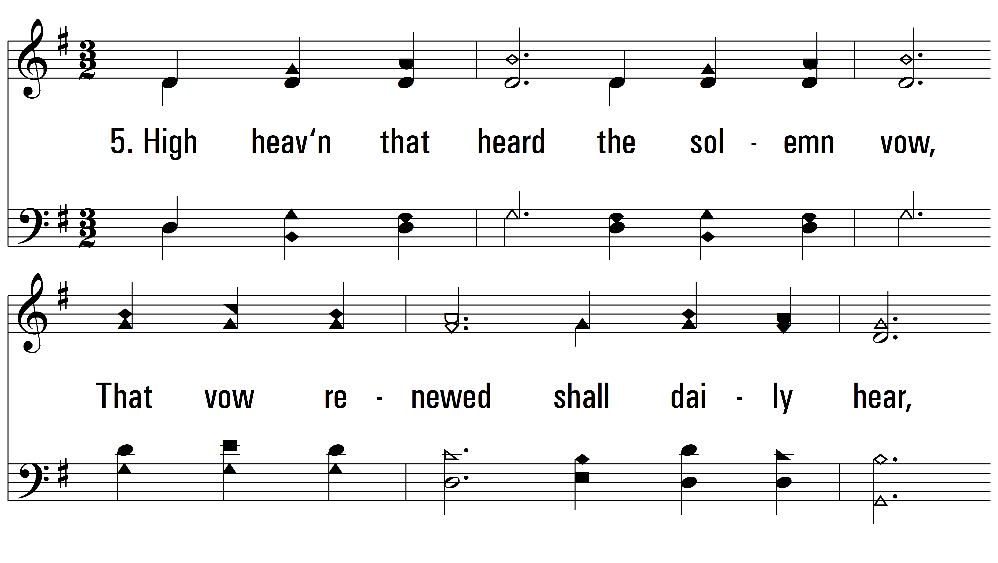
vs. 5 ~ O Happy Day

Slide 23
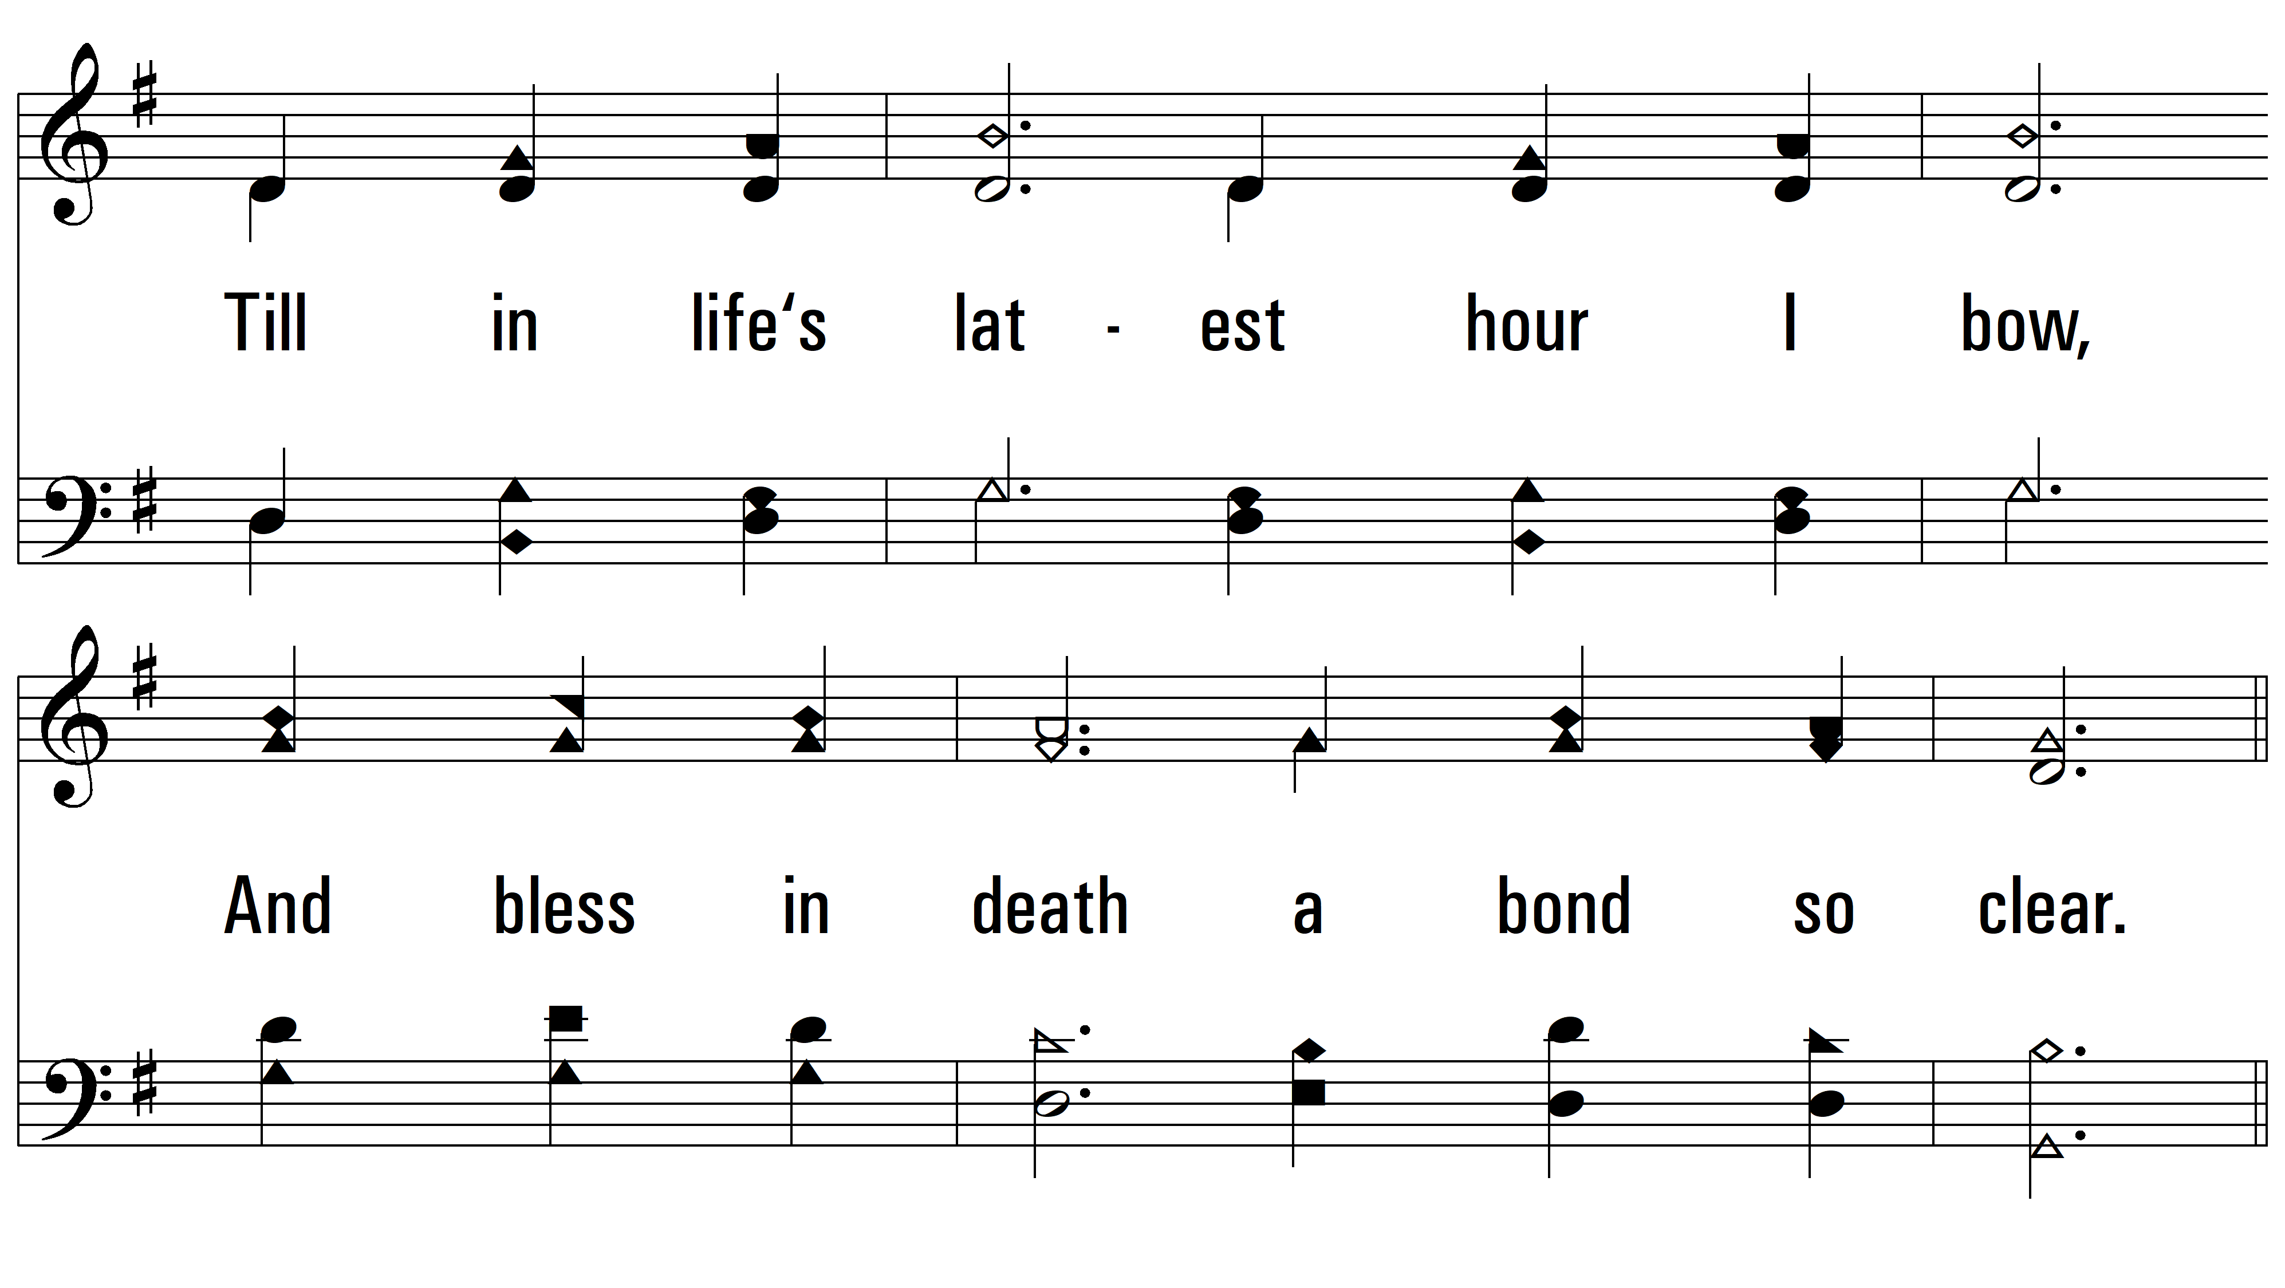
vs. 5

Slide 24
vs. 5

Slide 25
vs. 5

Slide 26
vs. 5
PDHymns.com
END

