Slide 1
O For A Thousand Tongues To Sing
AZMON
CM
Words: | Charles Wesley (1740)
Music: | Carl G. Glasser (1828), Arr. by Lowell Mason (1839)
3/2
A^{b}/E^{b} - SOL
Verses: 5
Lead - | SOL
Alto - | SOL
Tenor - | SOL
Bass - | SOL
PDHymns.com

Slide 2
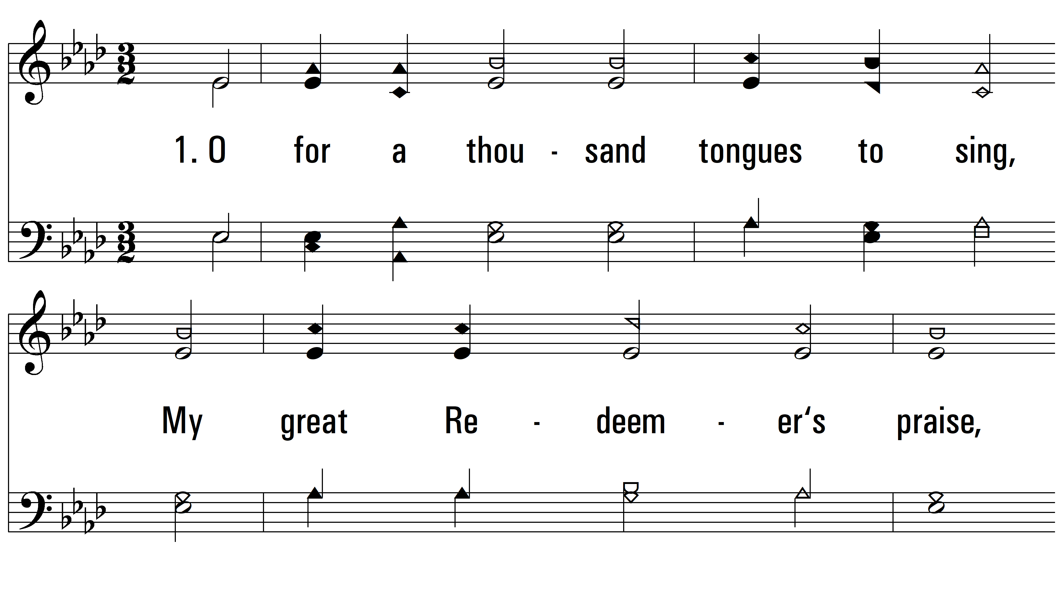
vs. 1 ~ O For A Thousand Tongues To Sing

Slide 3
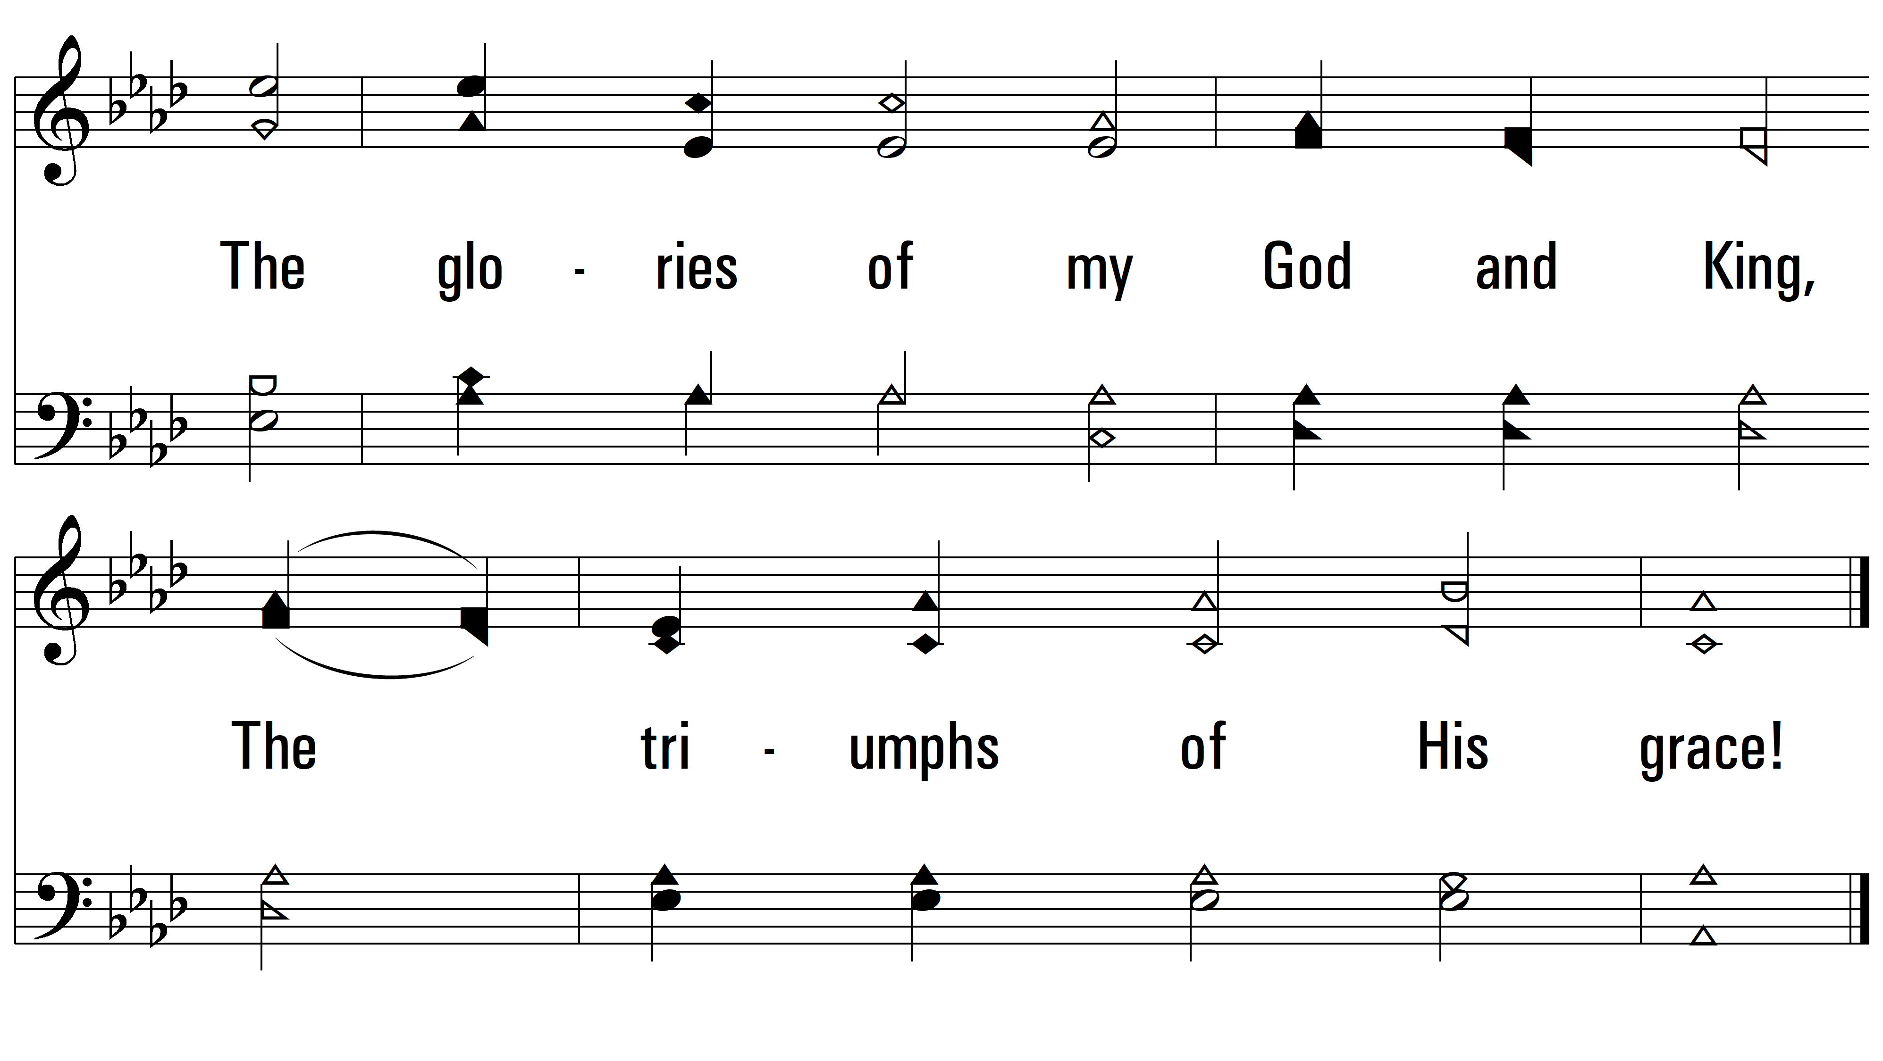
vs. 1

Slide 4
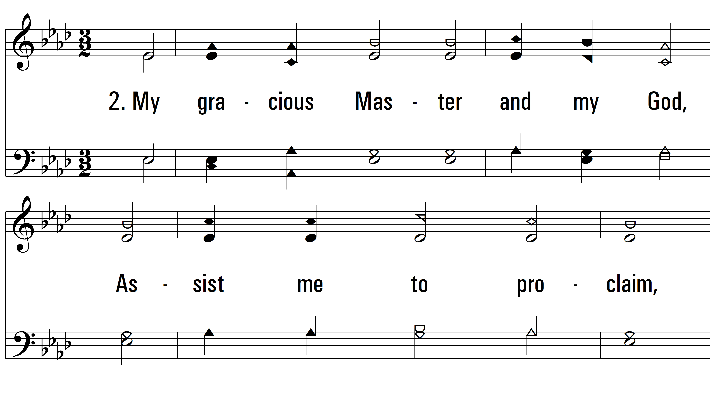
vs. 2 ~ O For A Thousand Tongues To Sing

Slide 5
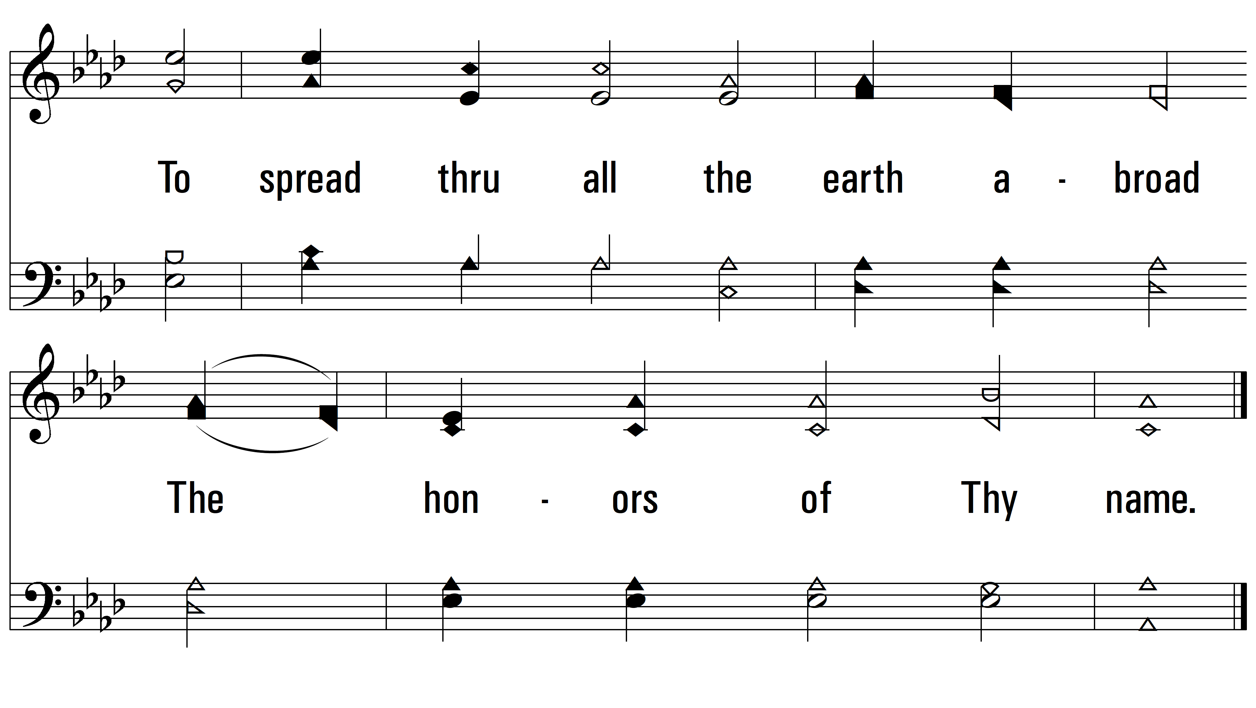
vs. 1

Slide 6
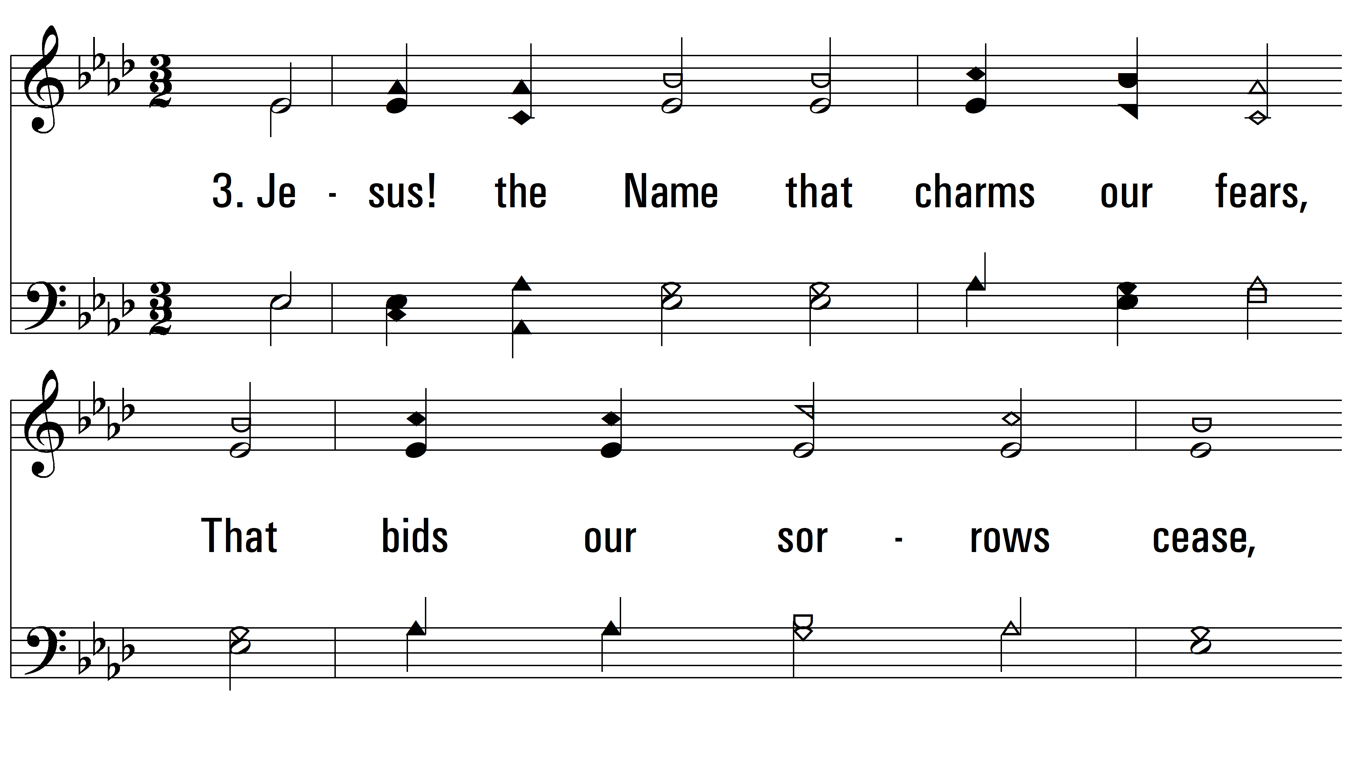
vs. 3 ~ O For A Thousand Tongues To Sing

Slide 7
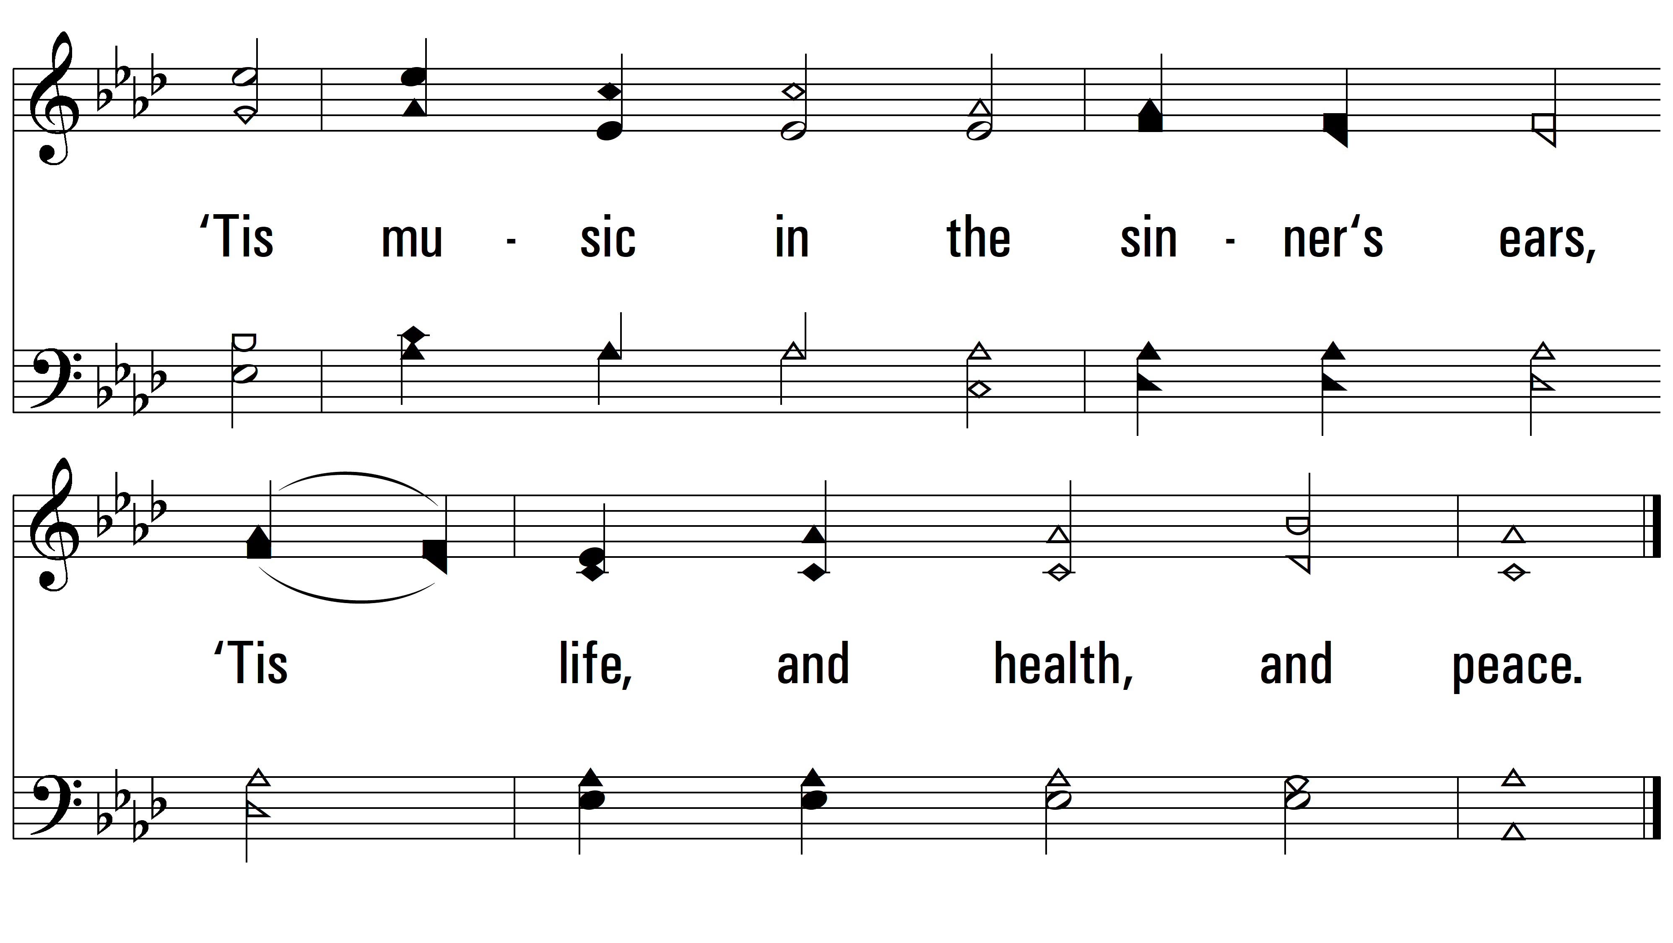
vs. 3

Slide 8
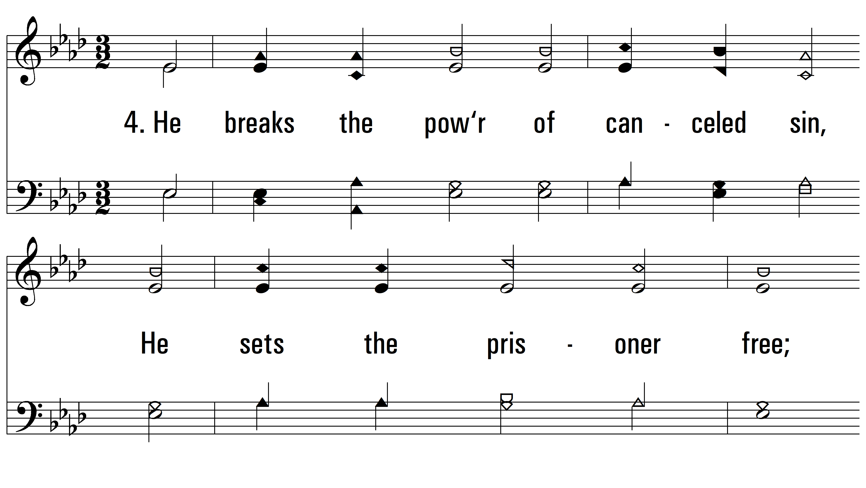
vs. 4 ~ O For A Thousand Tongues To Sing

Slide 9
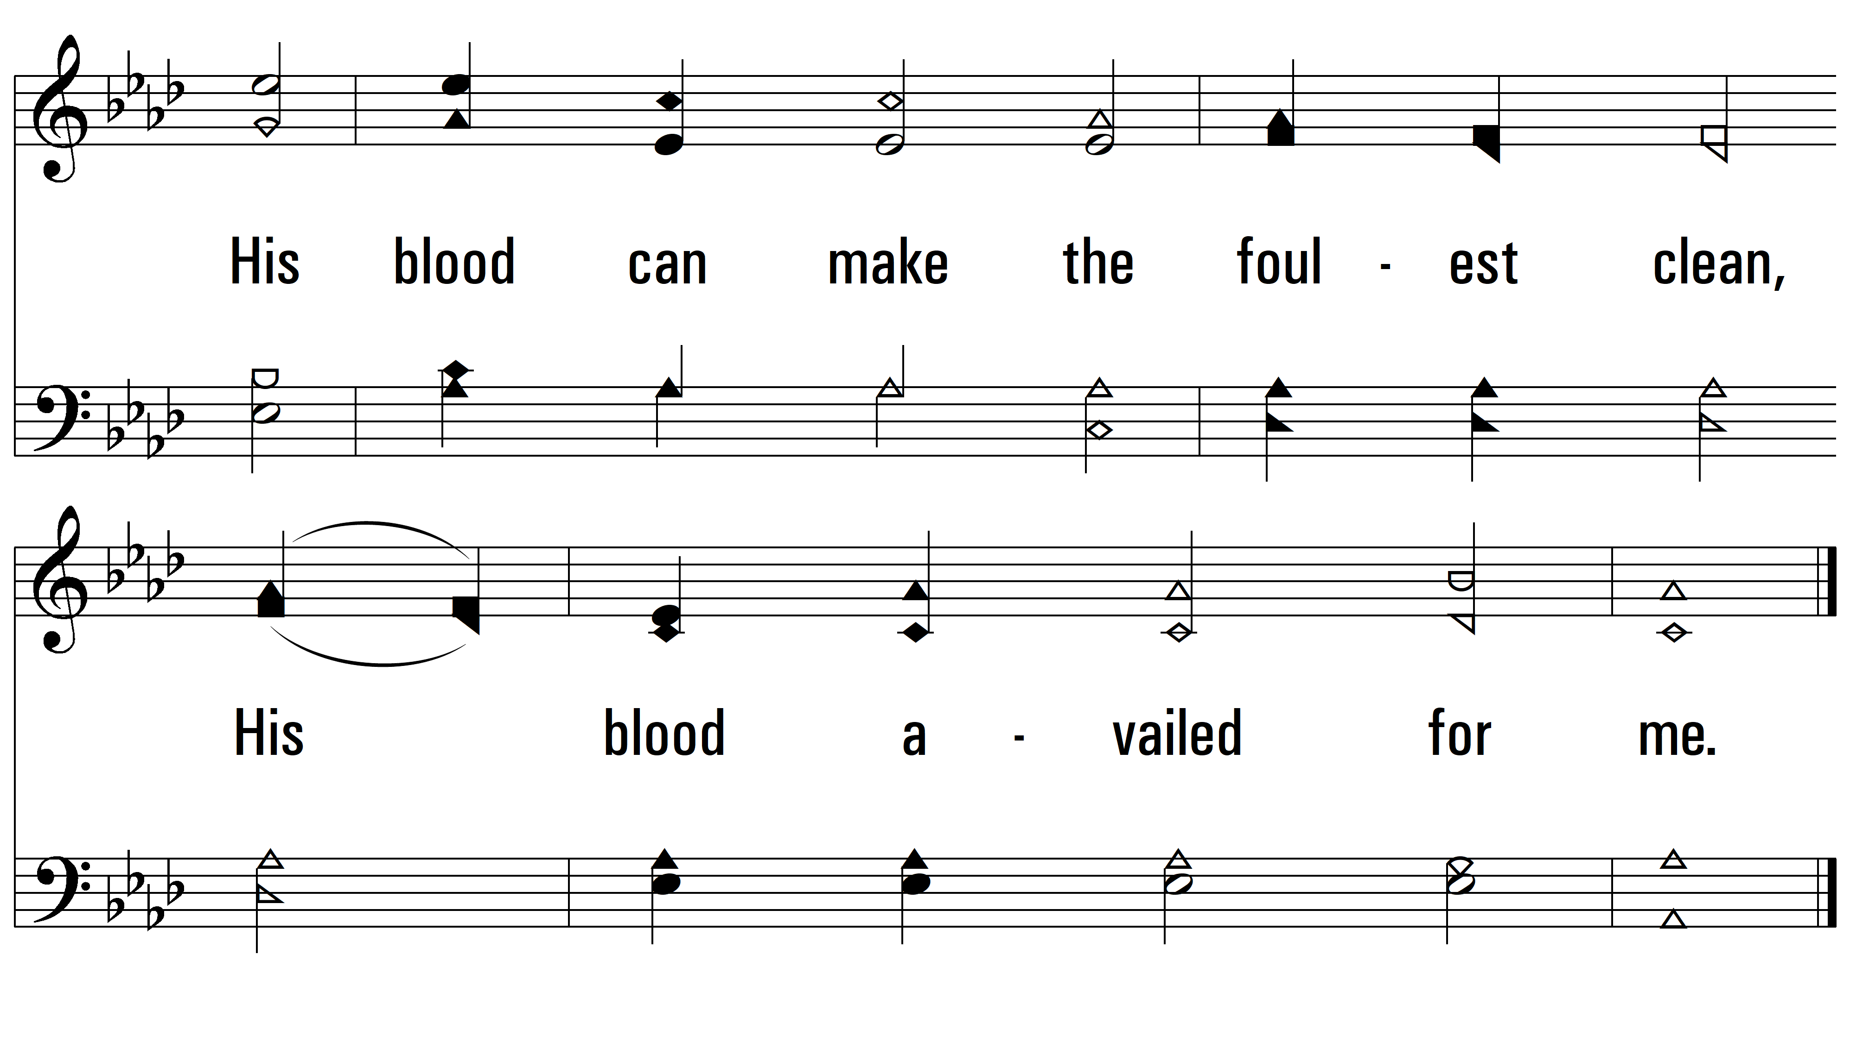
vs. 4

Slide 10
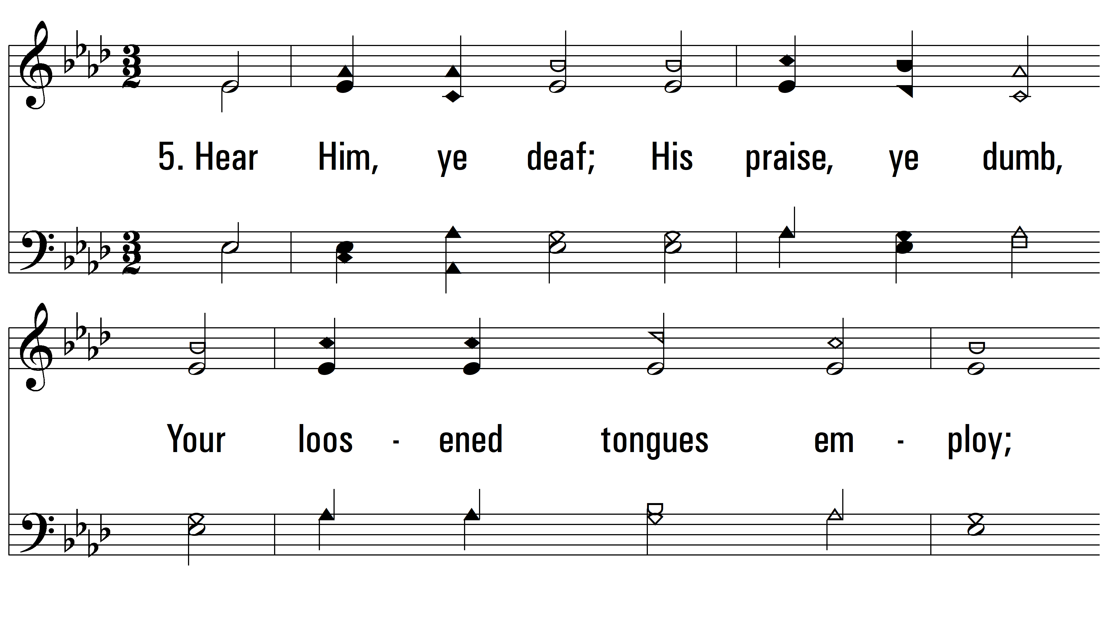
vs. 5 ~ O For A Thousand Tongues To Sing

Slide 11
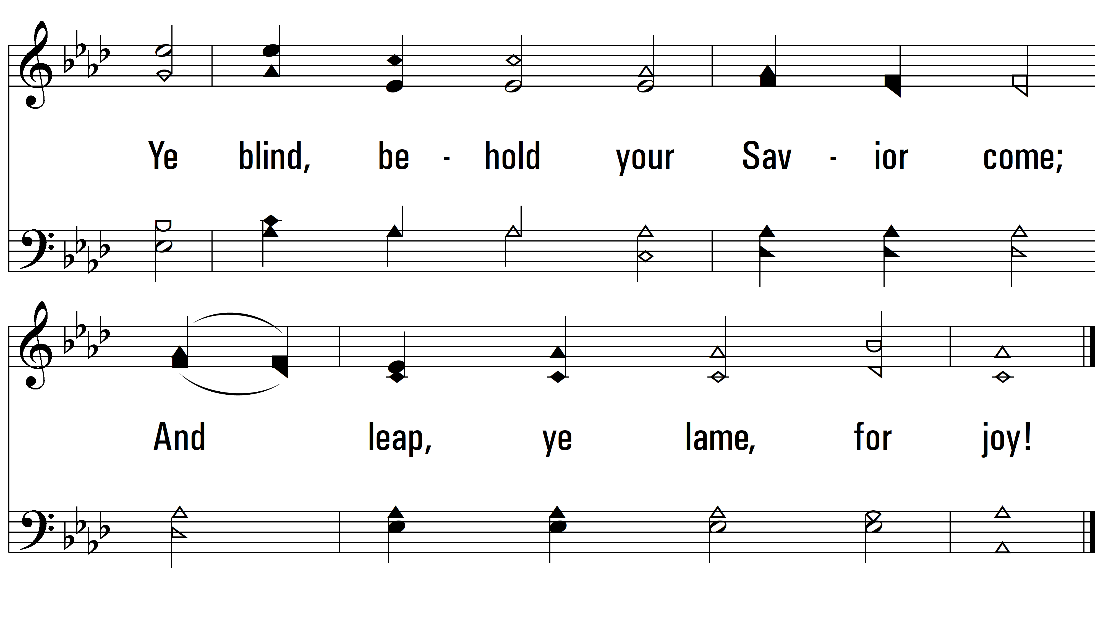
vs. 5
PDHymns.com
END

