Slide 1
O For A Closer Walk With God
BEATITUDO
CM
Words: | William Cowper (1779)
Music: | John B. Dykes (1868)
3/4
A^{b}/A^{b} - DO
Verses: 4
Lead - | DO
Alto - | MI
Tenor - | SOL
Bass - | DO
PDHymns.com

Slide 2
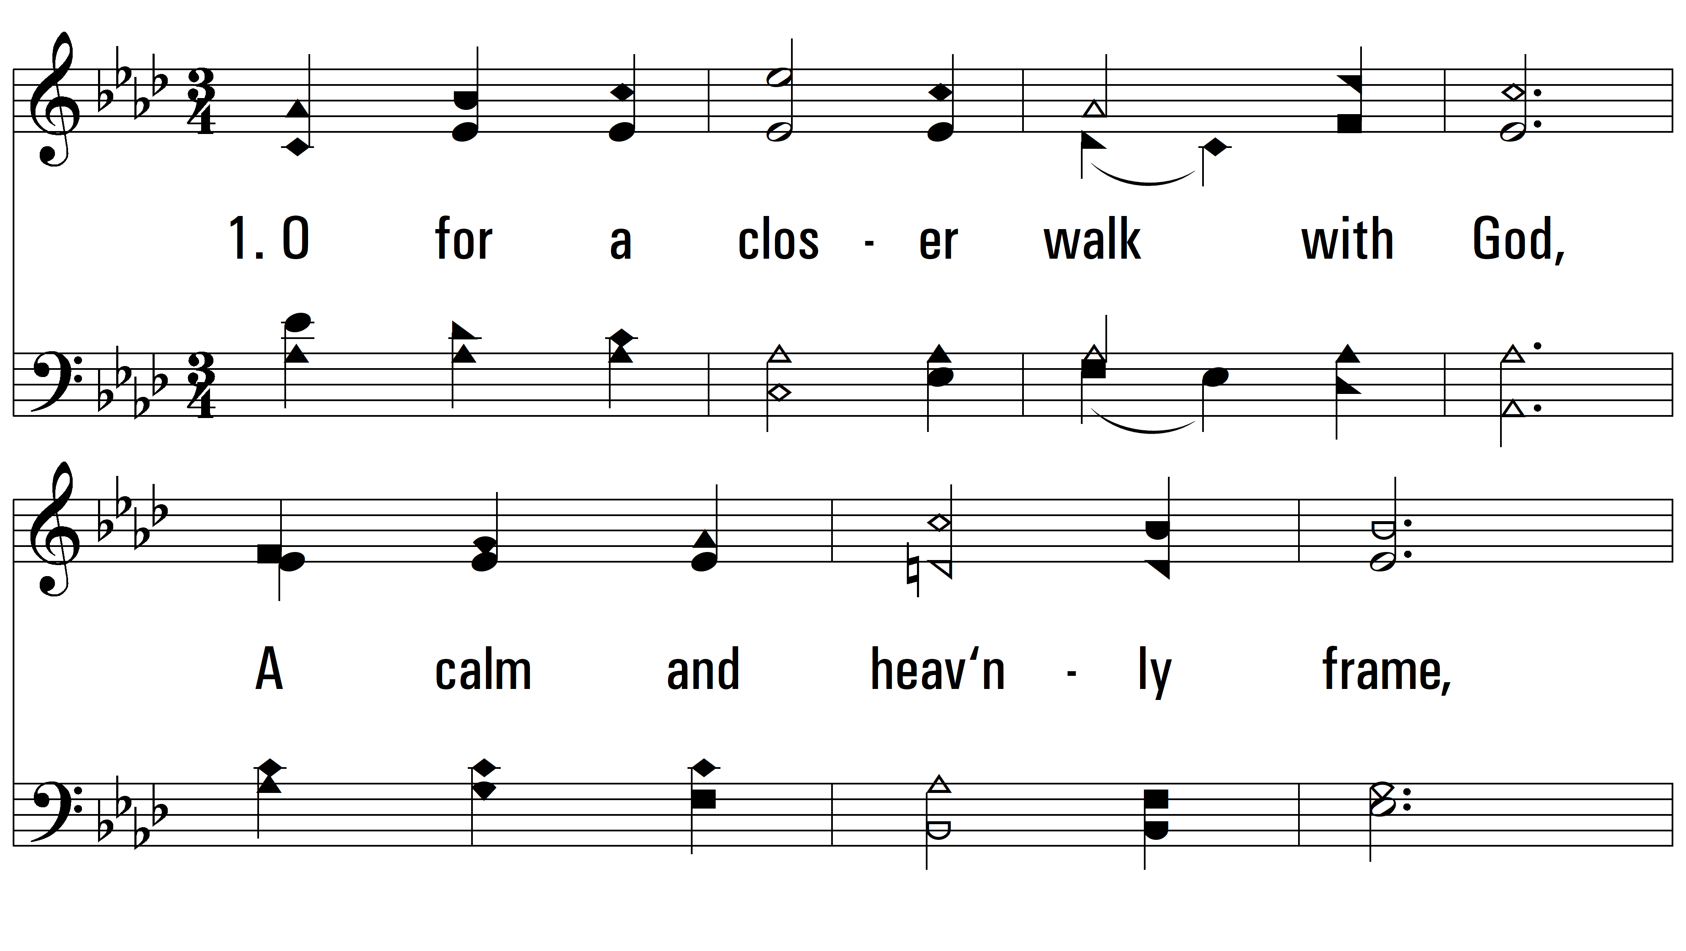
vs. 1 ~ O For A Closer Walk With God

Slide 3
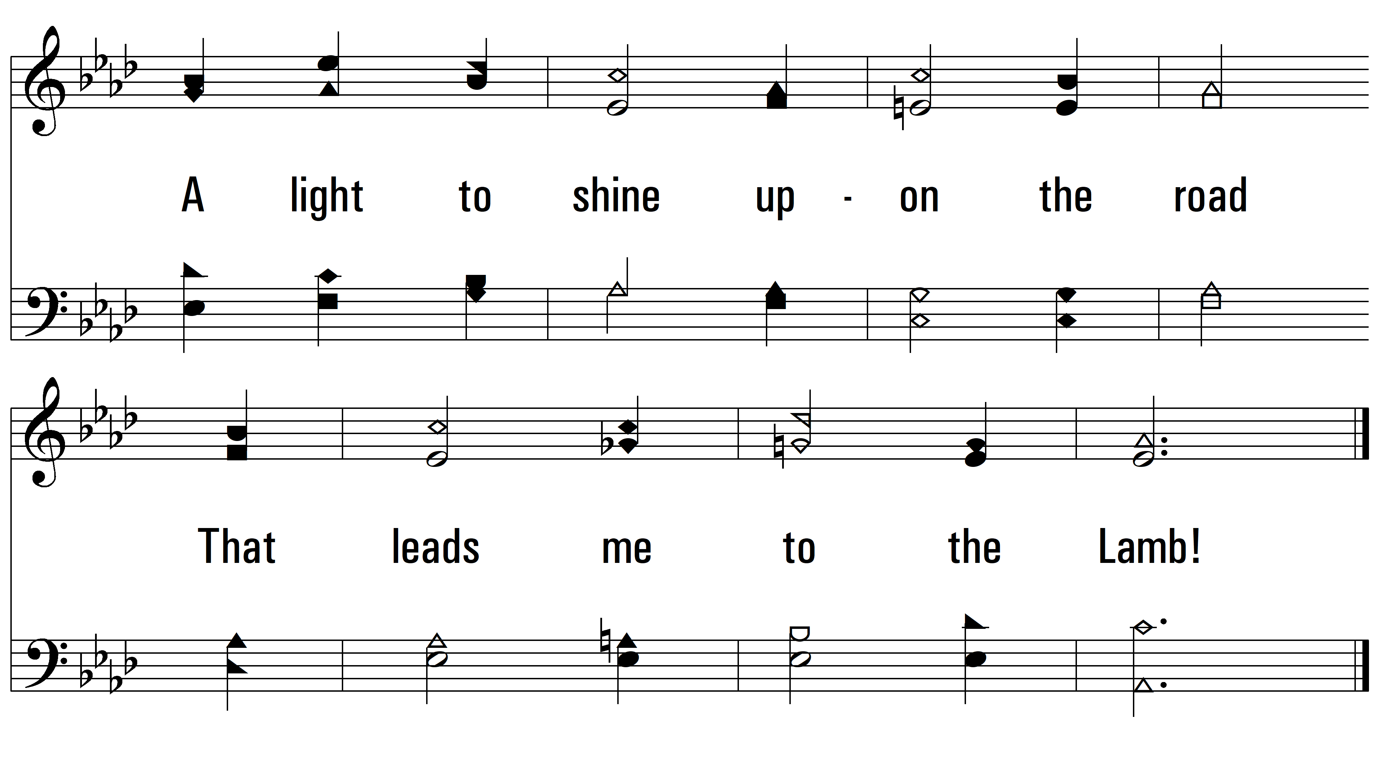
vs. 1

Slide 4
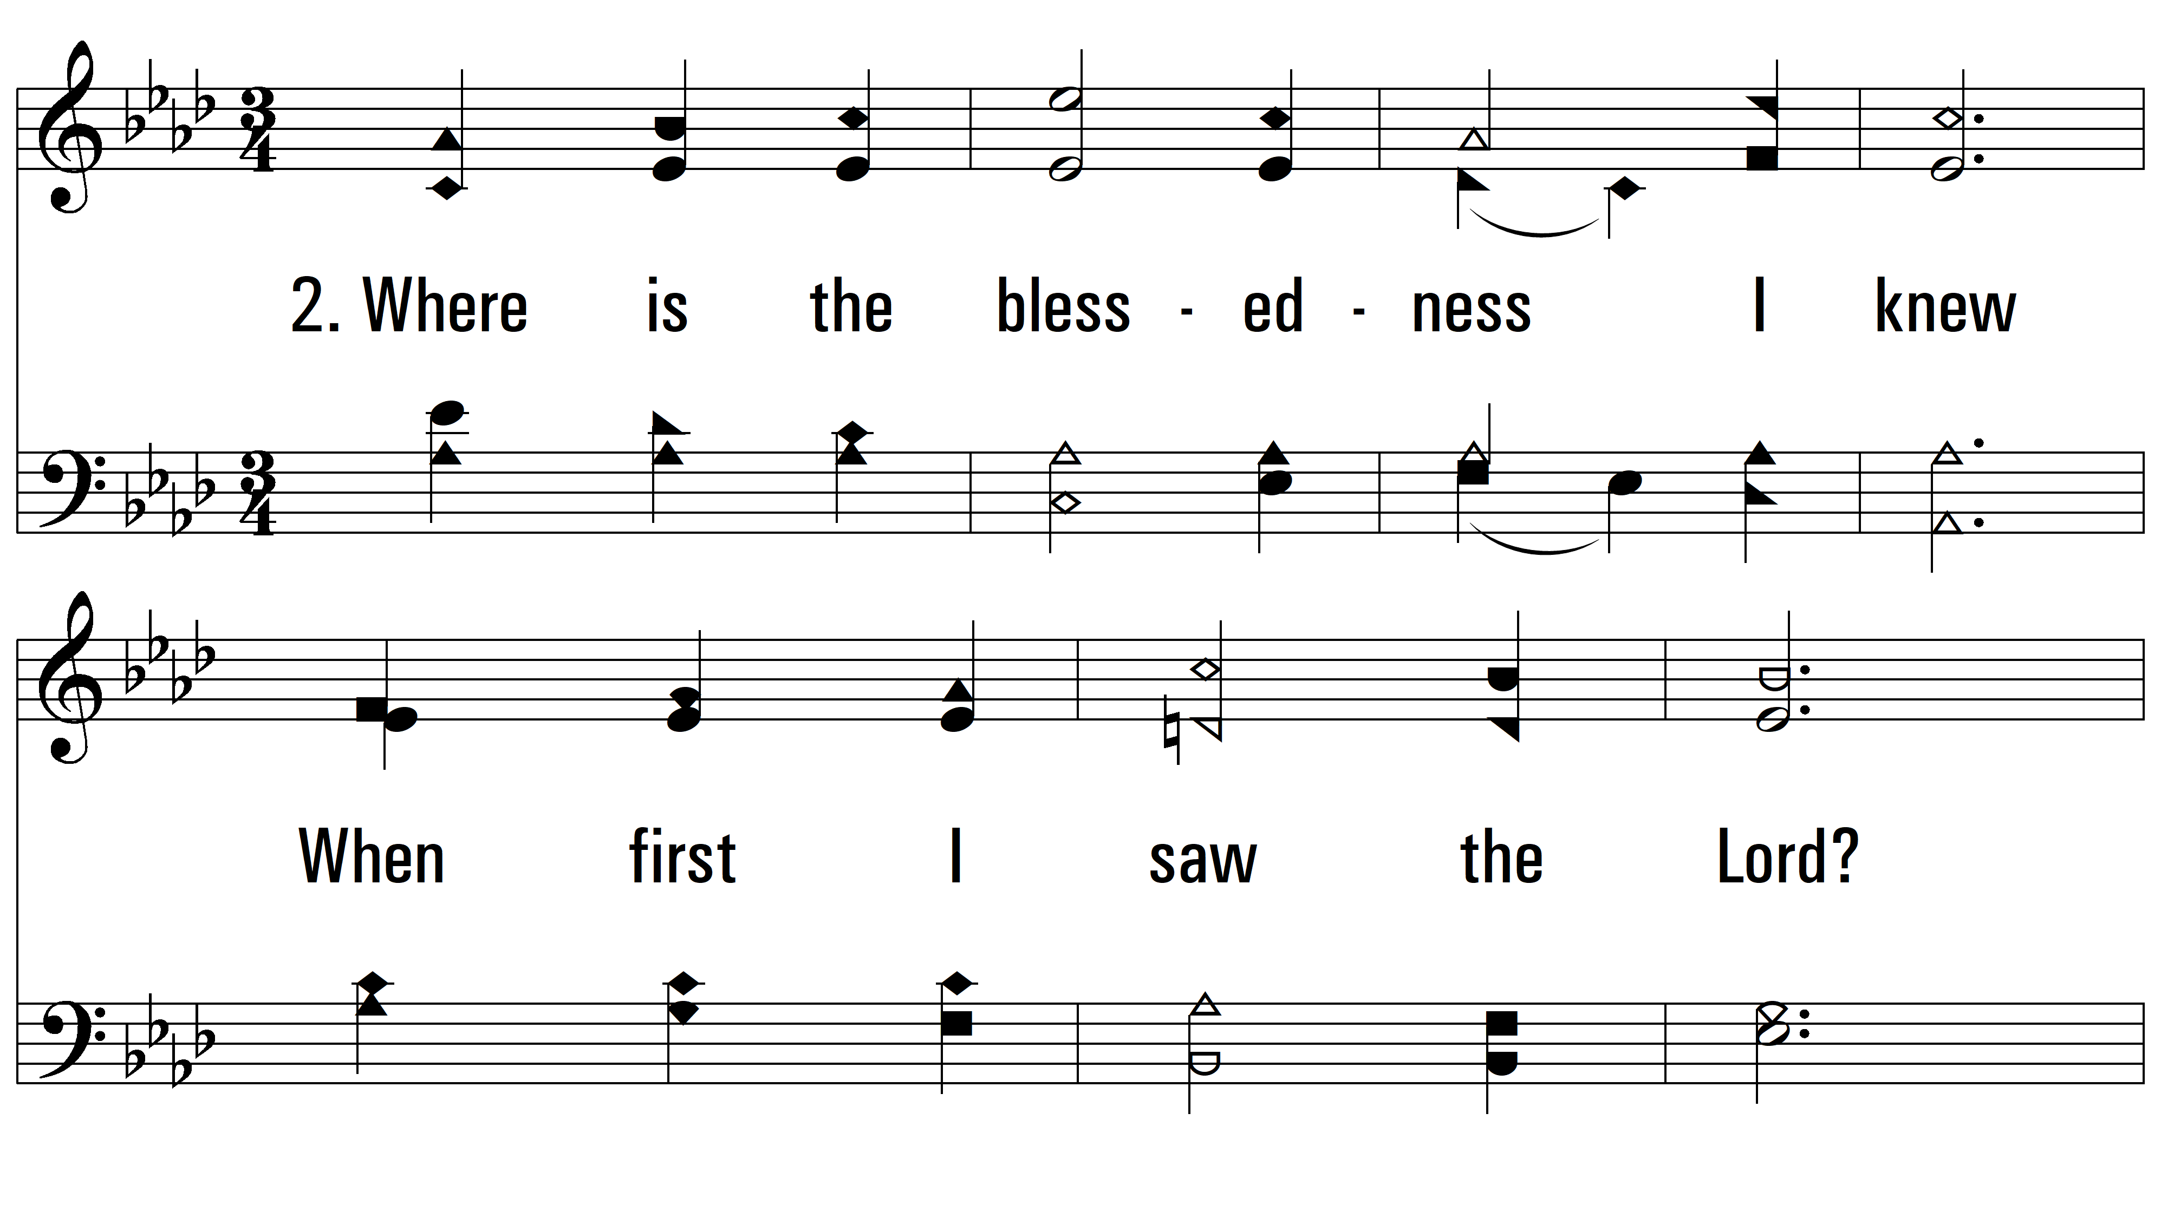
vs. 2 ~ O For A Closer Walk With God

Slide 5
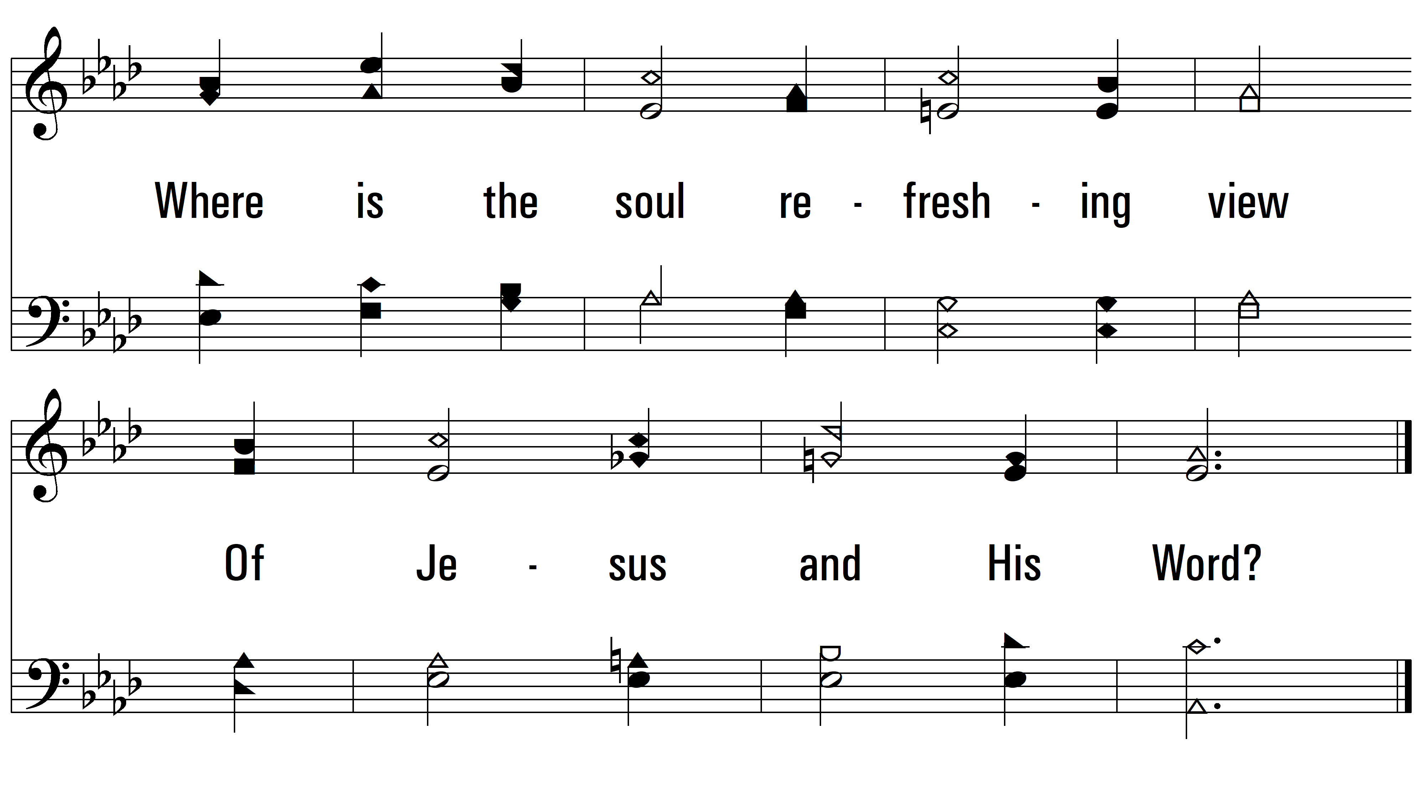
vs. 2

Slide 6
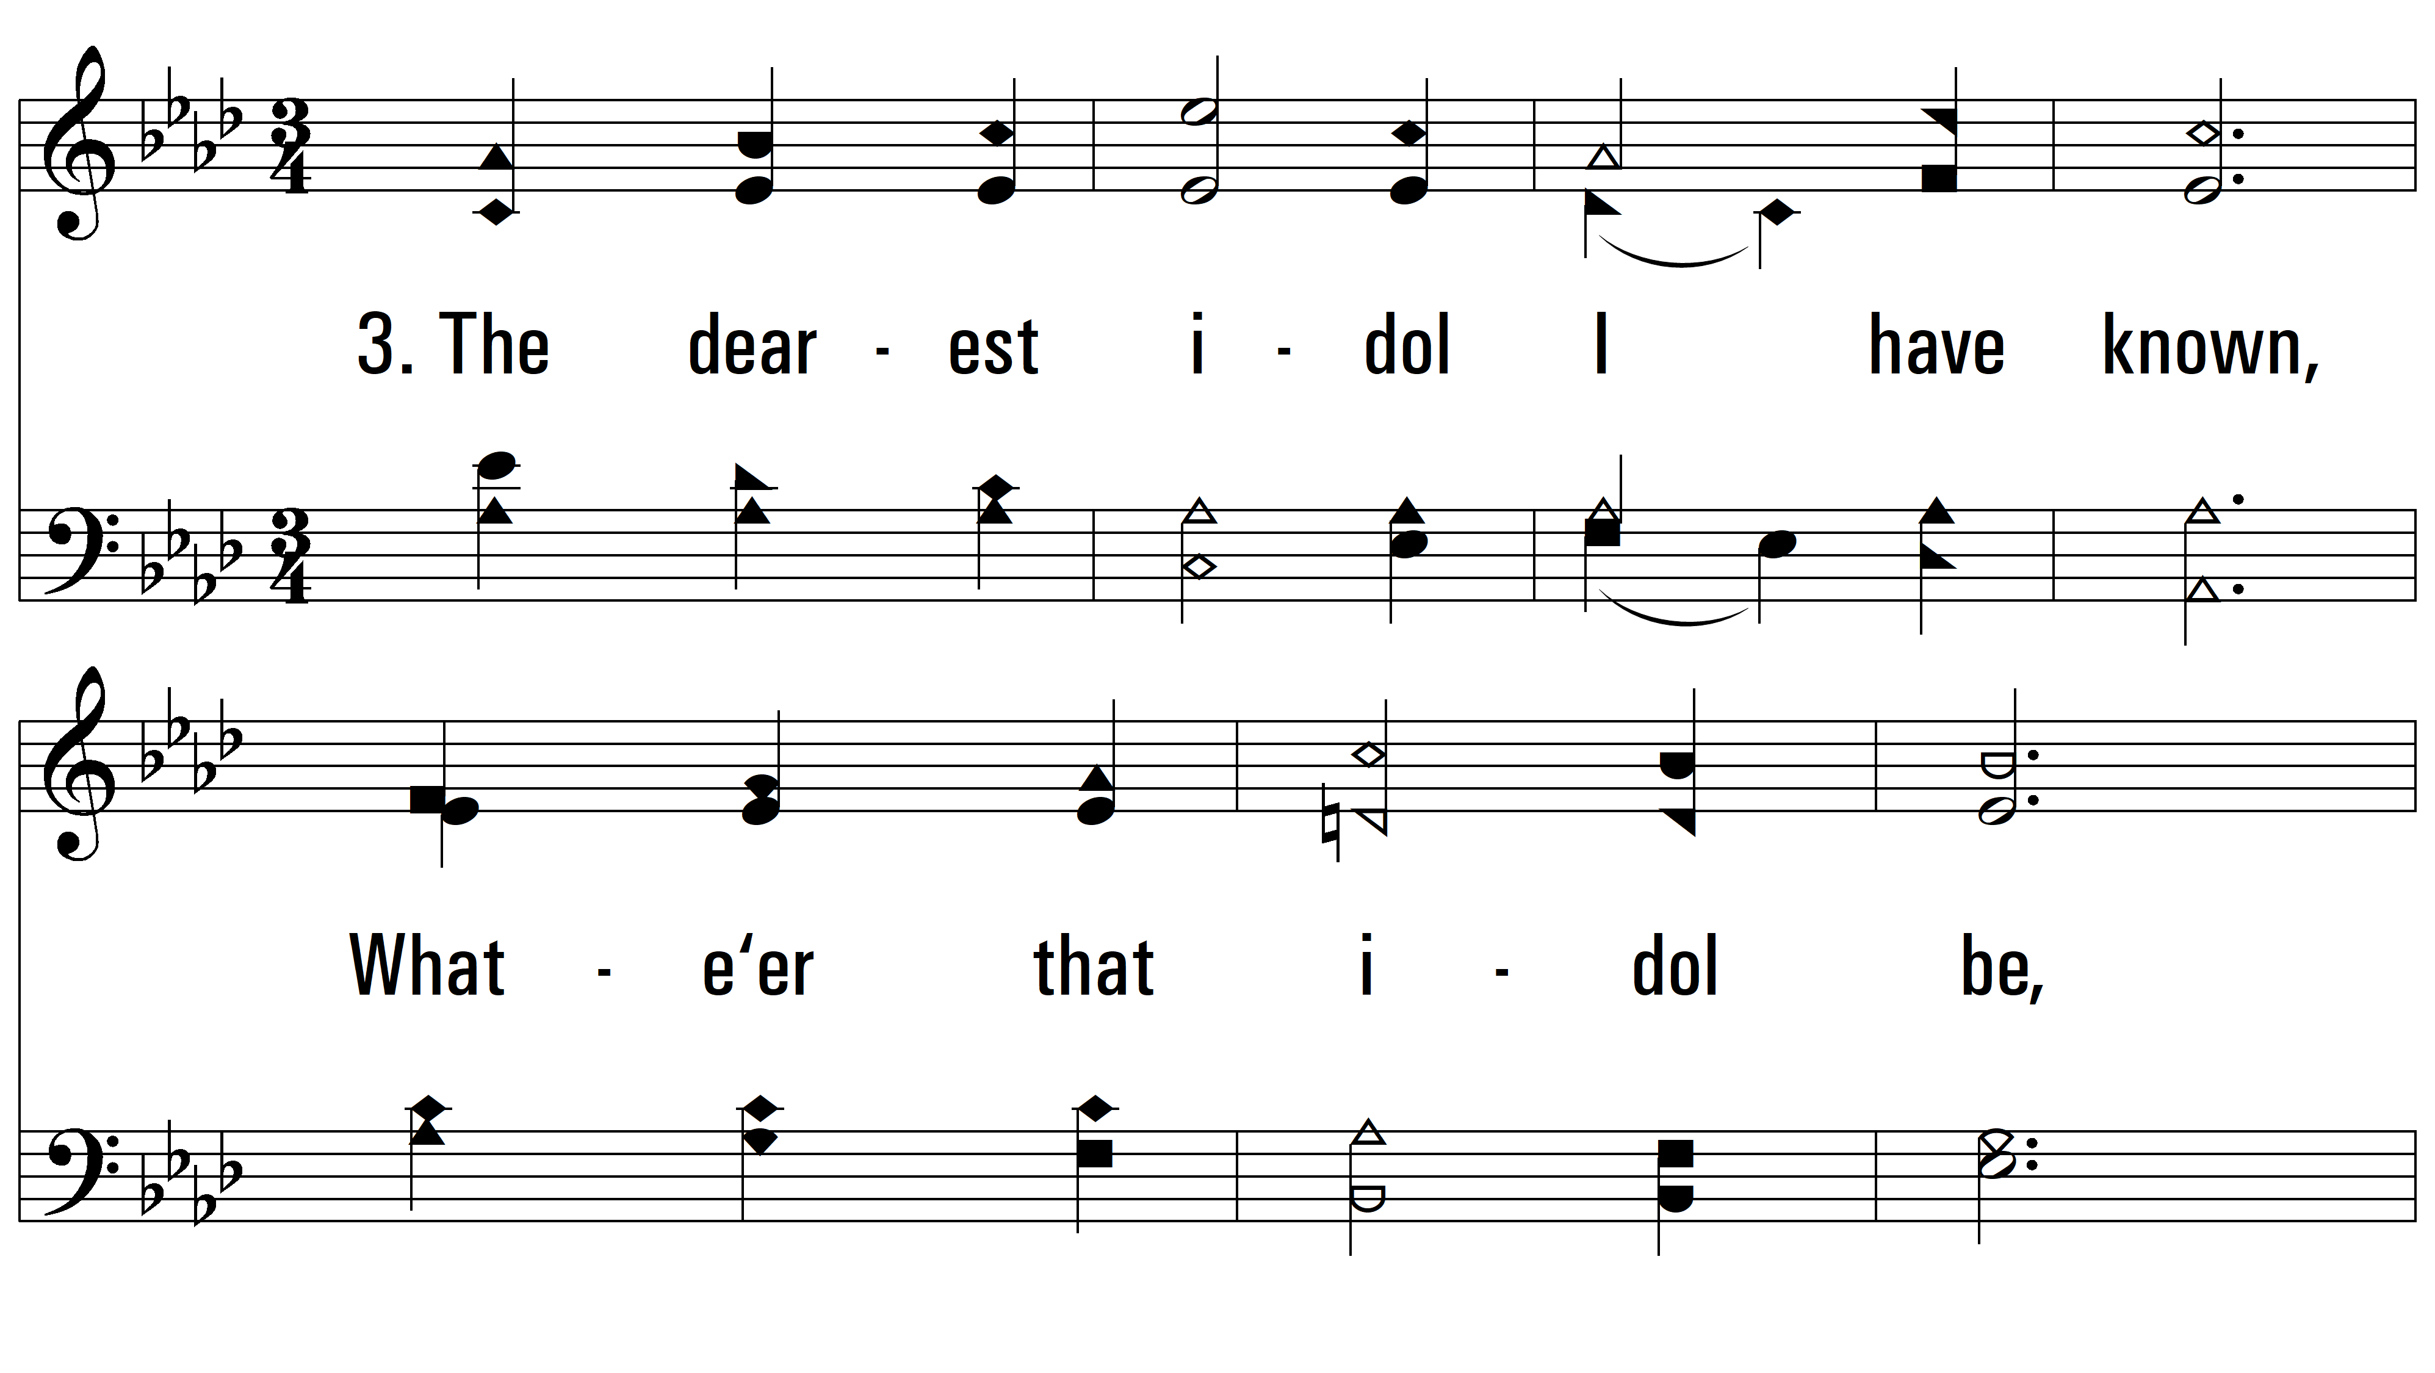
vs. 3 ~ O For A Closer Walk With God

Slide 7
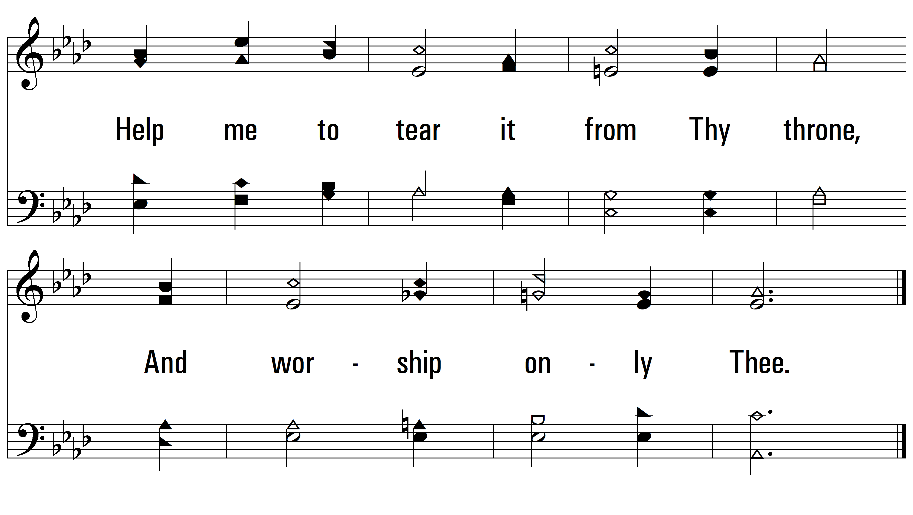
vs. 3

Slide 8
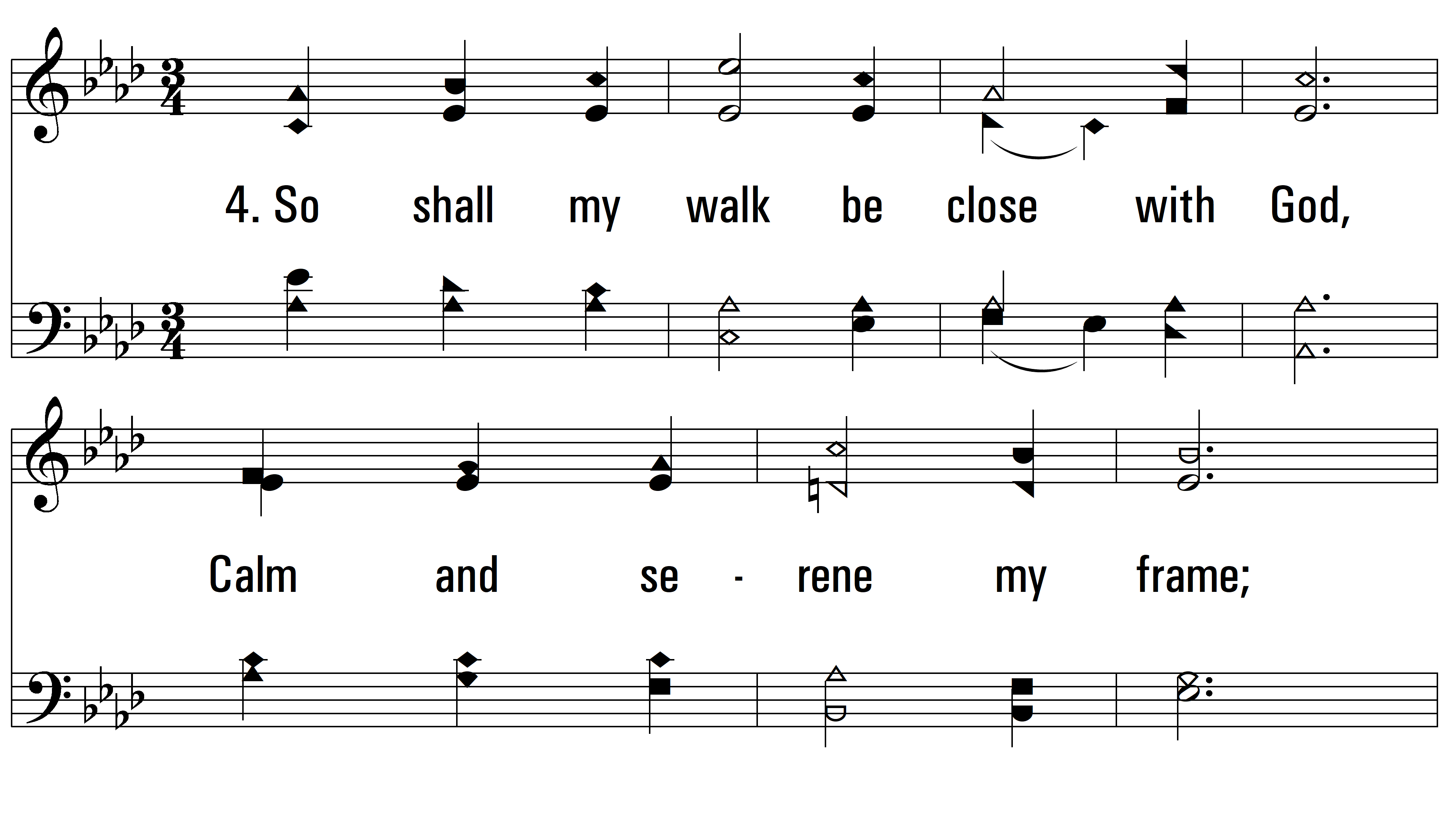
vs. 4 ~ O For A Closer Walk With God

Slide 9
vs. 4
PDHymns.com
END

