Slide 1
Now The Day Is Over
MERRIAL
6.5.6.5
Words: | Sabine Baring-Gould (1865)
Music: | Joseph Barnby (1868)
4/4
A/E - SOL
Verses: 6
Lead - | SOL
Alto - | MI
Tenor - | DO
Bass - | DO
PDHymns.com

Slide 2
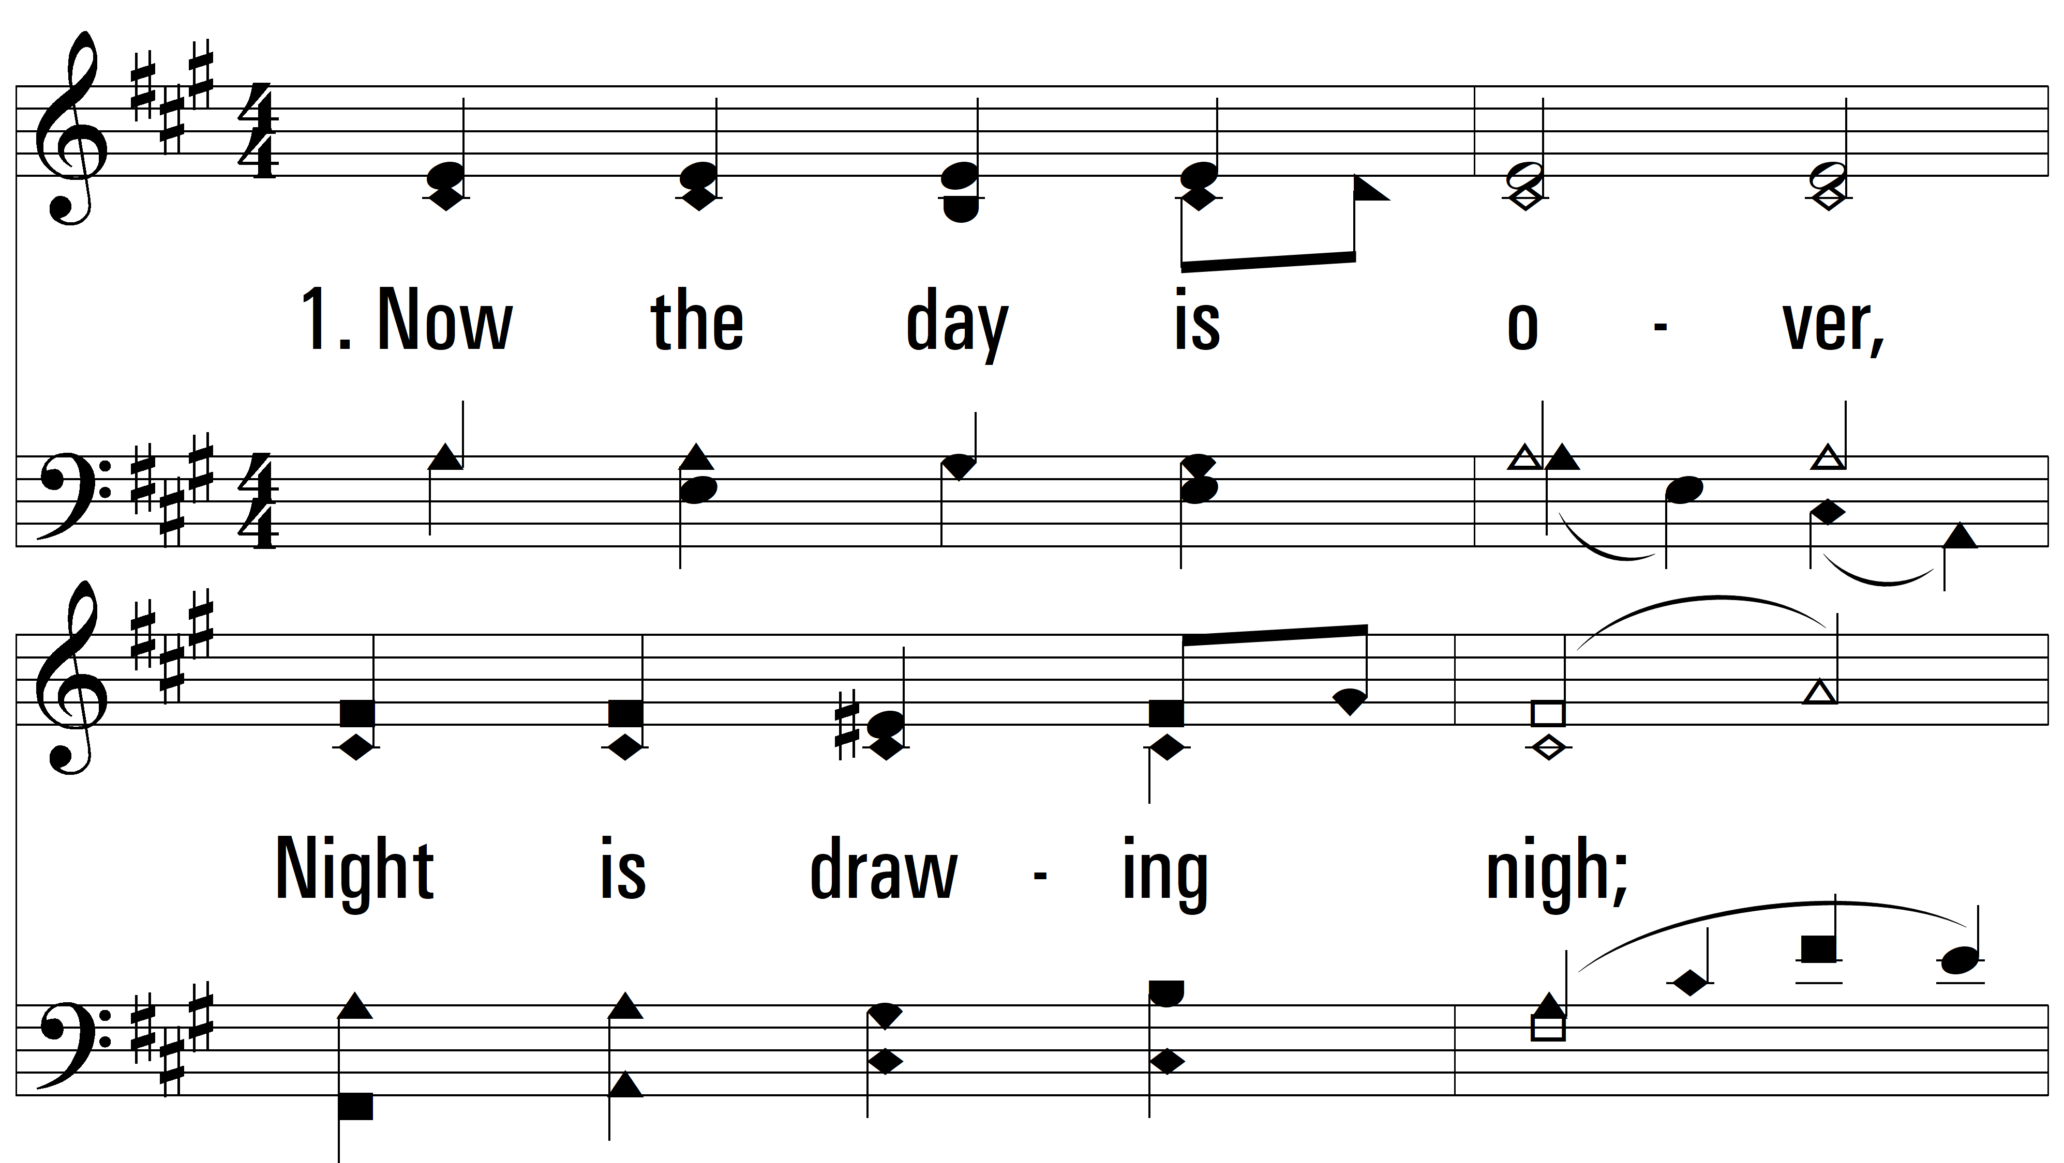
vs. 1 ~ Now The Day Is Over

Slide 3
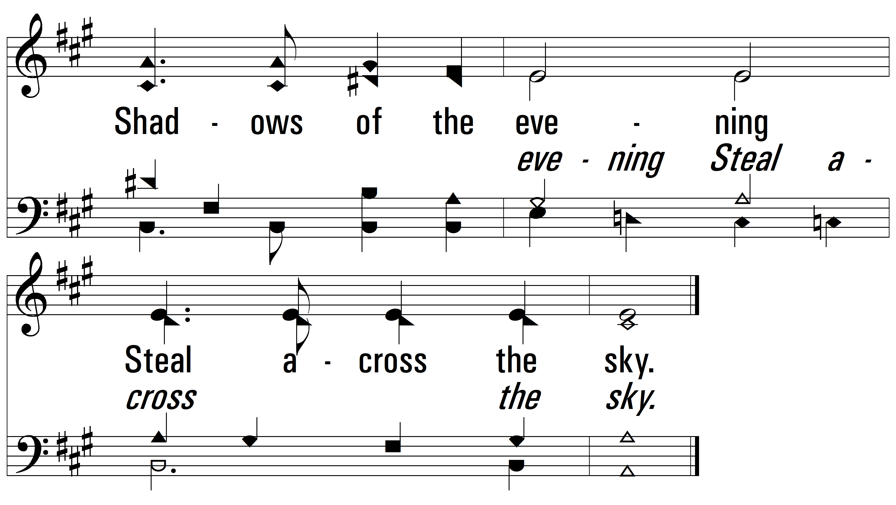
vs. 1

Slide 4
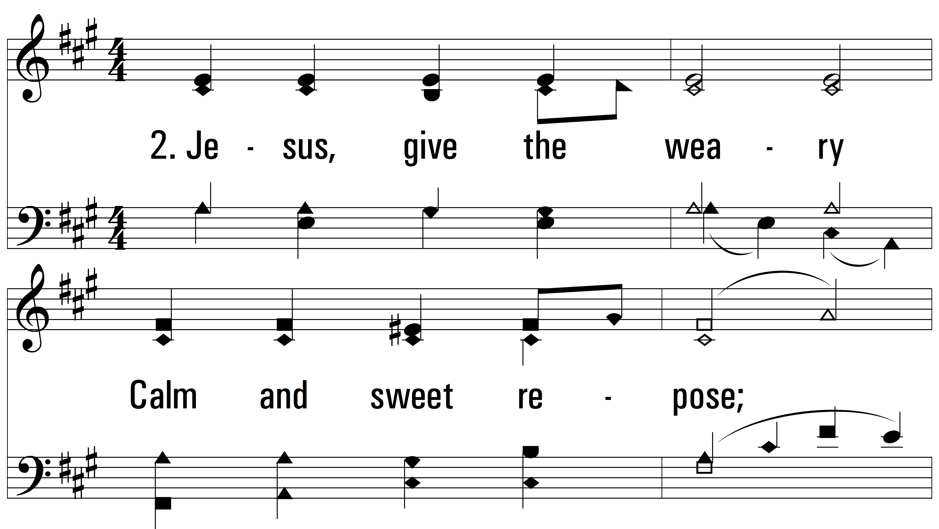
vs. 2 ~ Now The Day Is Over

Slide 5
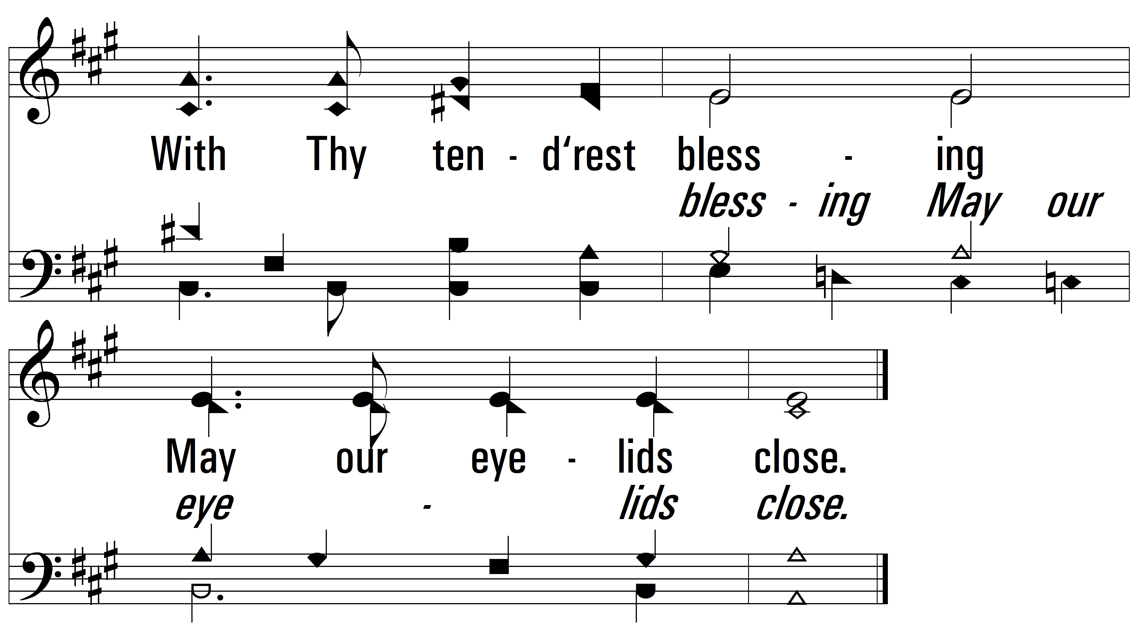
vs. 2

Slide 6
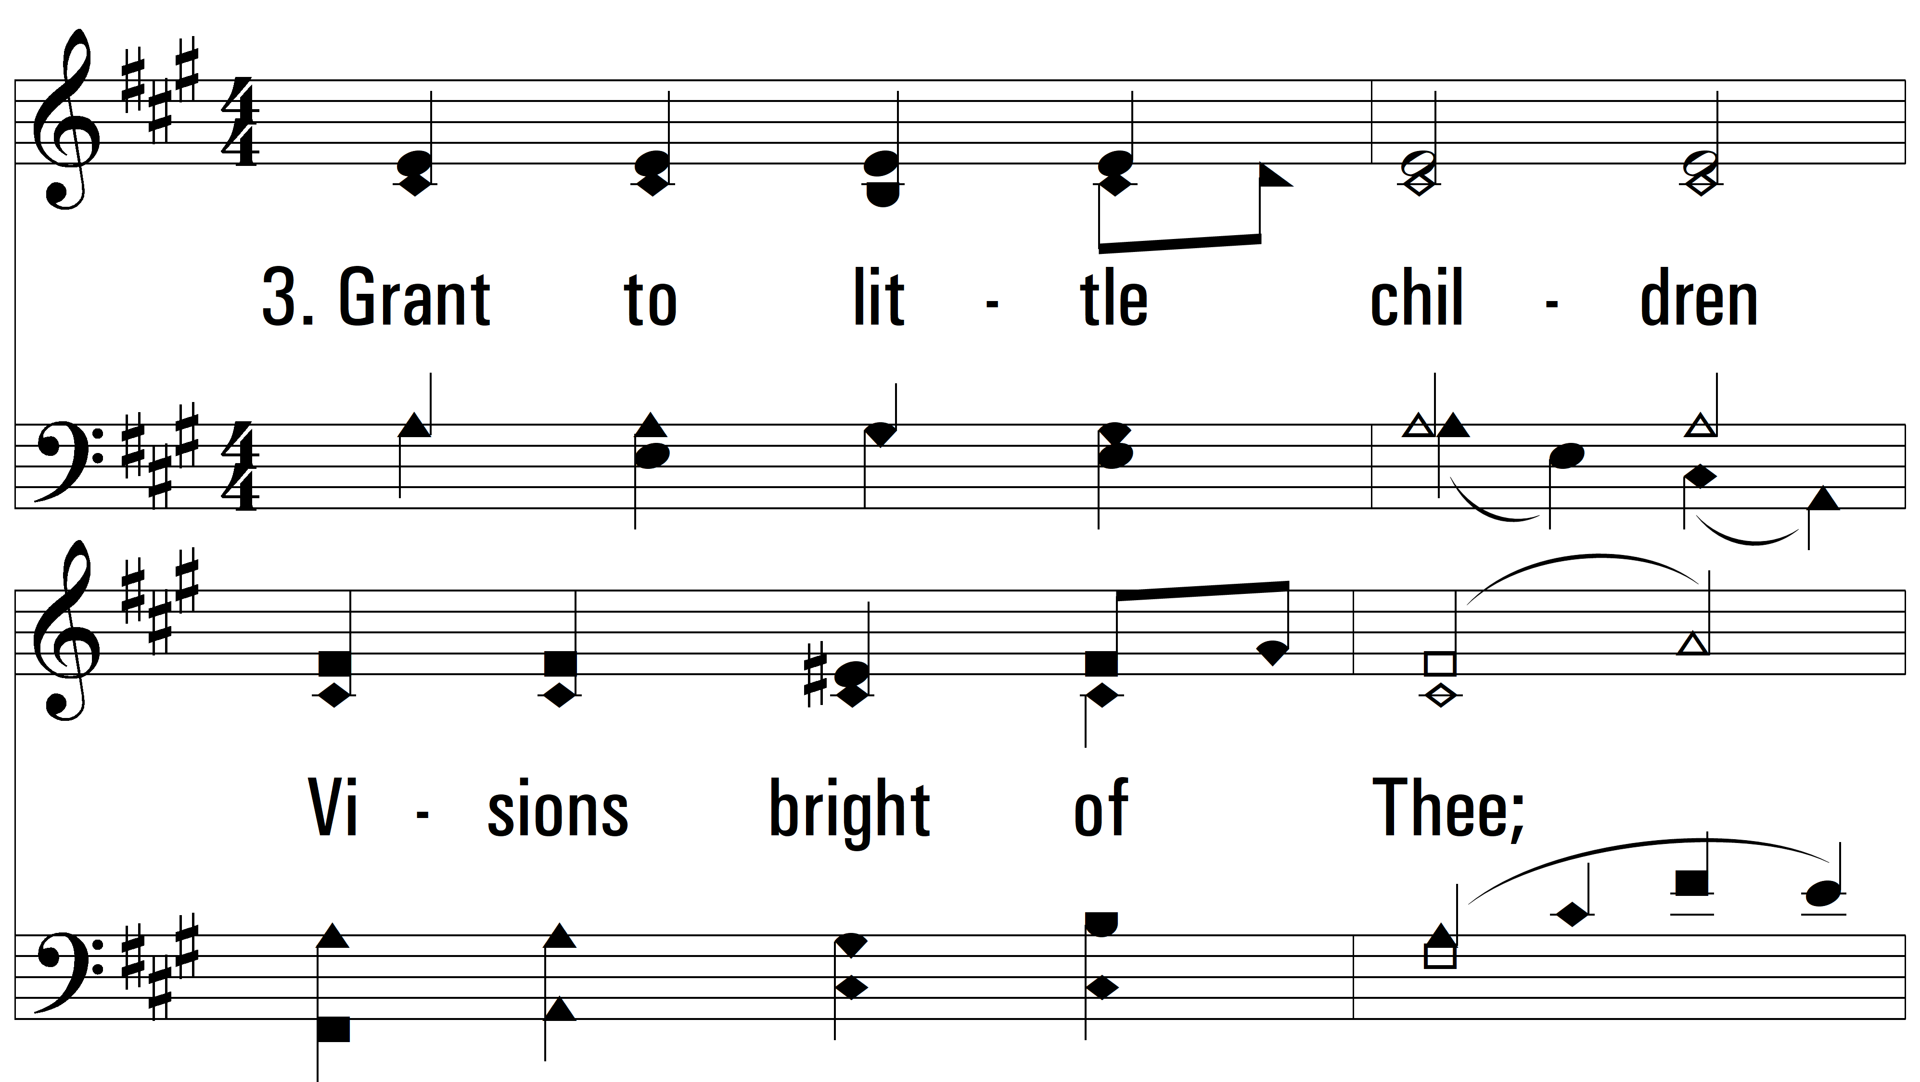
vs. 3 ~ Now The Day Is Over

Slide 7
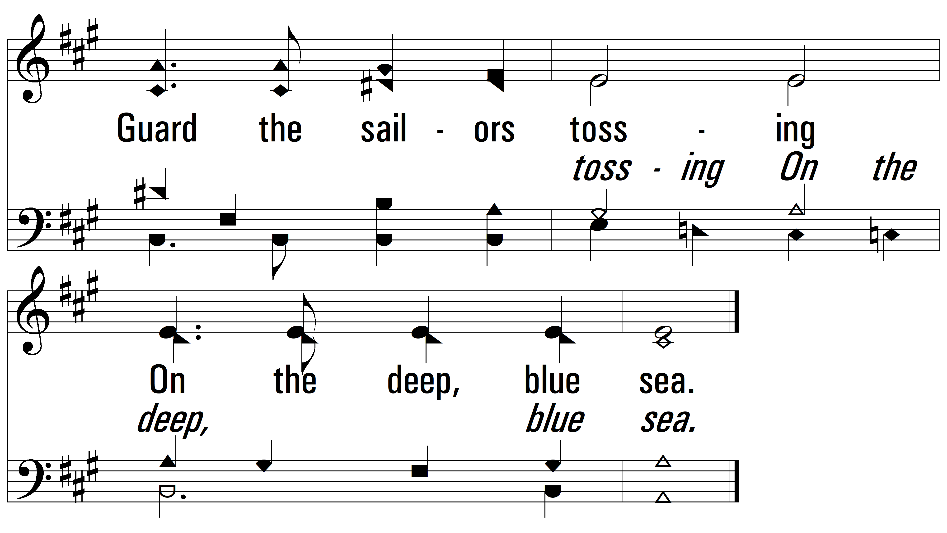
vs. 3

Slide 8
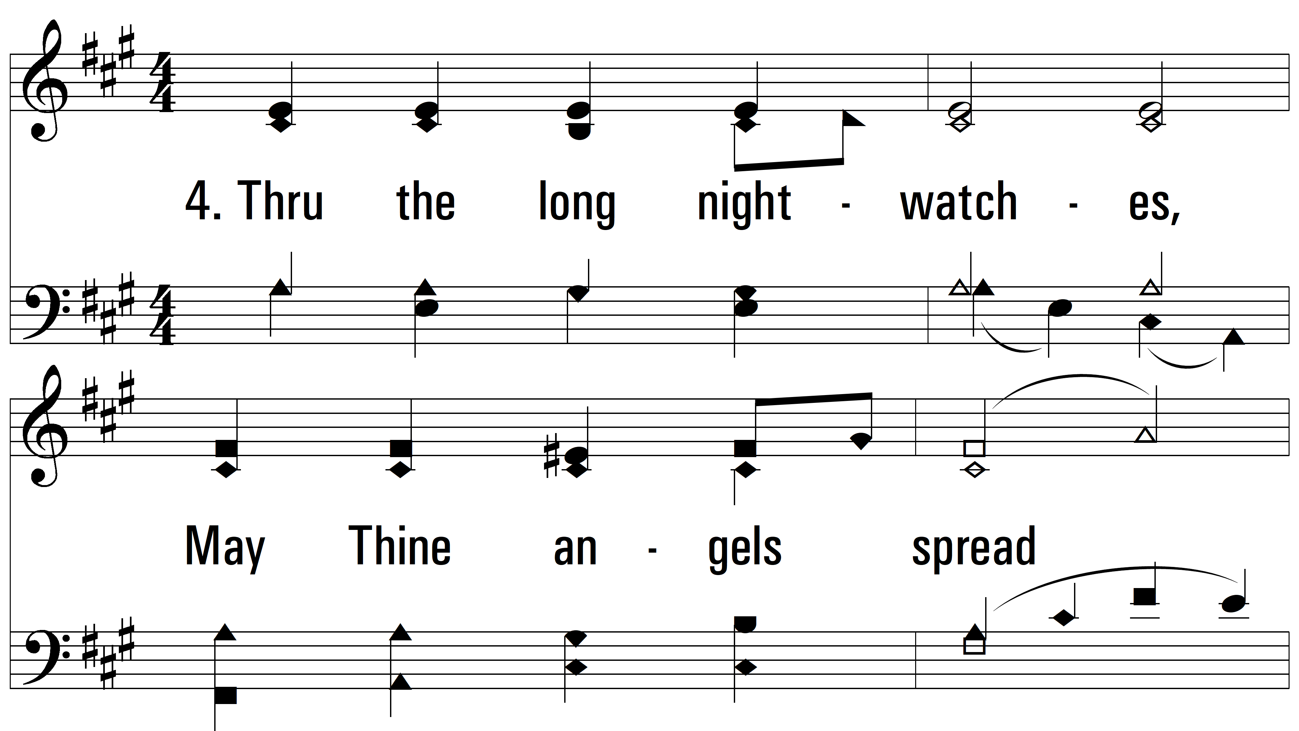
vs. 4 ~ Now The Day Is Over

Slide 9
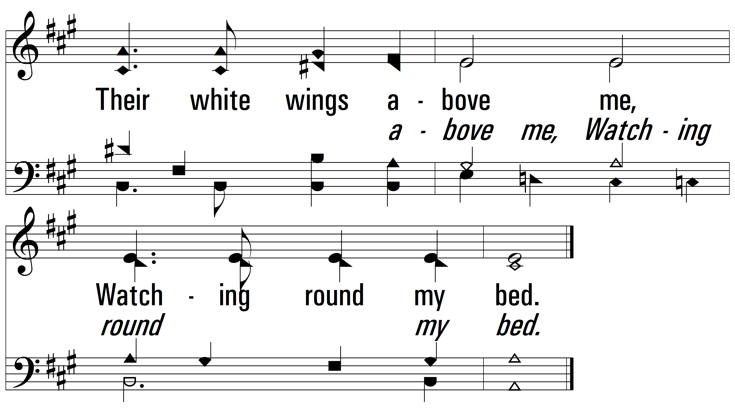
vs. 4

Slide 10
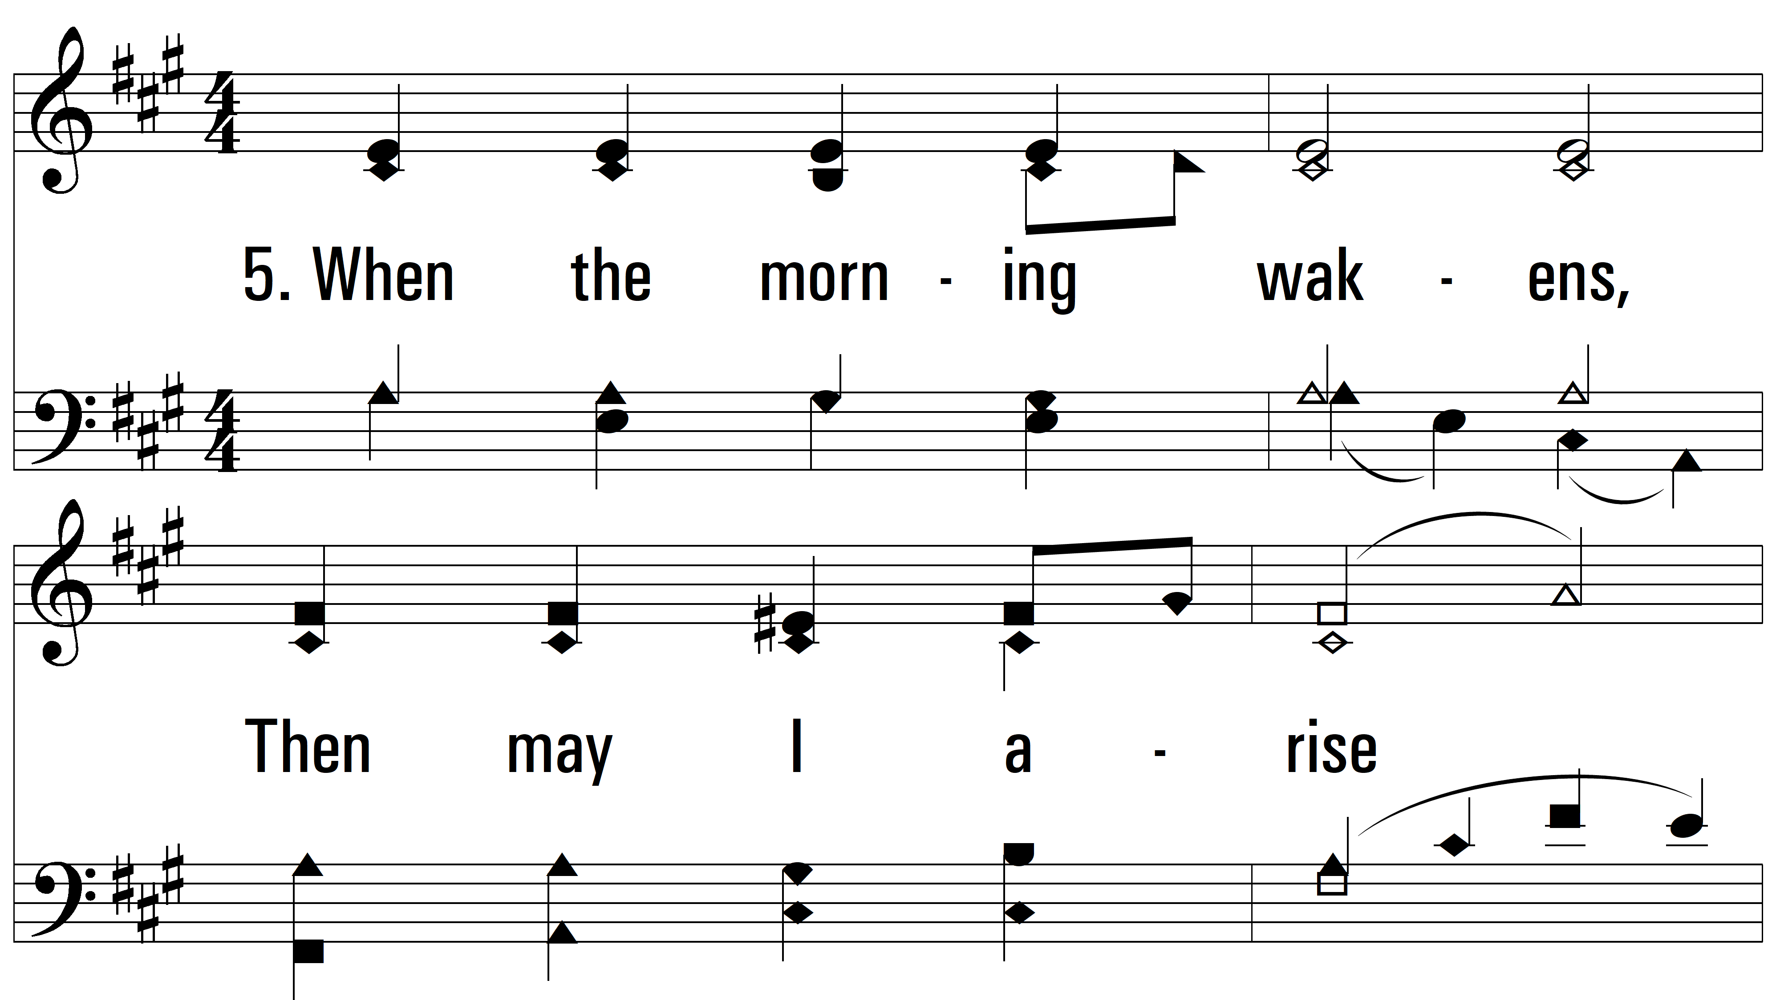
vs. 5 ~ Now The Day Is Over

Slide 11
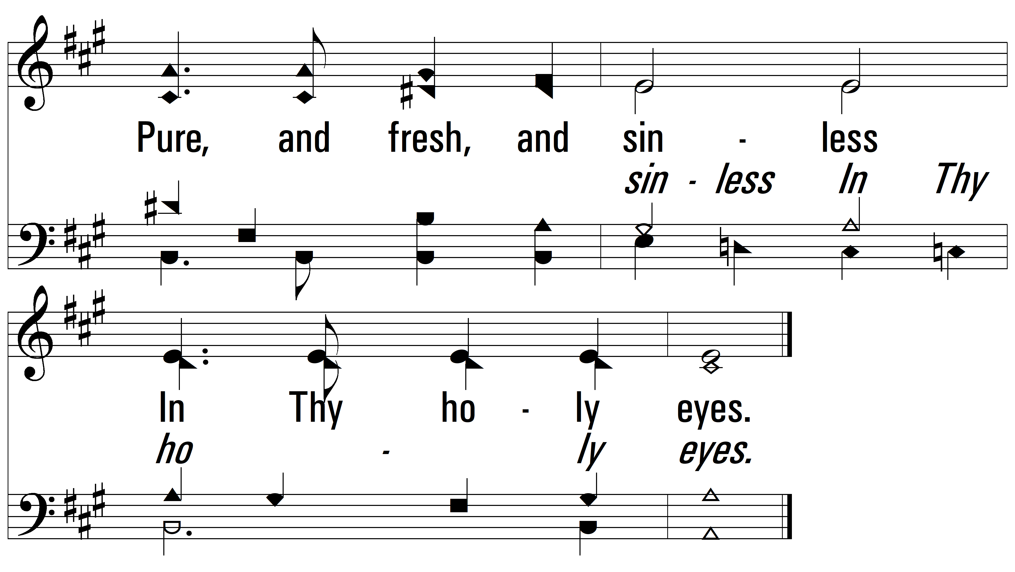
vs. 5

Slide 12
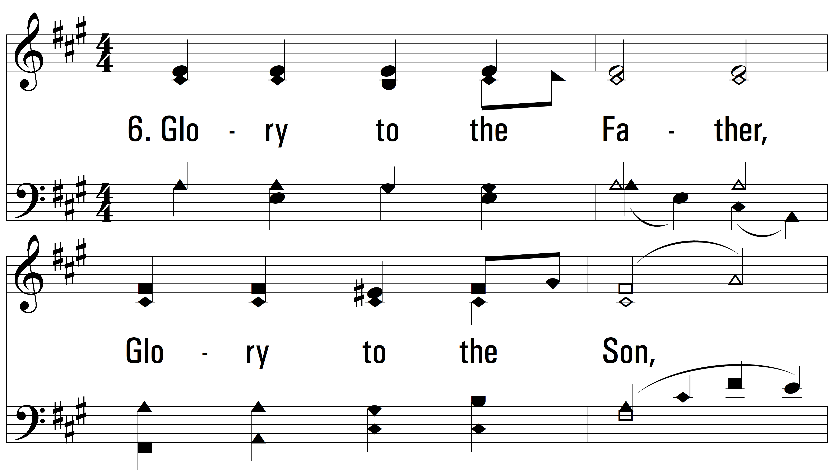
vs. 6 ~ Now The Day Is Over

Slide 13
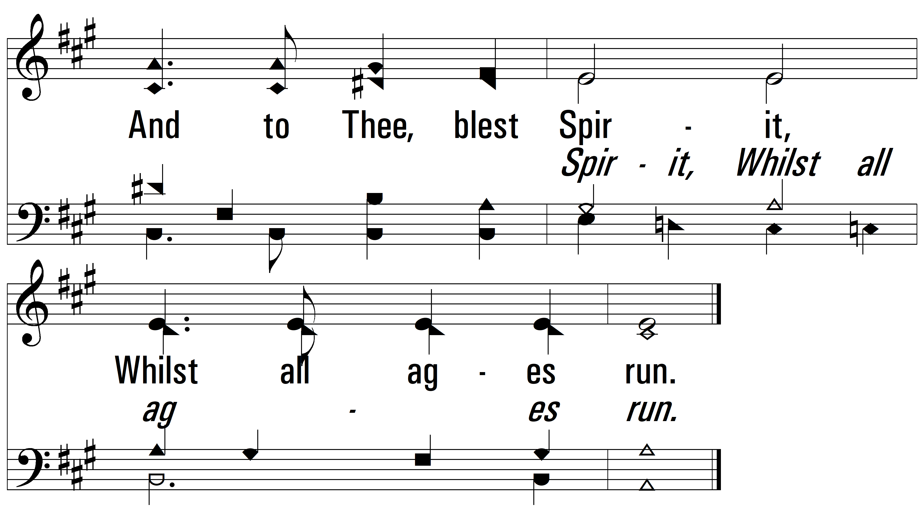
vs. 6
PDHymns.com
END

