Slide 1
Nothing But The Blood
Words: | Robert Lowry (1876)
Music: | Robert Lowry (1876)
4/4
F/F - DO
Verses: 3/Chorus
Lead - | DO
Alto - | SOL
Tenor - | MI
Bass - | DO
PDHymns.com

Slide 2
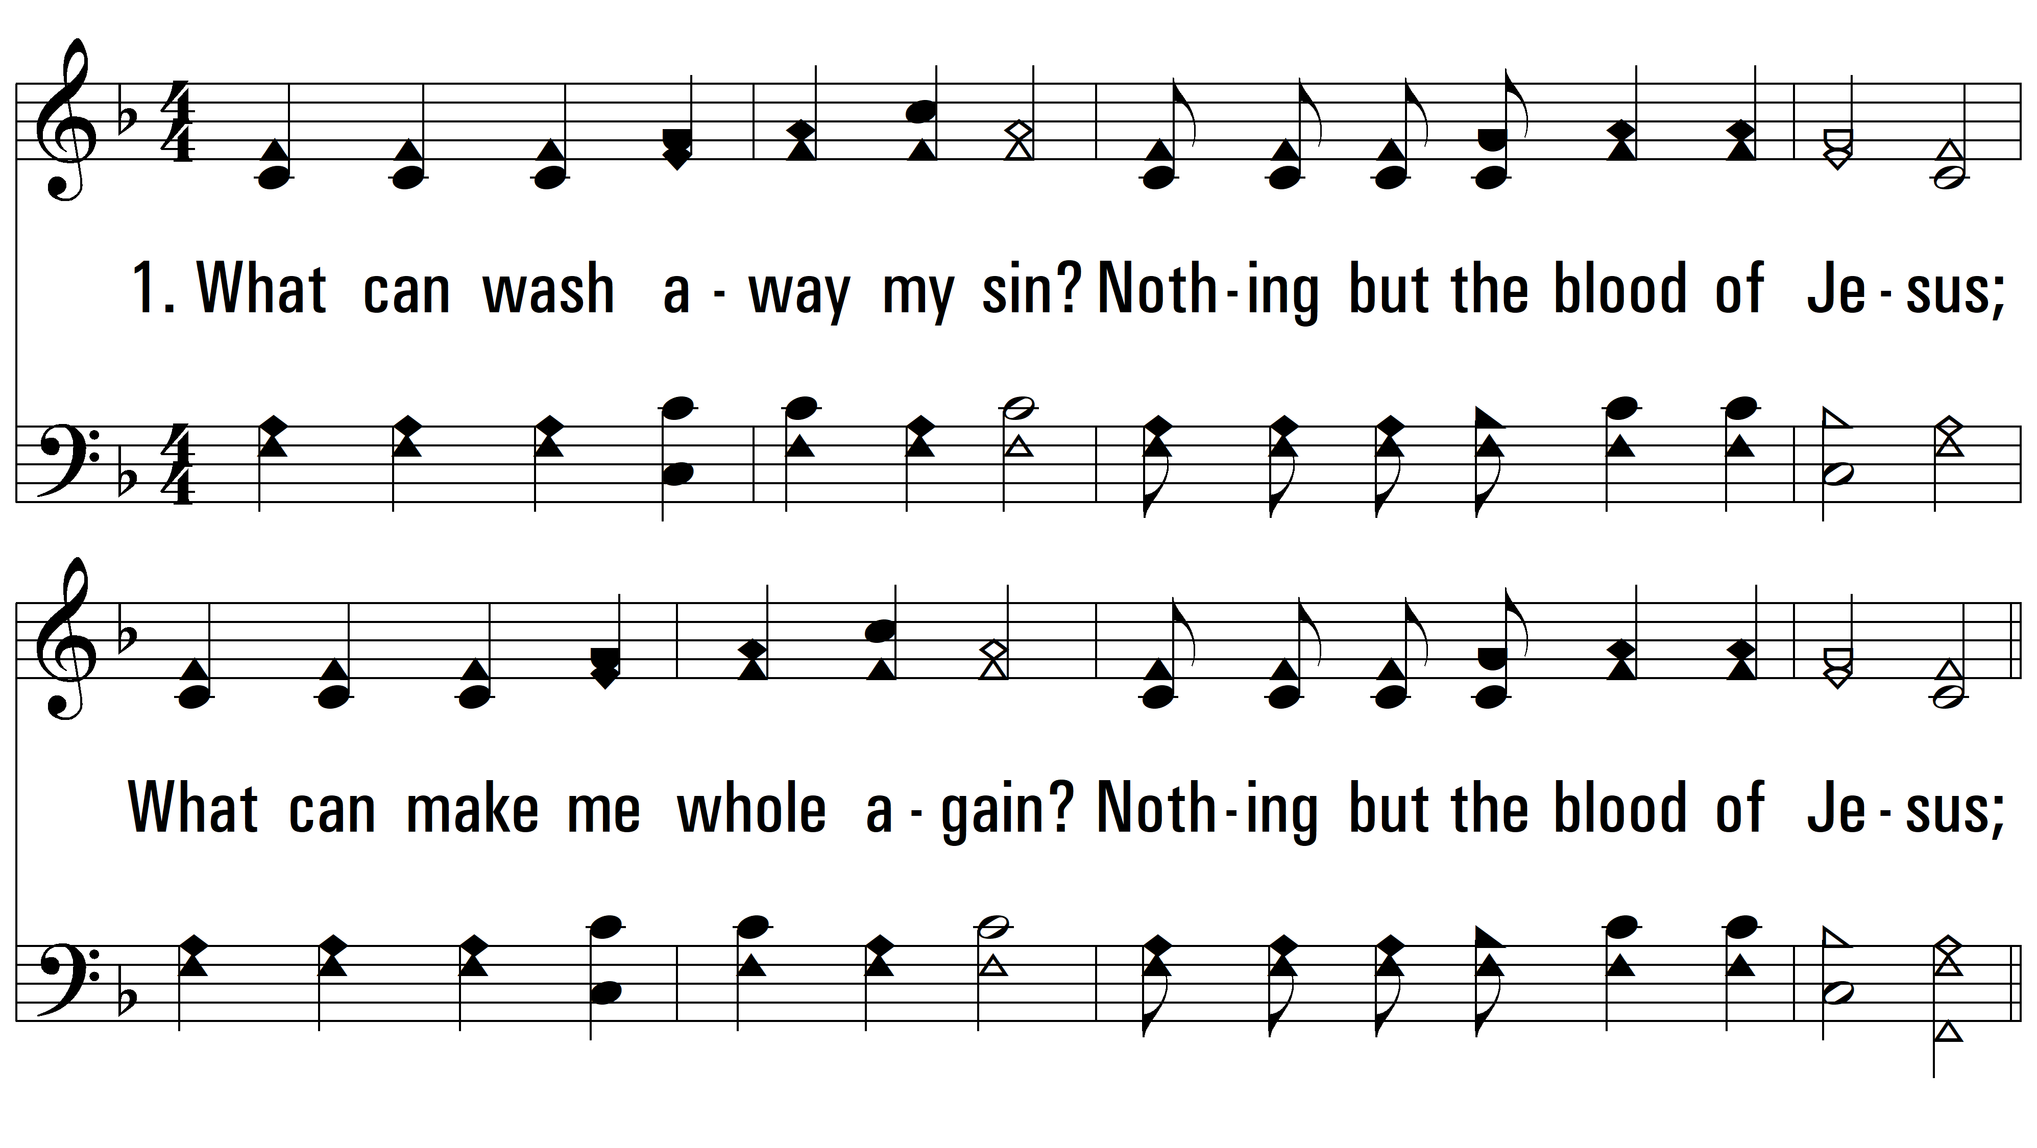
vs. 1 ~ Nothing But The Blood

Slide 3
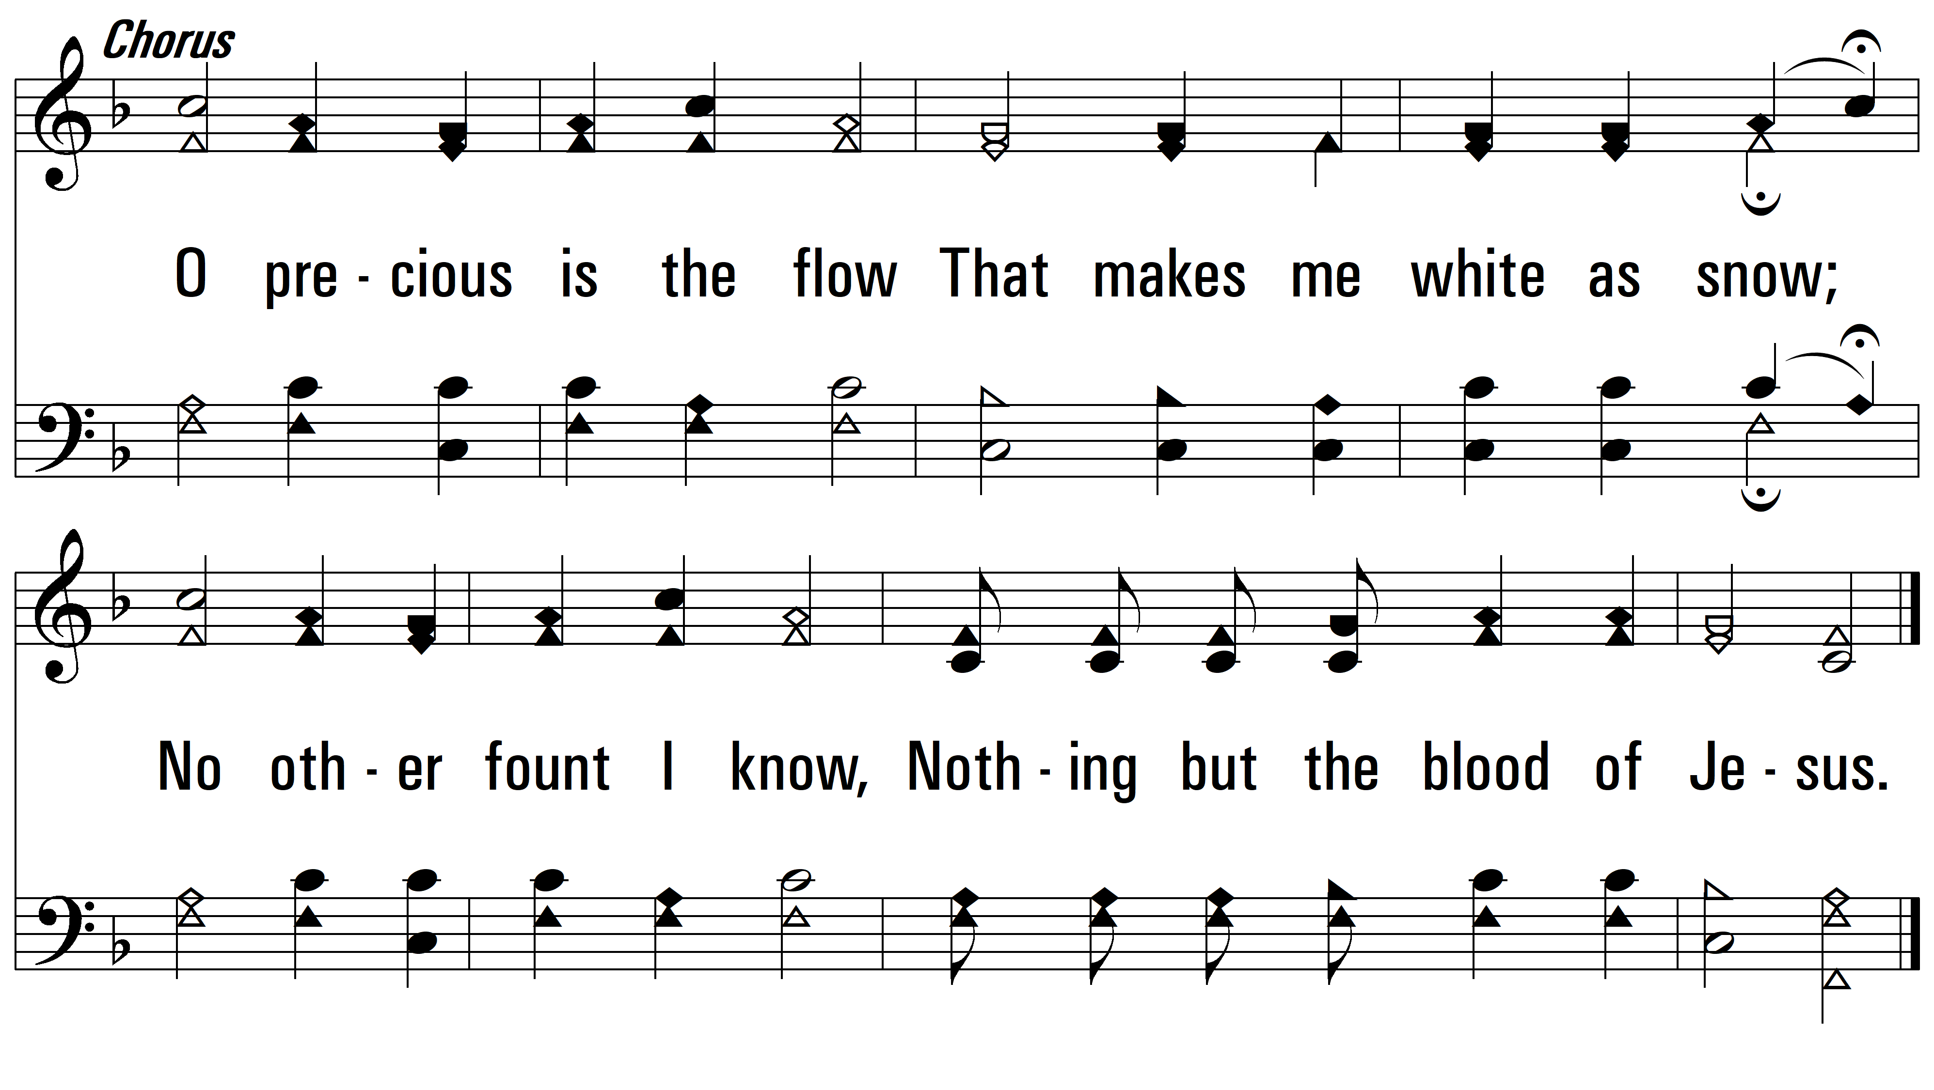
vs. 1

Slide 4
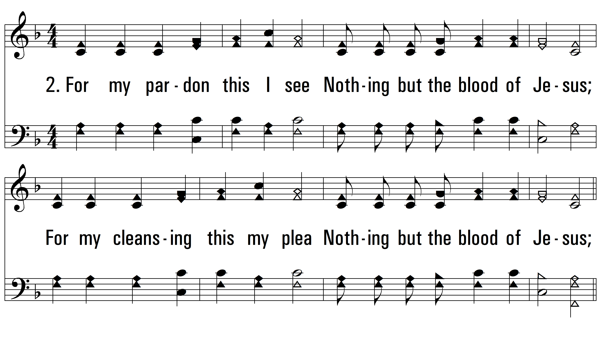
vs. 2 ~ Nothing But The Blood

Slide 5
vs. 2

Slide 6
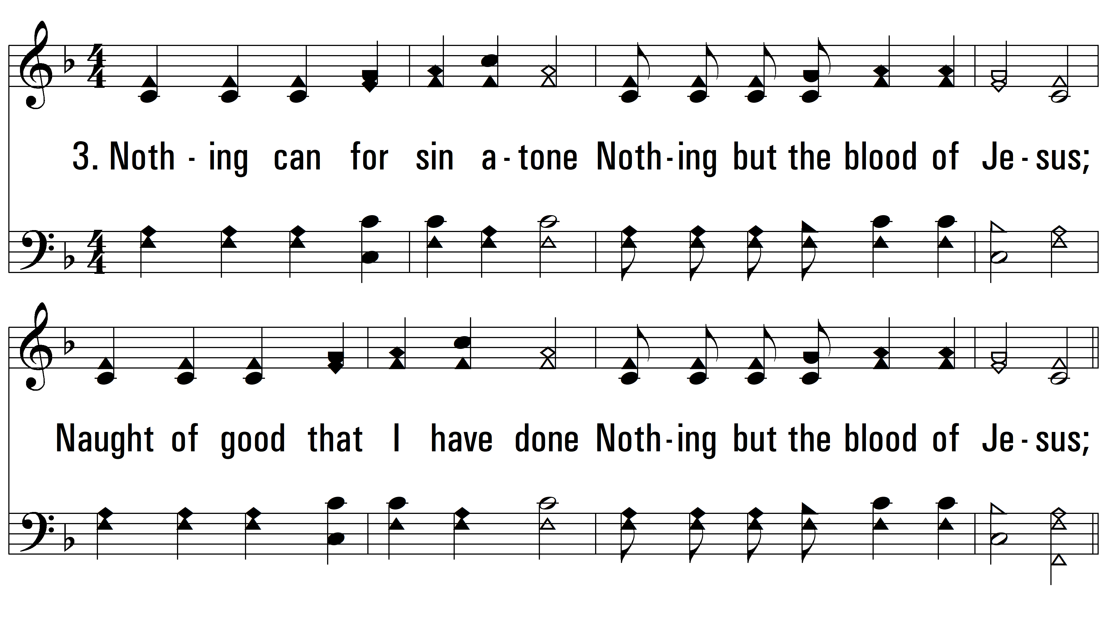
vs. 3 ~ Nothing But The Blood

Slide 7
vs. 3
PDHymns.com
END

