Slide 1
Nobody Knows the Trouble I See
OH, YES LORD
Irregular w/ Chorus
Words: | Traditional
Music: | Southern U.S. Spiritual
4/4
G/B - MI
Verses: 3/Chorus
Lead - | MI
Alto - | SOL
Tenor - | DO
Bass - | DO
PDHymns.com

Slide 2
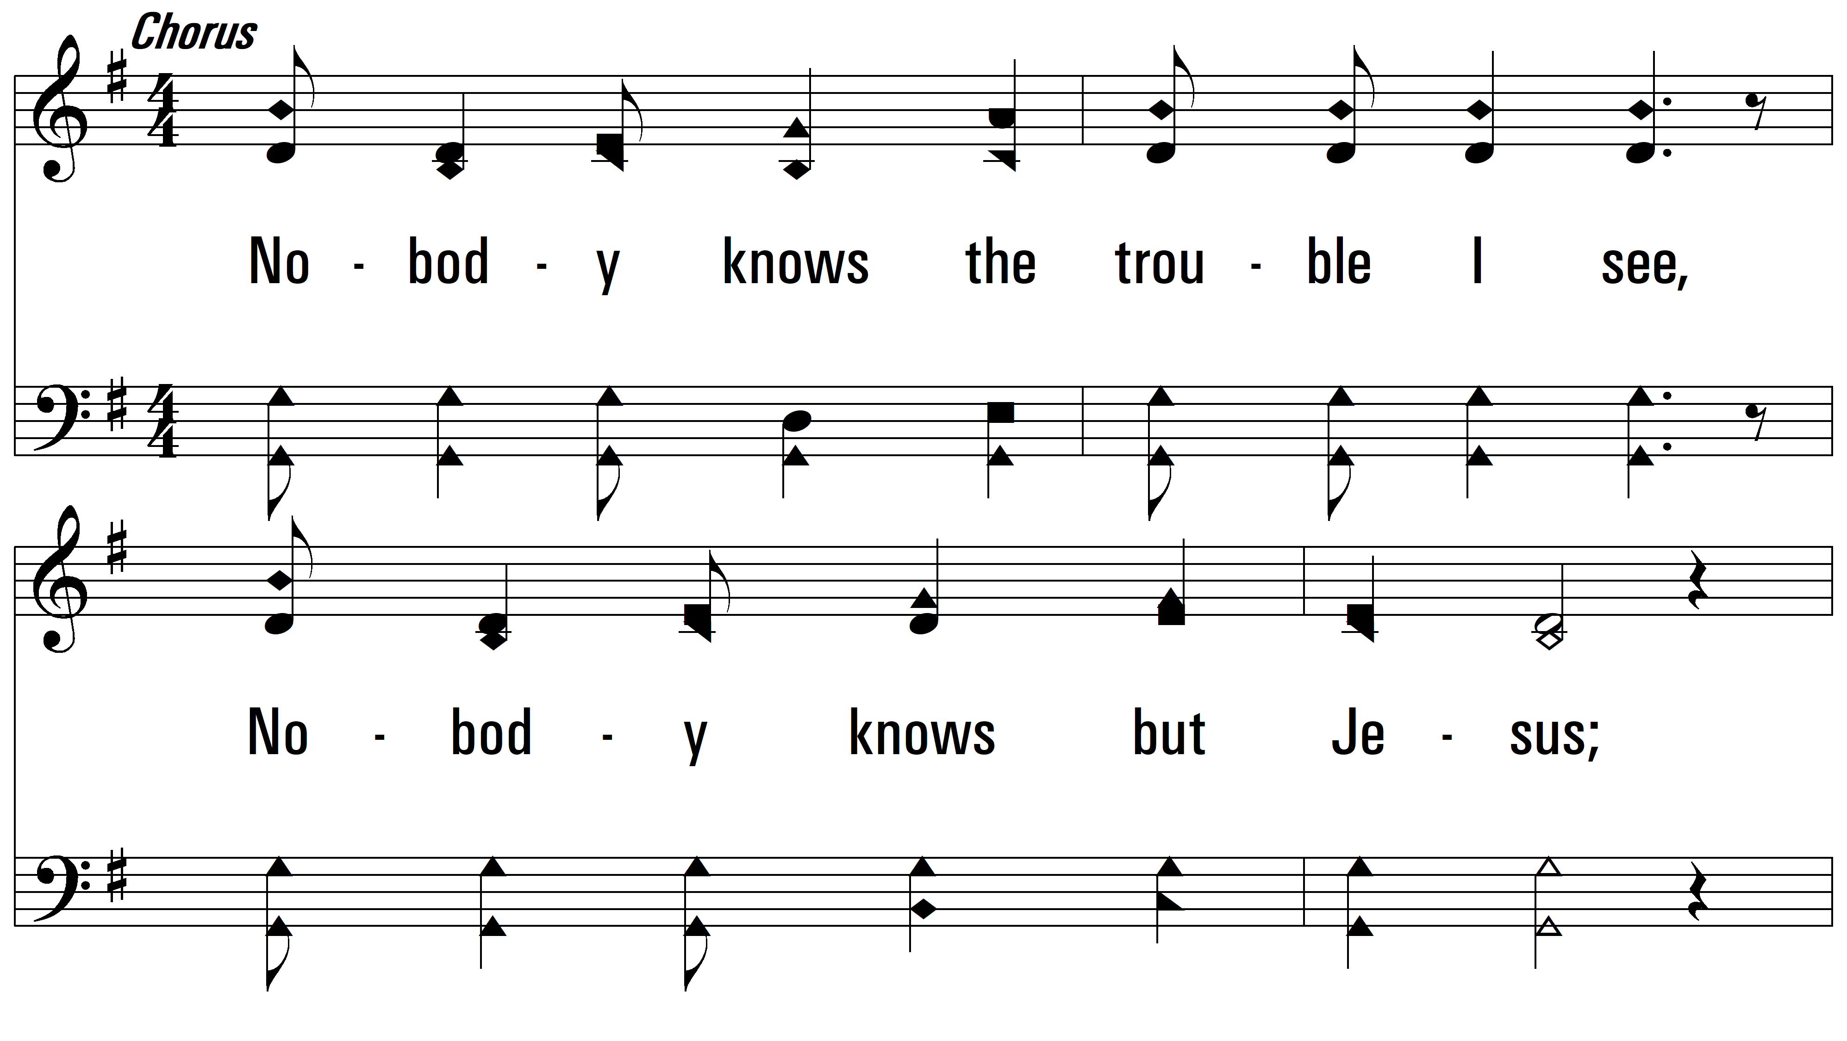
Chorus ~ Nobody Knows the Trouble I See

Slide 3
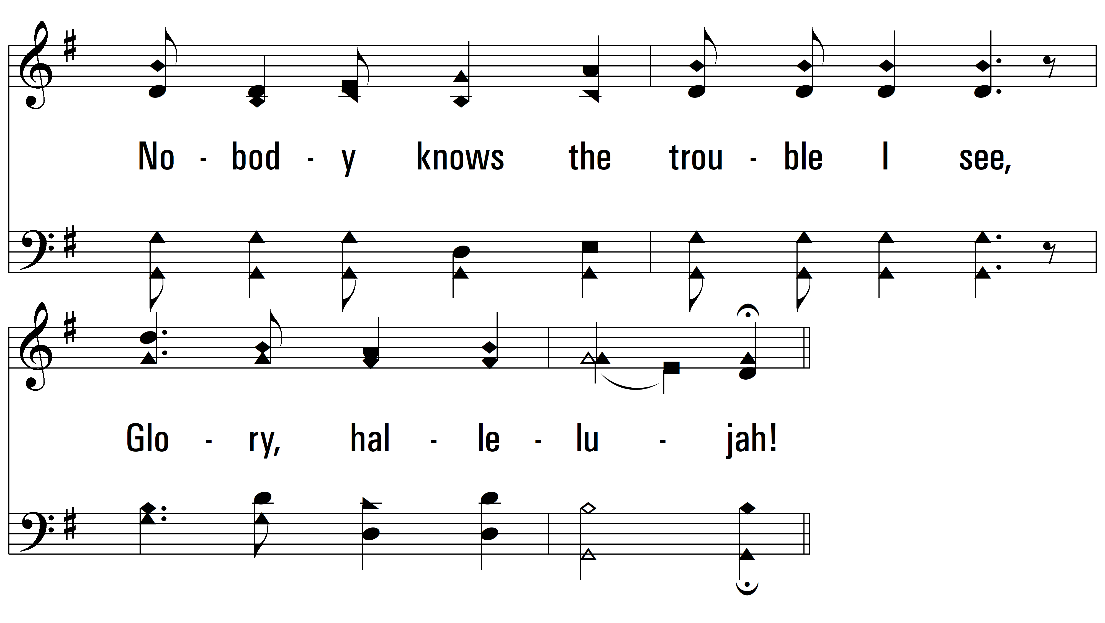
Chorus

Slide 4
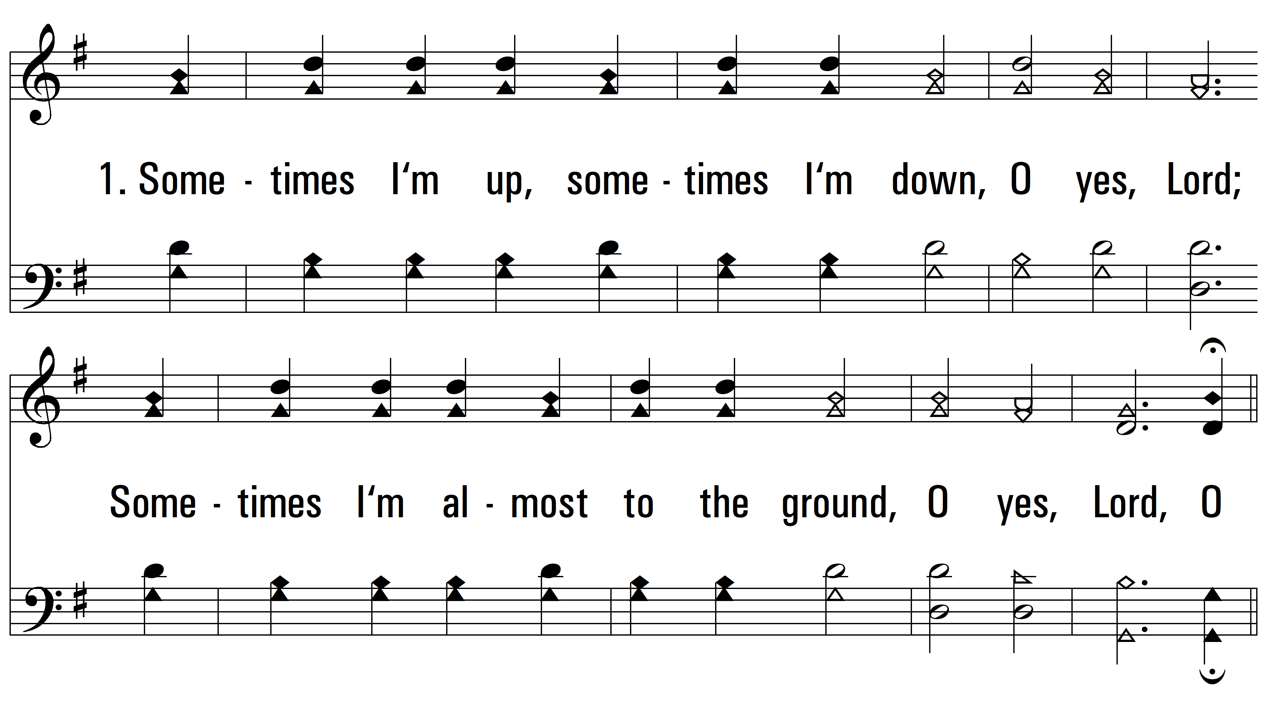
vs. 1 ~ Nobody Knows the Trouble I See

Slide 5
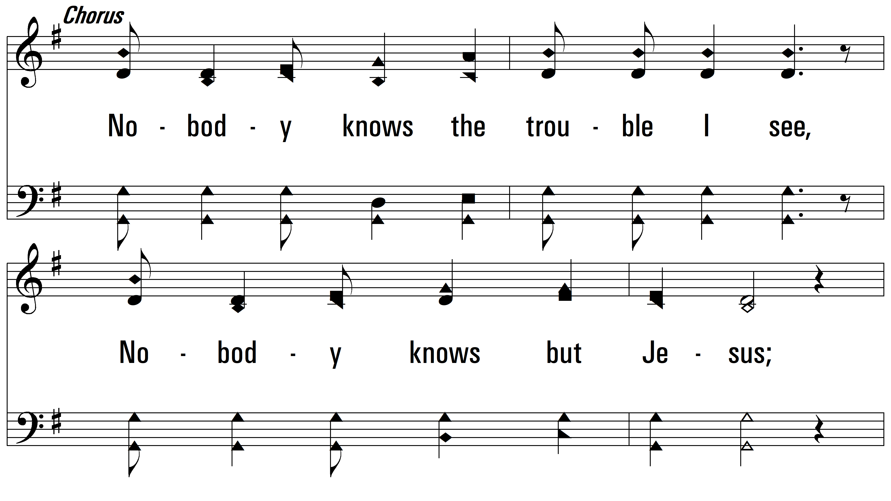
vs. 1

Slide 6
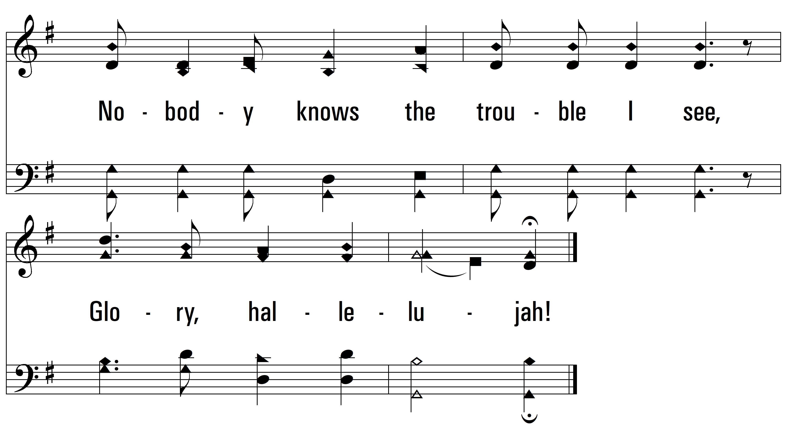
vs. 1

Slide 7
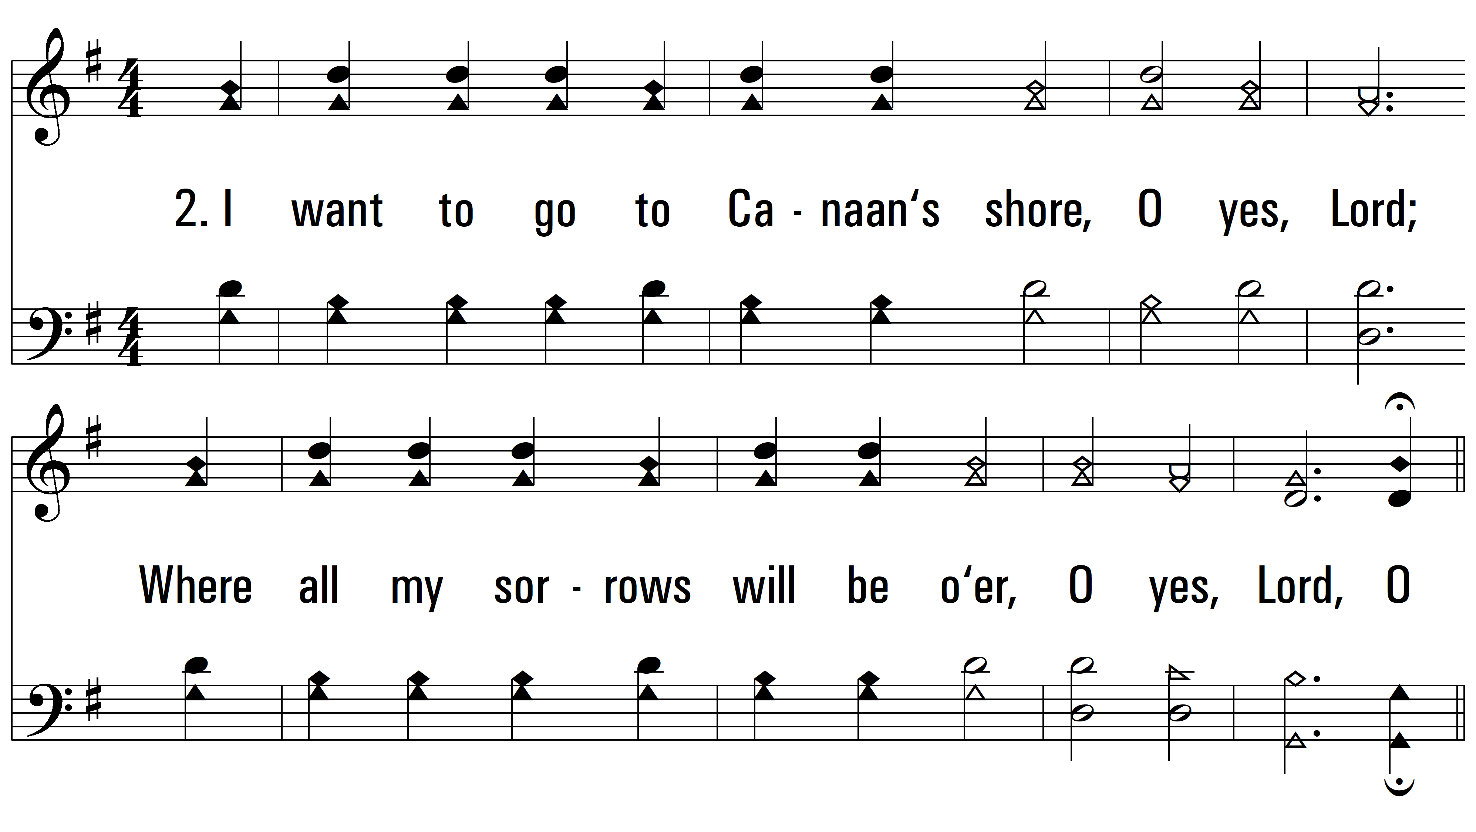
vs. 2 ~ Nobody Knows the Trouble I See

Slide 8
vs. 2

Slide 9
vs. 2

Slide 10
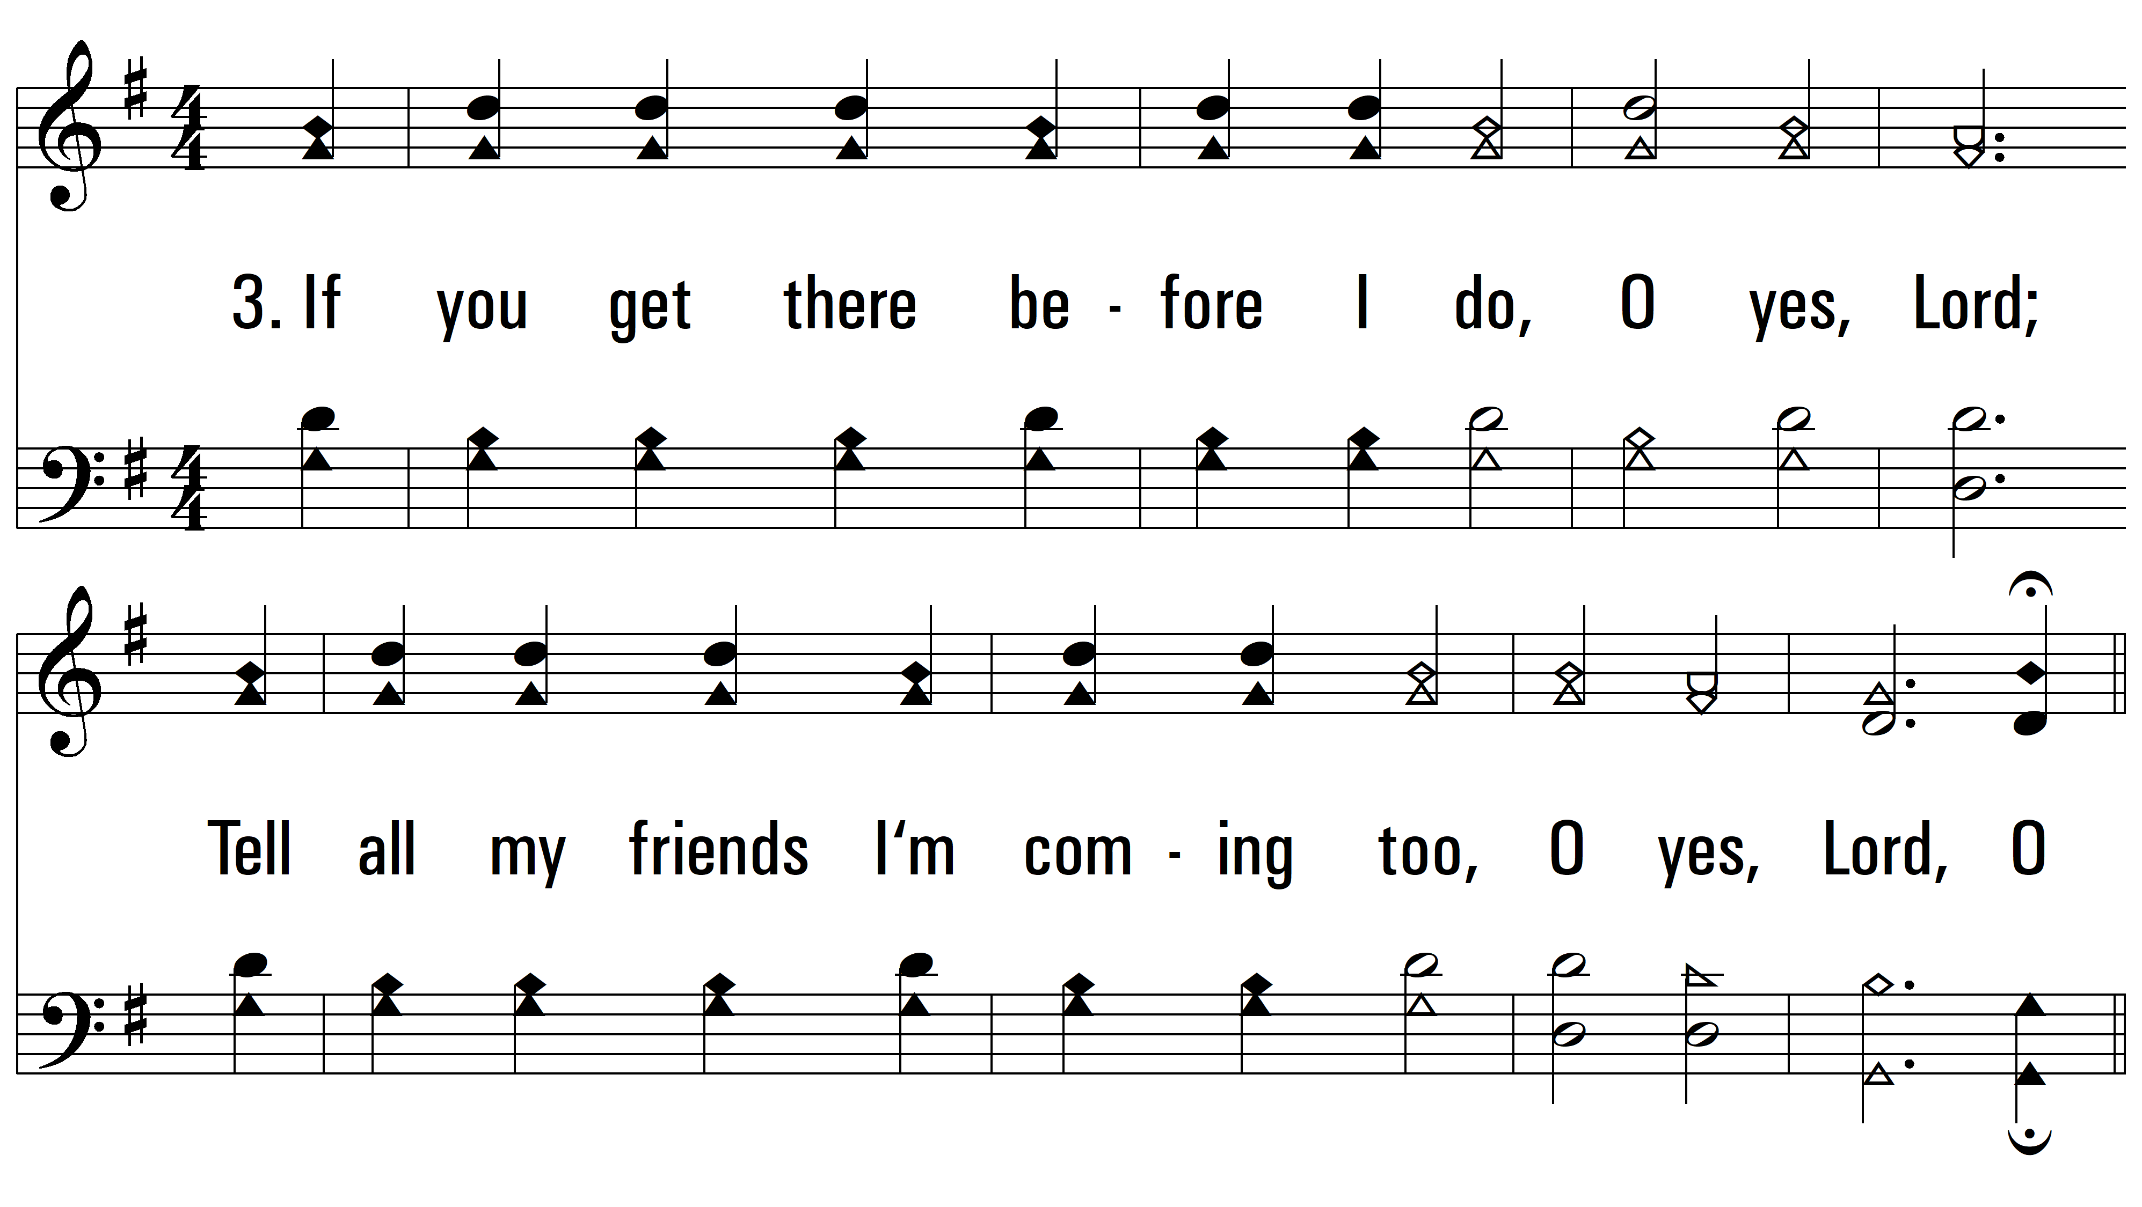
vs. 3 ~ Nobody Knows the Trouble I See

Slide 11
vs. 3

Slide 12
vs. 3
PDHymns.com
END

