Slide 1
No Not One
(There’s Not A Friend)
Words: | Johnston Oatman, Jr. (1895)
Music: | George C. Hugg (1895)
4/4
F/A - MI
Verses: 5/Chorus
Lead - | MI
Alto - | DO
Tenor - | SOL
Bass - | DO
PDHymns.com

Slide 2
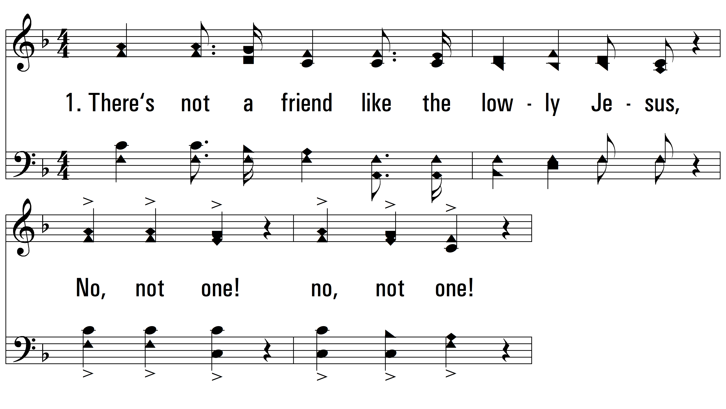
vs. 1 ~ No Not One

Slide 3
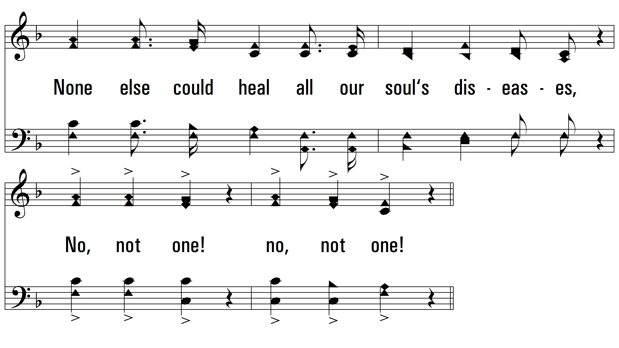
vs. 1

Slide 4
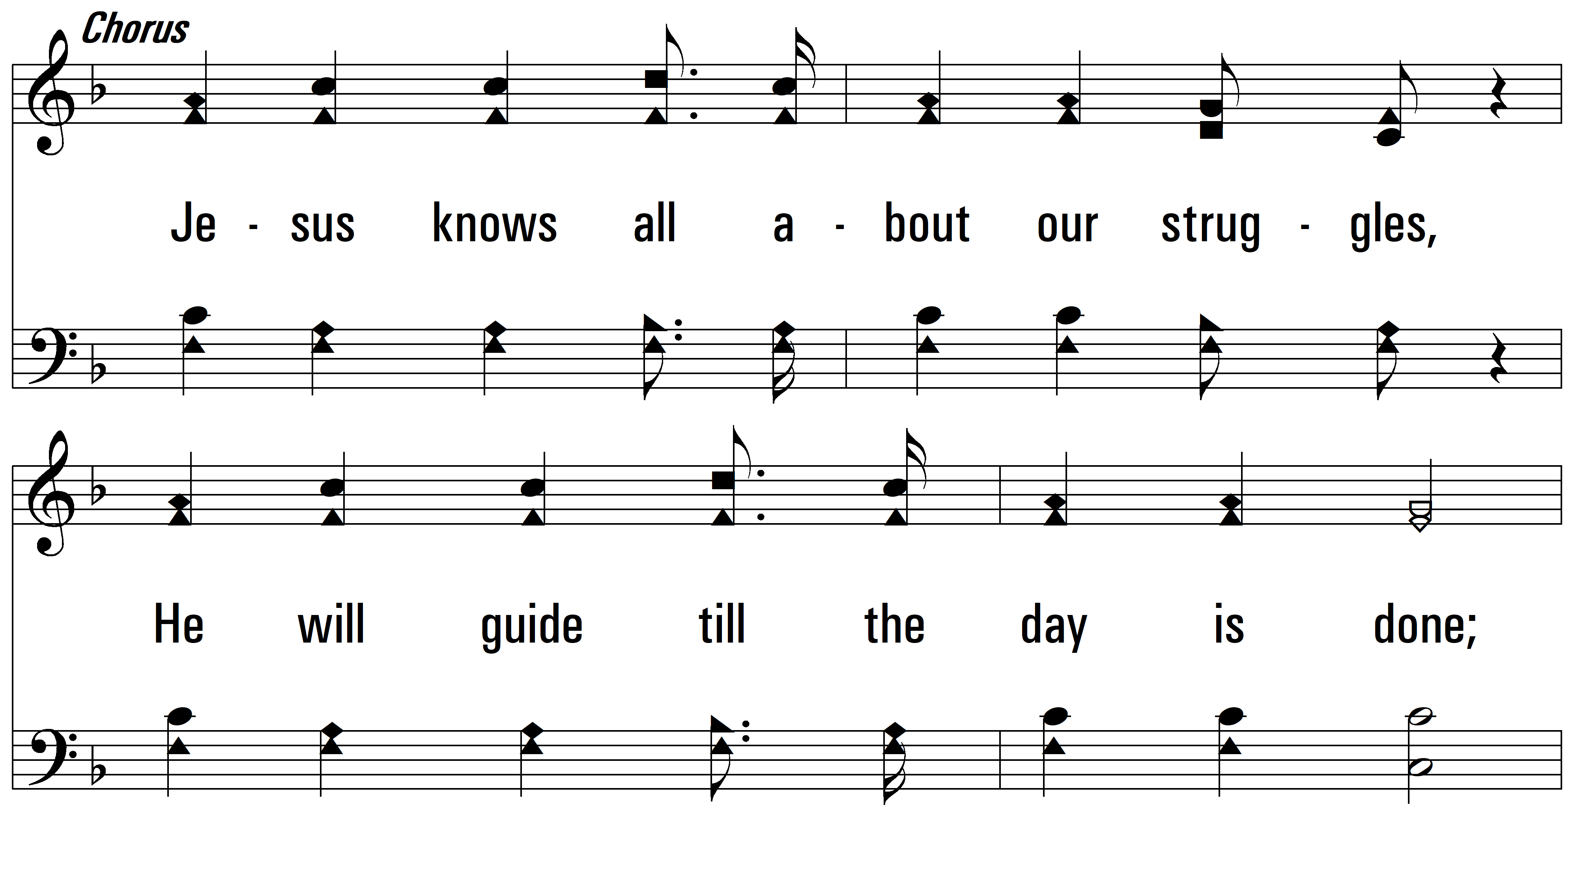
vs. 1

Slide 5
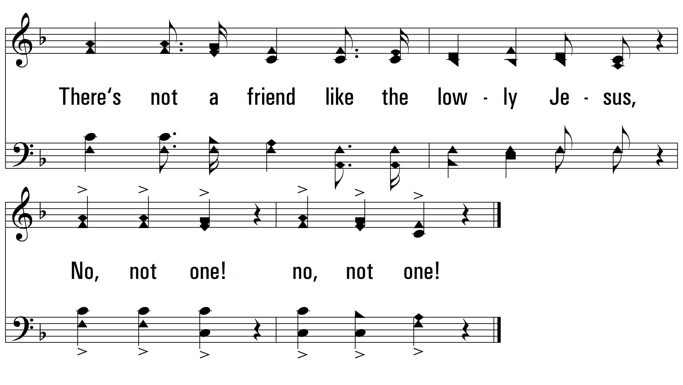
vs. 1

Slide 6

vs. 2 ~ No Not One

Slide 7
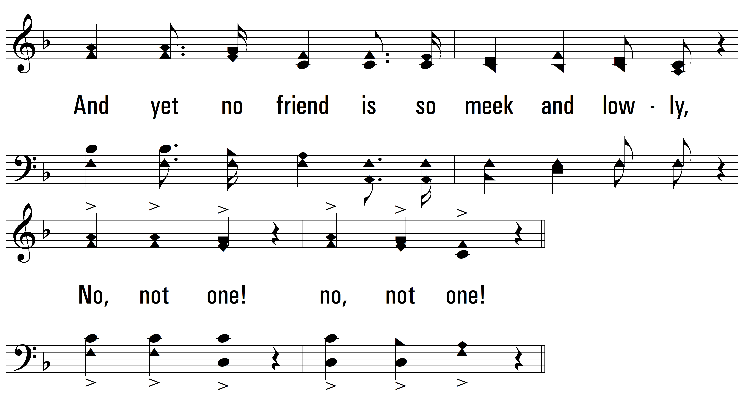
vs. 2

Slide 8
vs. 2

Slide 9
vs. 2

Slide 10
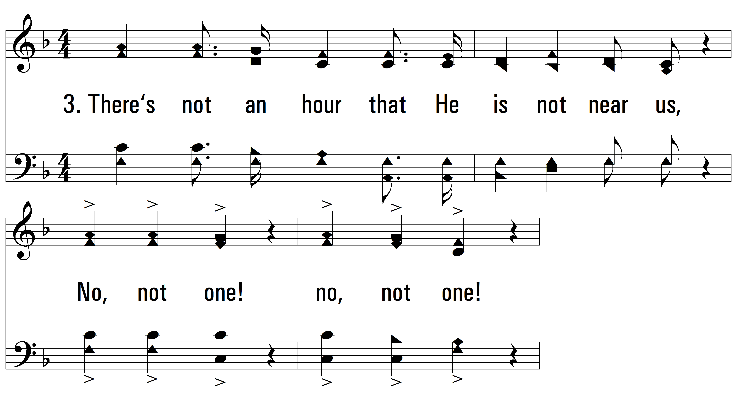
vs. 3 ~ No Not One

Slide 11
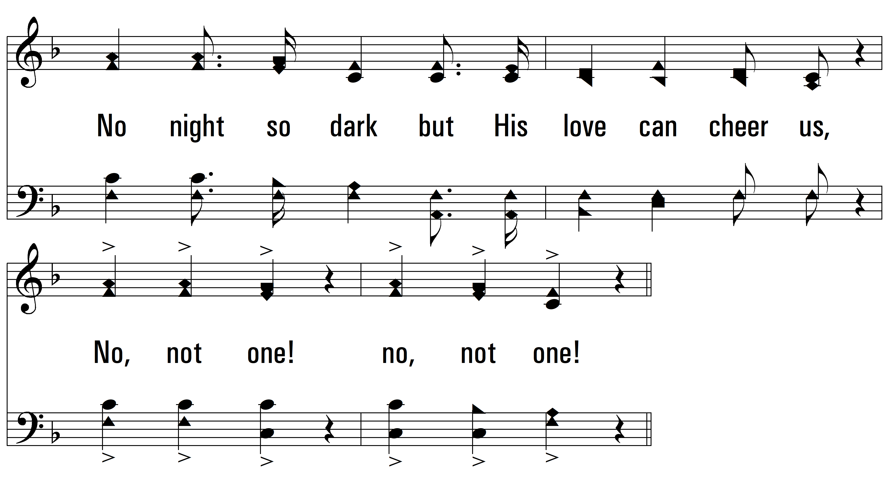
vs. 3

Slide 12
vs. 3

Slide 13
vs. 3

Slide 14
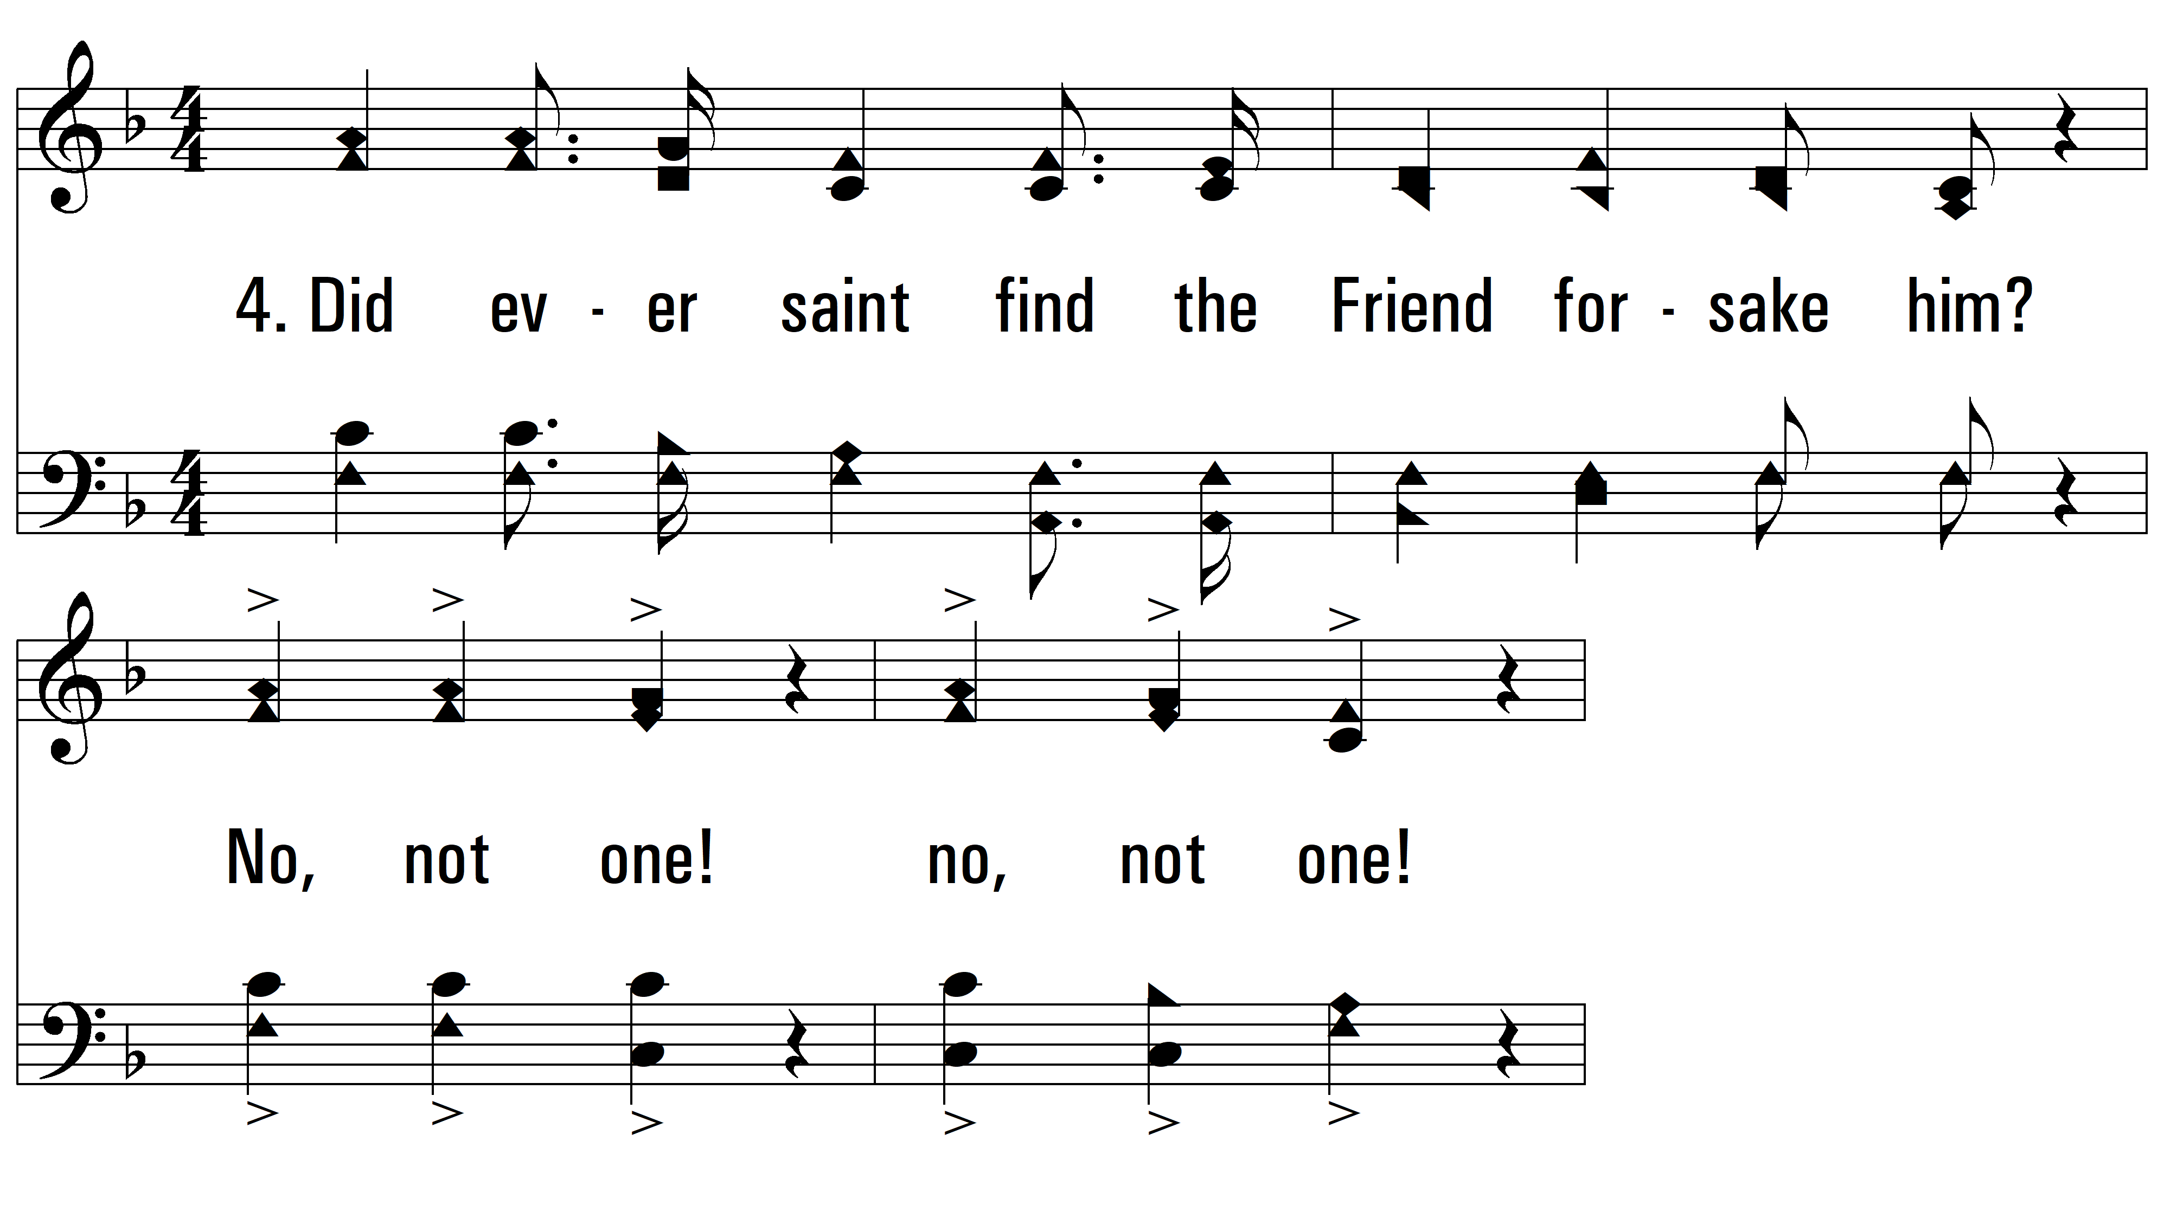
vs. 4 ~ No Not One

Slide 15

vs. 4

Slide 16
vs. 4

Slide 17
vs. 4

Slide 18

vs. 5 ~ No Not One

Slide 19

vs. 5

Slide 20
vs. 5

Slide 21
vs. 5
PDHymns.com
END

