Slide 1
Nearer, My God, To Thee
BETHANY
6.4.6.4.6.6.4
Words: | Sarah F. Adams (1840)
Music: | Lowell Mason (1856)
4/4
G/B - MI
Verses: 5
Lead - | MI
Alto - | SOL
Tenor - | DO
Bass - | DO
PDHymns.com

Slide 2
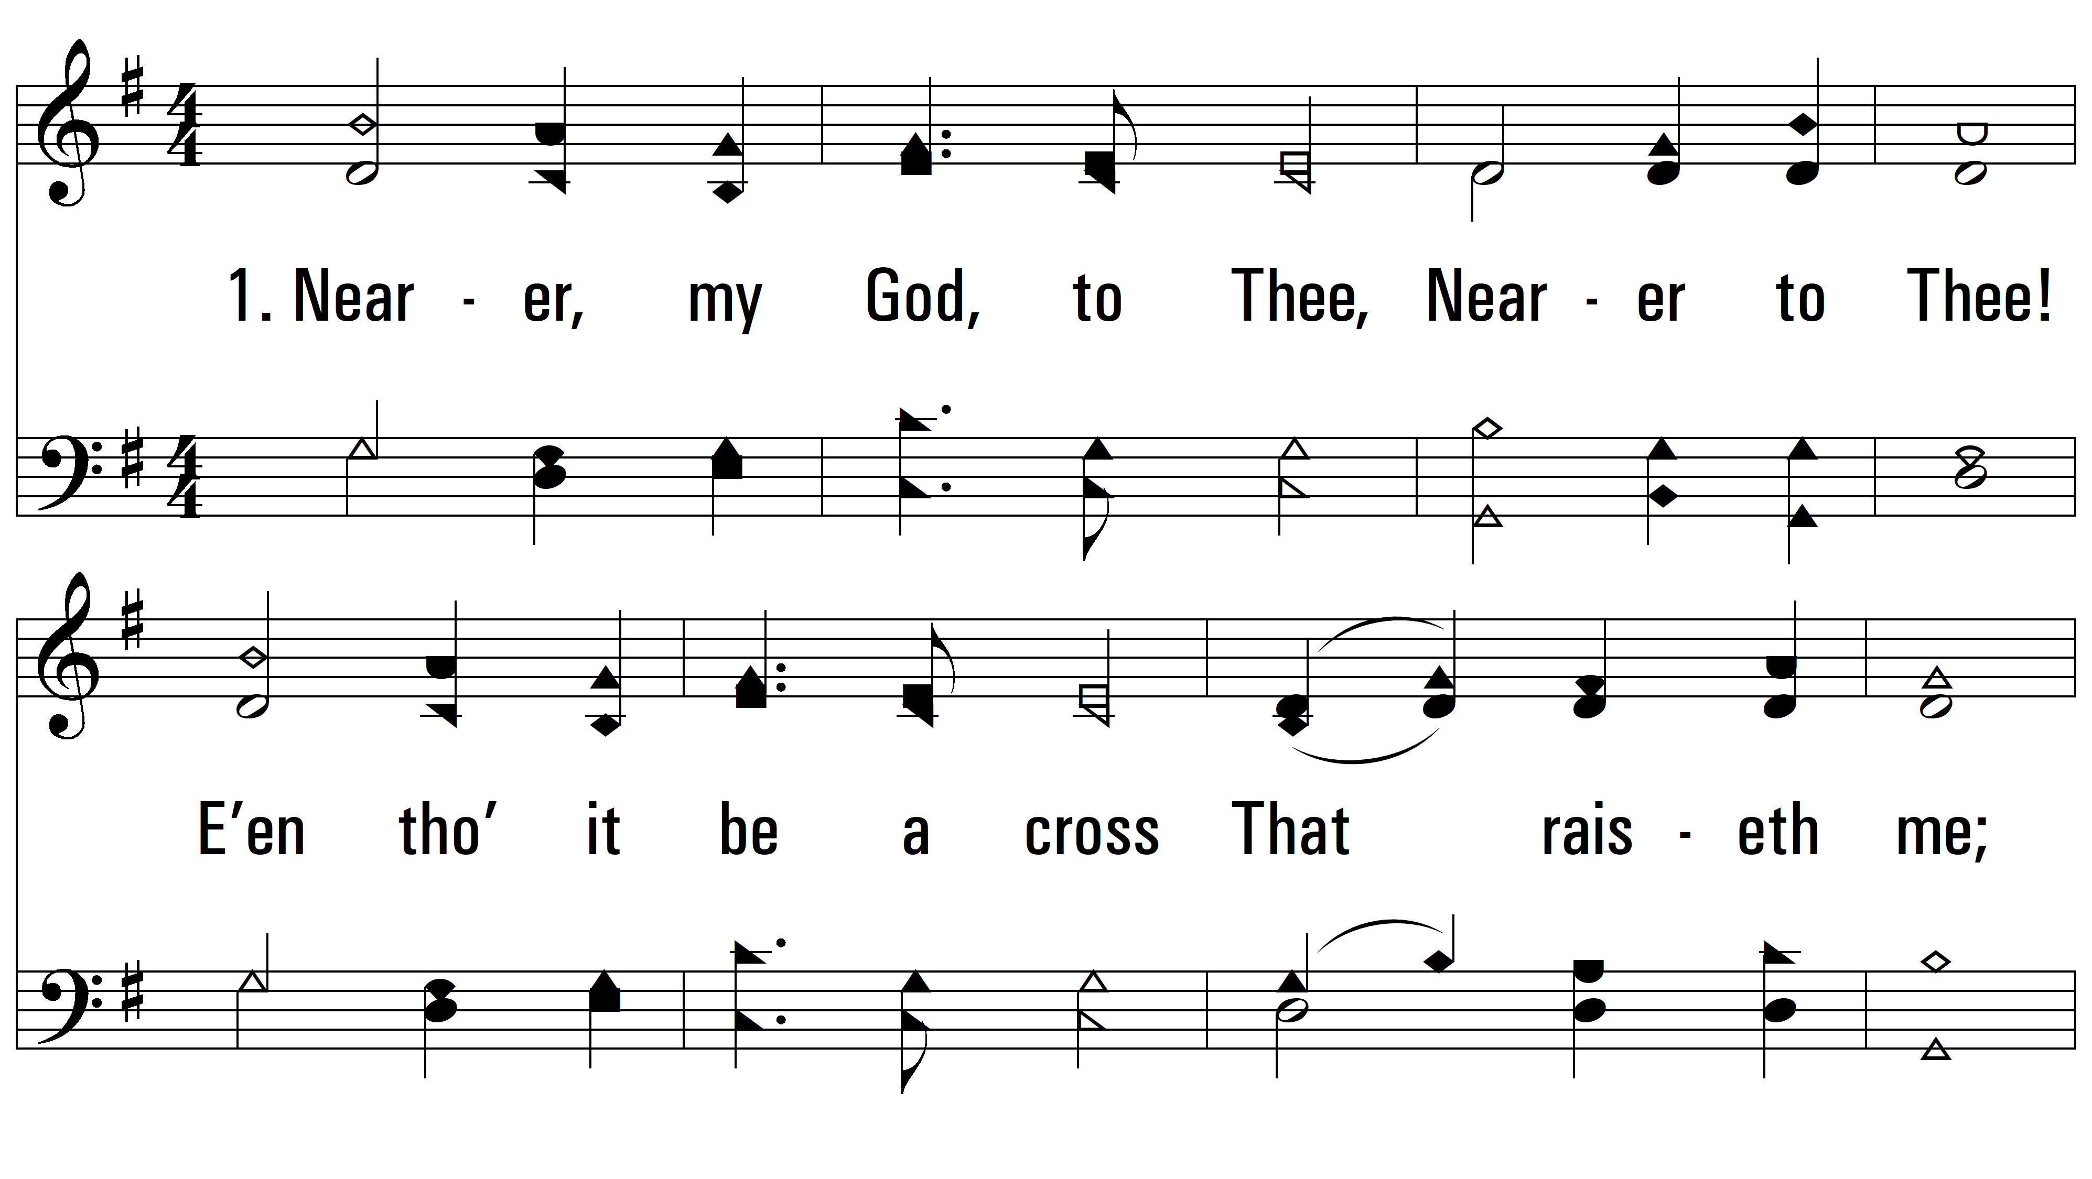
vs. 1 ~ Nearer, My God, To Thee

Slide 3
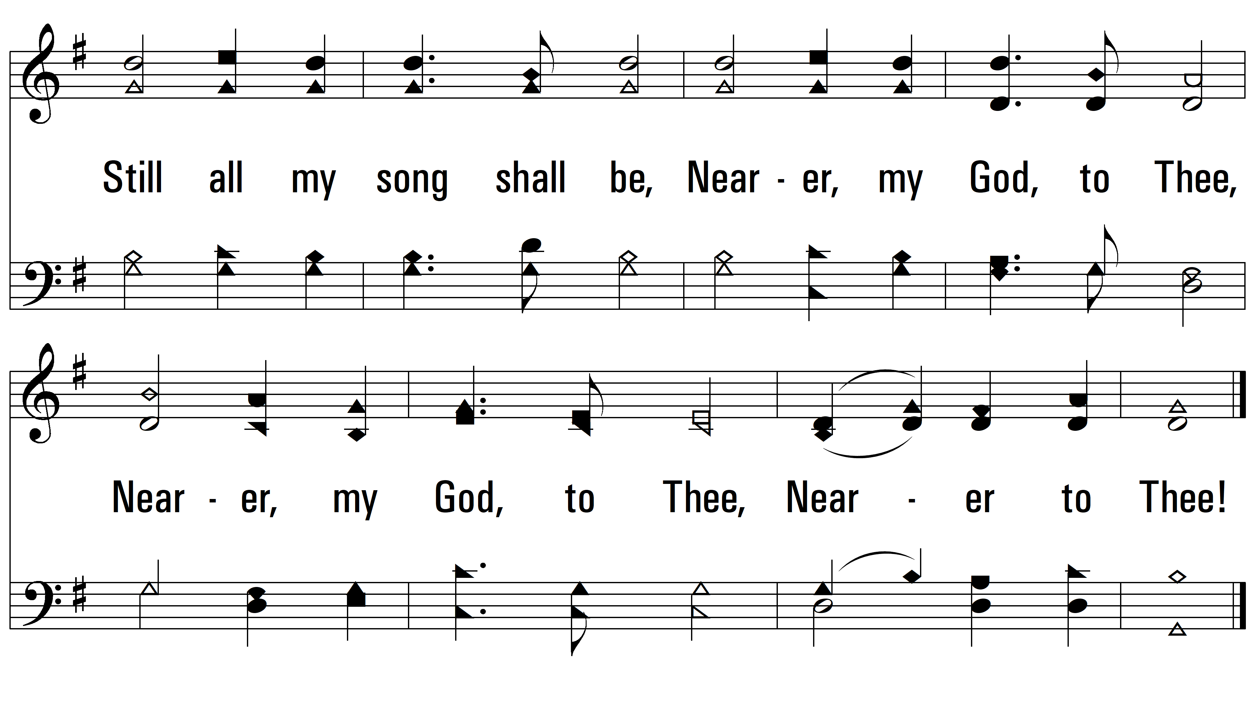
vs. 1

Slide 4
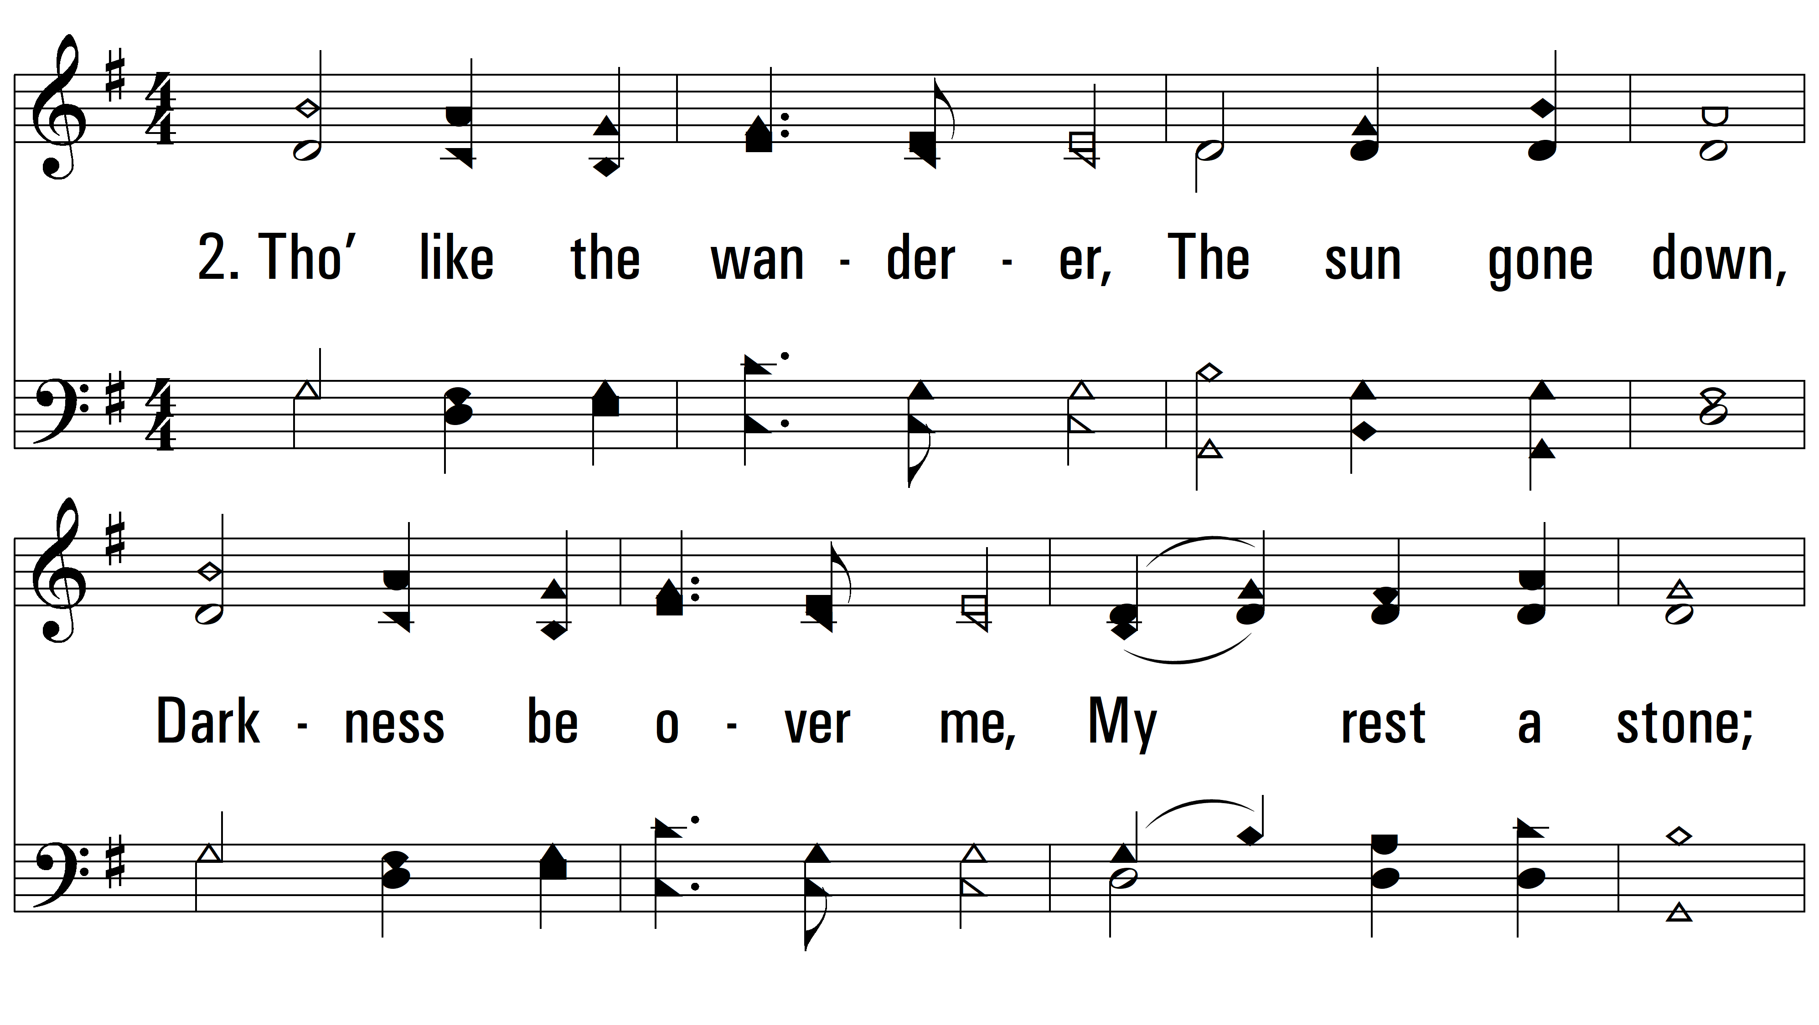
vs. 2 ~ Nearer, My God, To Thee

Slide 5
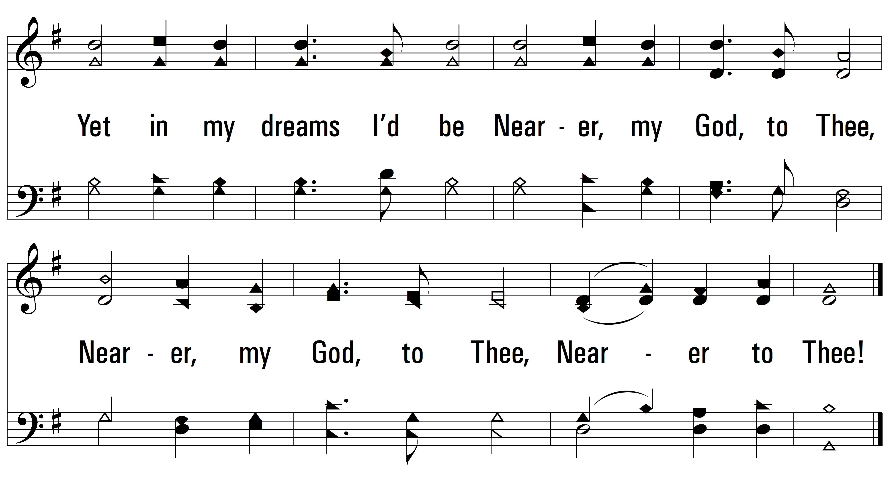
vs. 2

Slide 6
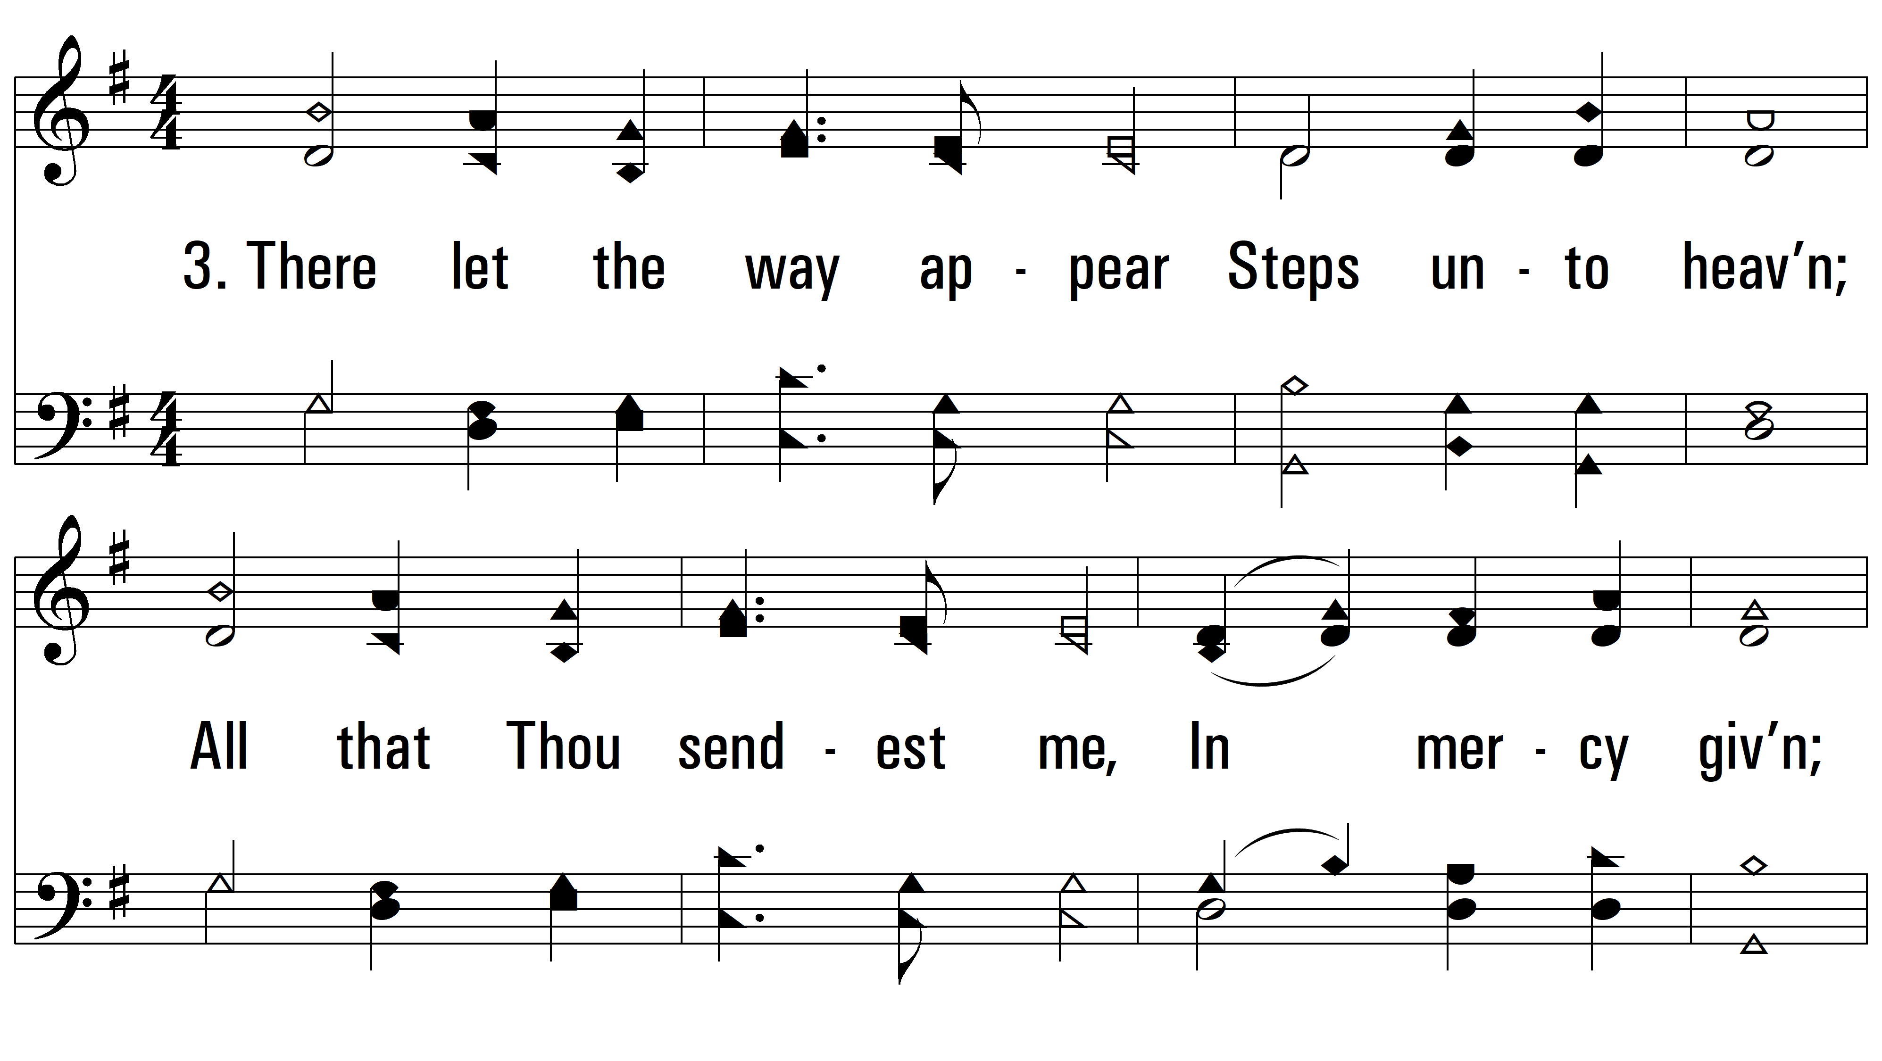
vs. 3 ~ Nearer, My God, To Thee

Slide 7
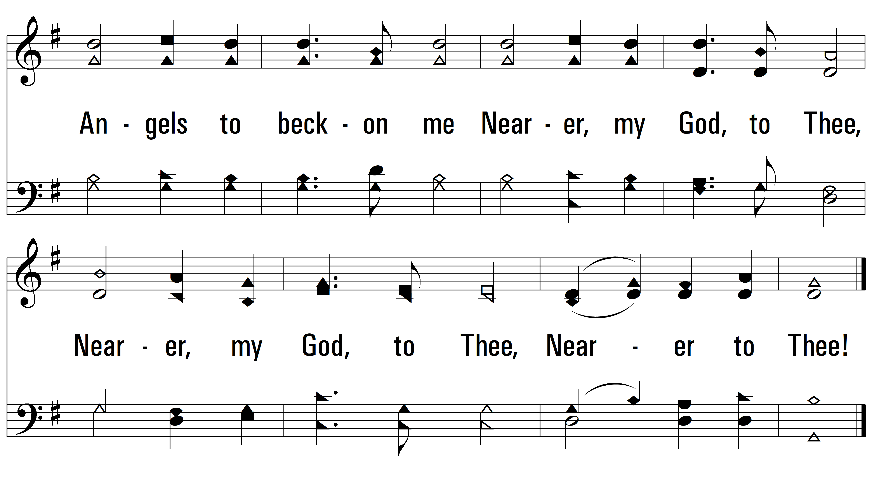
vs. 3

Slide 8
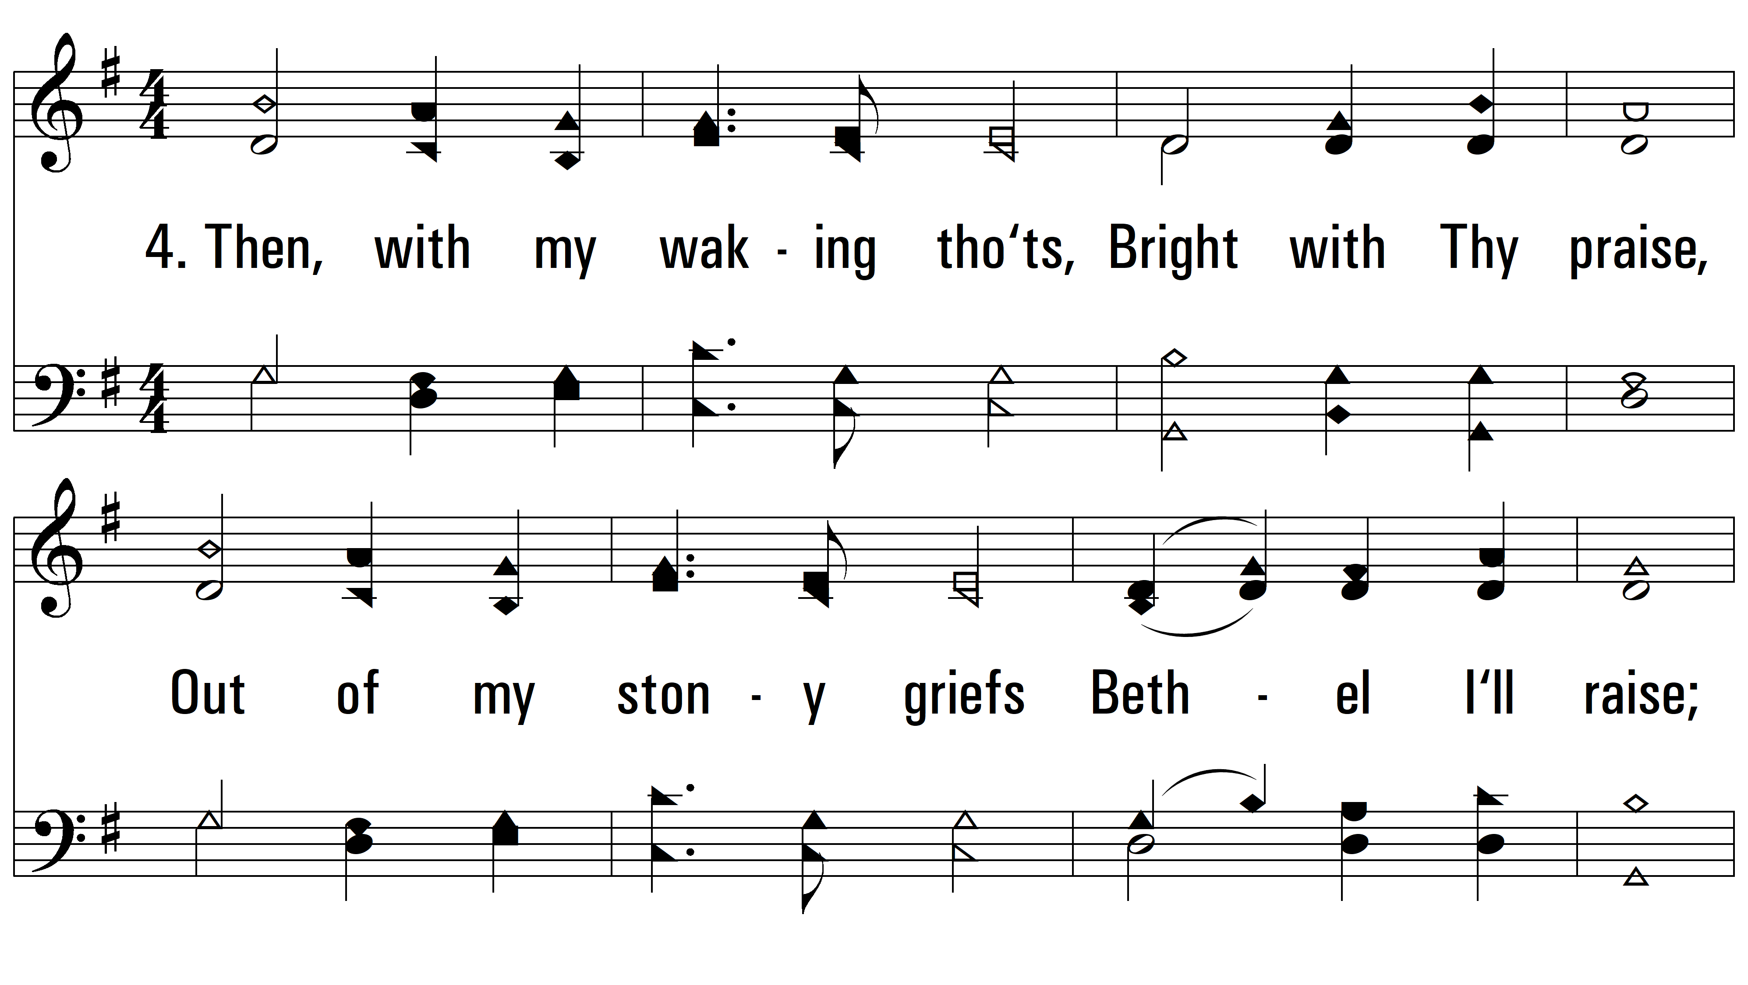
vs. 4 ~ Nearer, My God, To Thee

Slide 9
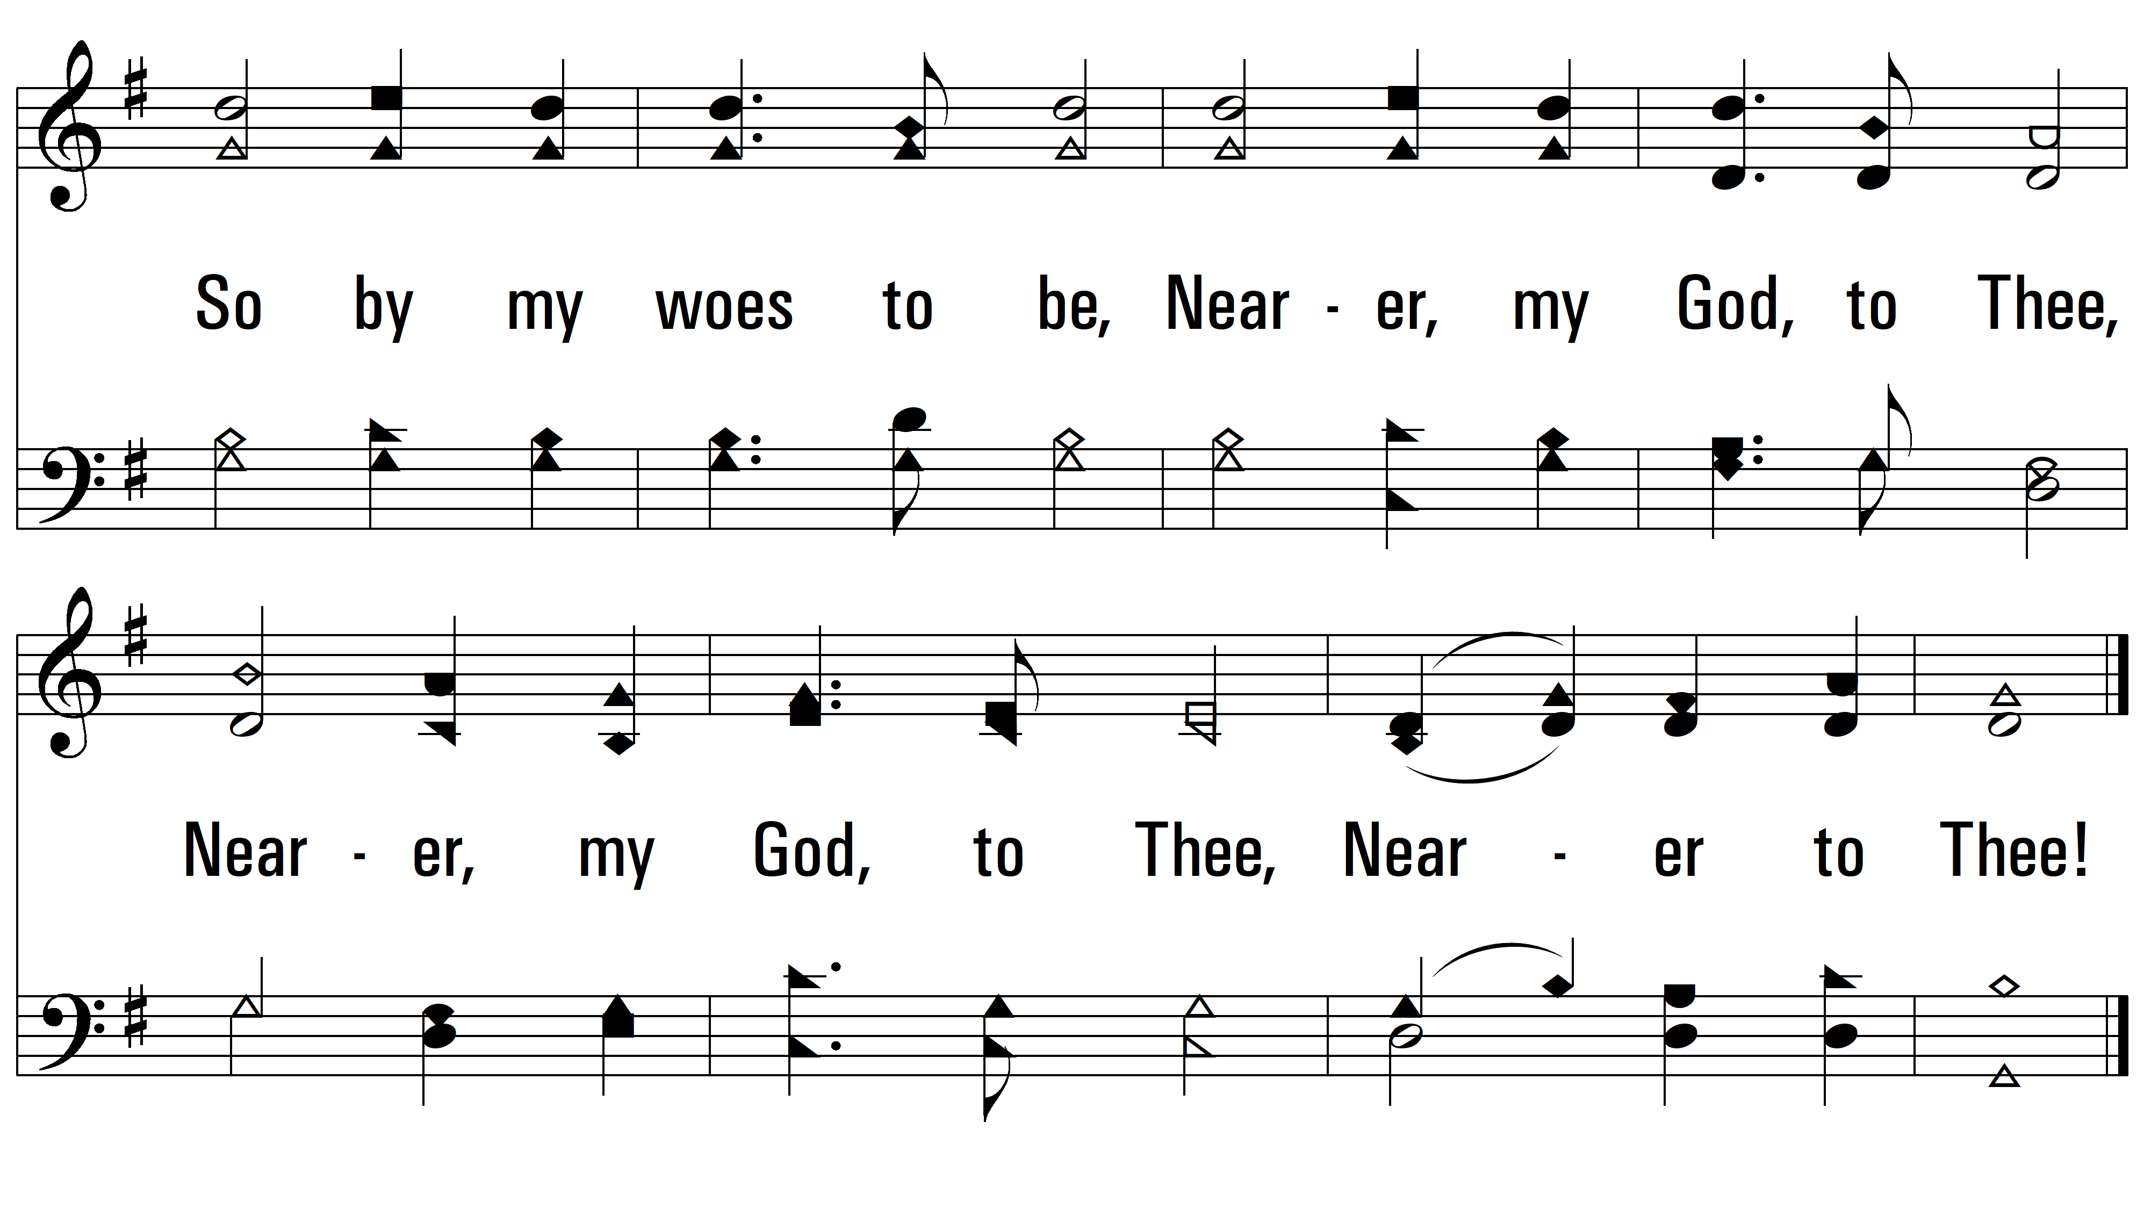
vs. 4

Slide 10
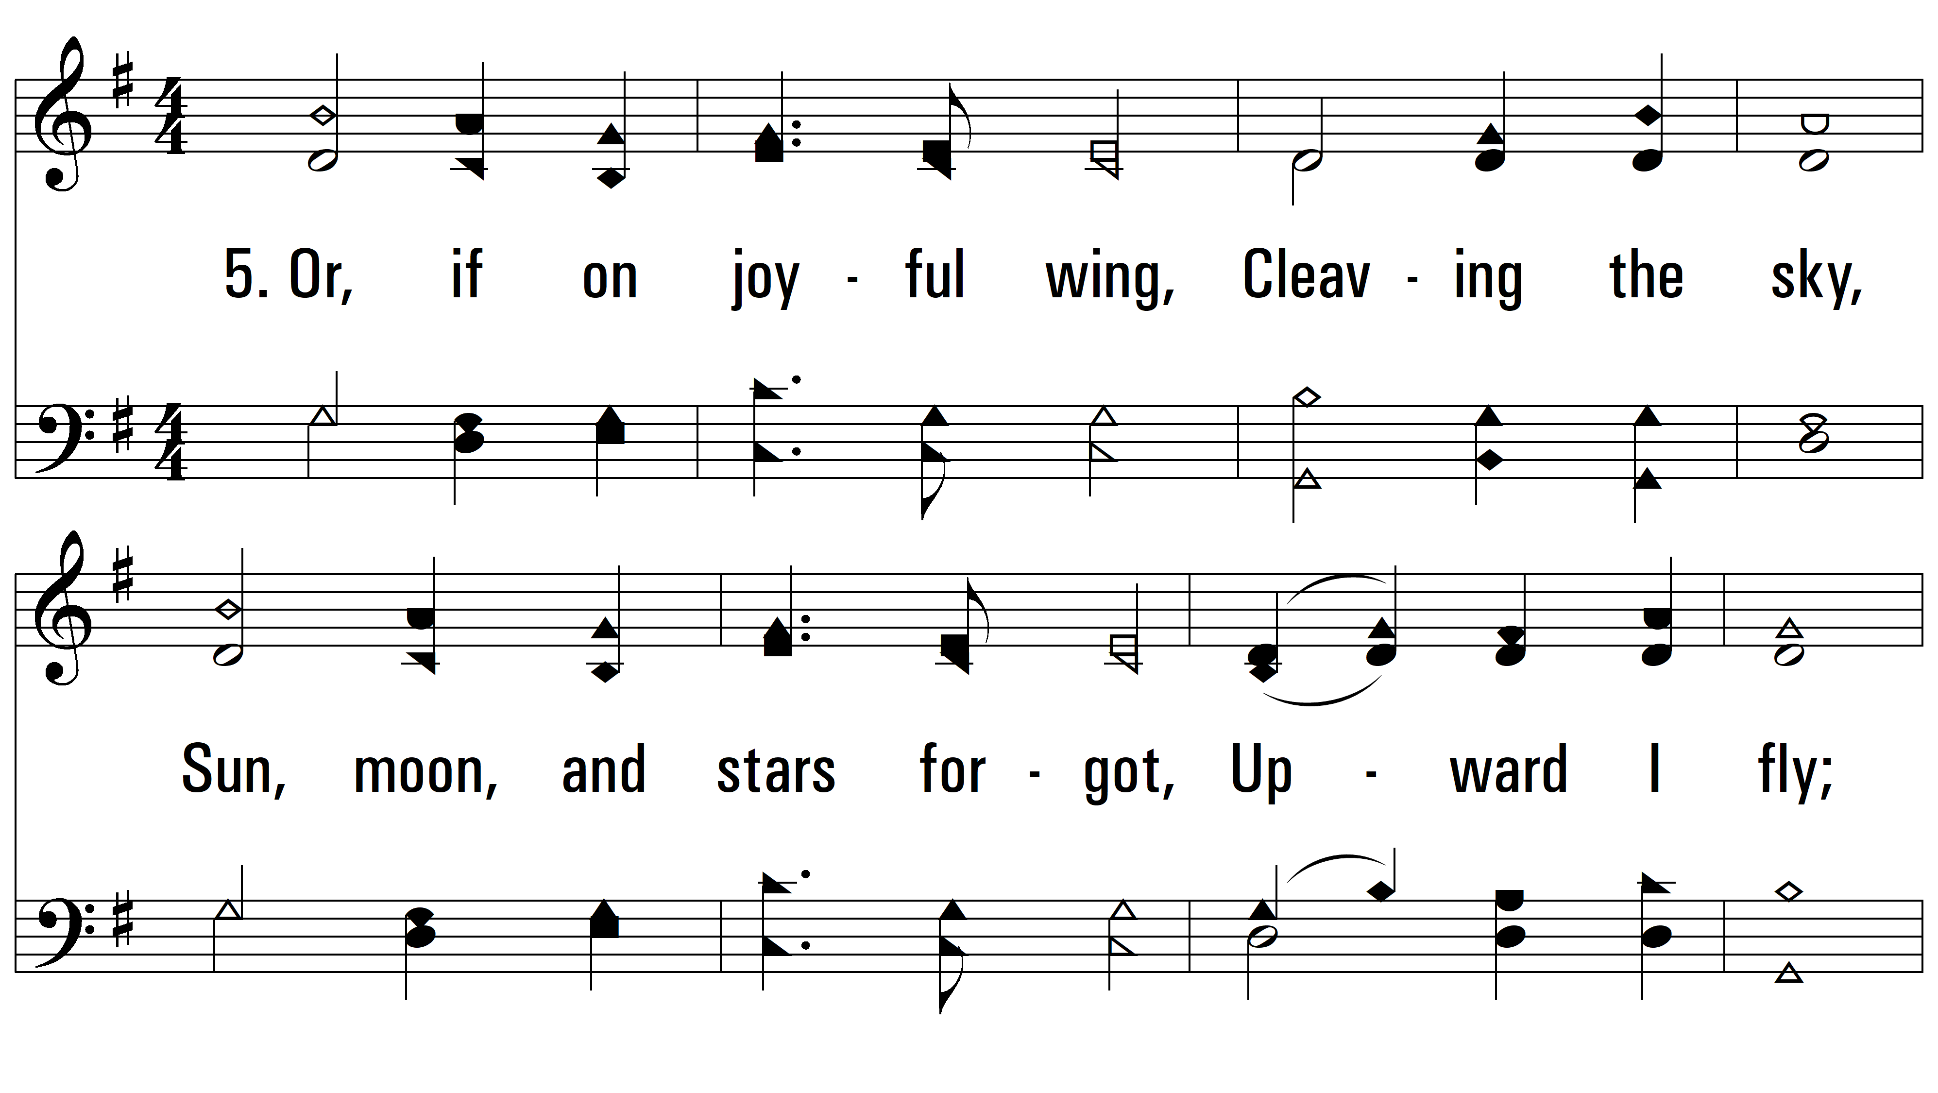
vs. 5 ~ Nearer, My God, To Thee

Slide 11

vs. 5
PDHymns.com
END

