Slide 1
Near To The Heart Of God
Words: | C. B. McAfee (1901)
Music: | C. B. McAfee (1901)
4/4
D/F# - MI
Verses: 3/Chorus
Lead - | MI
Alto - | DO
Tenor - | SOL
Bass - | DO
PDHymns.com

Slide 2
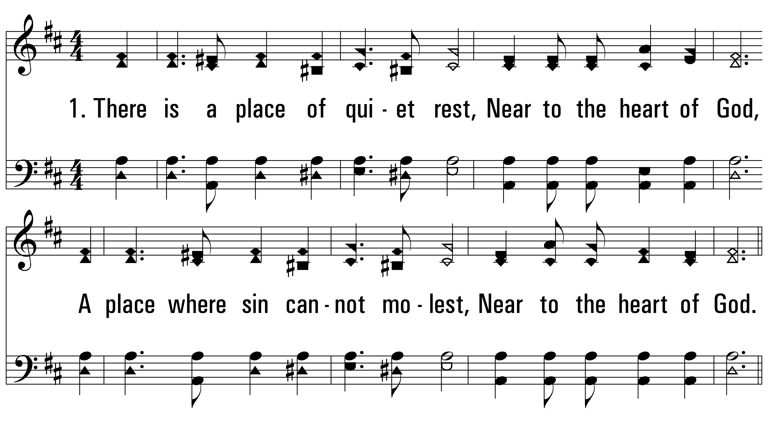
vs. 1 ~ Near To The Heart Of God

Slide 3
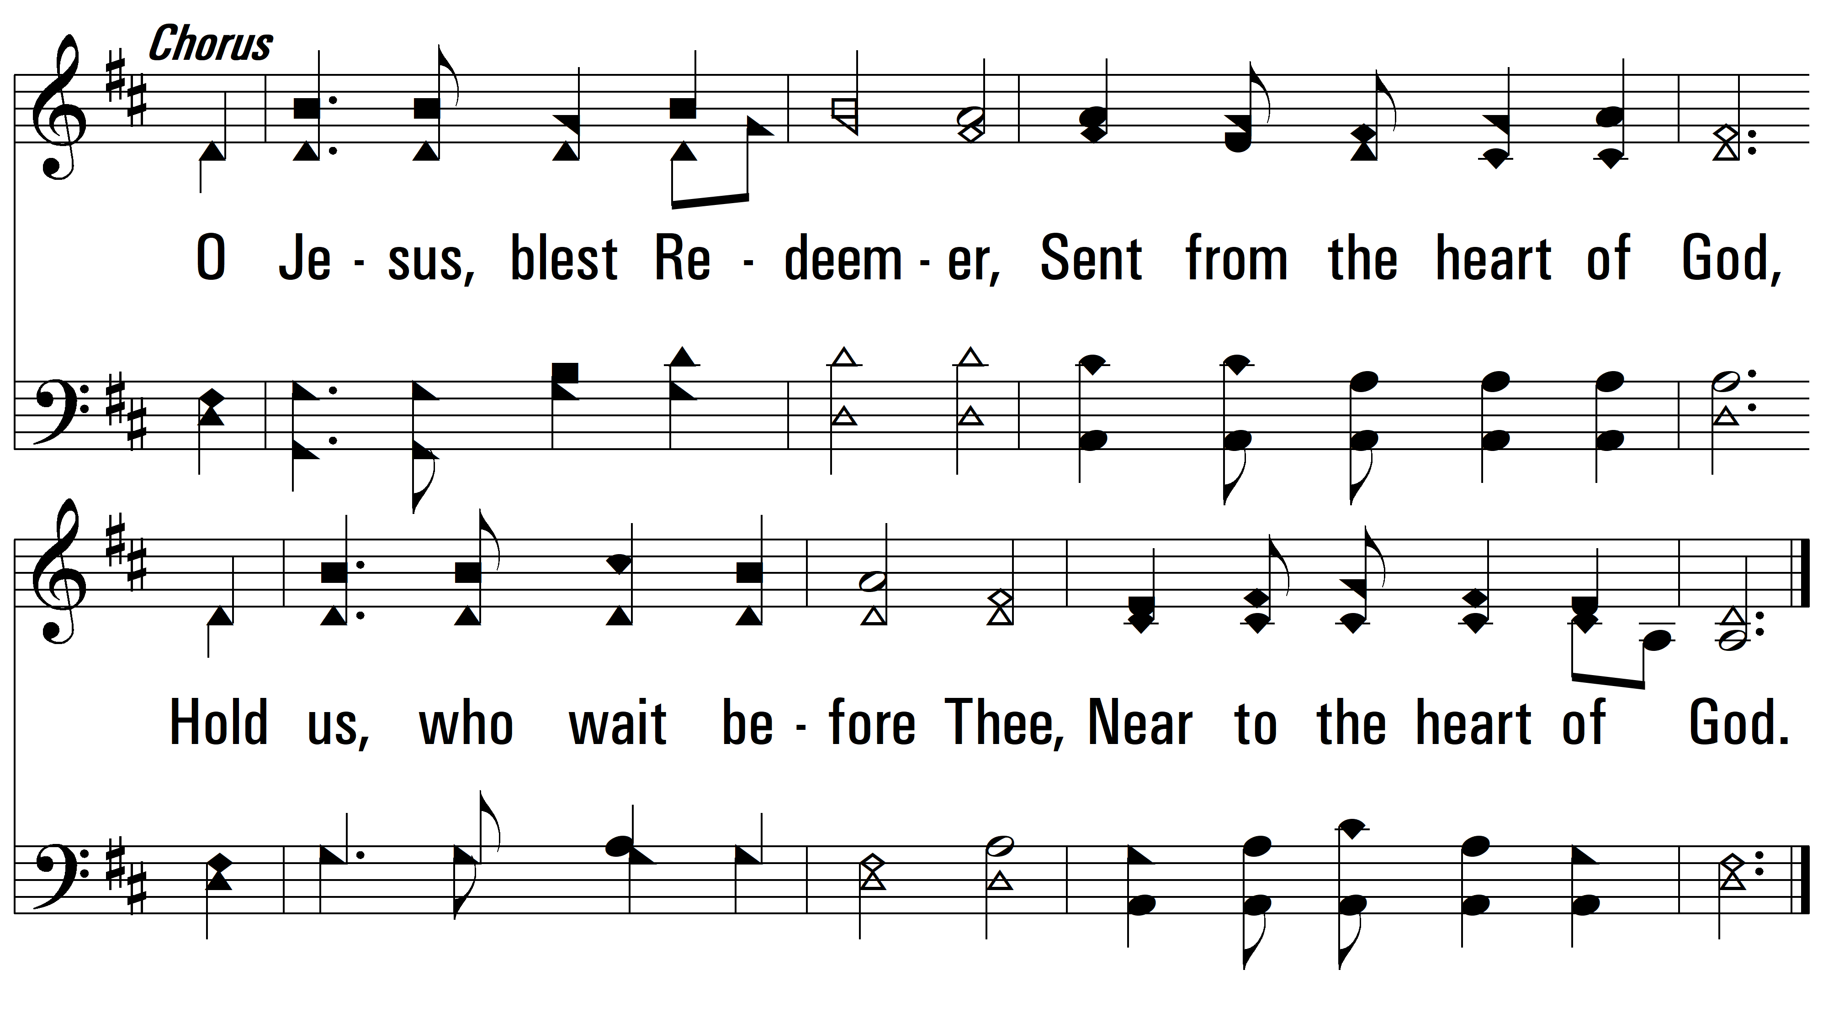
vs. 1

Slide 4
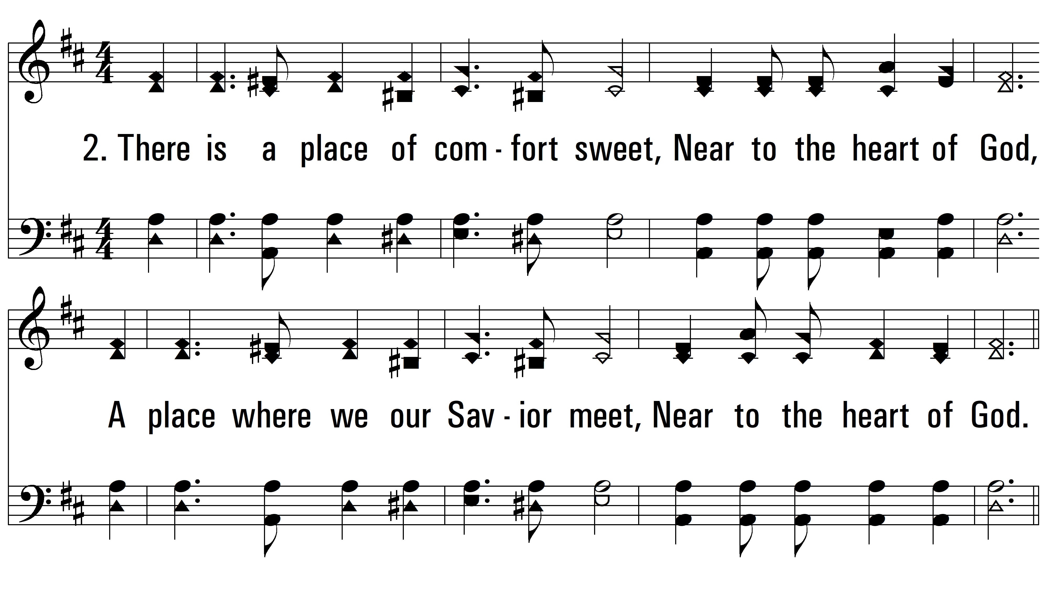
vs. 2 ~ Near To The Heart Of God

Slide 5
vs. 2

Slide 6
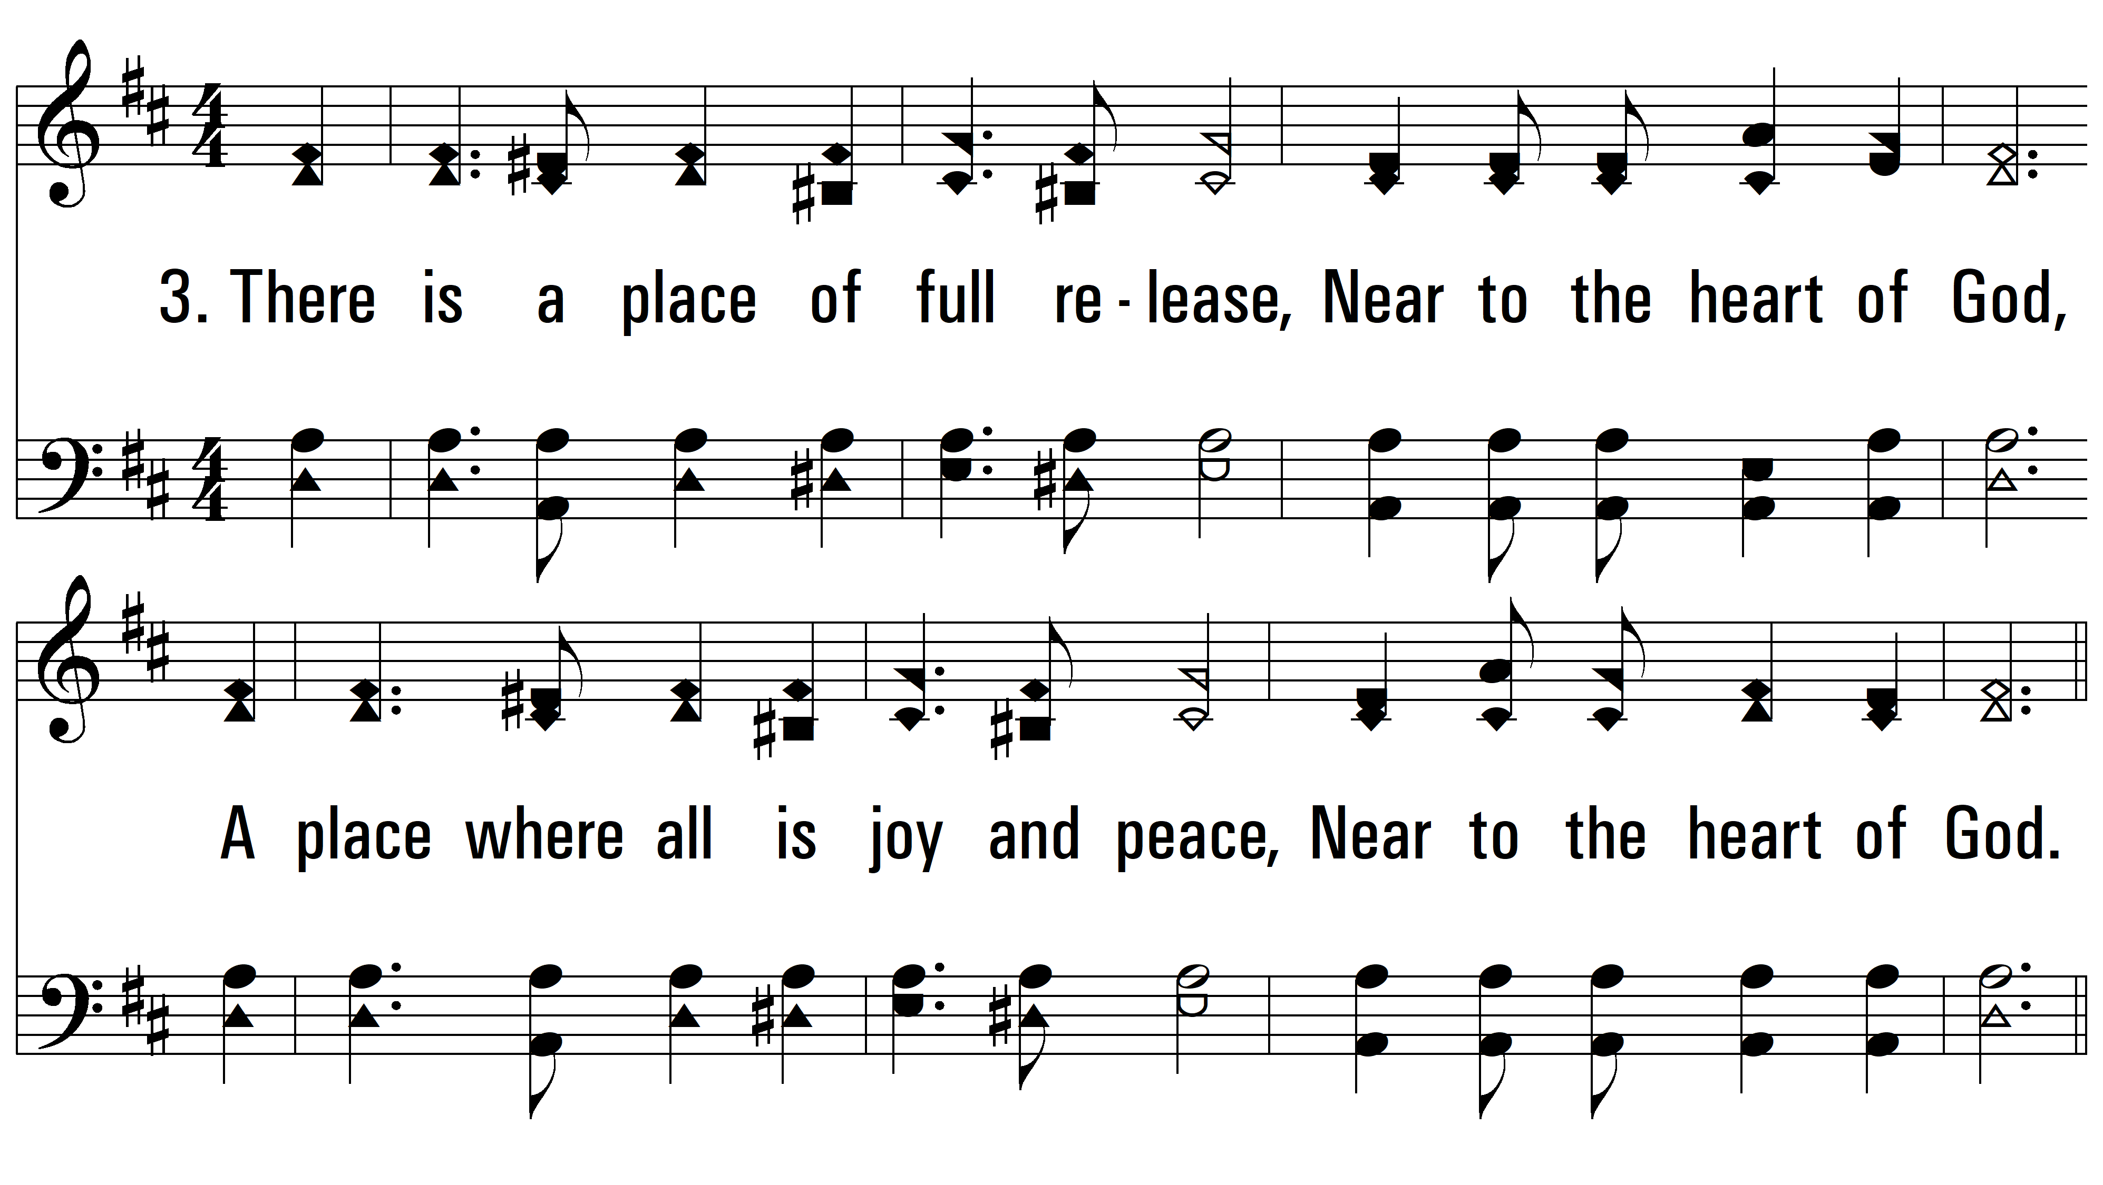
vs. 3 ~ Near To The Heart Of God

Slide 7
vs. 3
PDHymns.com
END

