Slide 1
Near The Cross
(Jesus, Keep Me Near The Cross)
Words: | Fanny J. Crosby (1869)
Music: | W. H. Doane (1869)
6/8
F/A - MI
Verses: 4/Chorus
Lead - | MI
Alto - | DO
Tenor - | SOL
Bass - | DO
PDHymns.com

Slide 2
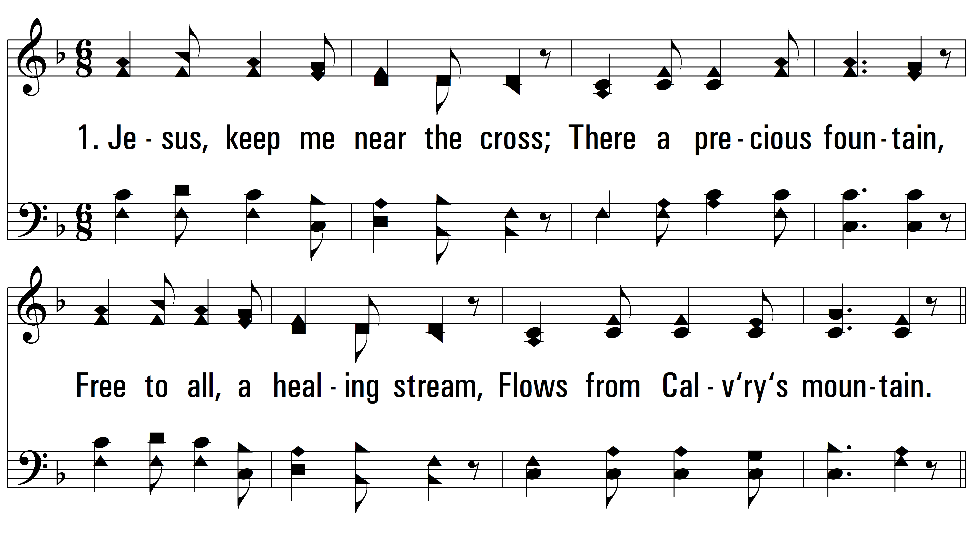
vs. 1 ~ Near The Cross

Slide 3
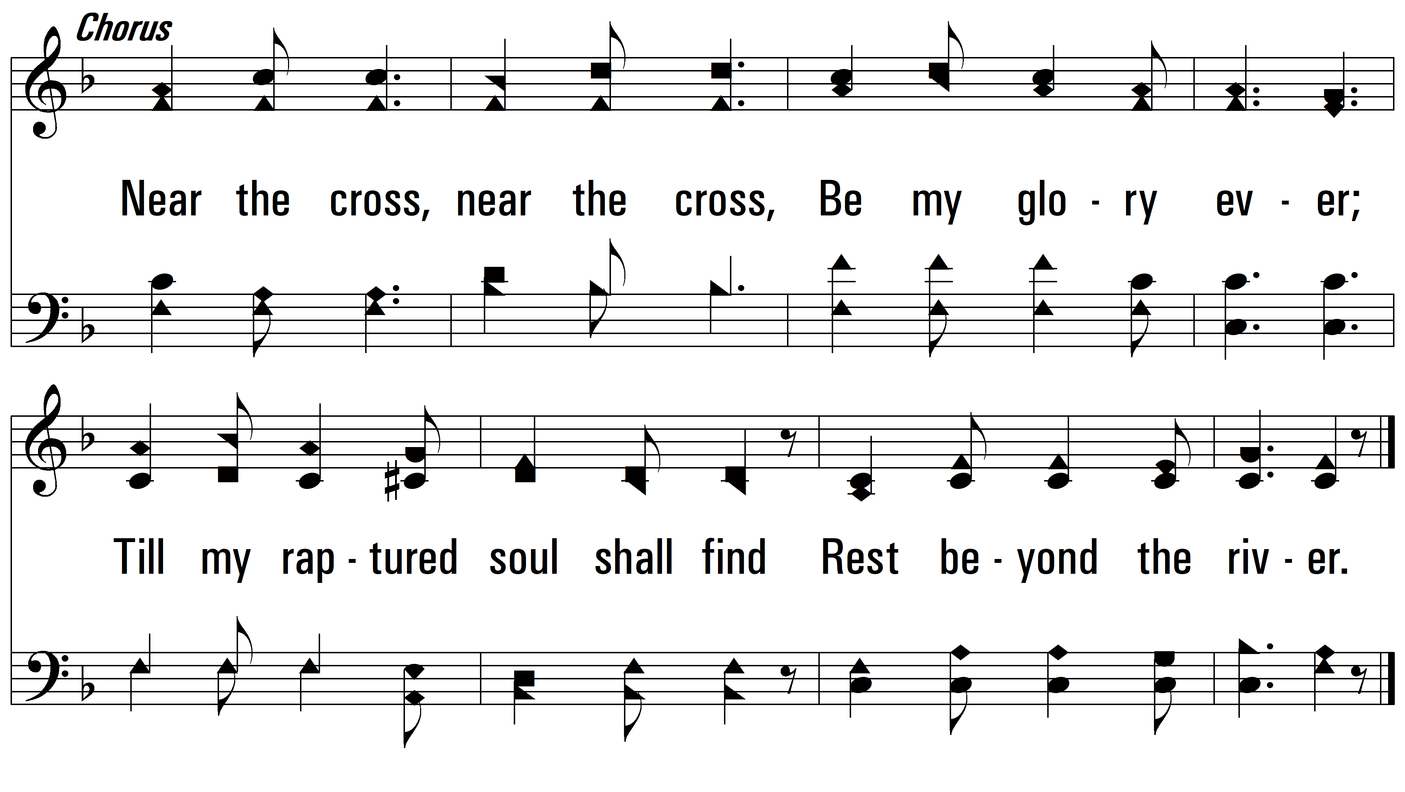
vs. 1

Slide 4
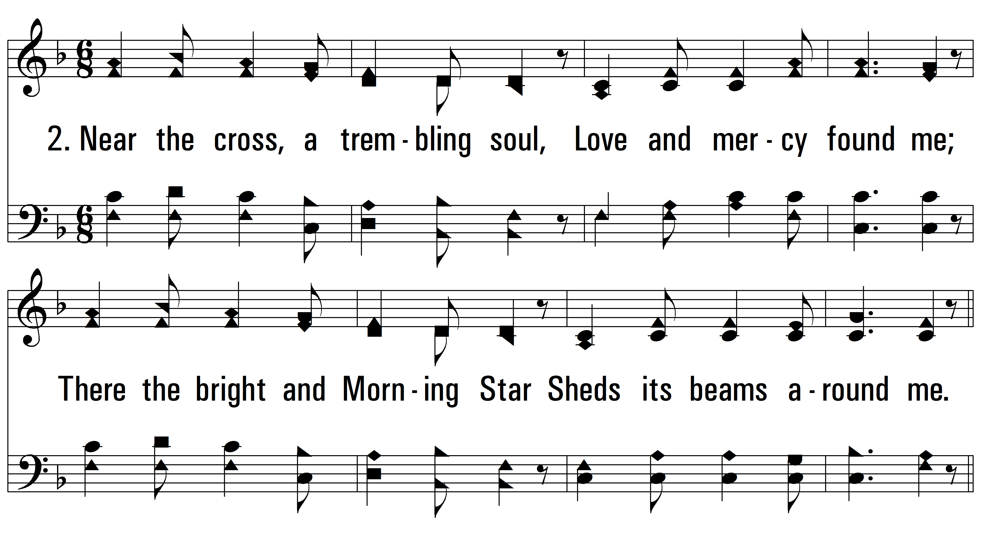
vs. 2 ~ Near The Cross

Slide 5
vs. 2

Slide 6
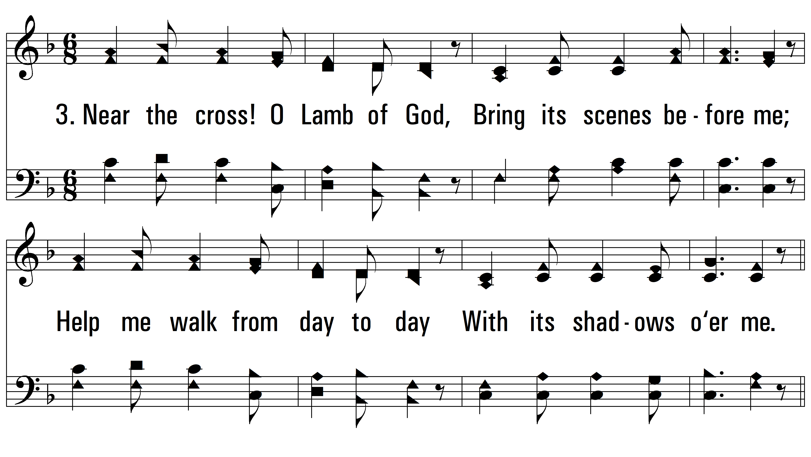
vs. 3 ~ Near The Cross

Slide 7
vs. 3

Slide 8
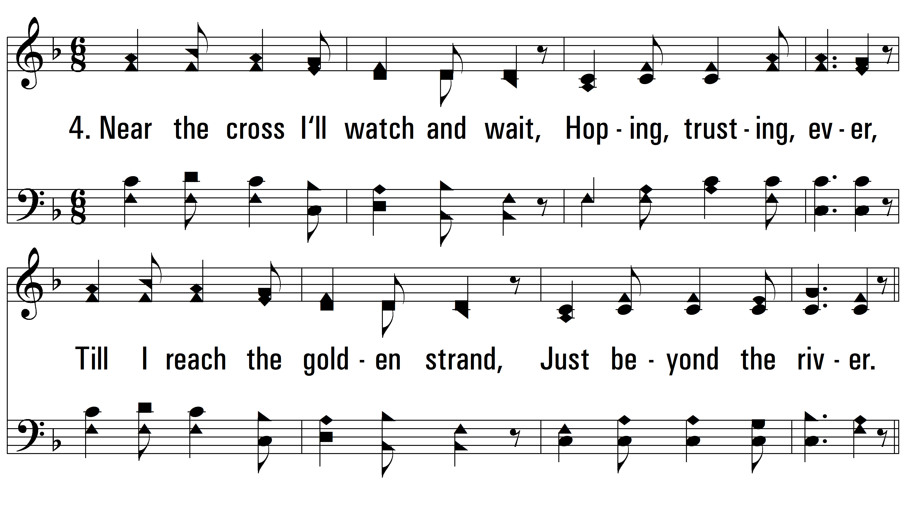
vs. 4 ~ Near The Cross

Slide 9
vs. 4
PDHymns.com
END

