Slide 1
My Name Is In The Book Of Life
(I Know My Name Is There)
Words: | Daniel S. Warner (1893)
Music: | Barney E. Warren (1893)
6/8
D^{b}/A^{b} - SOL
Verses: 4/Chorus
Lead - | SOL
Alto - | MI
Tenor - | SOL
Bass - | DO
PDHymns.com

Slide 2
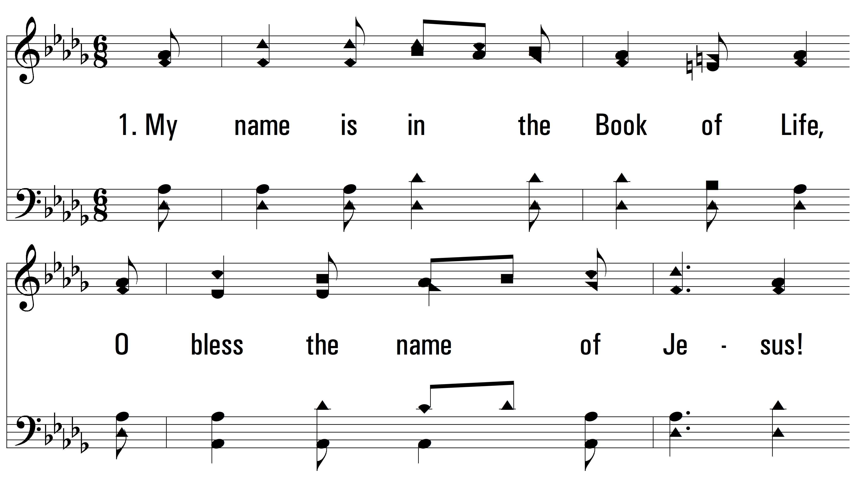
vs. 1 ~ My Name Is In The Book Of Life

Slide 3
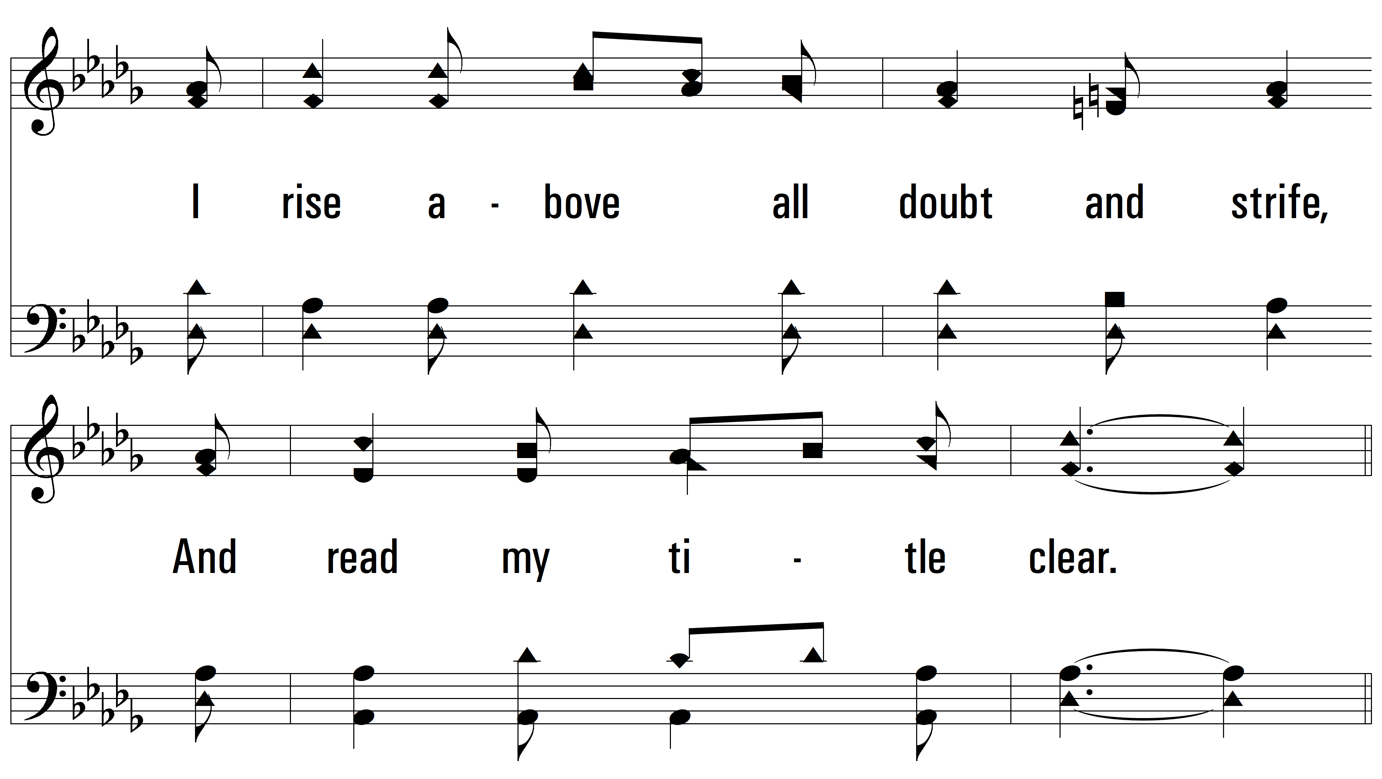
vs. 1

Slide 4
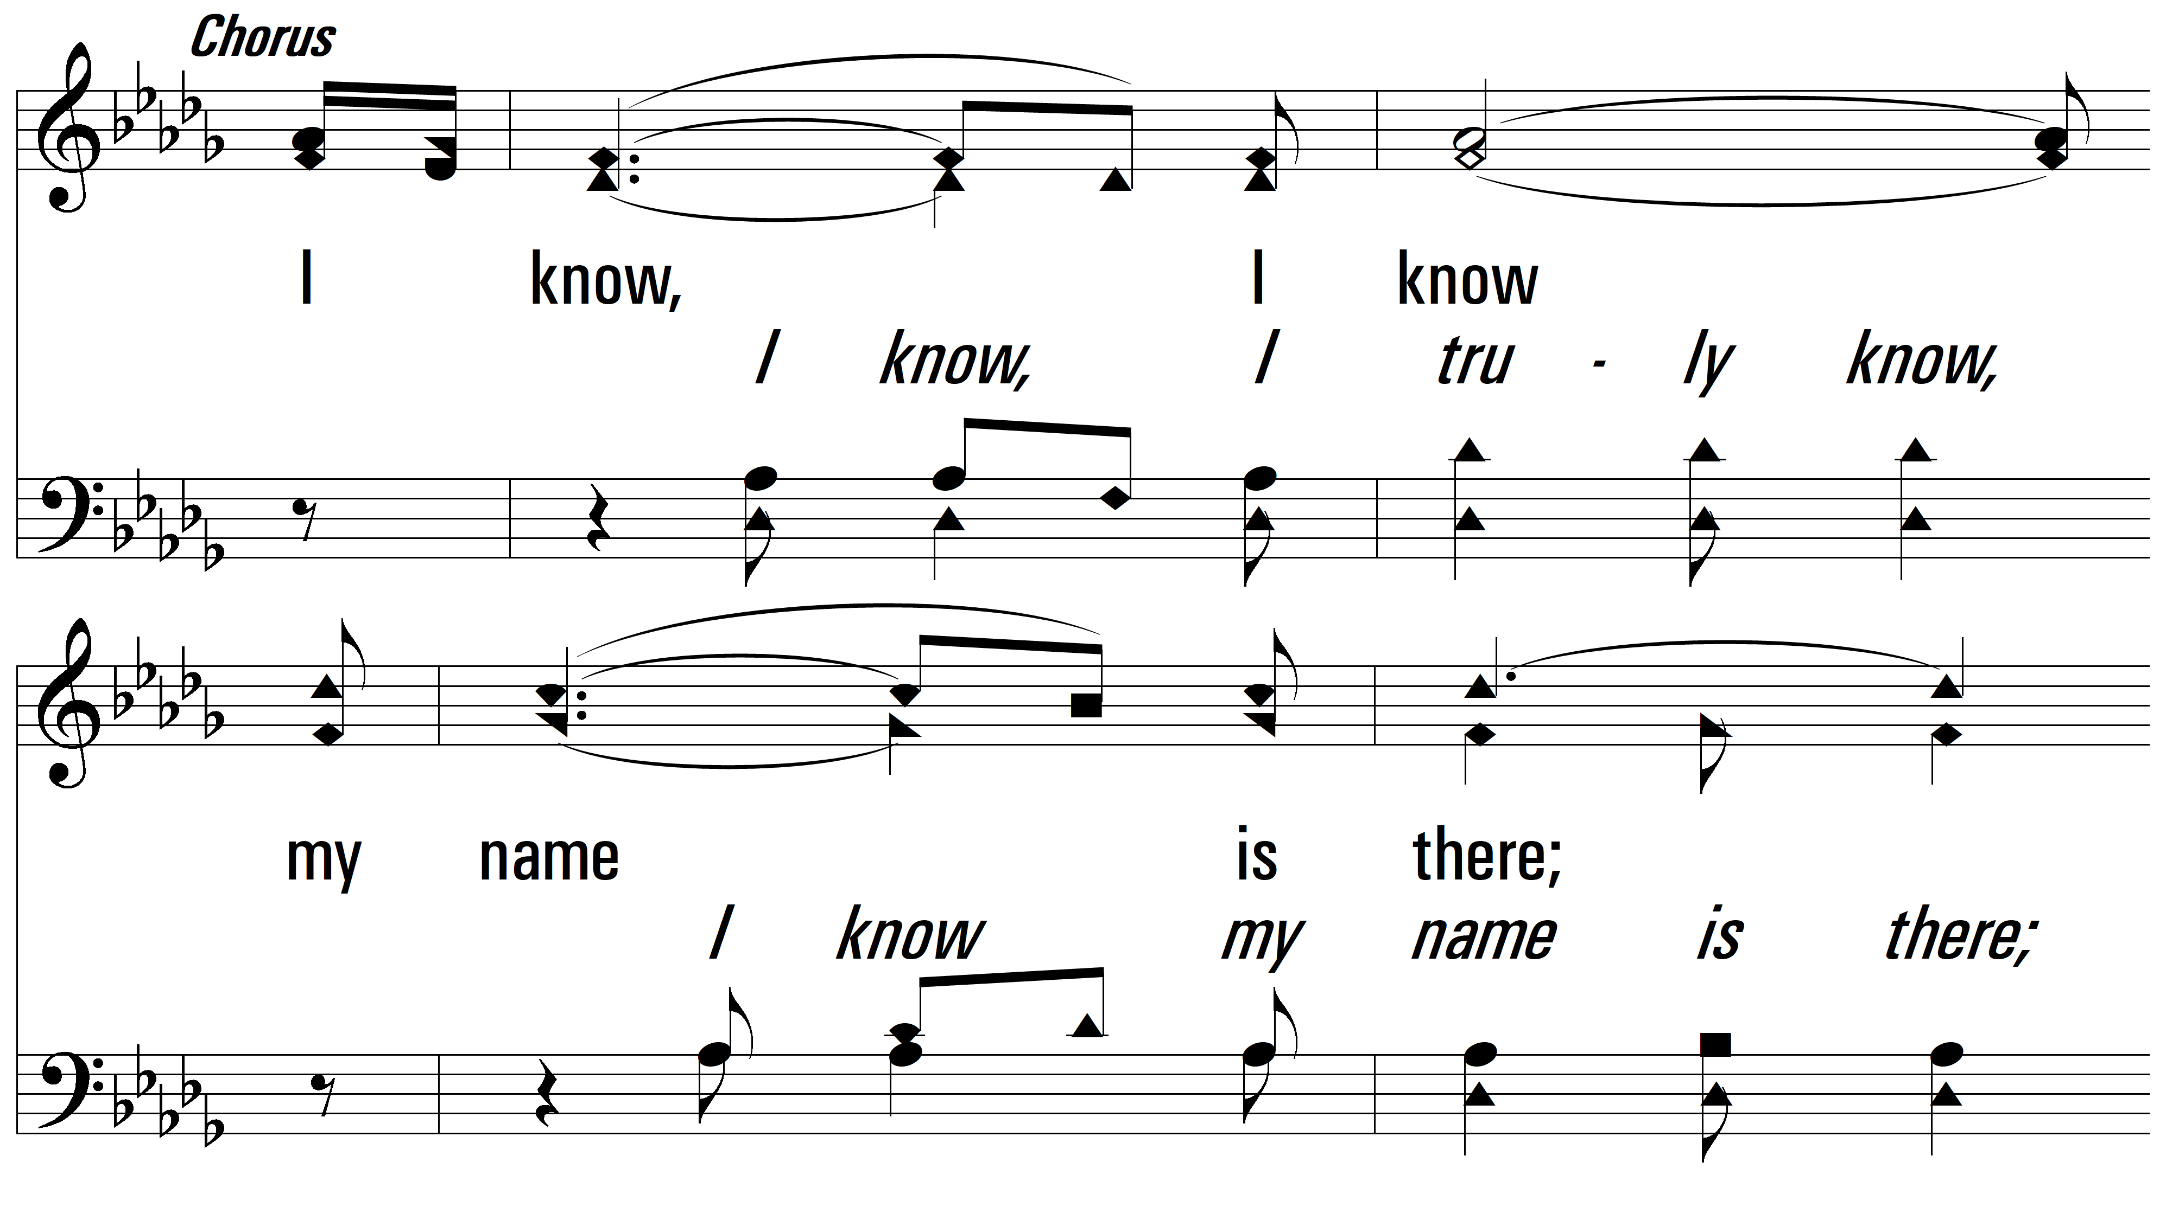
vs. 1

Slide 5
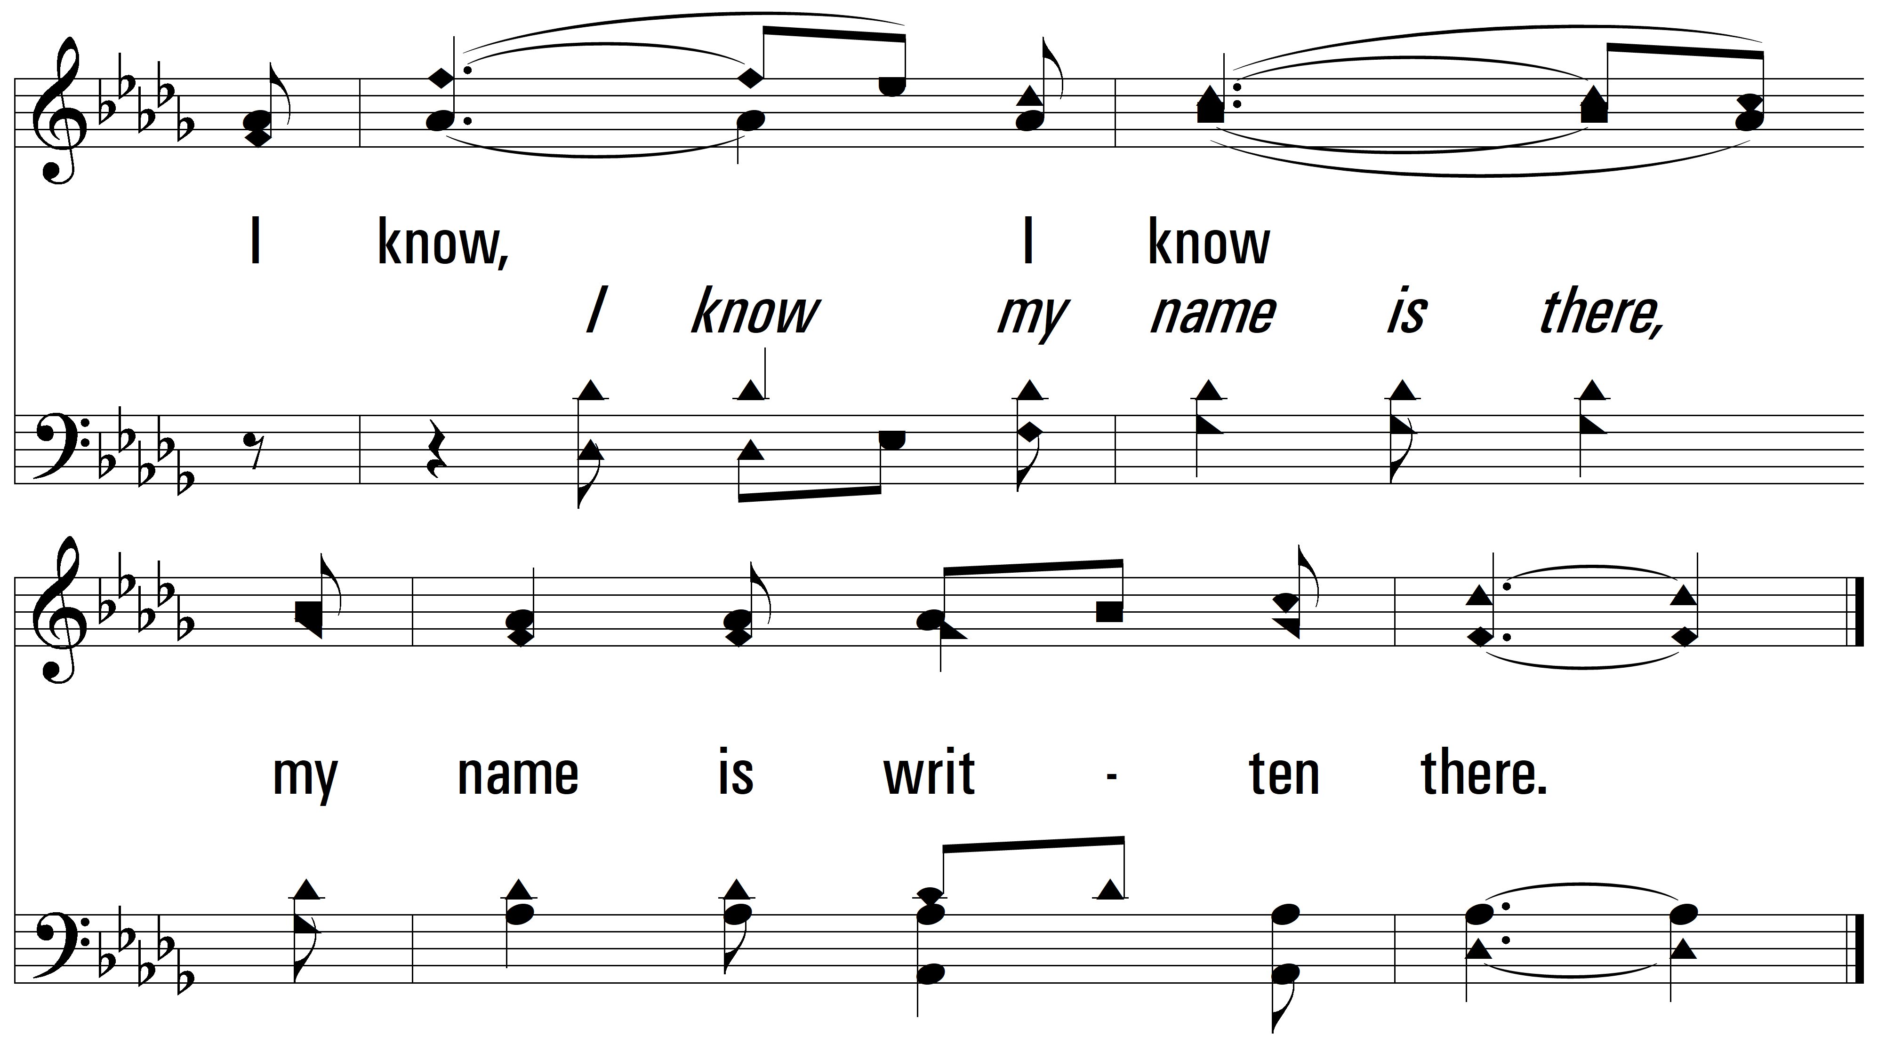
vs. 1

Slide 6
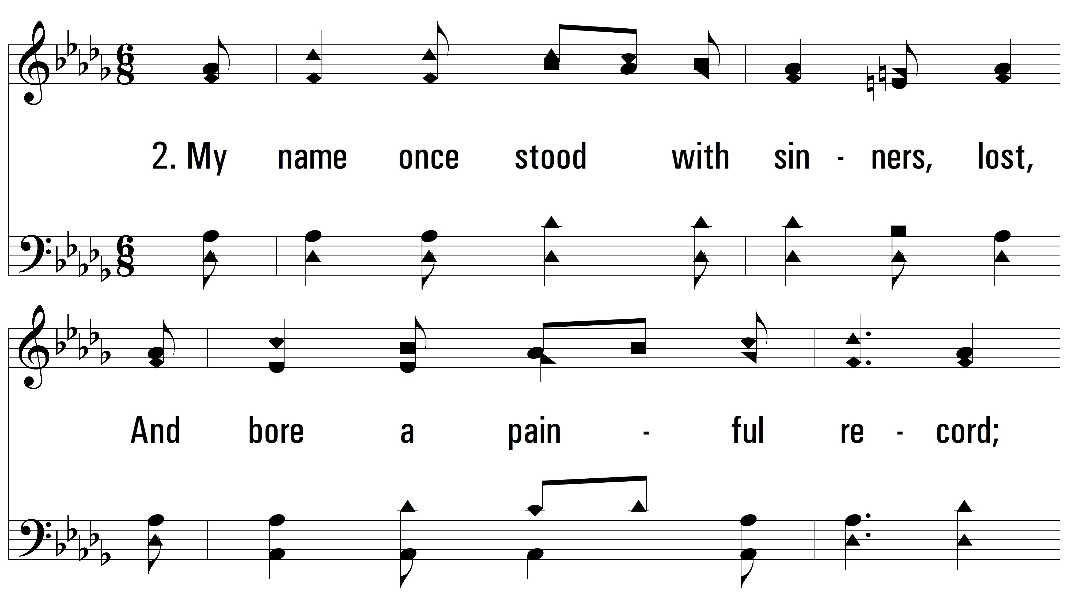
vs. 2 ~ My Name Is In The Book Of Life

Slide 7
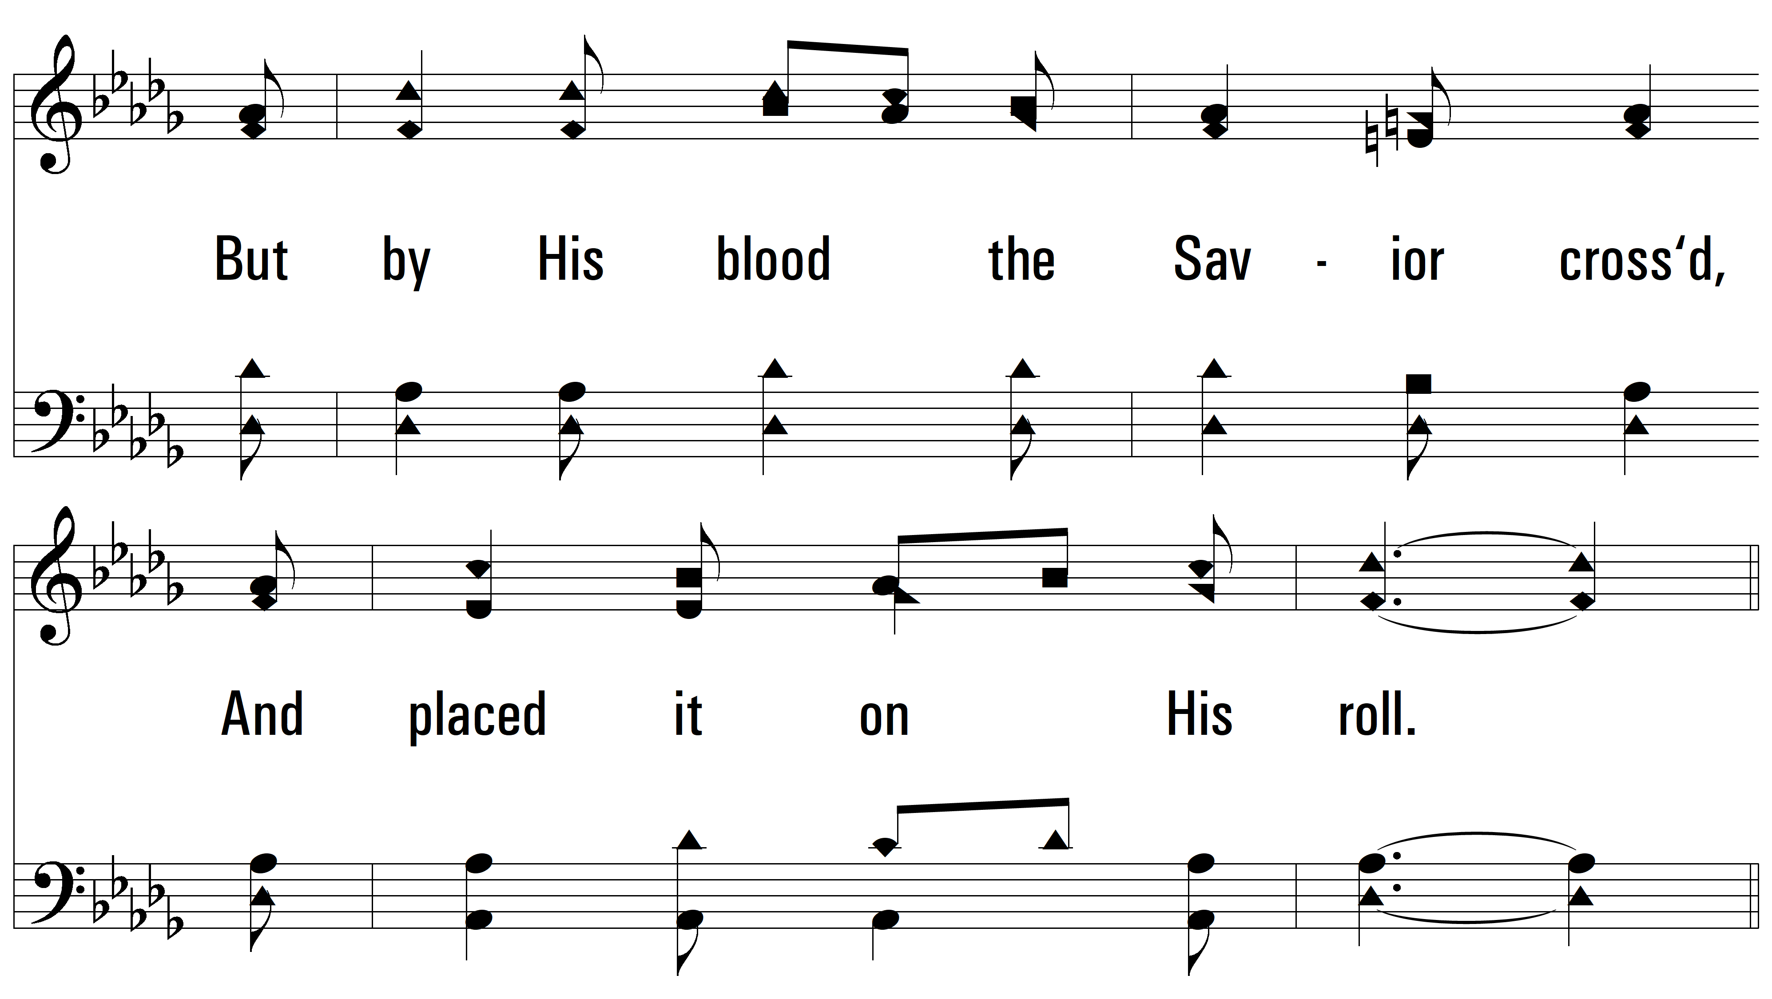
vs. 2

Slide 8
vs. 2

Slide 9
vs. 2

Slide 10
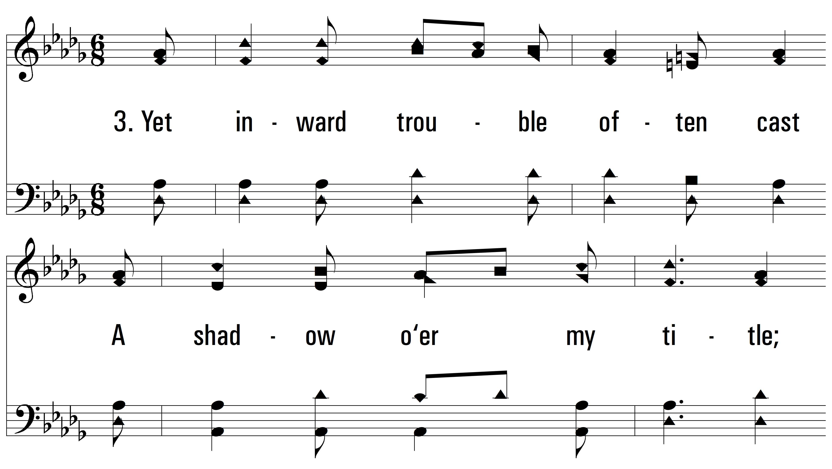
vs. 3 ~ My Name Is In The Book Of Life

Slide 11
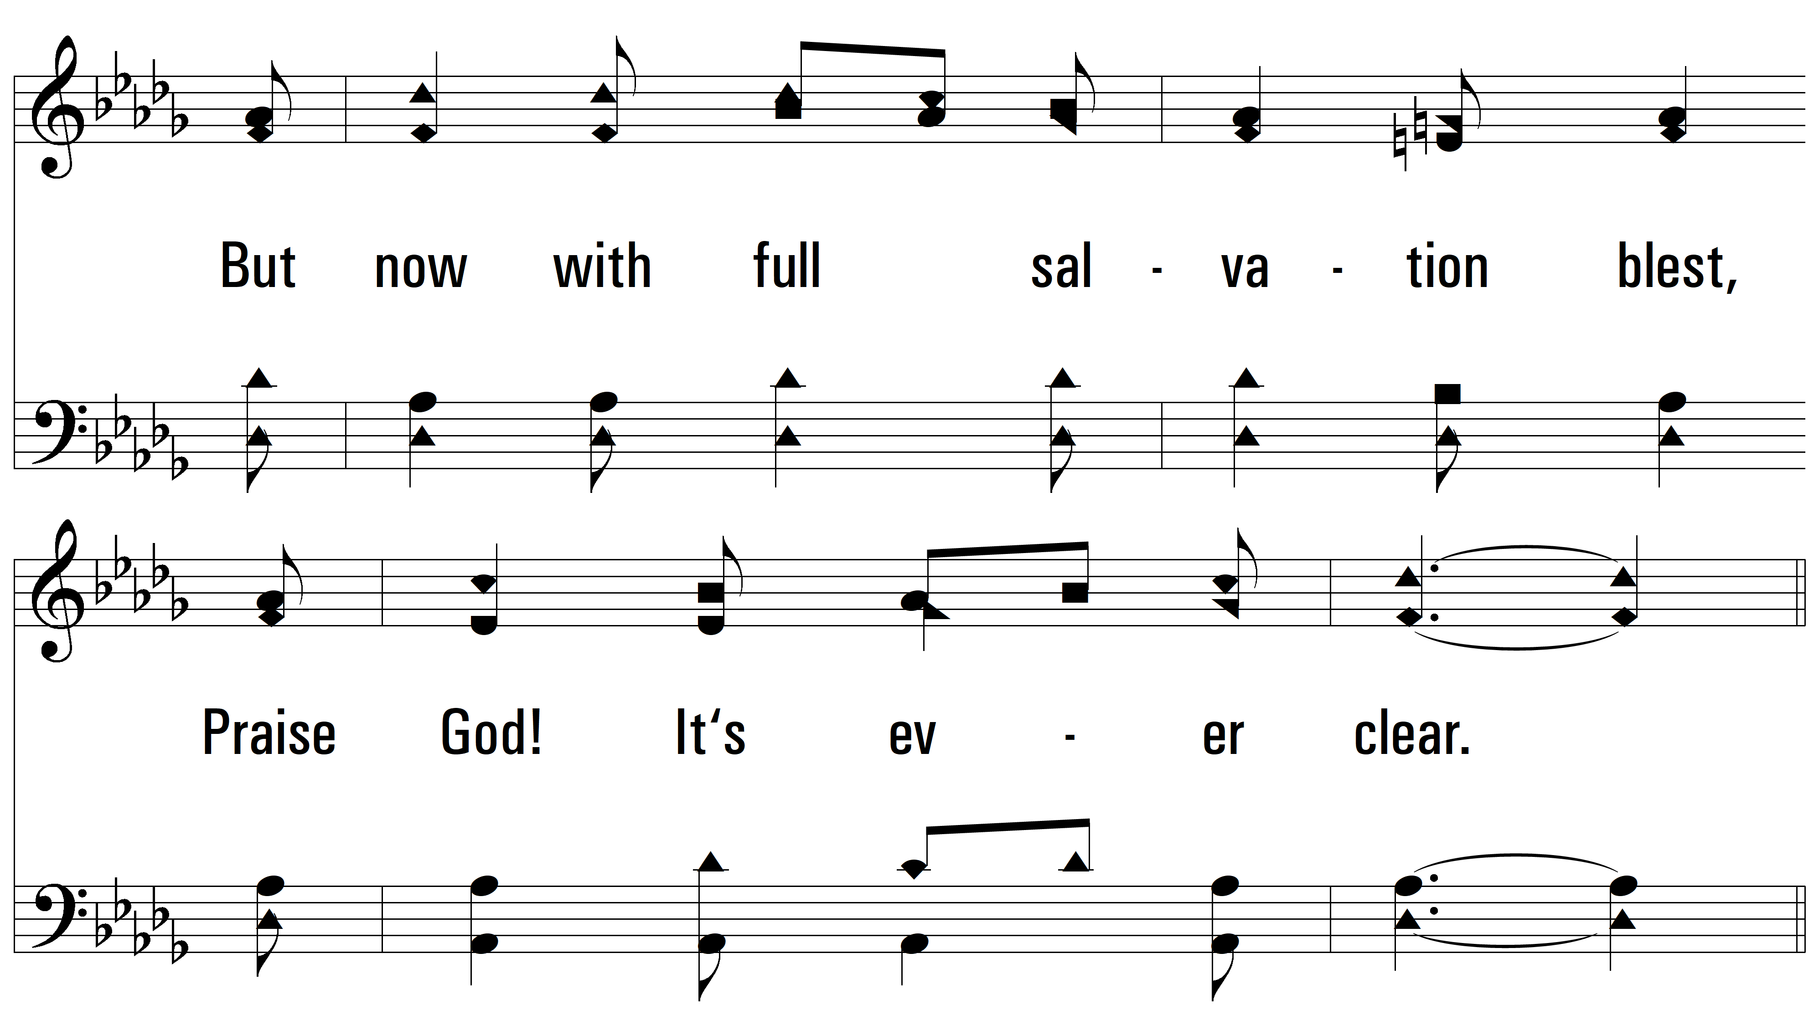
vs. 3

Slide 12
vs. 3

Slide 13
vs. 3

Slide 14
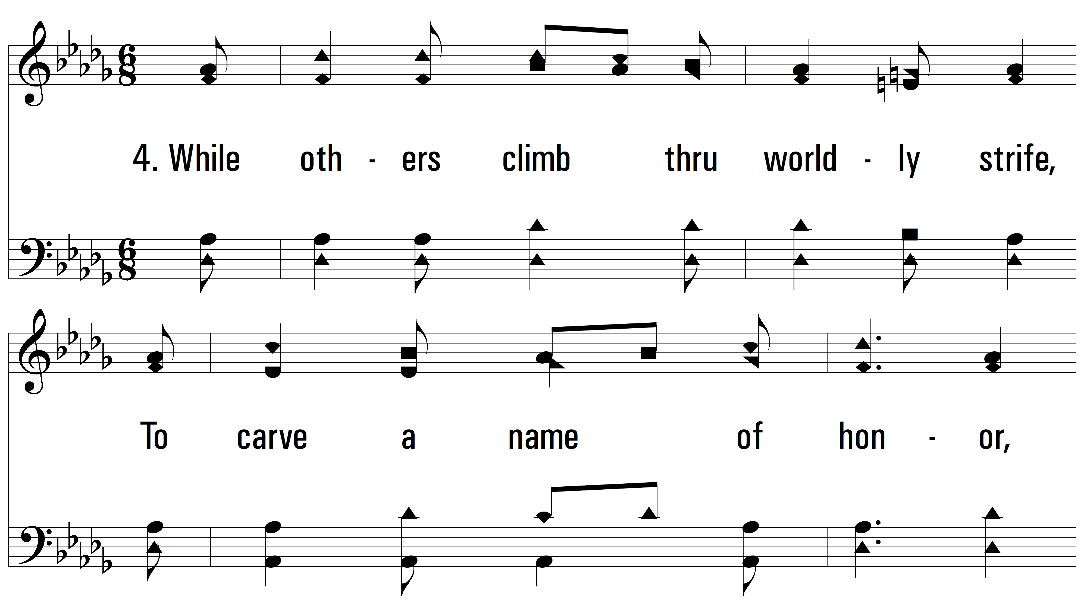
vs. 4 ~ My Name Is In The Book Of Life

Slide 15
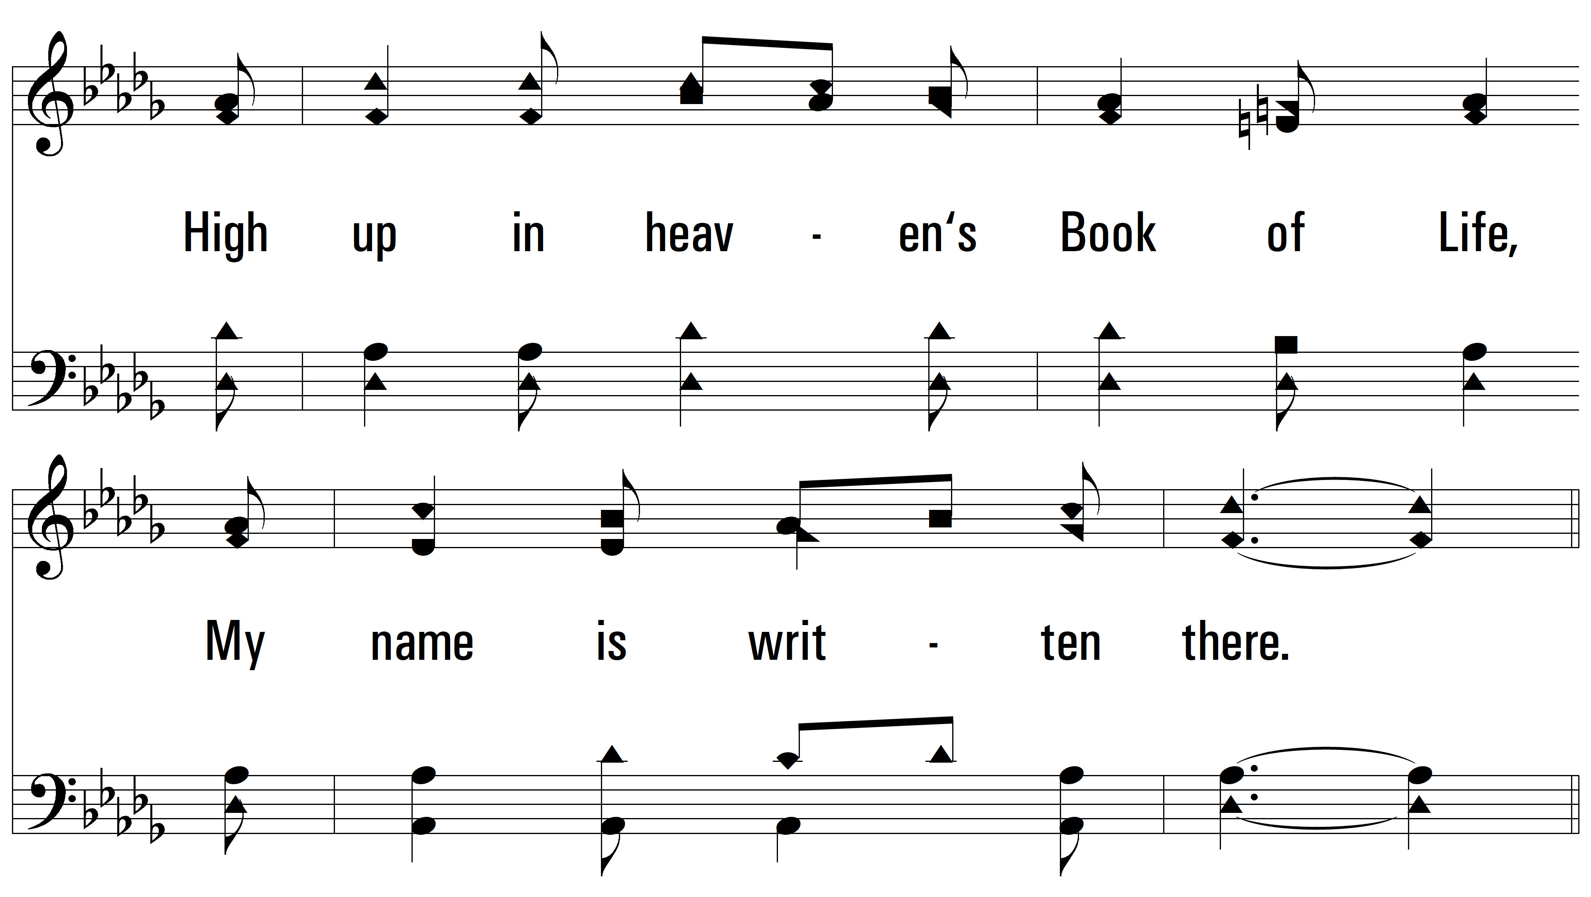
vs. 4

Slide 16
vs. 4

Slide 17
vs. 4
PDHymns.com
END

