Slide 1
My Jesus, I Love Thee
Words: | Primitive Methodist Magazine (1862), Arr. W. R. Featherston (1876)
Music: | A. J. Gordon (1876)
4/4
F/F - DO
Verses: 3
Lead - | DO
Alto - | SOL
Tenor - | MI
Bass - | DO
PDHymns.com

Slide 2
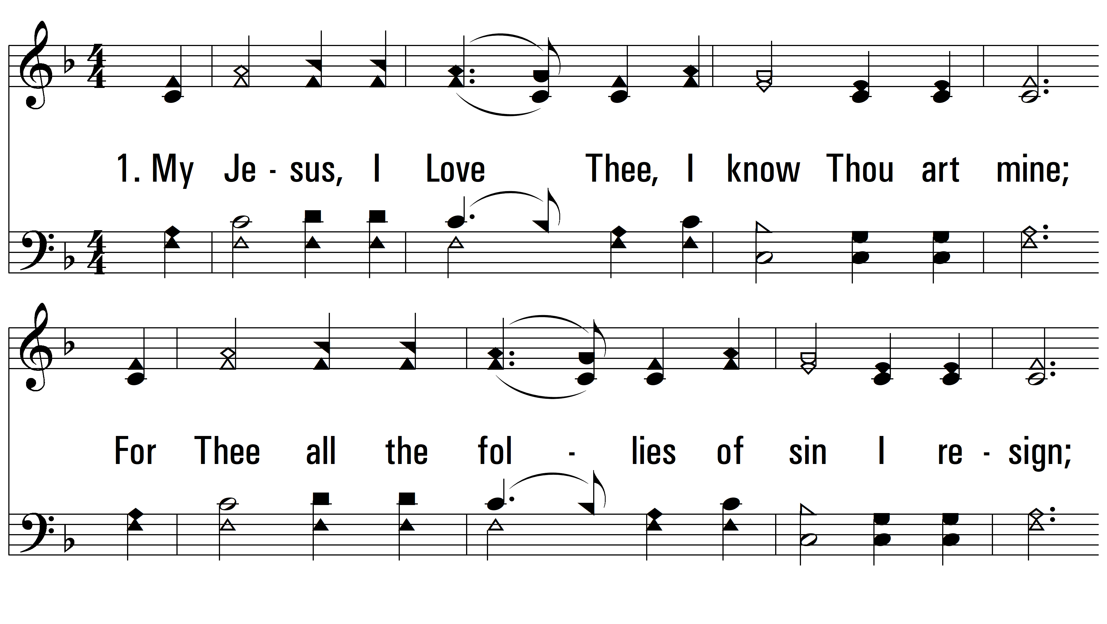
vs. 1 ~ My Jesus, I Love Thee

Slide 3
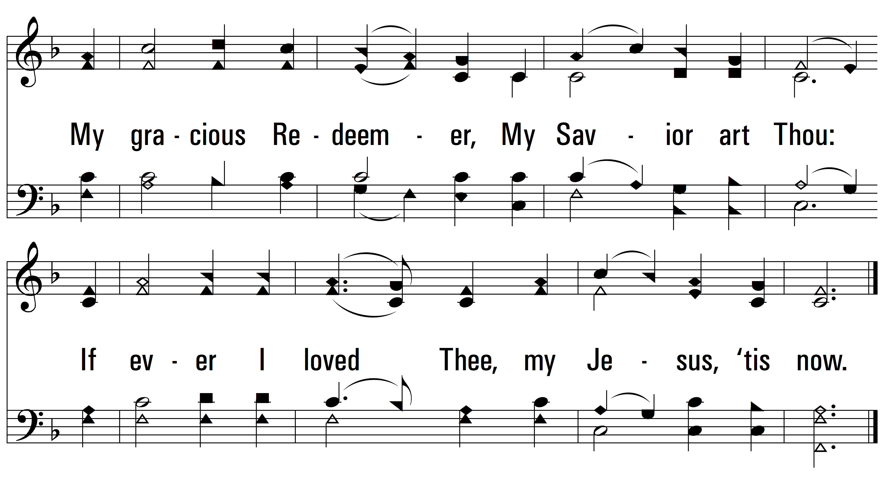
vs. 1

Slide 4
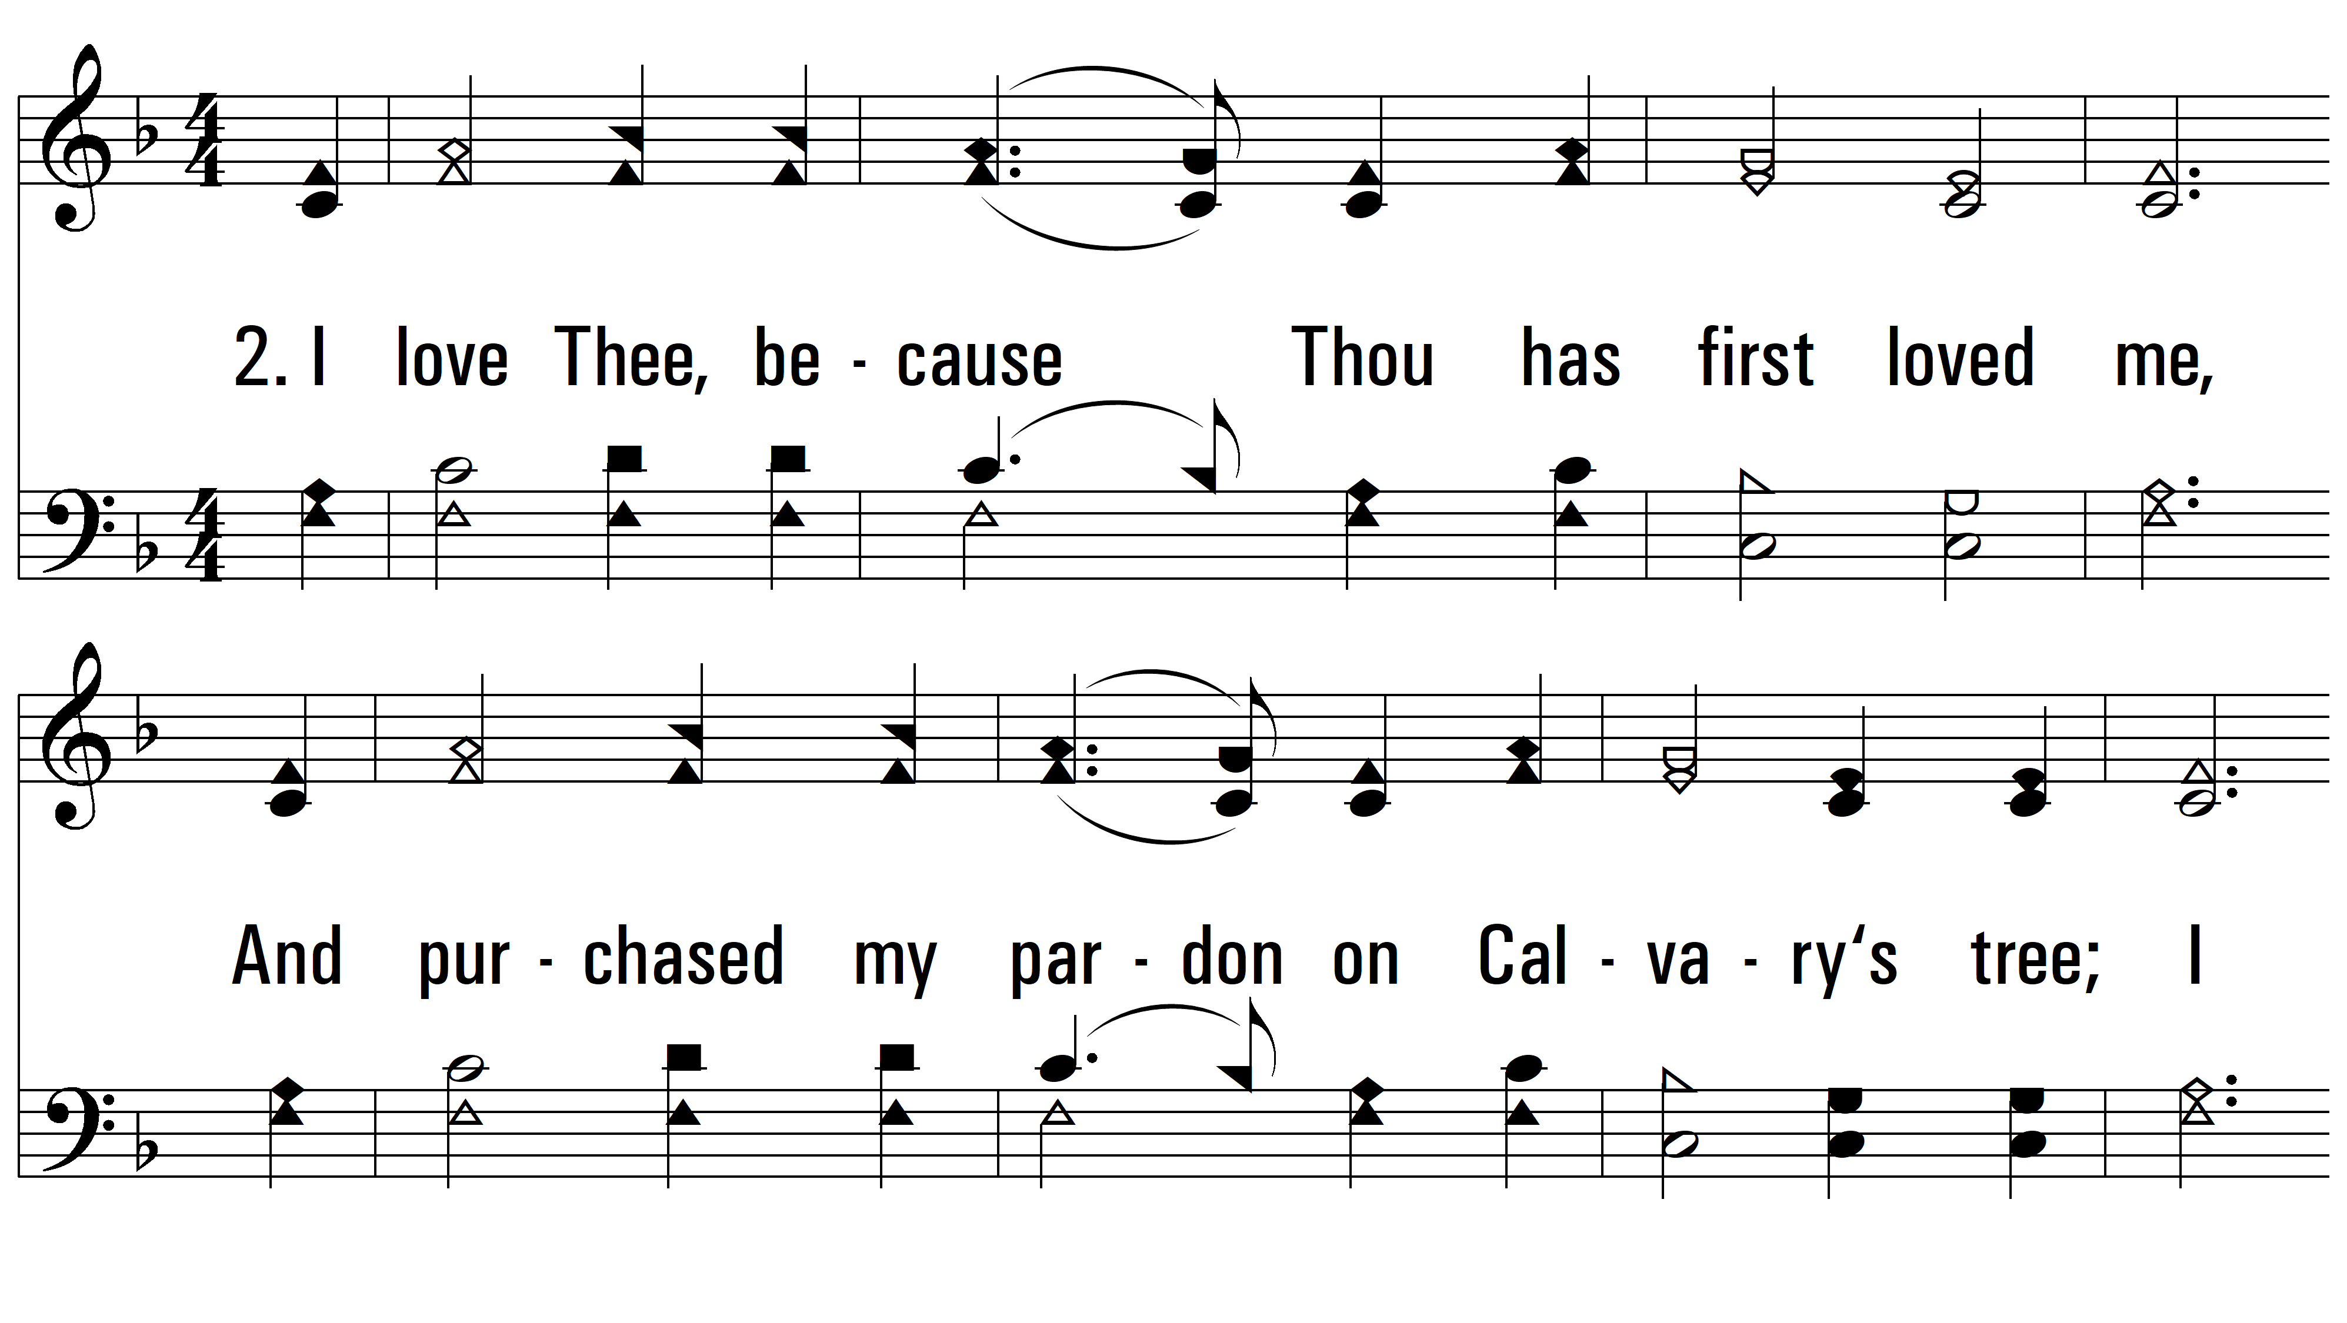
vs. 2 ~ My Jesus, I Love Thee

Slide 5
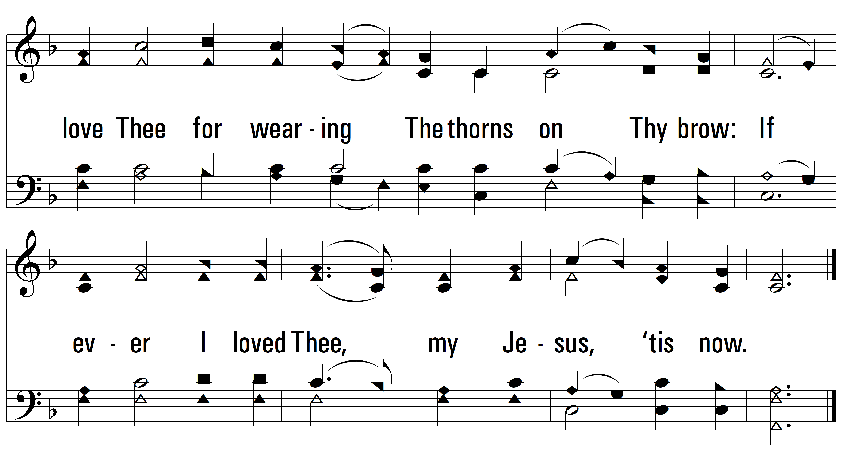
vs. 2

Slide 6
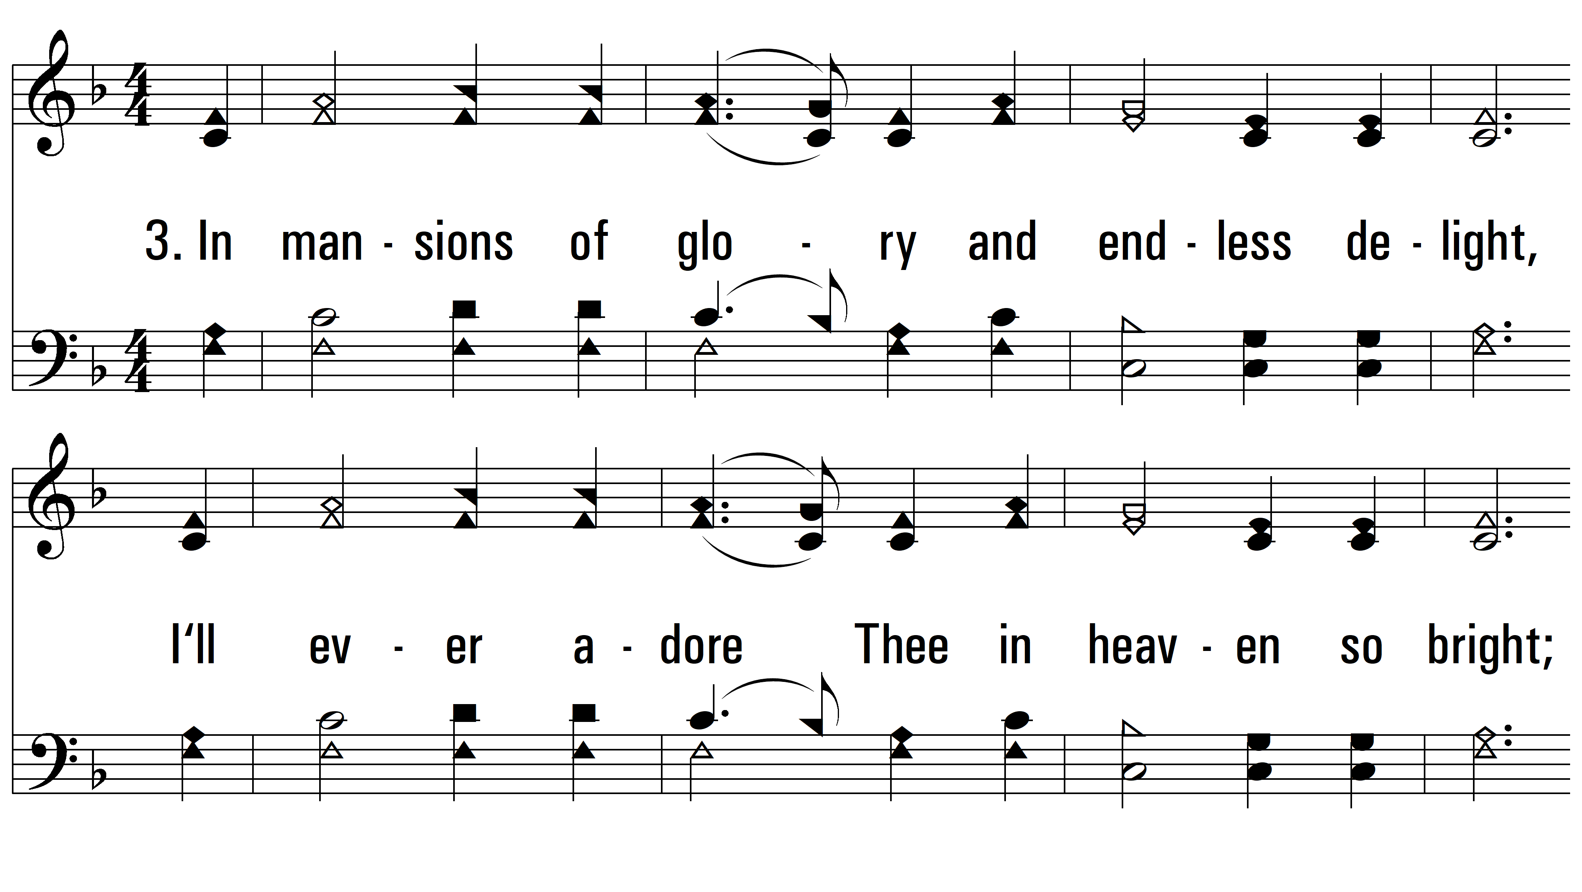
vs. 3 ~ My Jesus, I Love Thee

Slide 7
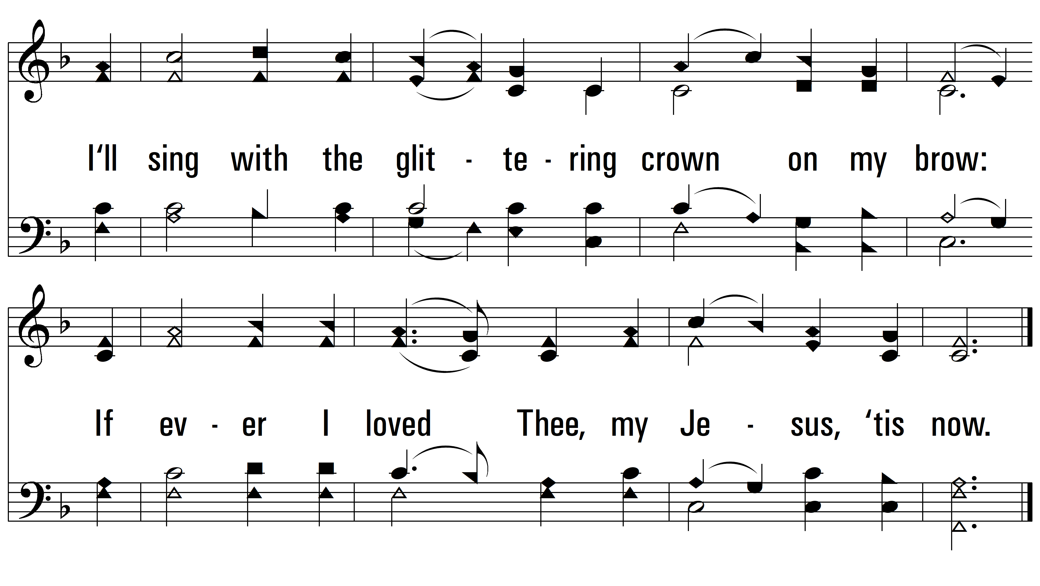
vs. 3
PDHymns.com
END

