Slide 1
My Faith Looks Up To Thee
OLIVET
6.6.4.6.6.6.4
Words: | Ray Palmer (1830)
Music: | Lowell Mason (1830)
2/2
E^{b}/E^{b} - DO
Verses: 4
Lead - | DO
Alto - | DO
Tenor - | MI
Bass - | DO
PDHymns.com

Slide 2
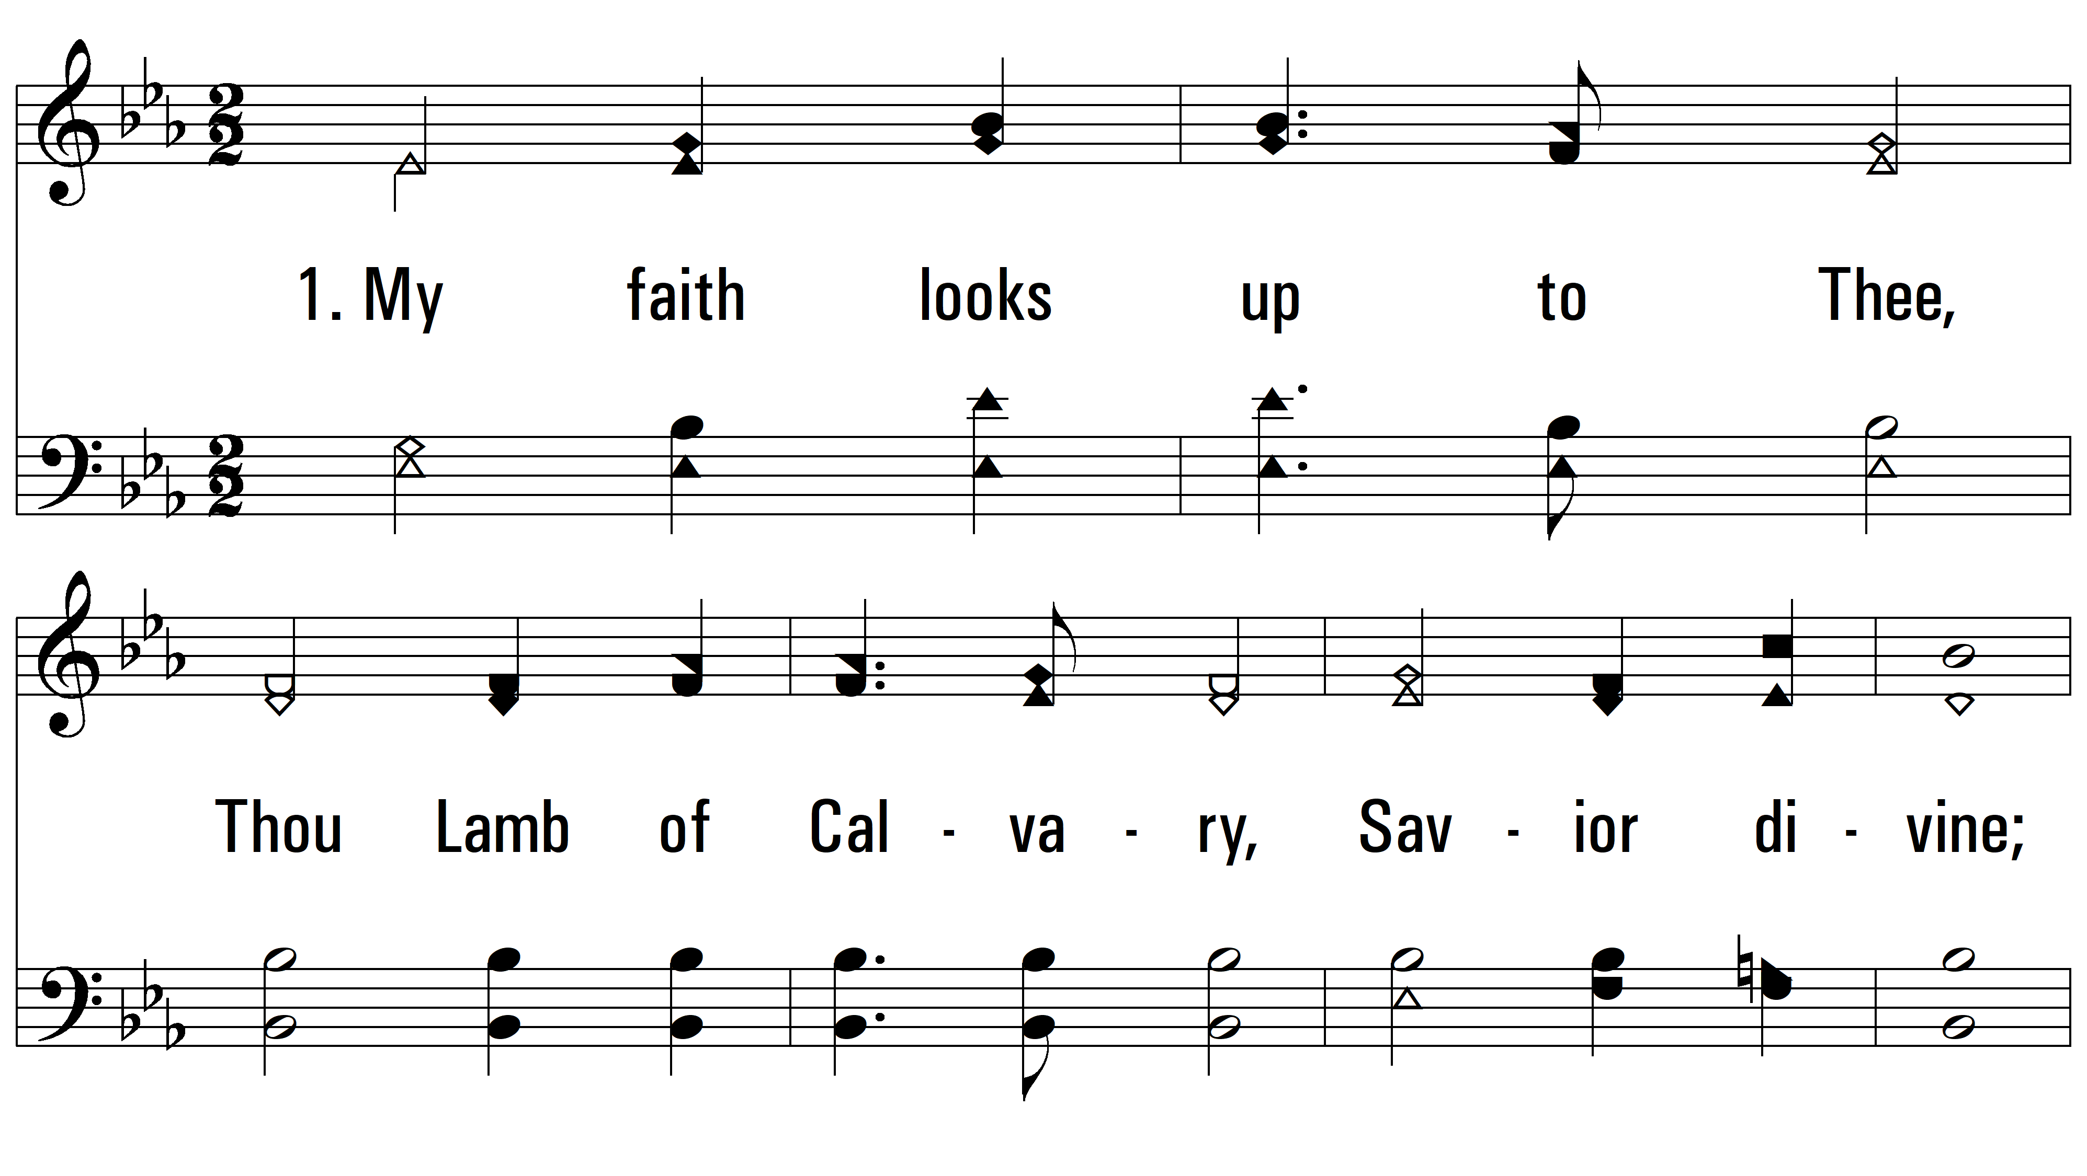
vs. 1 ~ My Faith Looks Up To Thee

Slide 3
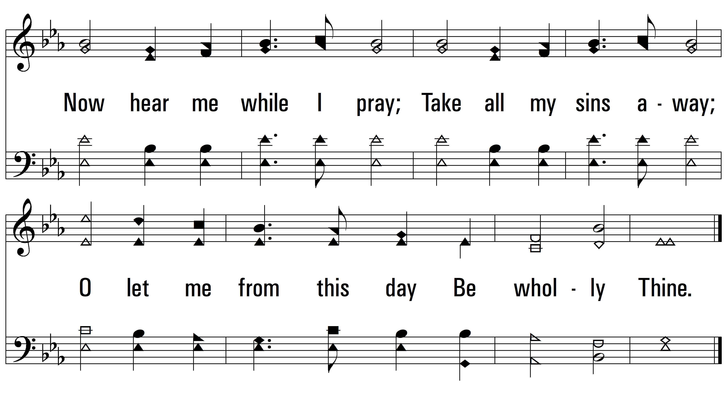
vs. 1

Slide 4
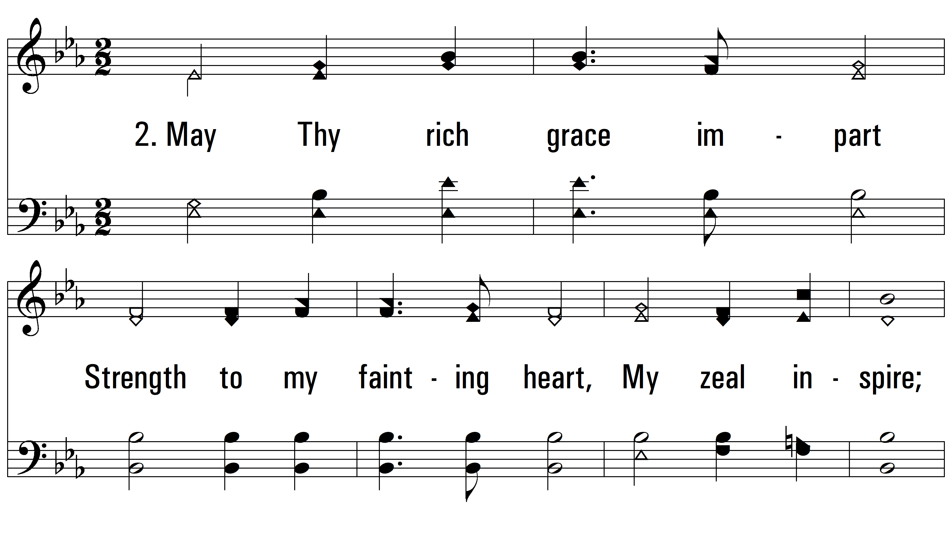
vs. 2 ~ My Faith Looks Up To Thee

Slide 5
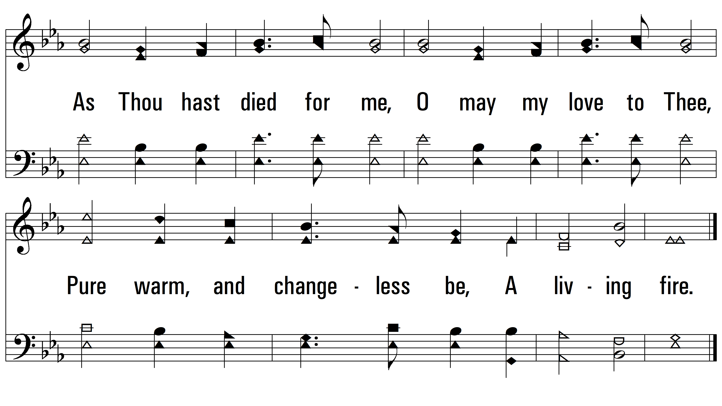
vs. 2

Slide 6
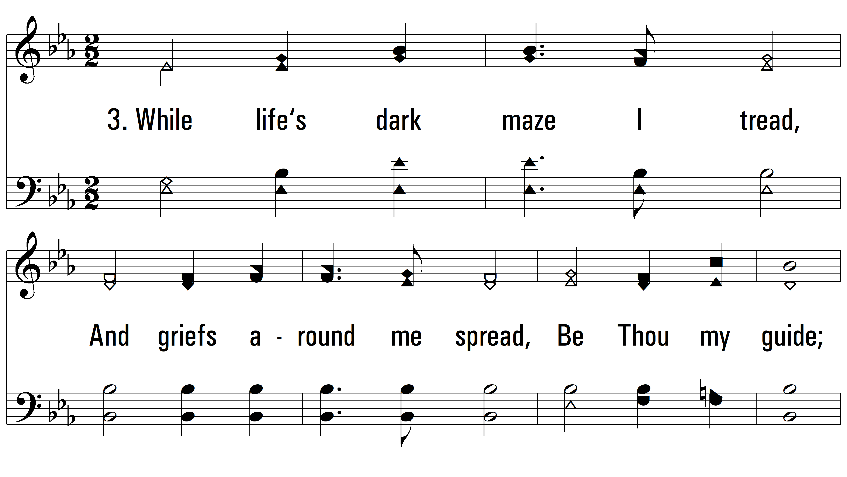
vs. 3 ~ My Faith Looks Up To Thee

Slide 7
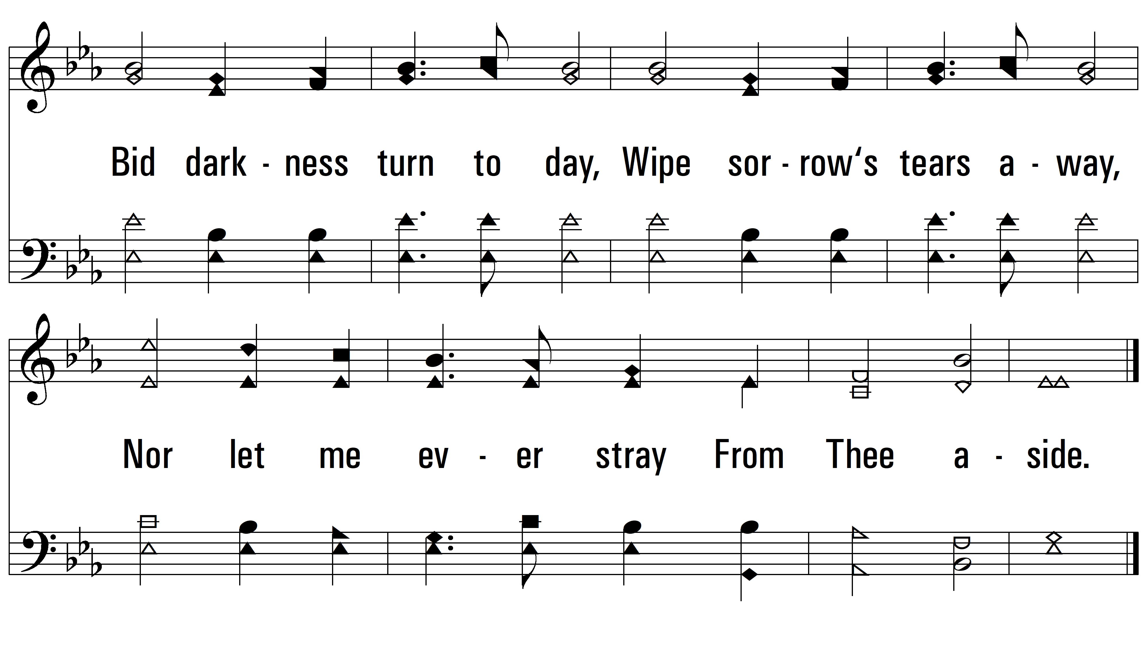
vs. 3

Slide 8
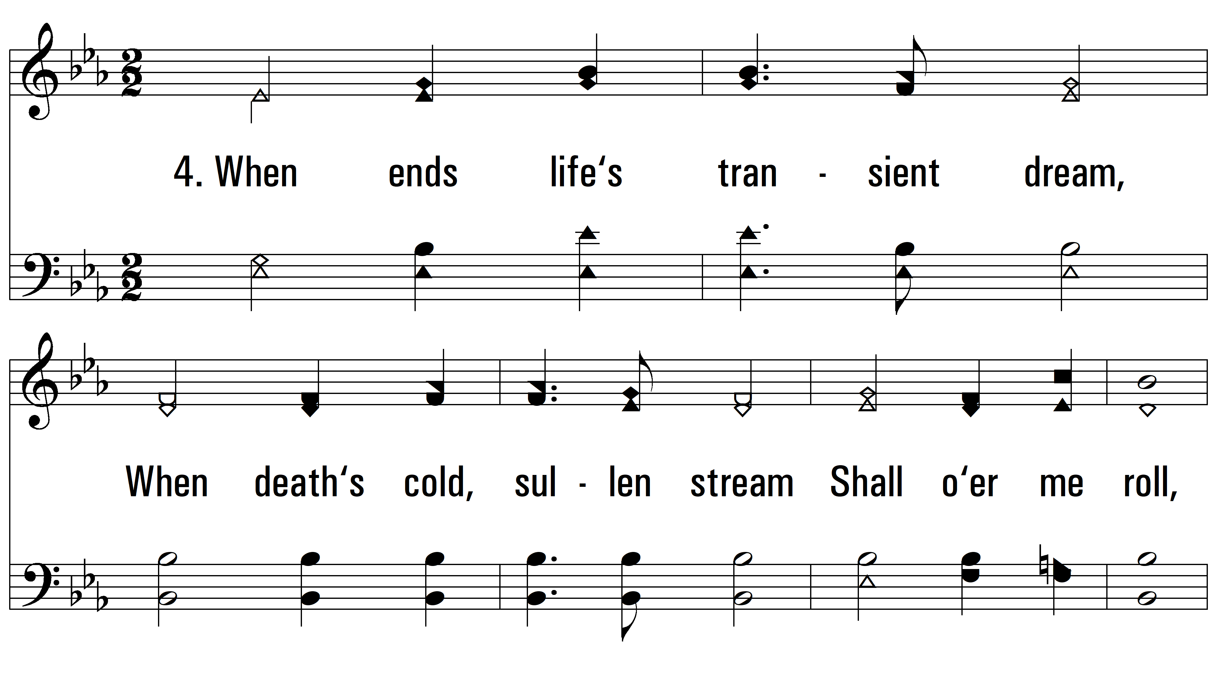
vs. 4 ~ My Faith Looks Up To Thee

Slide 9
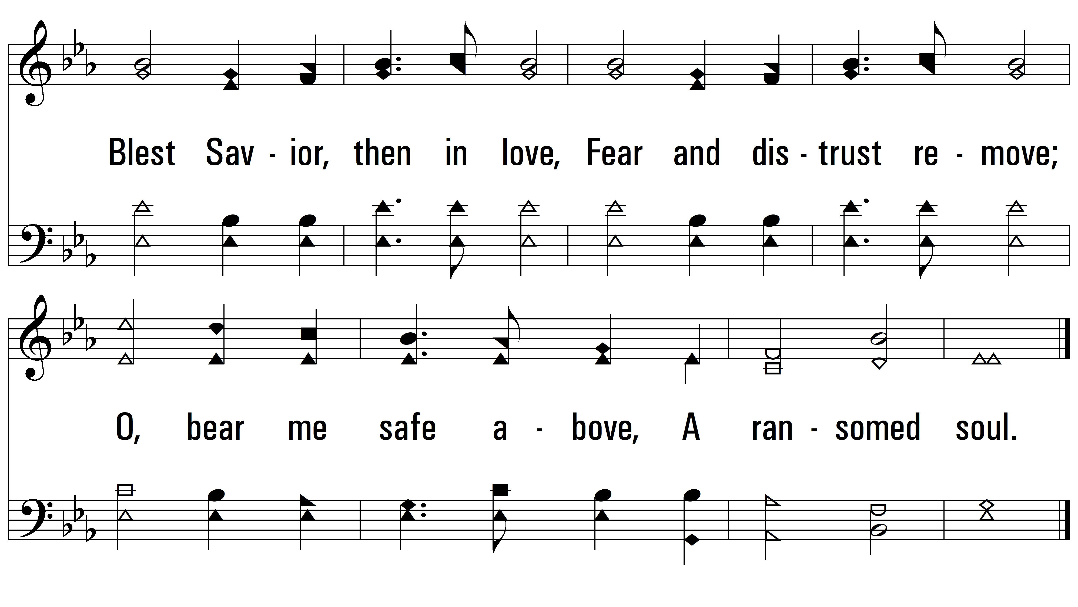
vs. 4
PDHymns.com
END

