Slide 1
Must Jesus Bear The Cross Alone?
MAITLAND
CM
Words: | Thomas Shepherd (1693)
Music: | George N. Allen (1844)
6/4
A/C# - MI
Verses: 4
Lead - | MI
Alto - | DO
Tenor - | SOL
Bass - | DO
PDHymns.com

Slide 2
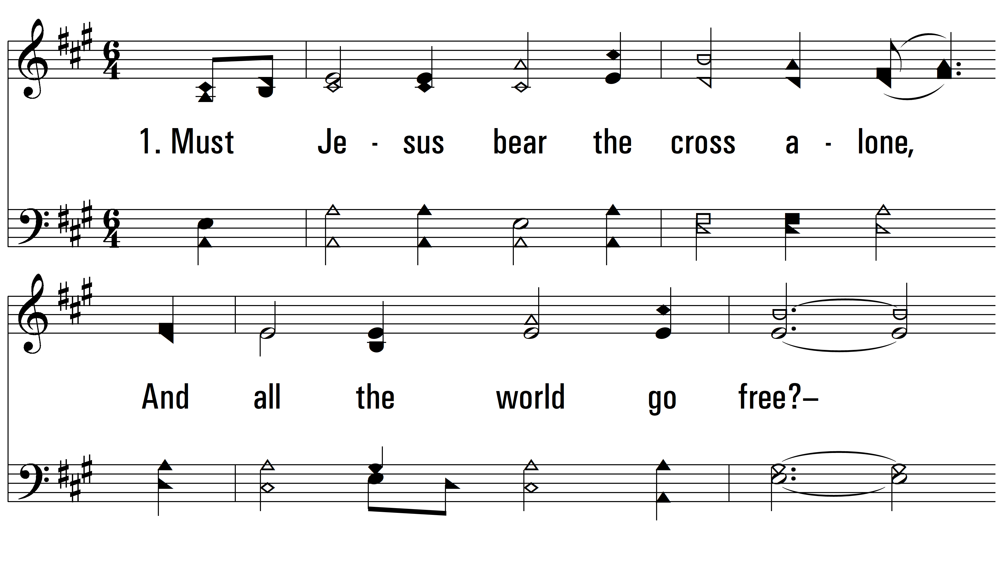
vs. 1 ~ Must Jesus Bear The Cross Alone?

Slide 3
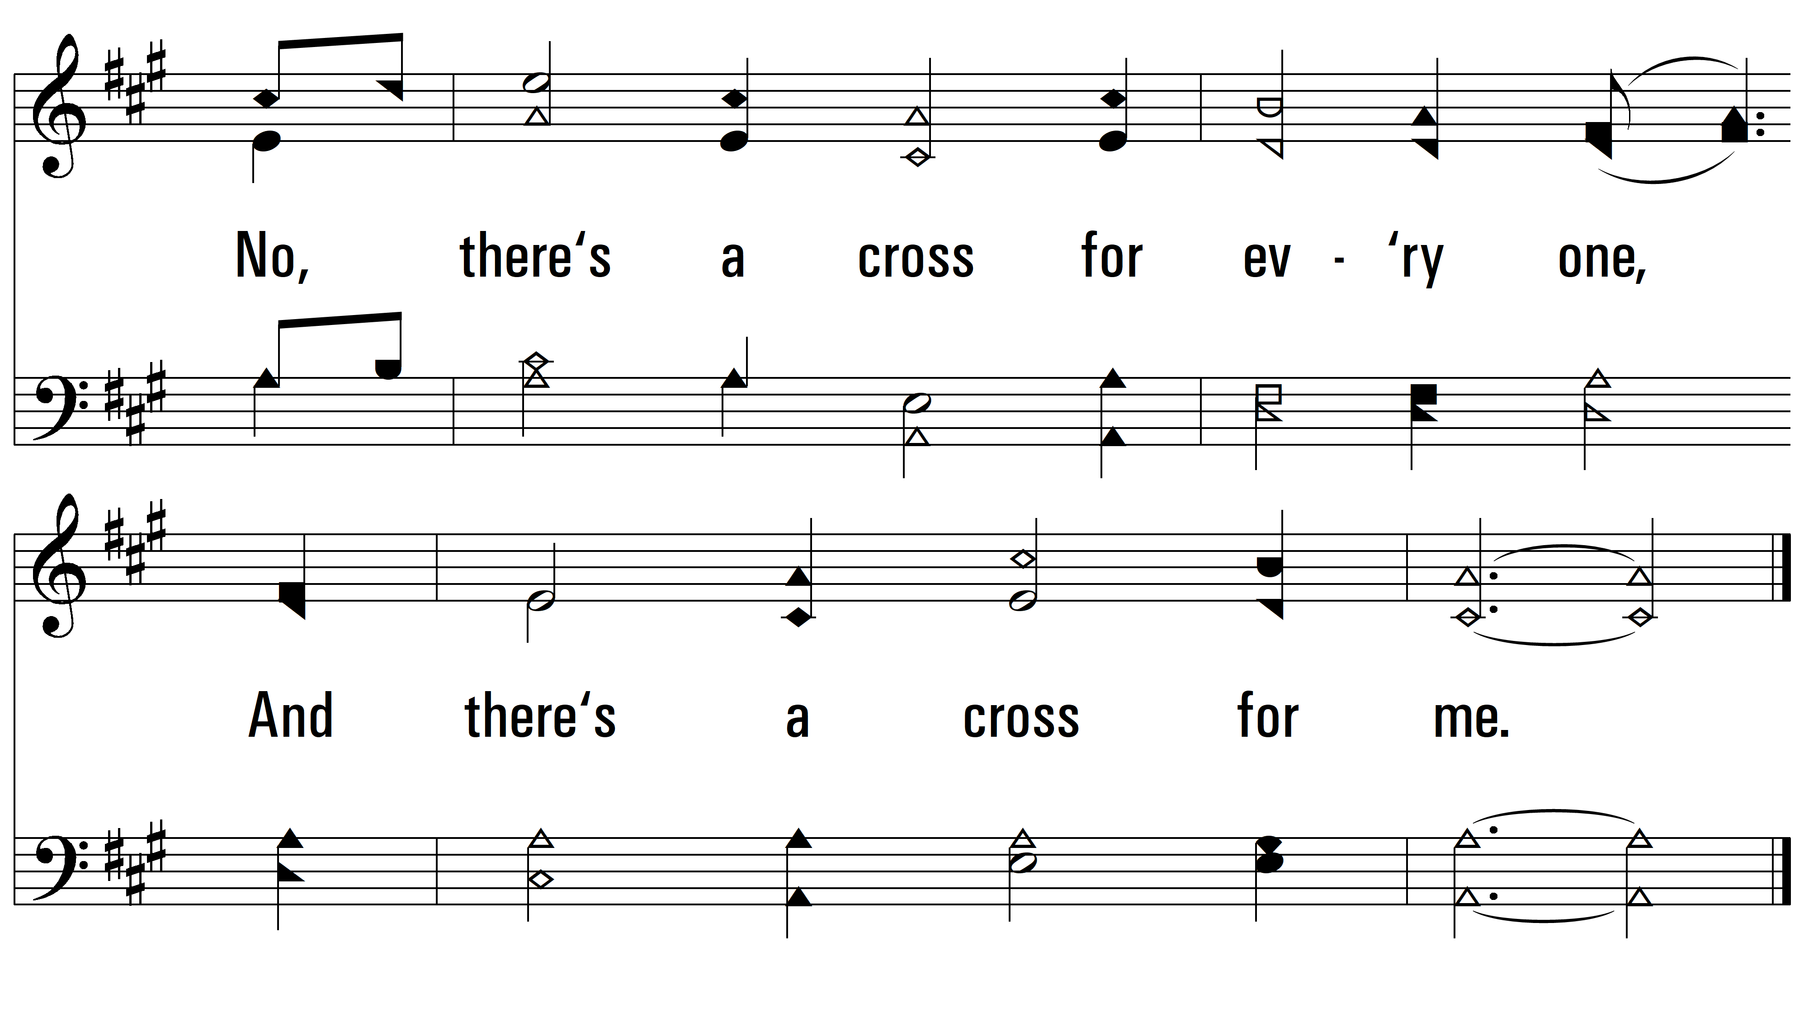
vs. 1

Slide 4
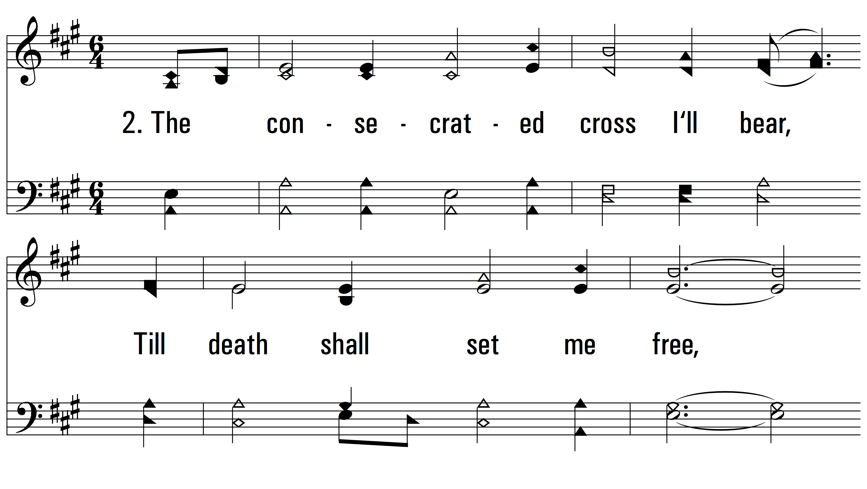
vs. 2 ~ Must Jesus Bear The Cross Alone?

Slide 5
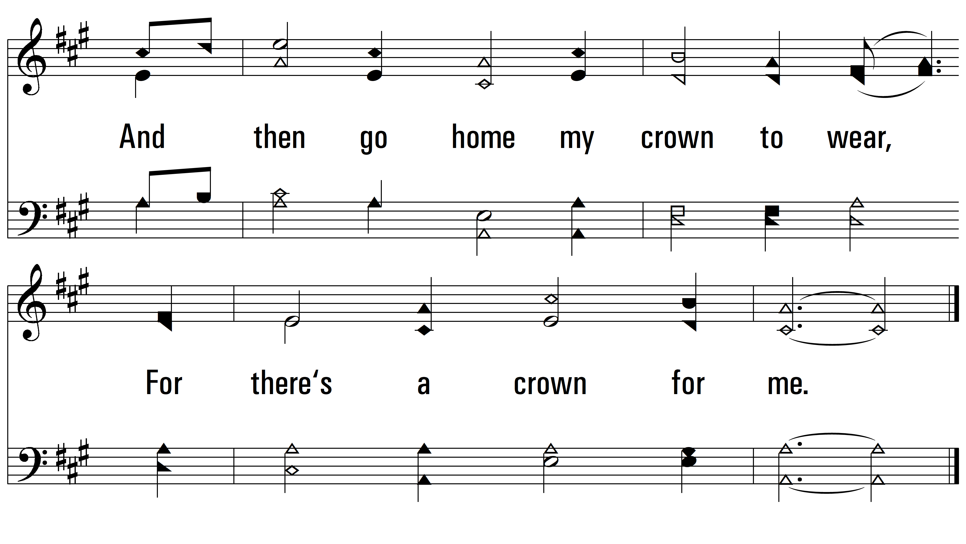
vs. 2

Slide 6
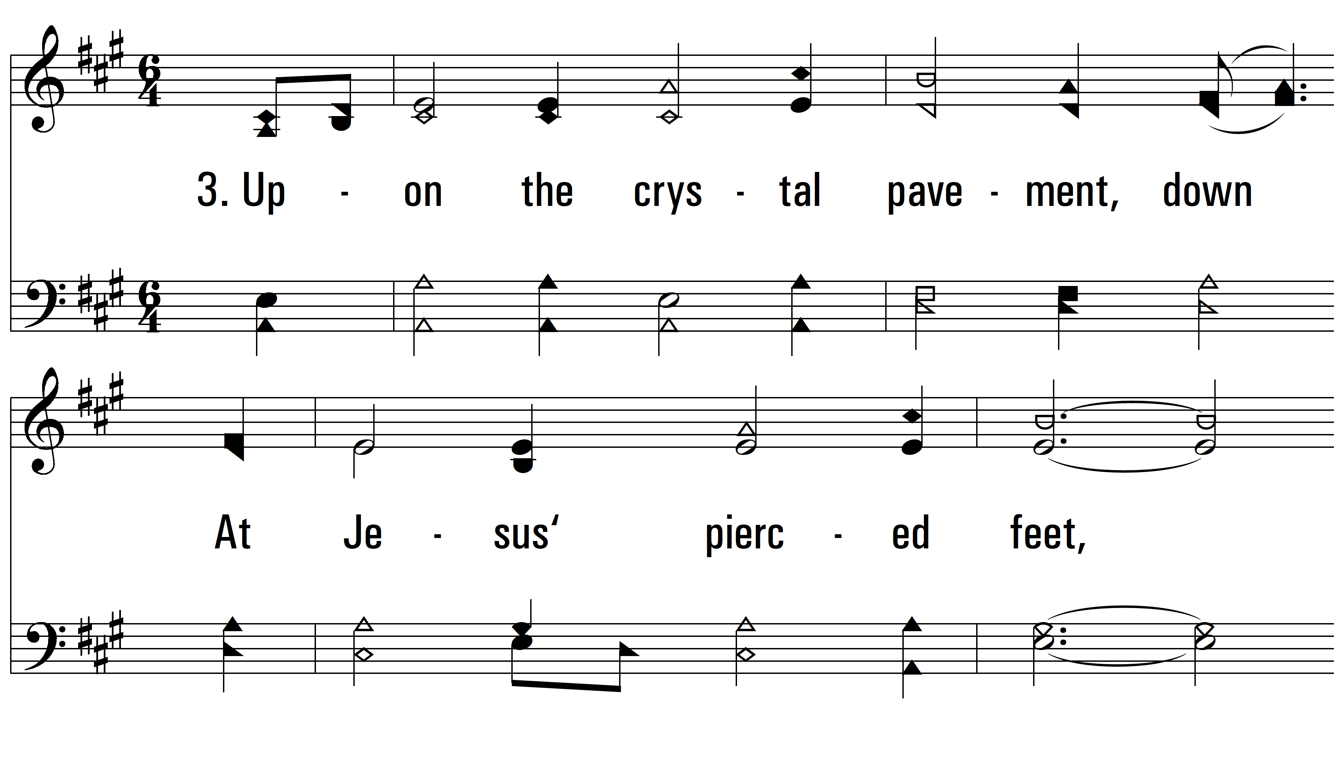
vs. 3 ~ Must Jesus Bear The Cross Alone?

Slide 7
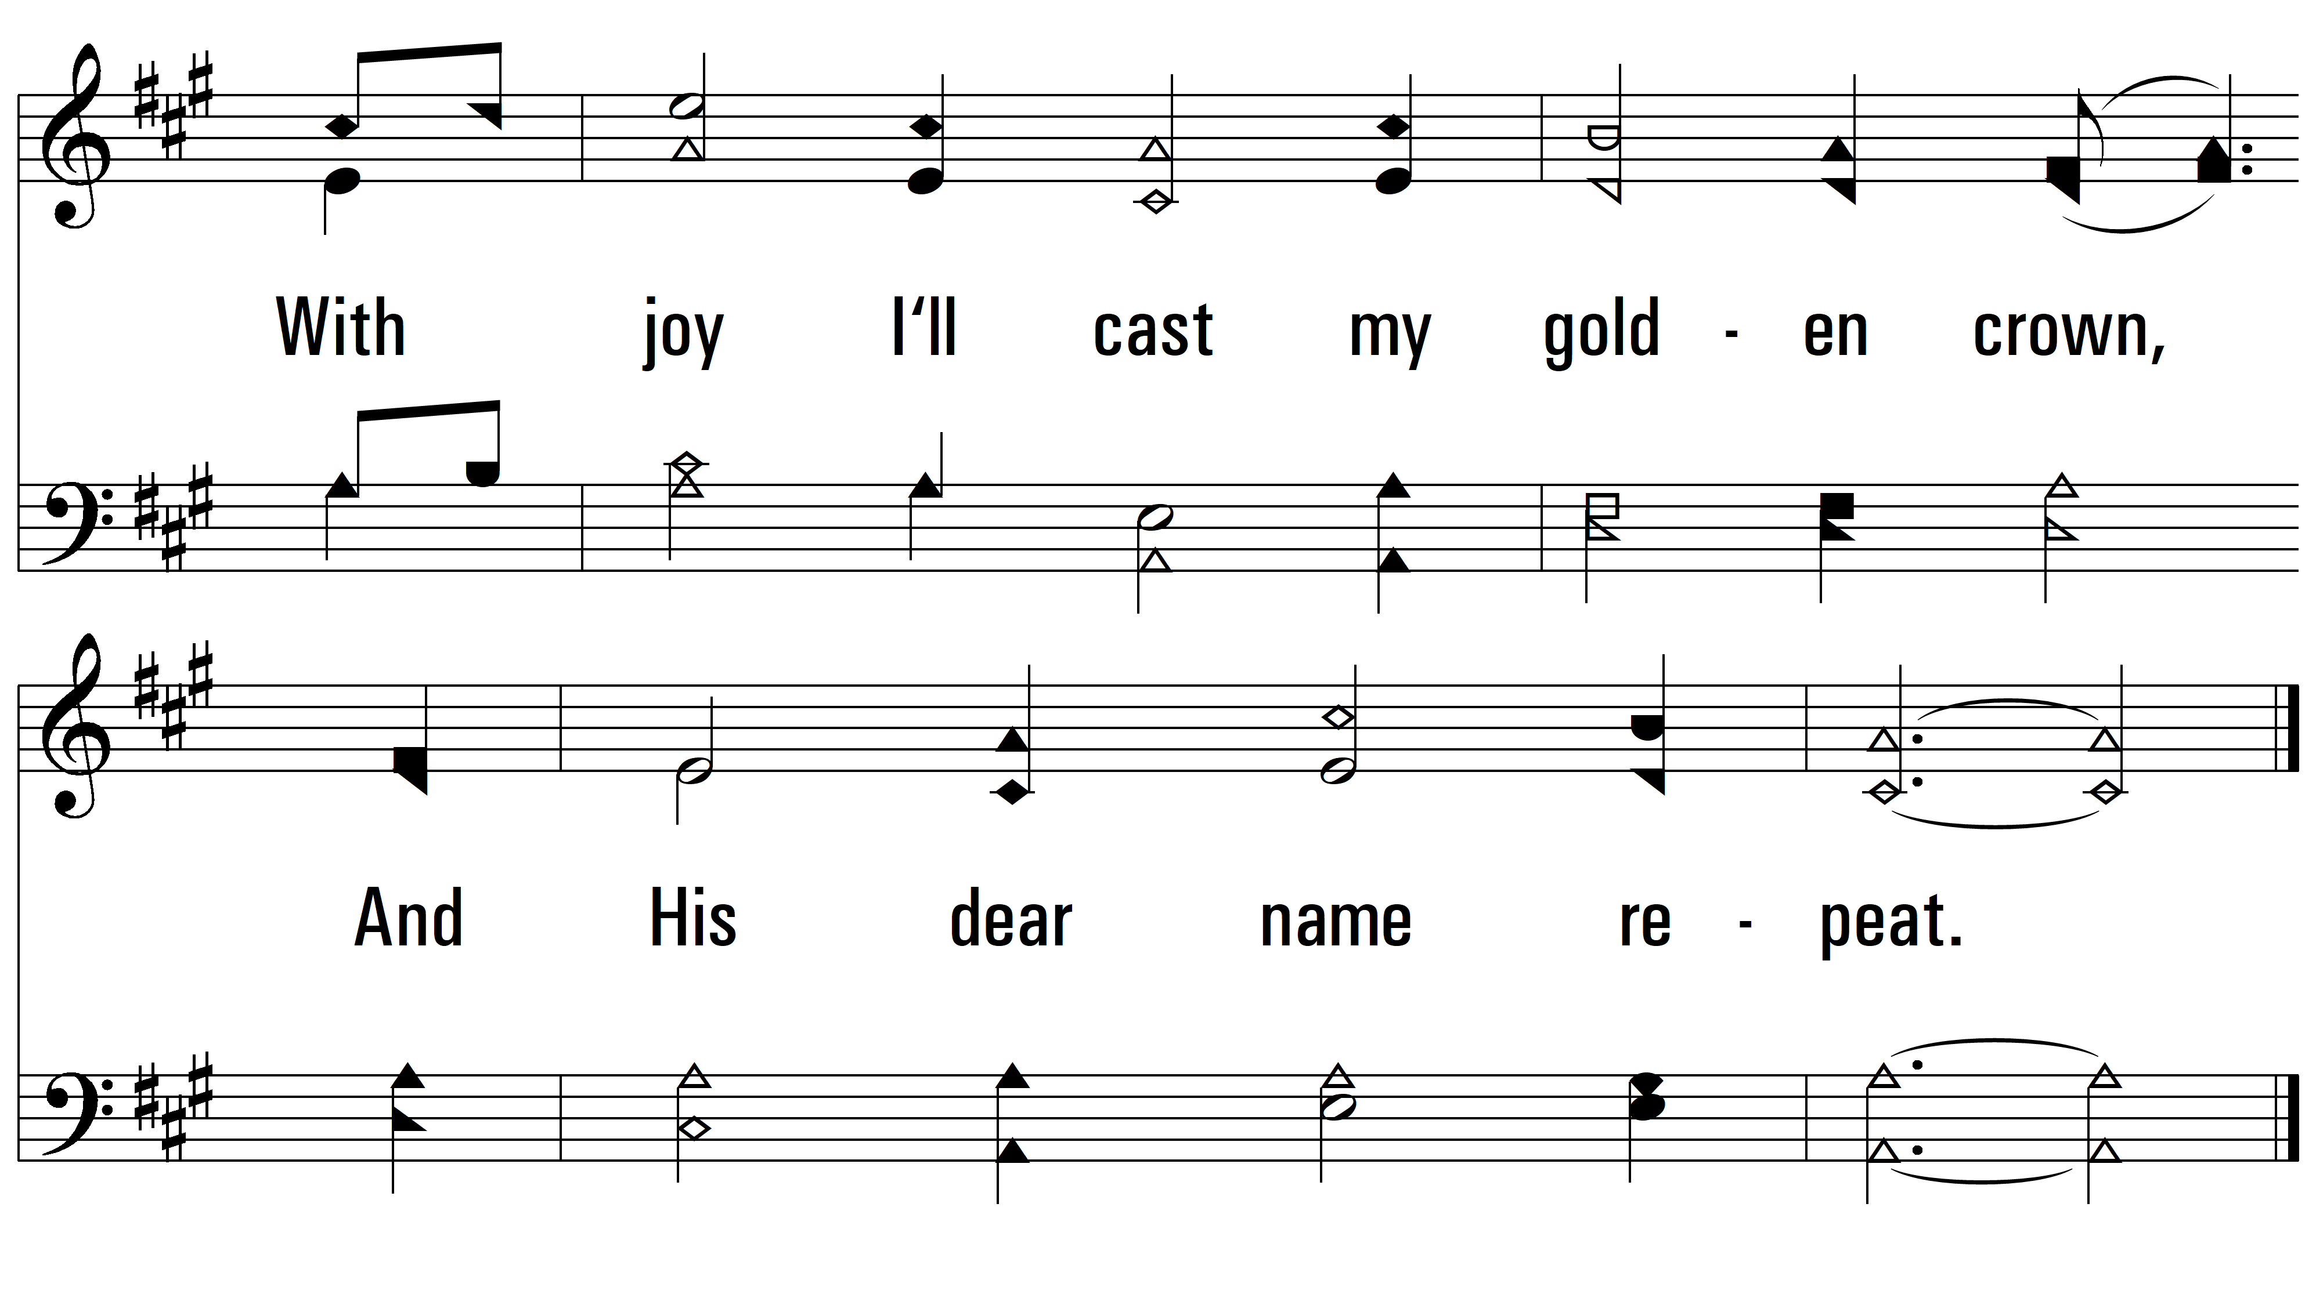
vs. 3

Slide 8
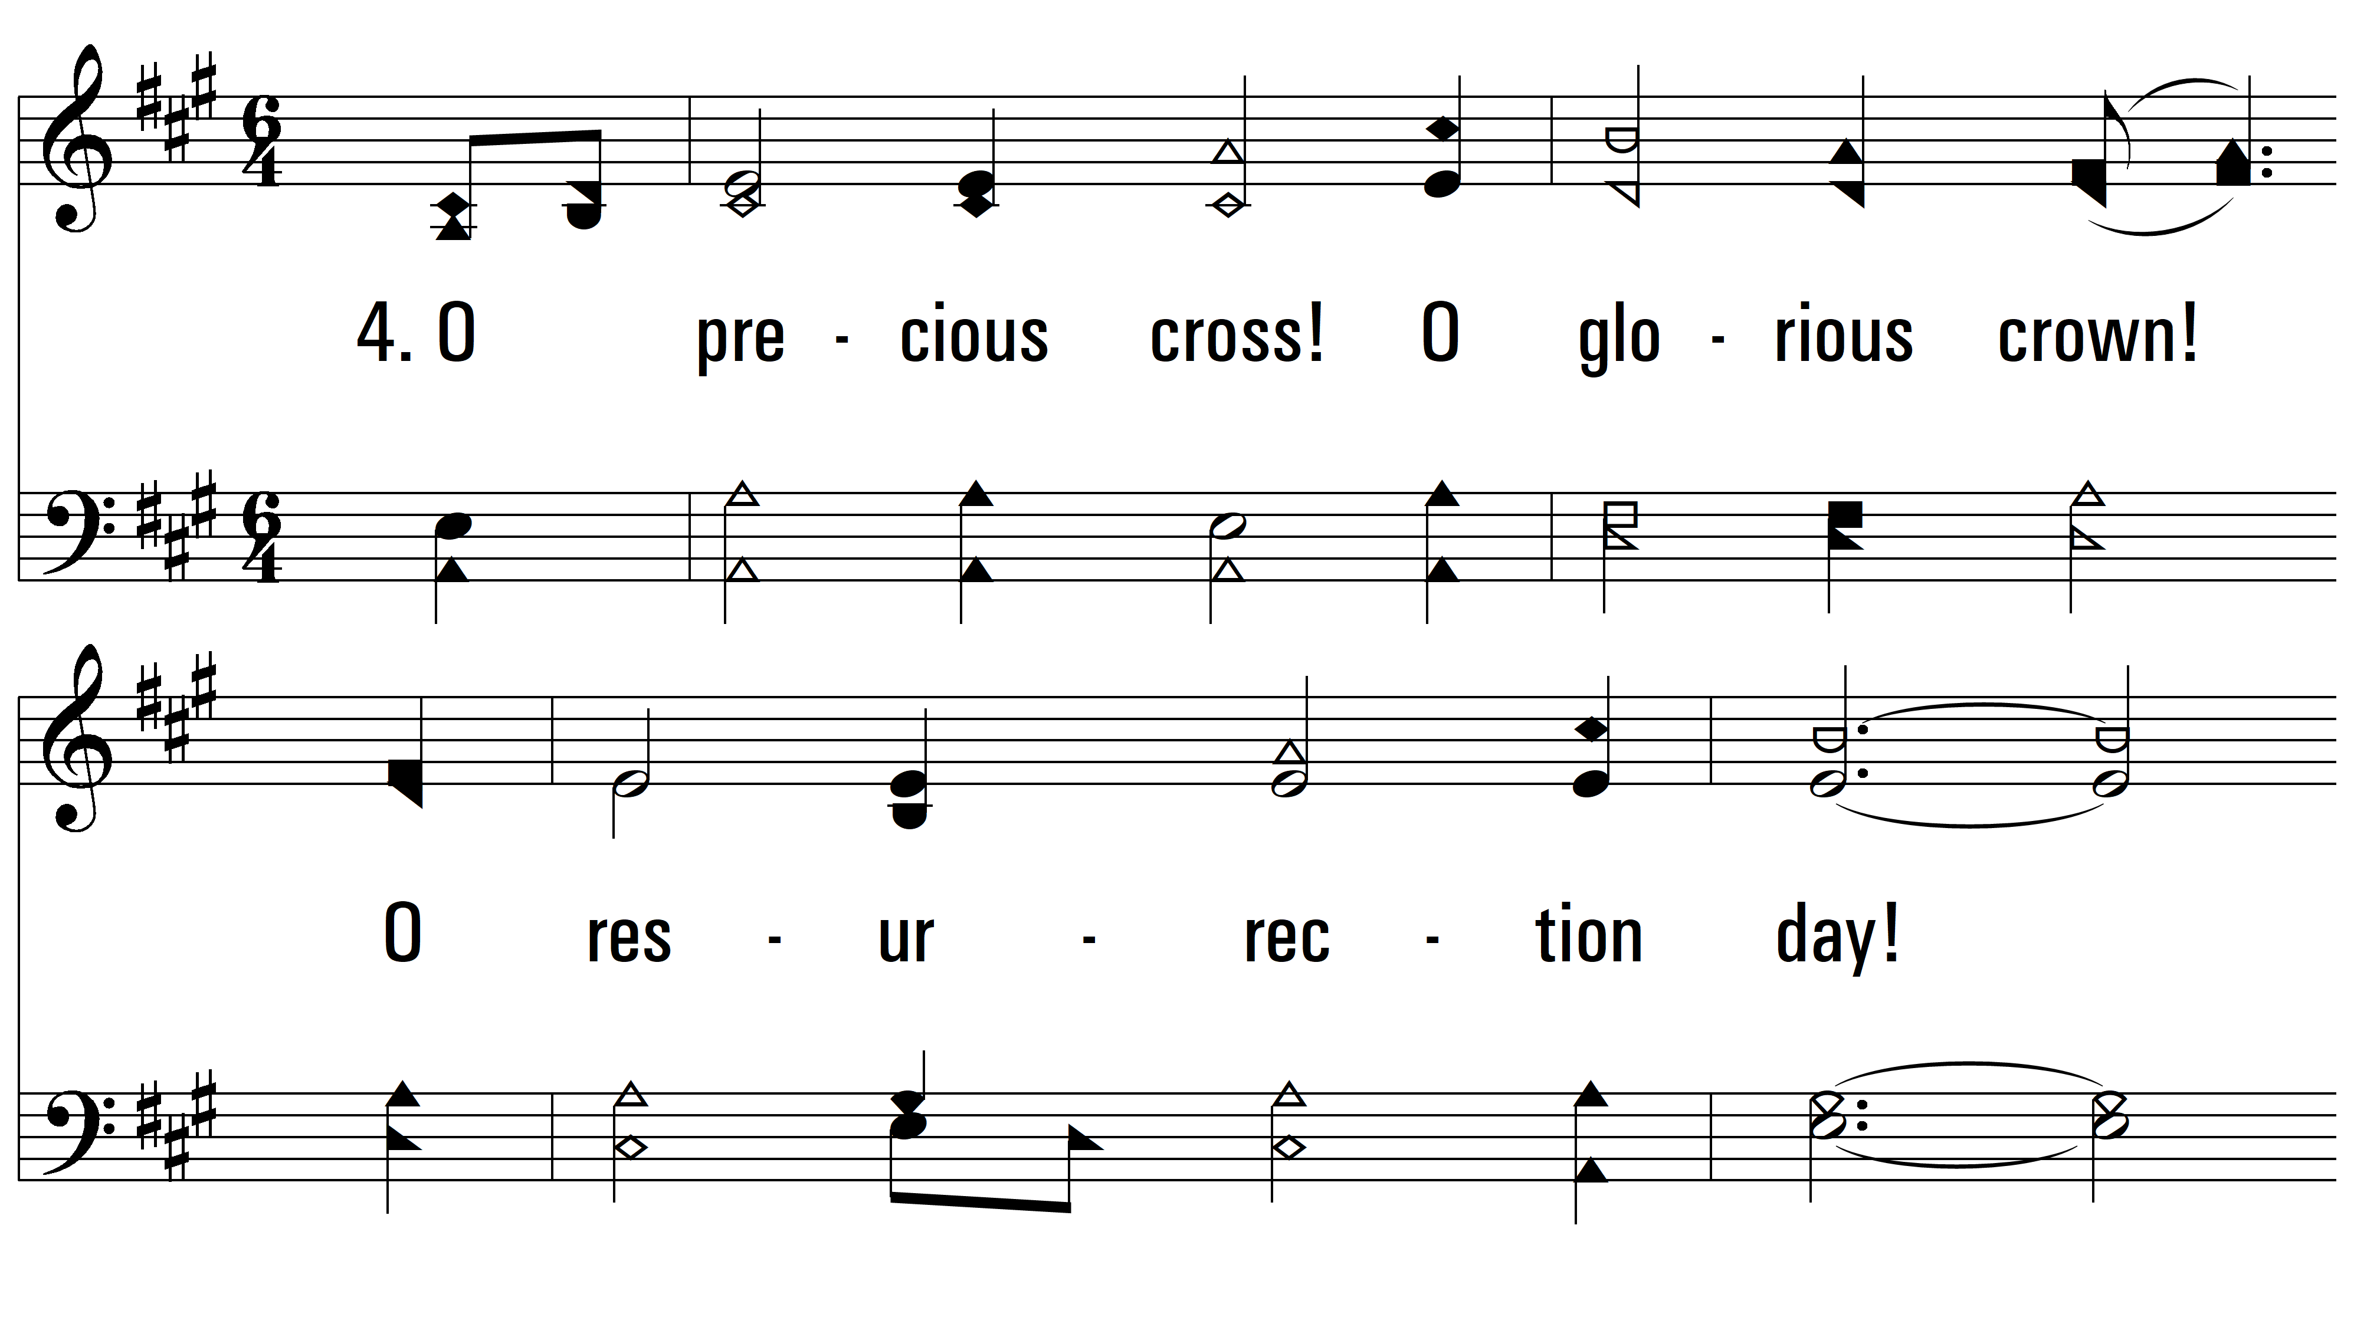
vs. 4 ~ Must Jesus Bear The Cross Alone?

Slide 9
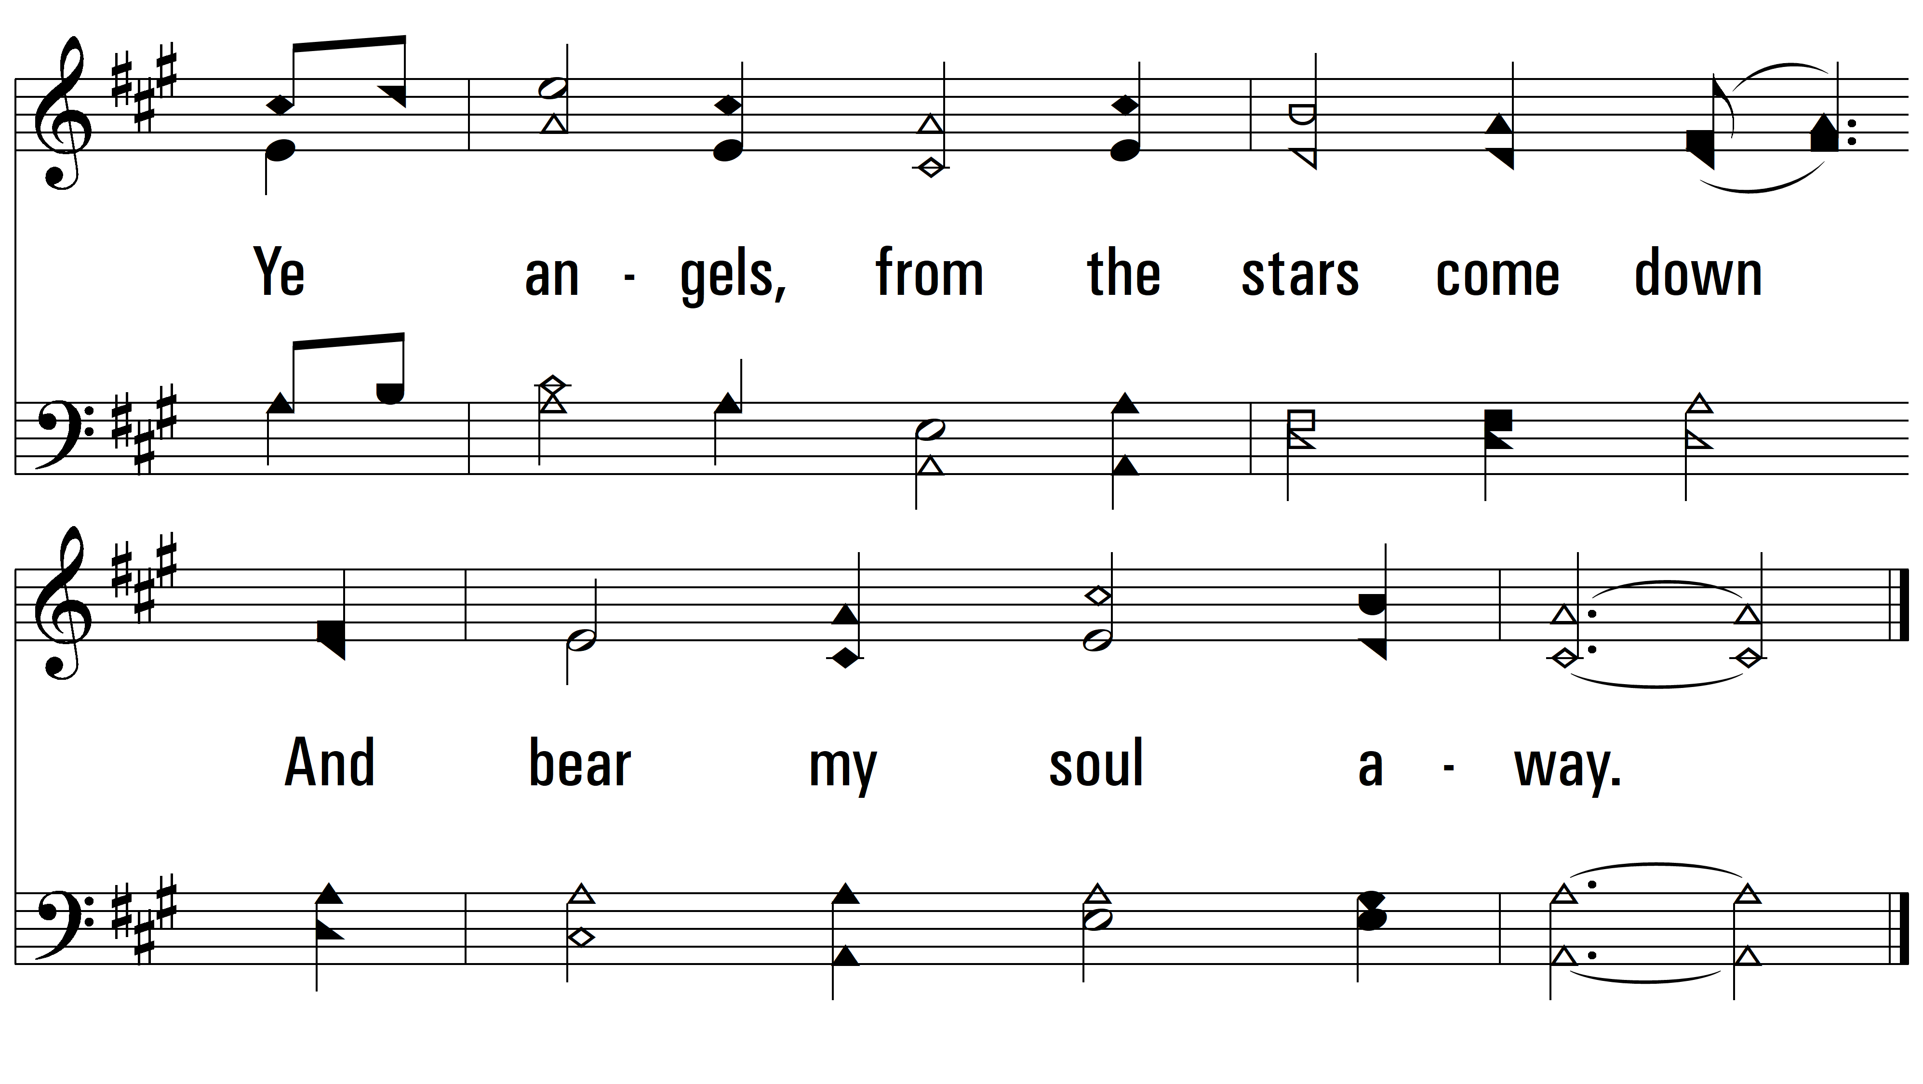
vs. 4
PDHymns.com
END

