Slide 1
More Holiness Give Me
MY PRAYER
6.5.6.5.D
Words: | Phillip P. Bliss (1873)
Music: | Phillip P. Bliss (1873)
12/8
E^{b}/G - MI
Verses: 3
Lead - | MI
Alto - | DO
Tenor - | SOL
Bass - | DO
PDHymns.com

Slide 2
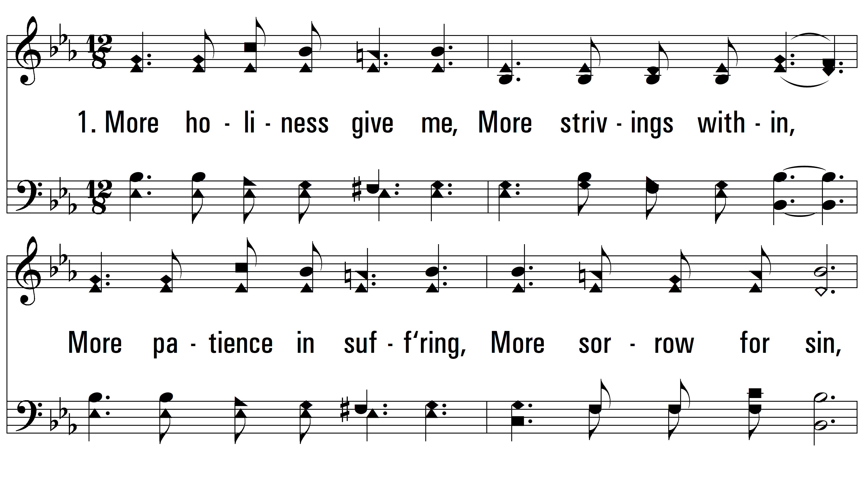
vs. 1 ~ More Holiness Give Me

Slide 3
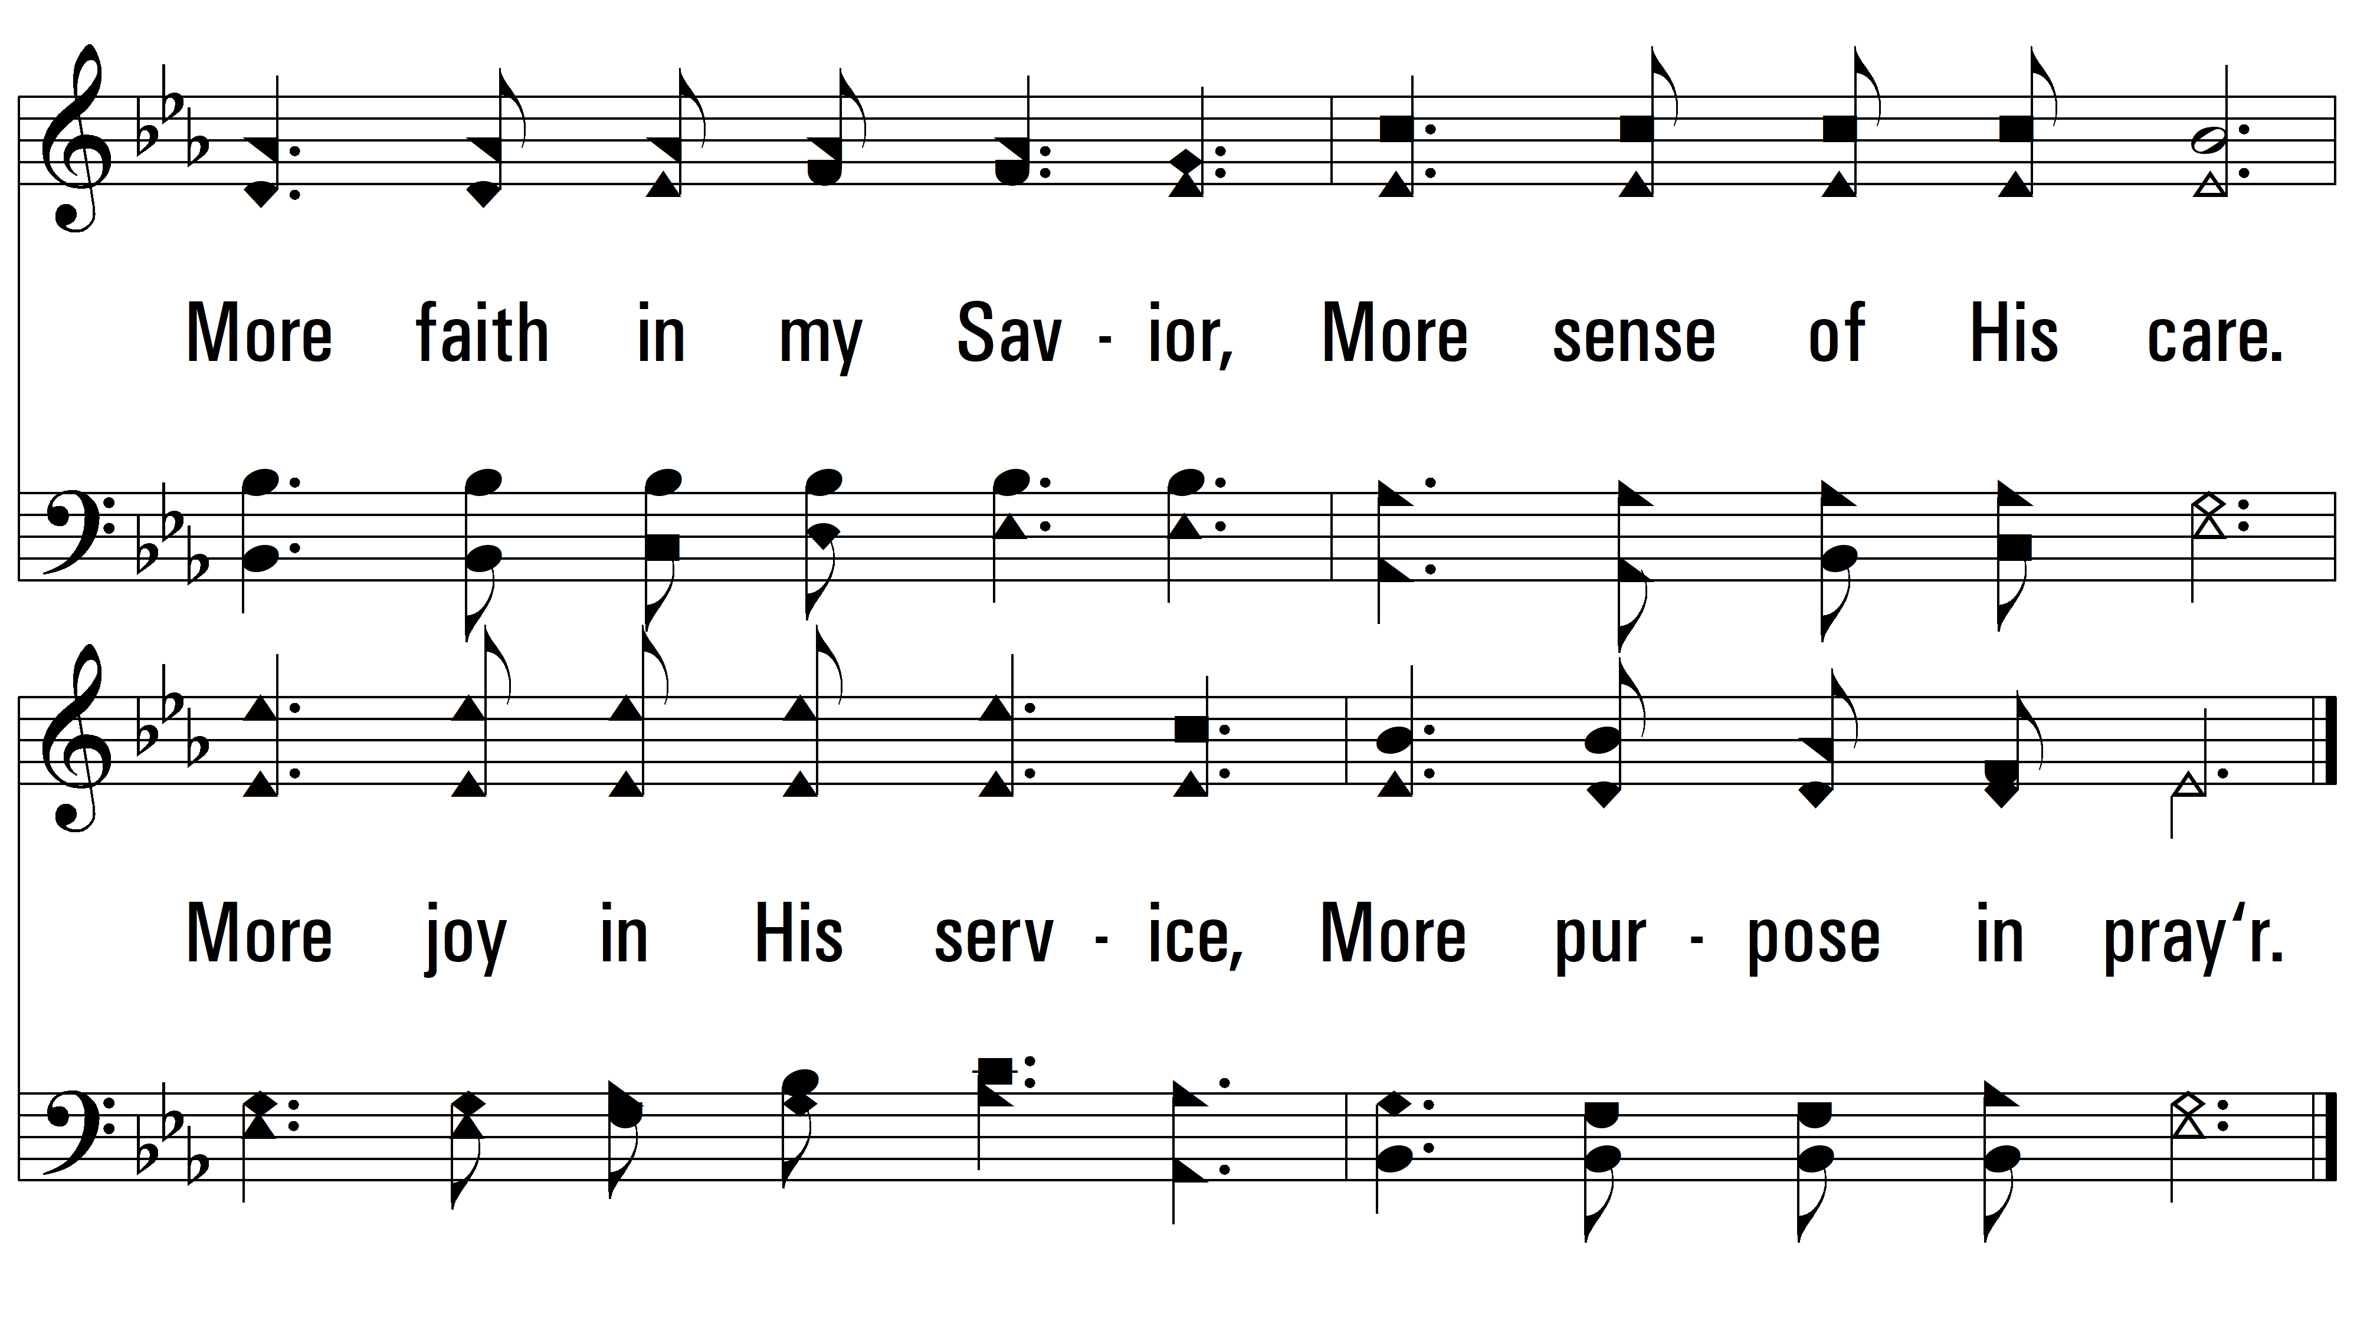
vs. 1

Slide 4
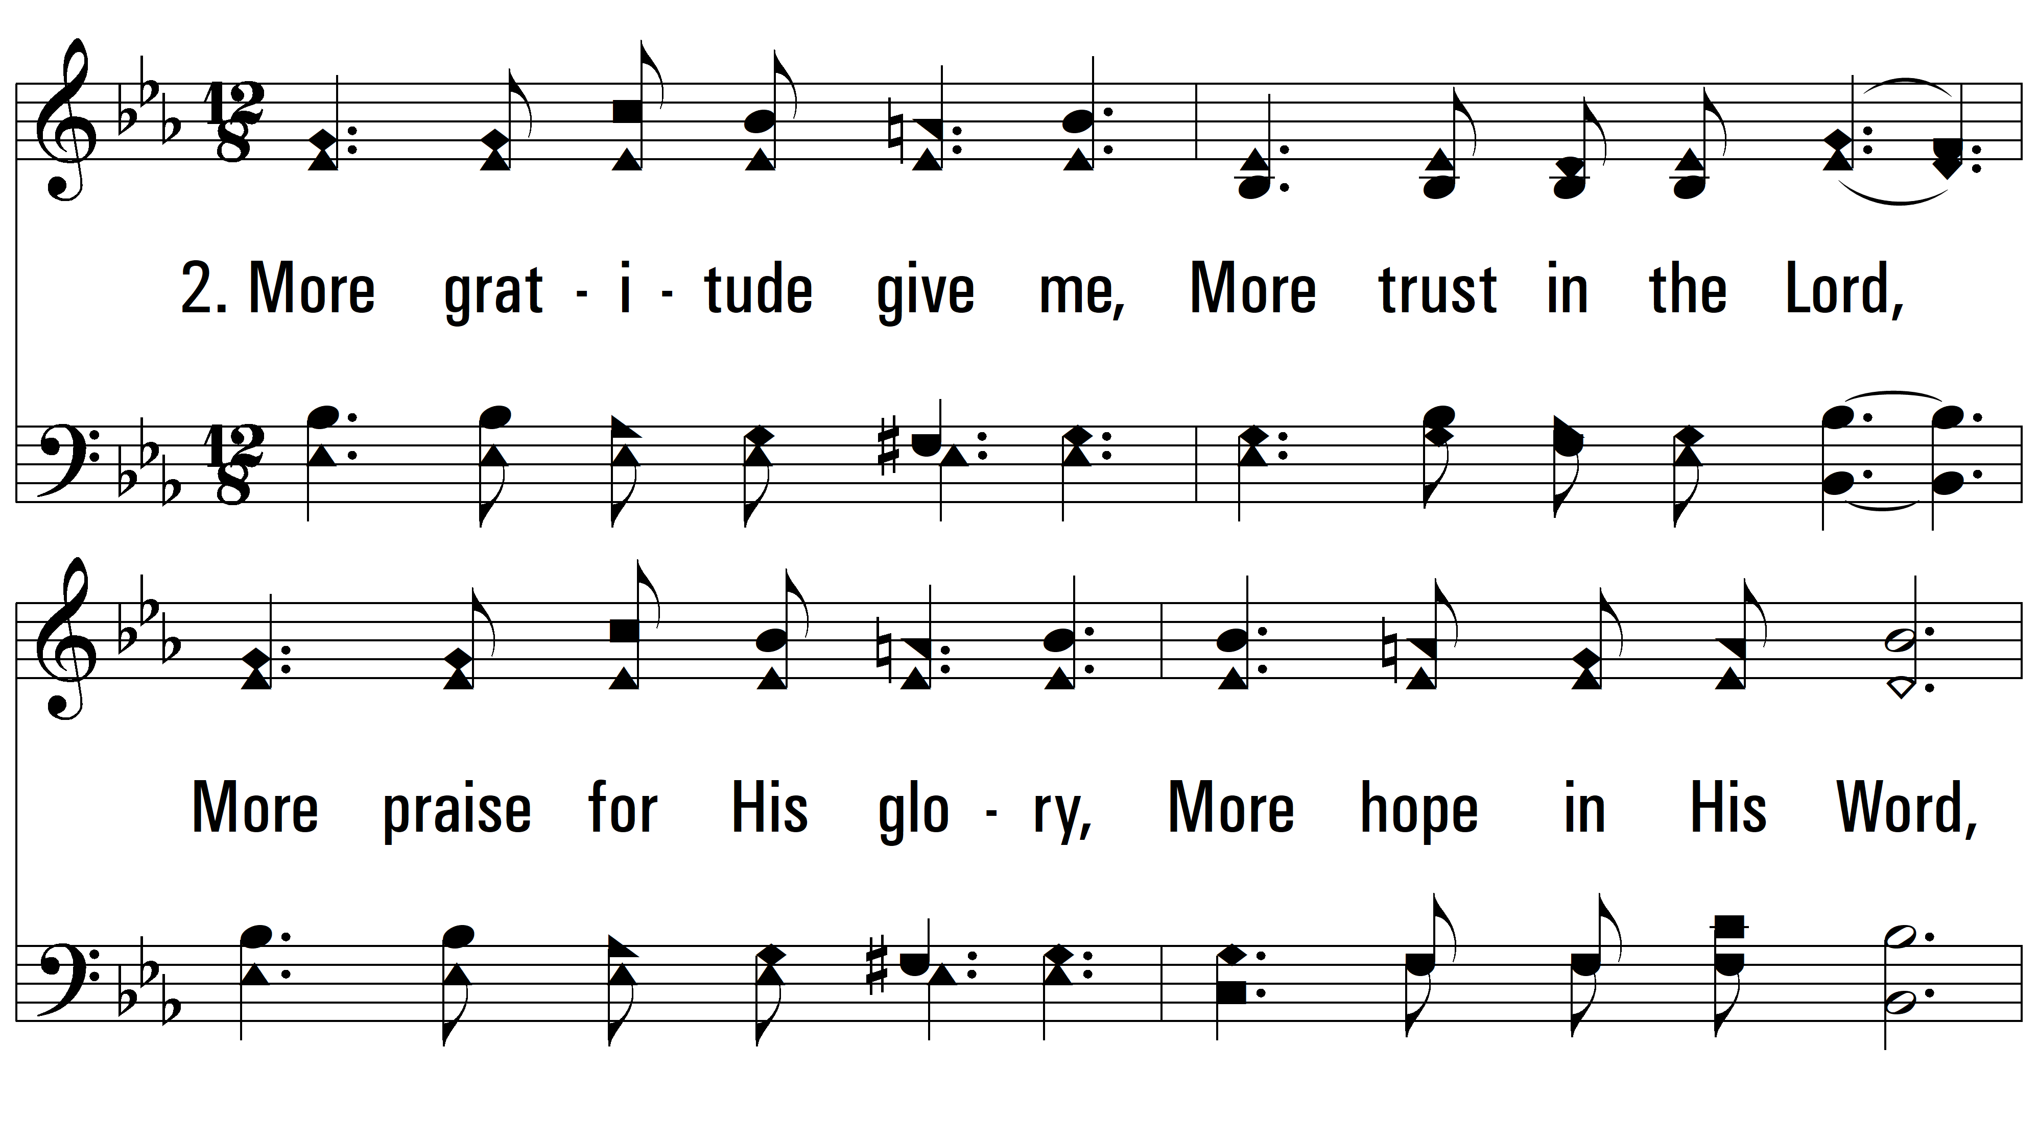
vs. 2 ~ More Holiness Give Me

Slide 5
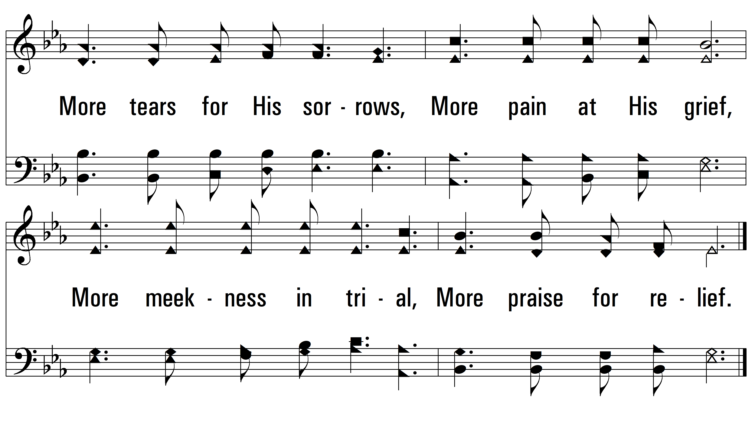
vs. 2

Slide 6
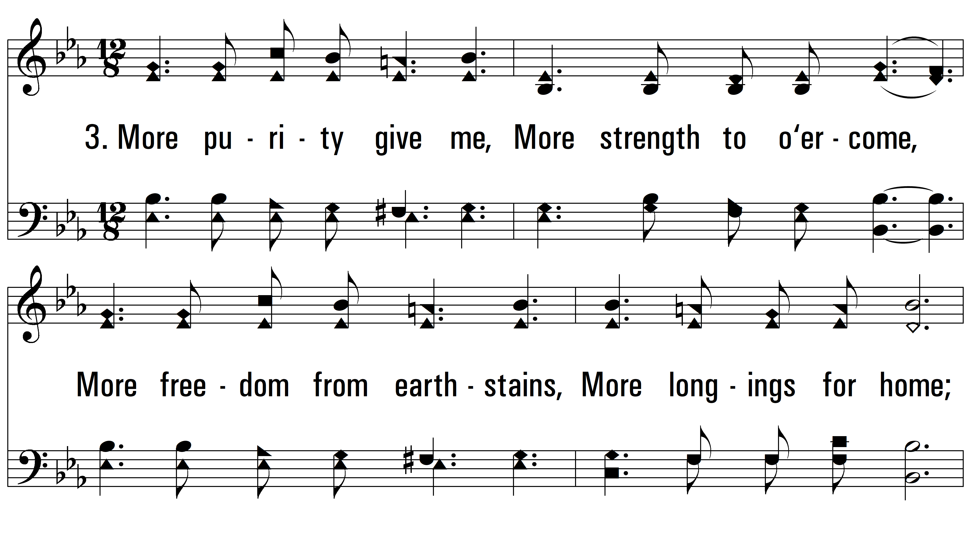
vs. 3 ~ More Holiness Give Me

Slide 7
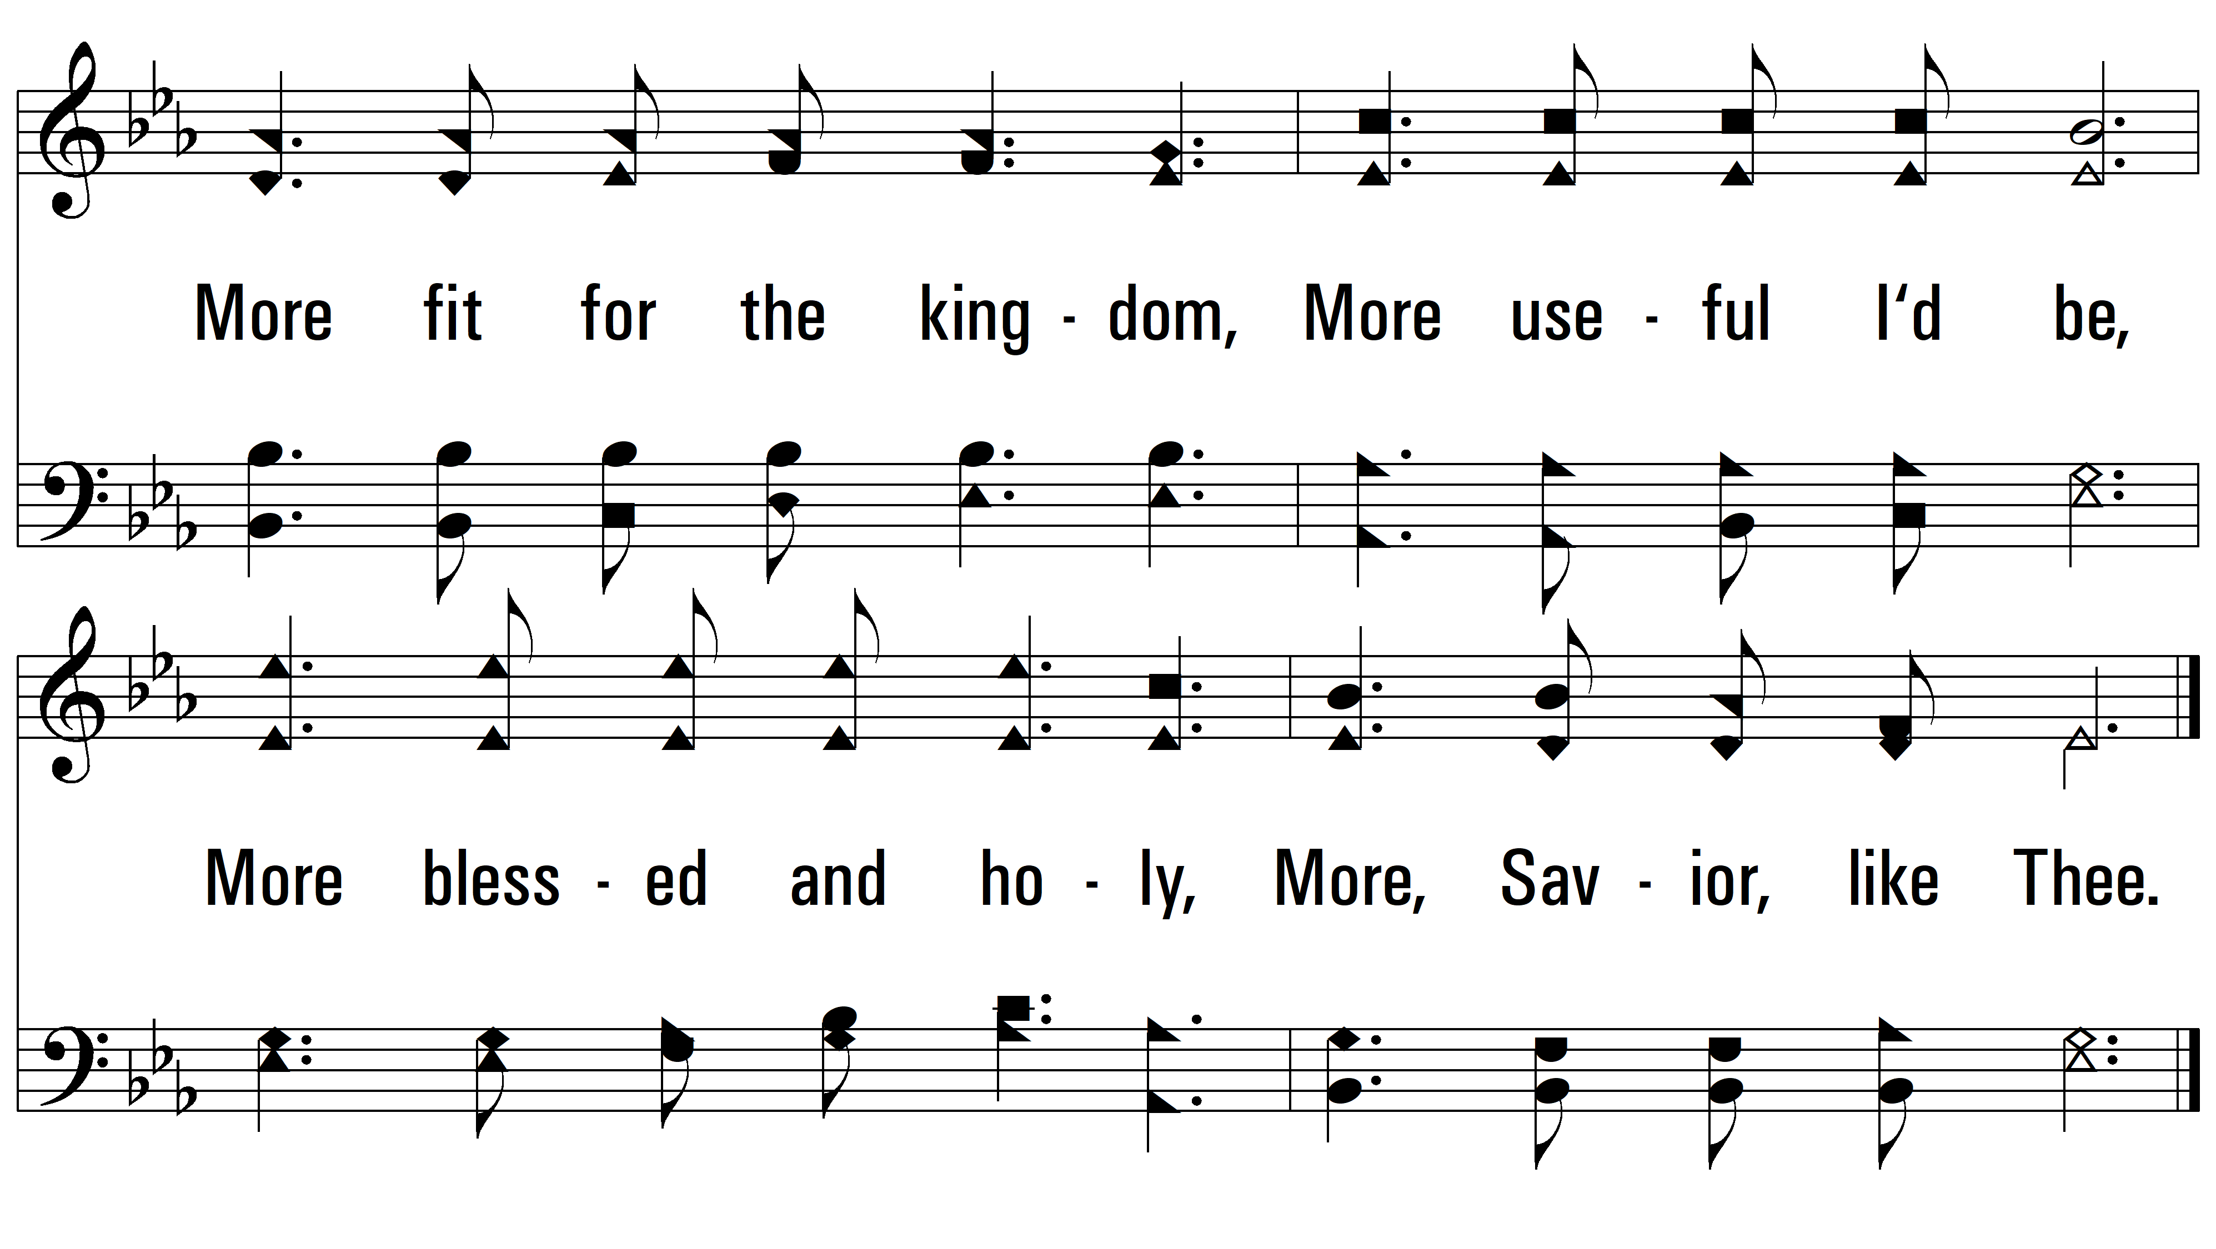
vs. 3
PDHymns.com
END

