Slide 1
Majestic Sweetness
MANOAH
8.6.8.6
Words: | Samuel Stennett (1787)
Music: | Greatorex’s Collection (1851)
3/4
A^{b}/A^{b} - DO
Verses: 5
Lead - | DO
Alto - | SOL
Tenor - | MI
Bass - | DO
PDHymns.com

Slide 2
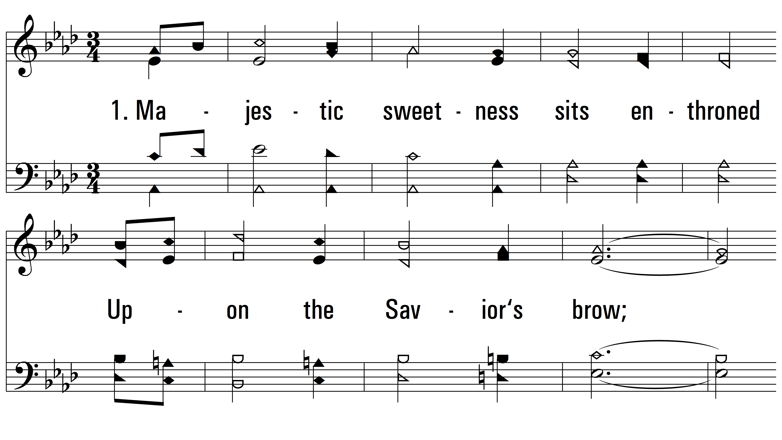
vs. 1 ~ Majestic Sweetness

Slide 3
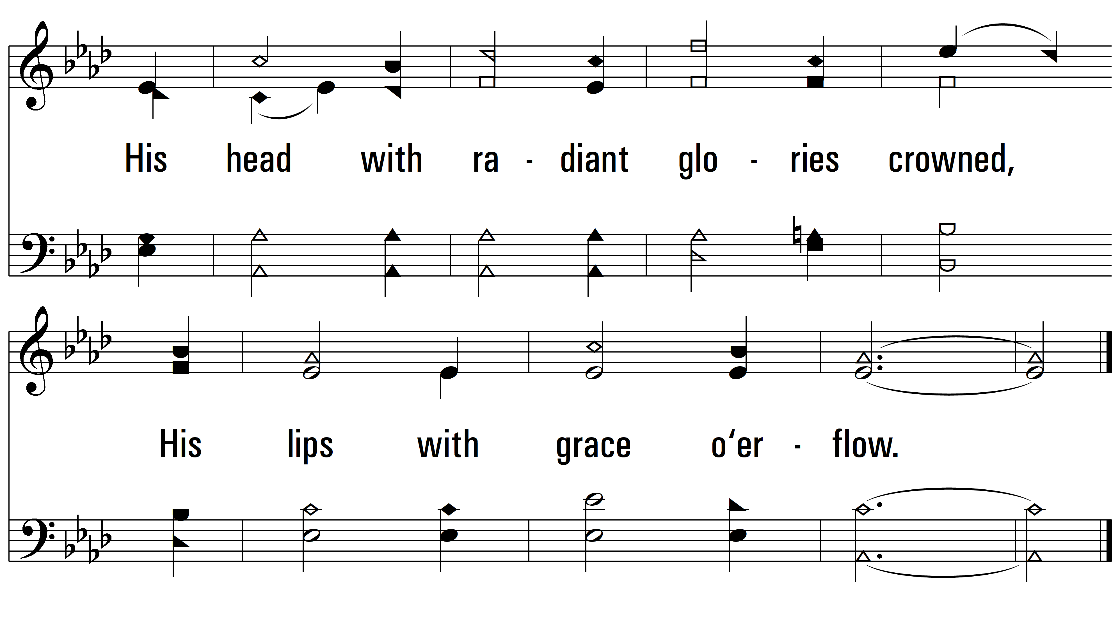
vs. 1

Slide 4
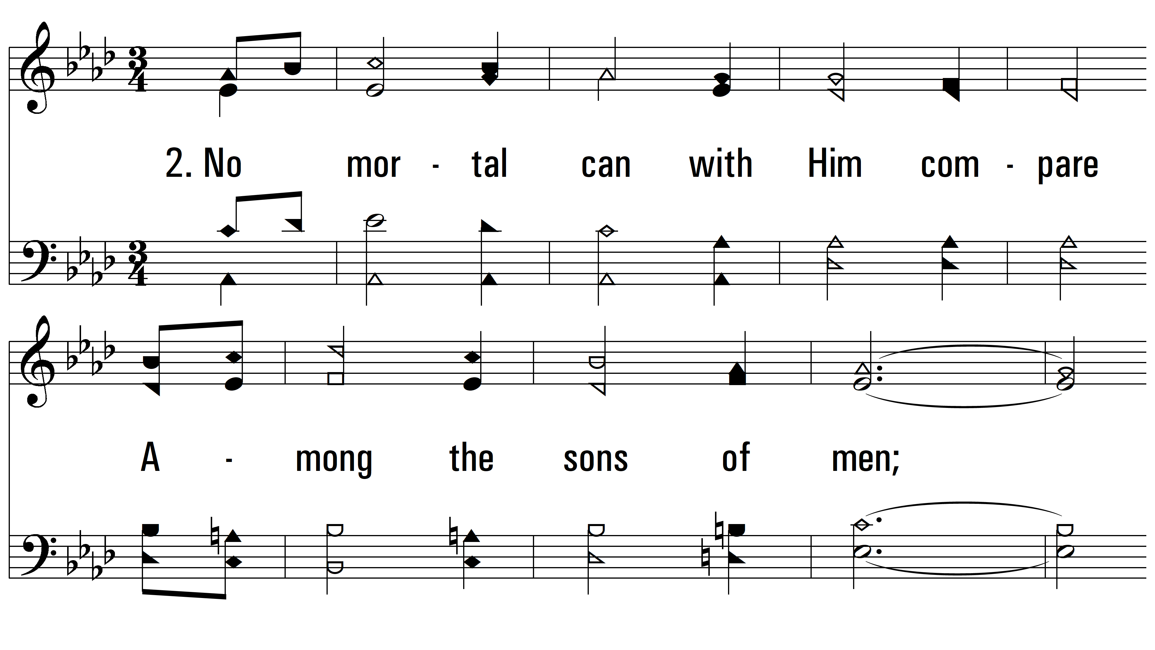
vs. 2 ~ Majestic Sweetness

Slide 5
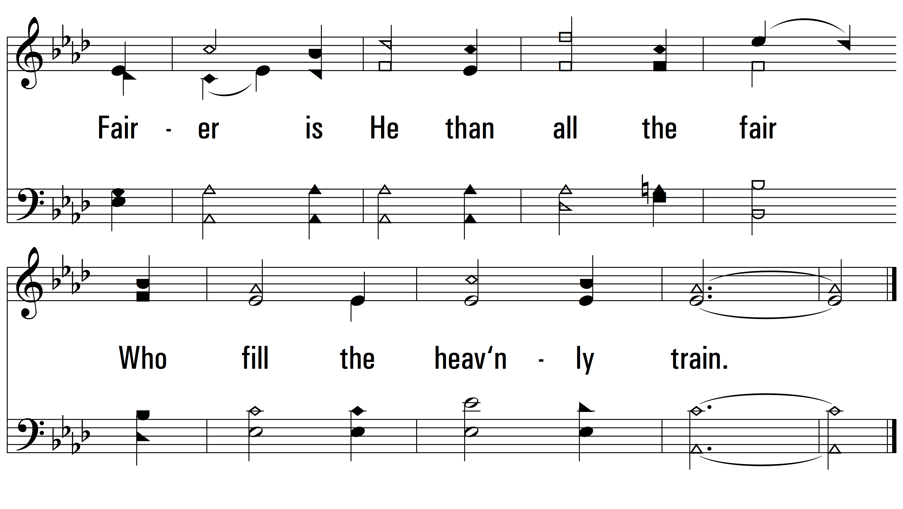
vs. 2

Slide 6
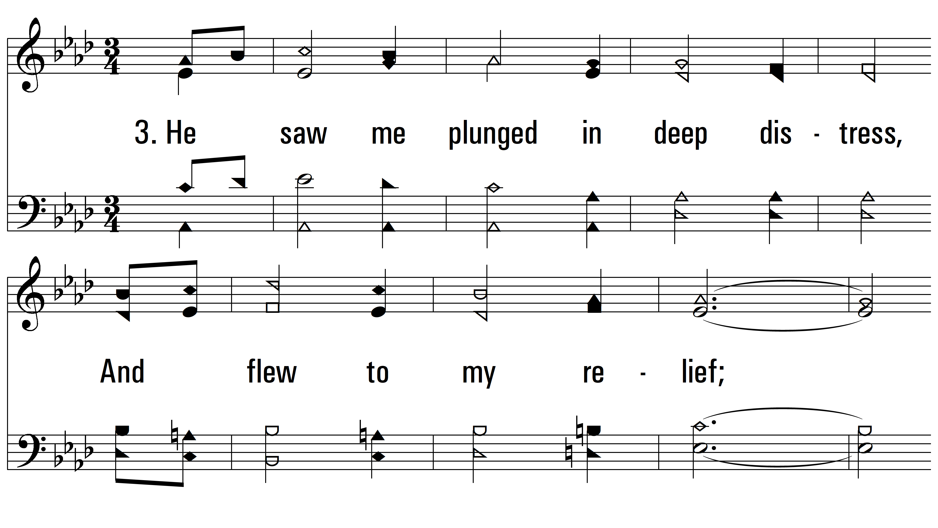
vs. 3 ~ Majestic Sweetness

Slide 7
vs. 3

Slide 8
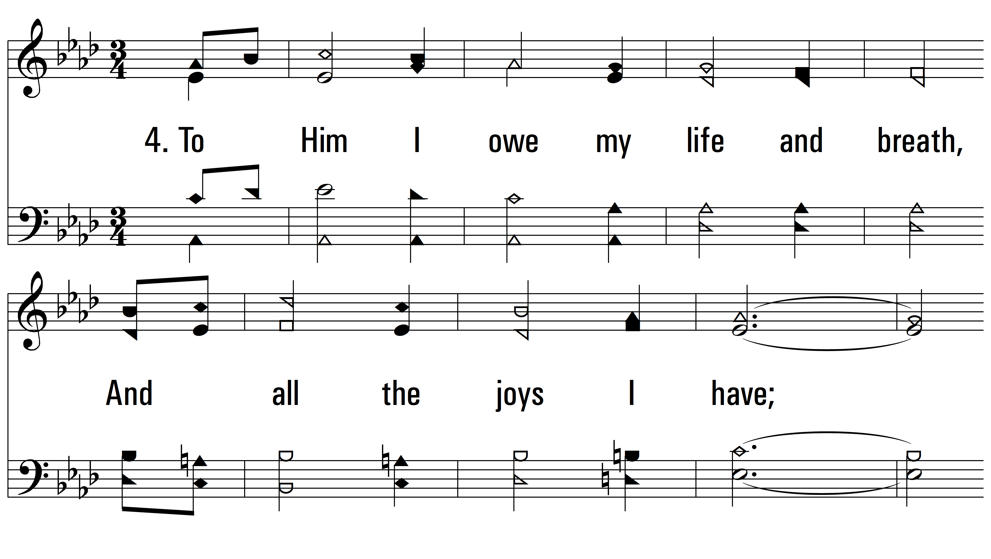
vs. 4 ~ Majestic Sweetness

Slide 9
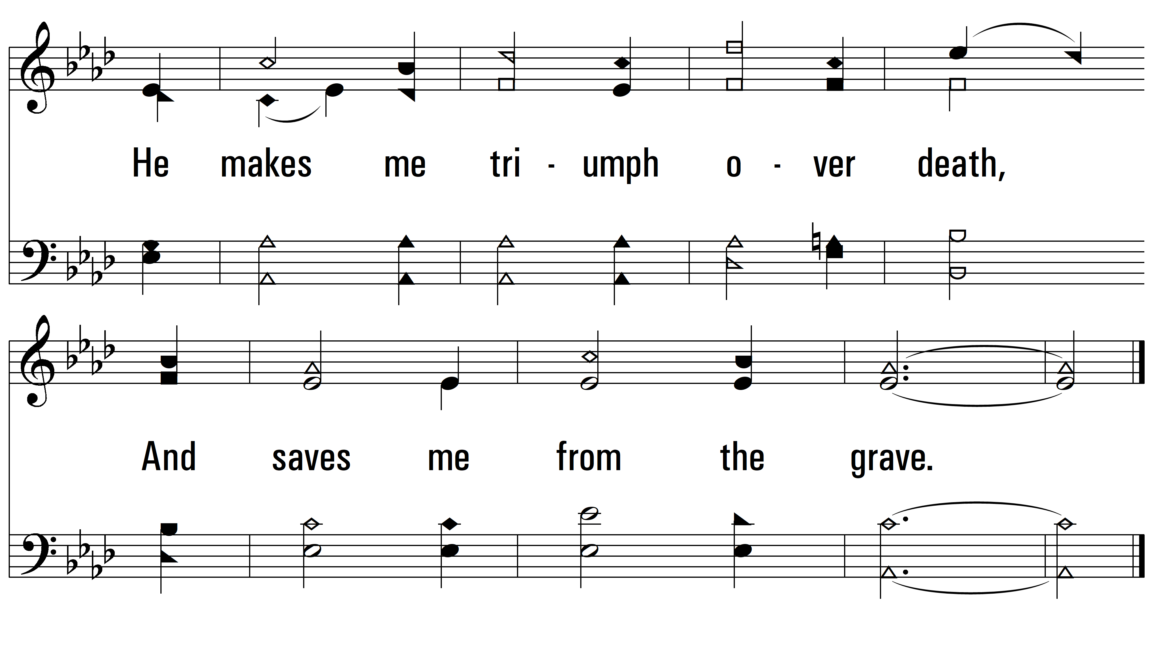
vs. 4

Slide 10
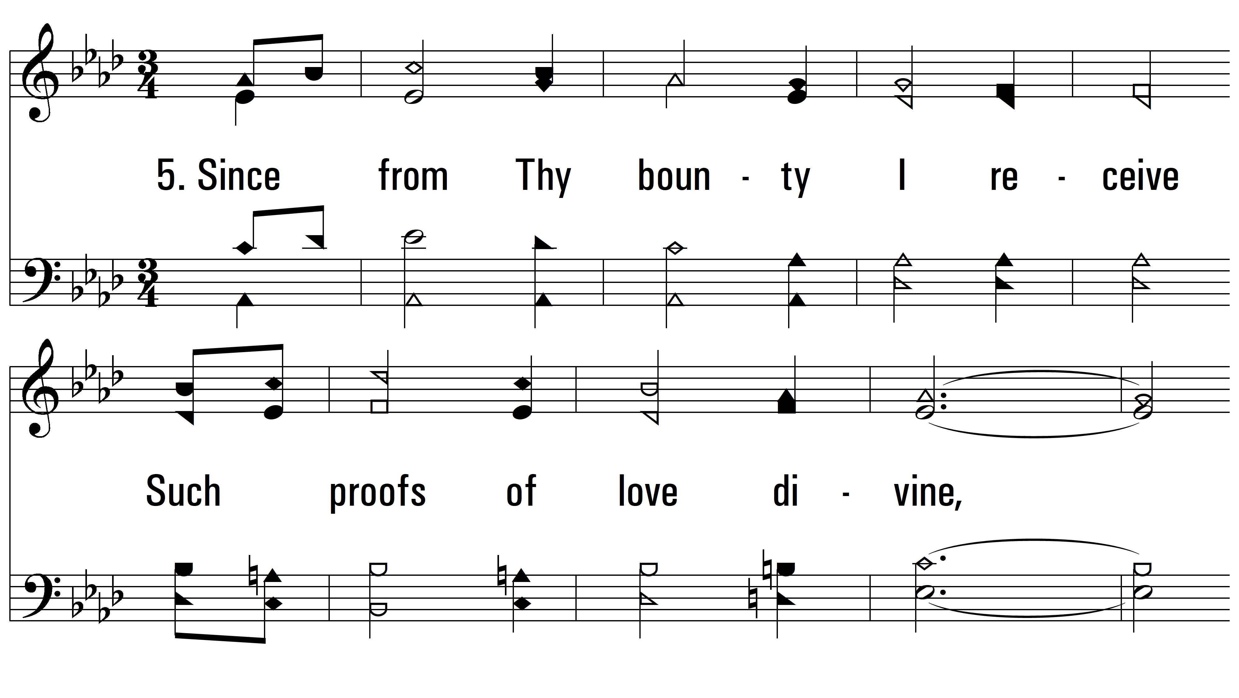
vs. 5 ~ Majestic Sweetness

Slide 11
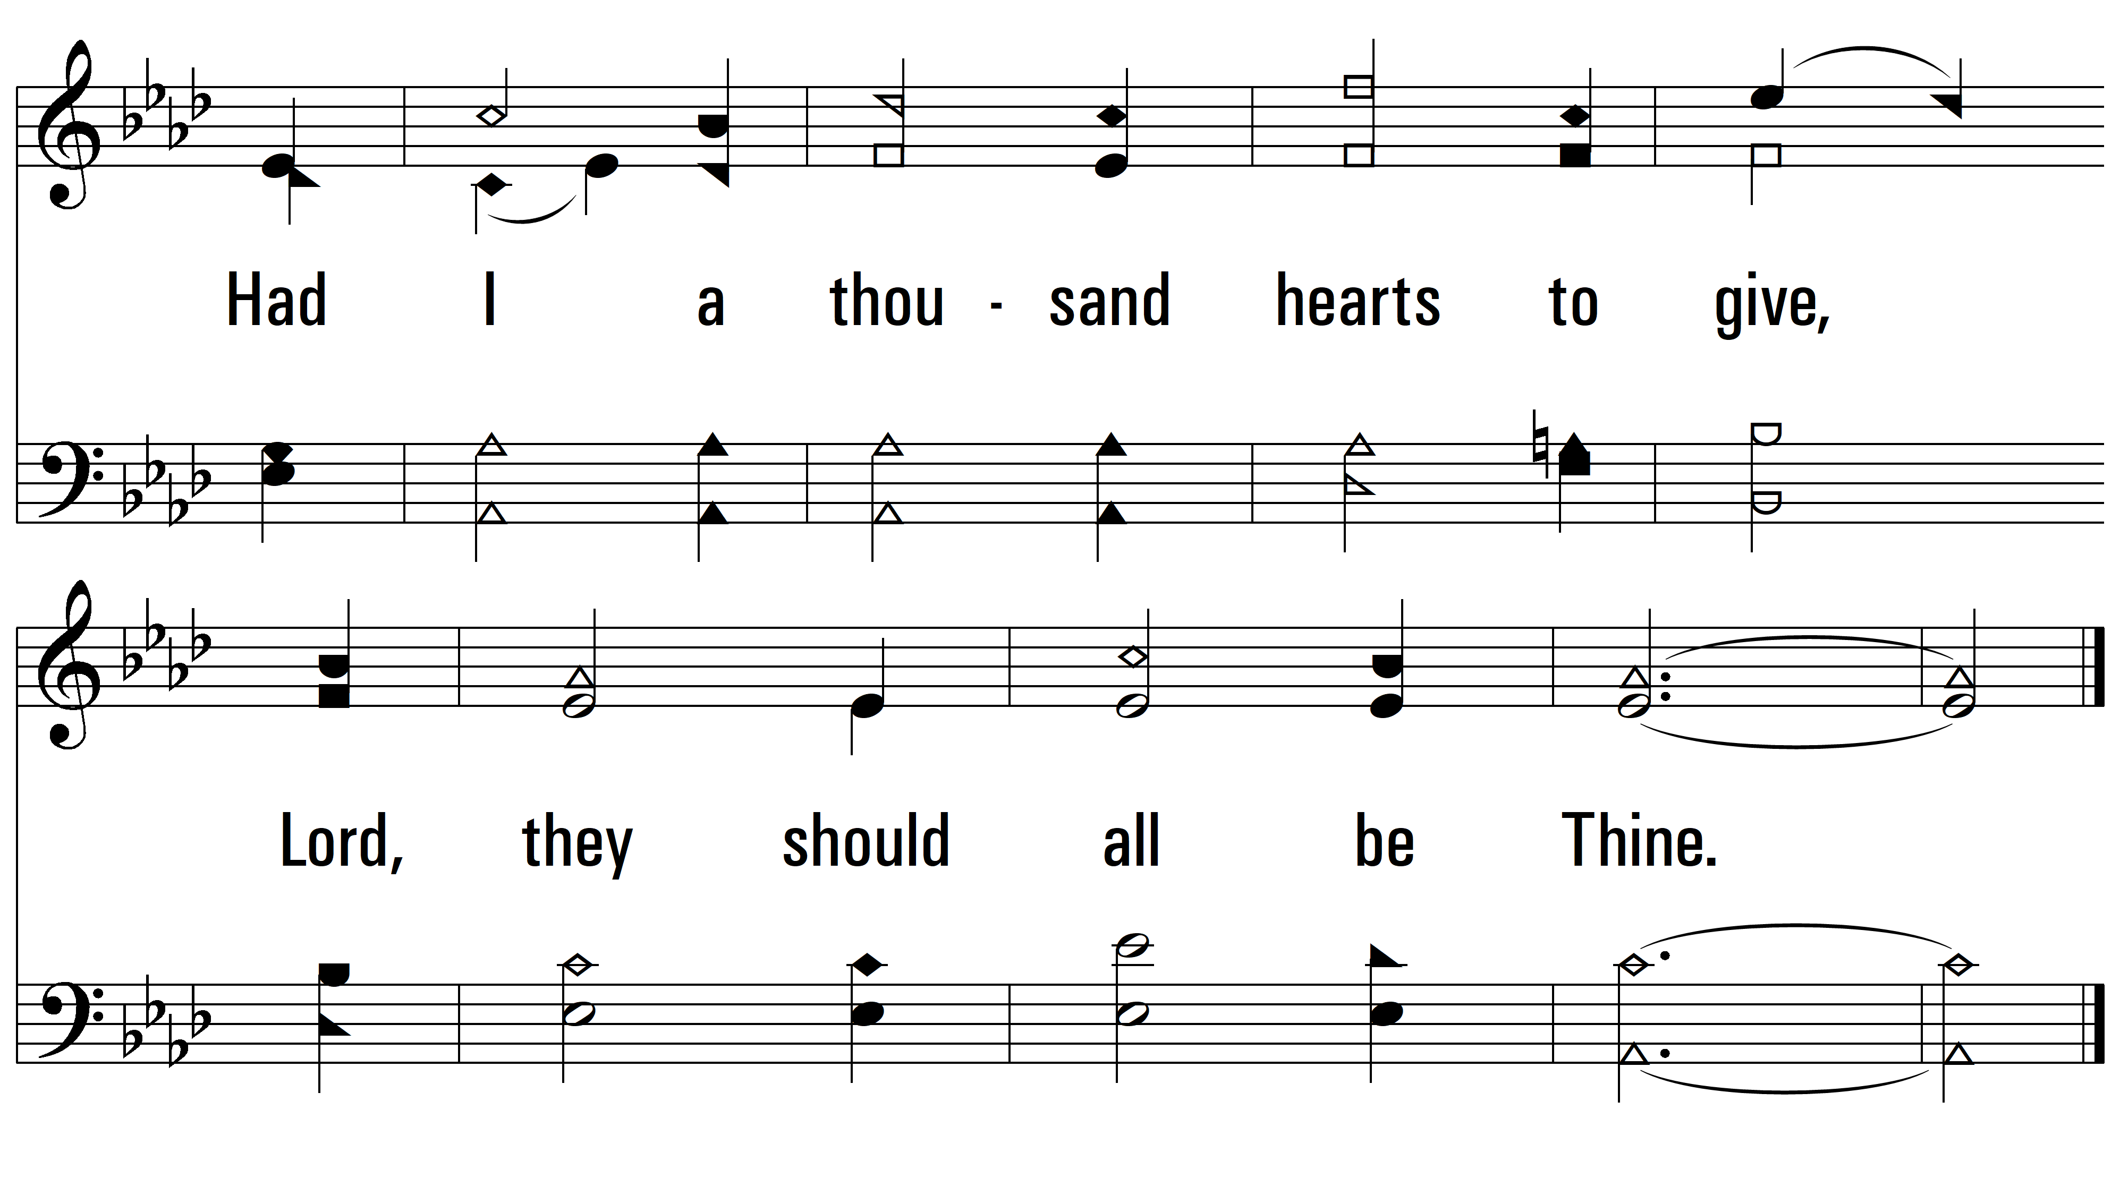
vs. 5
PDHymns.com
END

