Slide 1
Love For All
HORTON
7.7.7.7
Words: | Samuel Longfellow (1864)
Music: | Xavier Schnyder von Wartensee (1826)
3/4
A/E - SOL
Verses: 5
Lead - | SOL
Alto - | MI
Tenor - | DO
Bass - | DO
PDHymns.com

Slide 2
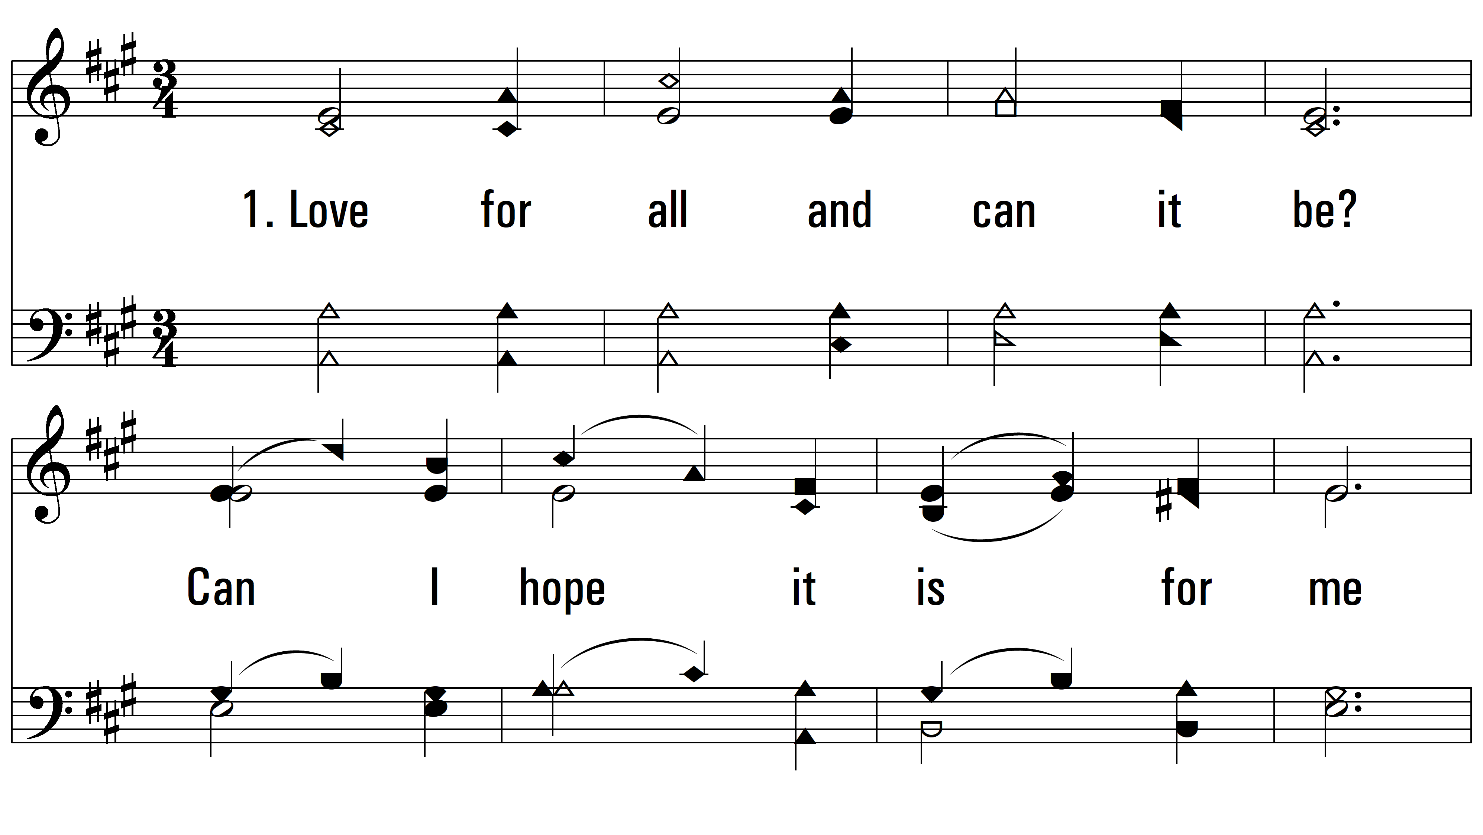
vs. 1 ~ Love For All

Slide 3
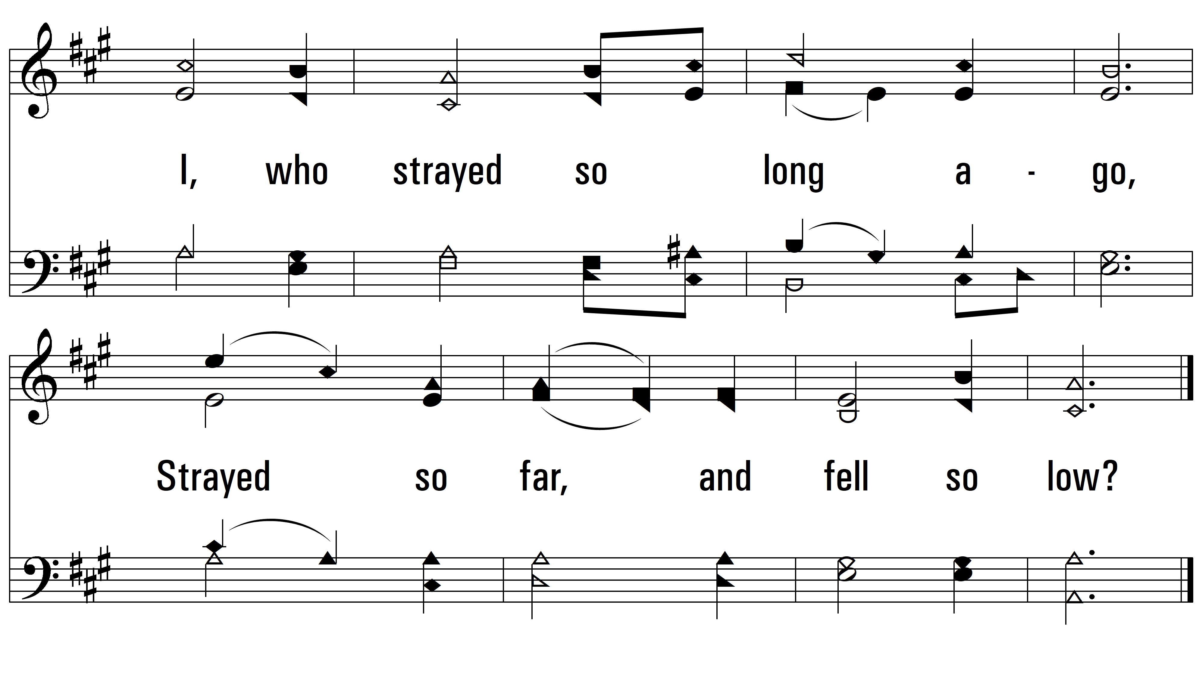
vs. 1

Slide 4
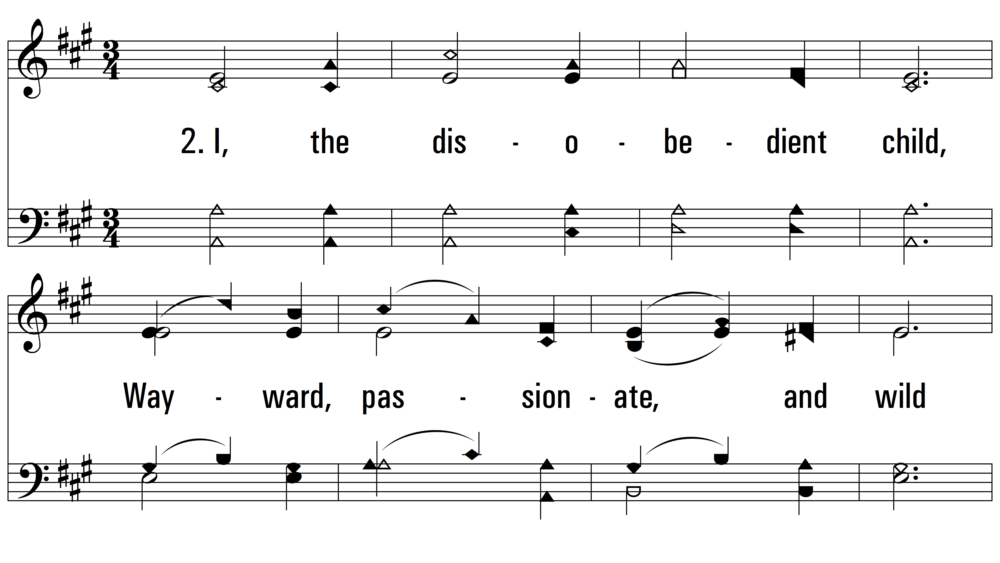
vs. 2 ~ Love For All

Slide 5
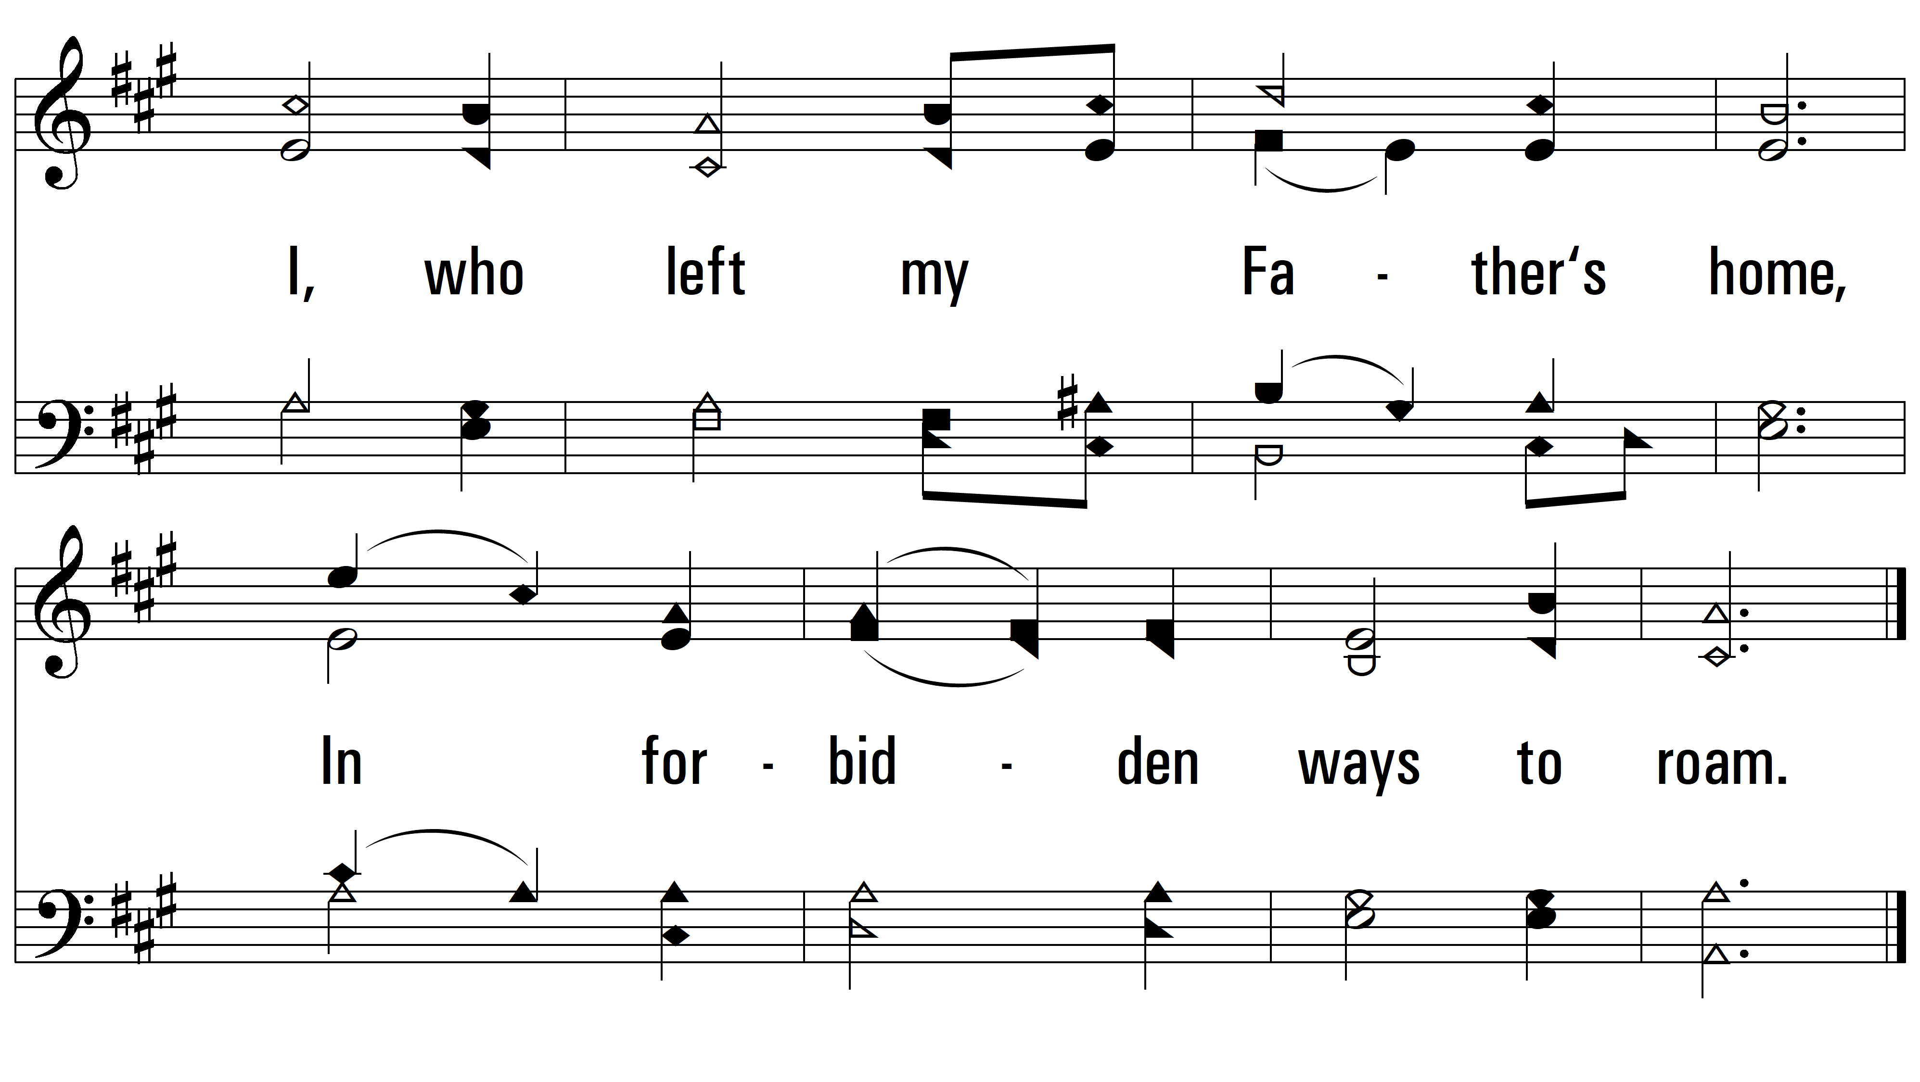
vs. 2

Slide 6
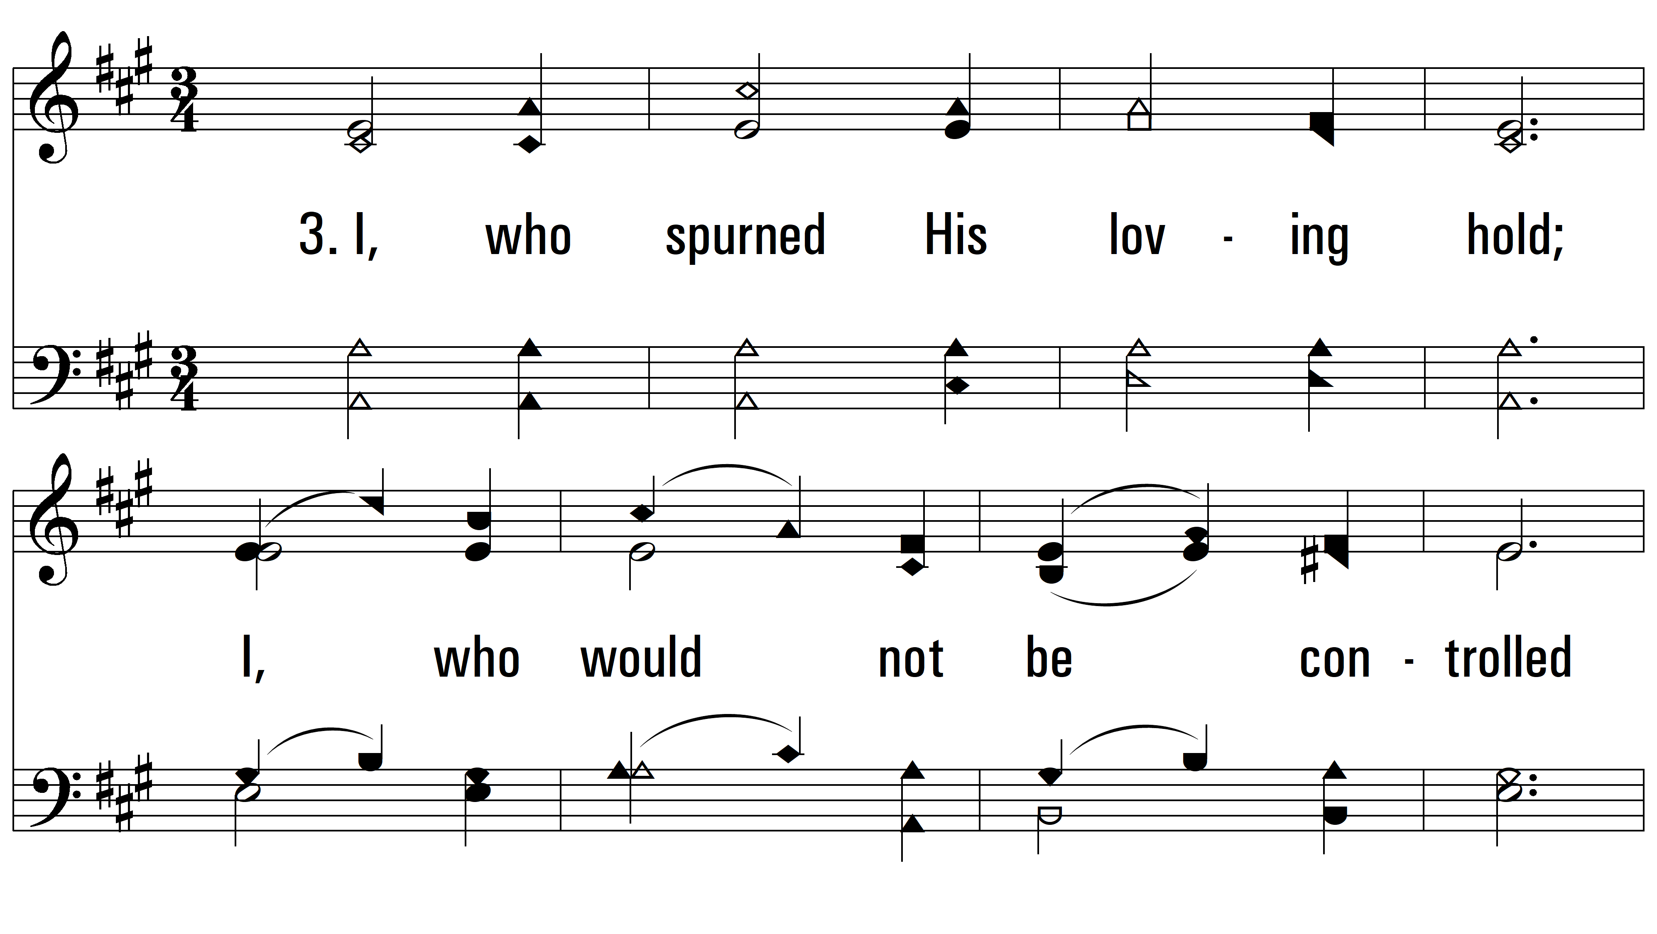
vs. 3 ~ Love For All

Slide 7
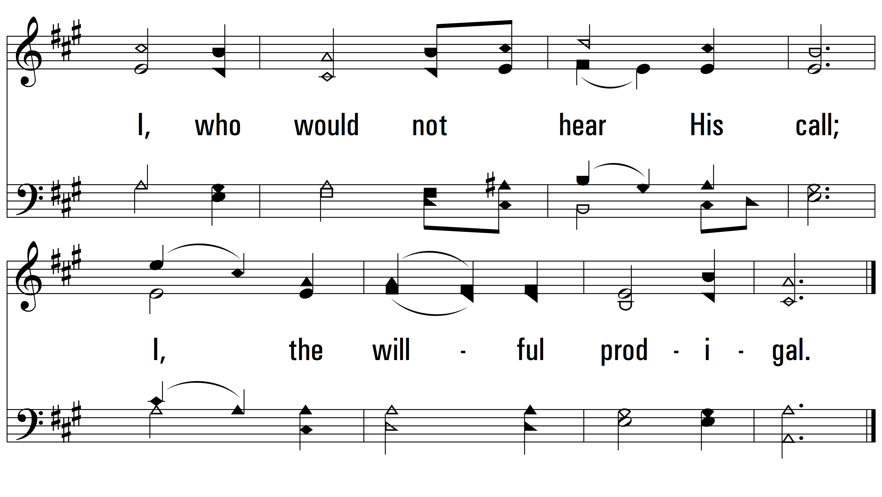
vs. 3

Slide 8
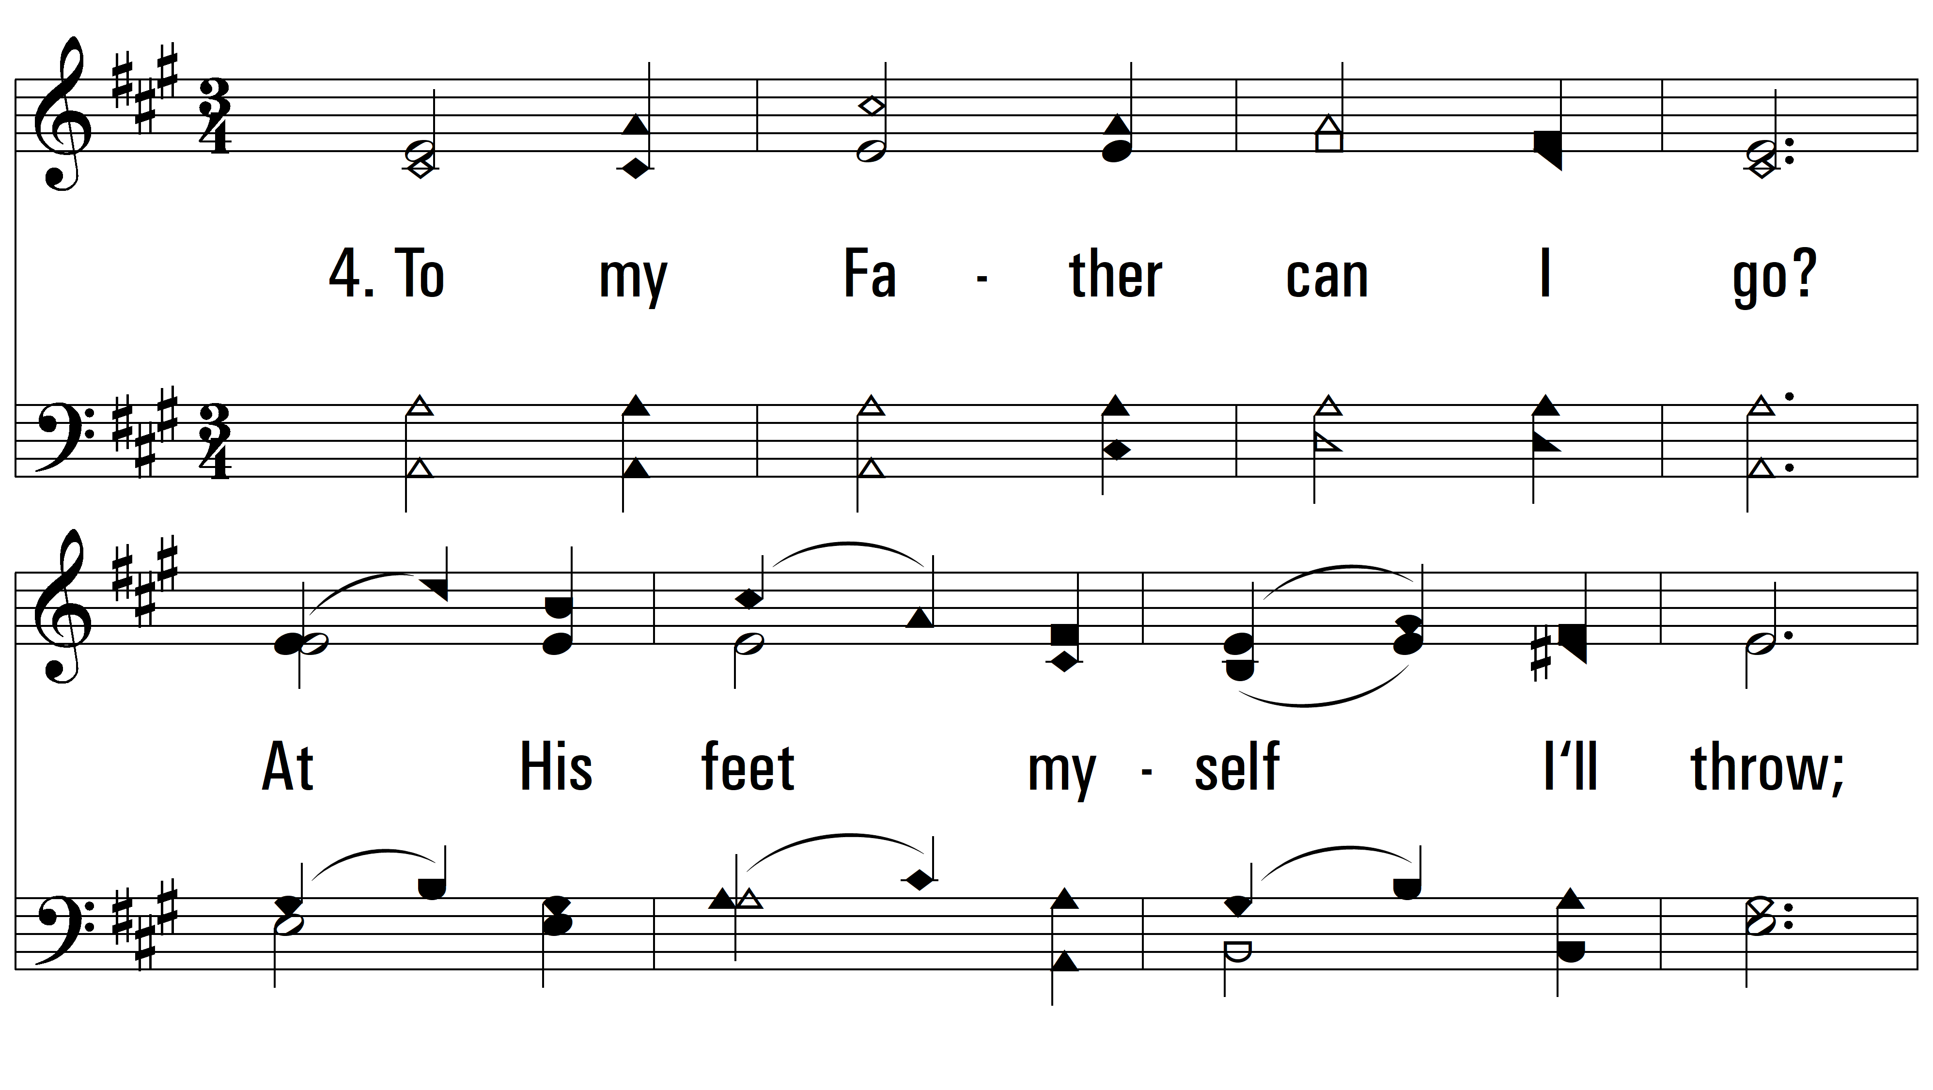
vs. 4 ~ Love For All

Slide 9
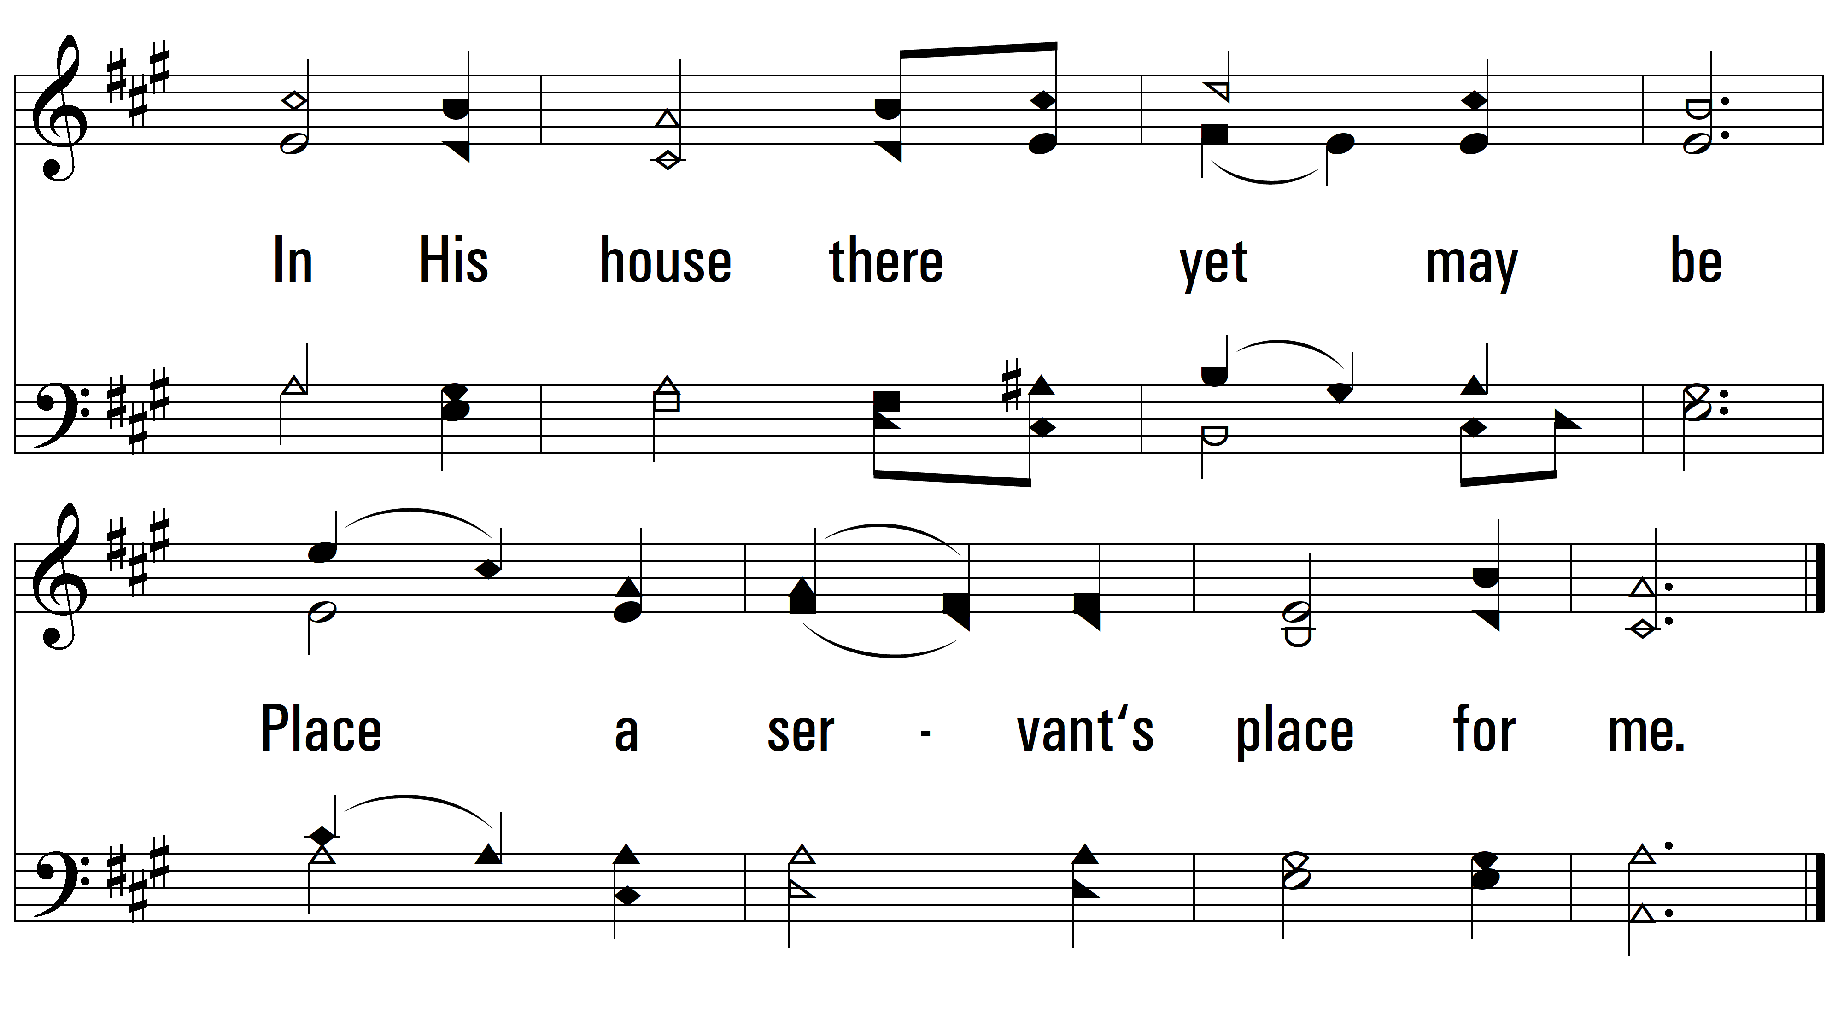
vs. 4

Slide 10
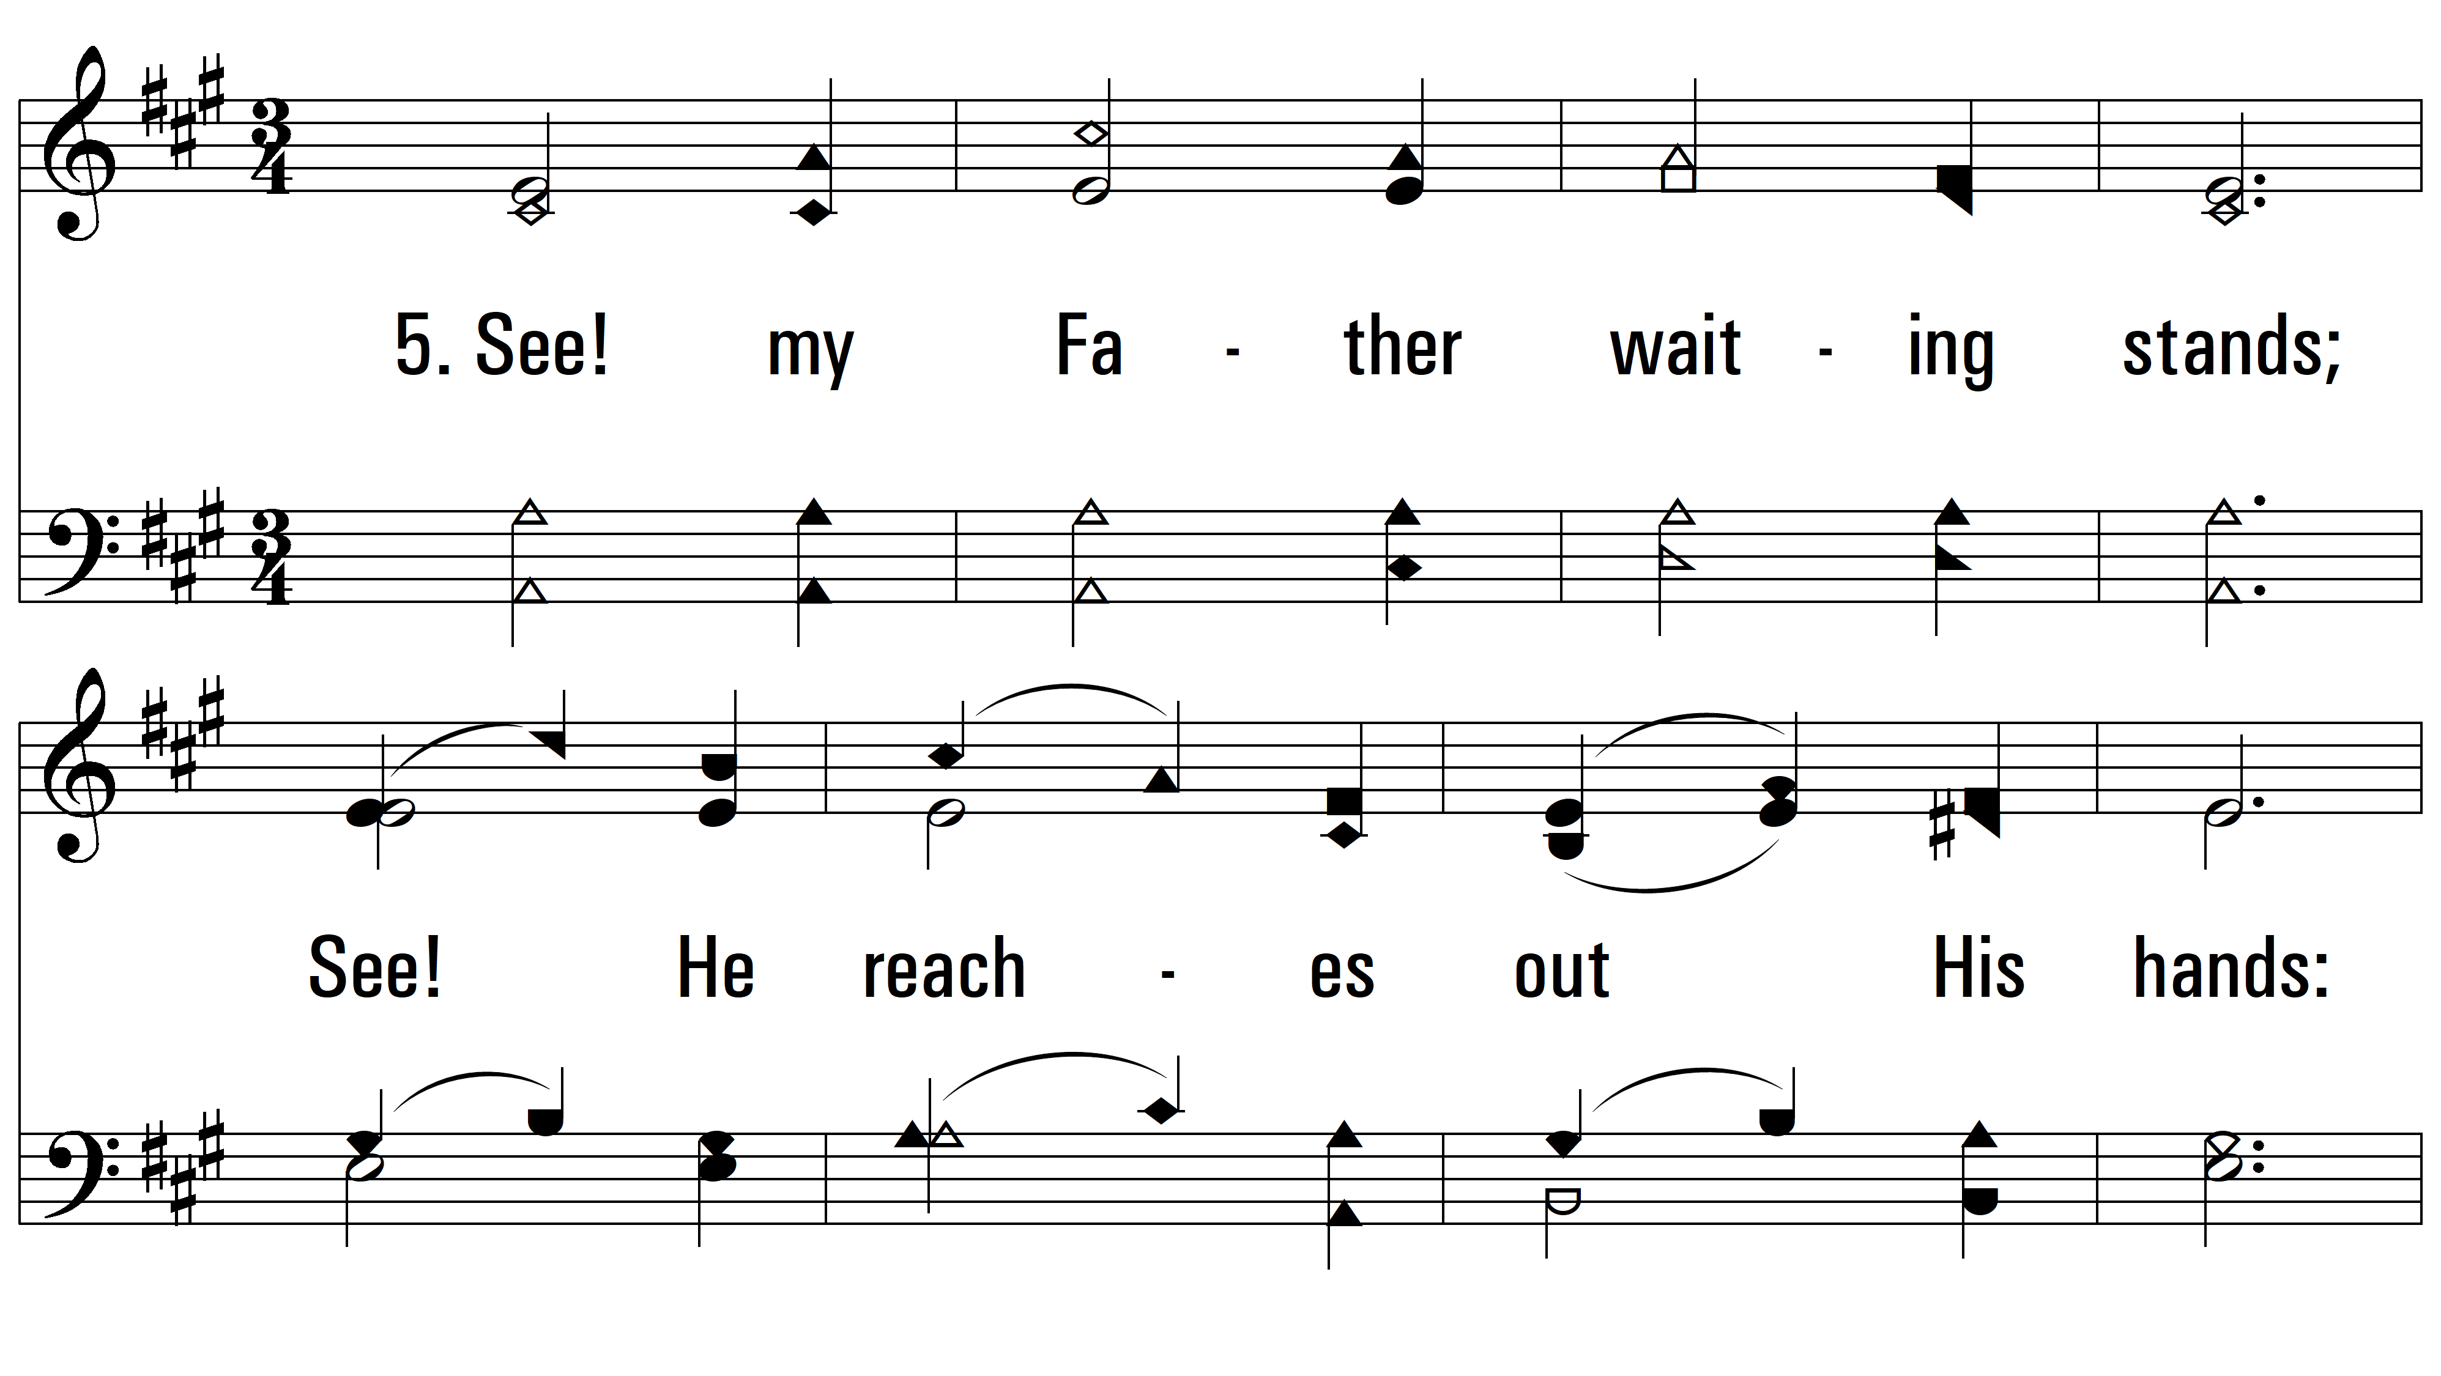
vs. 5 ~ Love For All

Slide 11
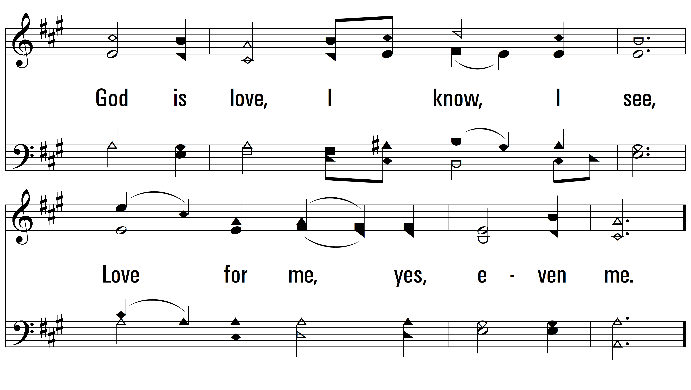
vs. 5
PDHymns.com
END

