Slide 1
Love Divine
BEECHER
8.7.8.7.D
Words: | Charles Wesley (1747)
Music: | John Zundel (1870)
4/4
B^{b}/F - SOL
Verses: 4
Lead - | SOL
Alto - | MI
Tenor - | SOL
Bass - | DO
PDHymns.com

Slide 2
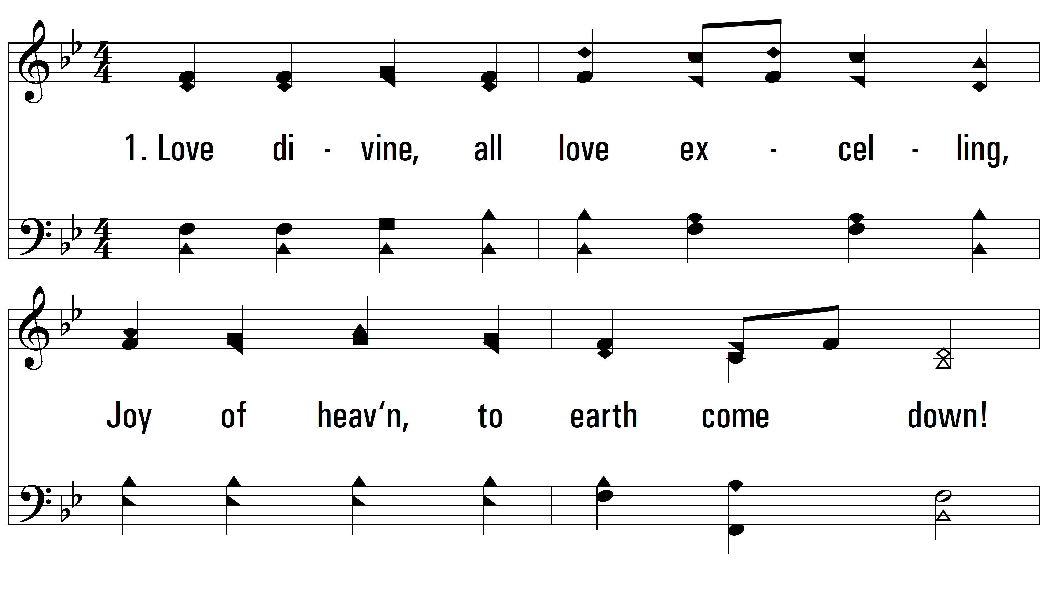
vs. 1 ~ Love Divine

Slide 3
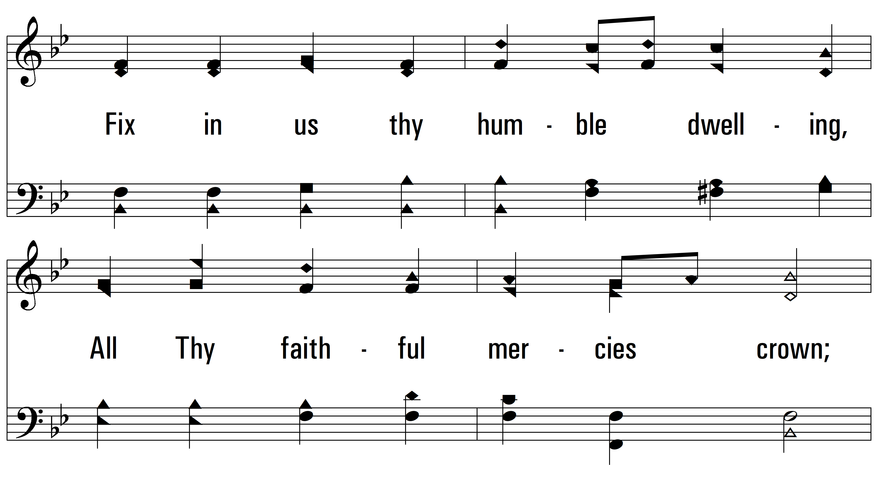
vs. 1

Slide 4
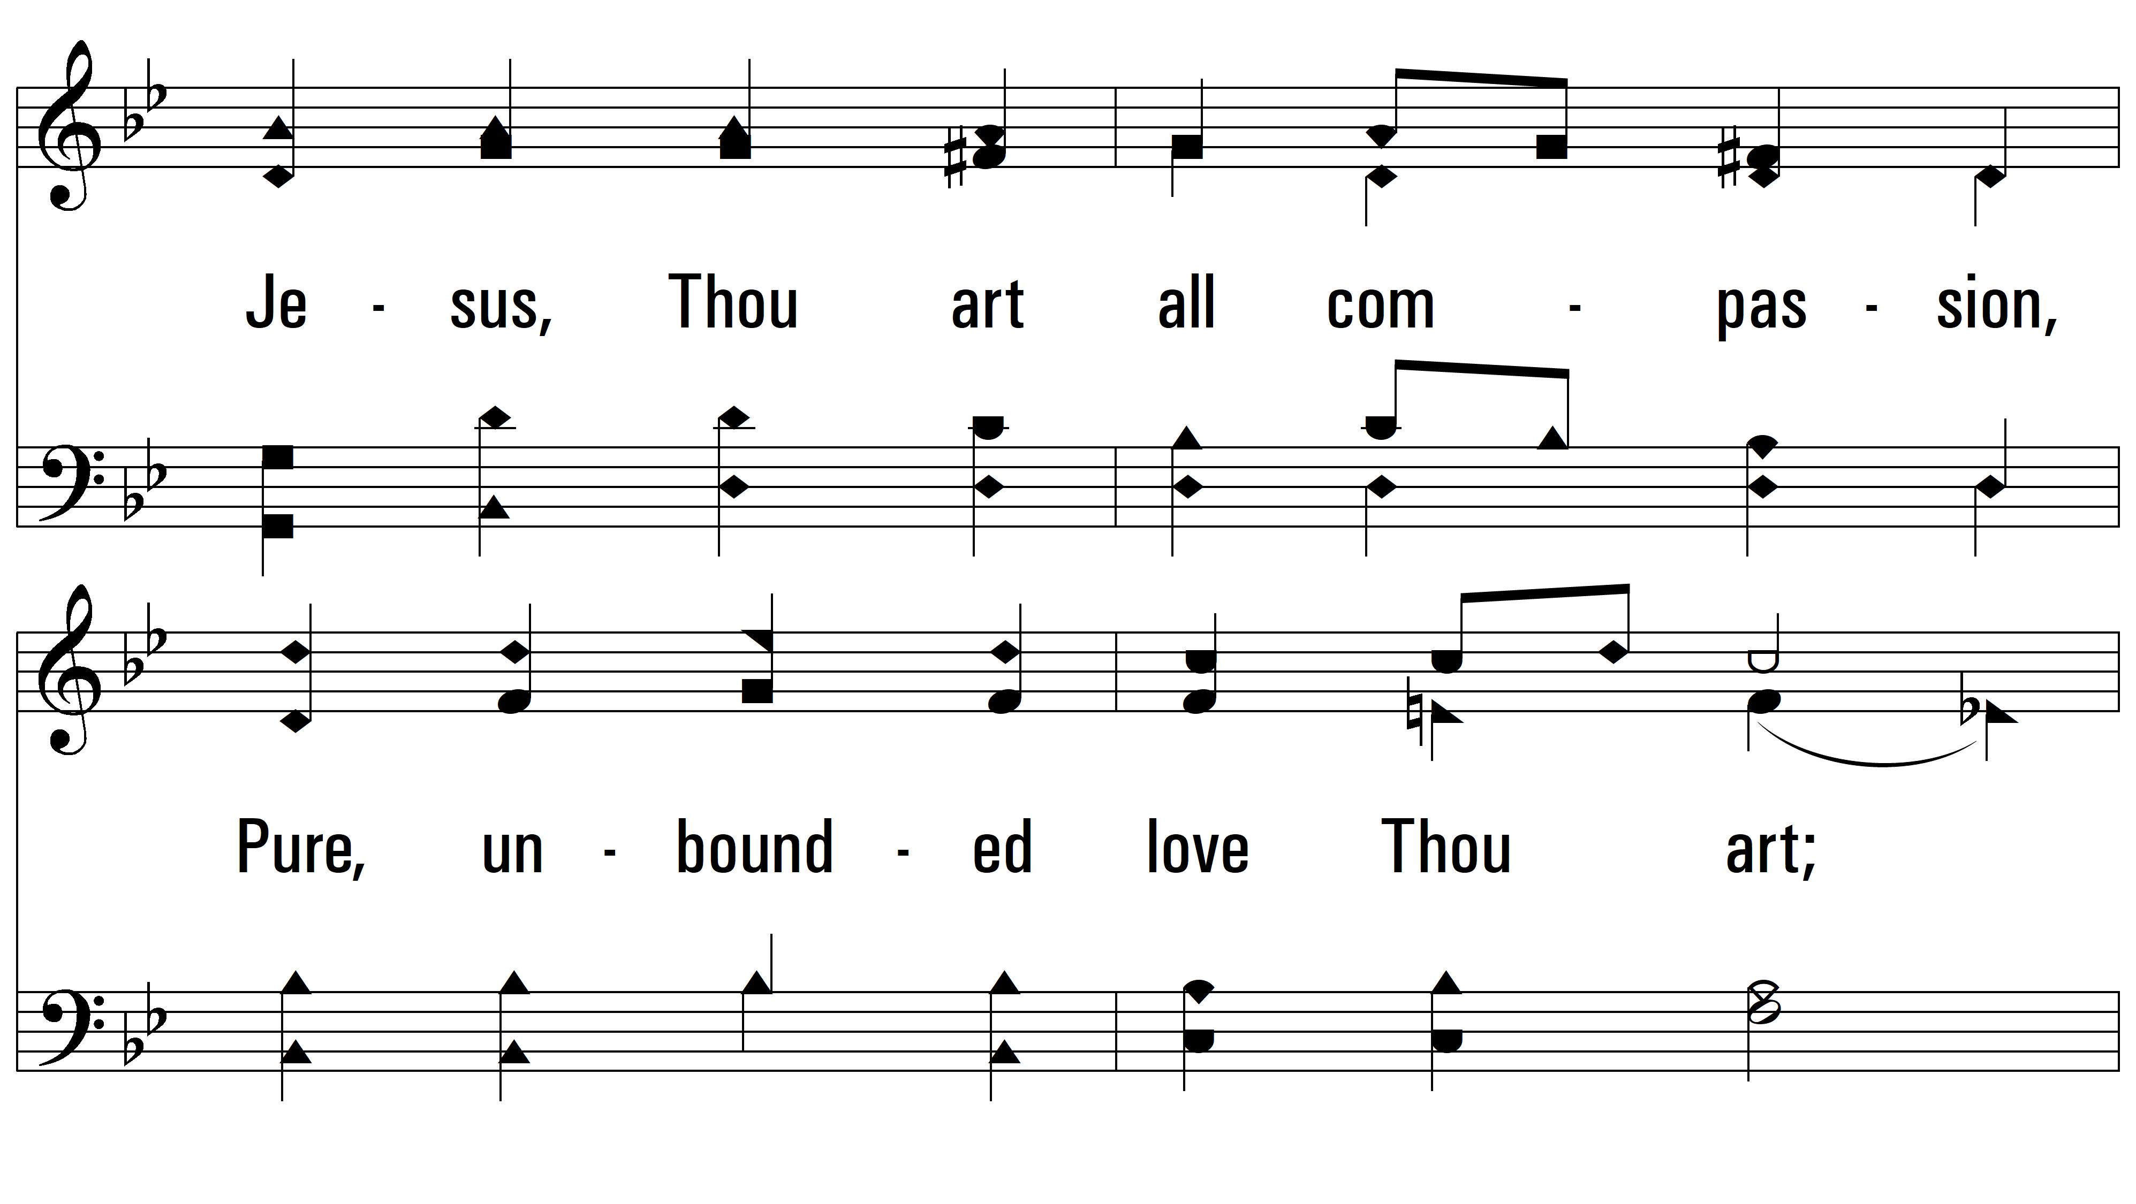
vs. 1

Slide 5
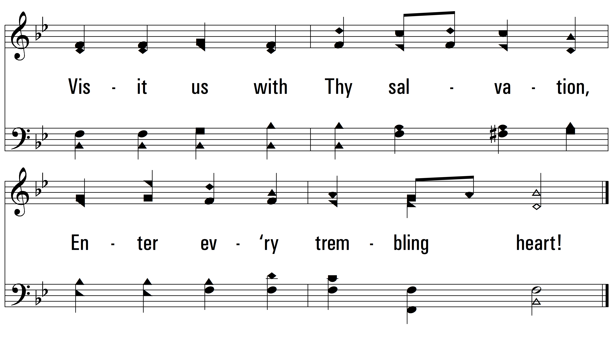
vs. 1

Slide 6
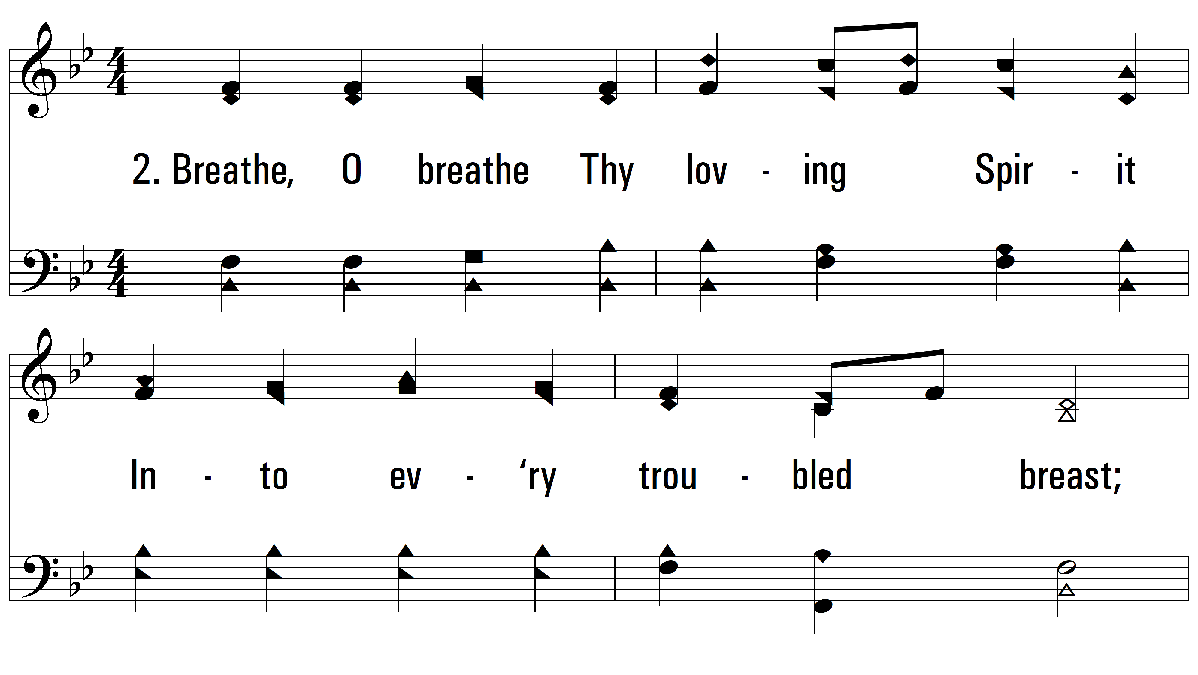
vs. 2 ~ Love Divine

Slide 7
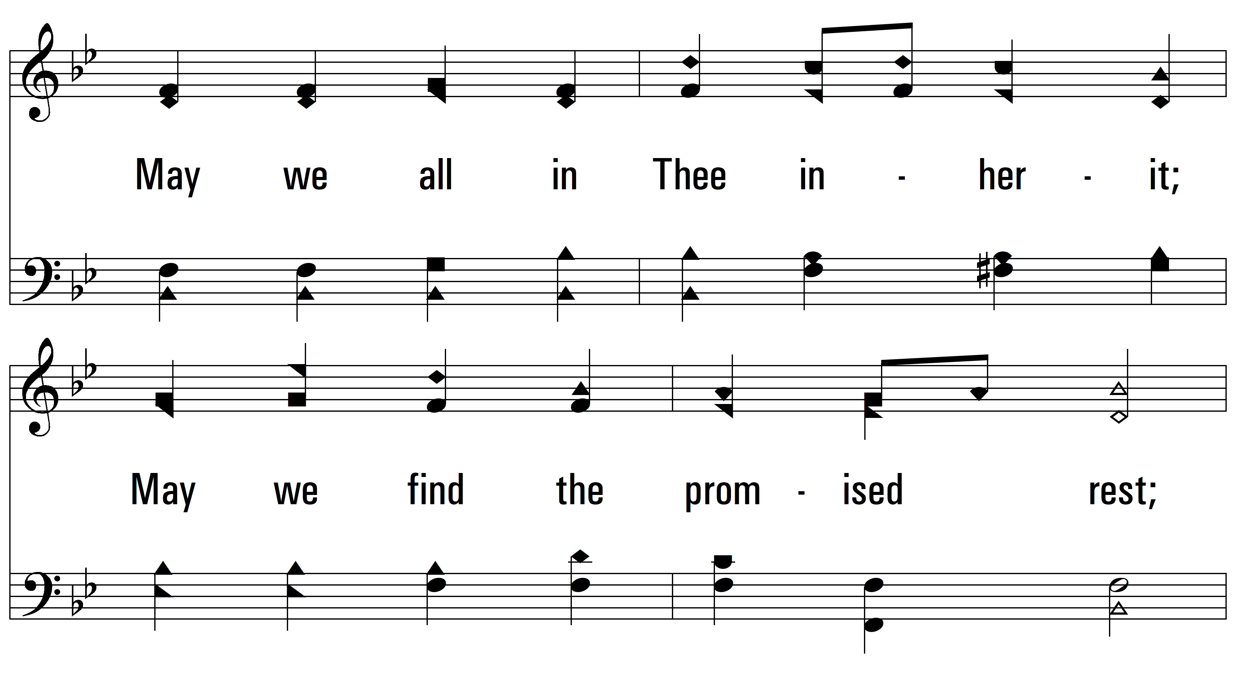
vs. 2

Slide 8
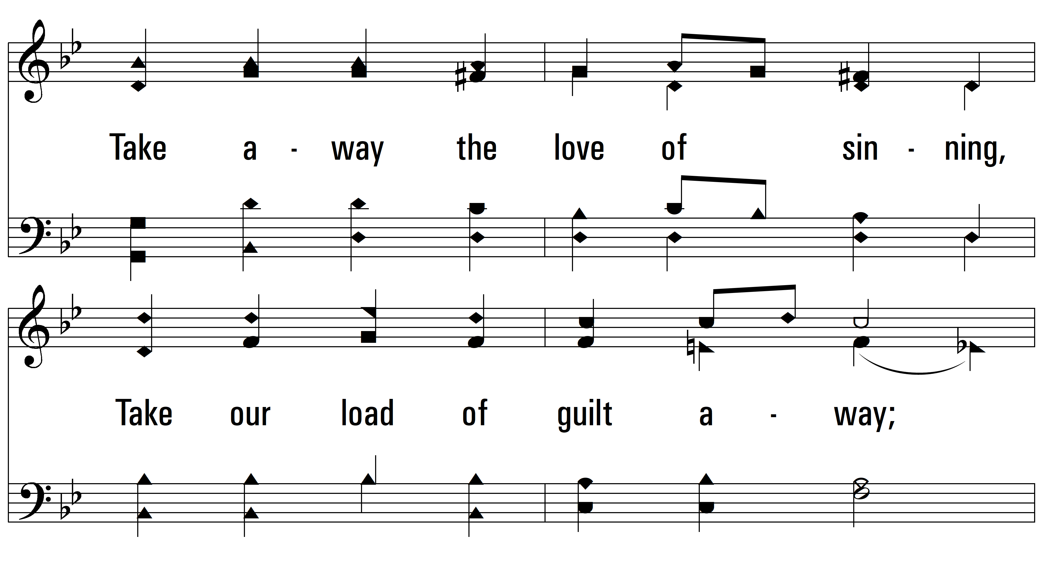
vs. 2

Slide 9
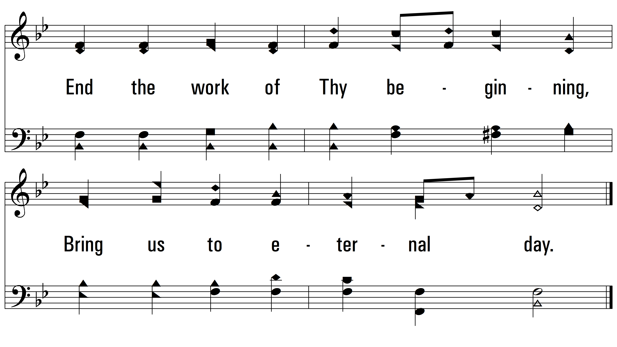
vs. 2

Slide 10
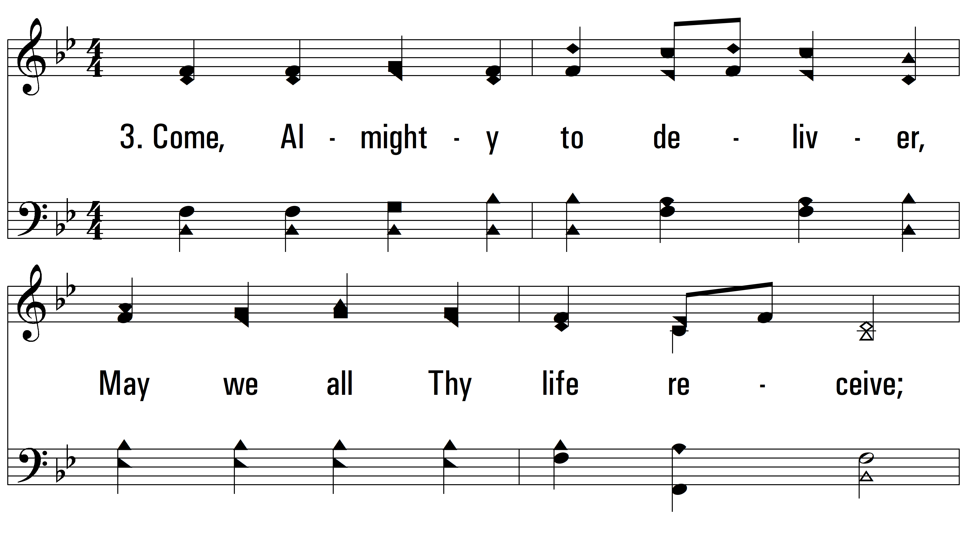
vs. 3 ~ Love Divine

Slide 11
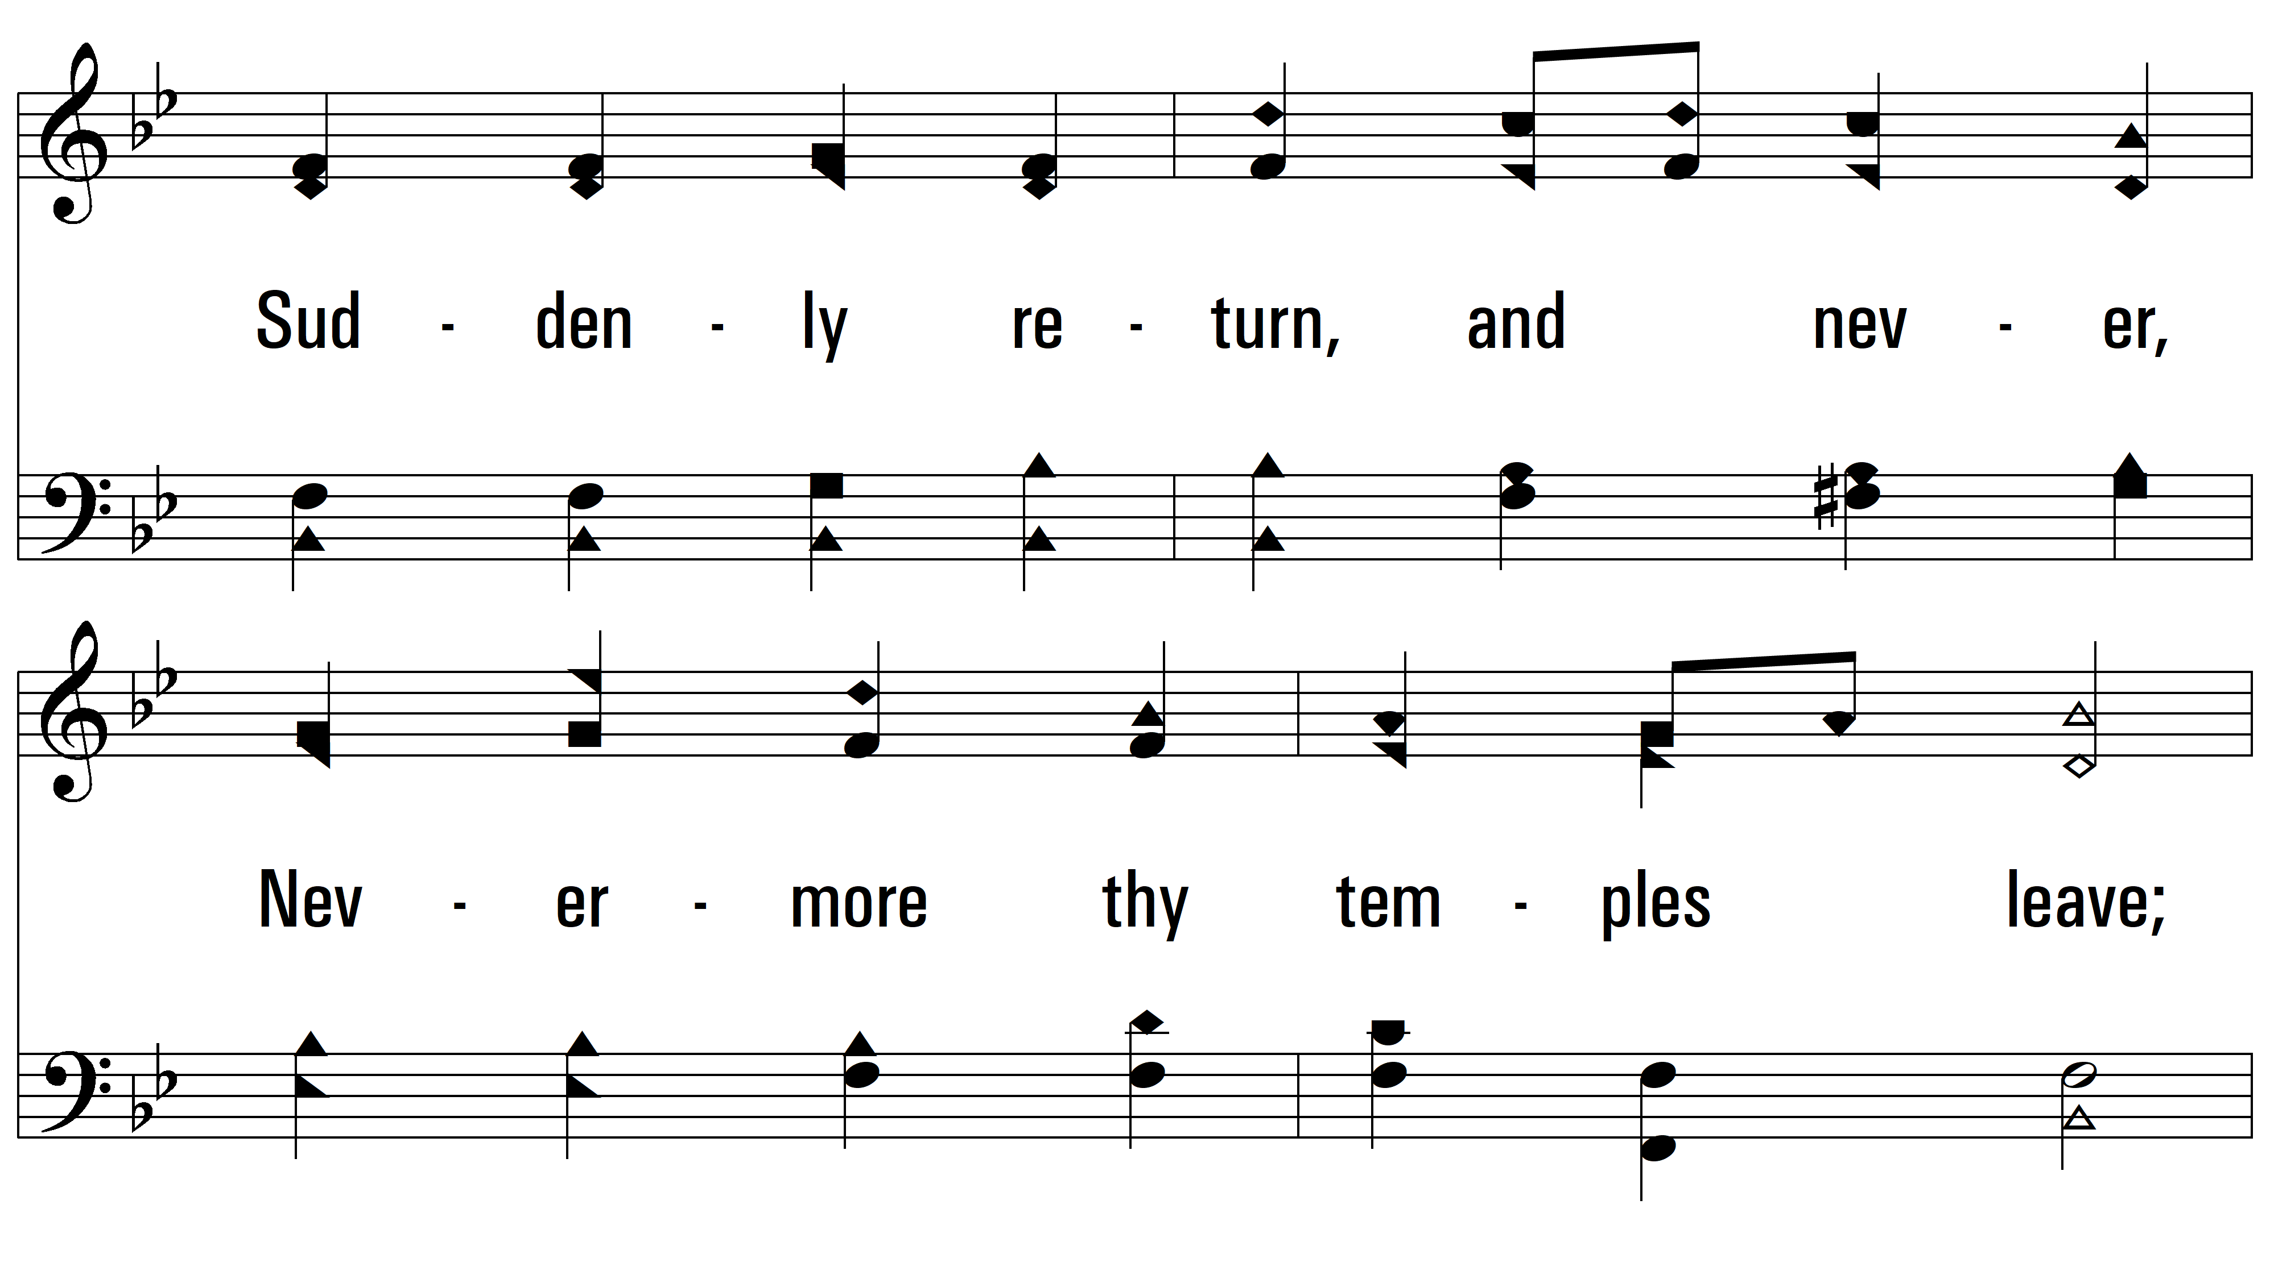
vs. 3

Slide 12
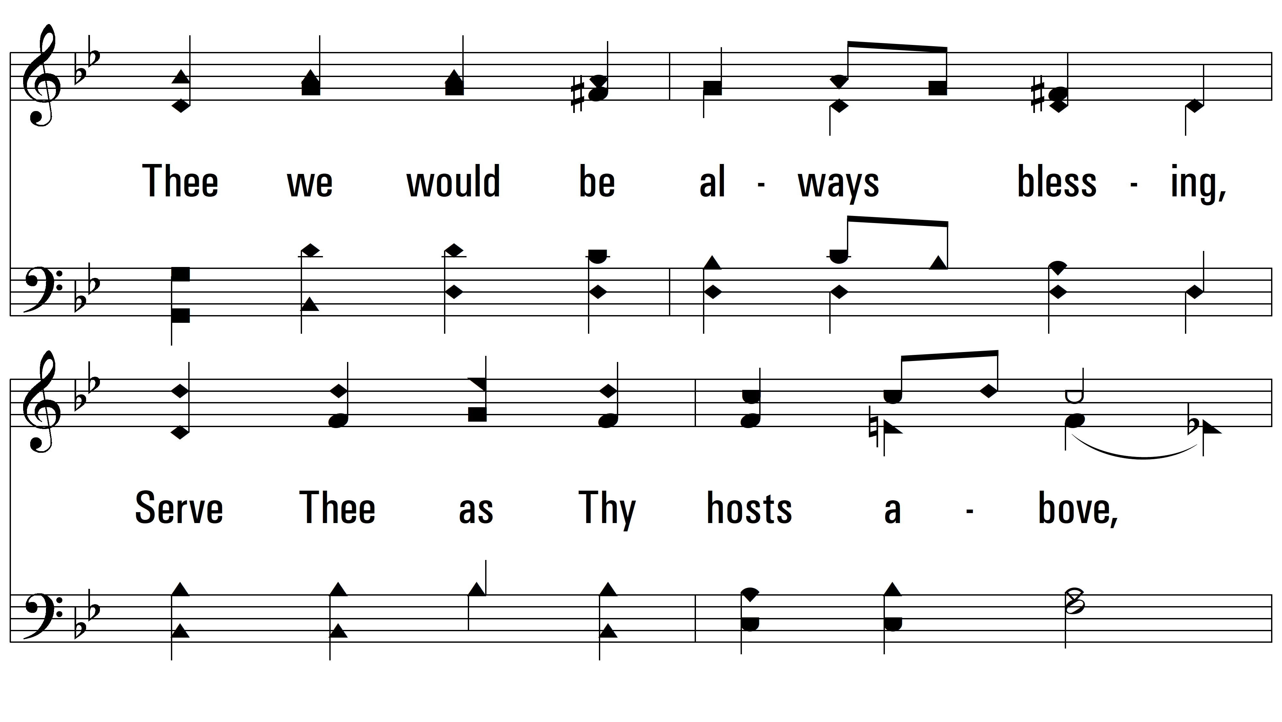
vs. 3

Slide 13
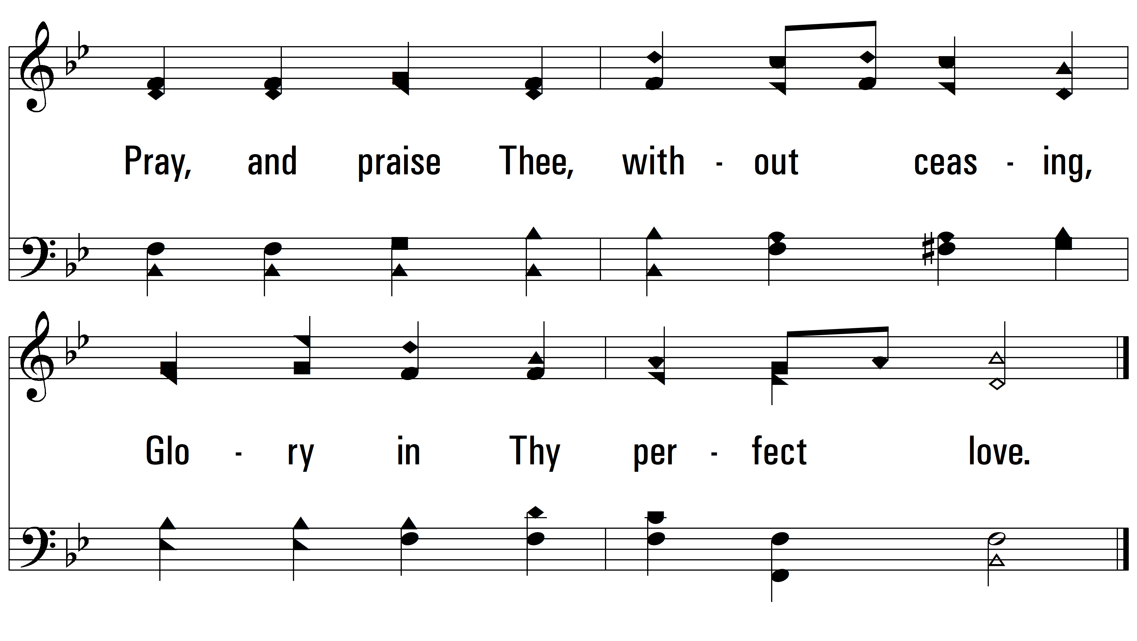
vs. 3

Slide 14
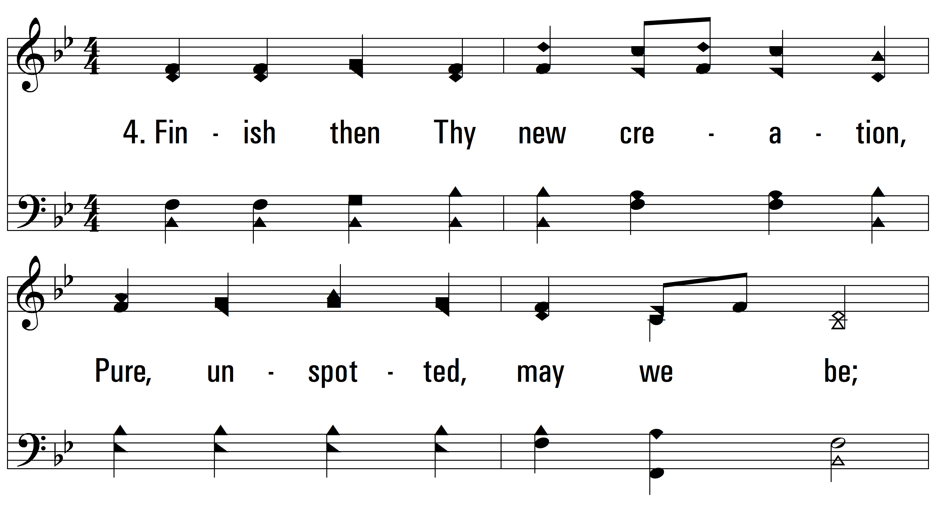
vs. 4 ~ Love Divine

Slide 15
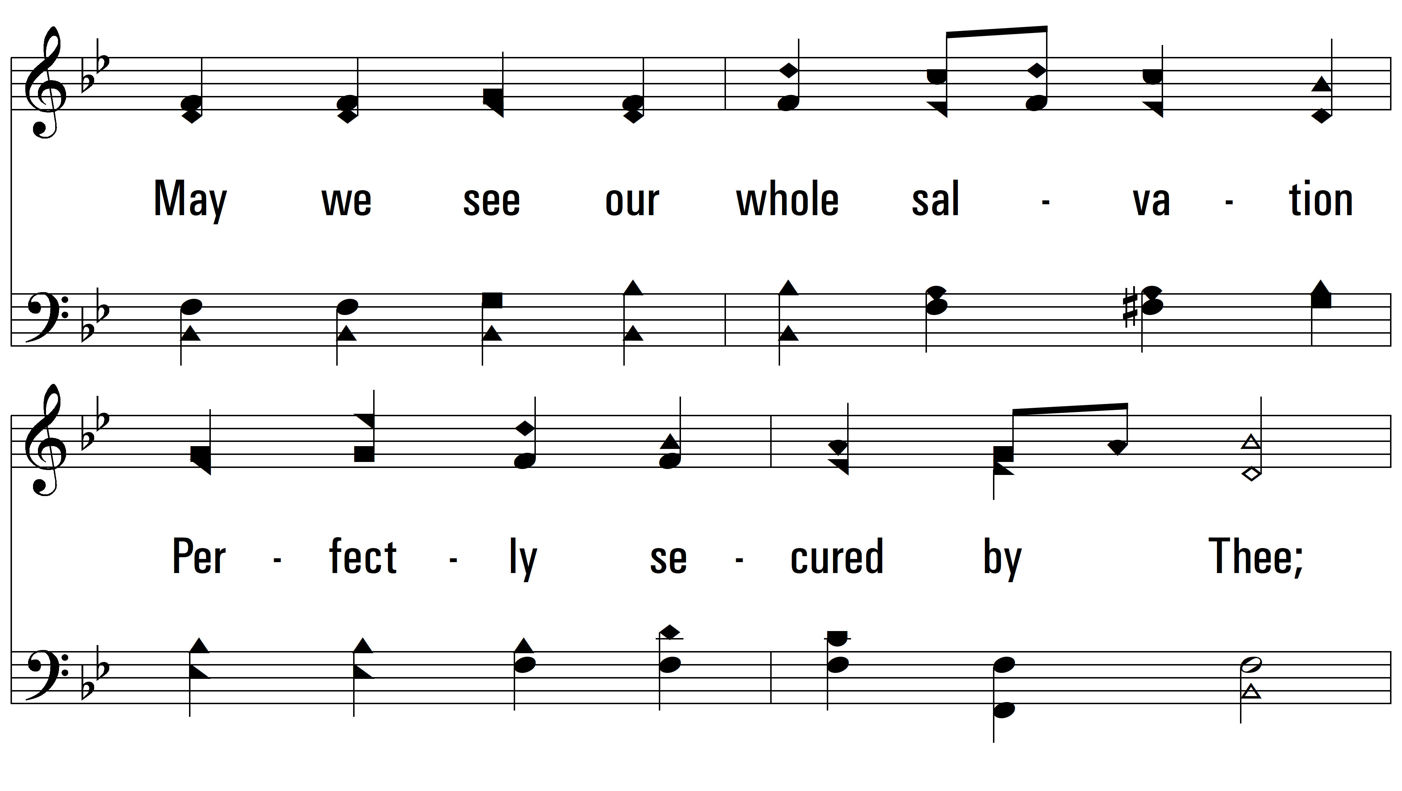
vs. 4

Slide 16
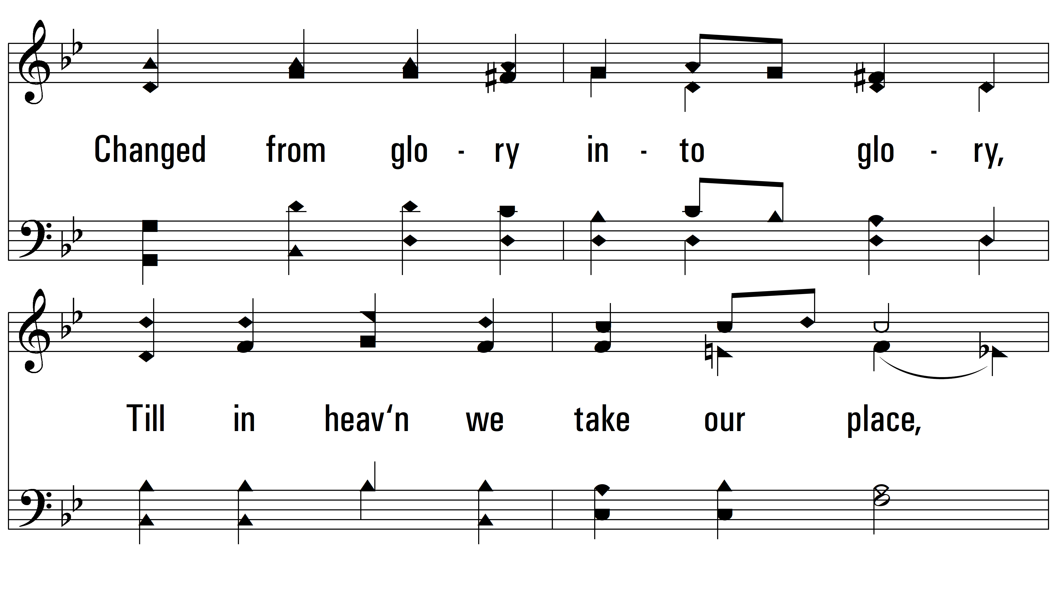
vs. 4

Slide 17
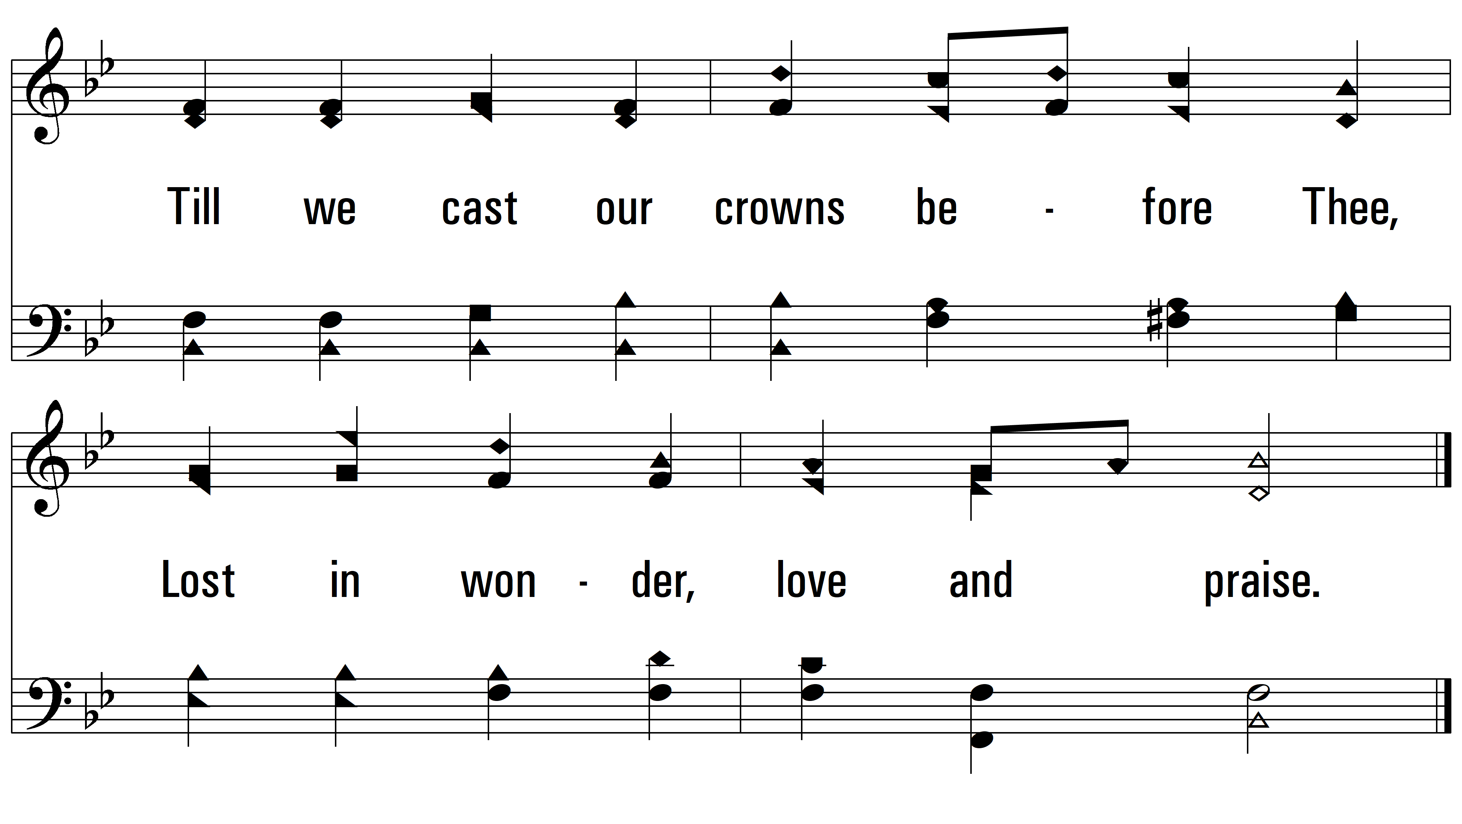
vs. 4
PDHymns.com
END

