Slide 1
Lord, Thy Word Abideth
RAVENSHAW
6.6.6.6
Words: | Henry W. Baker (1861)
Music: | Michael Weisse’s Ein Neu Gesengbuchlen (1531), Arr. William H. Monk (1861)
4/4
D/D - DO
Verses: 4
Lead - | DO
Alto - | SOL
Tenor - | MI
Bass - | DO
PDHymns.com

Slide 2
vs. 1 ~ Lord, Thy Word Abideth

Slide 3
vs. 2 ~ Lord, Thy Word Abideth

Slide 4
vs. 3 ~ Lord, Thy Word Abideth

Slide 5
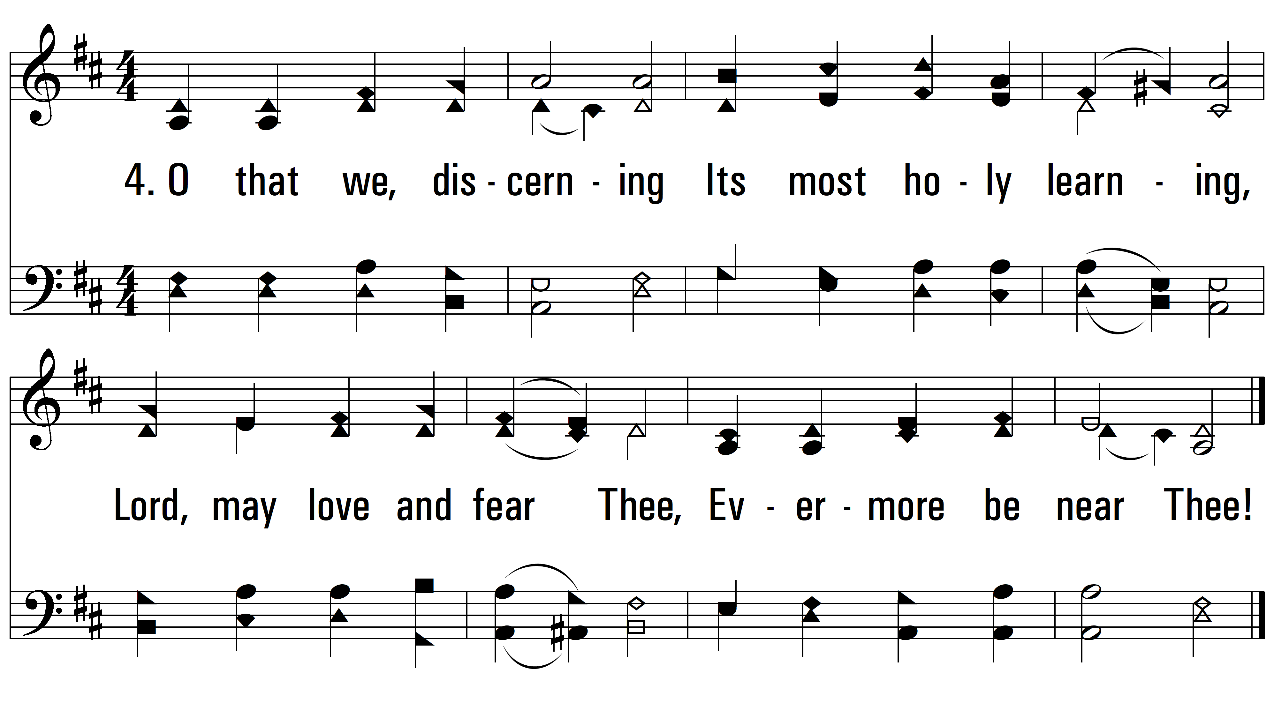
vs. 4 ~ Lord, Thy Word Abideth
PDHymns.com
END

