Slide 1
Lord, Take Control
Words: | Unknown
Music: | Unknown
4/4
F/C - SOL
Verses: 1
Lead - | SOL
Alto - | SOL
Tenor - | SOL
Bass - | SOL
PDHymns.com

Slide 2
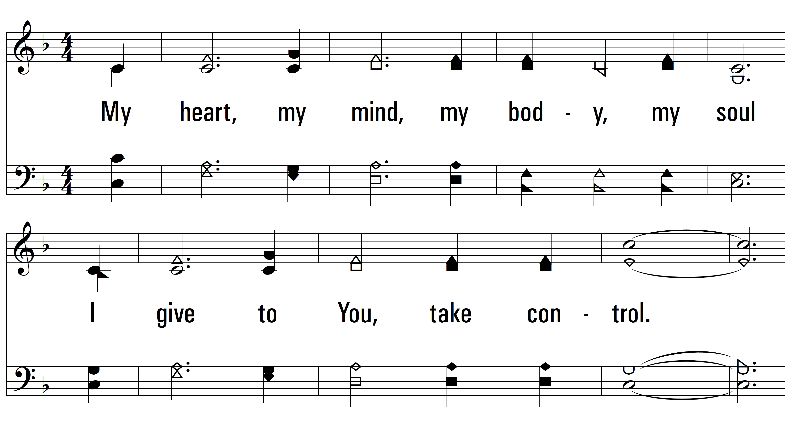
vs. 1 ~ Lord, Take Control

Slide 3
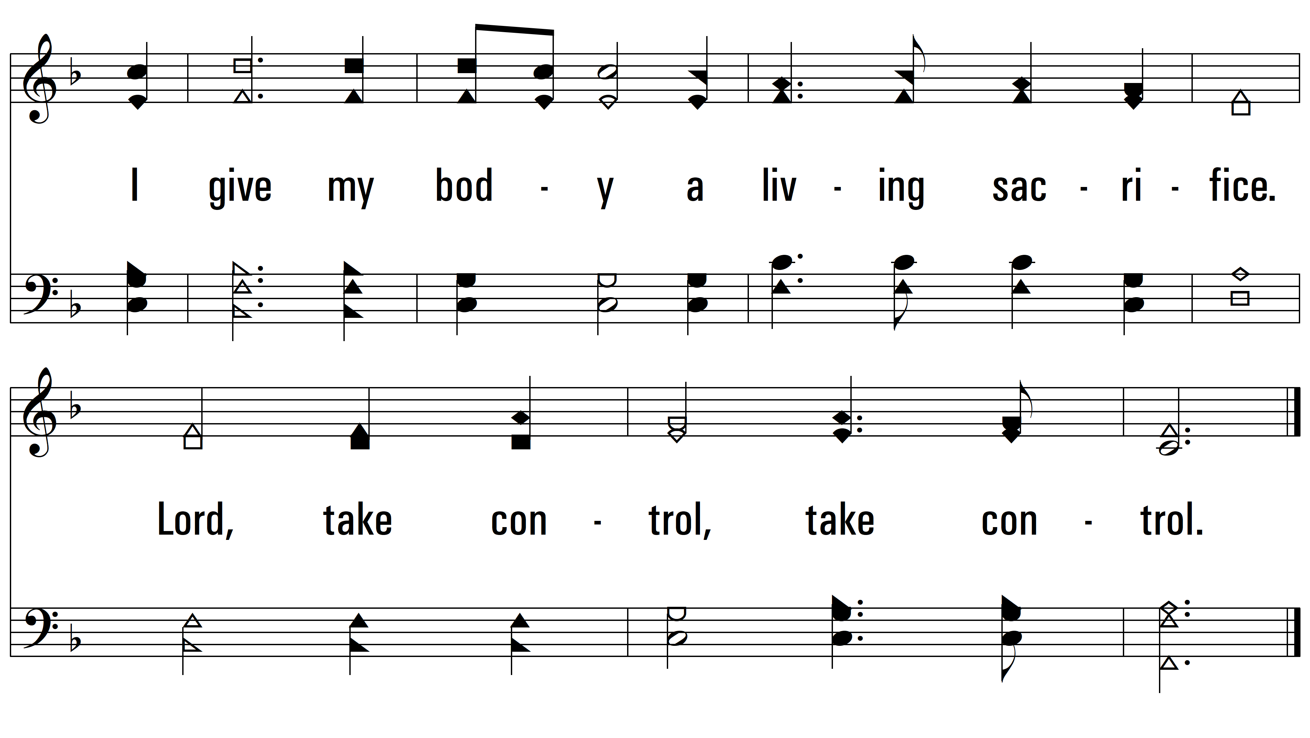
vs. 1
PDHymns.com
END

