Slide 1
Lord, Send Me
(There Is Much To Do)
Words: | M. W. Spencer (1893)
Music: | M. W. Spencer (1893)
4/4
E^{b}/G - MI
Verses: 4/Chorus
Lead - | MI
Alto - | DO
Tenor - | SOL
Bass - | DO
PDHymns.com

Slide 2
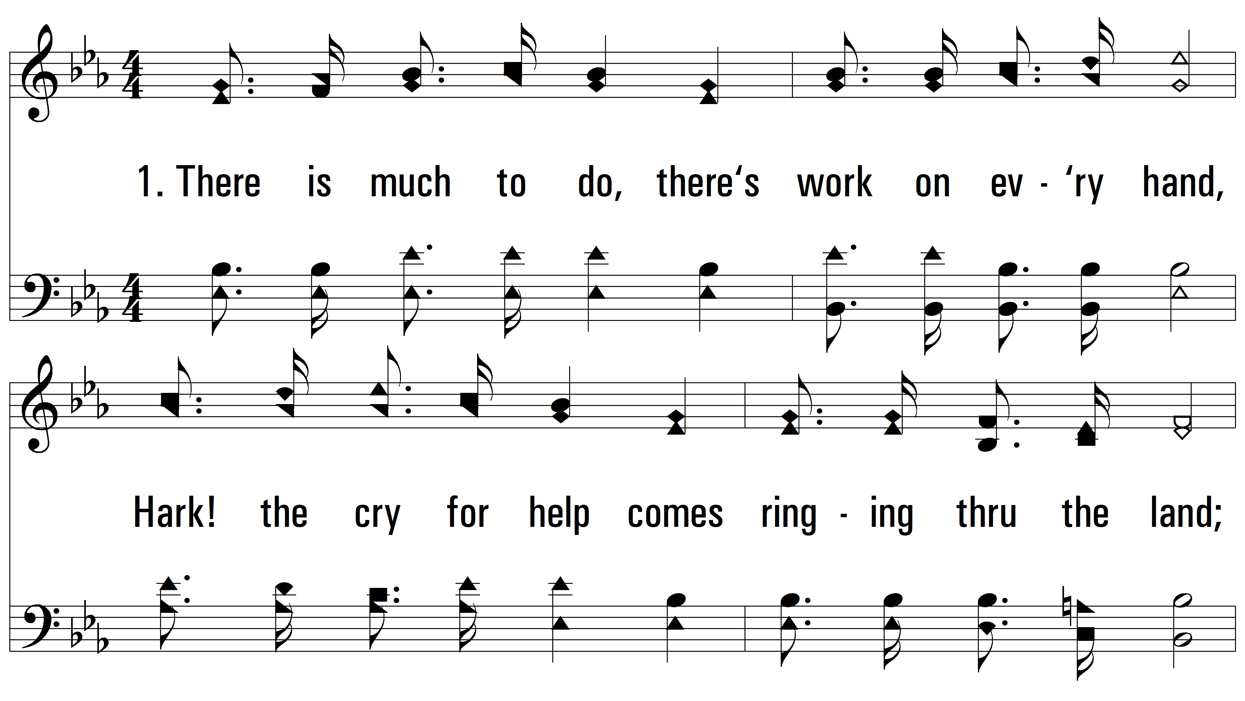
vs. 1 ~ Lord, Send Me

Slide 3
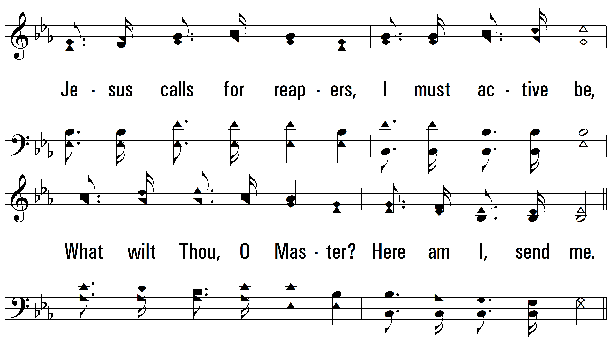
vs. 1

Slide 4
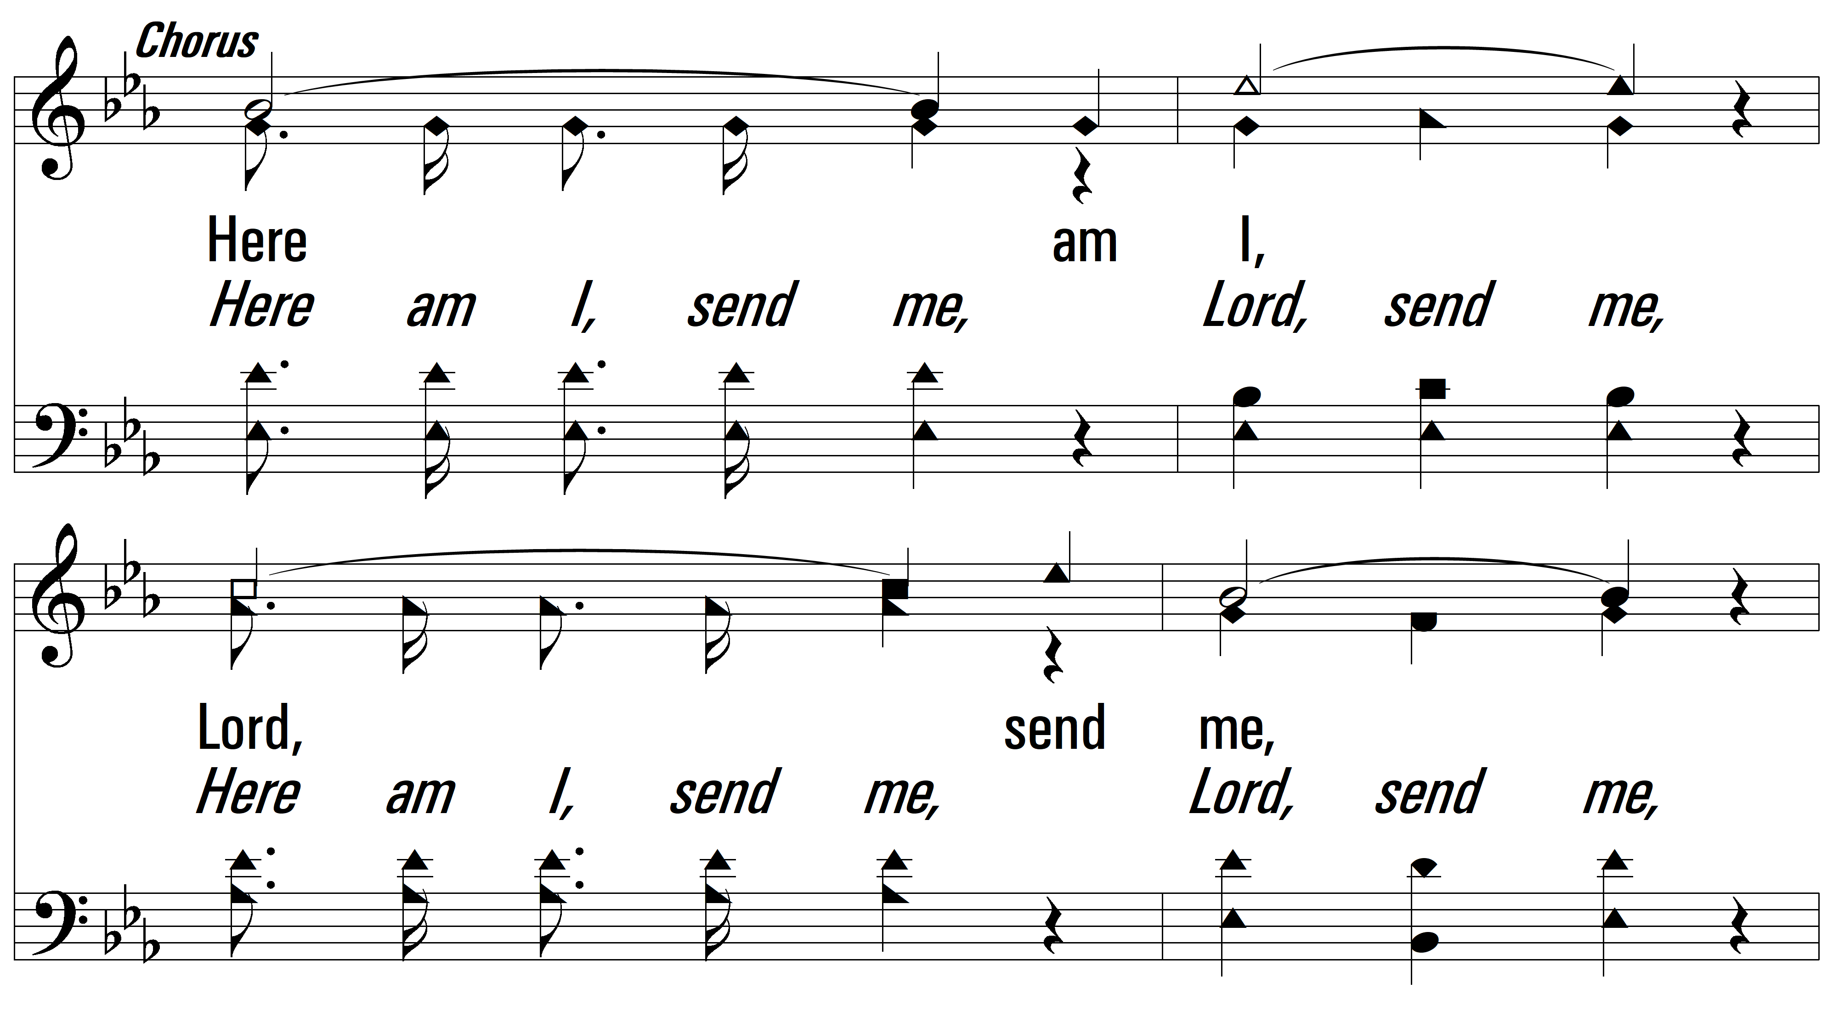
vs. 1

Slide 5
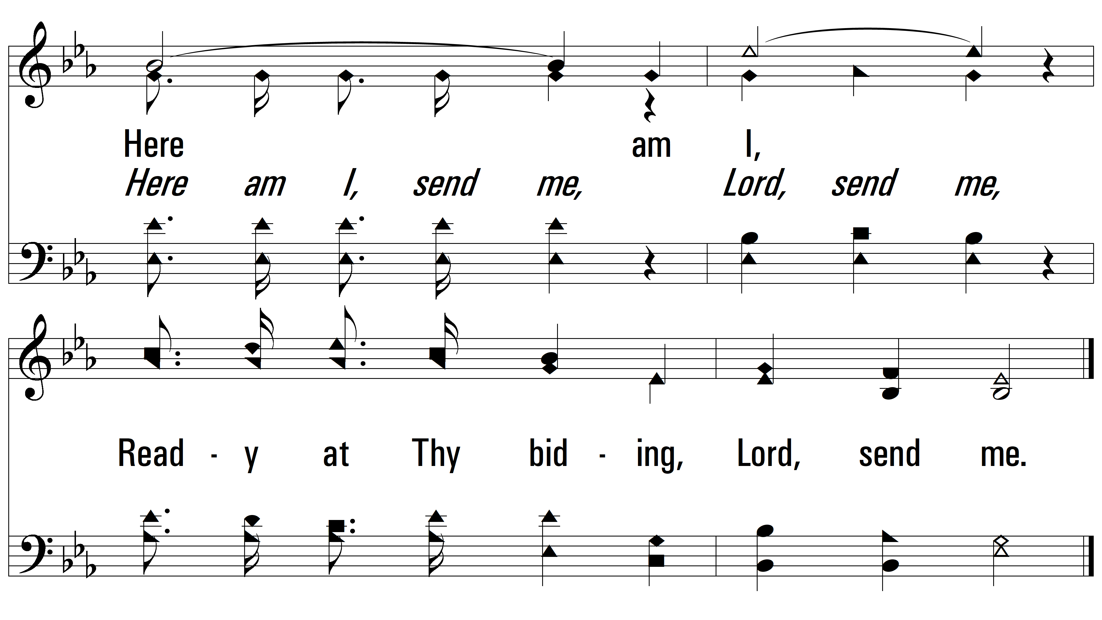
vs. 1

Slide 6
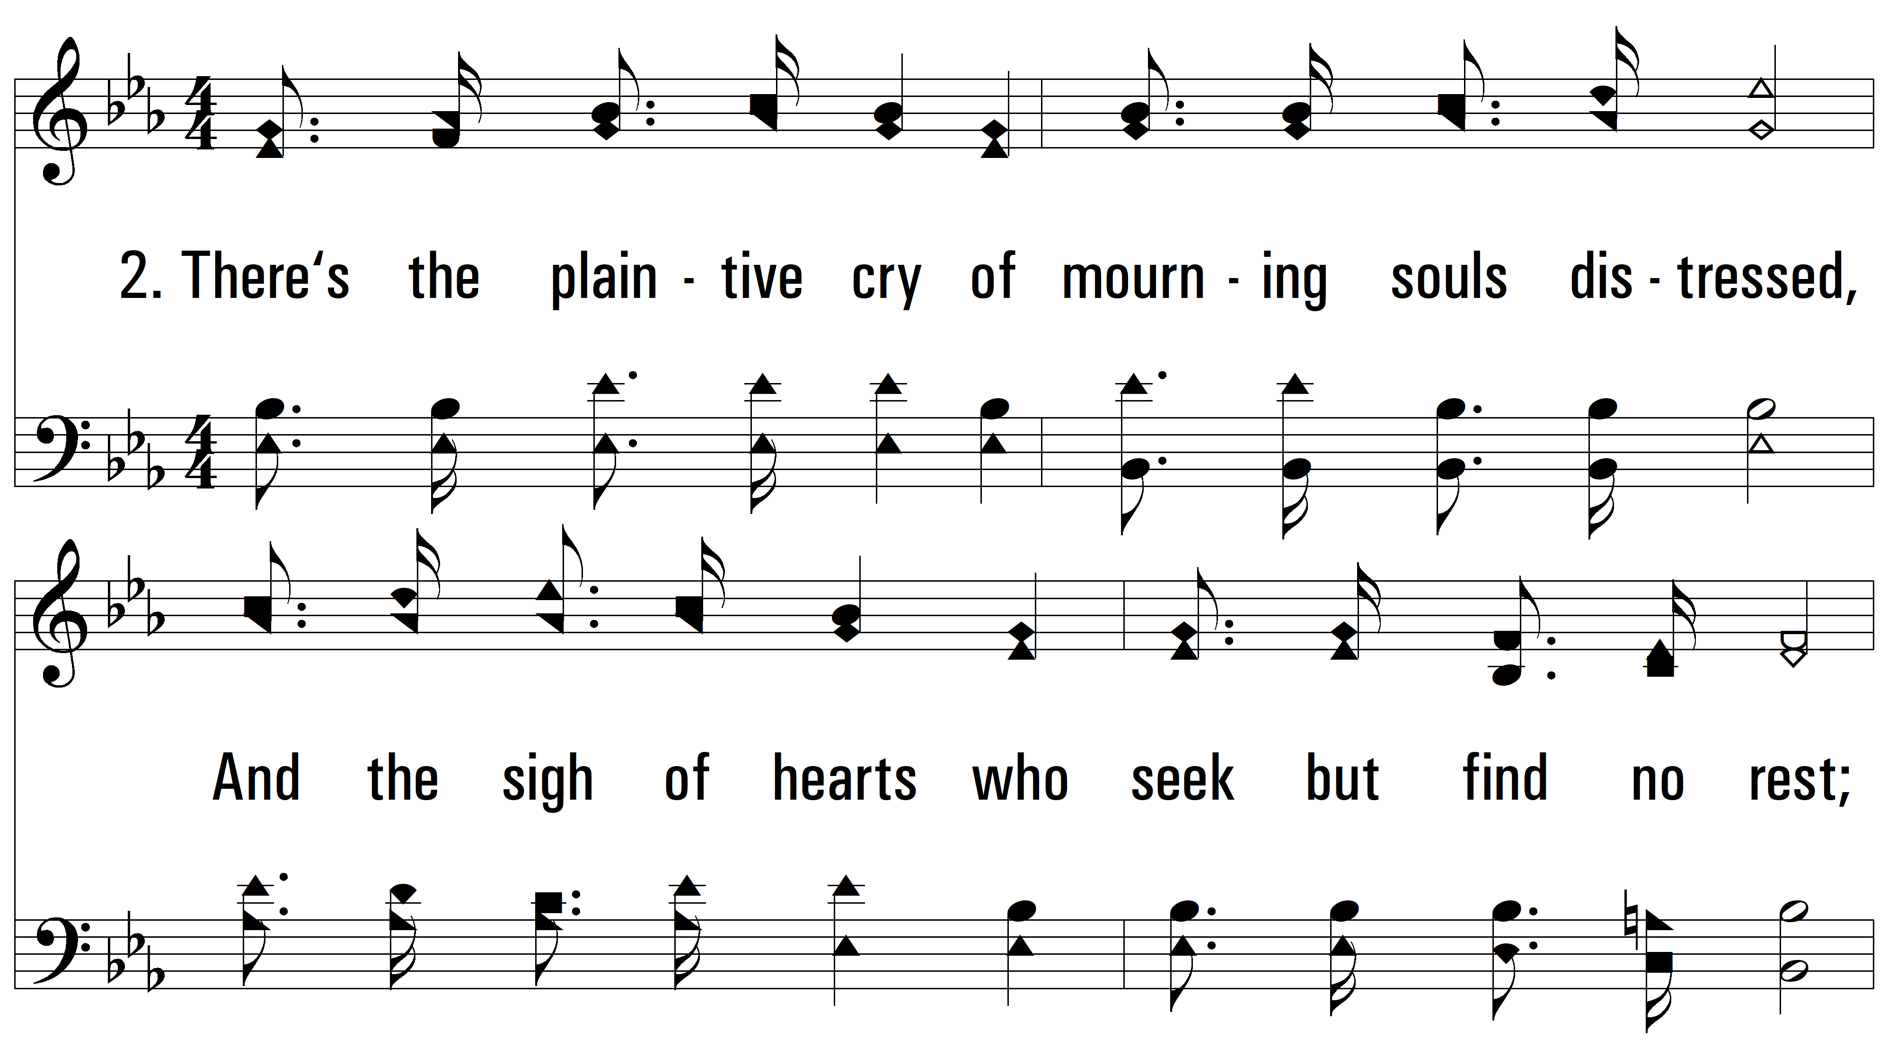
vs. 2 ~ Lord, Send Me

Slide 7
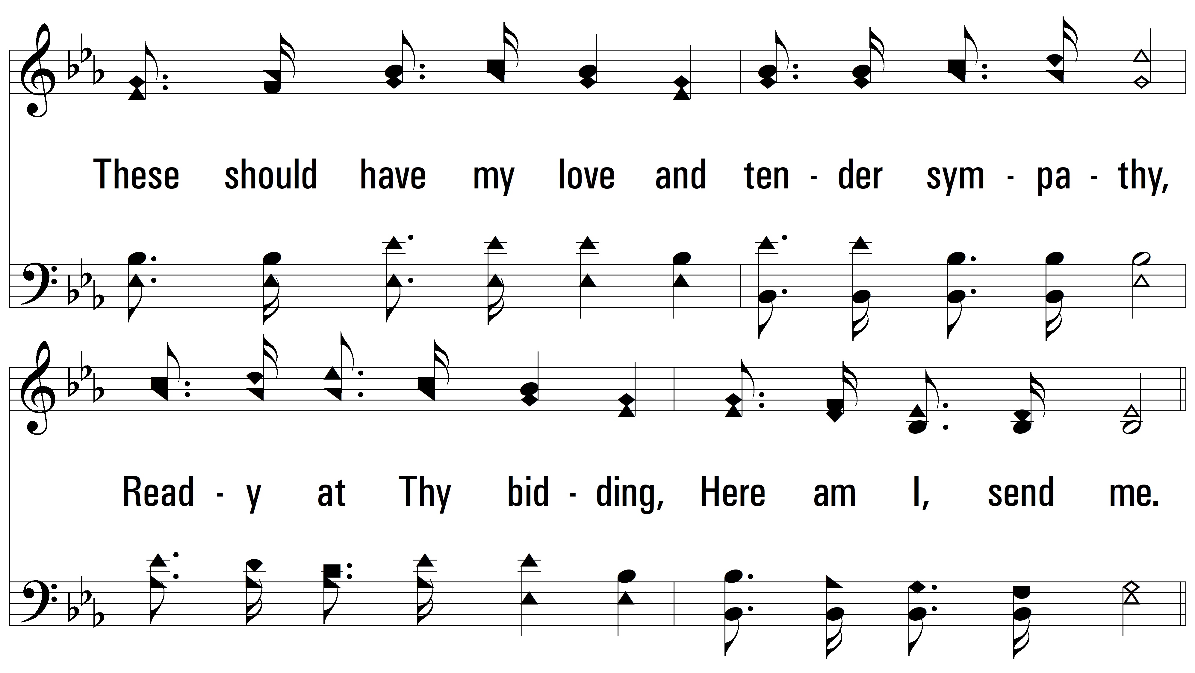
vs. 2

Slide 8
vs. 2

Slide 9
vs. 2

Slide 10
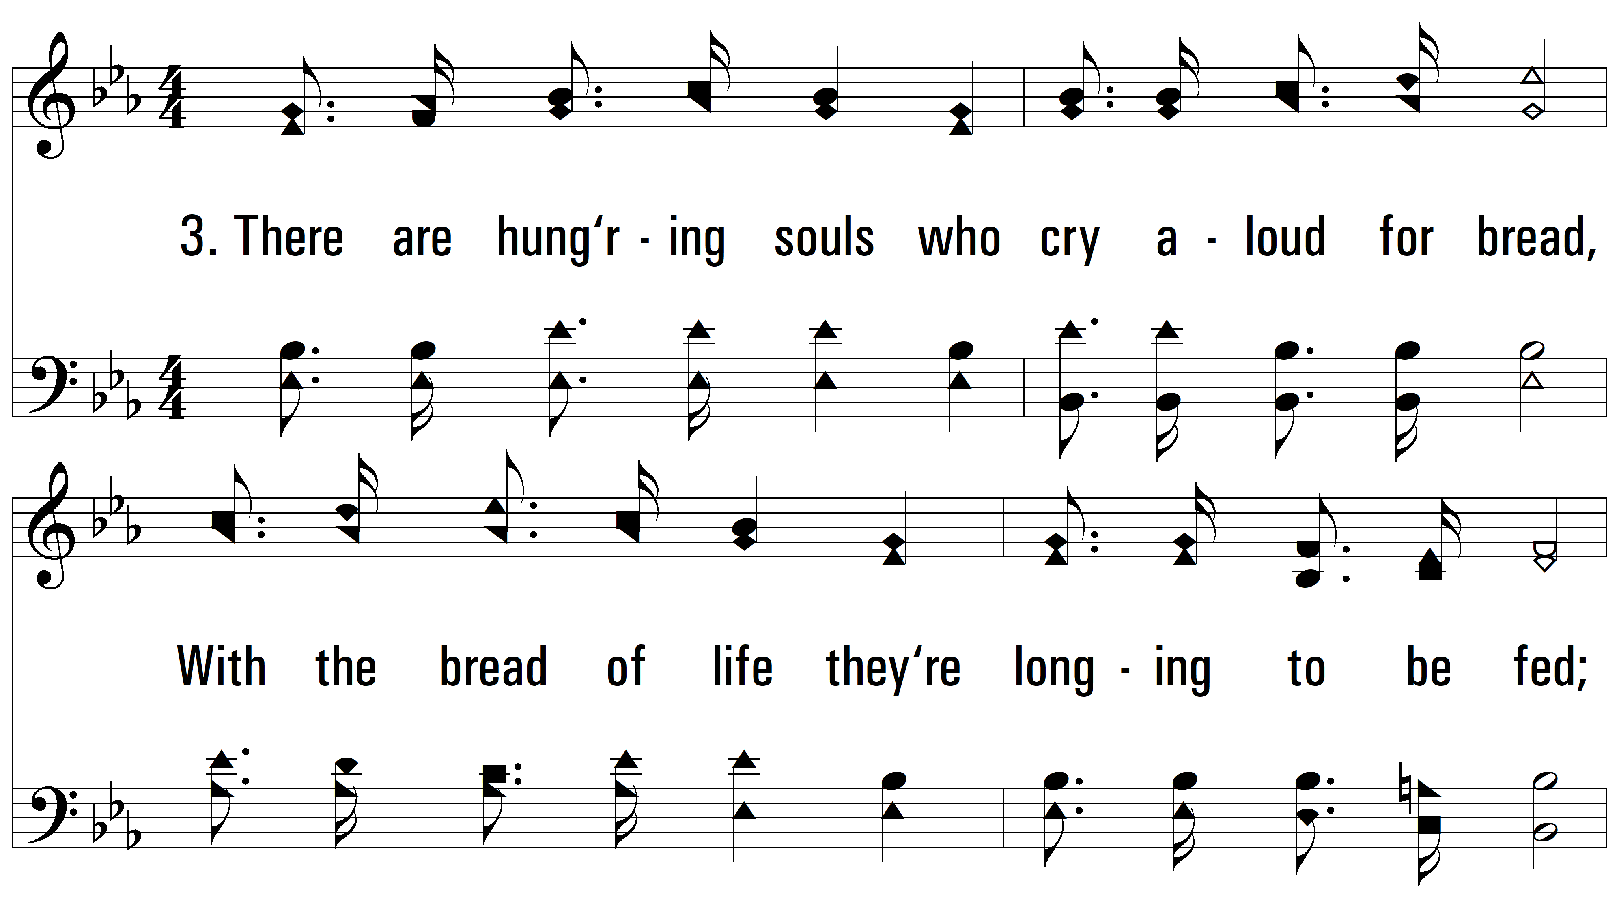
vs. 3 ~ Lord, Send Me

Slide 11
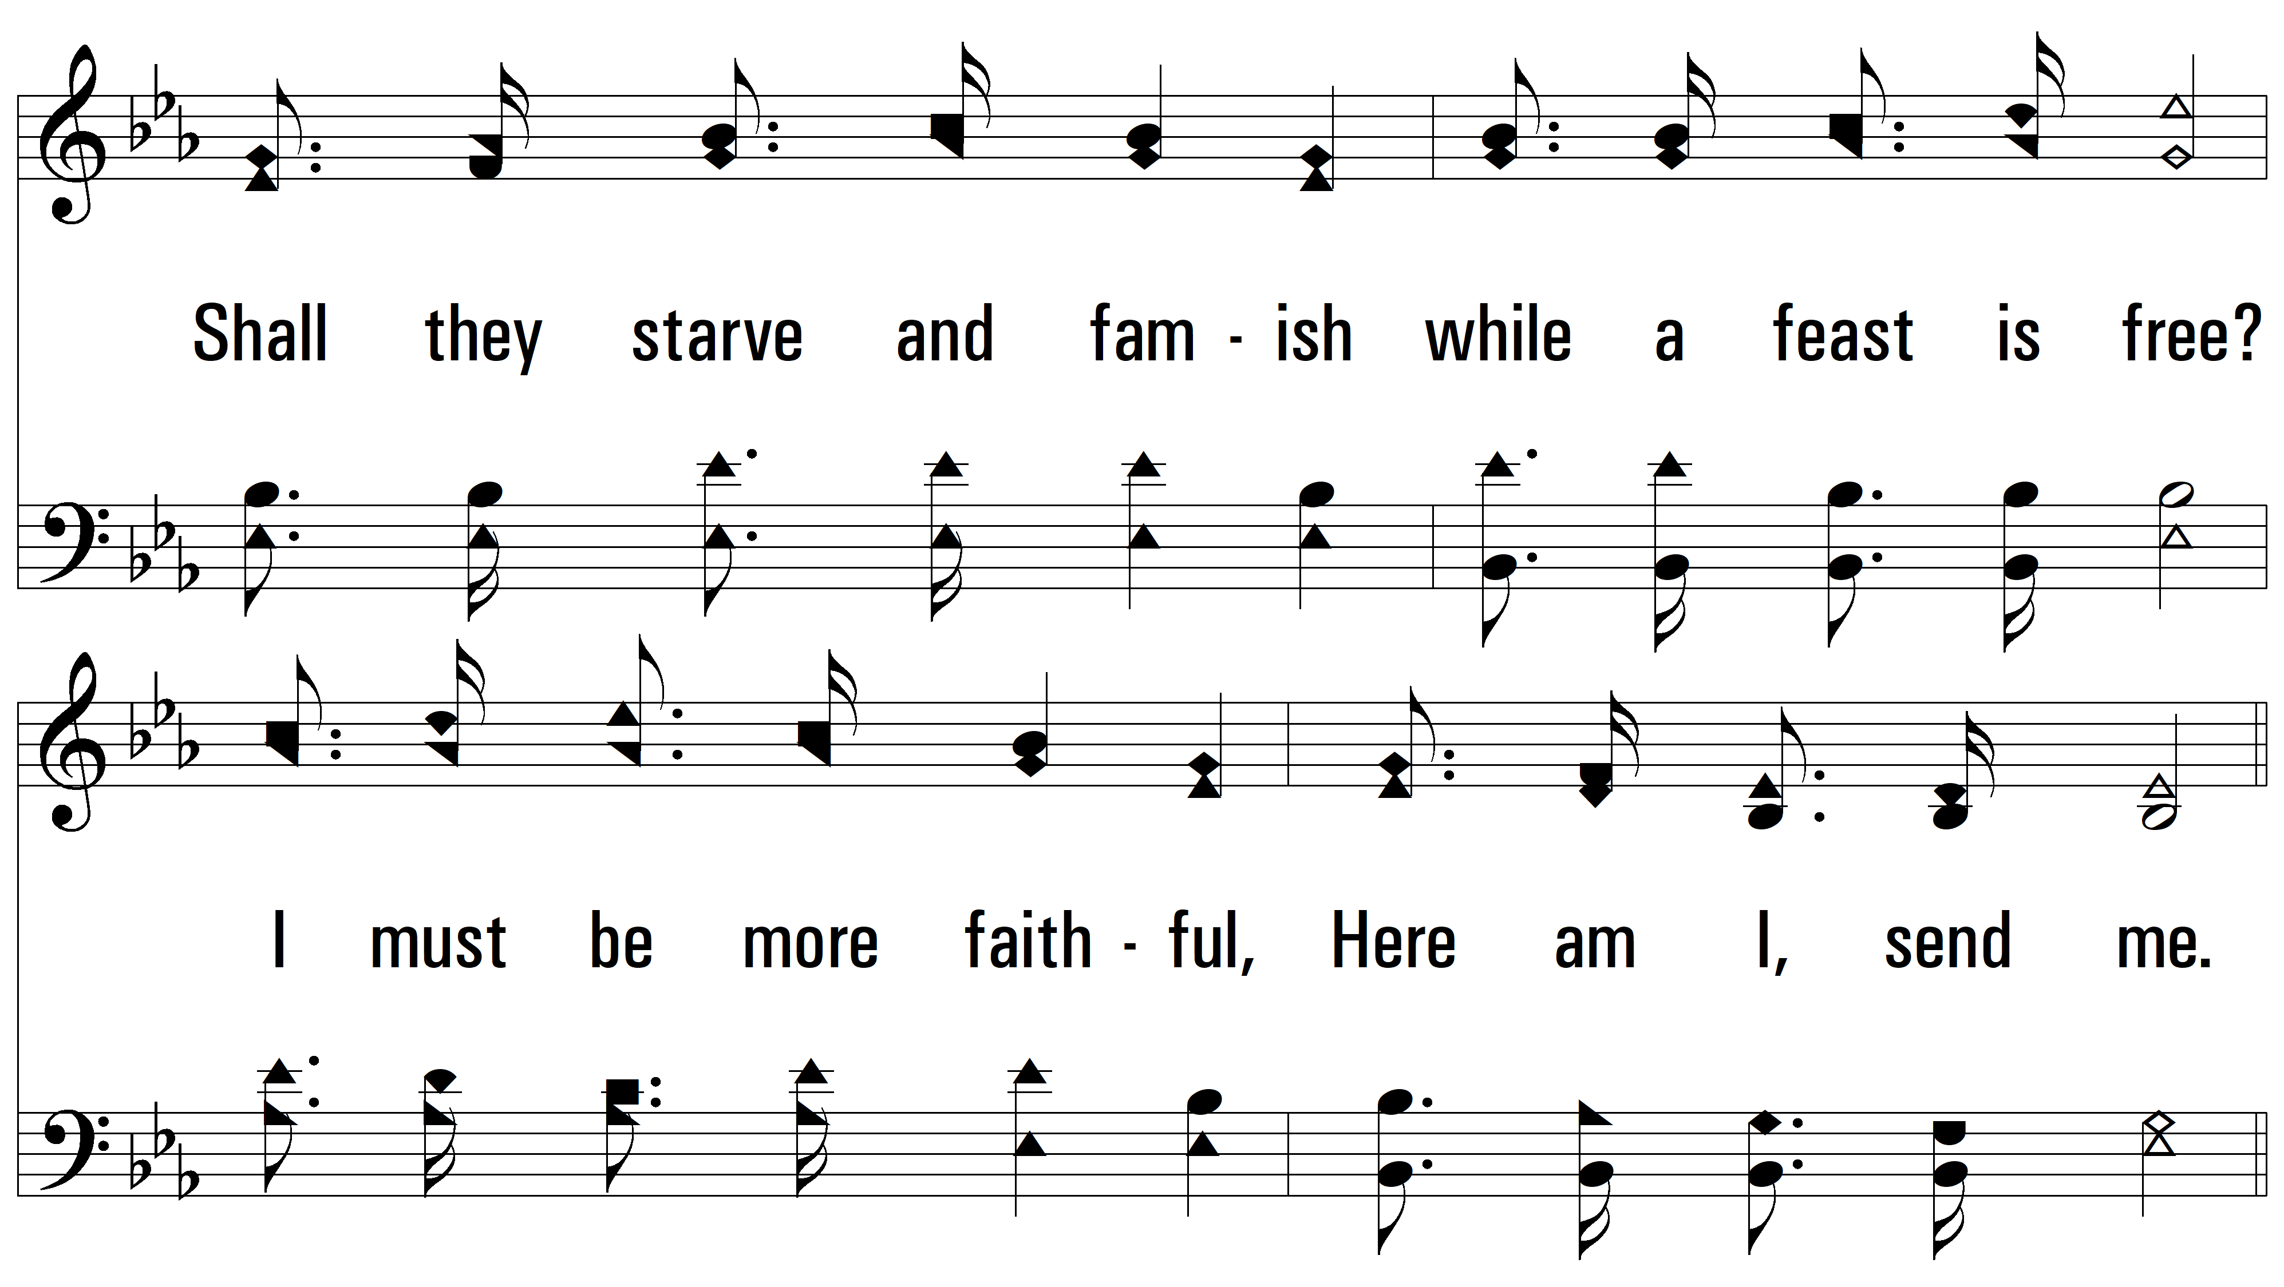
vs. 3

Slide 12
vs. 3

Slide 13
vs. 3

Slide 14
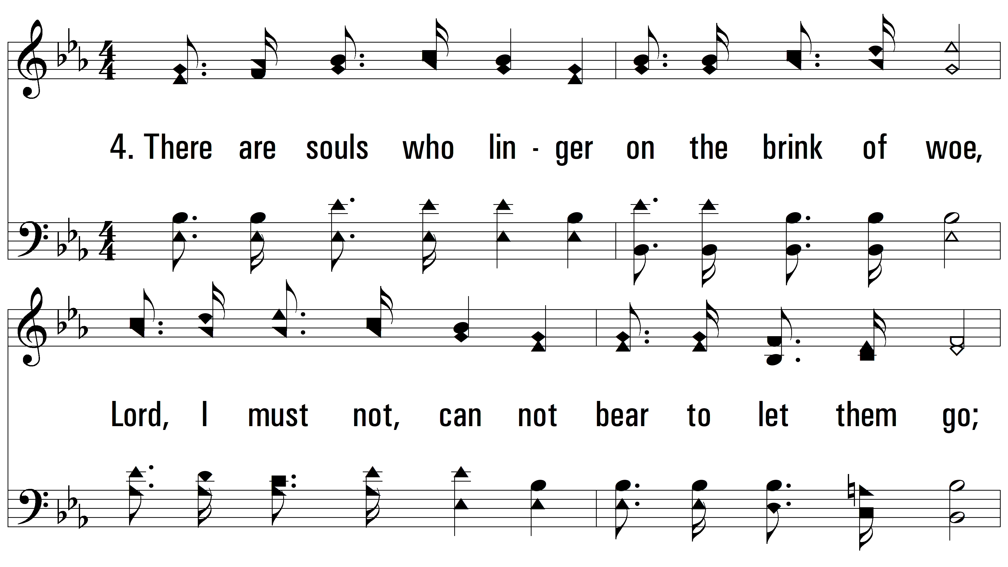
vs. 4 ~ Lord, Send Me

Slide 15
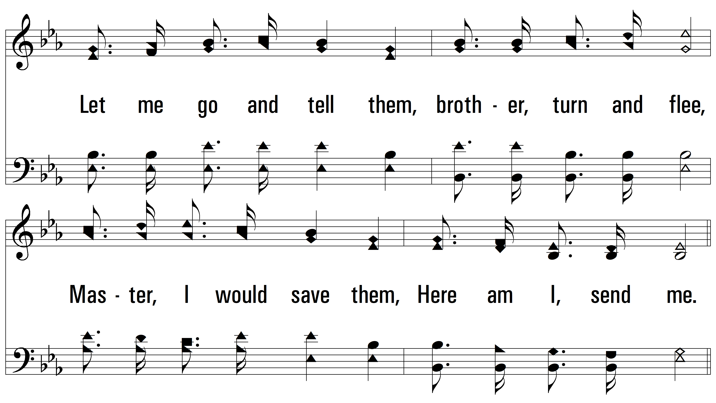
vs. 4

Slide 16
vs. 4

Slide 17
vs. 4
PDHymns.com
END

