Slide 1
Lord I’m Coming Home
(Coming Home)
Words: | William J. Kirkpatrick (1892)
Music: | William J. Kirkpatrick (1892)
4/4
A^{b}/E^{b} - SOL
Verses: 6/Chorus
Lead - | SOL
Alto - | MI
Tenor - | DO
Bass - | DO
PDHymns.com

Slide 2
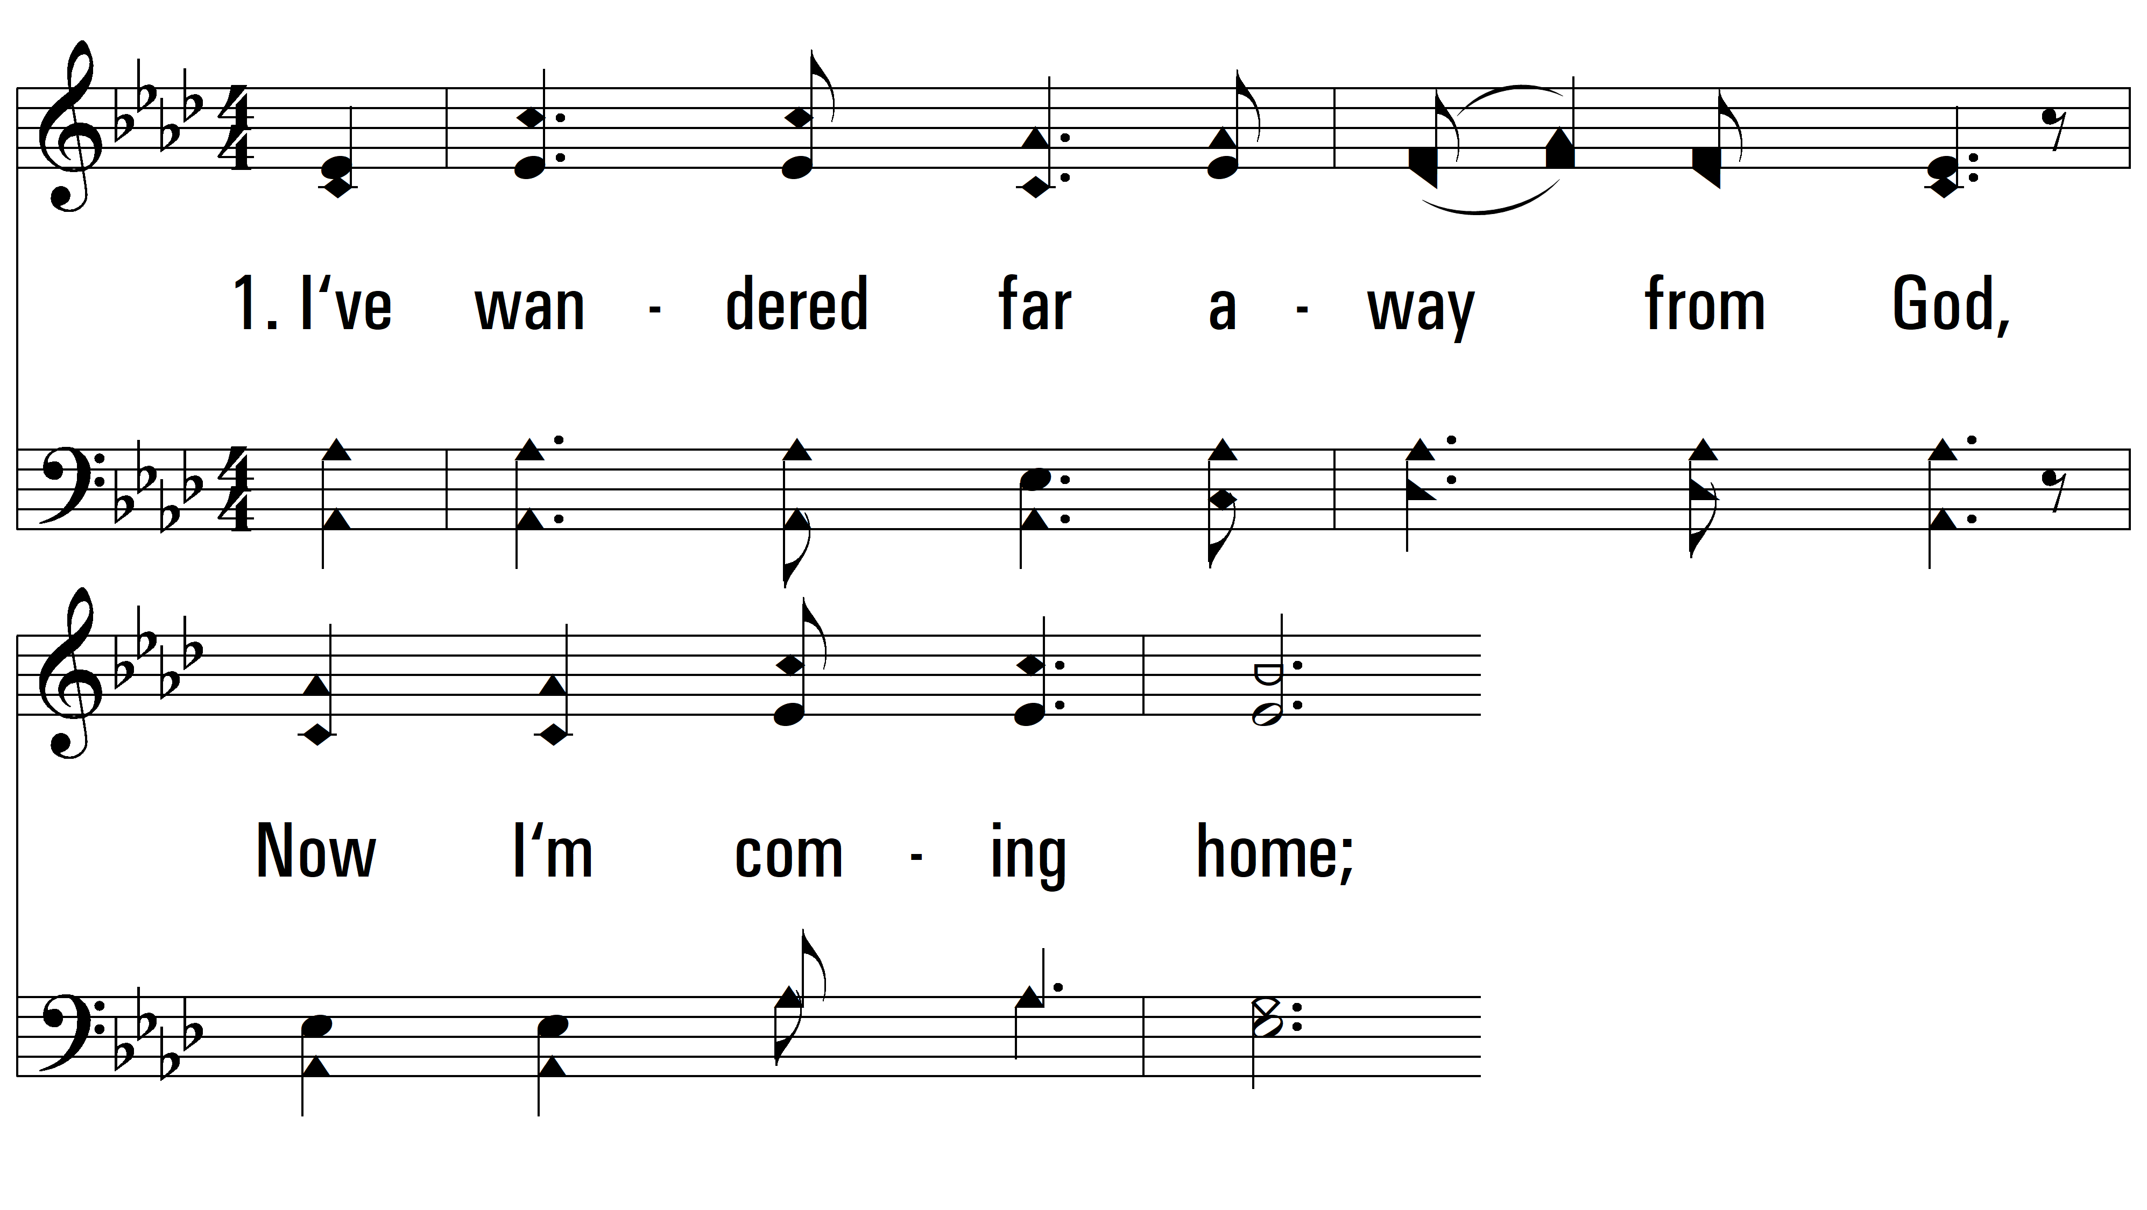
vs. 1 ~ Lord I’m Coming Home

Slide 3
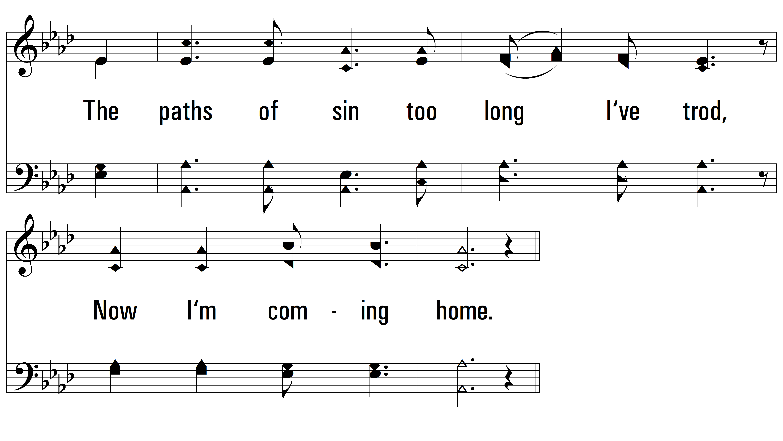
vs. 1

Slide 4
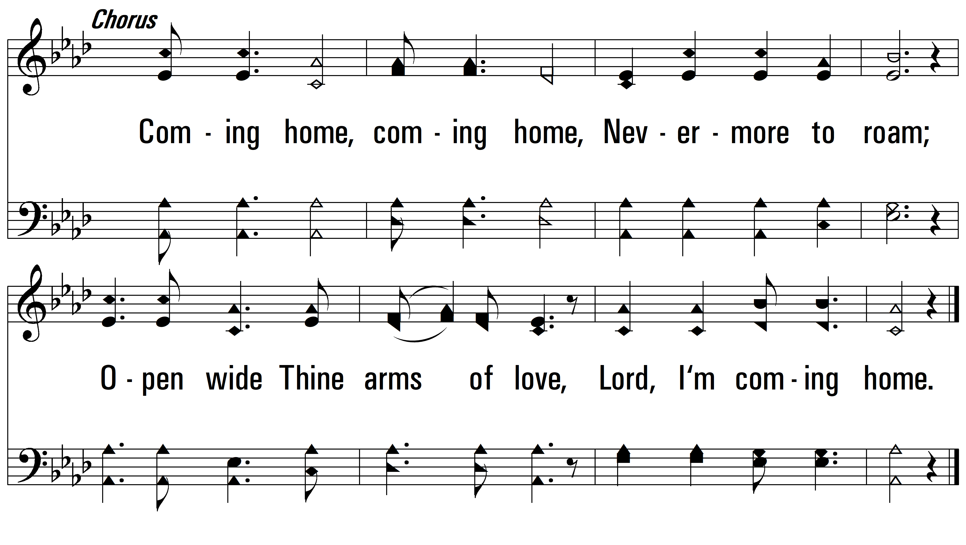
vs. 1

Slide 5
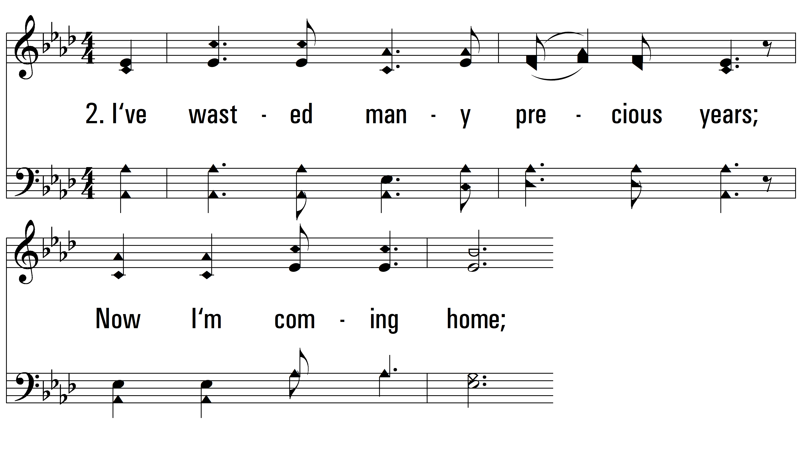
vs. 2 ~ Lord I’m Coming Home

Slide 6
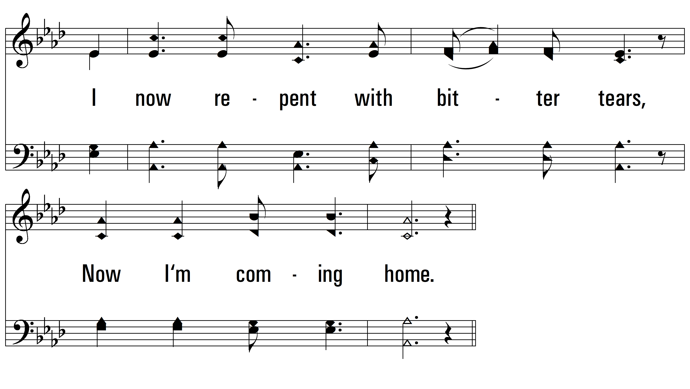
vs. 2

Slide 7
vs. 2

Slide 8
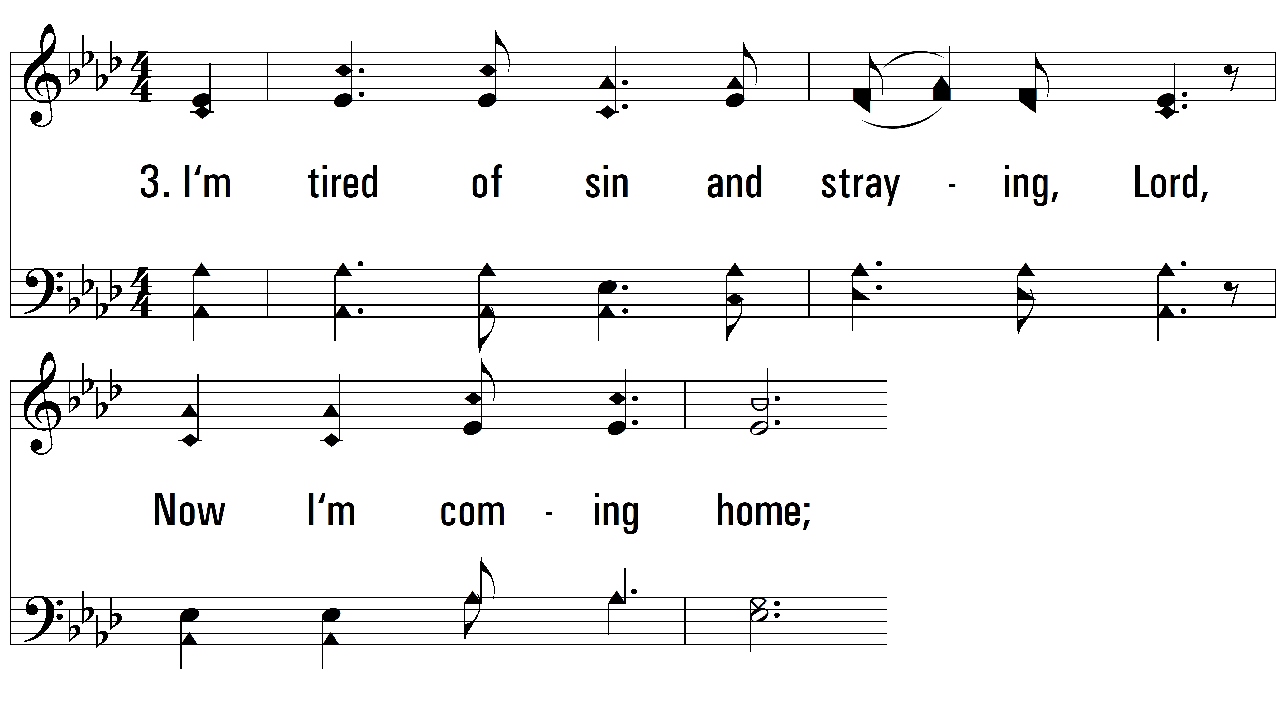
vs. 3 ~ Lord I’m Coming Home

Slide 9
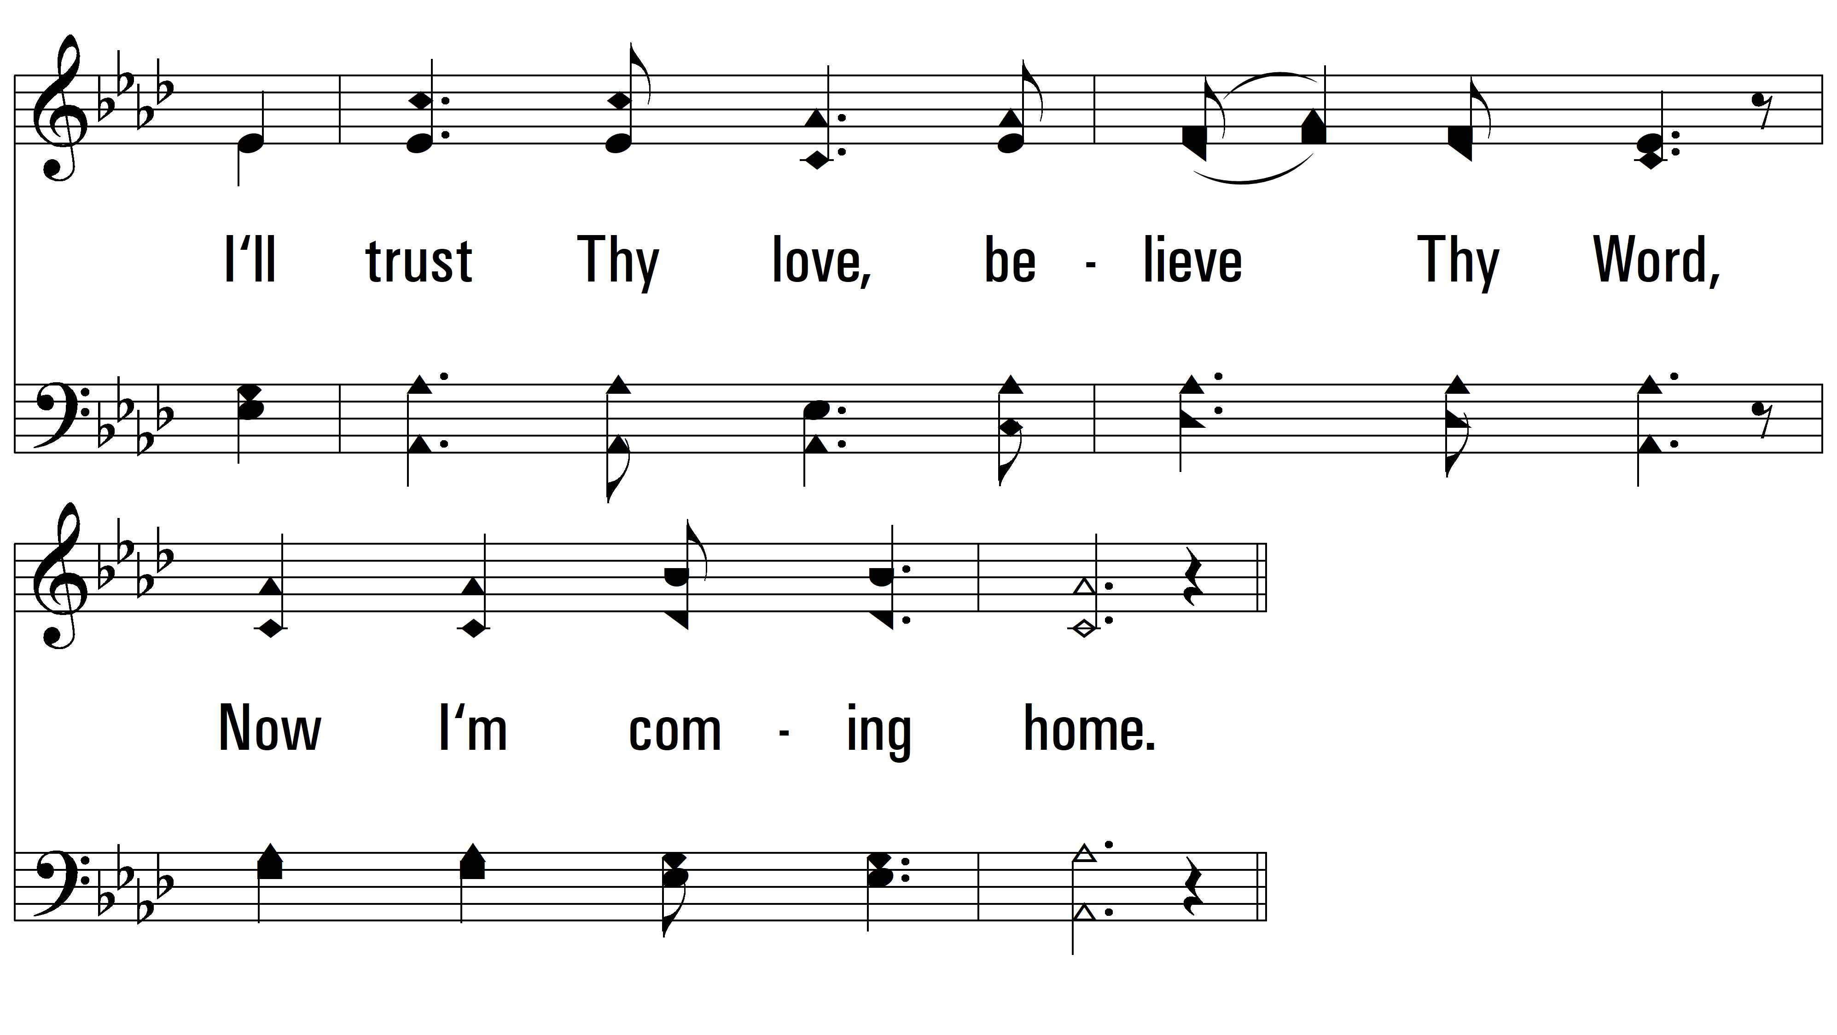
vs. 3

Slide 10
vs. 3

Slide 11
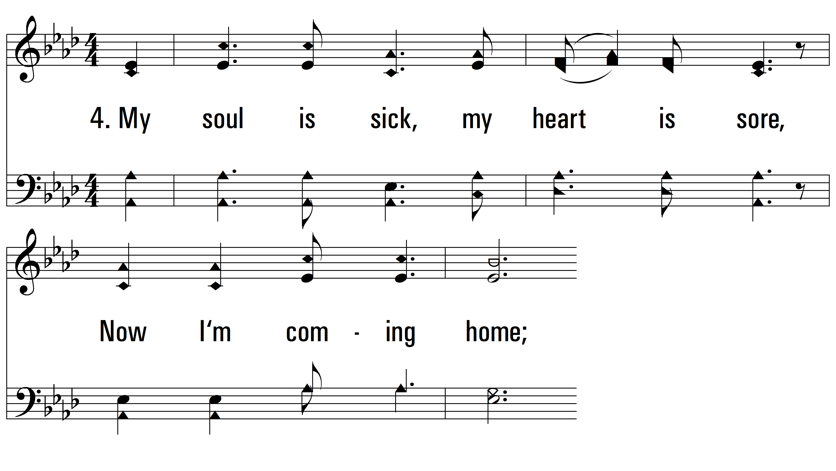
vs. 4 ~ Lord I’m Coming Home

Slide 12
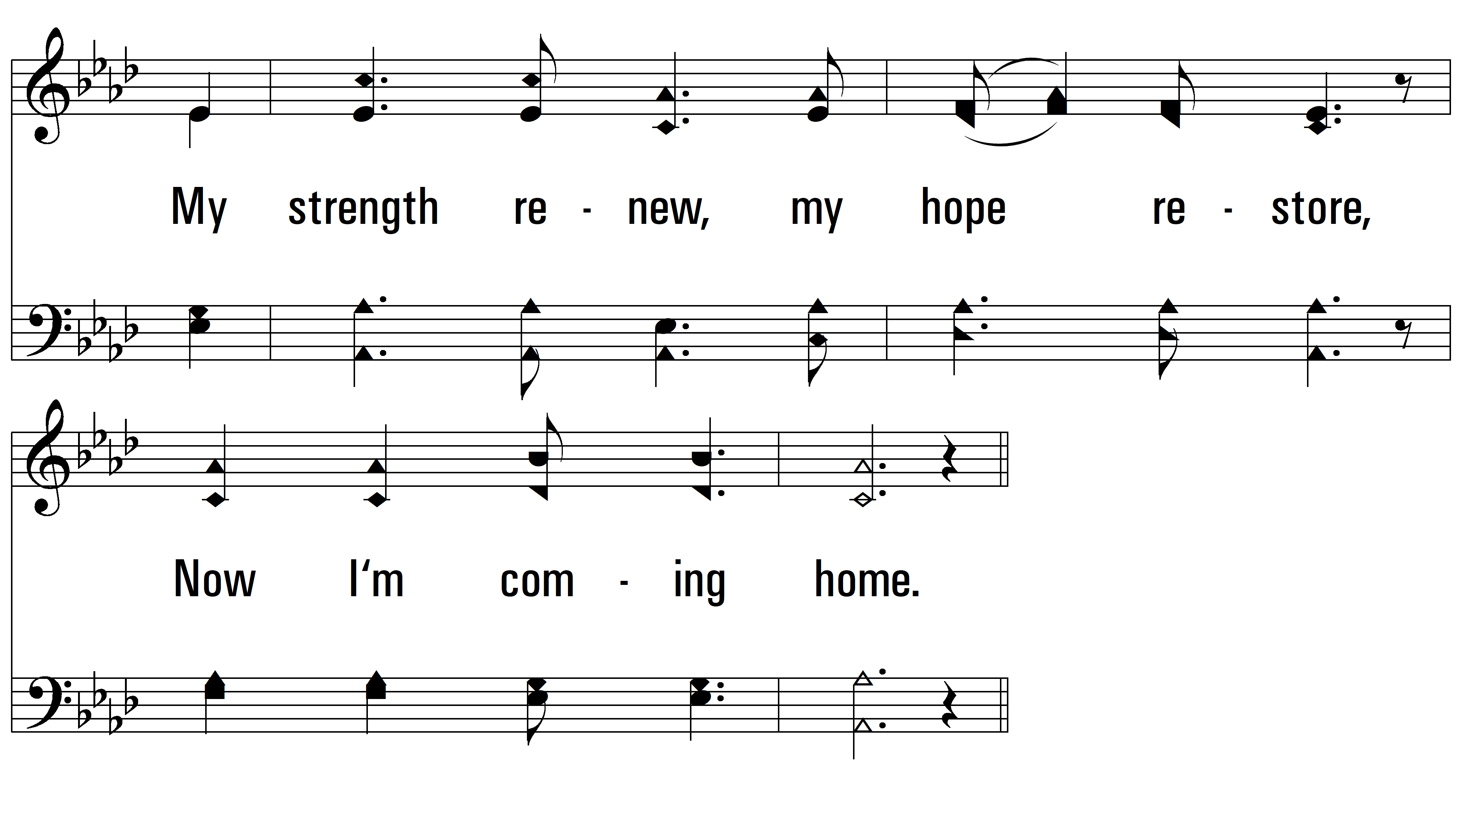
vs. 4

Slide 13
vs. 4

Slide 14
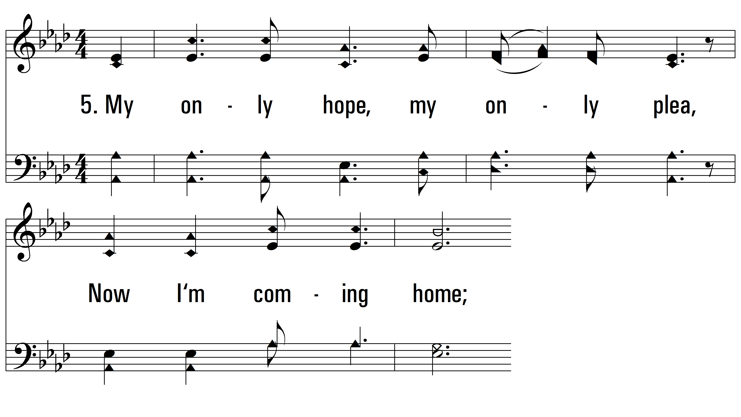
vs. 5 ~ Lord I’m Coming Home

Slide 15
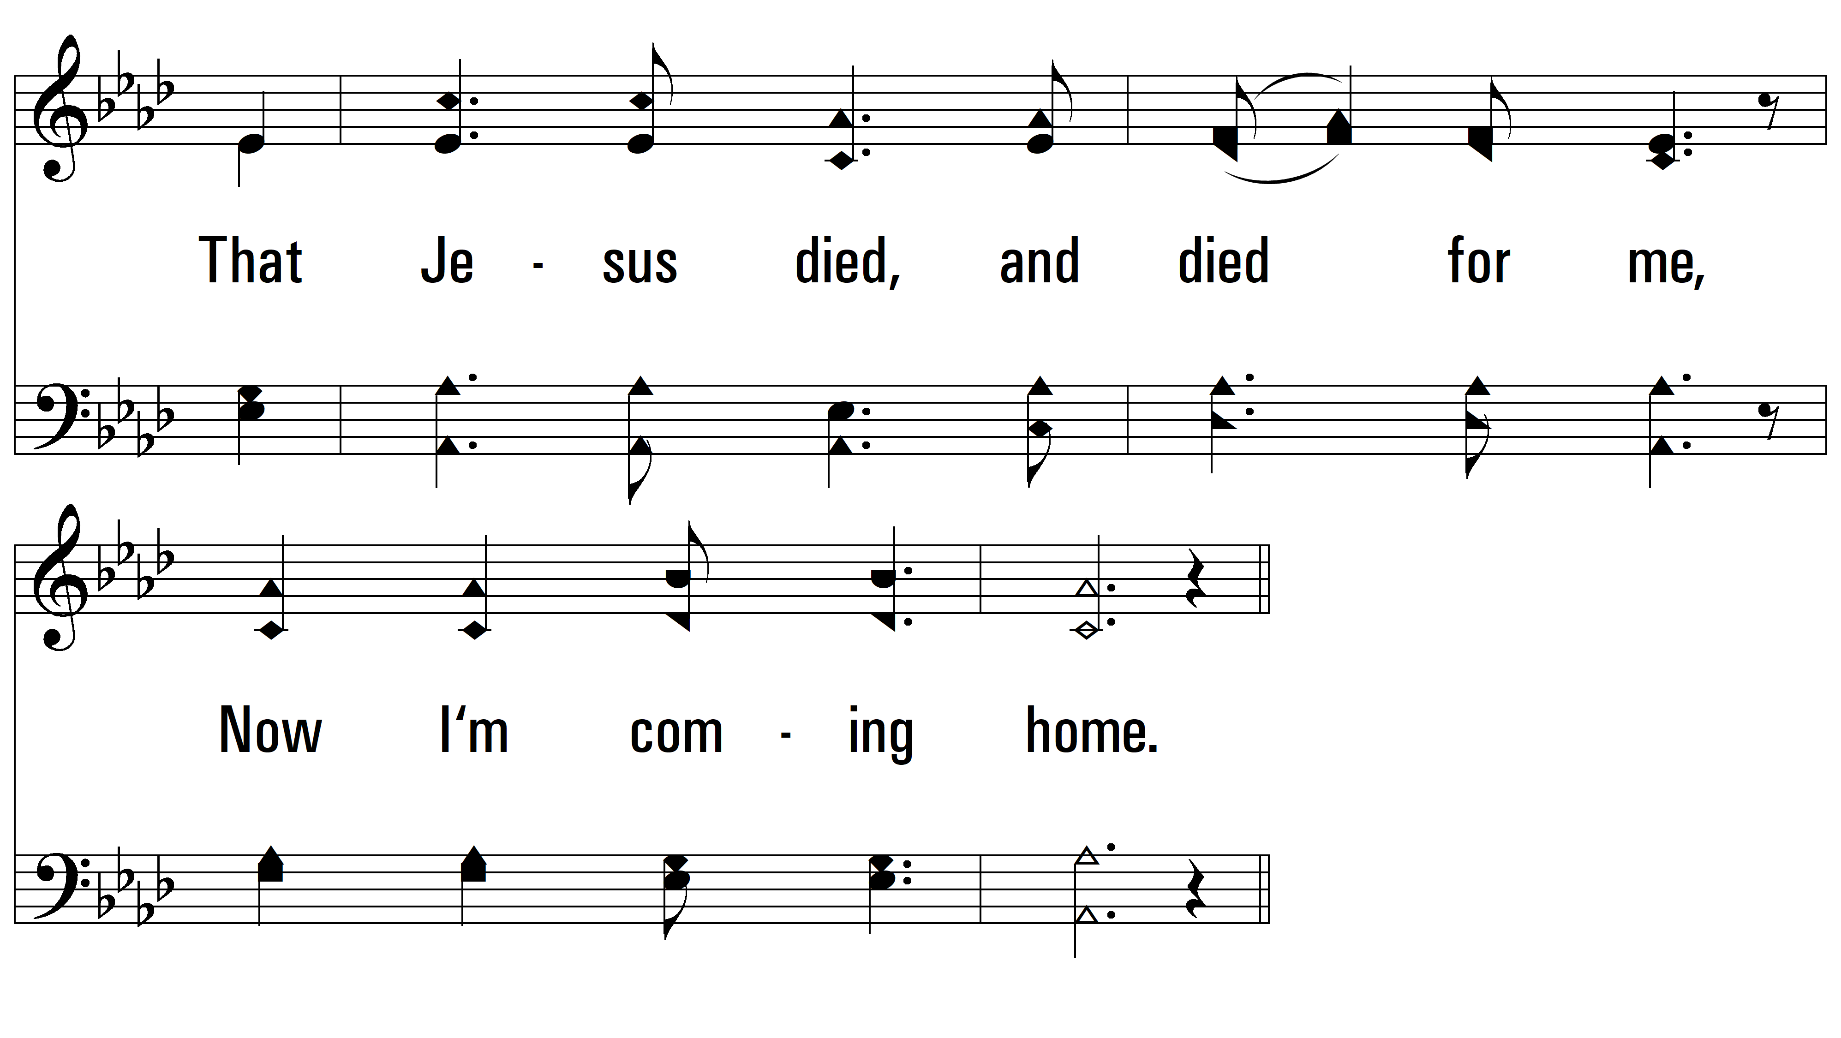
vs. 5

Slide 16
vs. 5

Slide 17
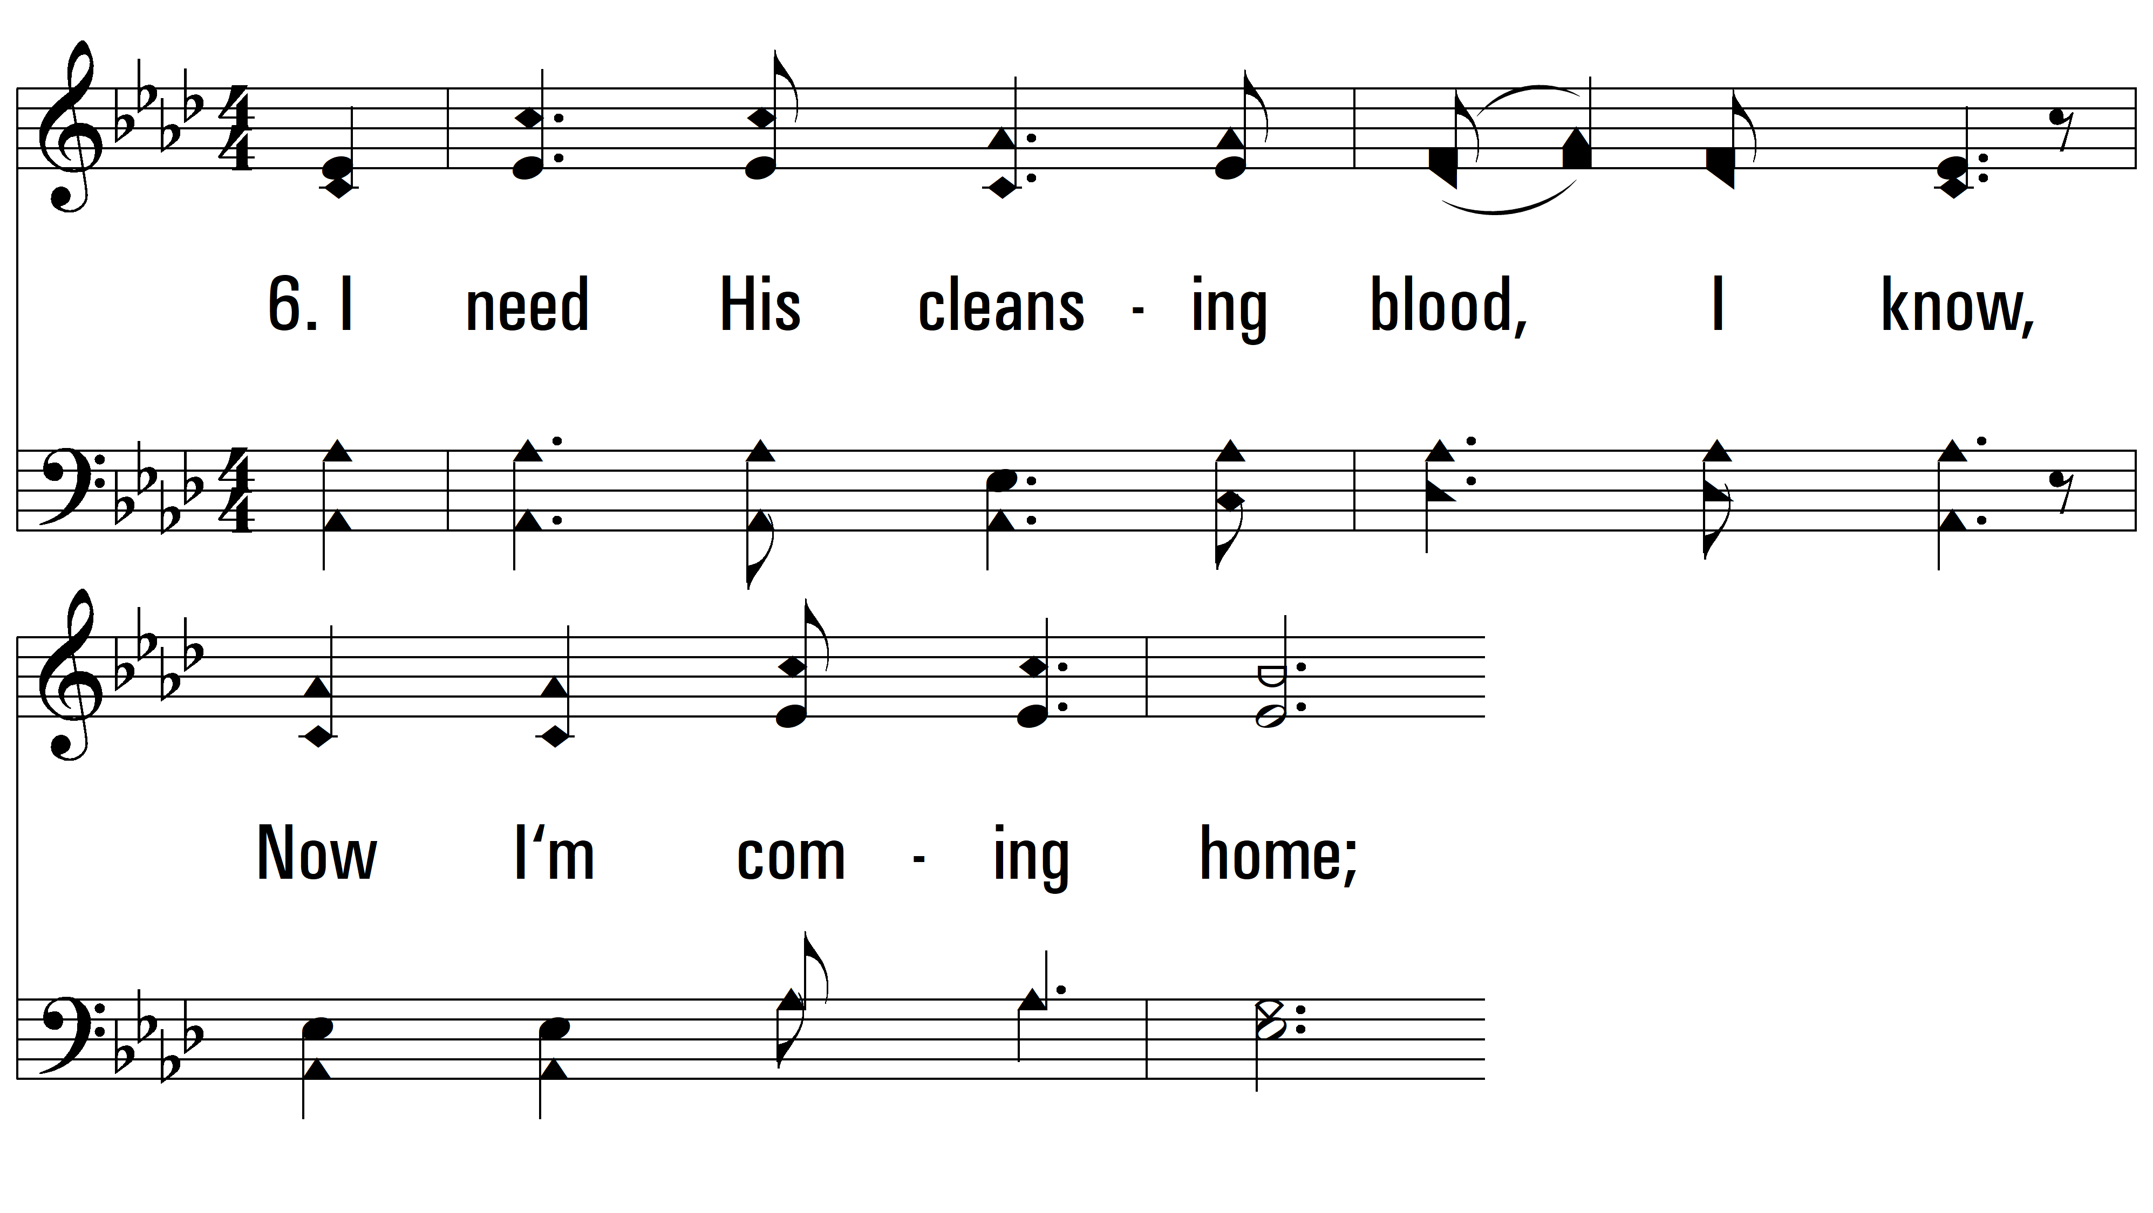
vs. 6 ~ Lord I’m Coming Home

Slide 18
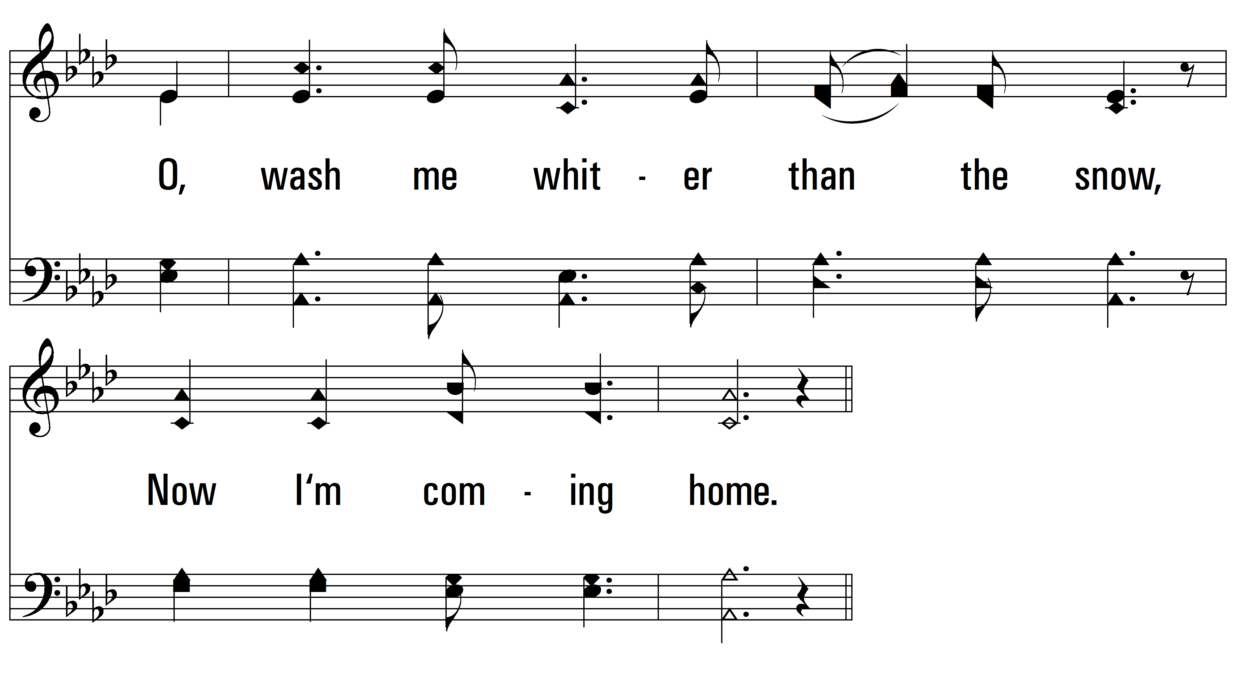
vs. 6

Slide 19
vs. 6
PDHymns.com
END

