Slide 1
Lord, Dismiss Us
DIJON
8.7.8.7
Words: | John Faecett (1773)
Music: | J. G. Bitthauer (1842)
4/4
F/F - DO
Verses: 2
Lead - | DO
Alto - | SOL
Tenor - | MI
Bass - | DO
PDHymns.com

Slide 2
vs. 1 ~ Lord, Dismiss Us

Slide 3
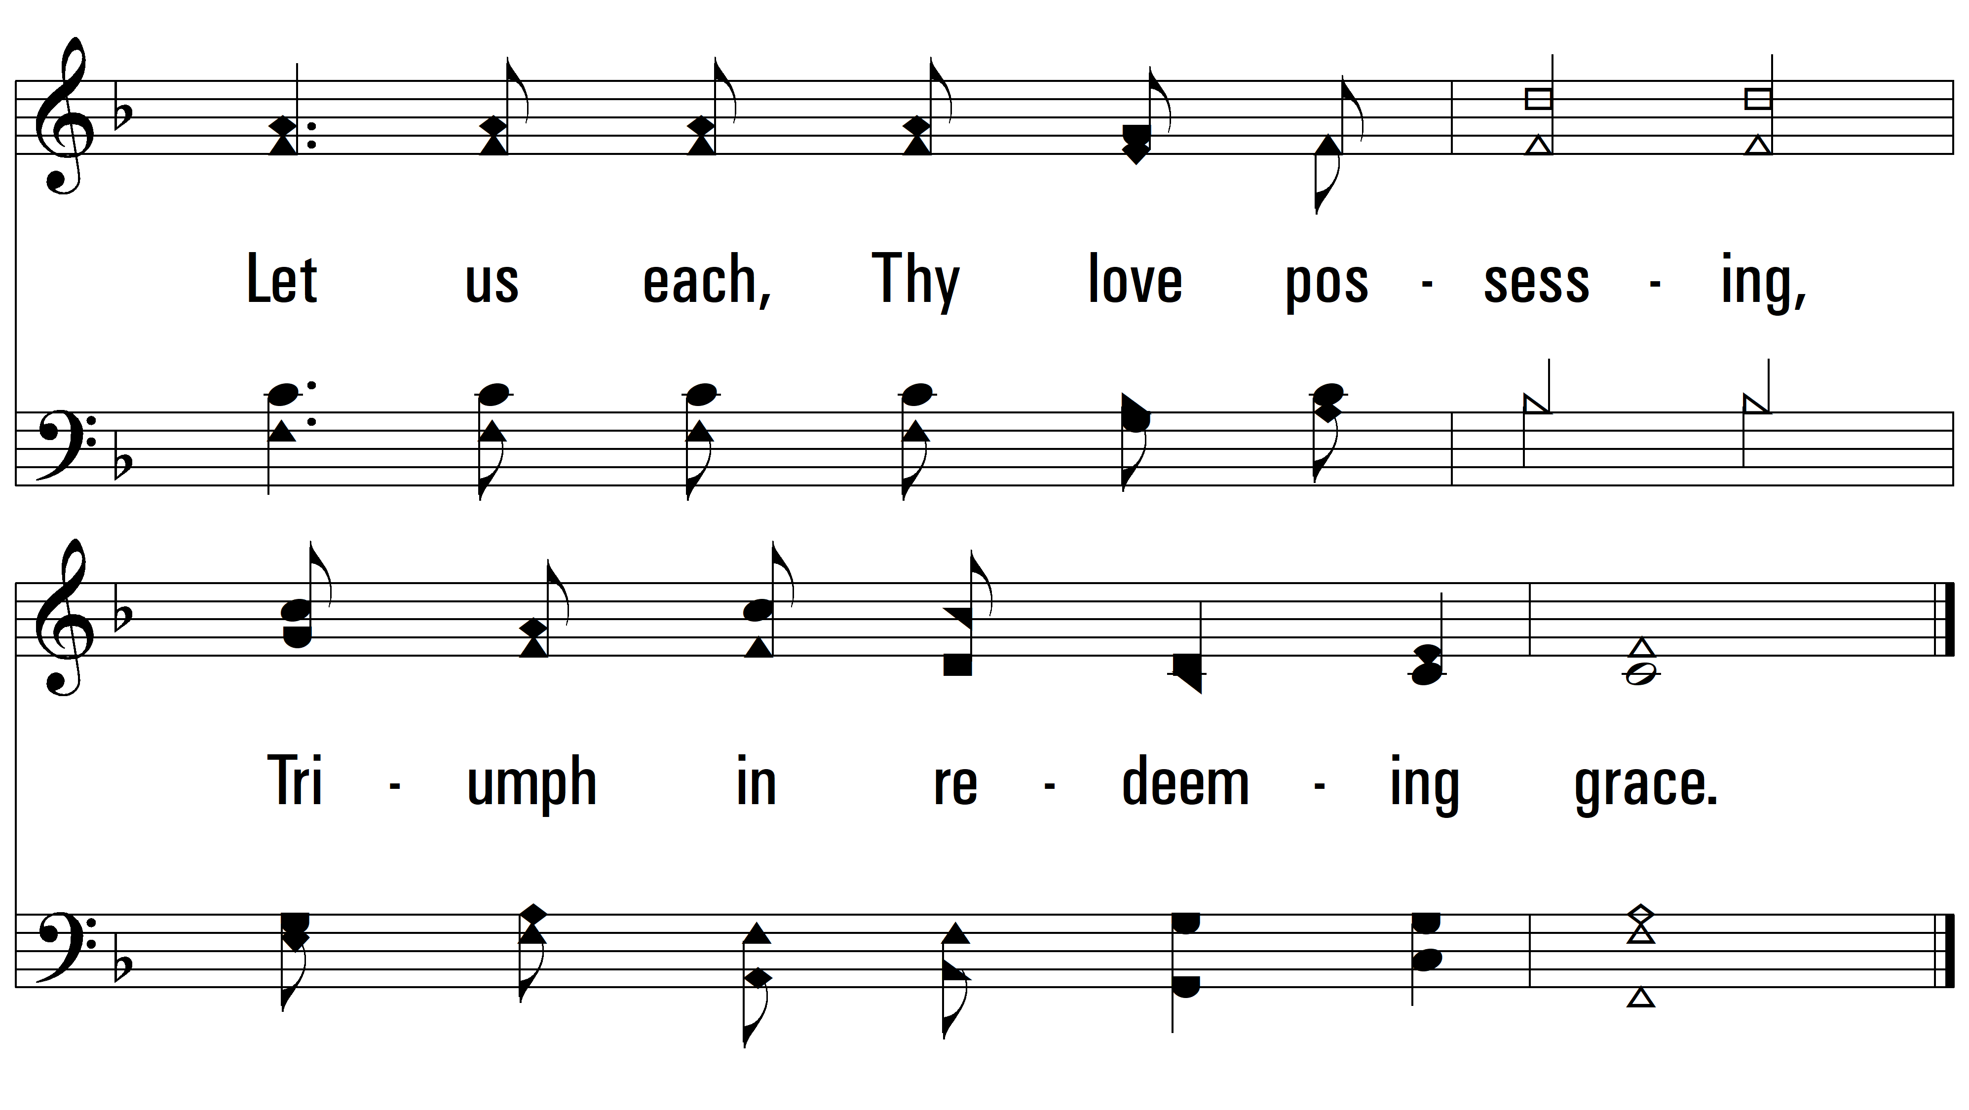
vs. 2

Slide 4
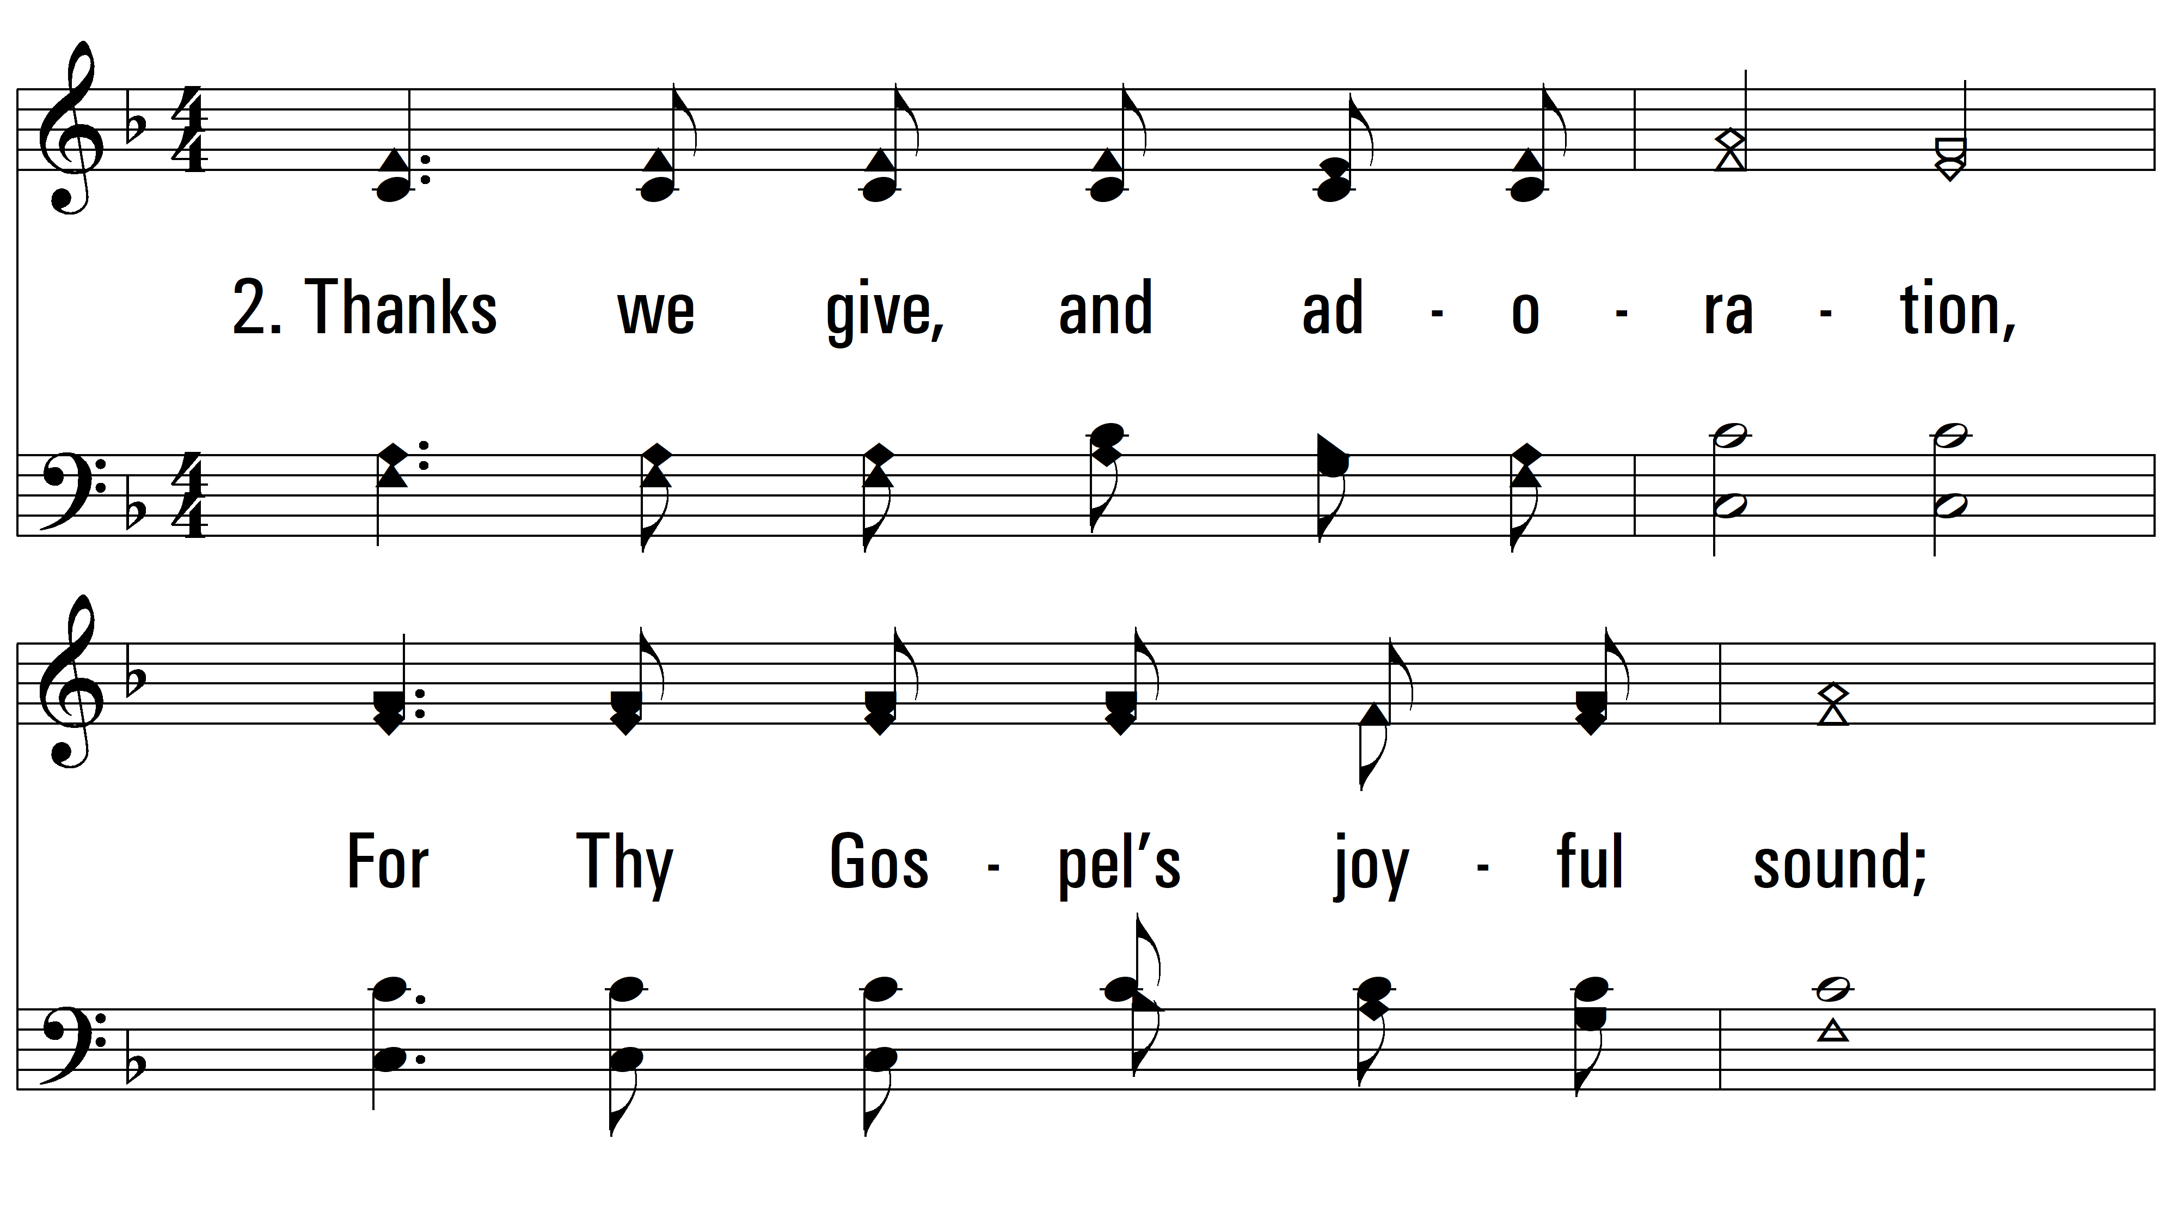
vs. 2 ~ Lord, Dismiss Us

Slide 5
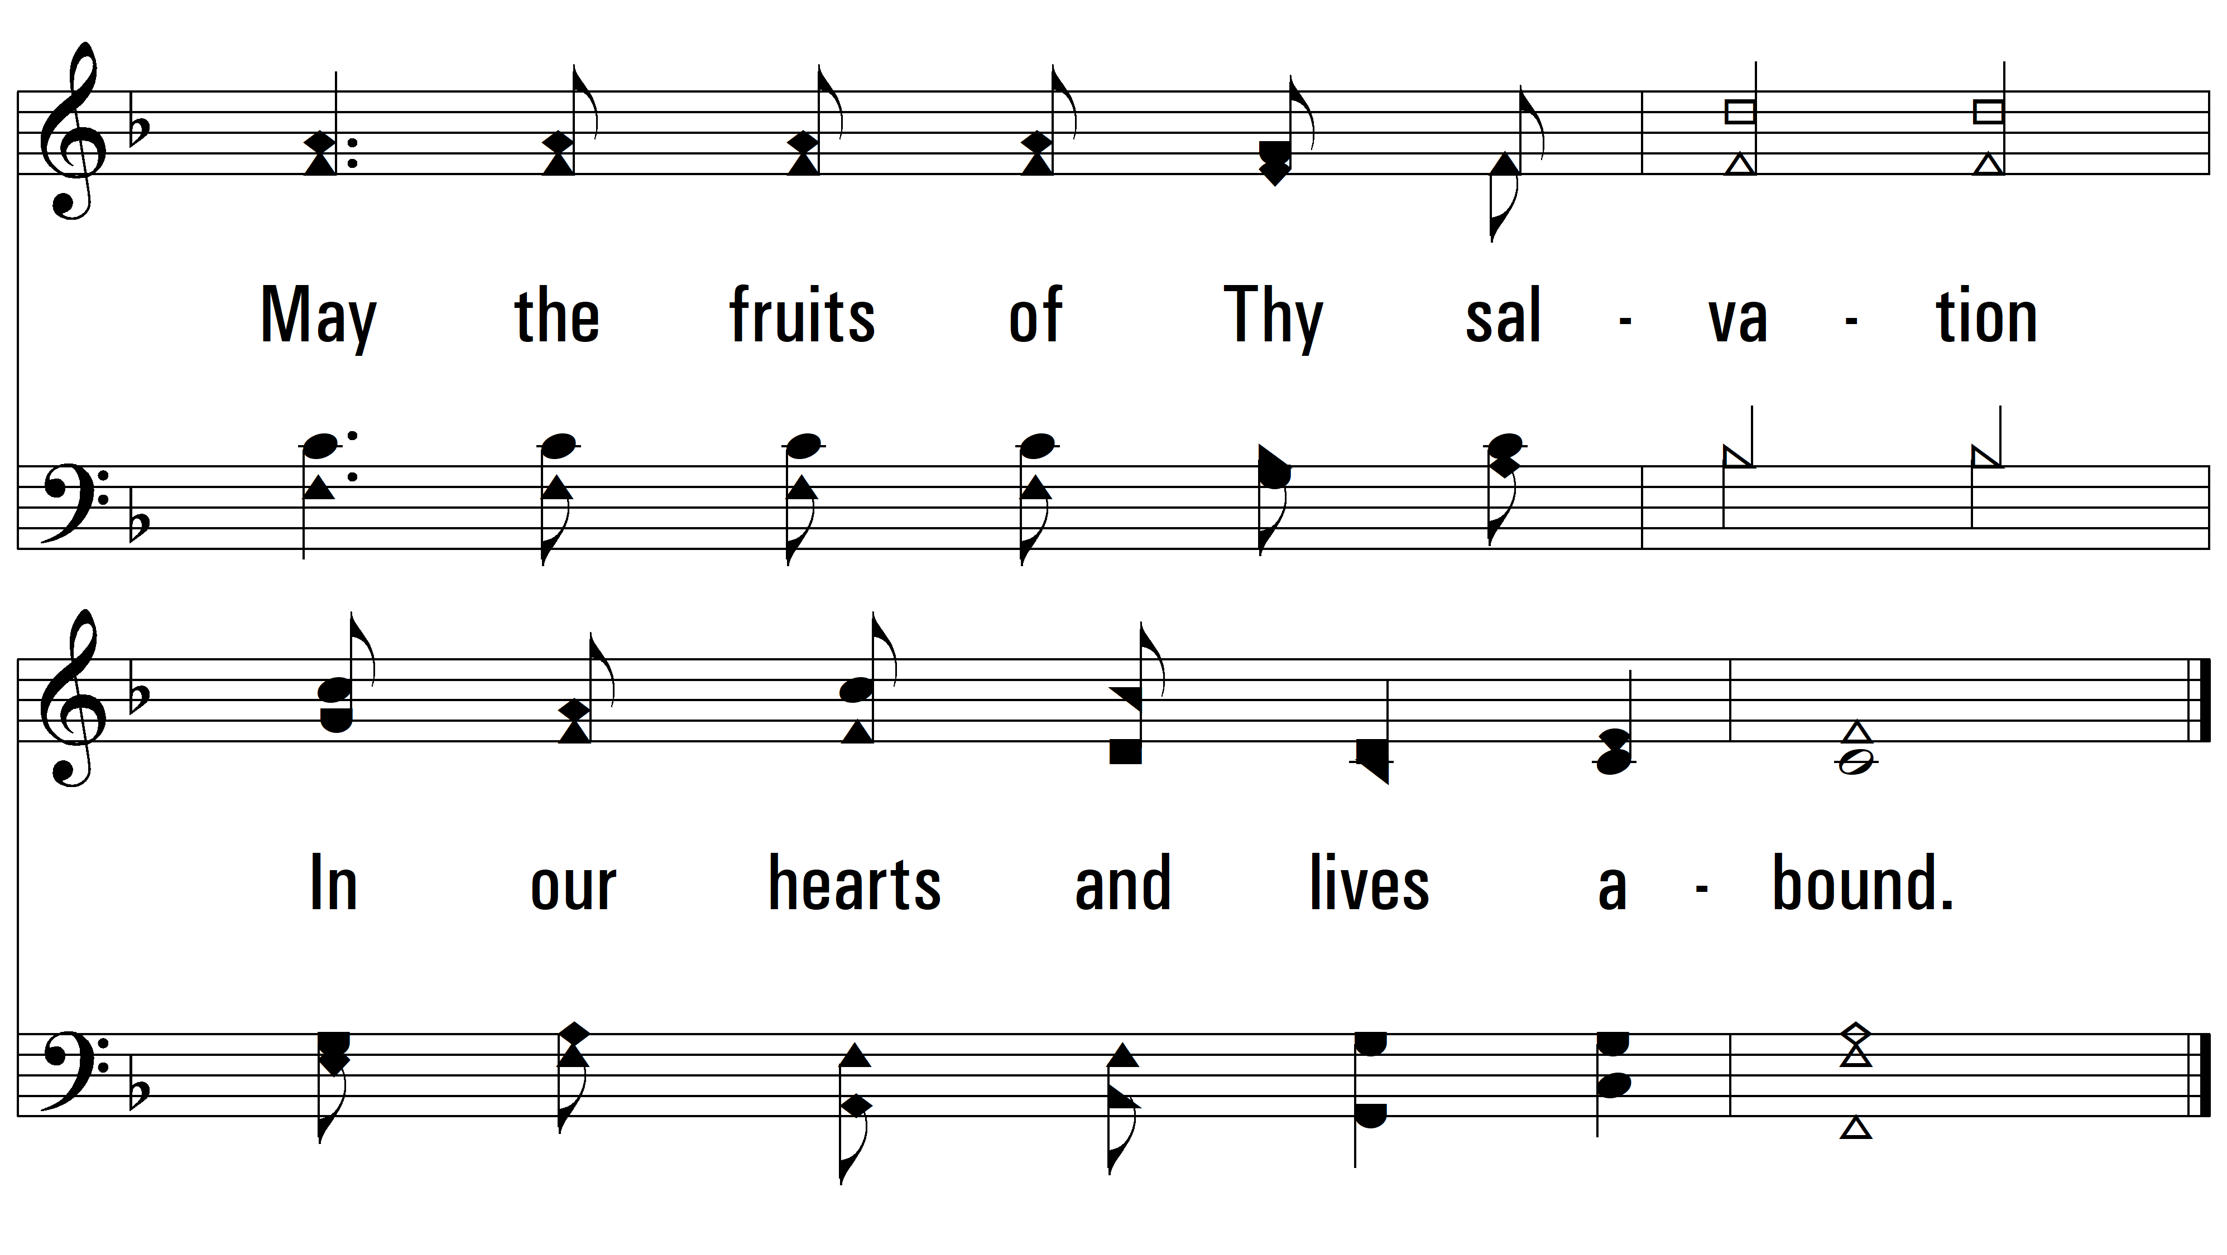
vs. 2
PDHymns.com
END

