Slide 1
Let Me Live Close To Thee
Words: | J. R. Baxter Jr.
Music: | V. O. Stamps
4/4
F/A - MI
Verses: 3/Chorus
Lead - | MI
Alto - | DO
Tenor - | SOL
Bass - | DO
PDHymns.com

Slide 2
vs. 1 ~ Let Me Live Close To Thee

Slide 3
vs. 1

Slide 4
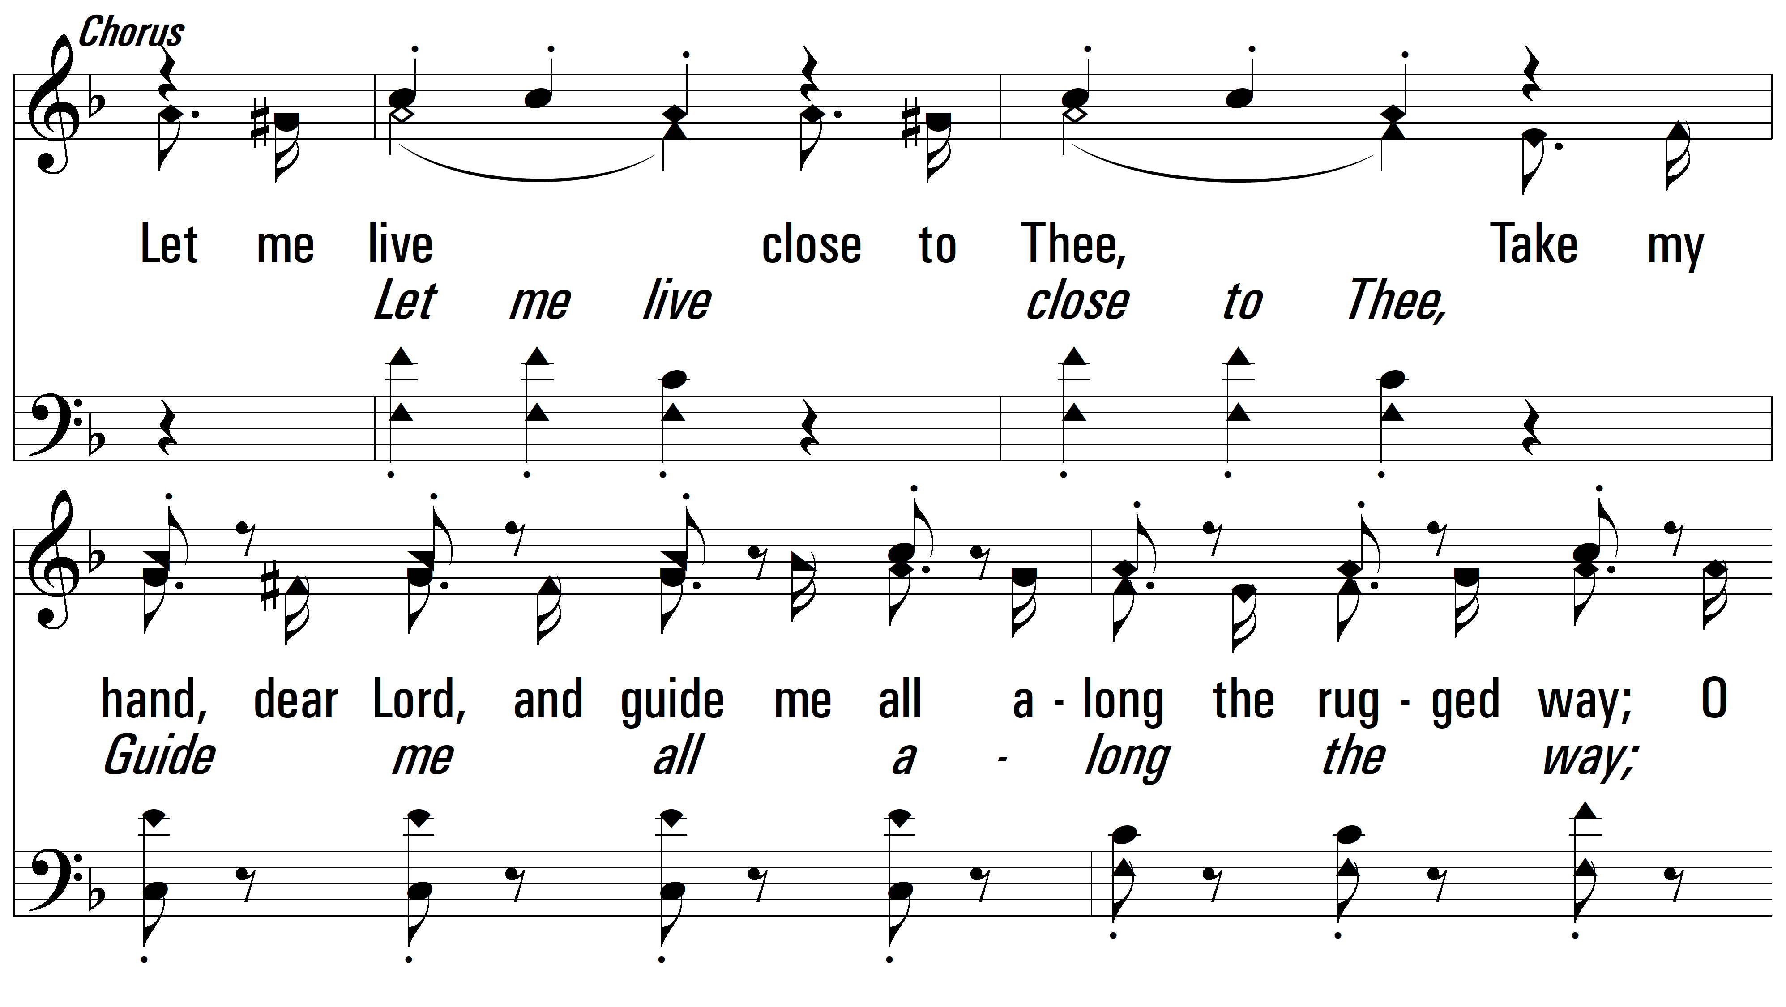
vs. 1

Slide 5
vs. 1

Slide 6
vs. 2 ~ Let Me Live Close To Thee

Slide 7
vs. 2

Slide 8
vs. 2

Slide 9
vs. 2

Slide 10
vs. 3 ~ Let Me Live Close To Thee

Slide 11
vs. 3

Slide 12
vs. 3

Slide 13
vs. 3
PDHymns.com
END

