Slide 1
Just What I Need He Gives
Words: | A. J. Showalter
Music: | A. J. Showalter
9/8
G/B - MI
Verses: 4/Chorus
Lead - | MI
Alto - | SOL
Tenor - | DO
Bass - | DO
PDHymns.com

Slide 2
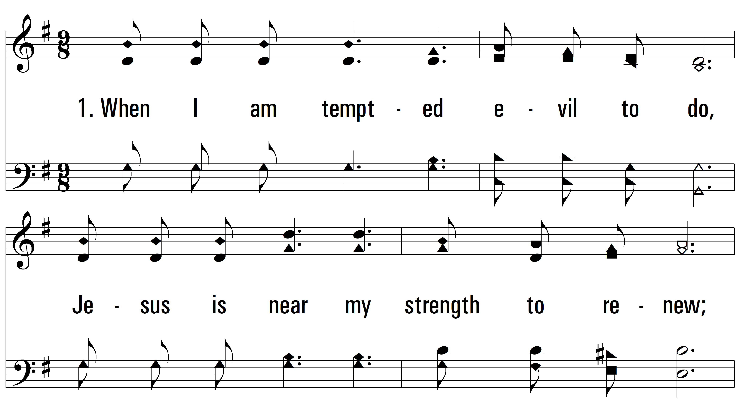
vs. 1 ~ Just What I Need He Gives

Slide 3
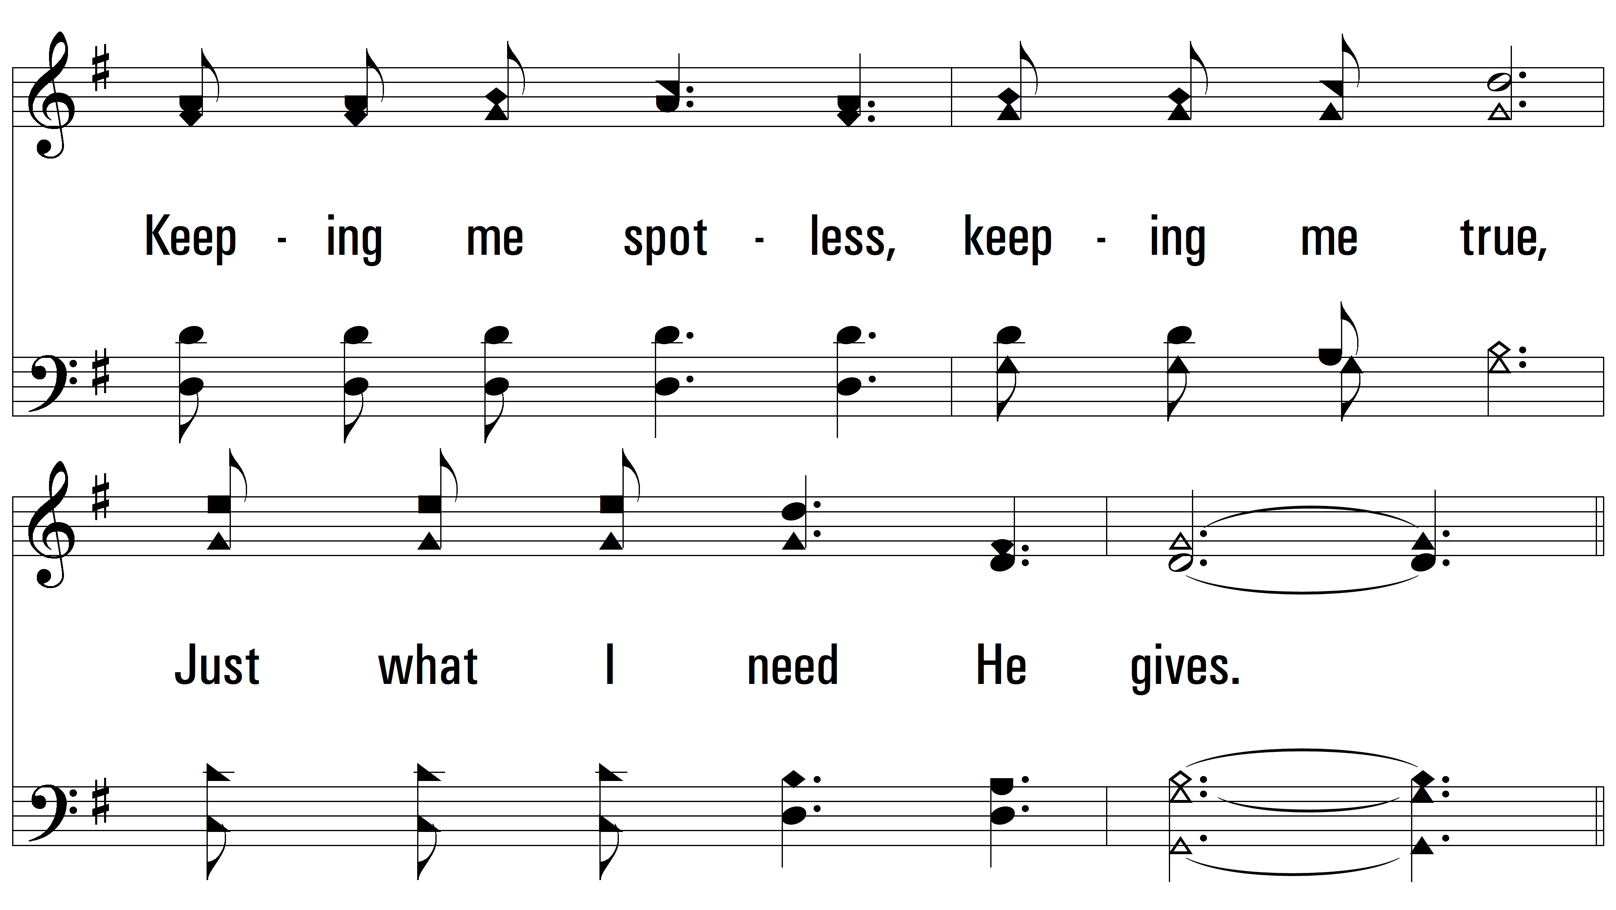
vs. 1

Slide 4
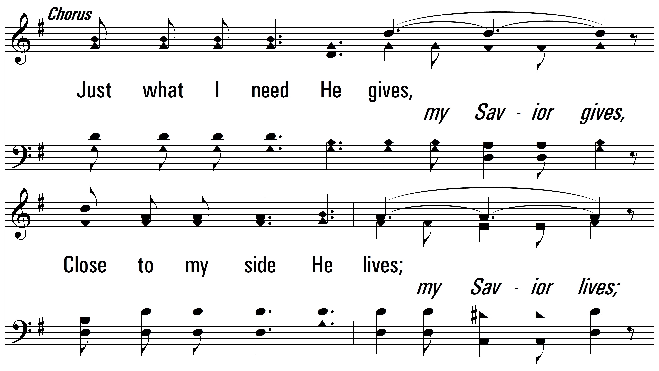
vs. 1

Slide 5
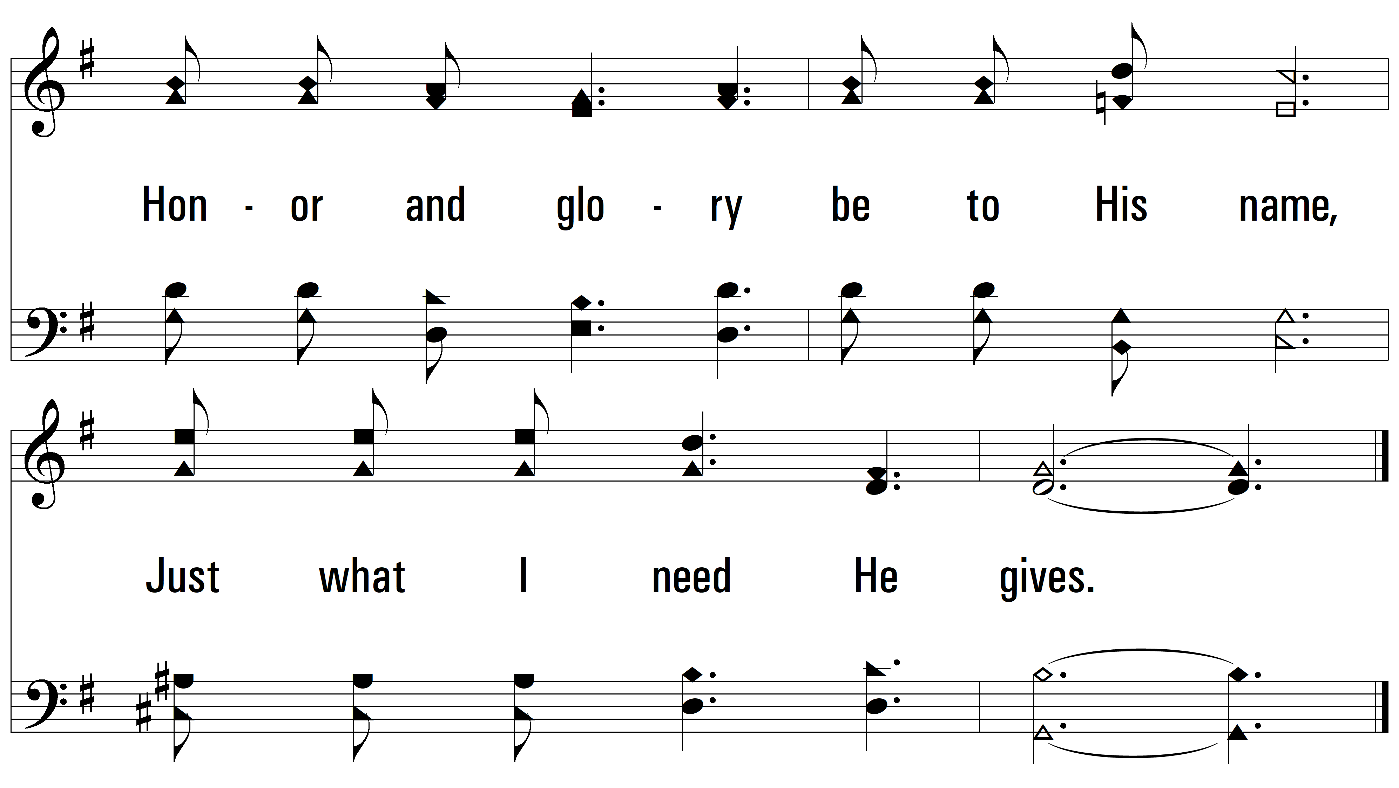
vs. 1

Slide 6
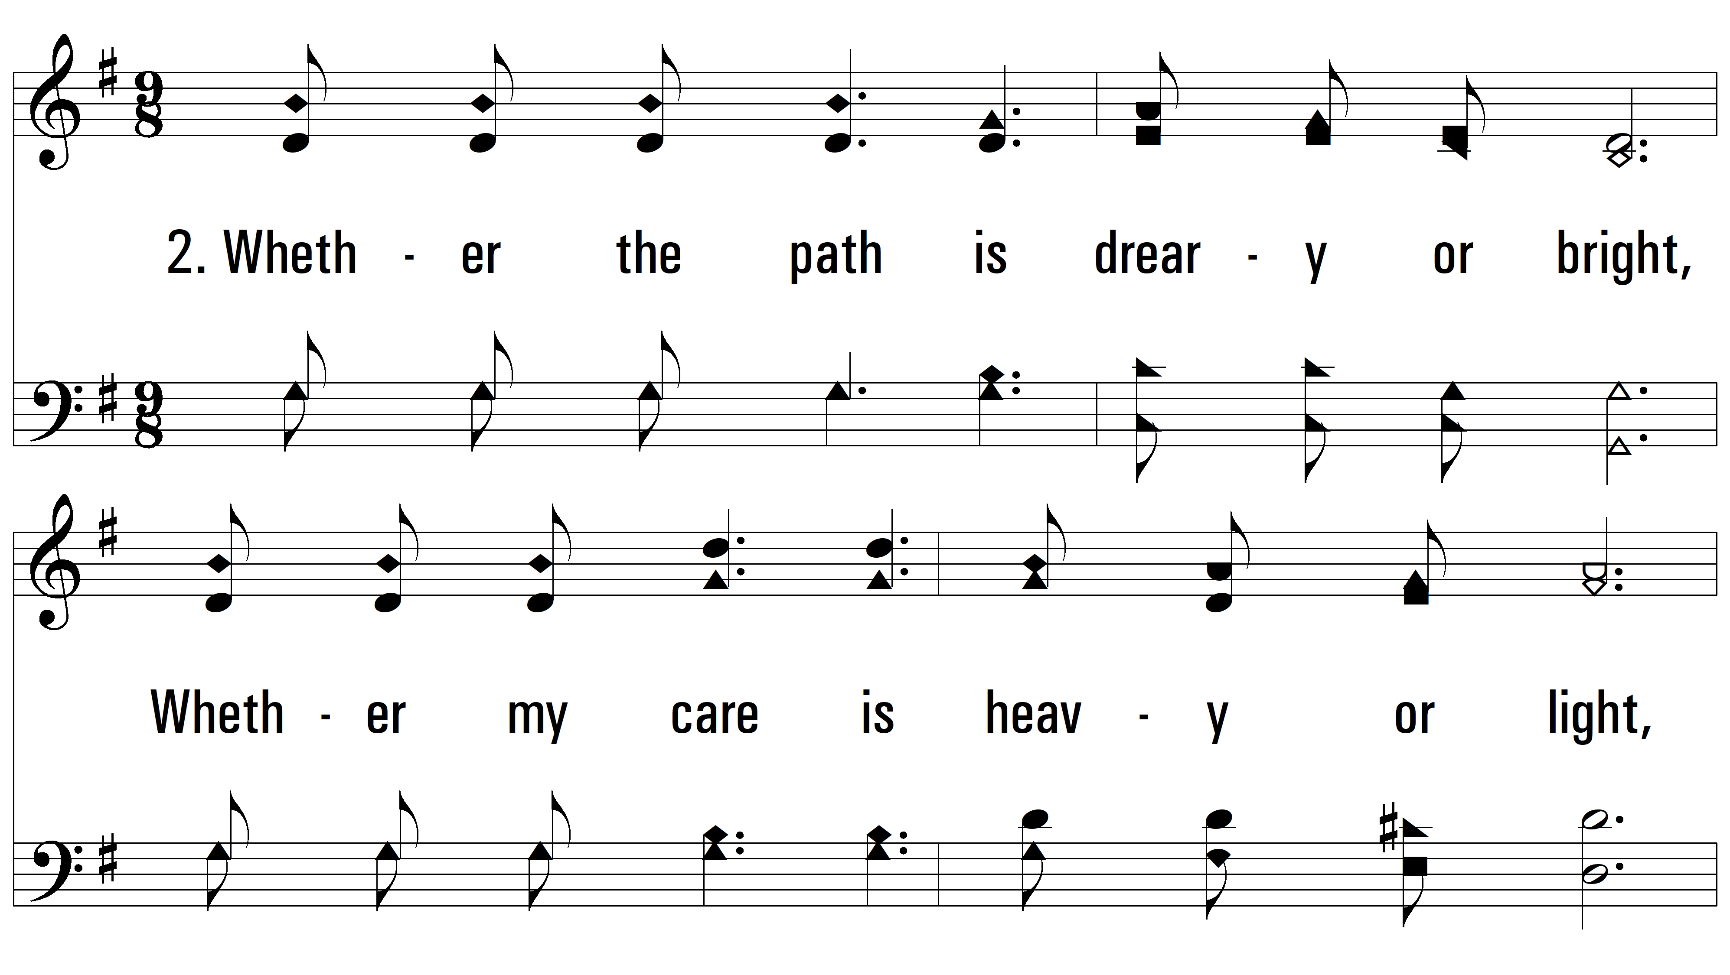
vs. 2 ~ Just What I Need He Gives

Slide 7
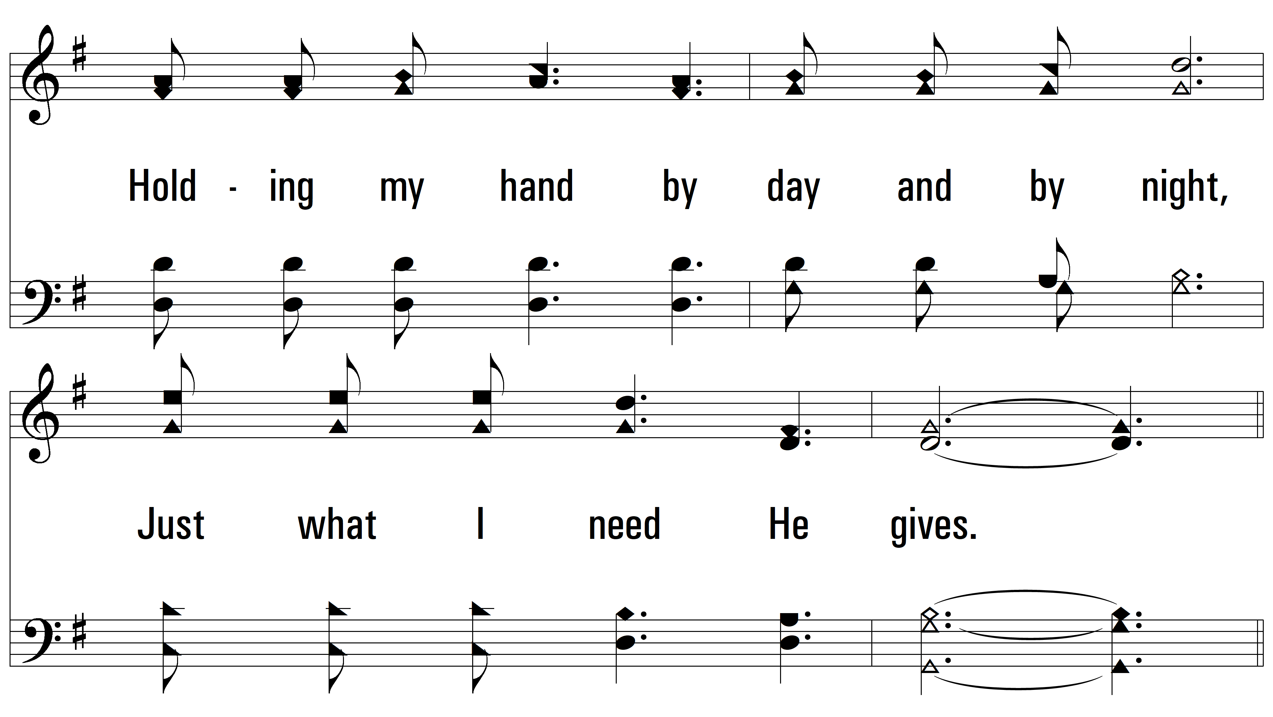
vs. 2

Slide 8
vs. 2

Slide 9
vs. 2

Slide 10
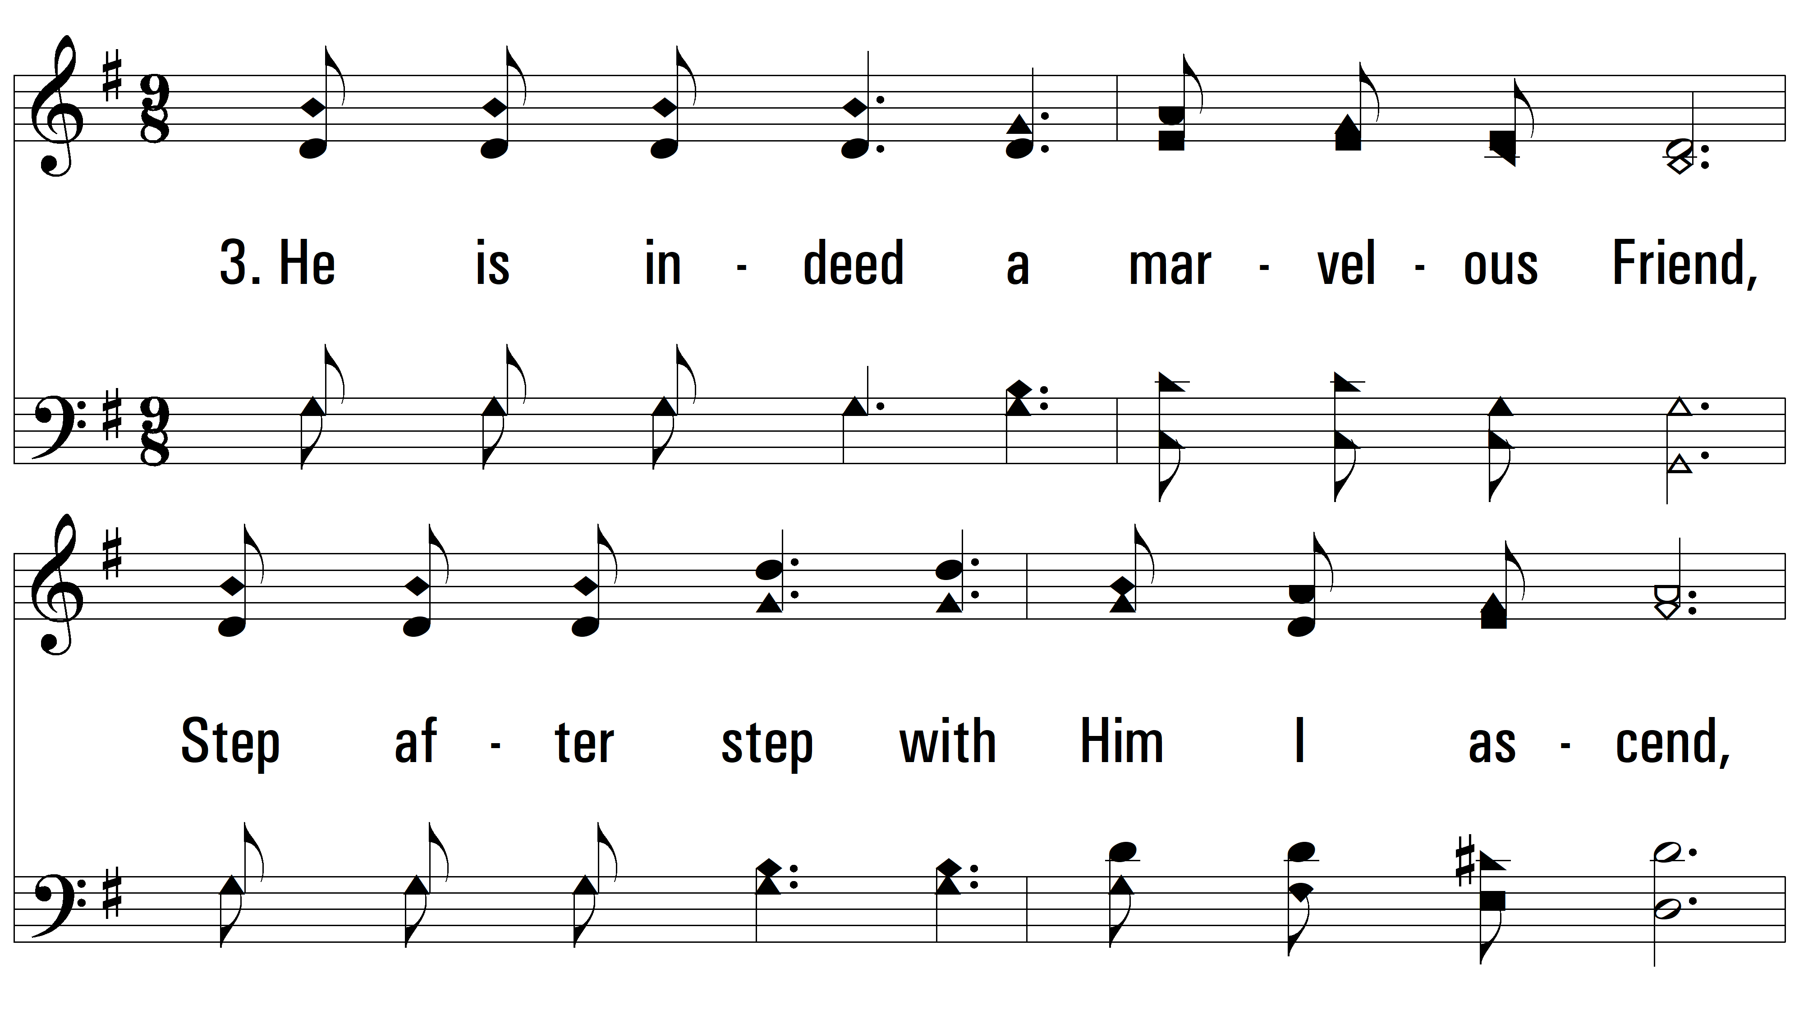
vs. 3 ~ Just What I Need He Gives

Slide 11
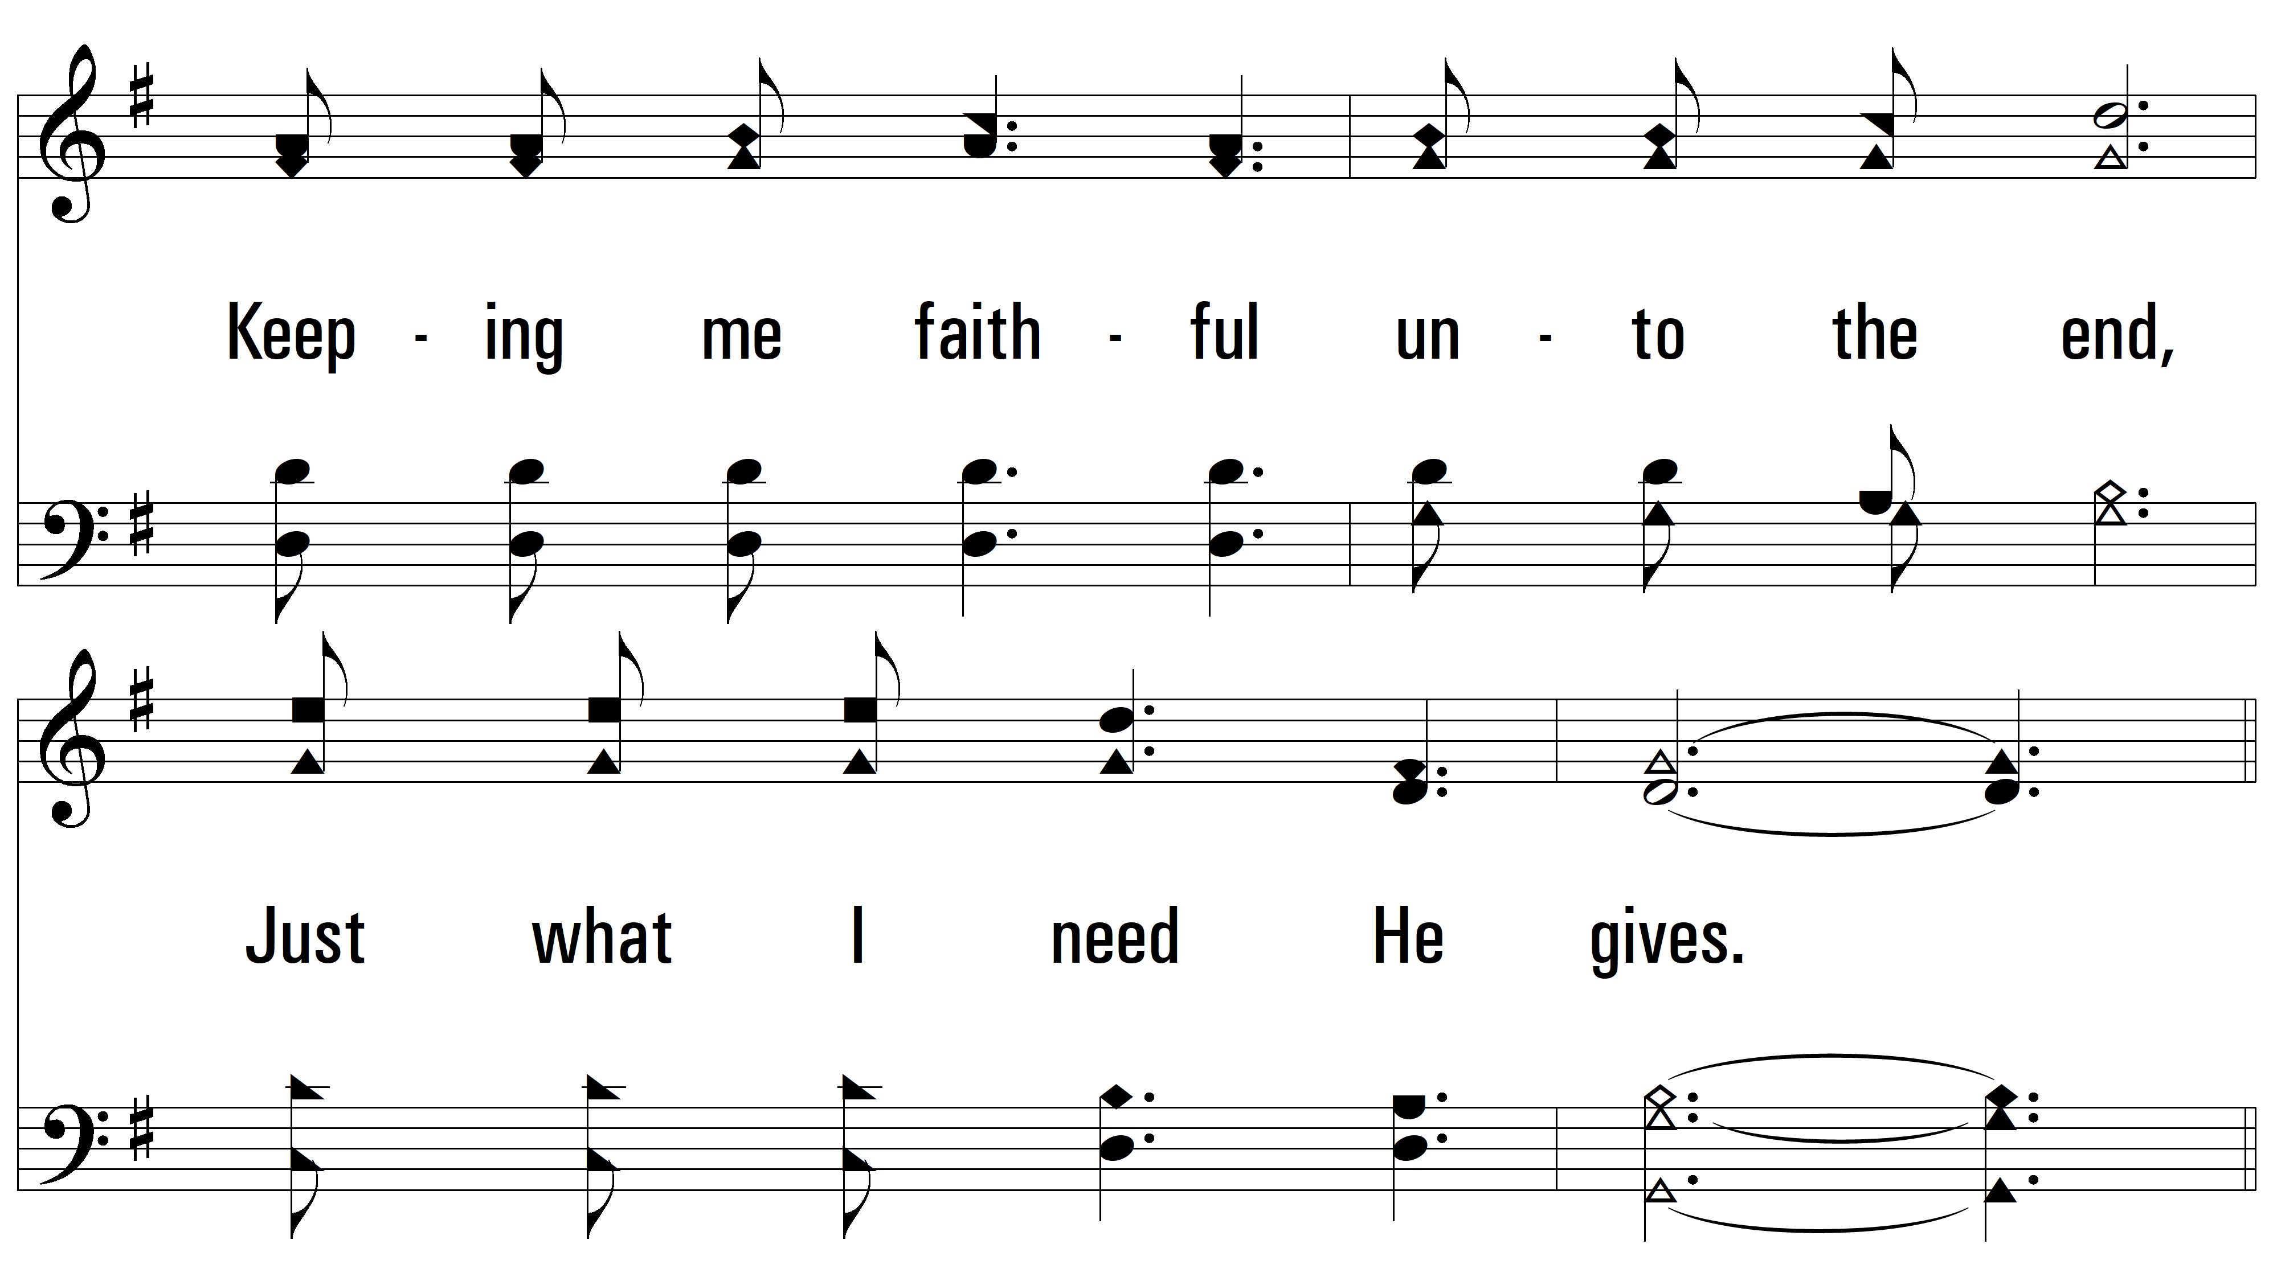
vs. 3

Slide 12
vs. 3

Slide 13
vs. 3

Slide 14
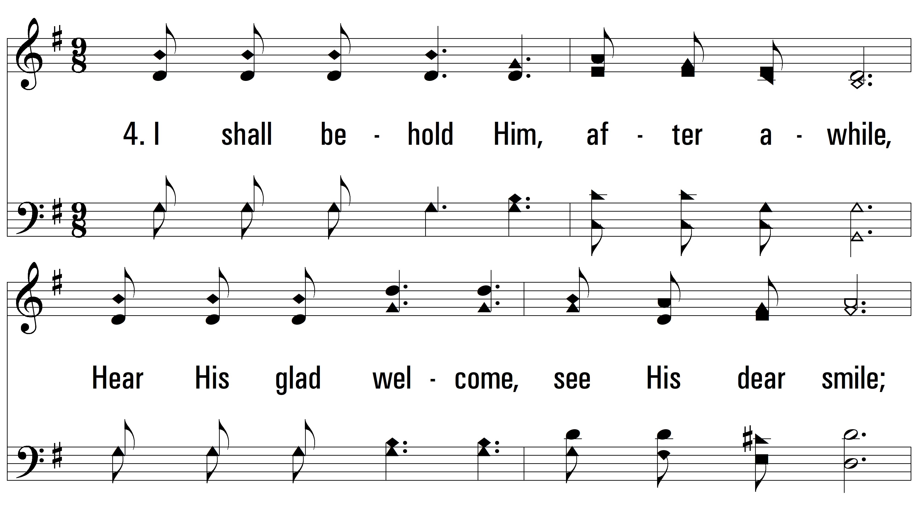
vs. 4 ~ Just What I Need He Gives

Slide 15
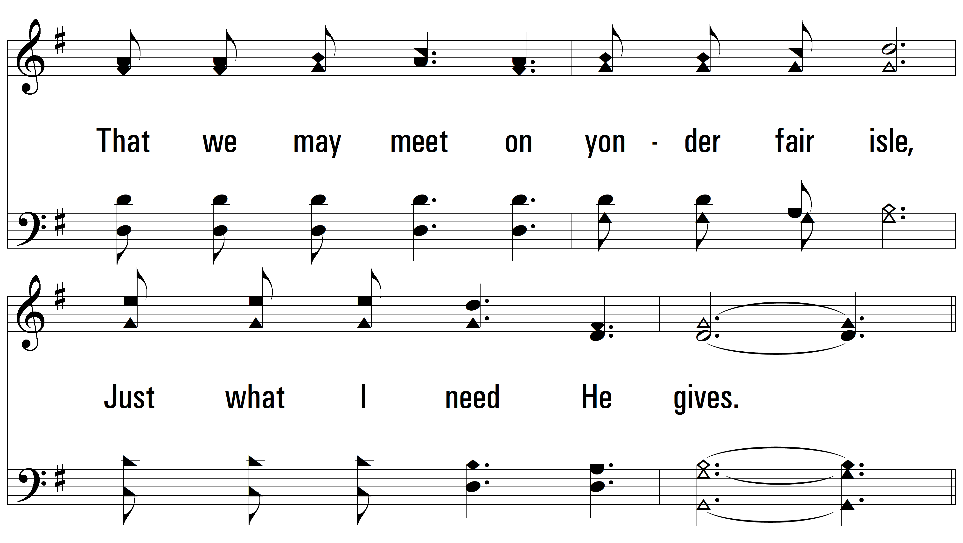
vs. 4

Slide 16
vs. 4

Slide 17
vs. 4
PDHymns.com
END

