Slide 1
Just Over In The Glory Land
Words: | James W. Acuff (1906)
Music: | Emmett S. Dean (1906)
4/4
B^{b}/F - SOL
Verses: 4/Chorus
Lead - | SOL
Alto - | MI
Tenor - | DO
Bass - | DO
PDHymns.com

Slide 2
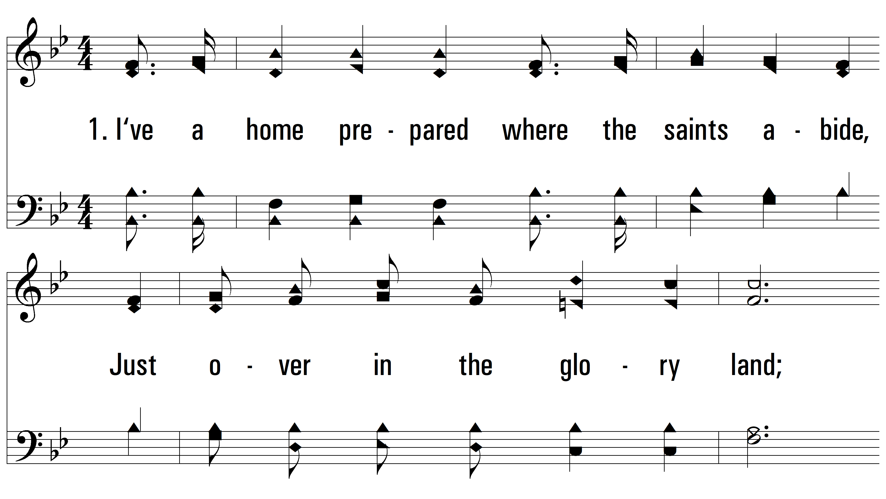
vs. 1 ~ Just Over In The Glory Land

Slide 3
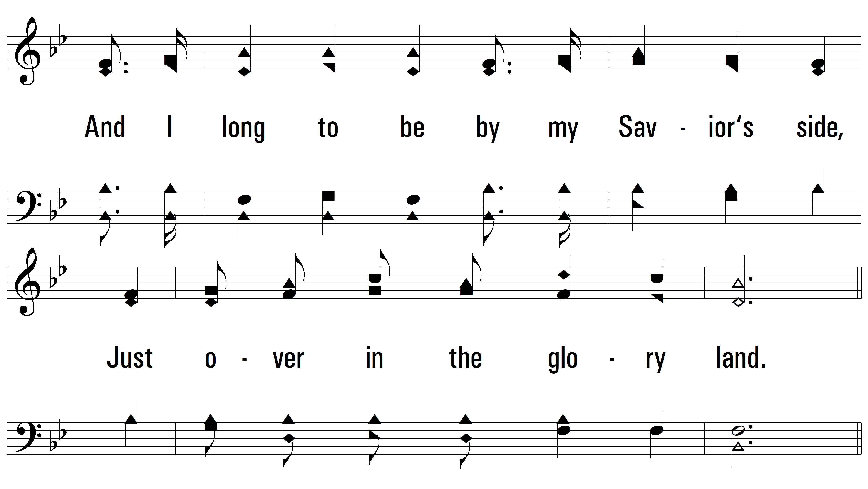
vs. 1

Slide 4
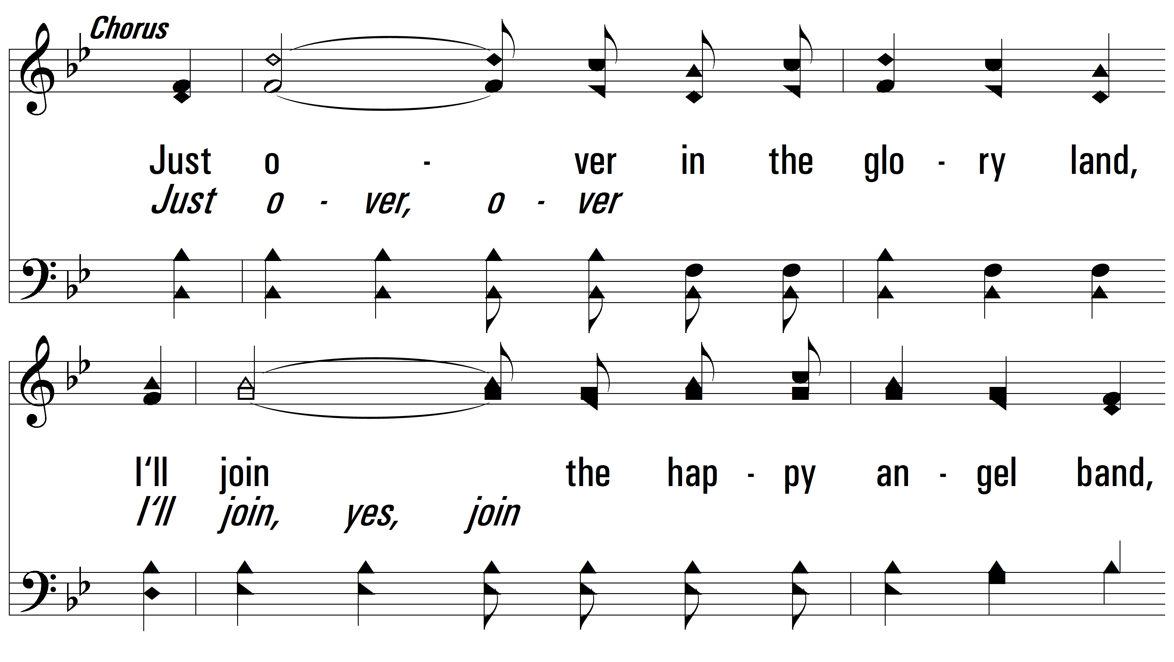
vs. 1

Slide 5
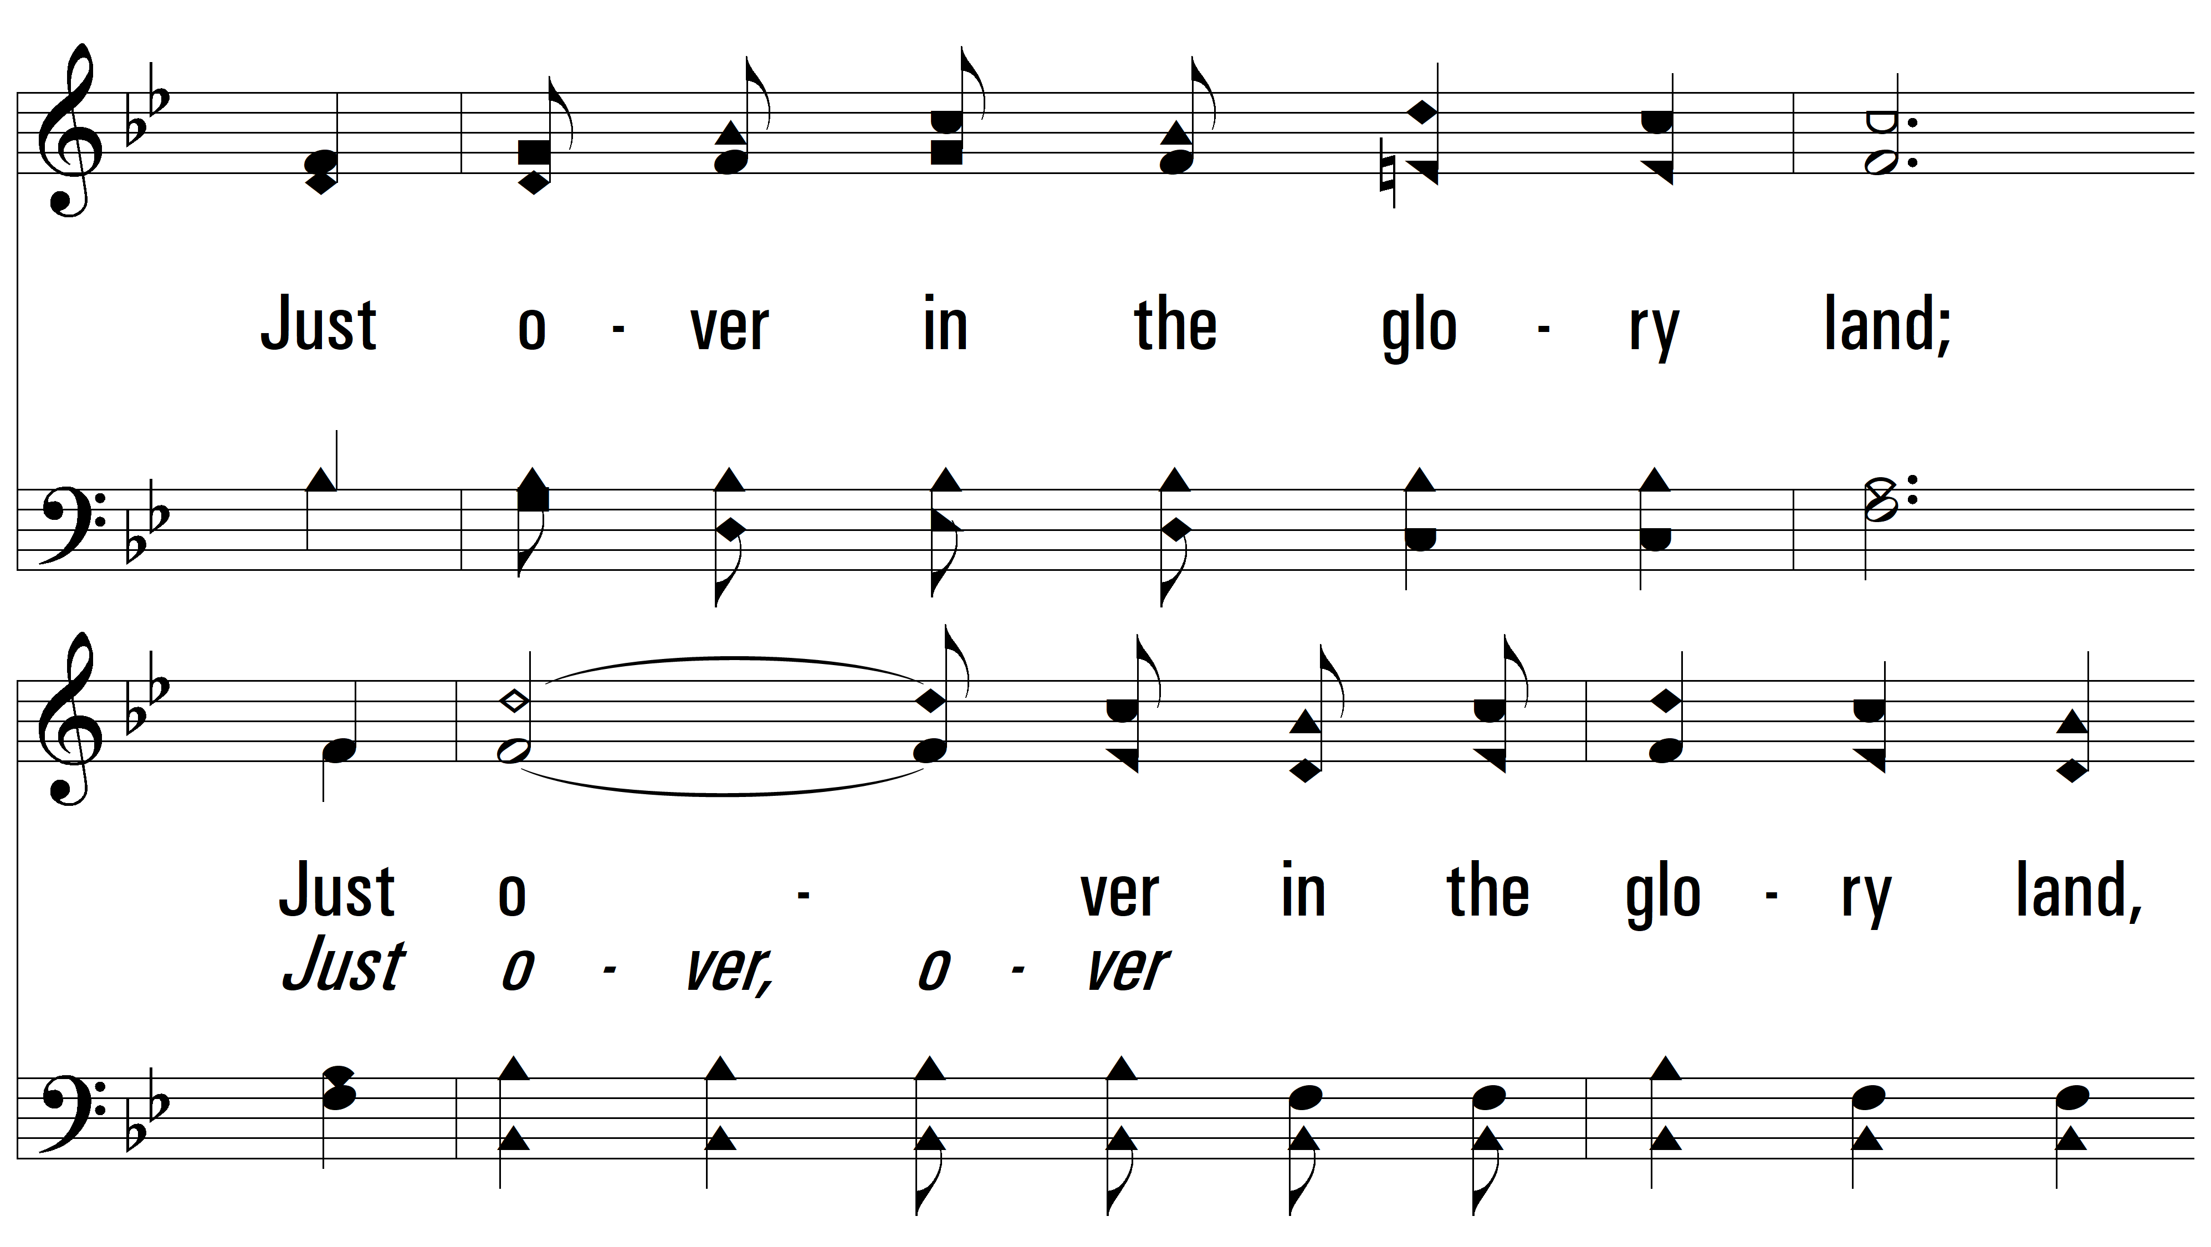
vs. 1

Slide 6
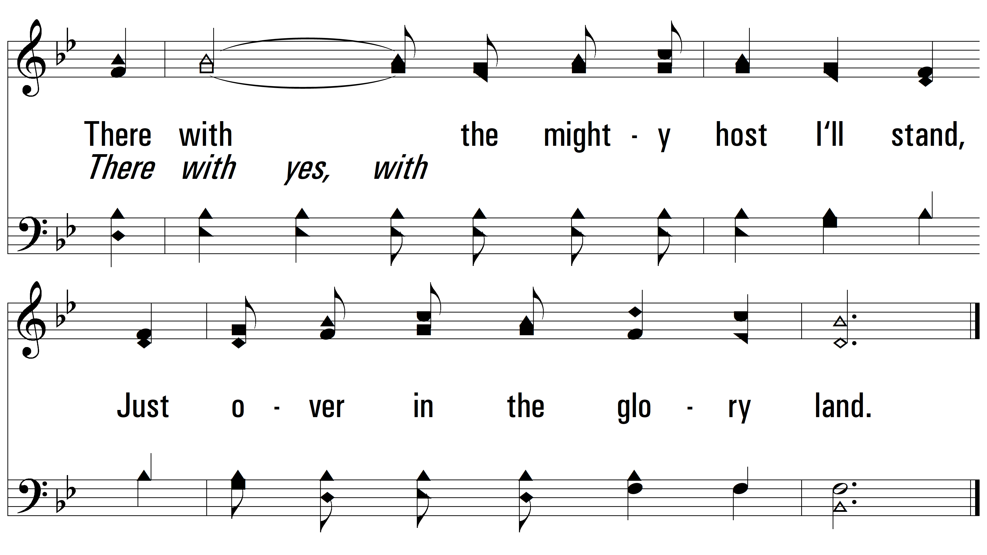
vs. 1

Slide 7
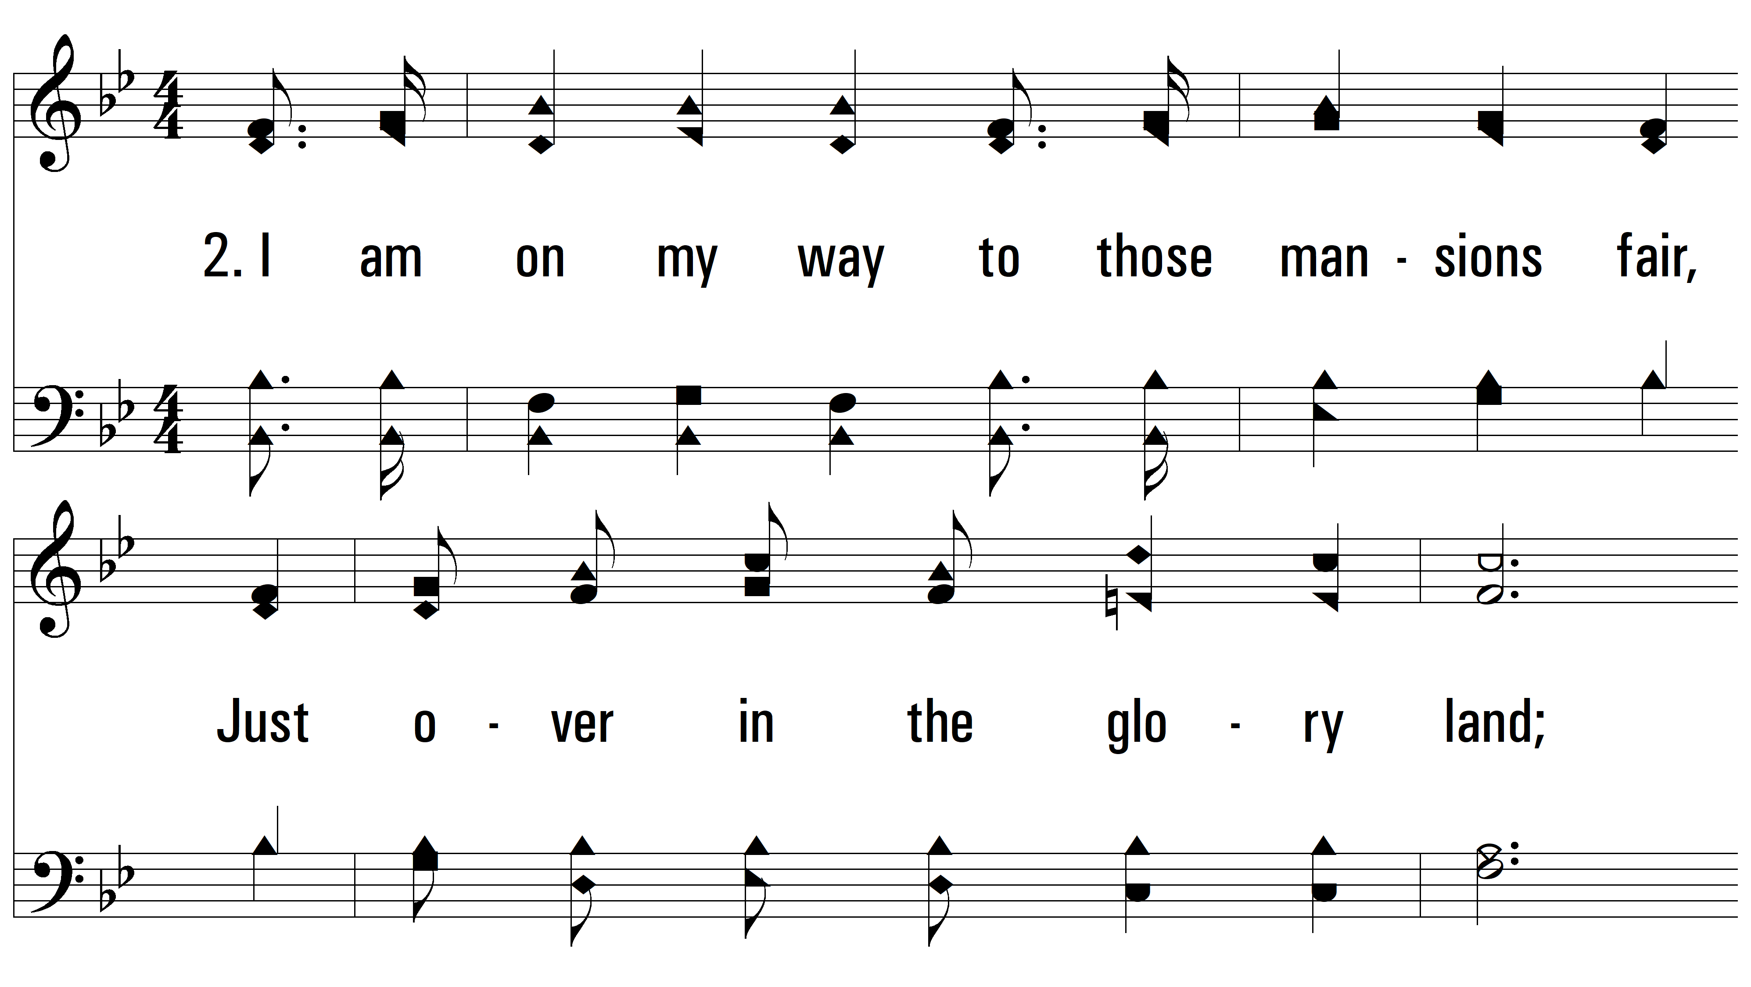
vs. 2 ~ Just Over In The Glory Land

Slide 8
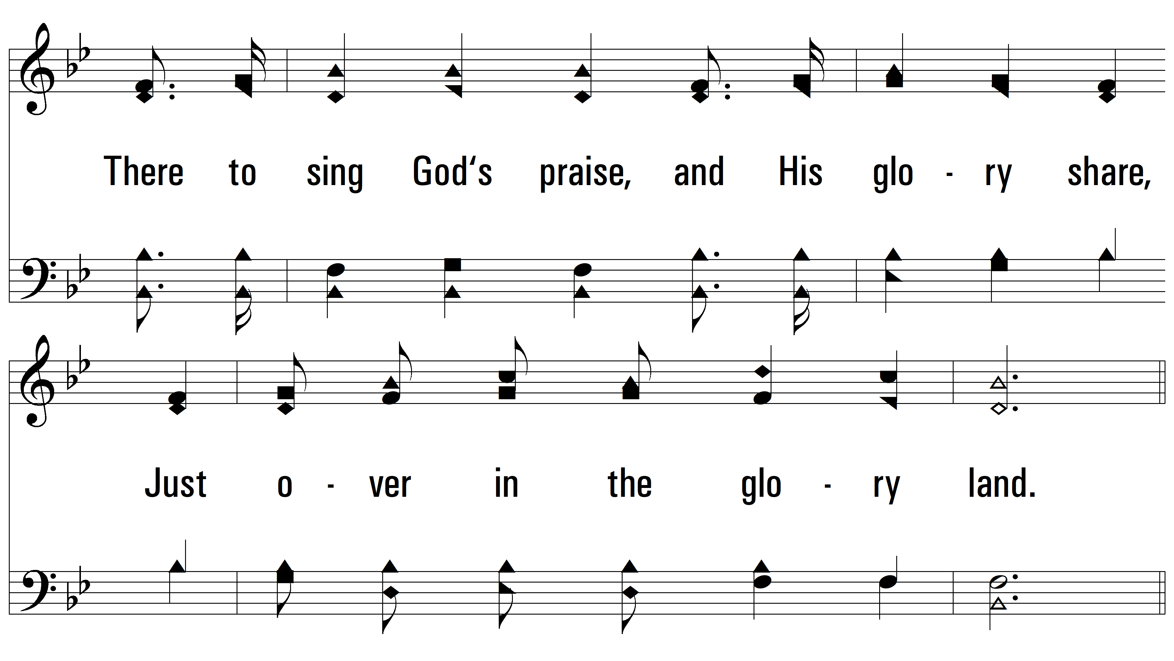
vs. 2

Slide 9
vs. 2

Slide 10
vs. 2

Slide 11
vs. 2

Slide 12
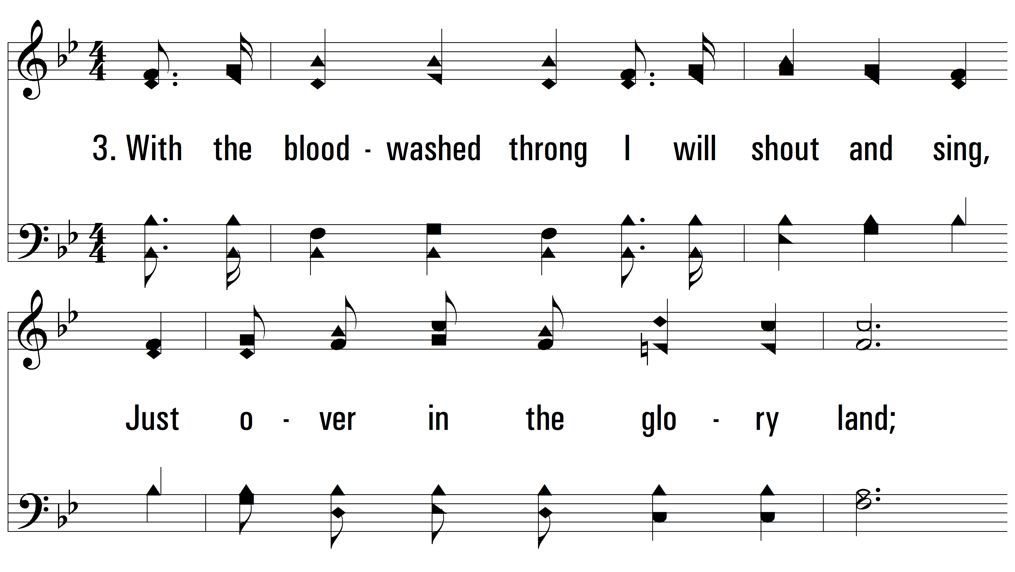
vs. 3 ~ Just Over In The Glory Land

Slide 13
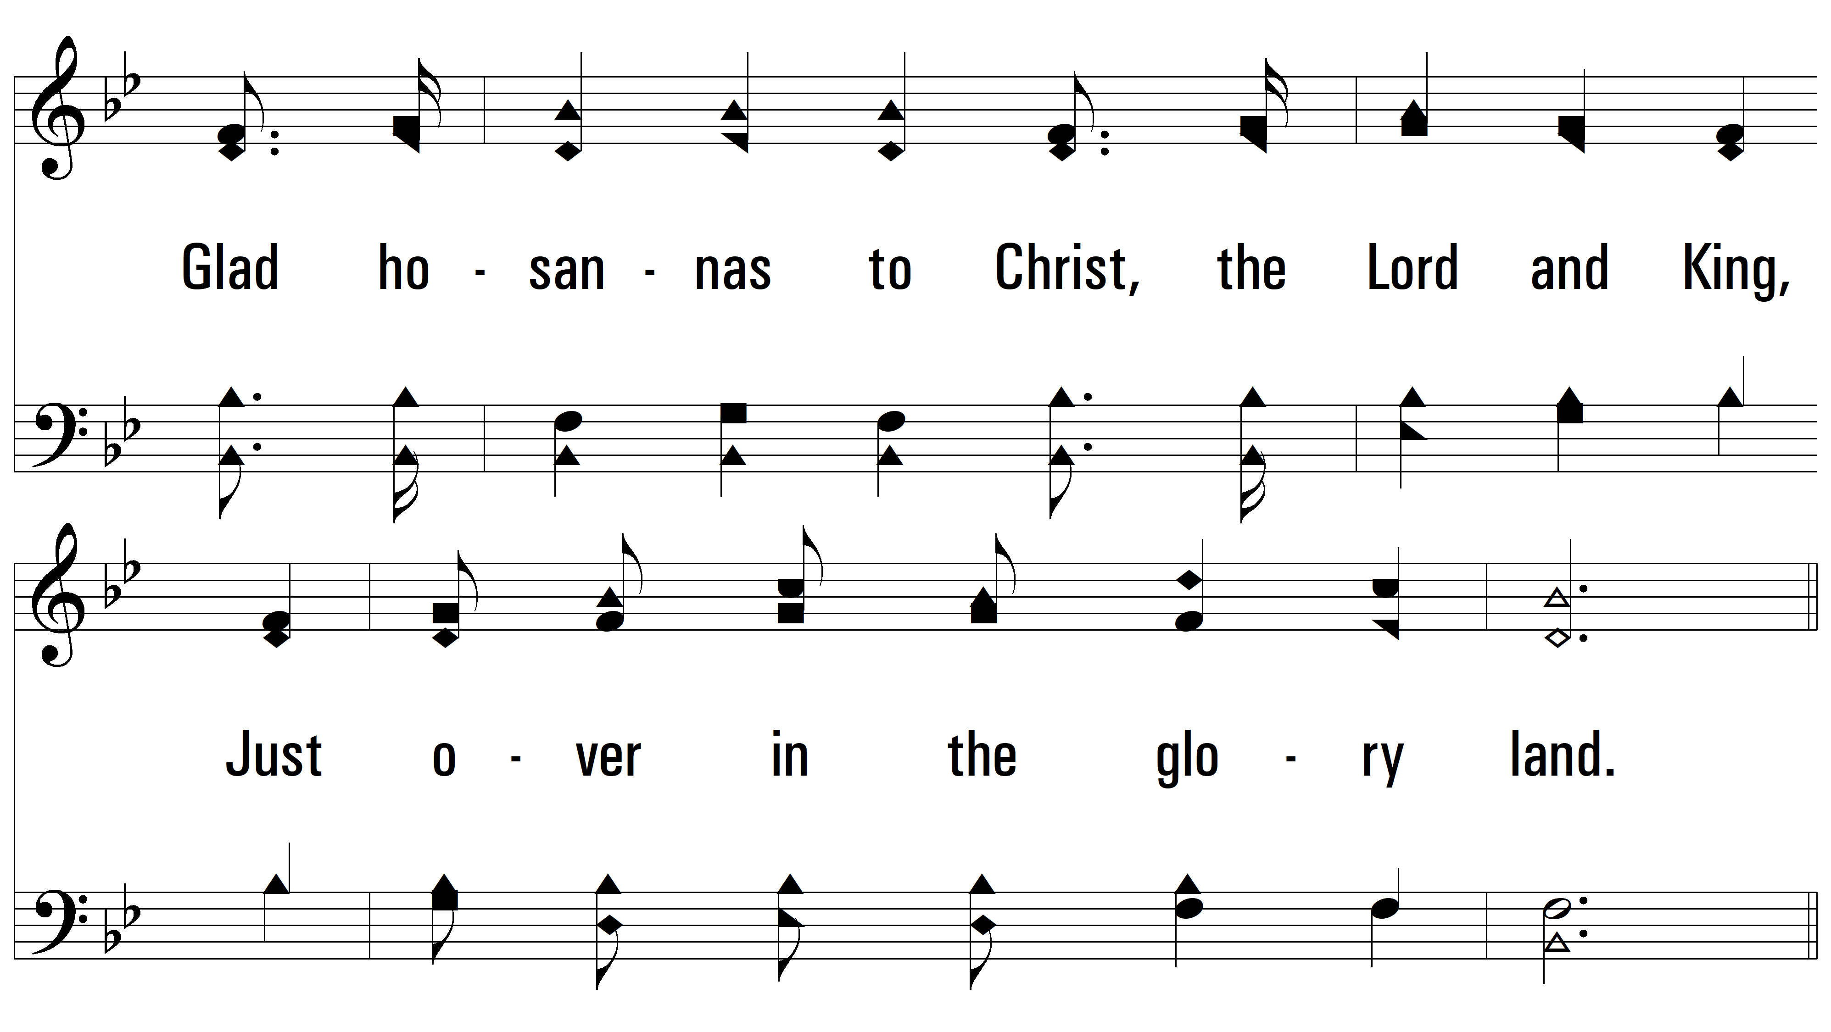
vs. 3

Slide 14
vs. 3

Slide 15
vs. 3

Slide 16
vs. 3
PDHymns.com
END

