Slide 1
Just As I Am
WOODWORTH
8.8.8.6
Words: | Charlotte Elliott (1834)
Music: | William B. Bradbury (1849)
6/4
E^{b}/E^{b} - DO
Verses: 6
Lead - | DO
Alto - | DO
Tenor - | MI
Bass - | DO
PDHymns.com

Slide 2
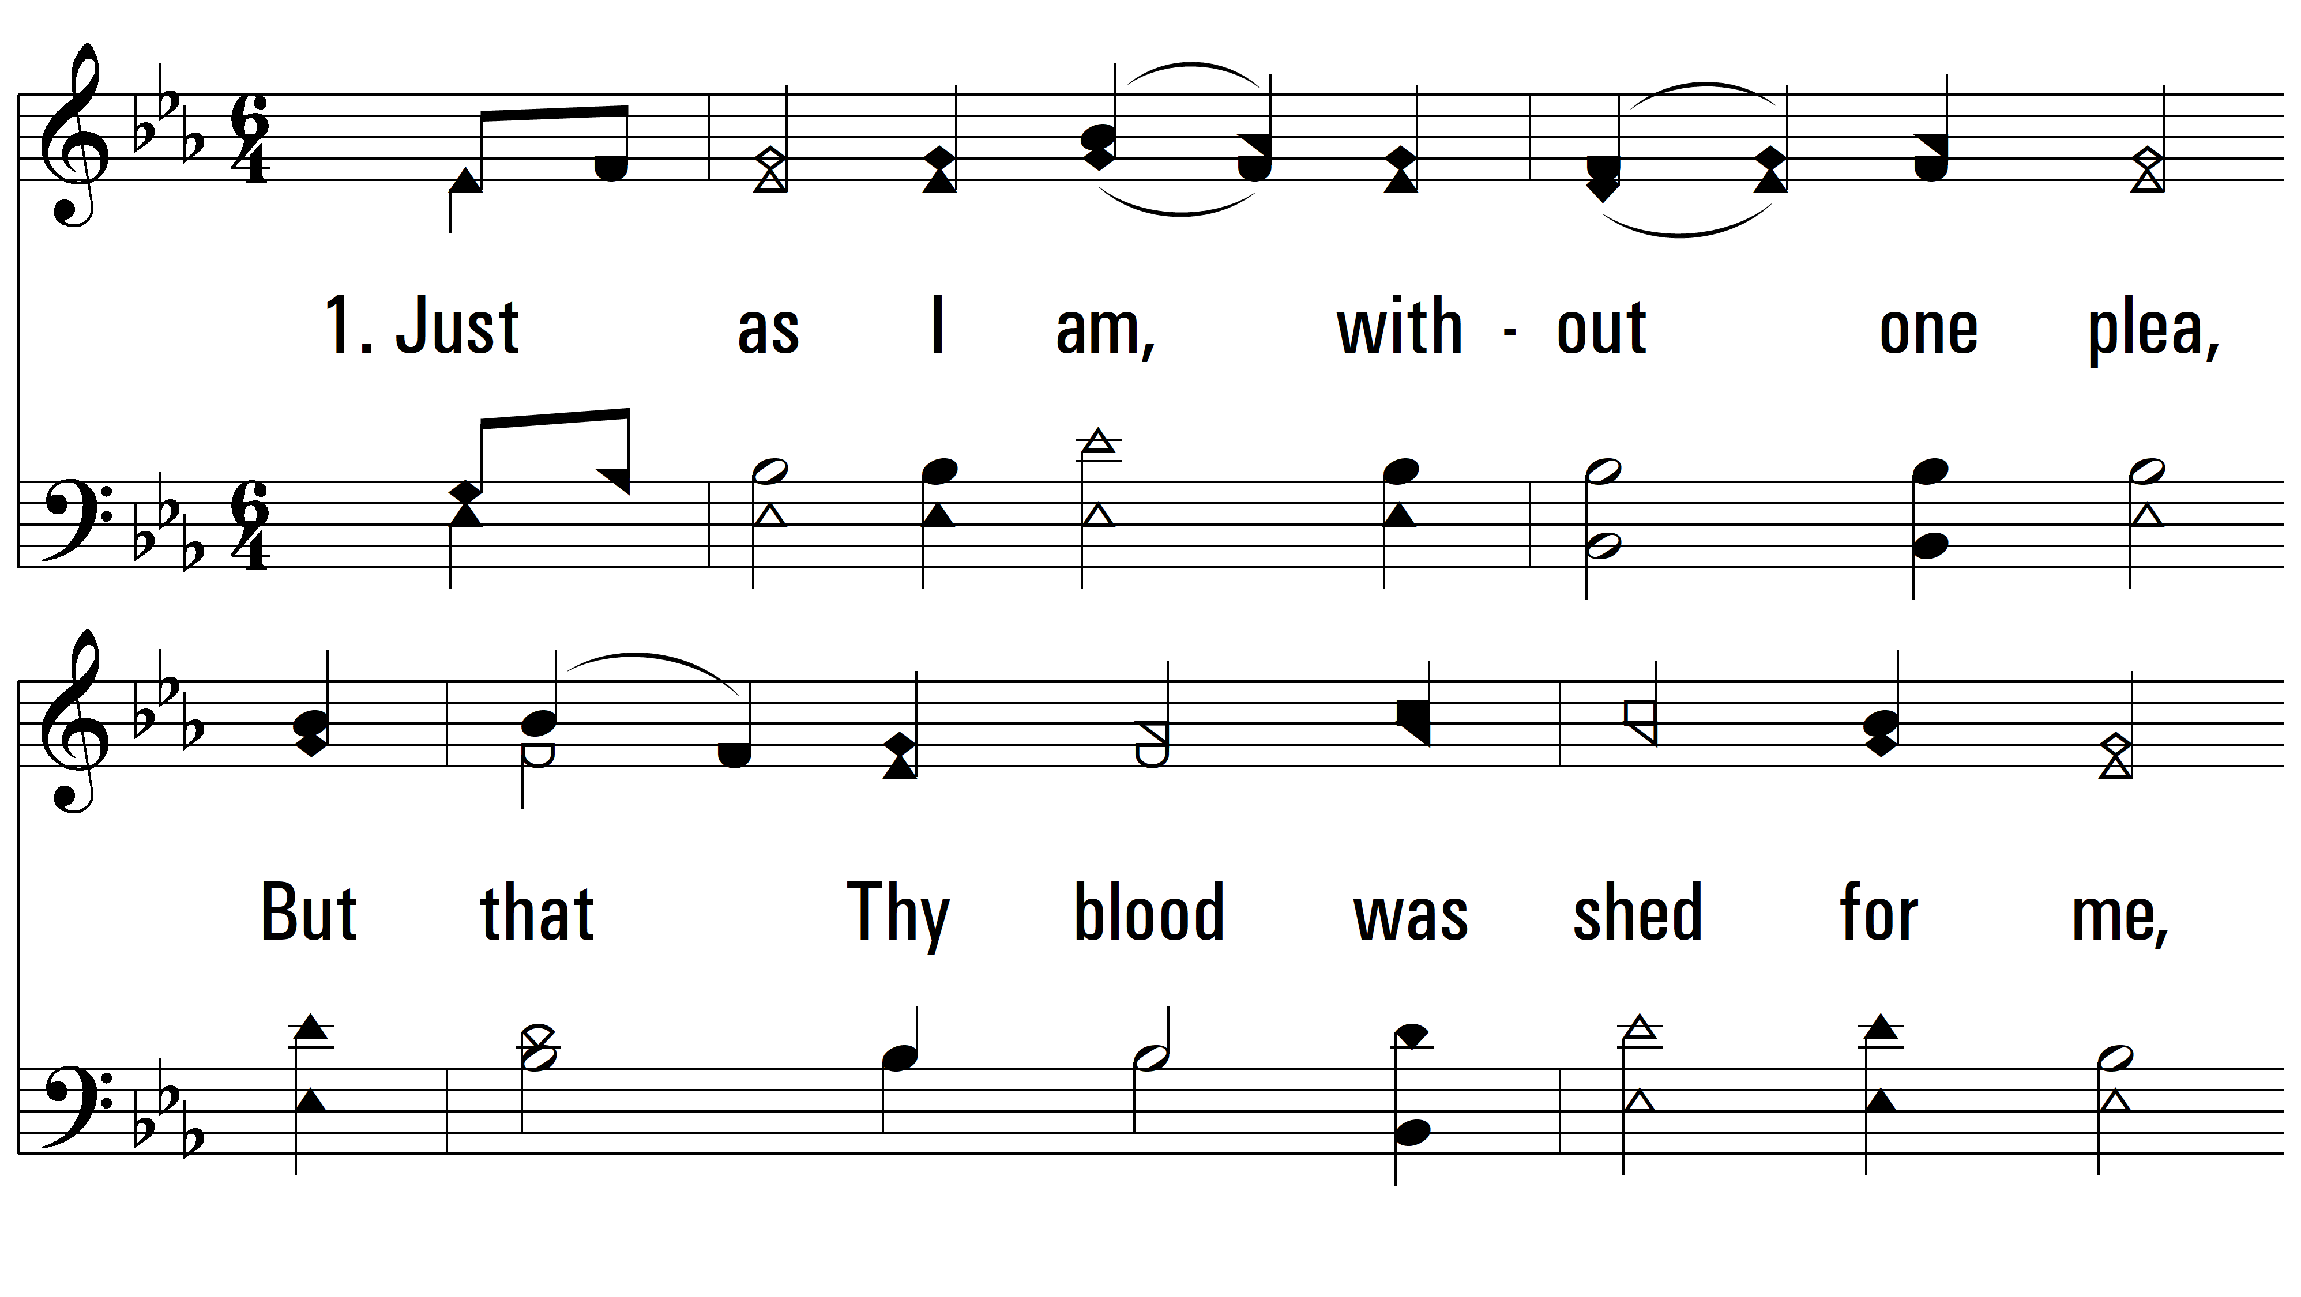
vs. 1 ~ Just As I Am

Slide 3
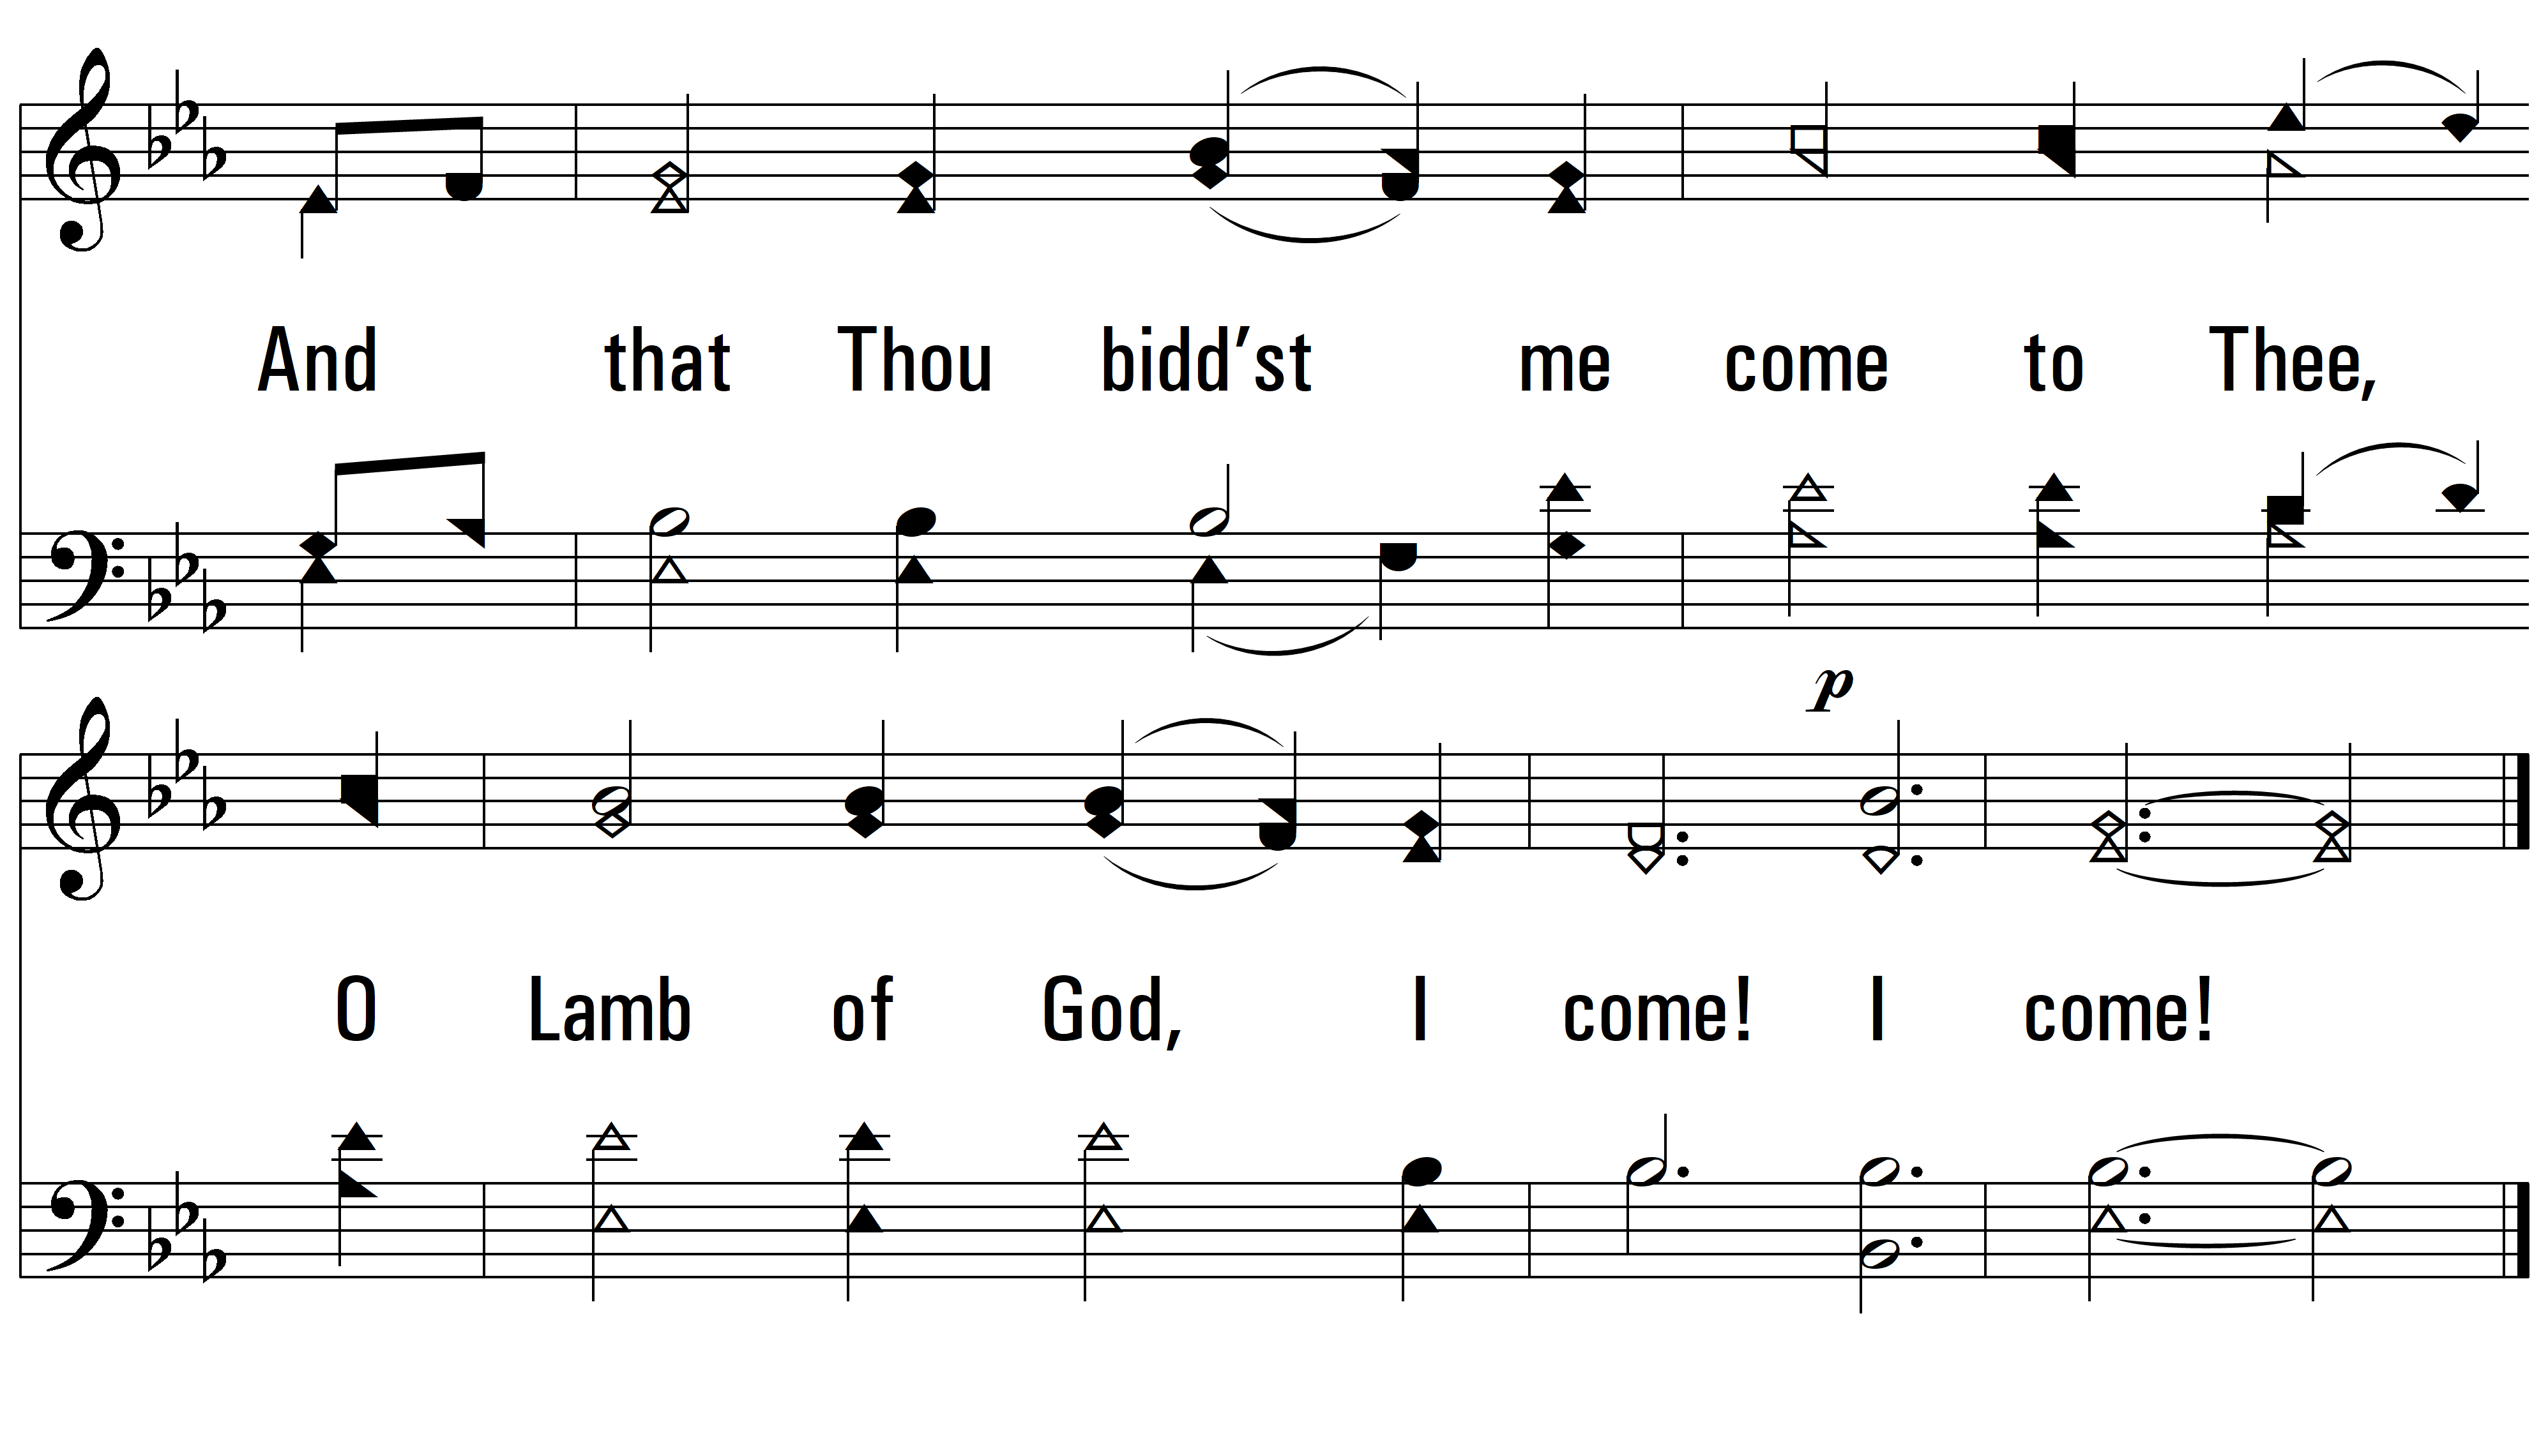
vs. 1

Slide 4
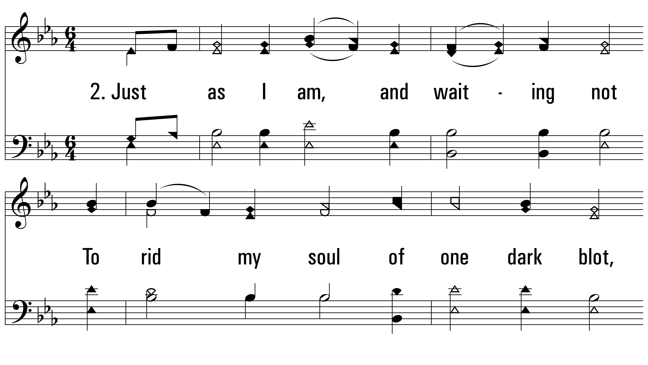
vs. 2 ~ Just As I Am

Slide 5
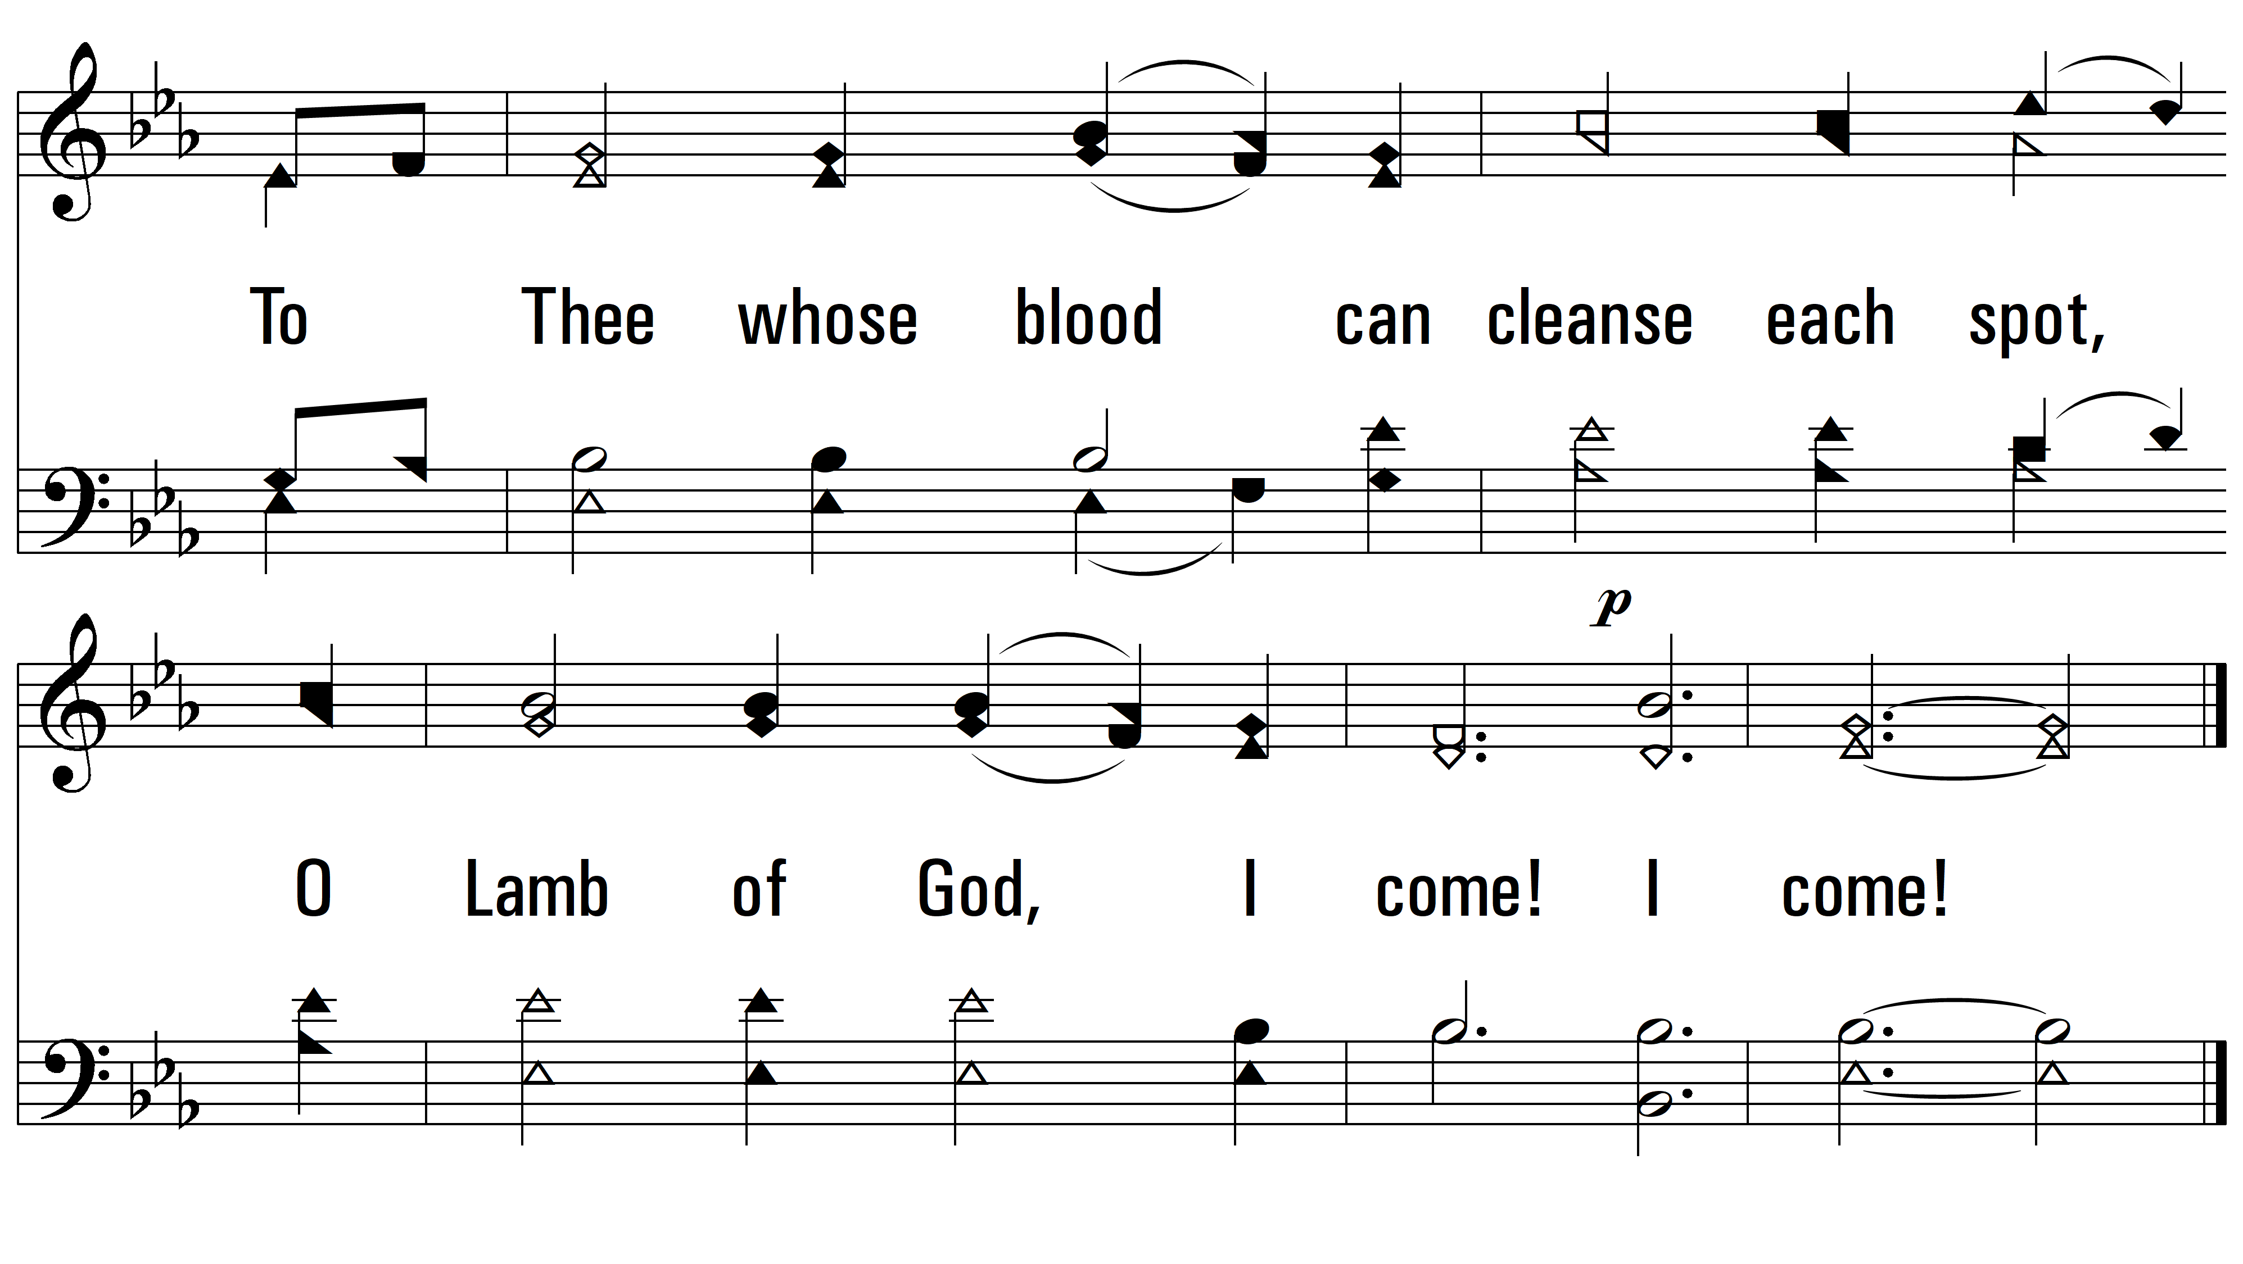
vs. 2

Slide 6
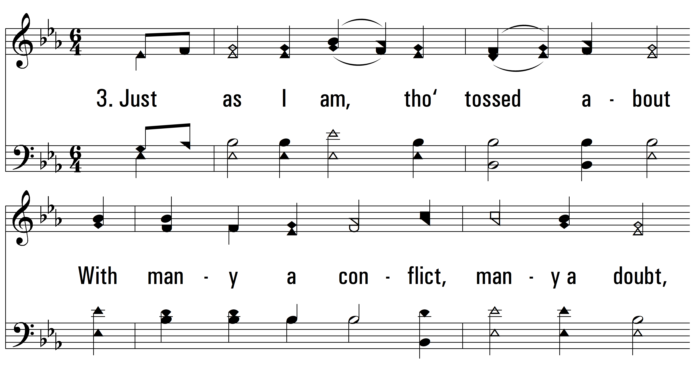
vs. 3 ~ Just As I Am

Slide 7
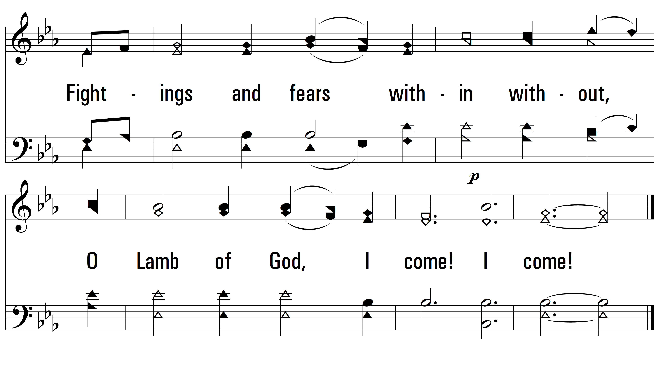
vs. 3

Slide 8
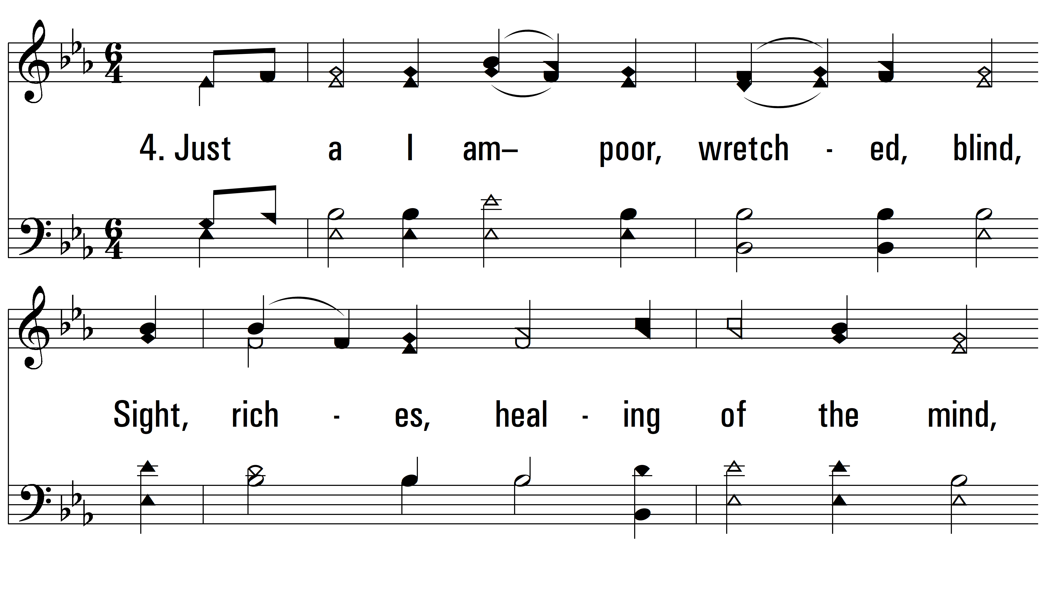
vs. 4 ~ Just As I Am

Slide 9
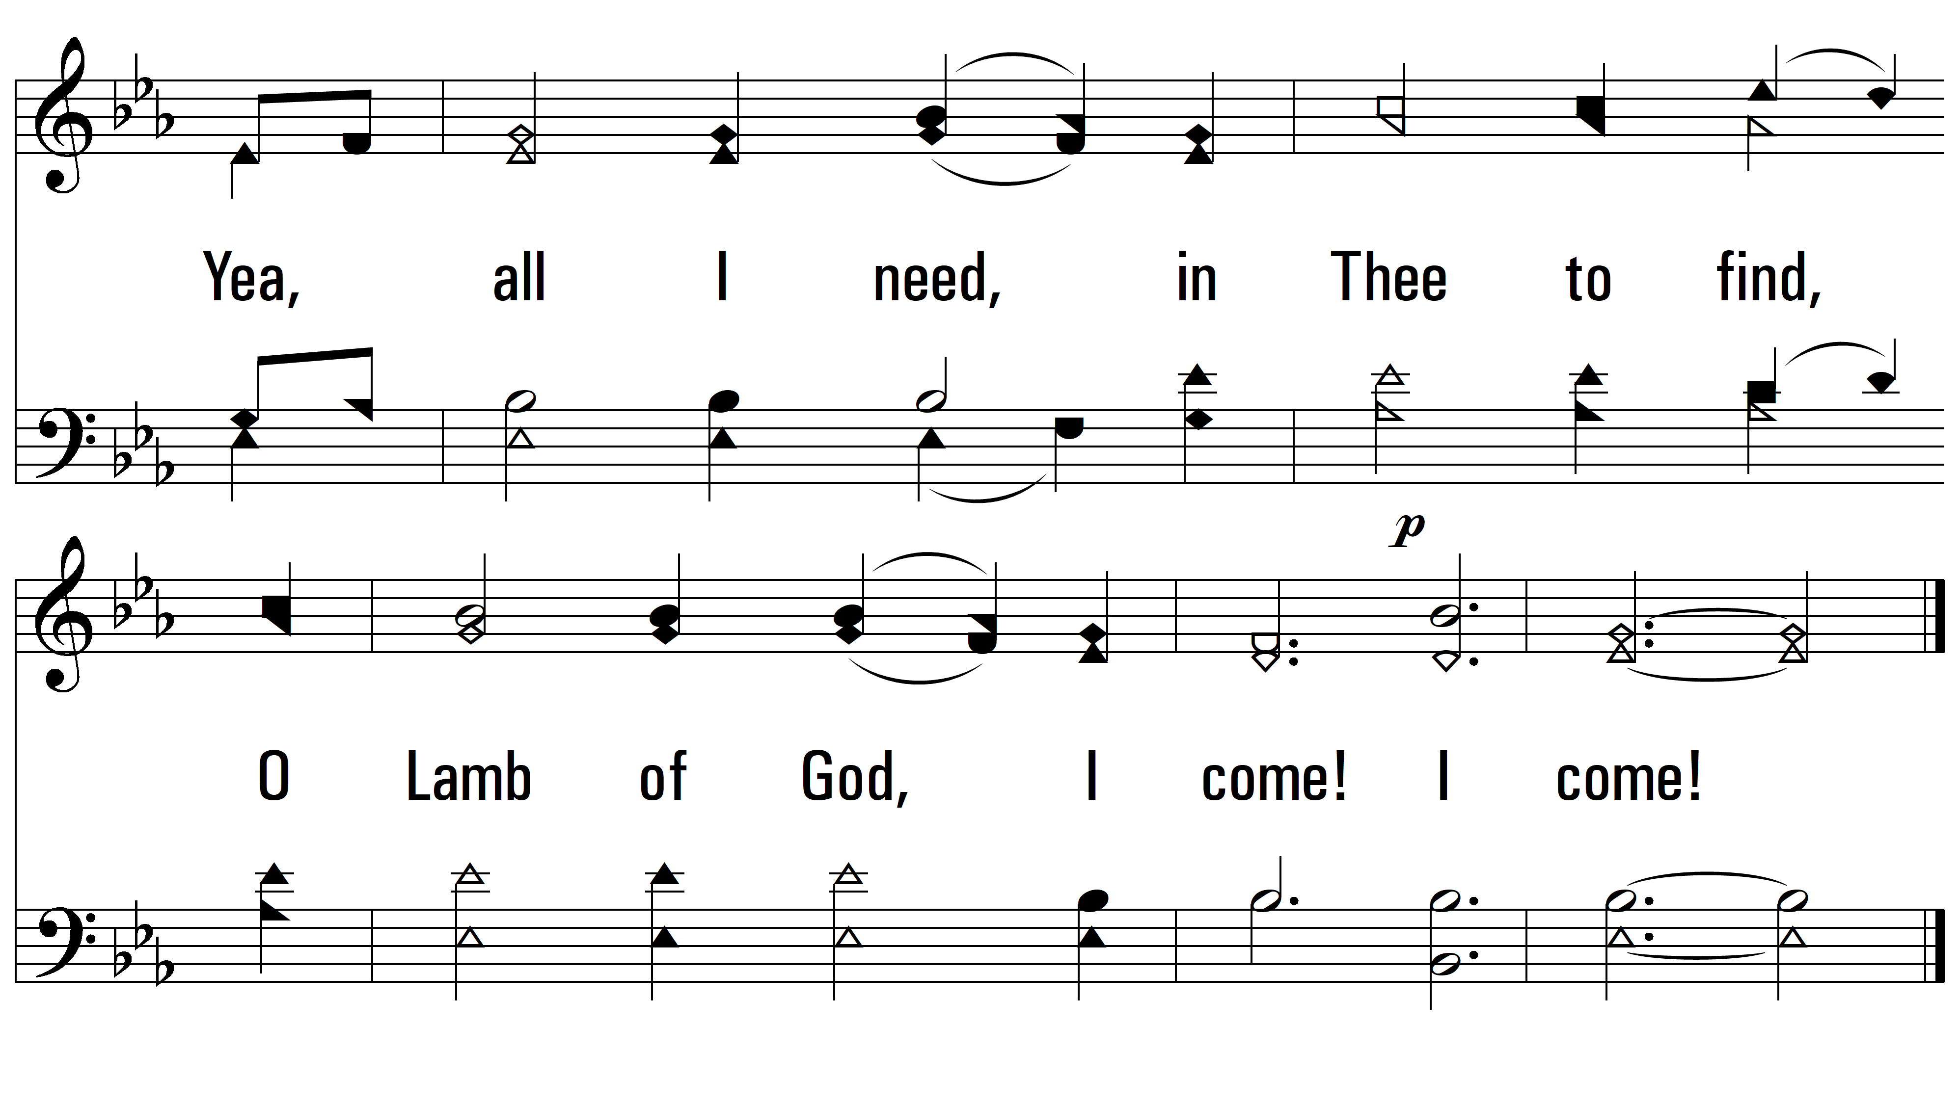
vs. 4

Slide 10
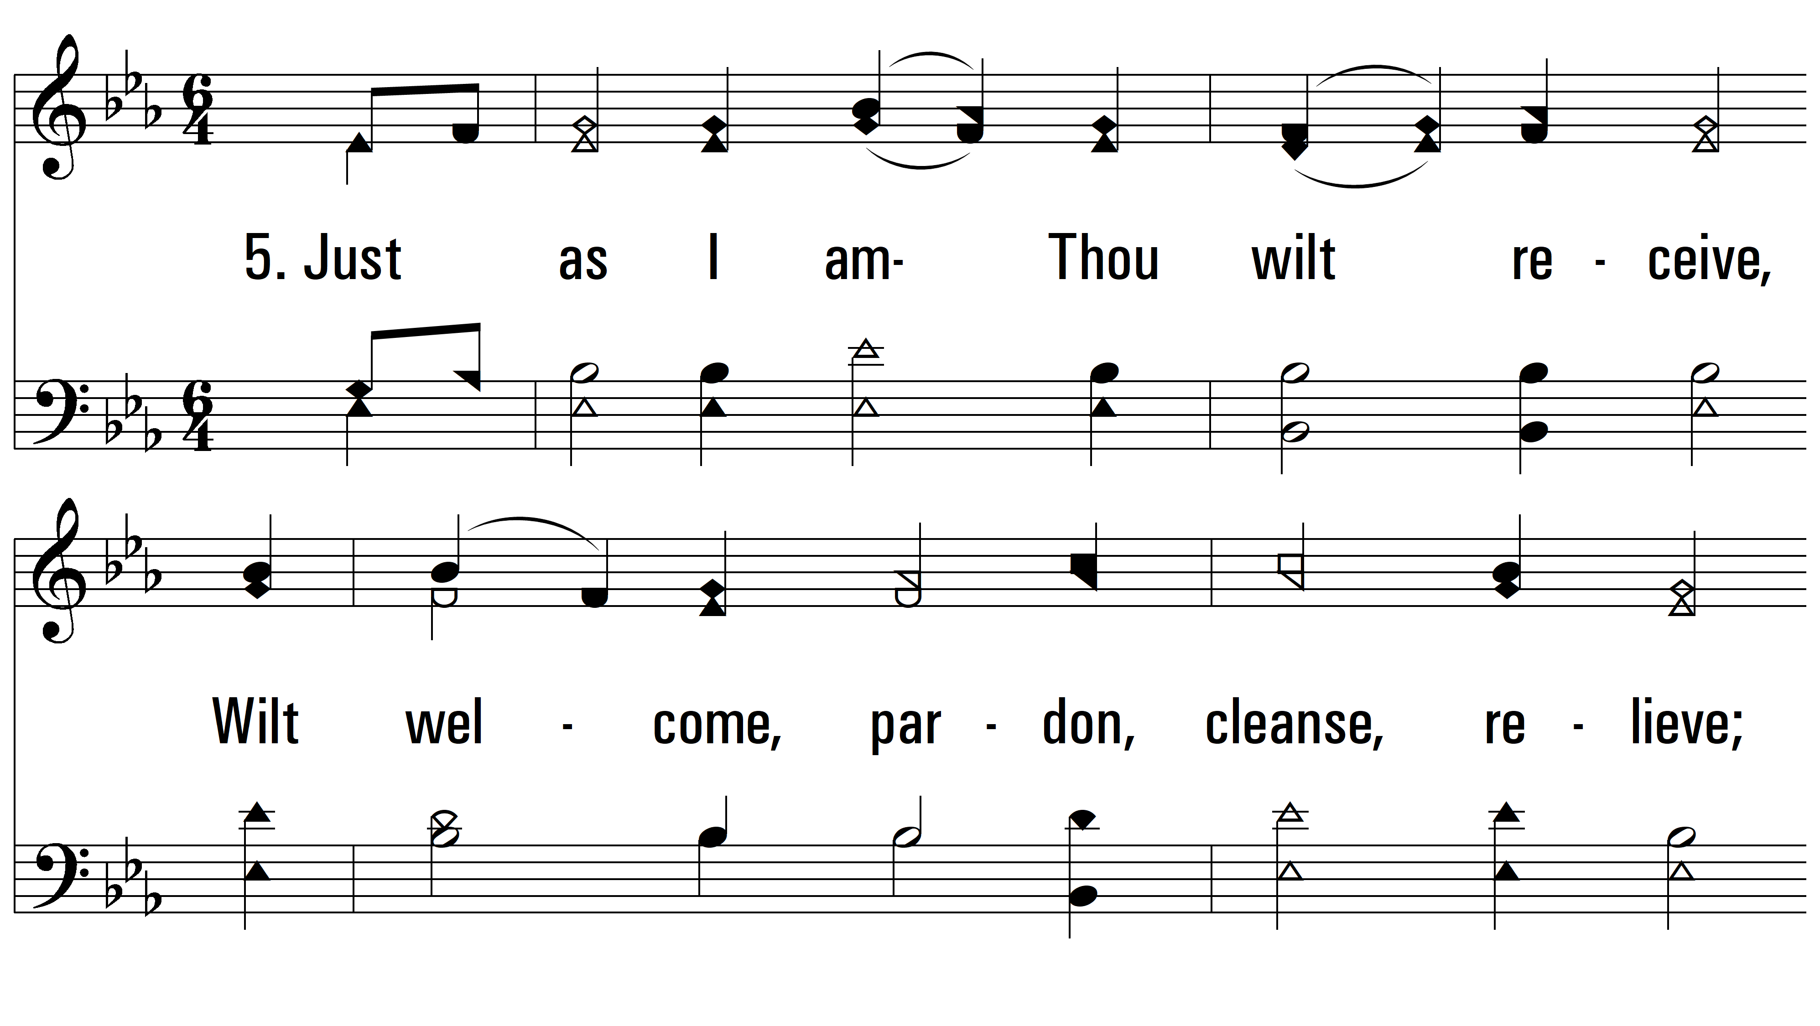
vs. 5 ~ Just As I Am

Slide 11
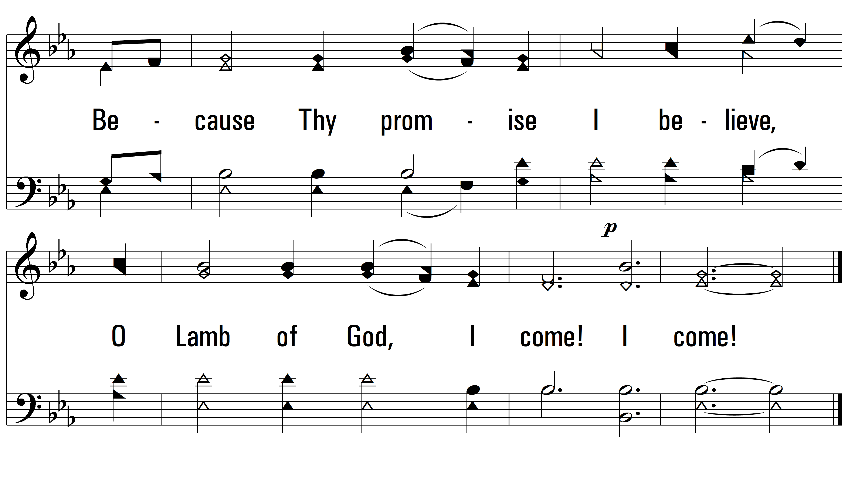
vs. 5

Slide 12
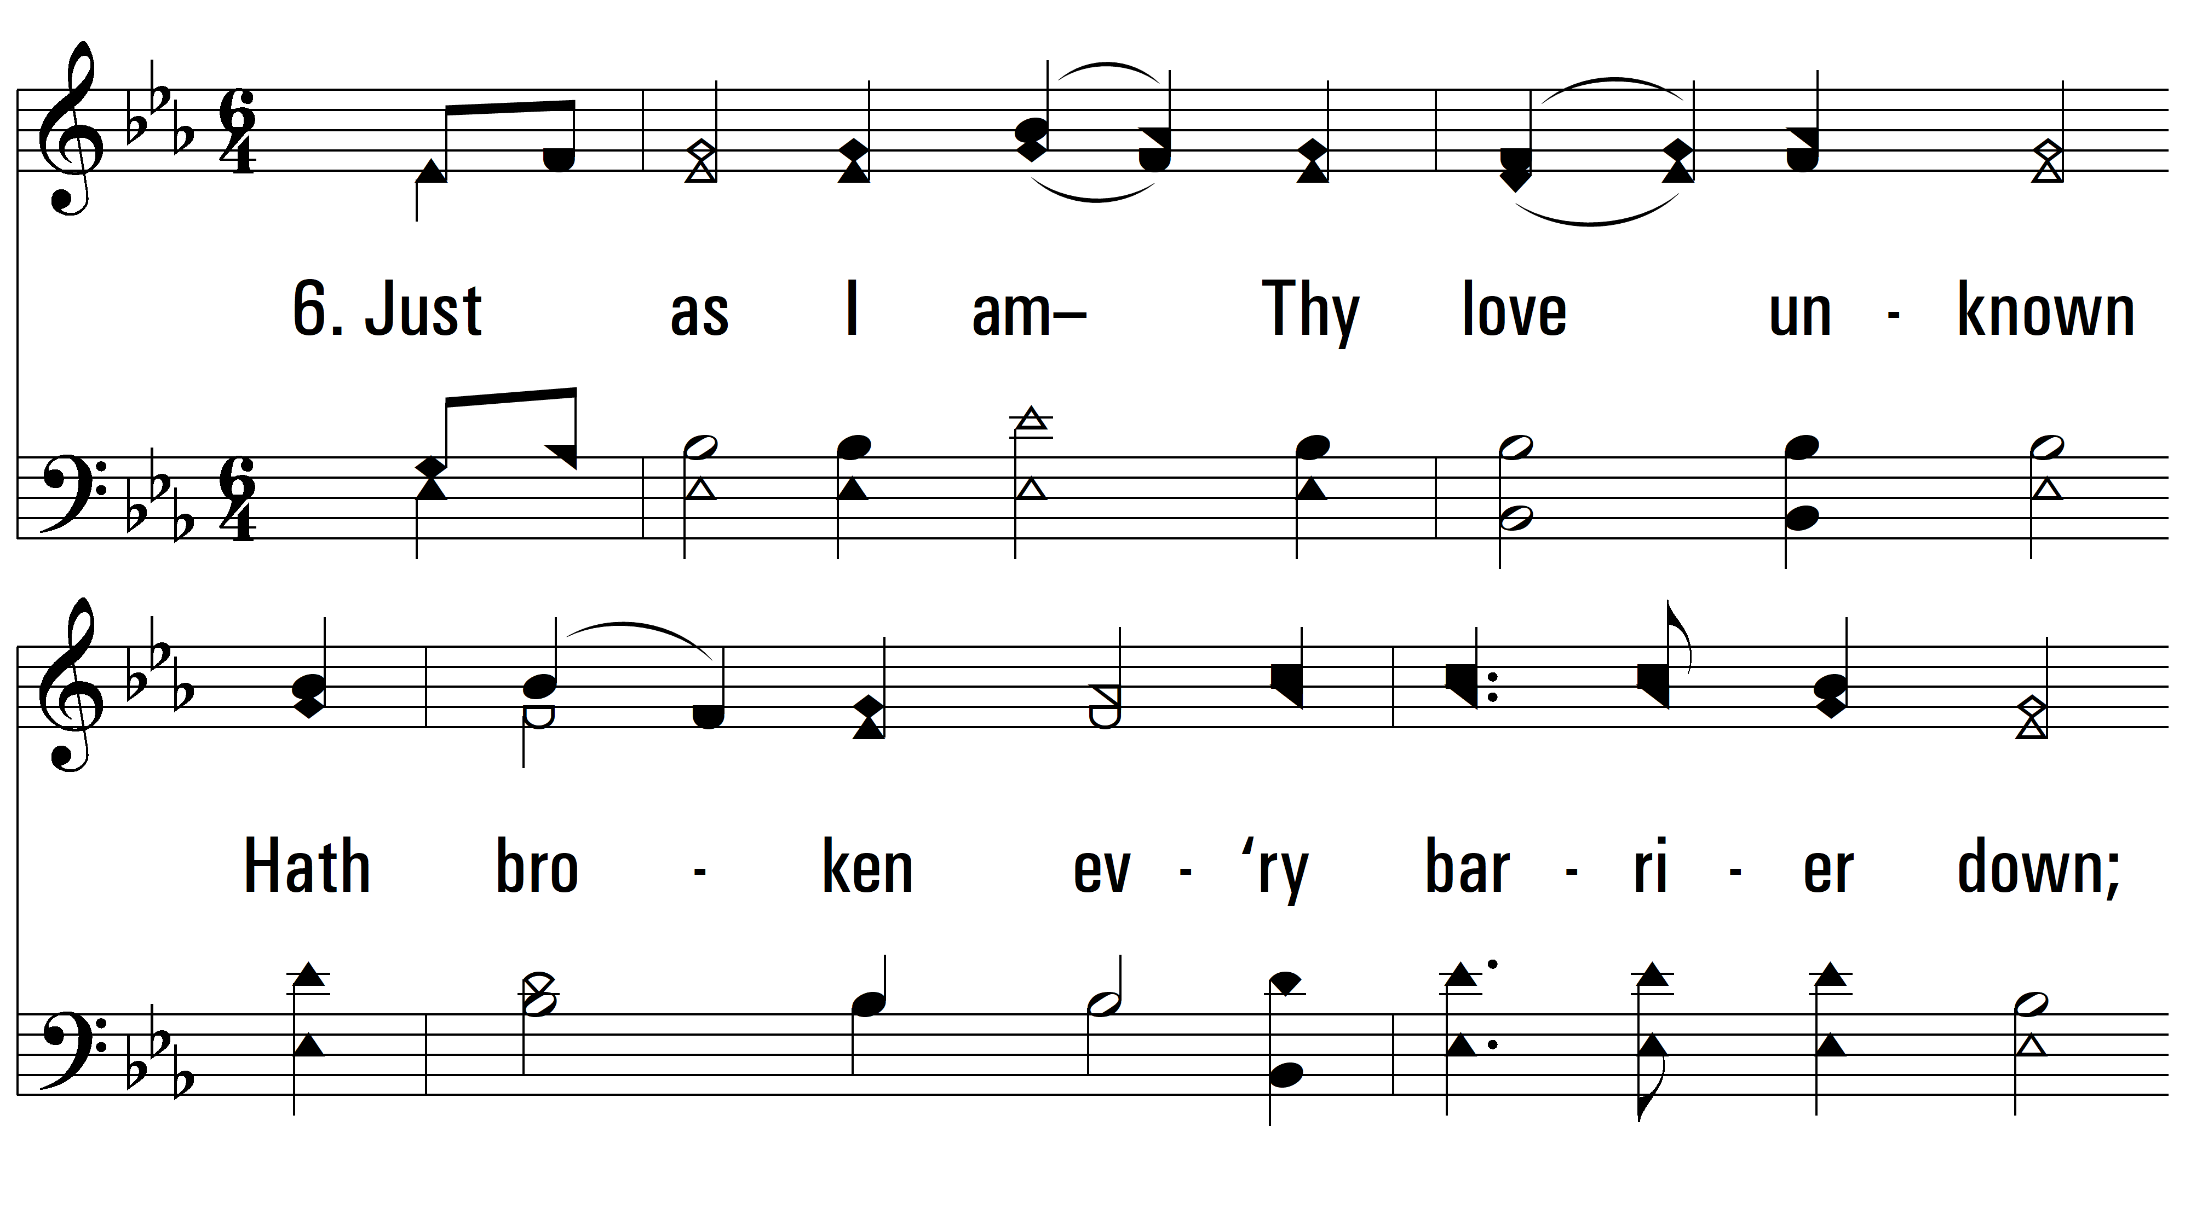
vs. 6 ~ Just As I Am

Slide 13
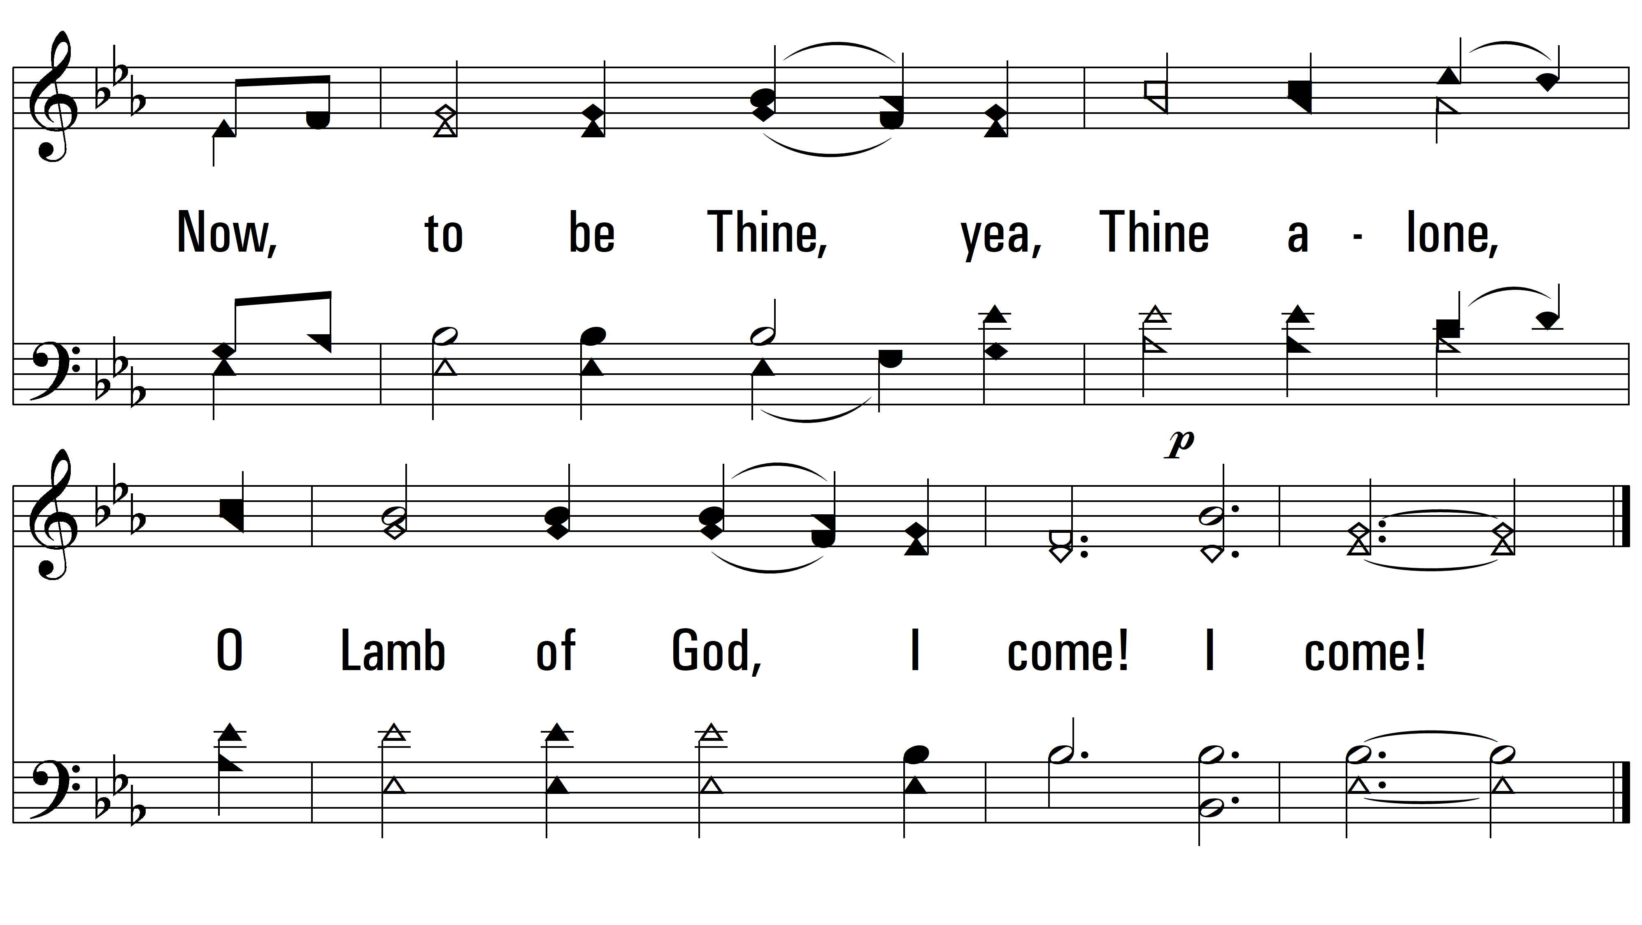
vs. 6
PDHymns.com
END

