Slide 1
Just A Closer Walk With Thee
Words: | American Folk Hymn
Music: | American Folk Melody, Arr. by Mosie Lister
4/4
C/G - SOL
Verses: 3/Chorus
Lead - | SOL
Alto - | MI
Tenor - | DO
Bass - | DO
PDHymns.com

Slide 2
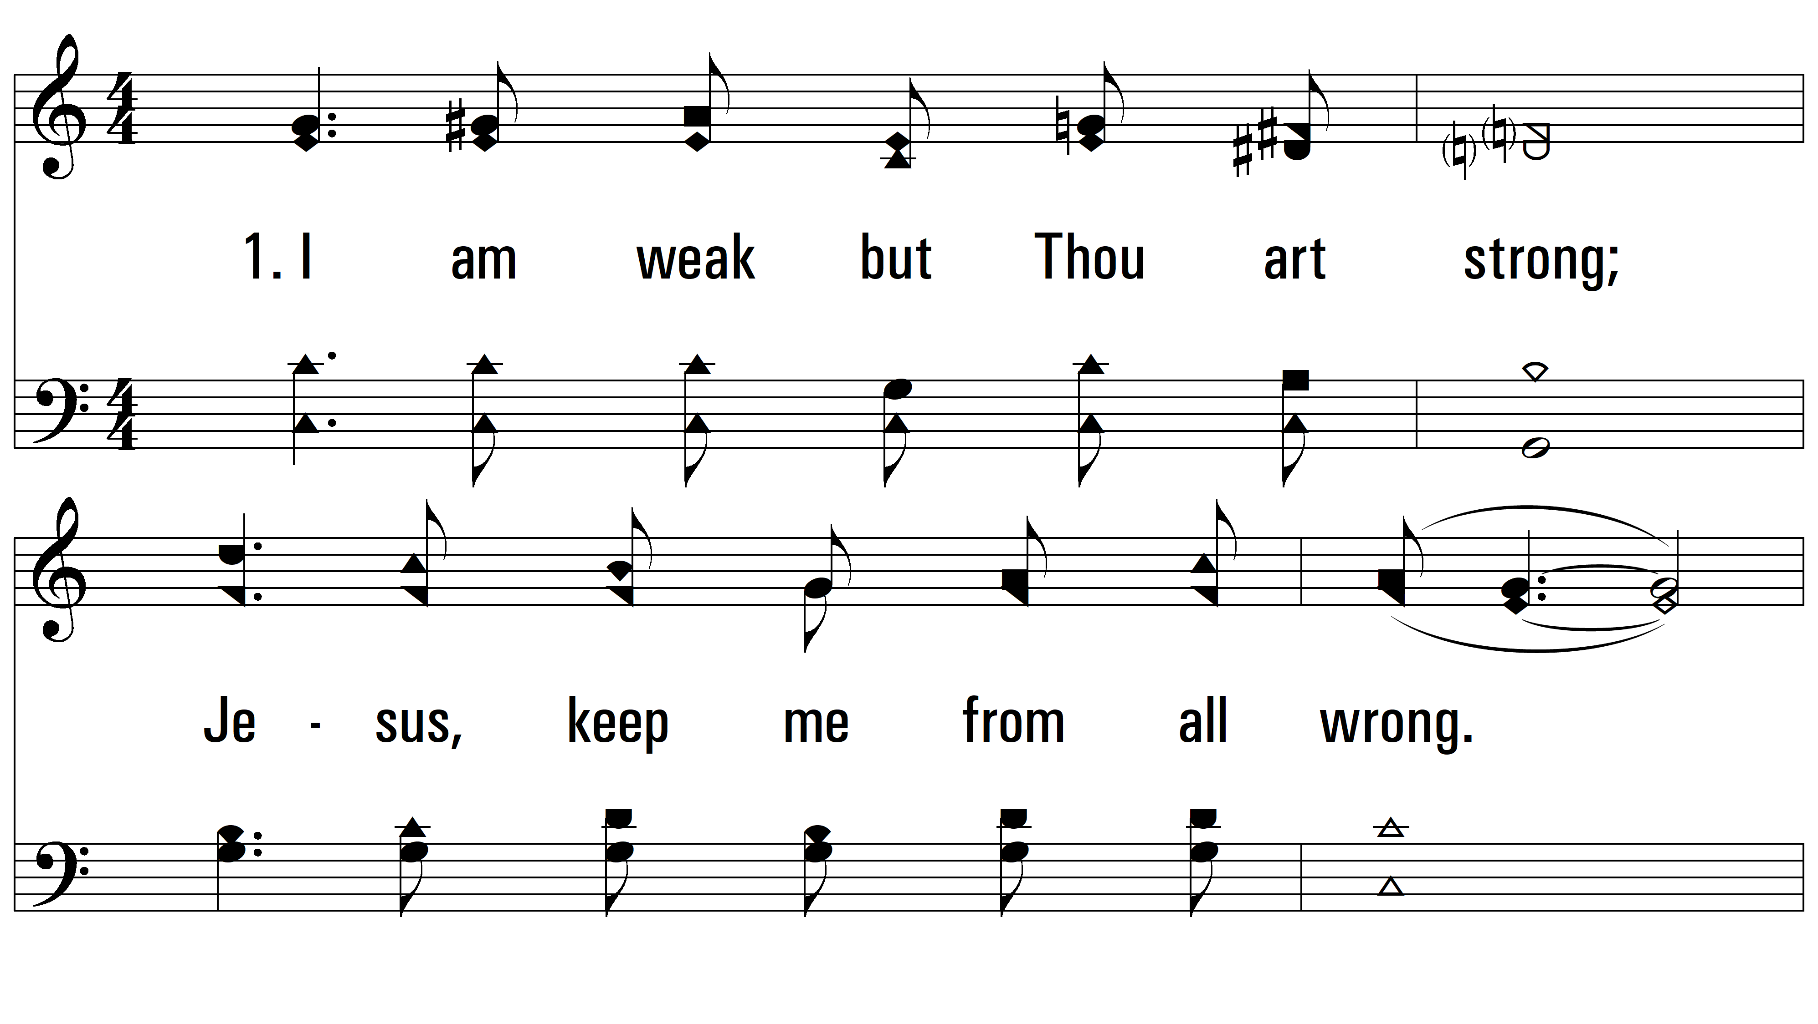
vs. 1 ~ Just A Closer Walk With Thee

Slide 3
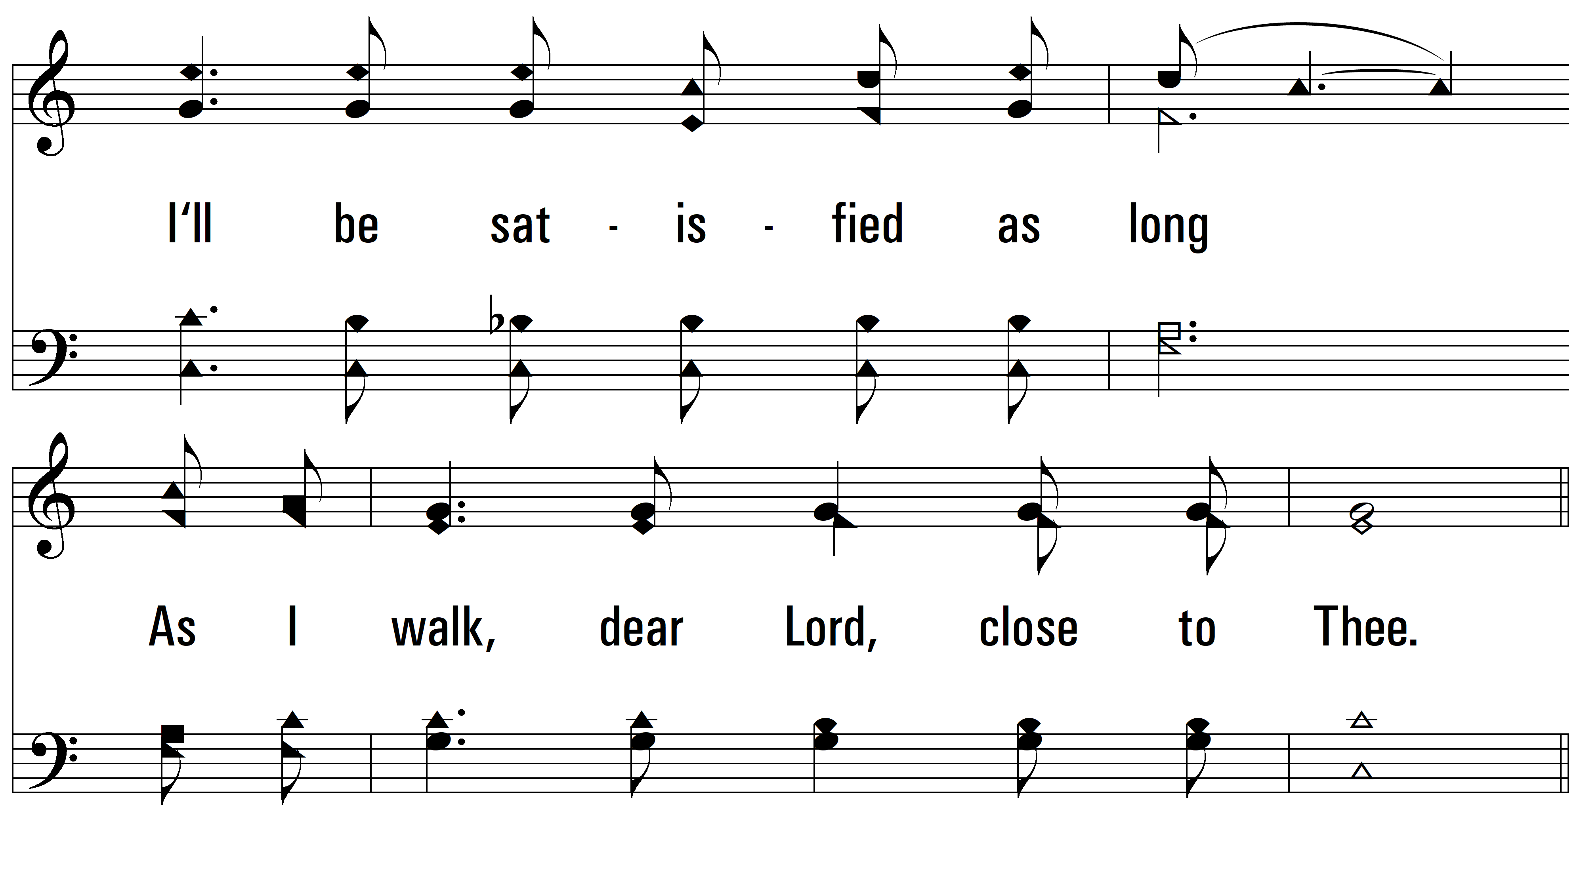
vs. 1

Slide 4
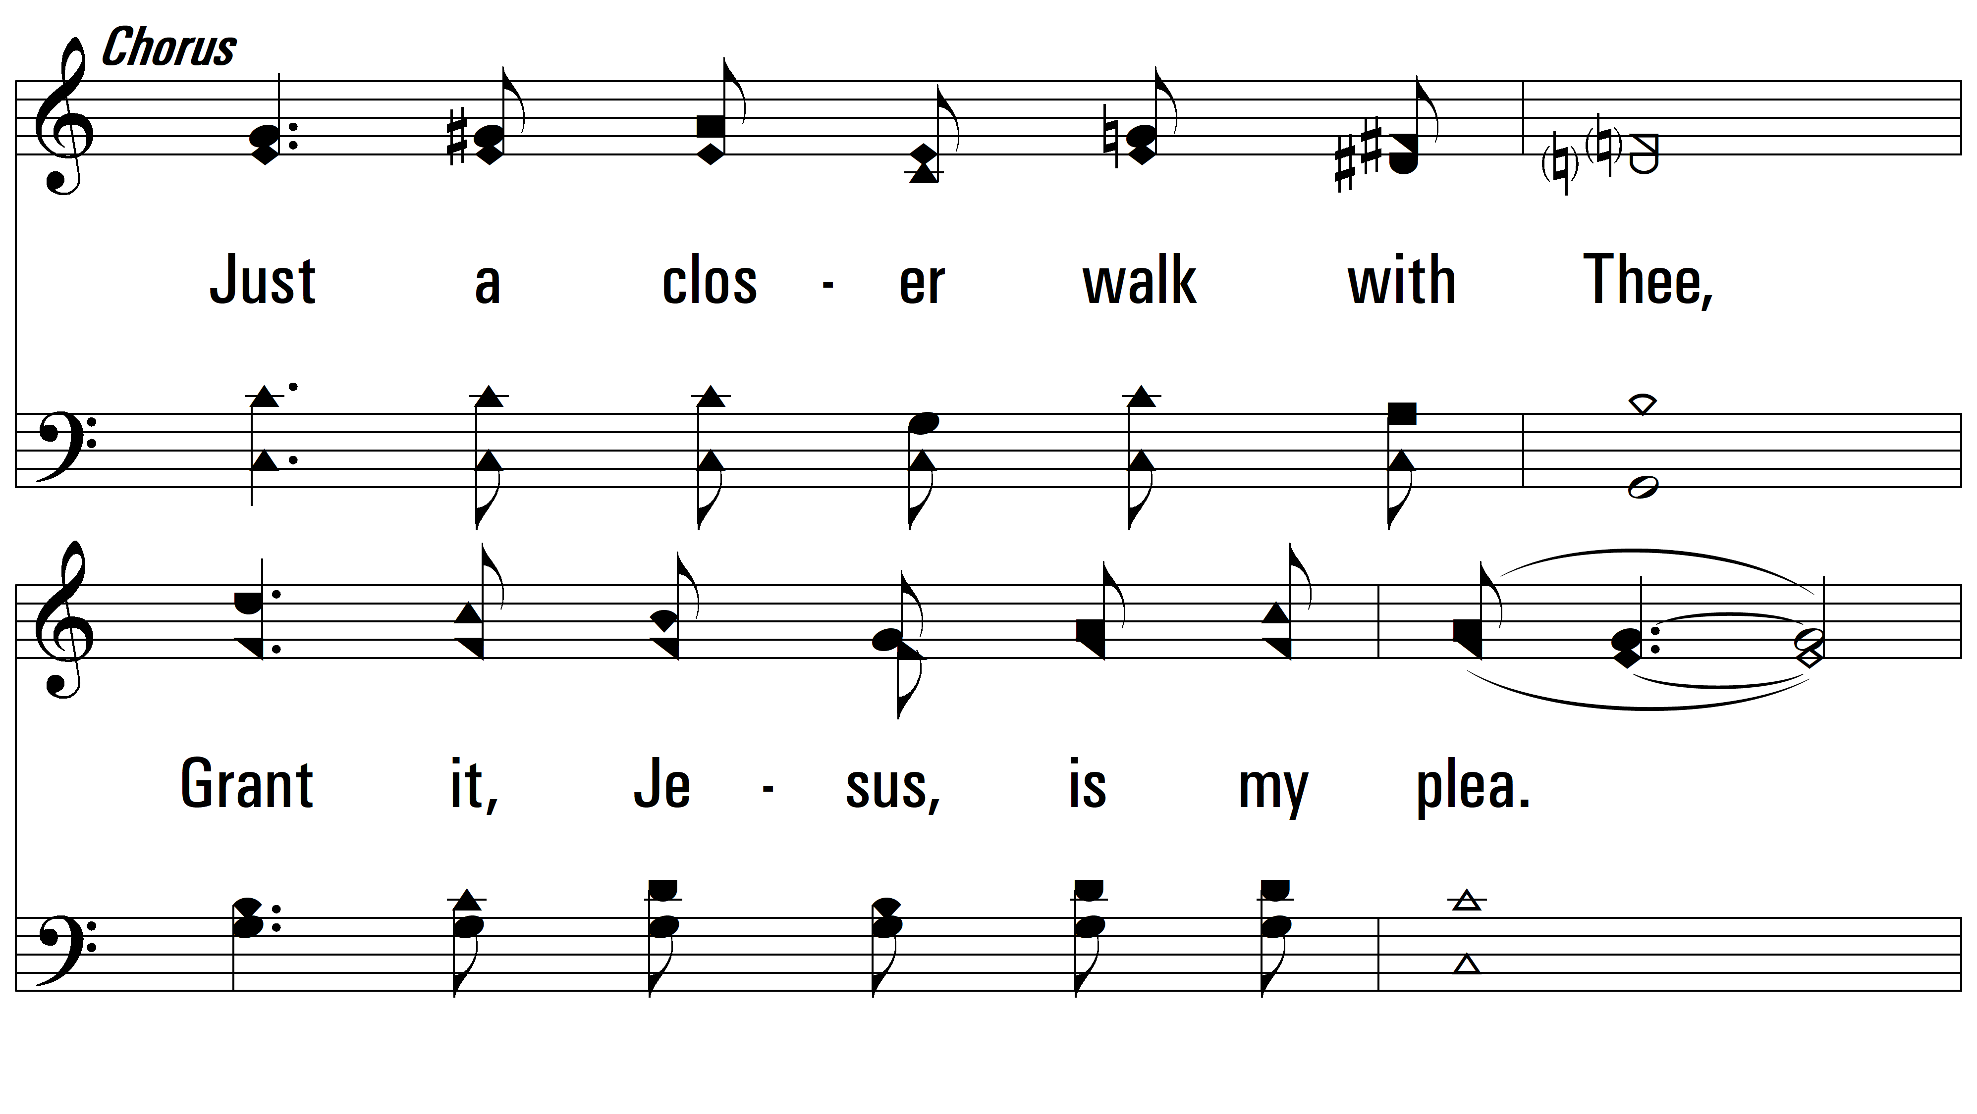
vs. 1

Slide 5
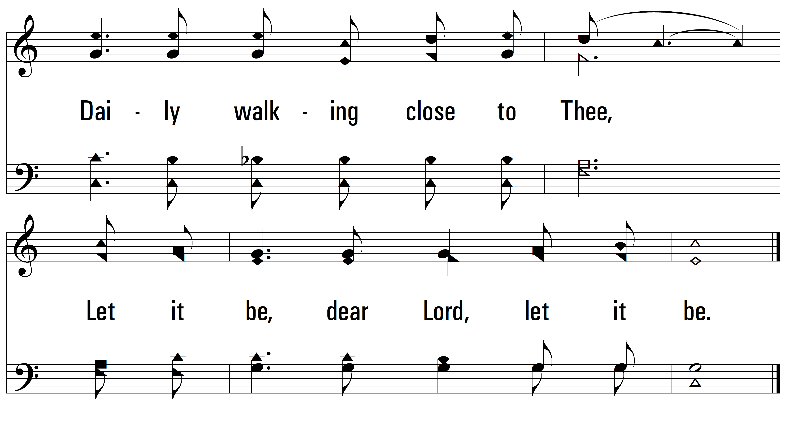
vs. 1

Slide 6
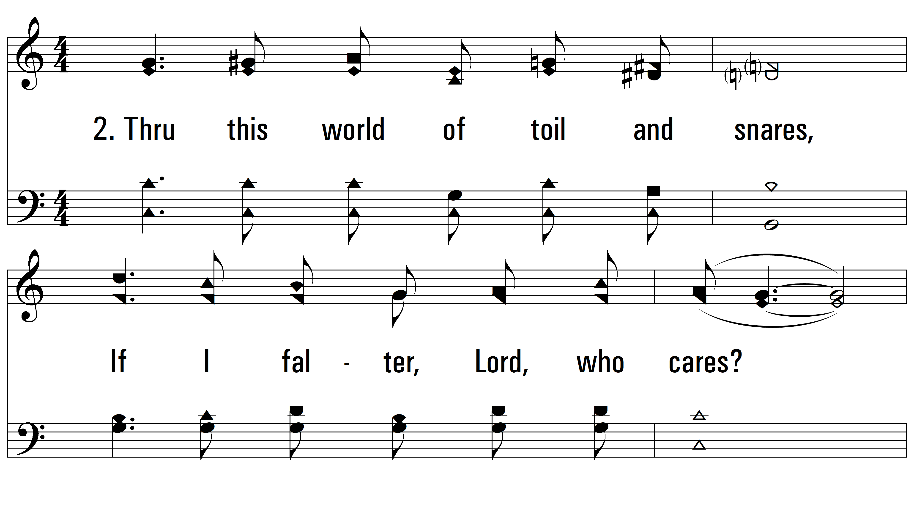
vs. 2 ~ Just A Closer Walk With Thee

Slide 7
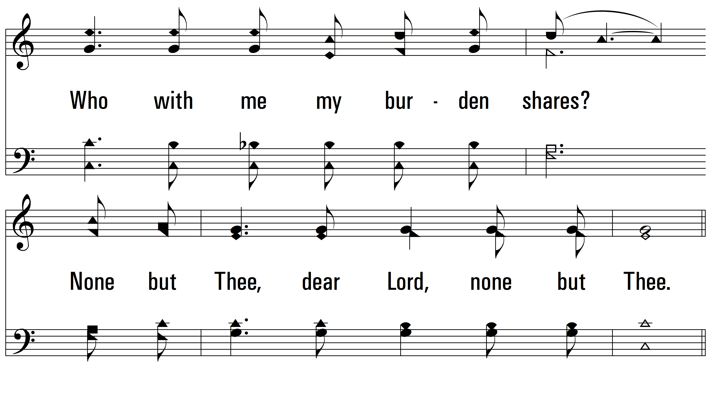
vs. 2

Slide 8
vs. 2

Slide 9
vs. 2

Slide 10
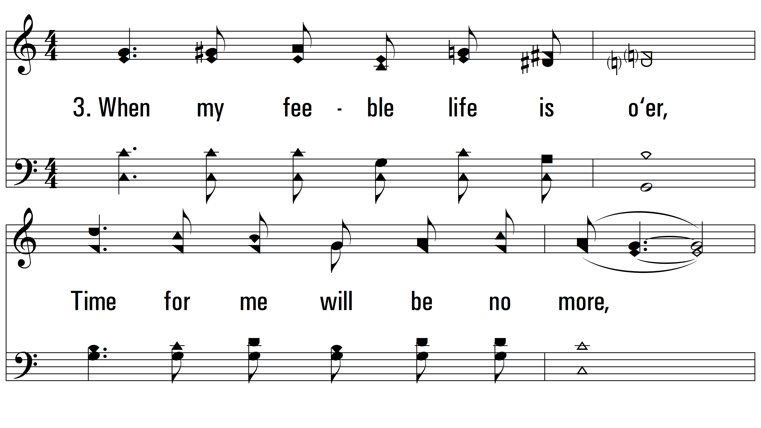
vs. 3 ~ Just A Closer Walk With Thee

Slide 11
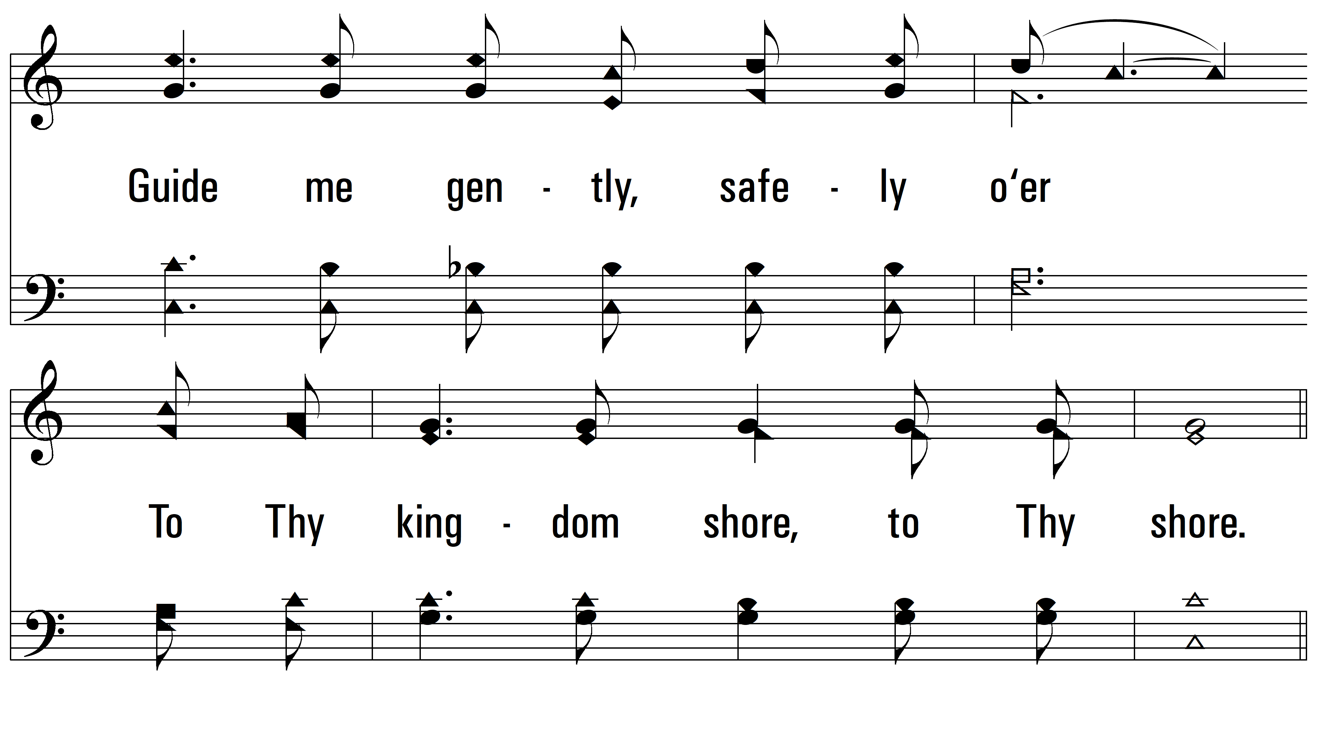
vs. 3

Slide 12
vs. 3

Slide 13
vs. 3
PDHymns.com
END

