Slide 1
Jesus Will Come Again
GLEN ELLYN
8.7.8.7.D
Words: | Mrs. W. S. Stroud (1919)
Music: | Flavil Hall (1919)
4/4
F/A - MI
Verses: 3/Chorus
Lead - | MI
Alto - | MI
Tenor - | SOL
Bass - | SOL
PDHymns.com

Slide 2
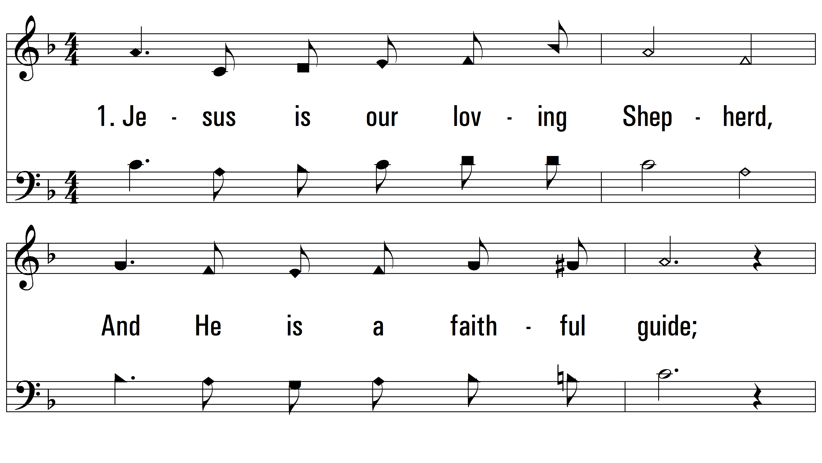
vs. 1 ~ Jesus Will Come Again

Slide 3
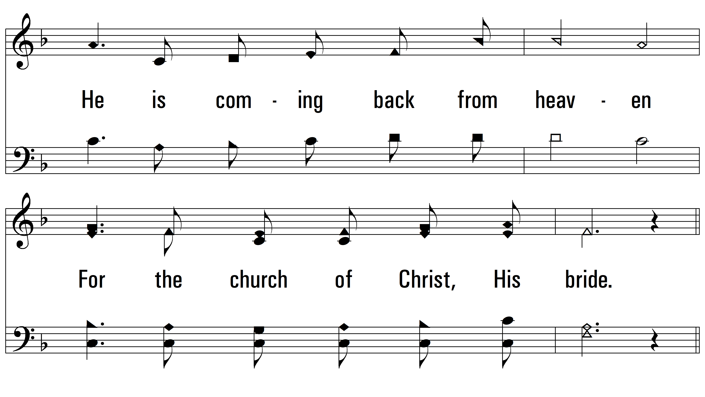
vs. 1

Slide 4
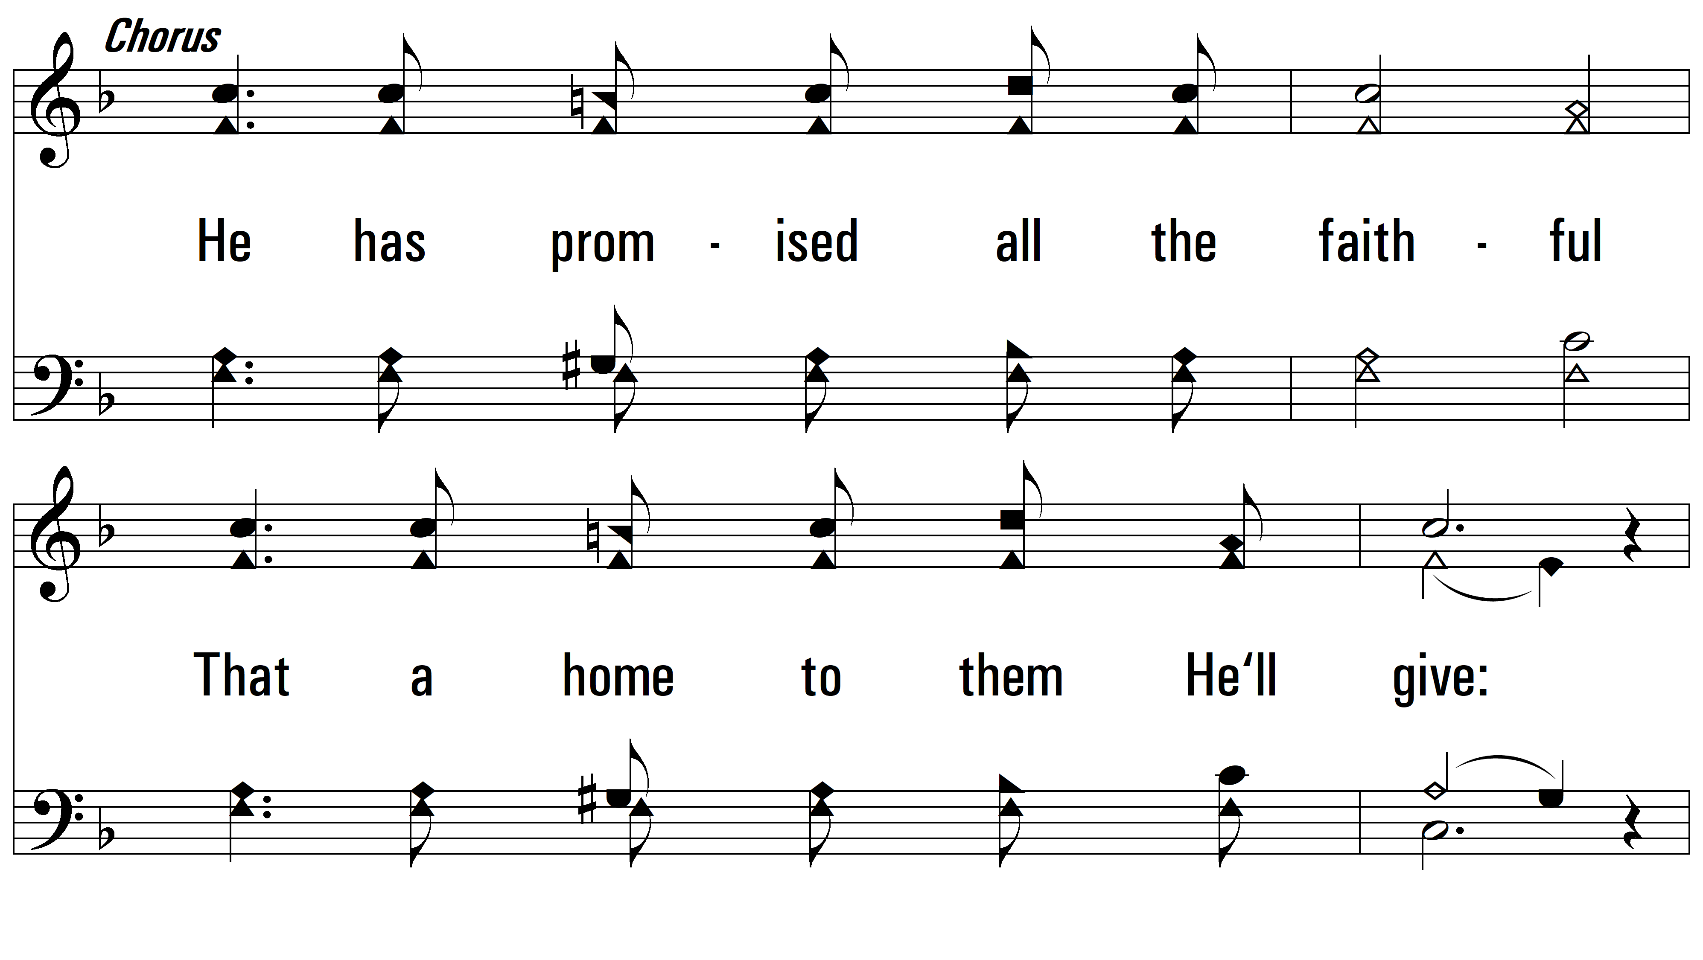
vs. 1

Slide 5
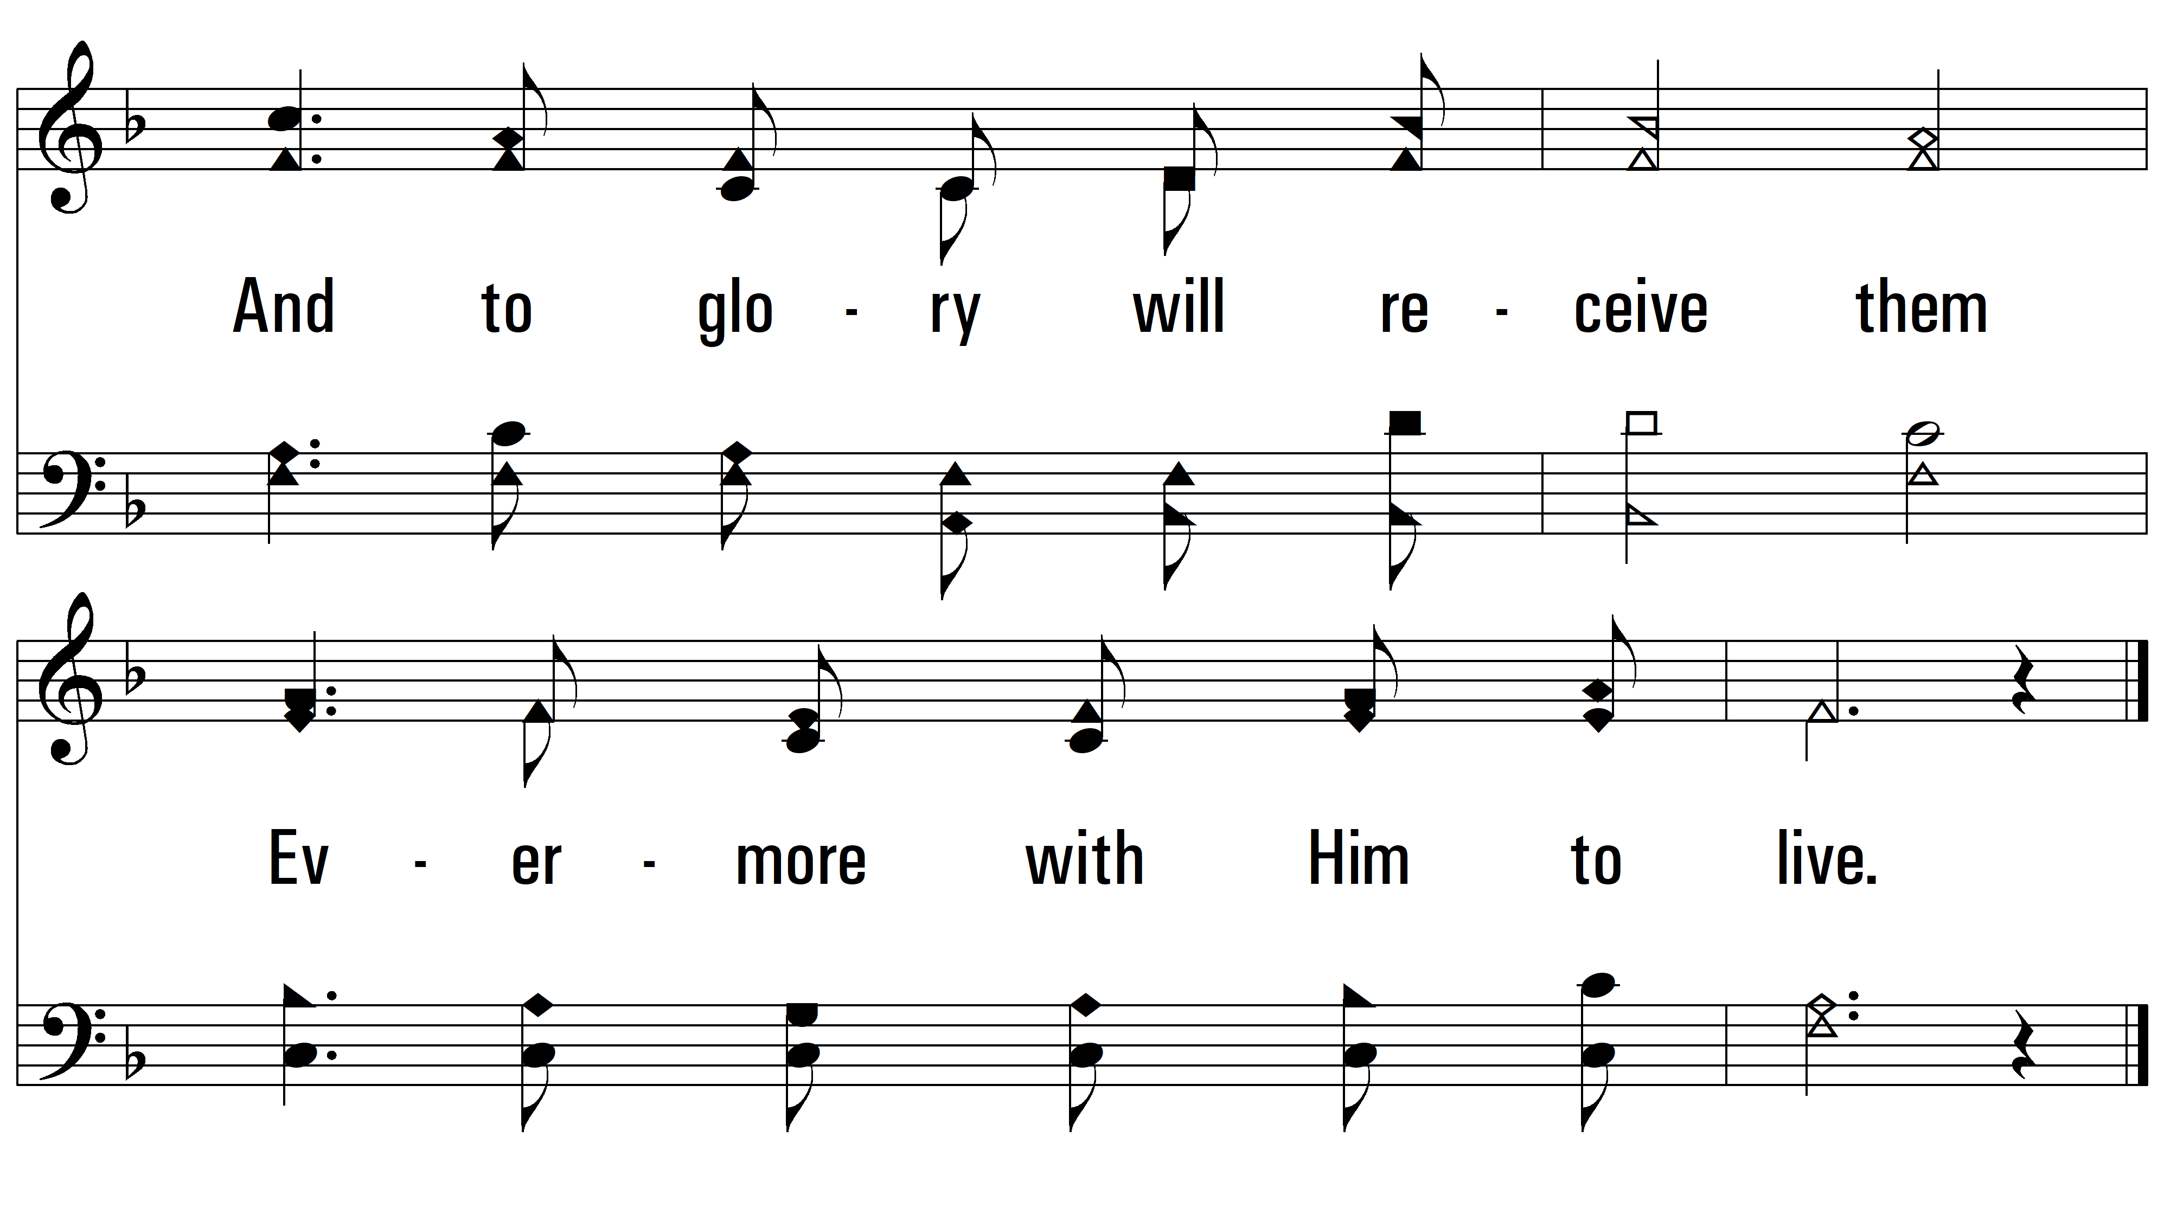
vs. 1

Slide 6
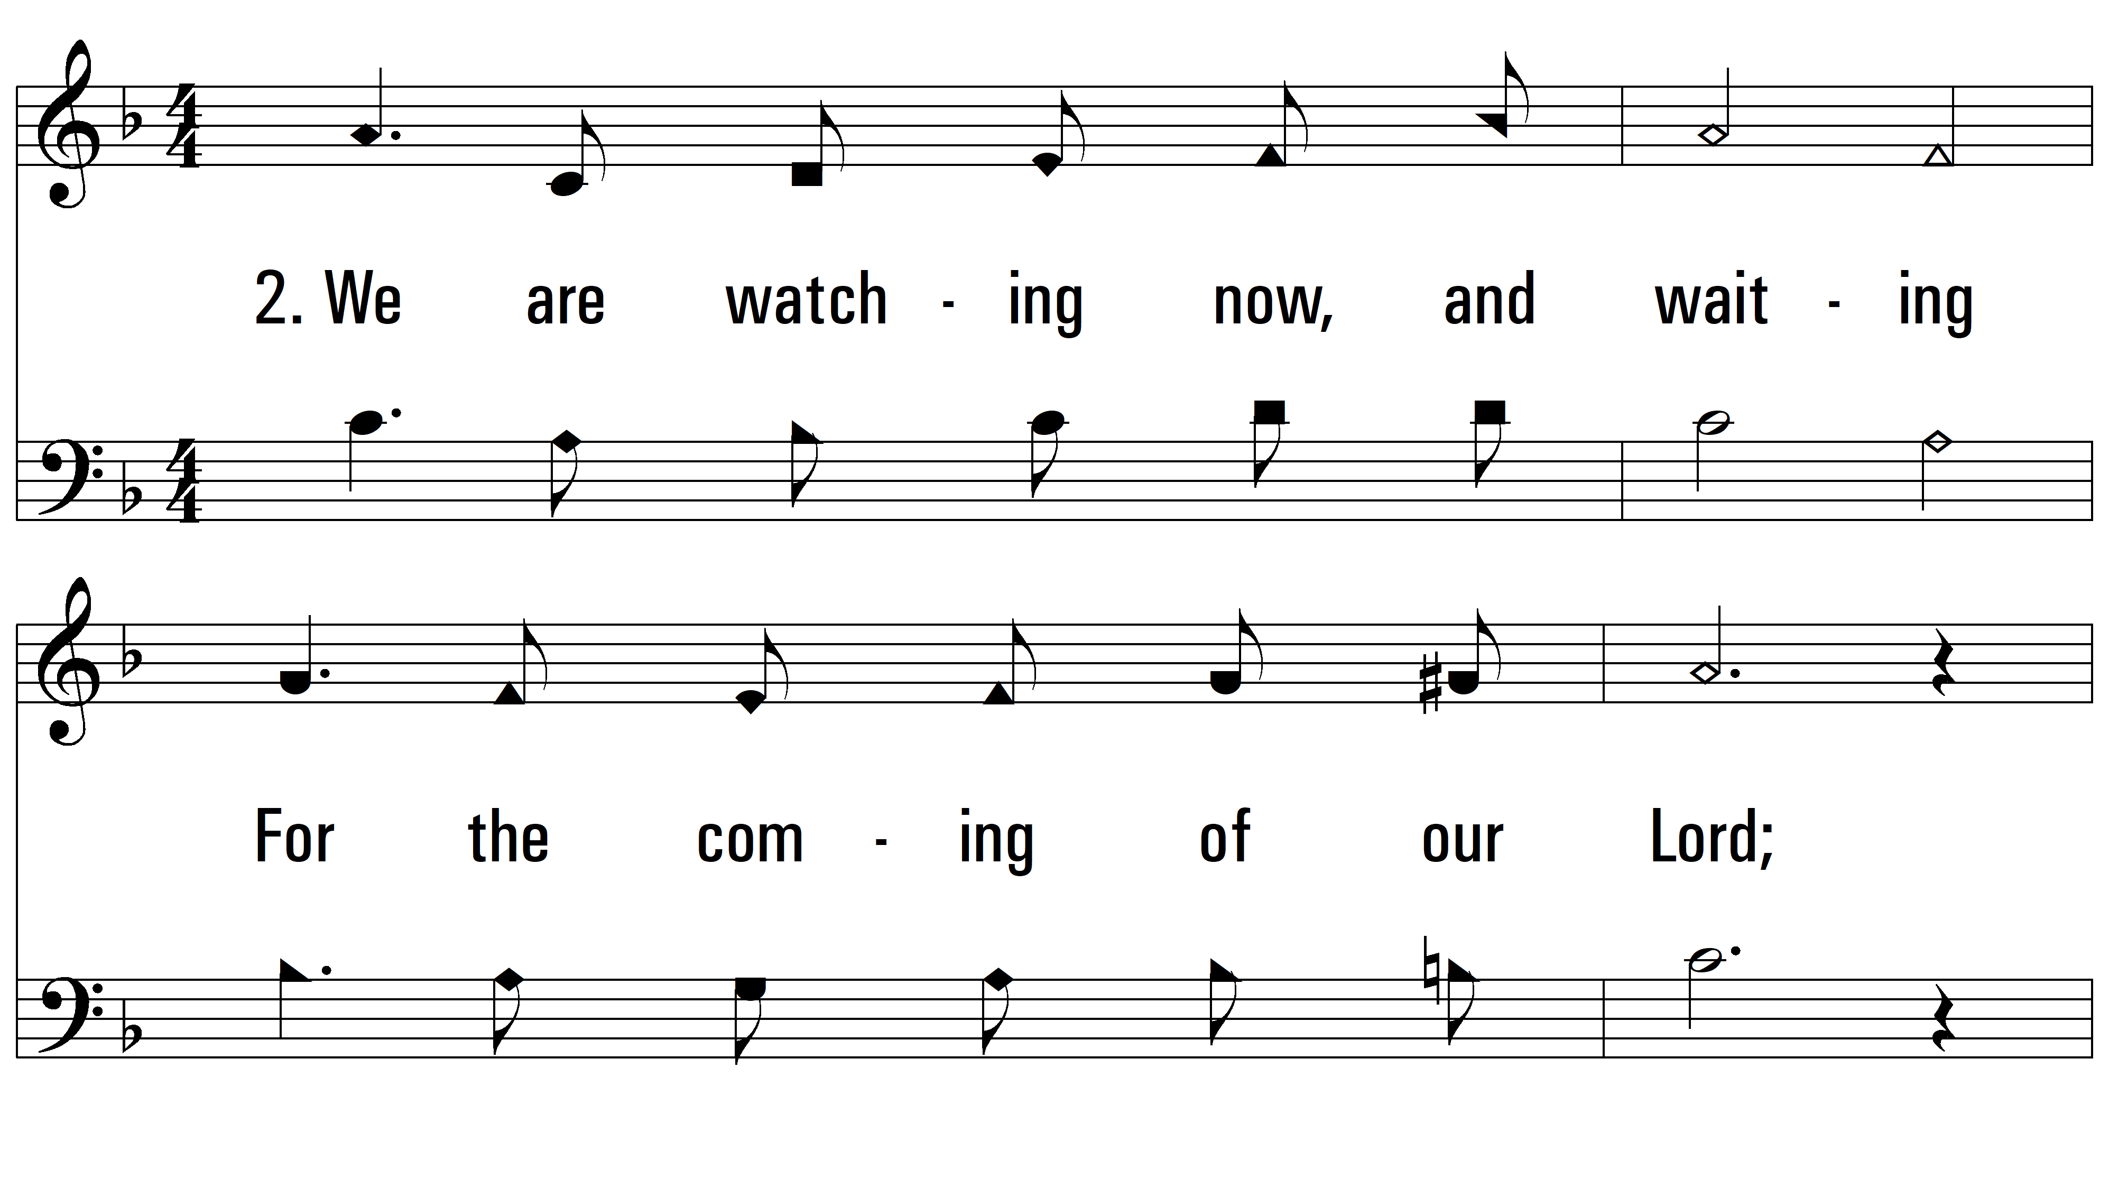
vs. 2 ~ Jesus Will Come Again

Slide 7
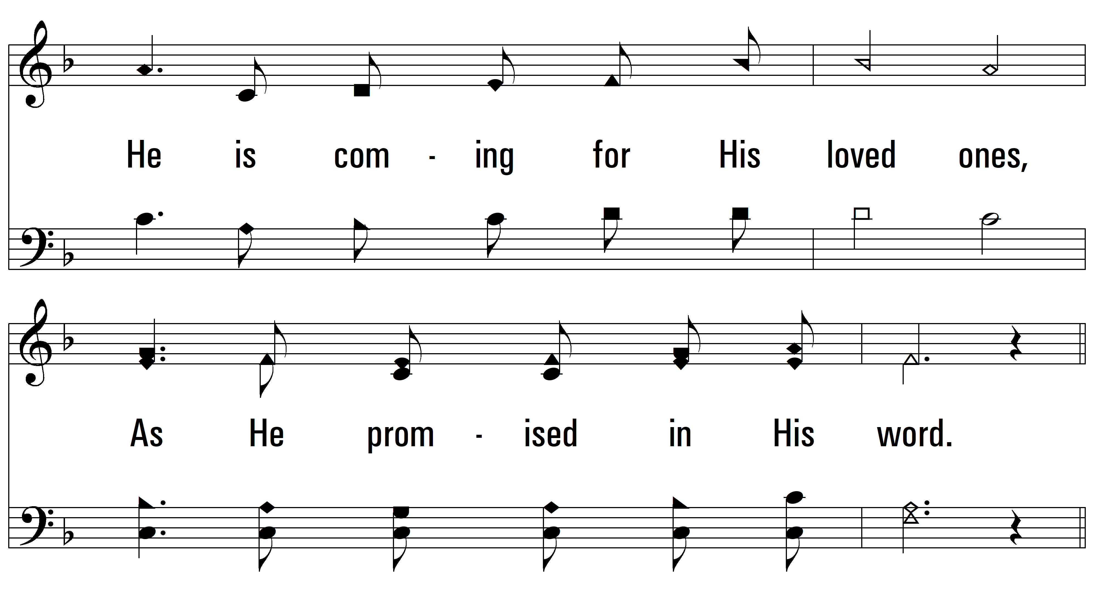
vs. 2

Slide 8
vs. 2

Slide 9
vs. 2

Slide 10
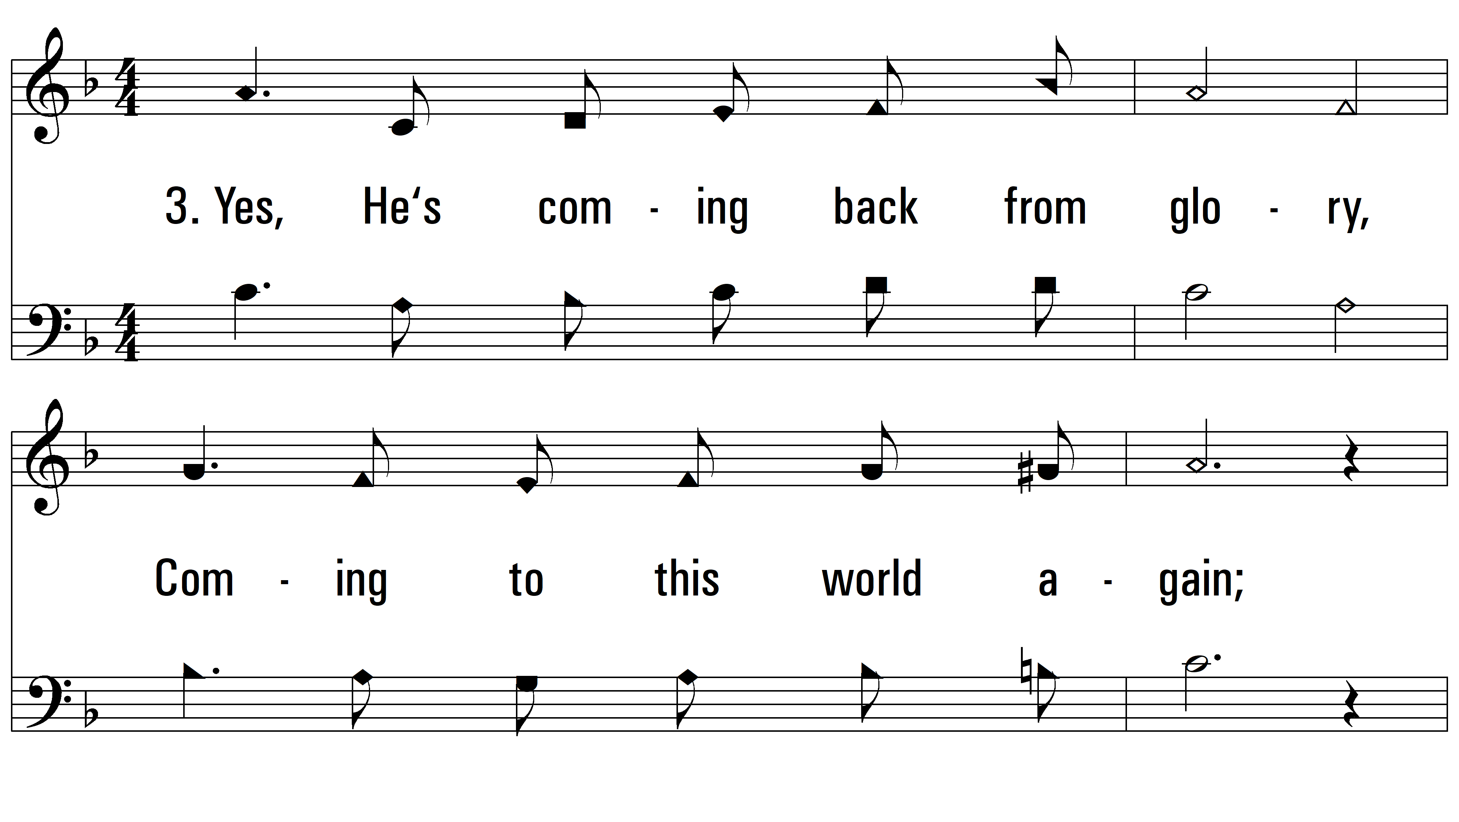
vs. 3 ~ Jesus Will Come Again

Slide 11
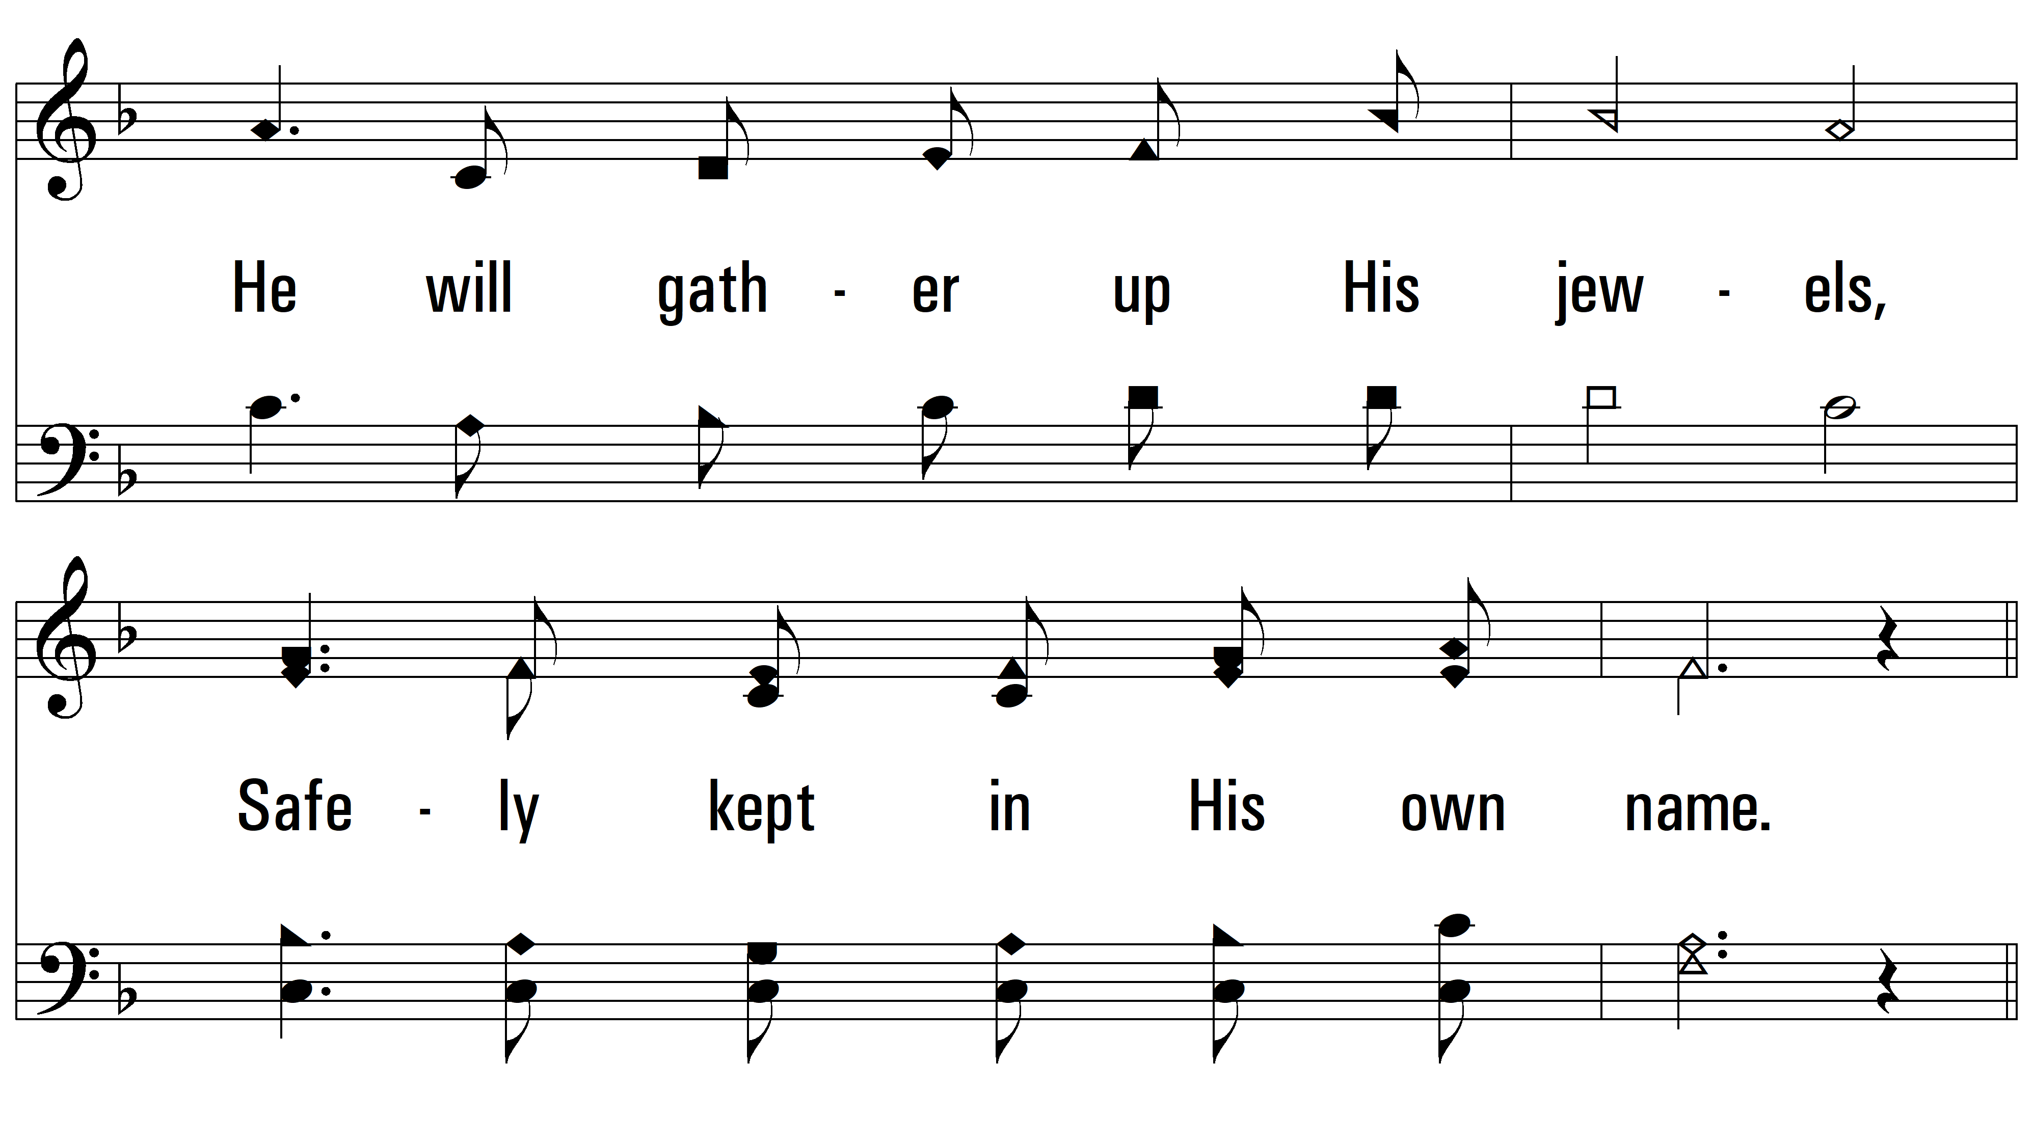
vs. 3

Slide 12
vs. 3

Slide 13
vs. 3
PDHymns.com
END

