Slide 1
Jesus, Thou Joy Of Loving Hearts
MARYTON
LM
Words: | Bernard of Clairvaux (c. 1150)
Music: | Henry P. Smith (1874)
3/4
E^{b}/G - MI
Verses: 5
Lead - | MI
Alto - | DO
Tenor - | SOL
Bass - | DO
PDHymns.com

Slide 2
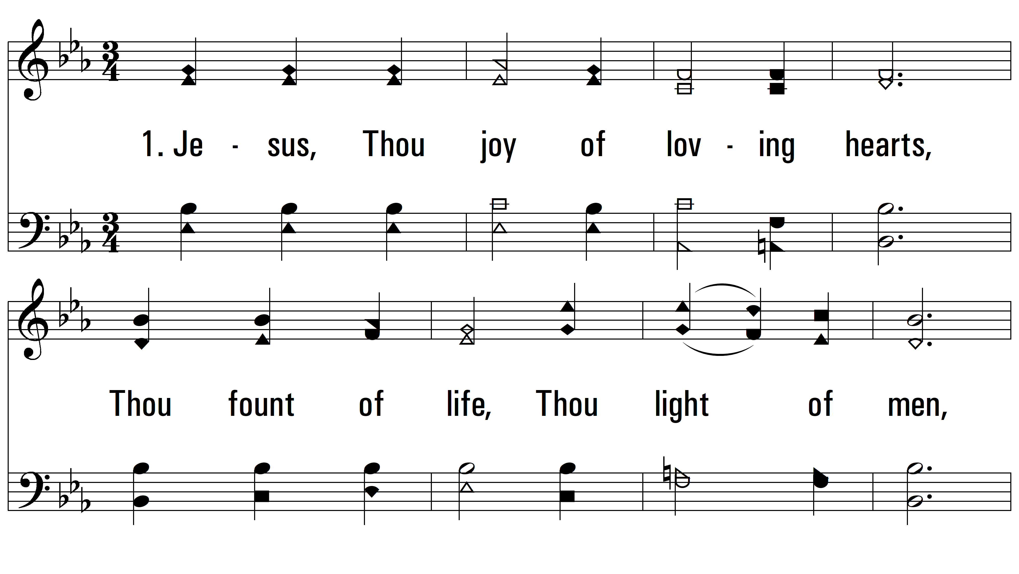
vs. 1 ~ Jesus, Thou Joy Of Loving Hearts

Slide 3
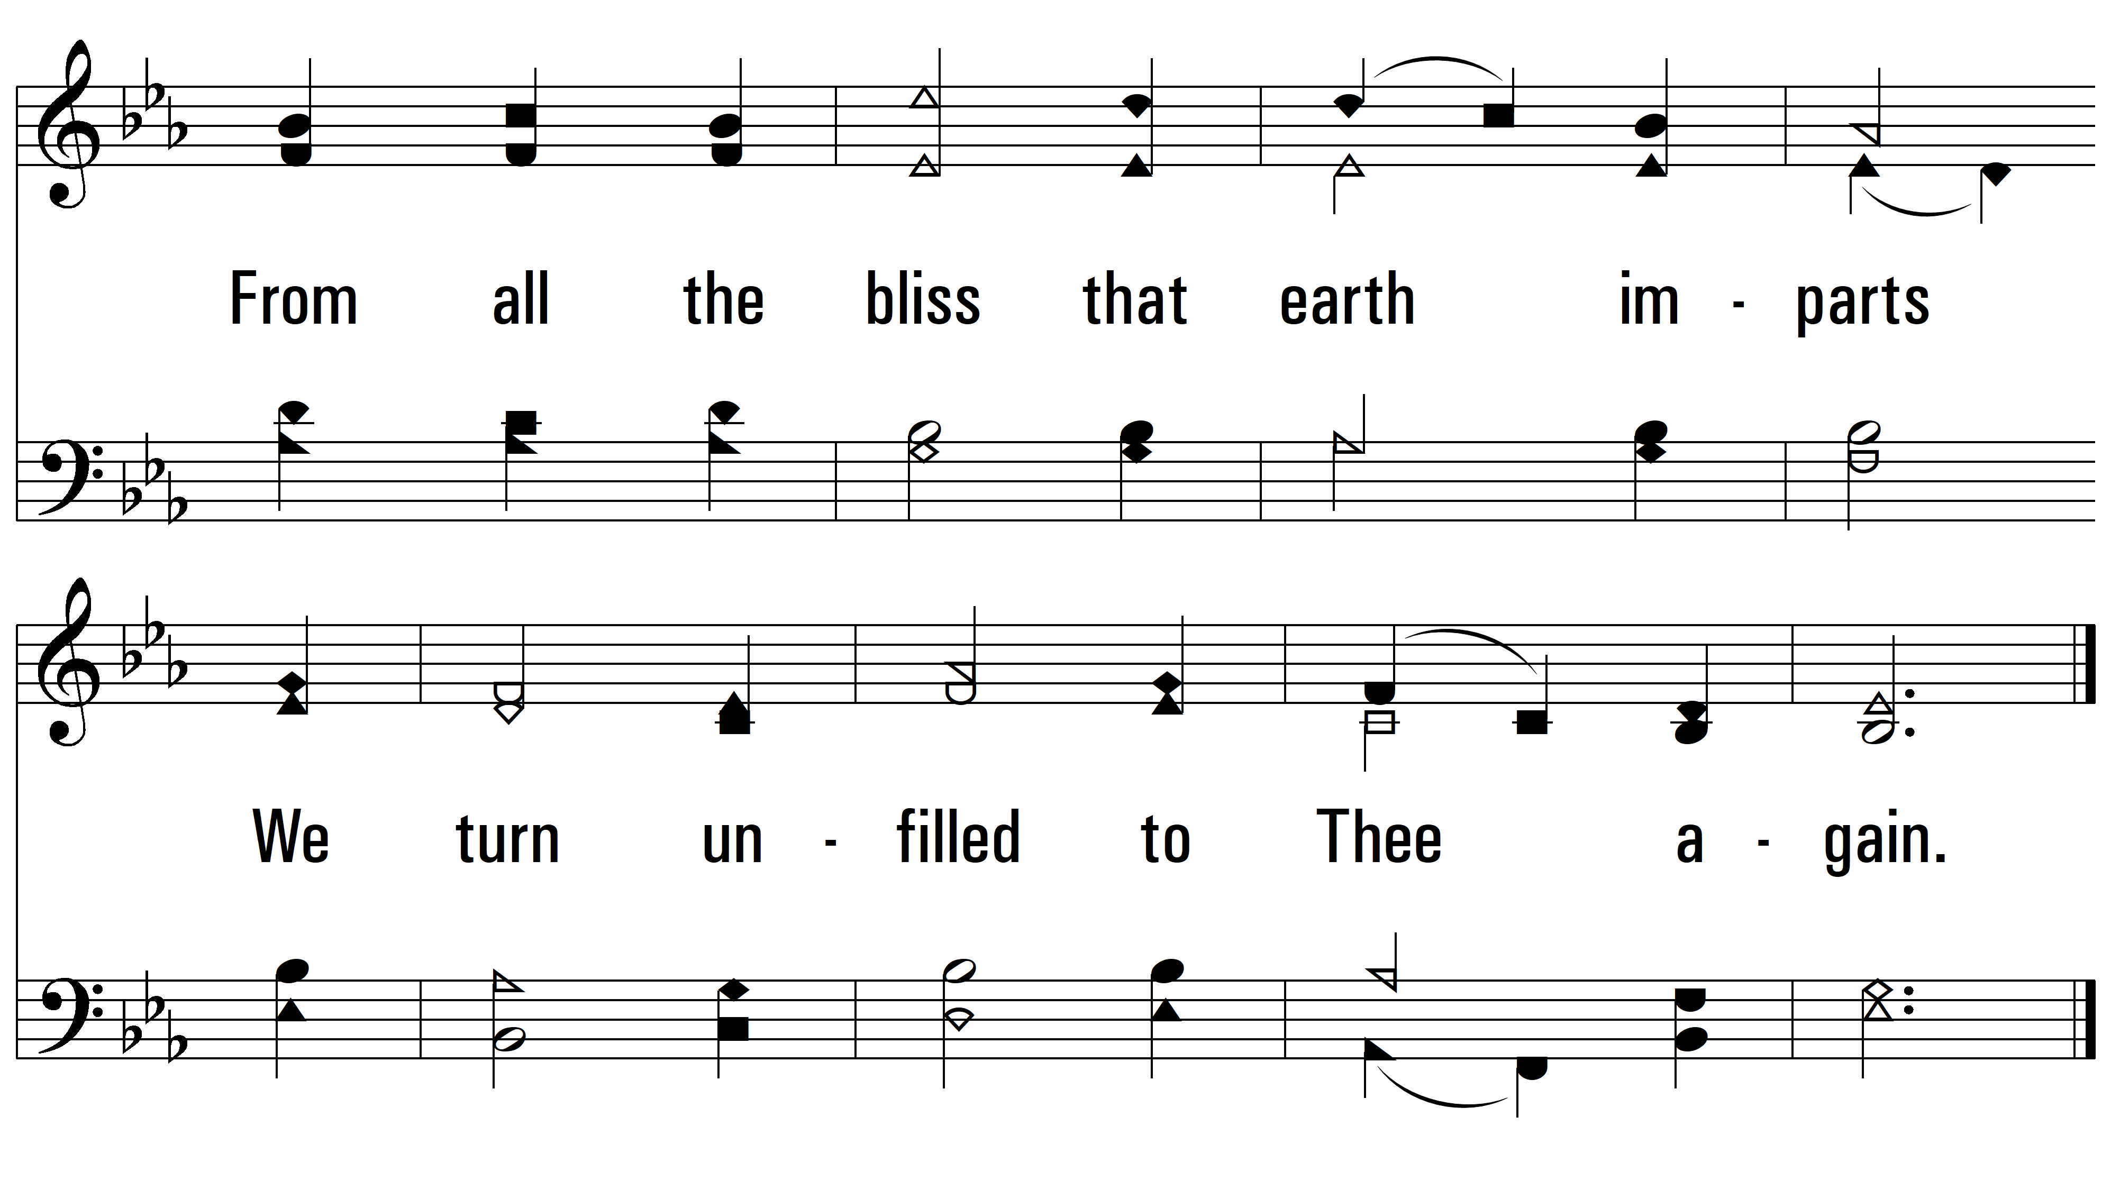
vs. 1

Slide 4
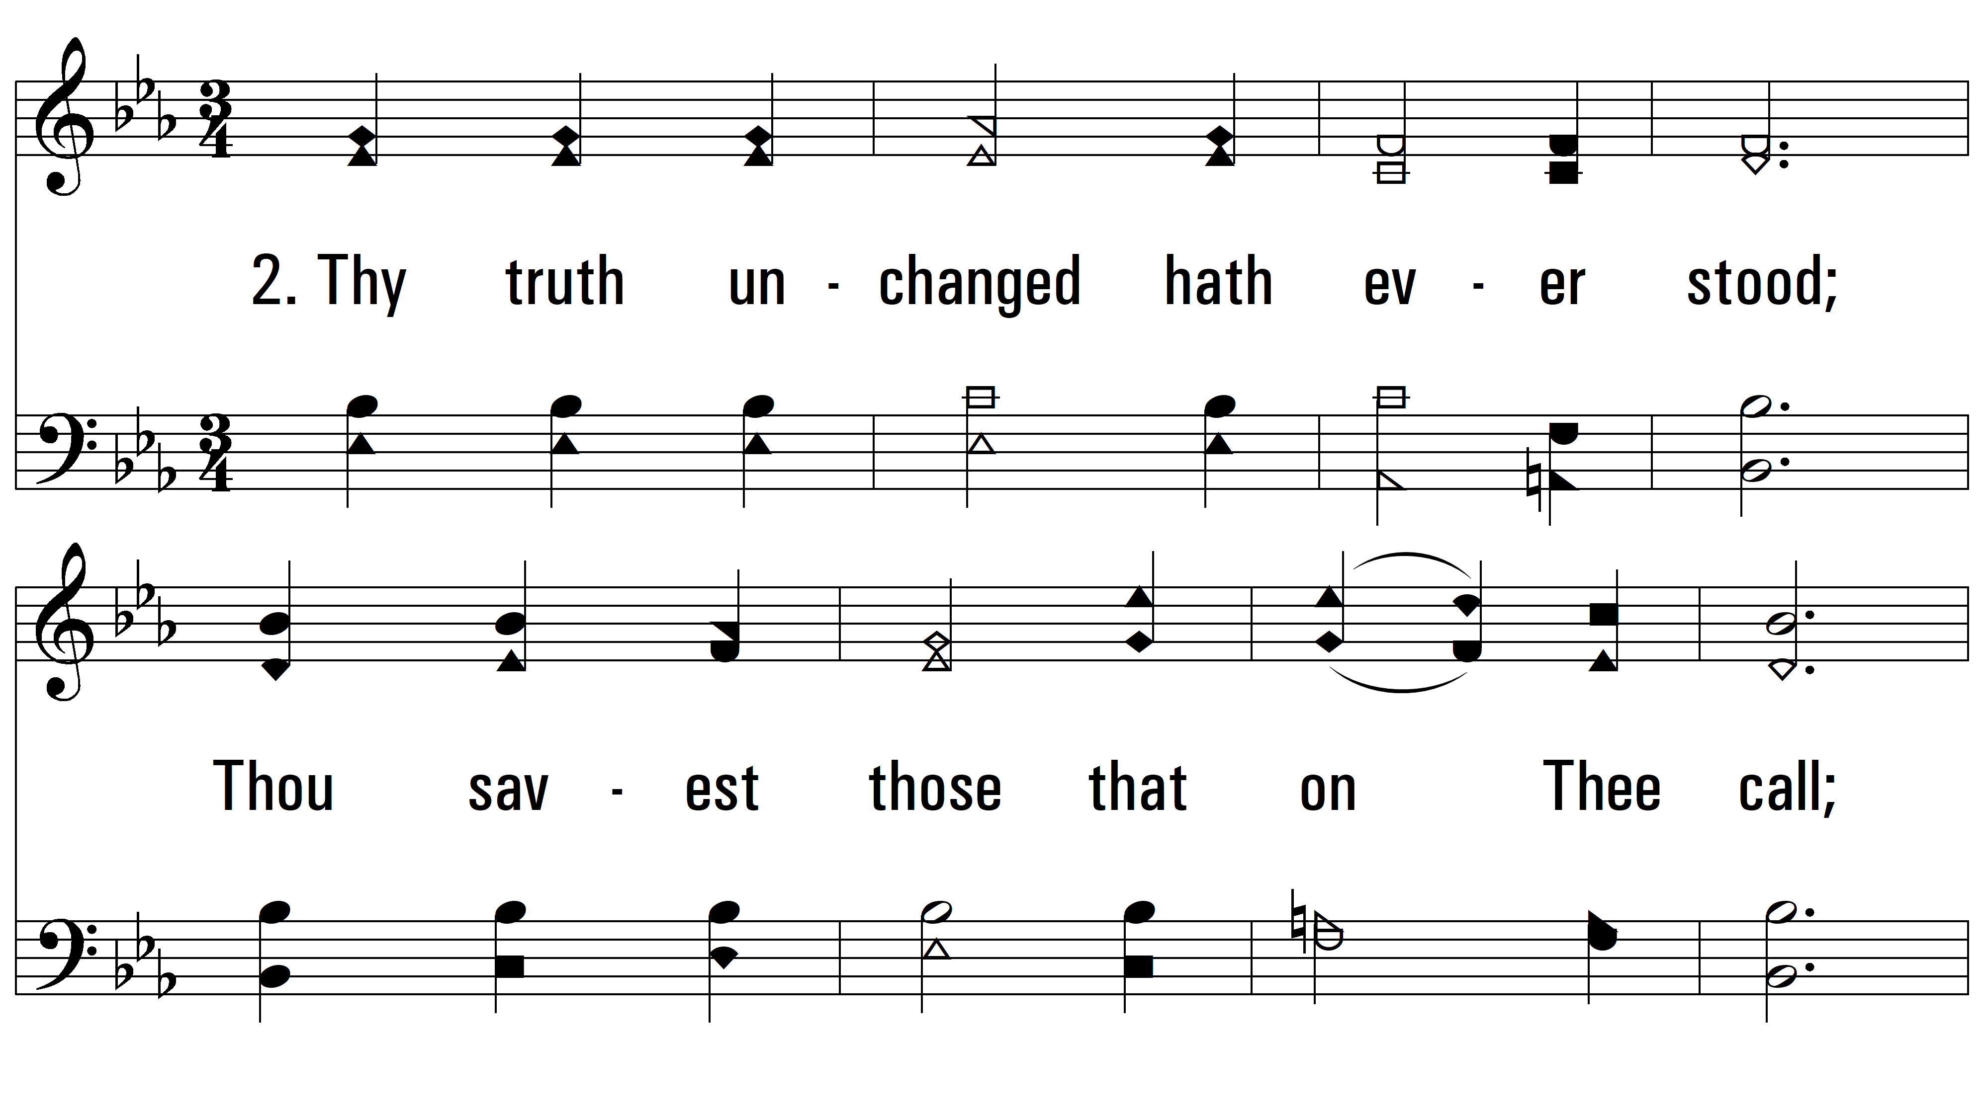
vs. 2 ~ Jesus, Thou Joy Of Loving Hearts

Slide 5
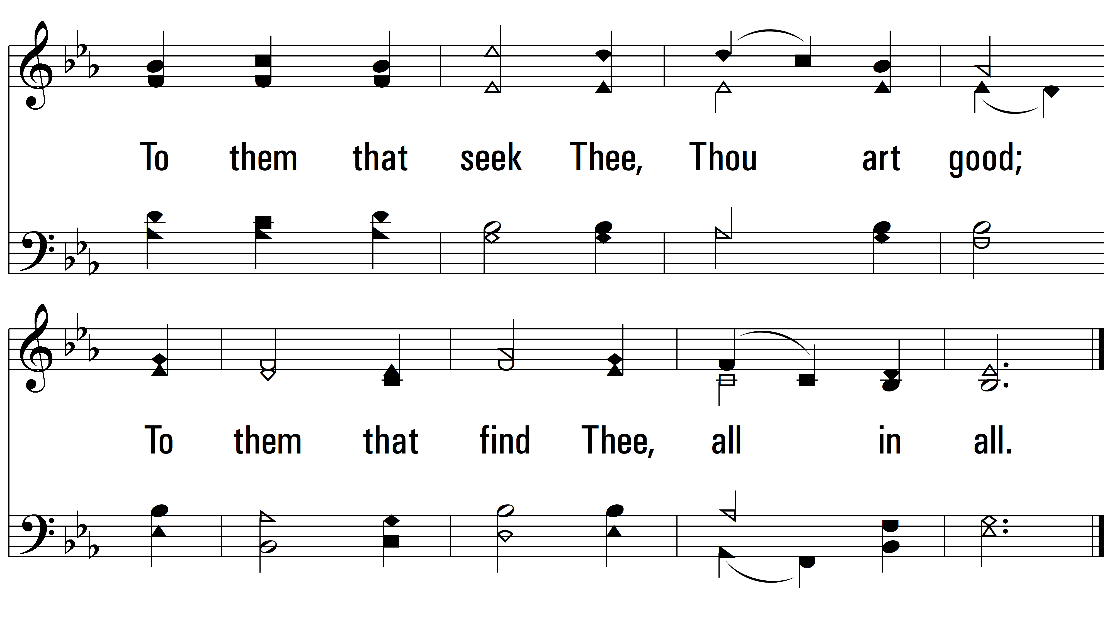
vs. 2

Slide 6
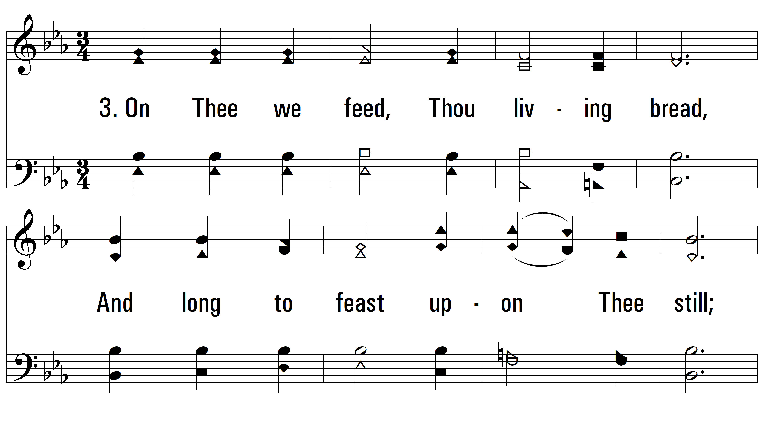
vs. 3 ~ Jesus, Thou Joy Of Loving Hearts

Slide 7
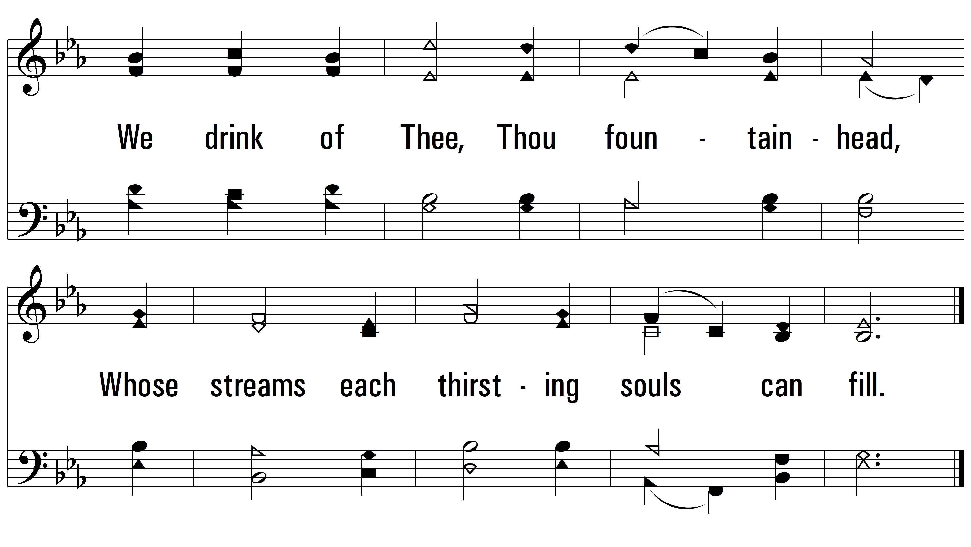
vs. 3

Slide 8
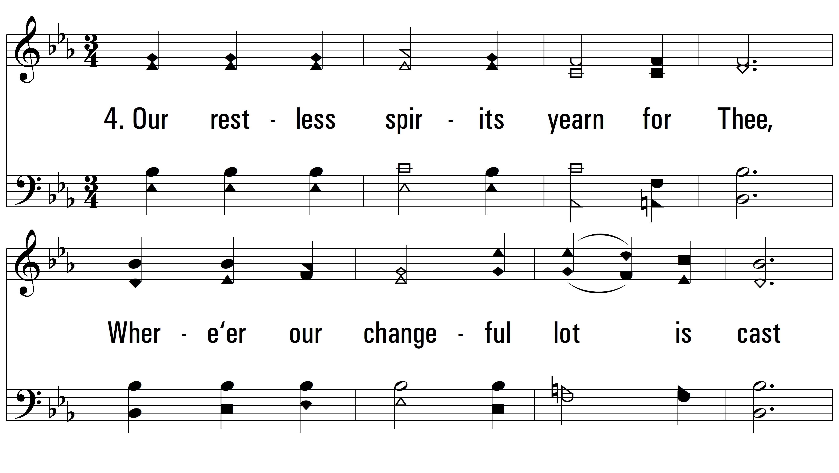
vs. 4 ~ Jesus, Thou Joy Of Loving Hearts

Slide 9
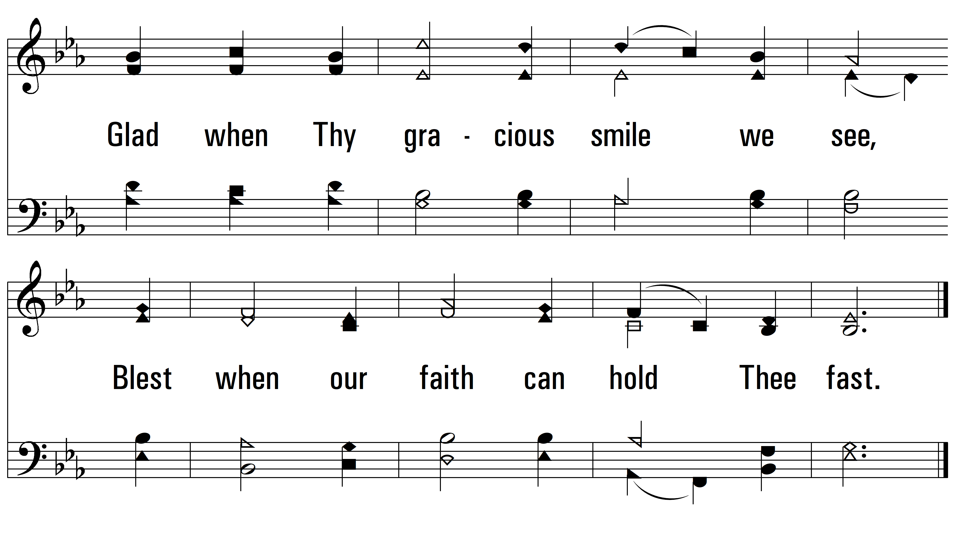
vs. 4

Slide 10
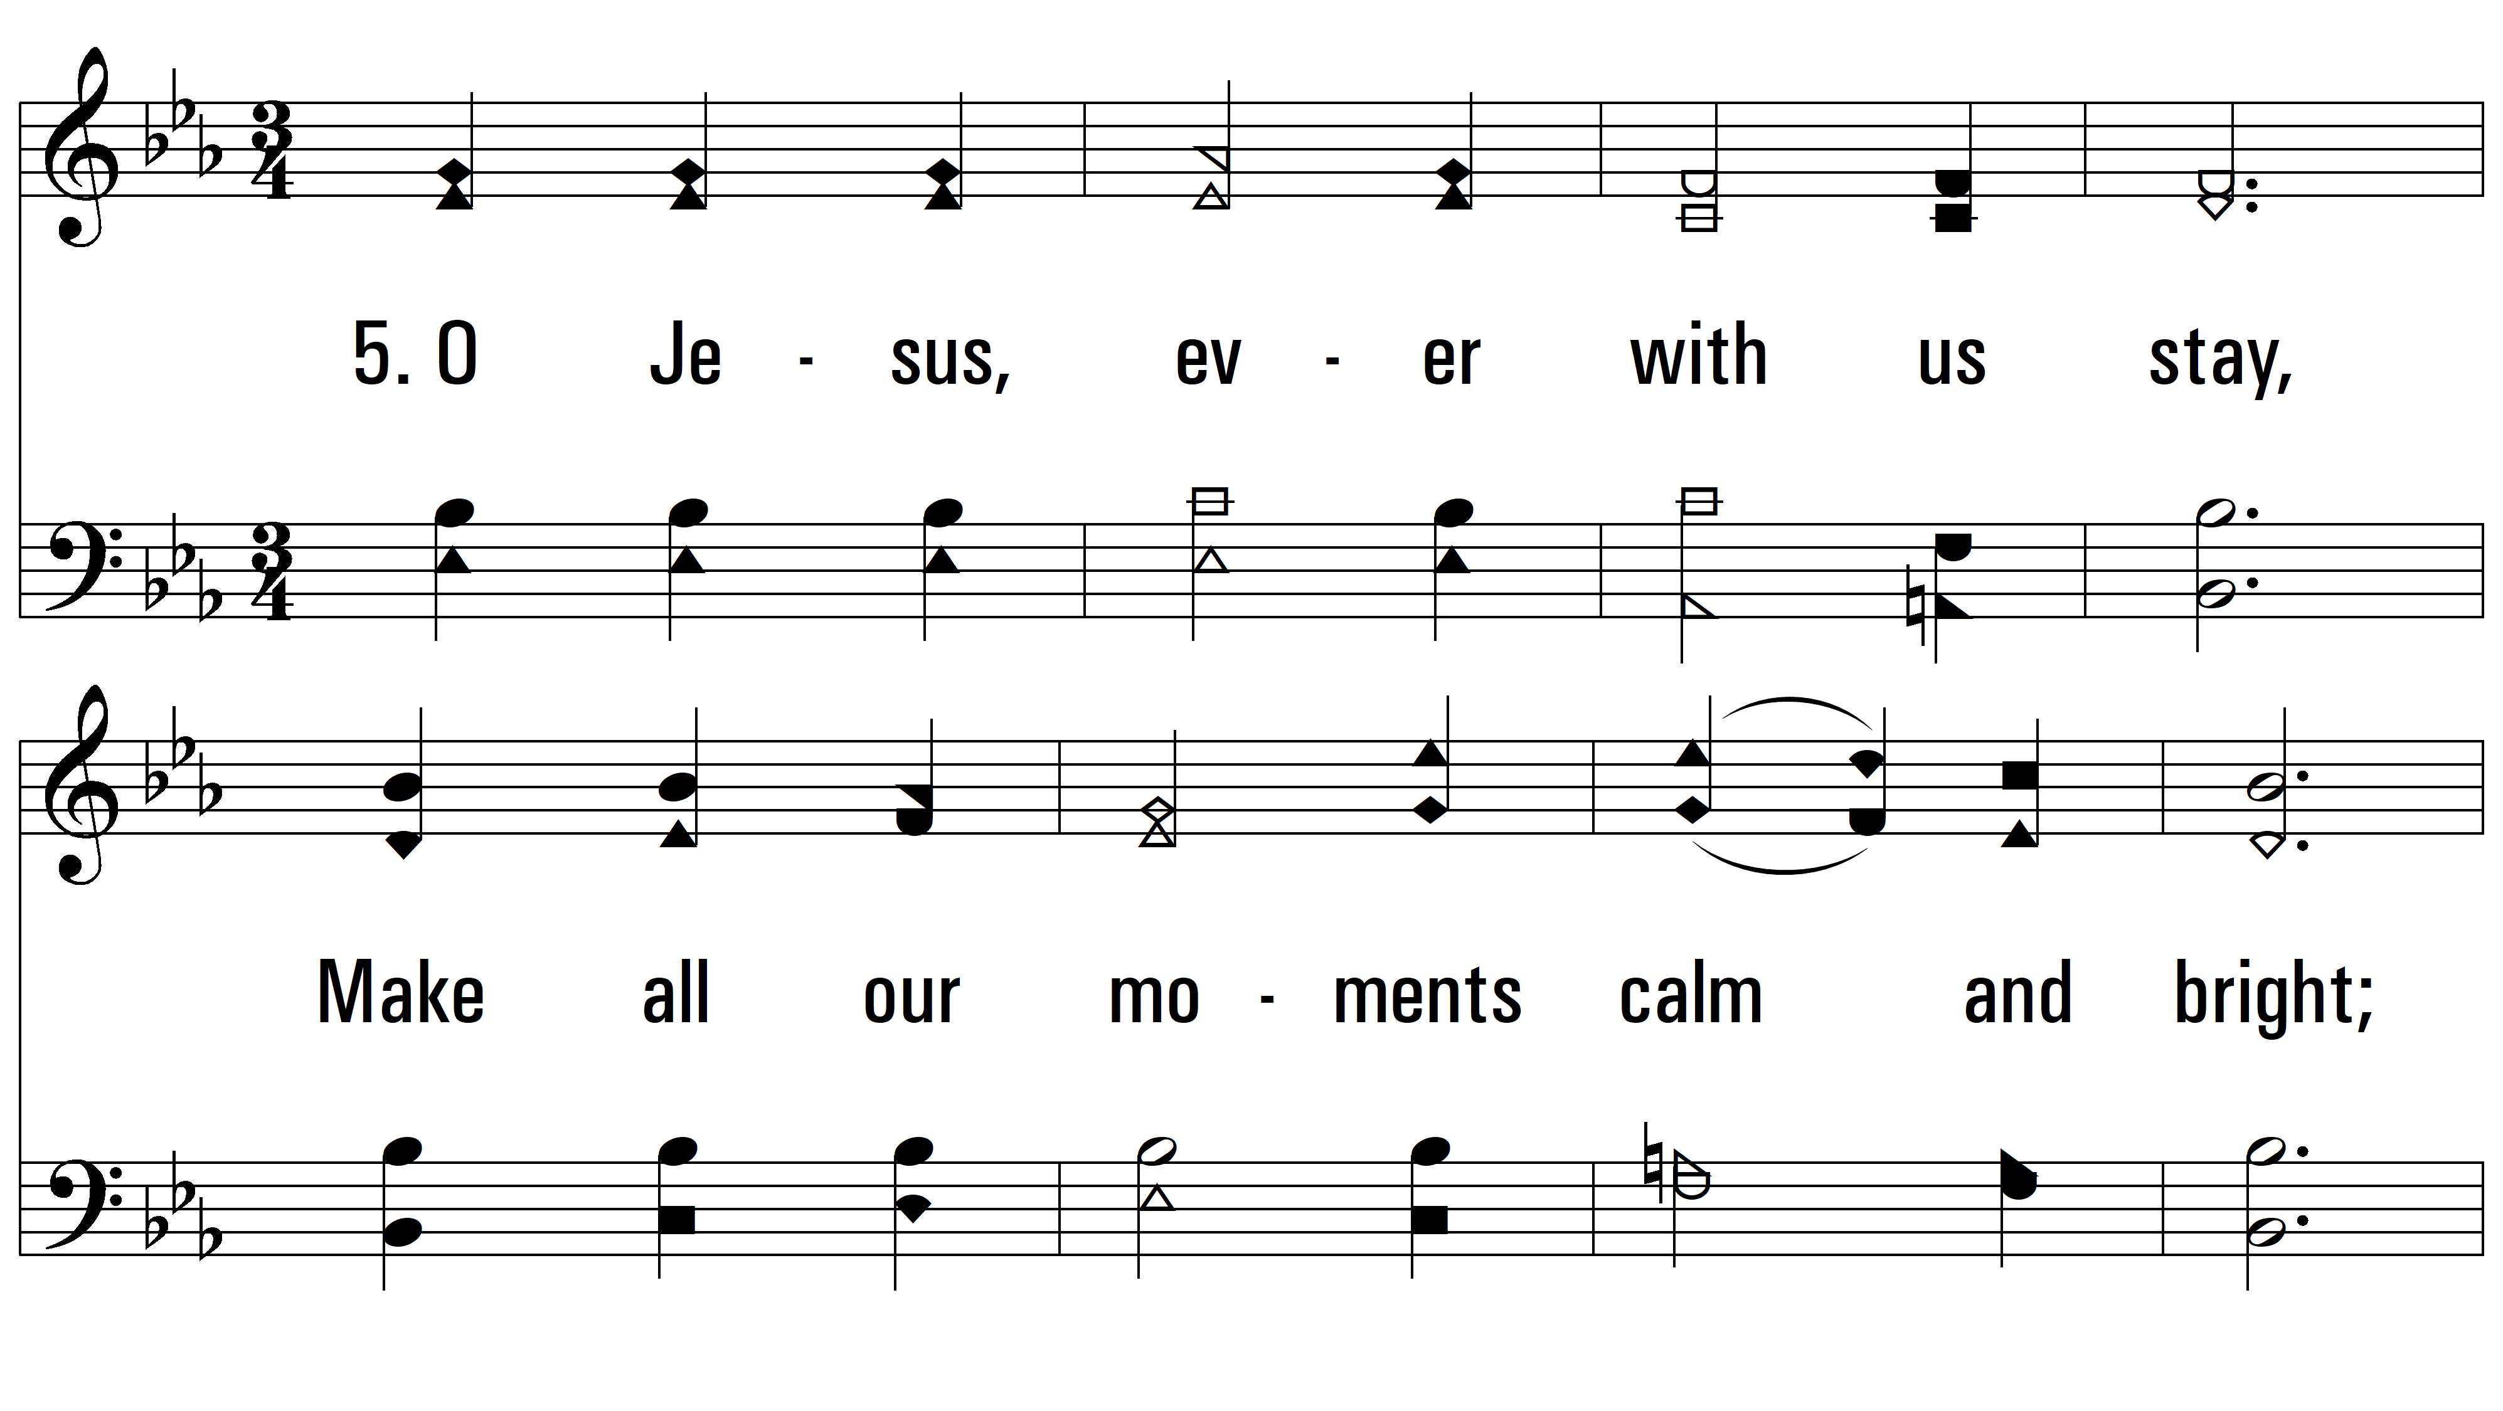
vs. 5 ~ Jesus, Thou Joy Of Loving Hearts

Slide 11
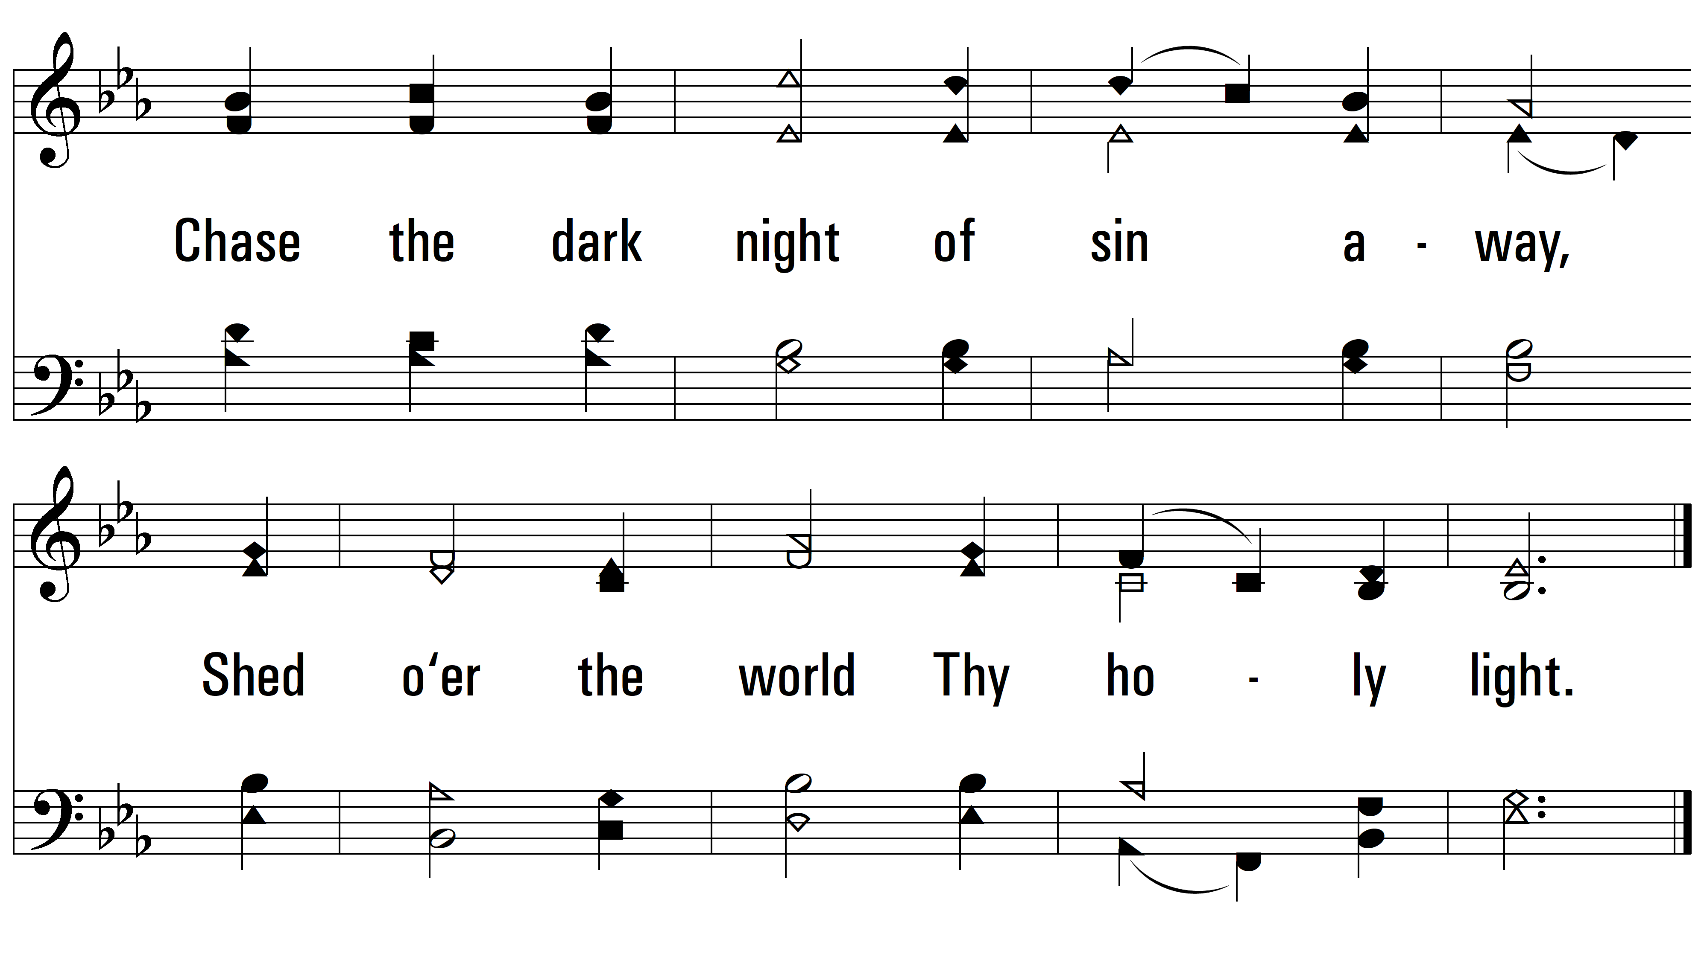
vs. 5
PDHymns.com
END

