Slide 1
Jesus, the Very Thought of Thee
ST. AGNES
CM
Words: | Bernard of Clairvaux (1150); Tr. Edward Caswell (1849)
Music: | John B. Dykes (1866)
3/4
G/B - MI
Verses: 6
Lead - | MI
Alto - | SOL
Tenor - | MI
Bass - | DO
PDHymns.com

Slide 2
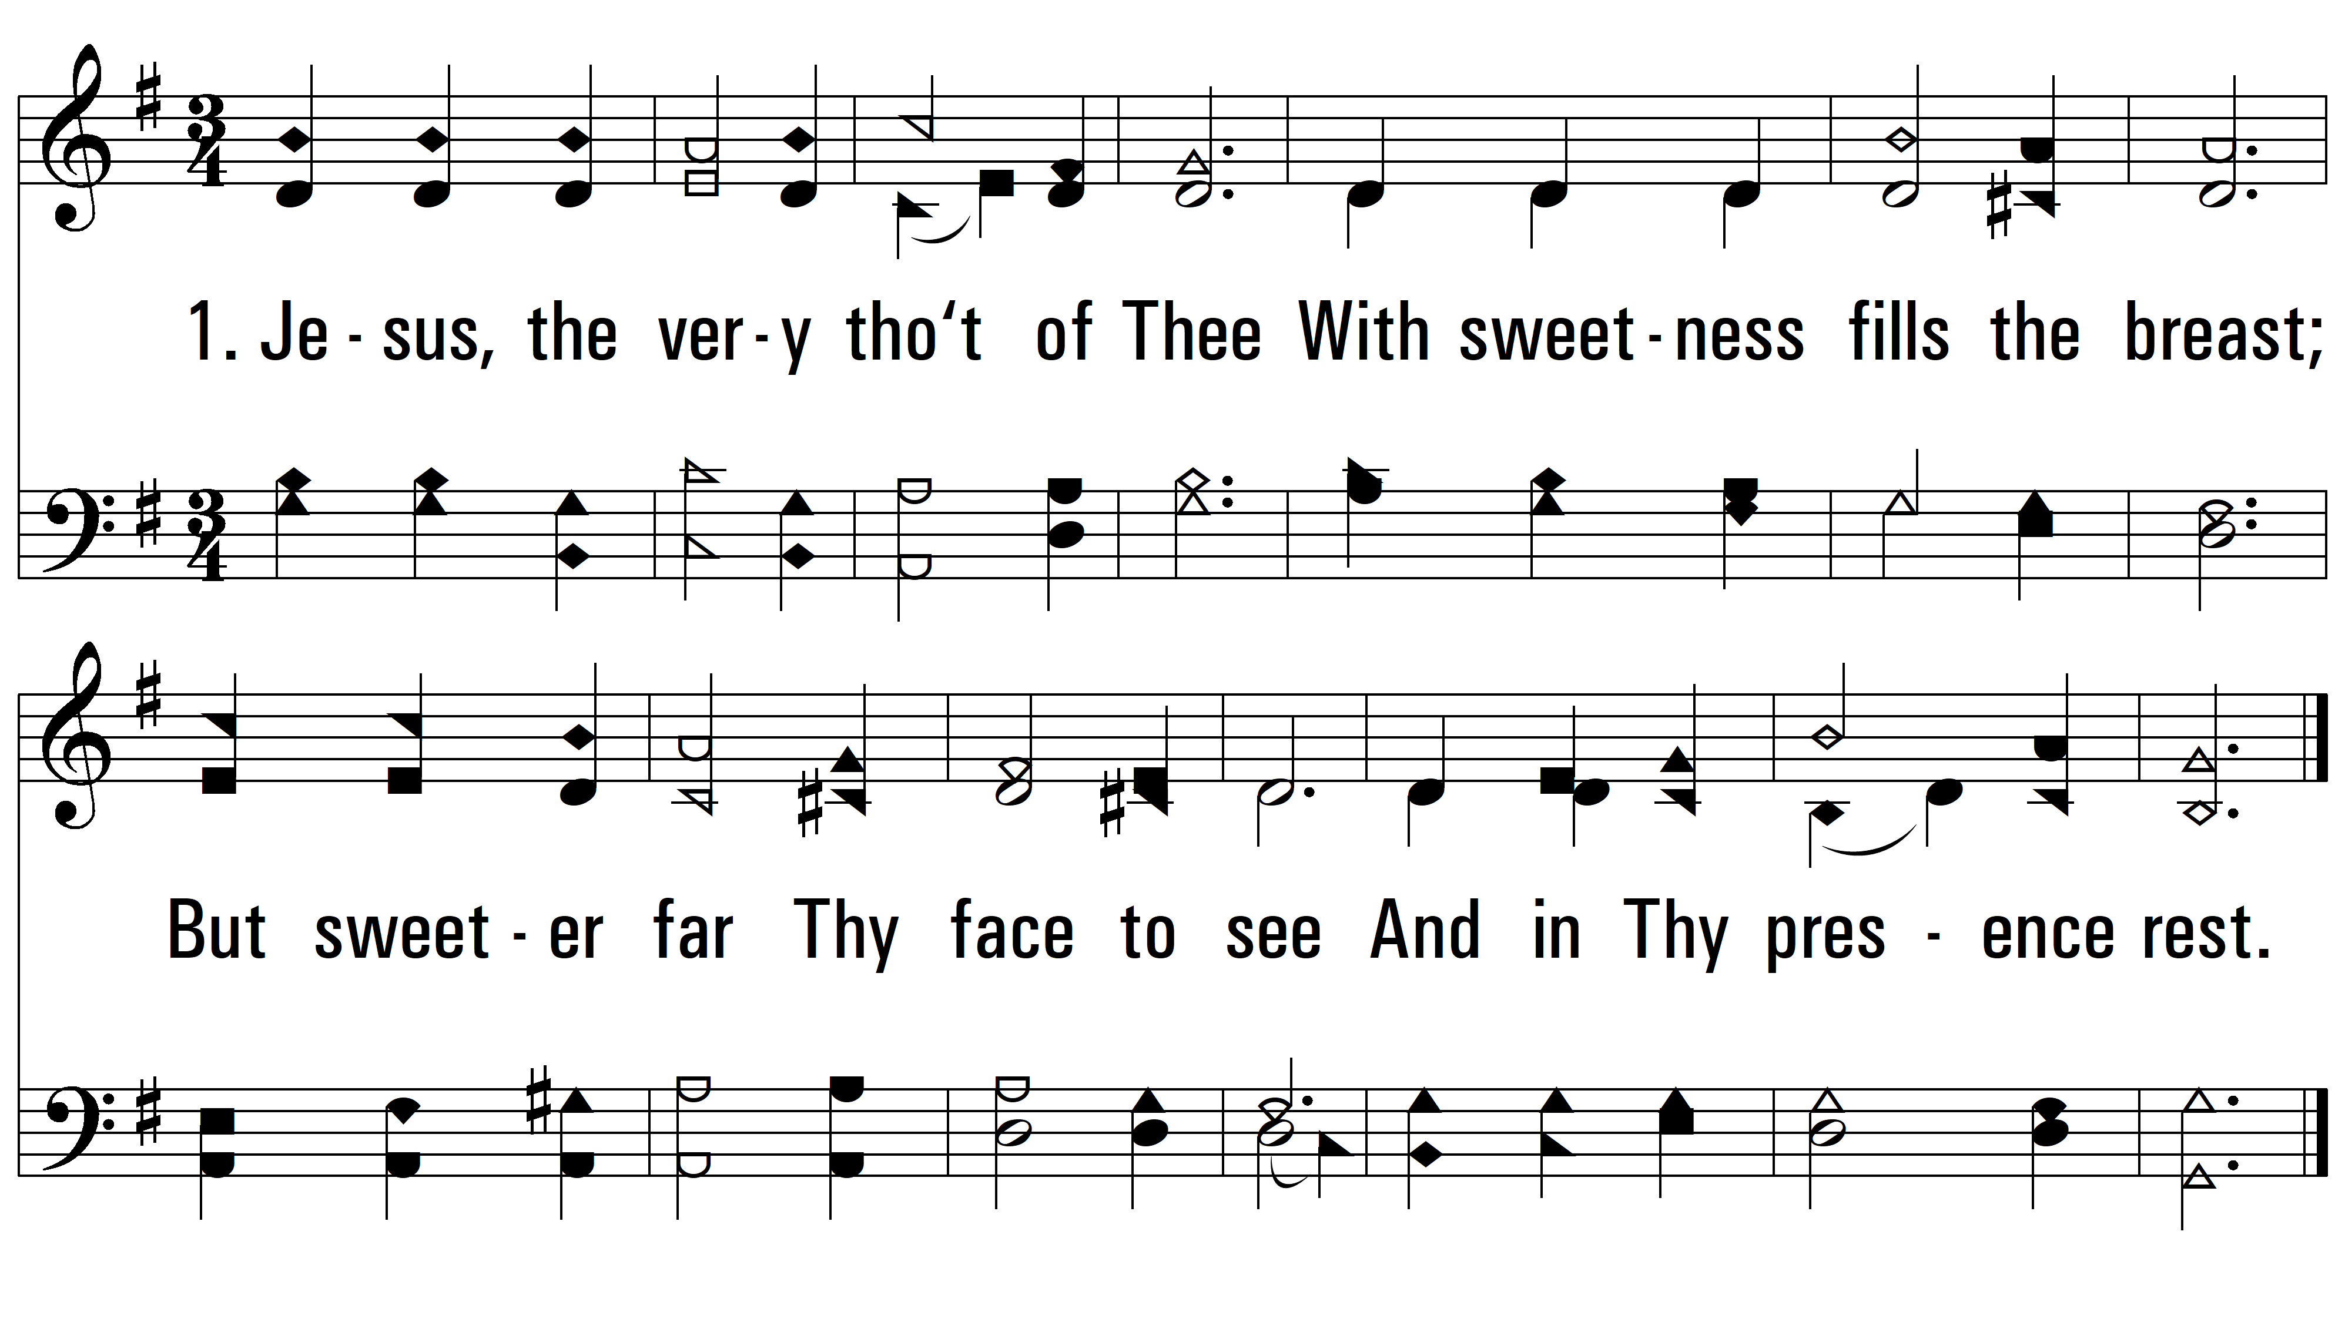
vs. 1 ~ Jesus, the Very Thought of Thee

Slide 3
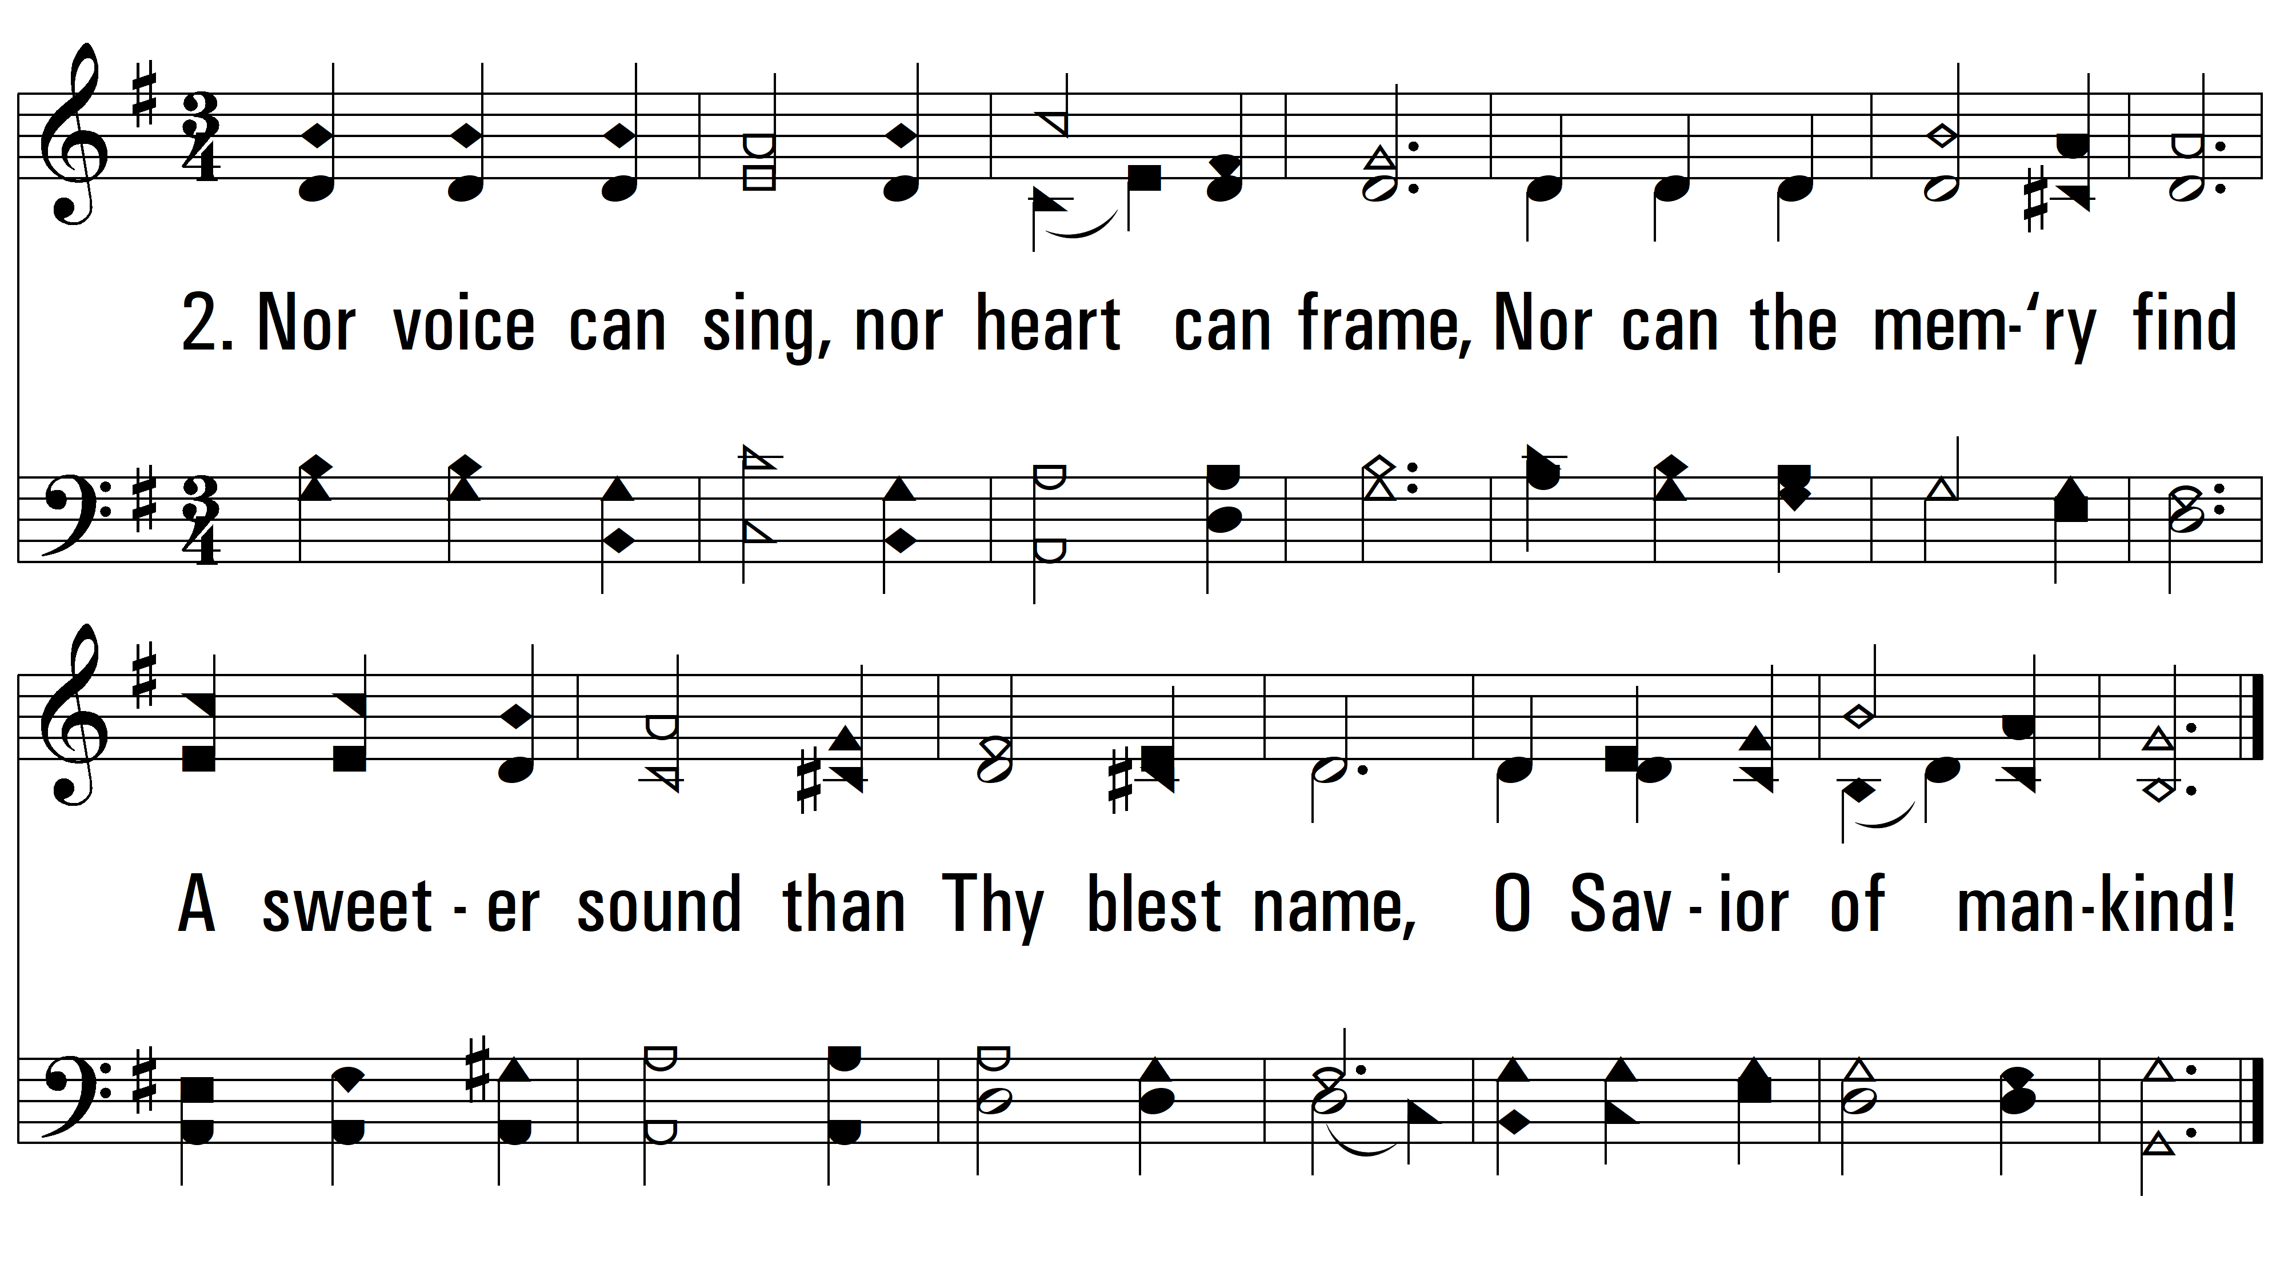
vs. 2 ~ Jesus, the Very Thought of Thee

Slide 4
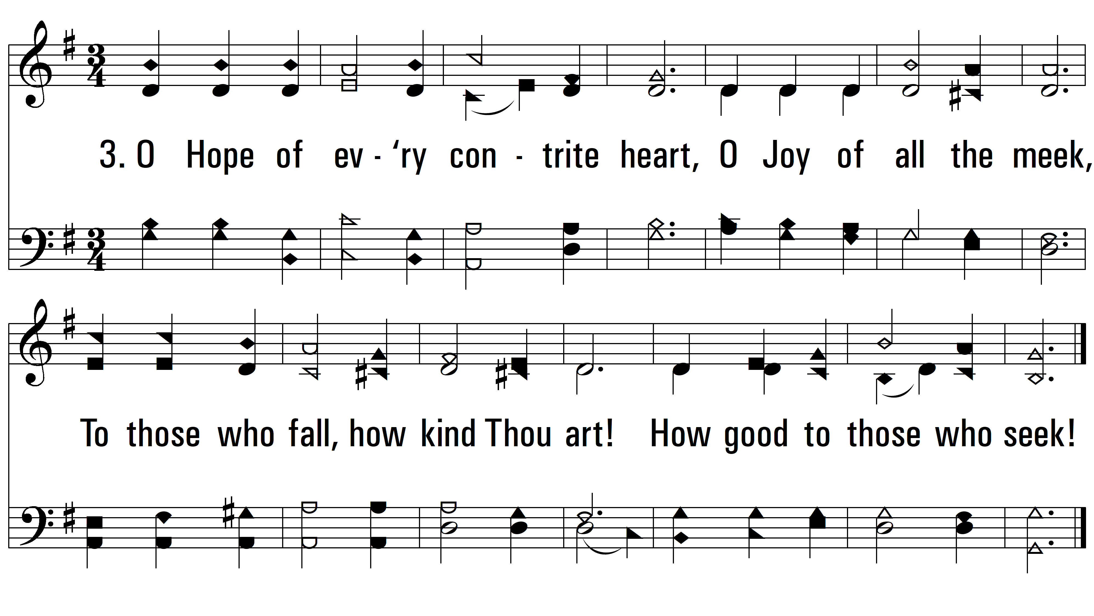
vs. 3 ~ Jesus, the Very Thought of Thee

Slide 5
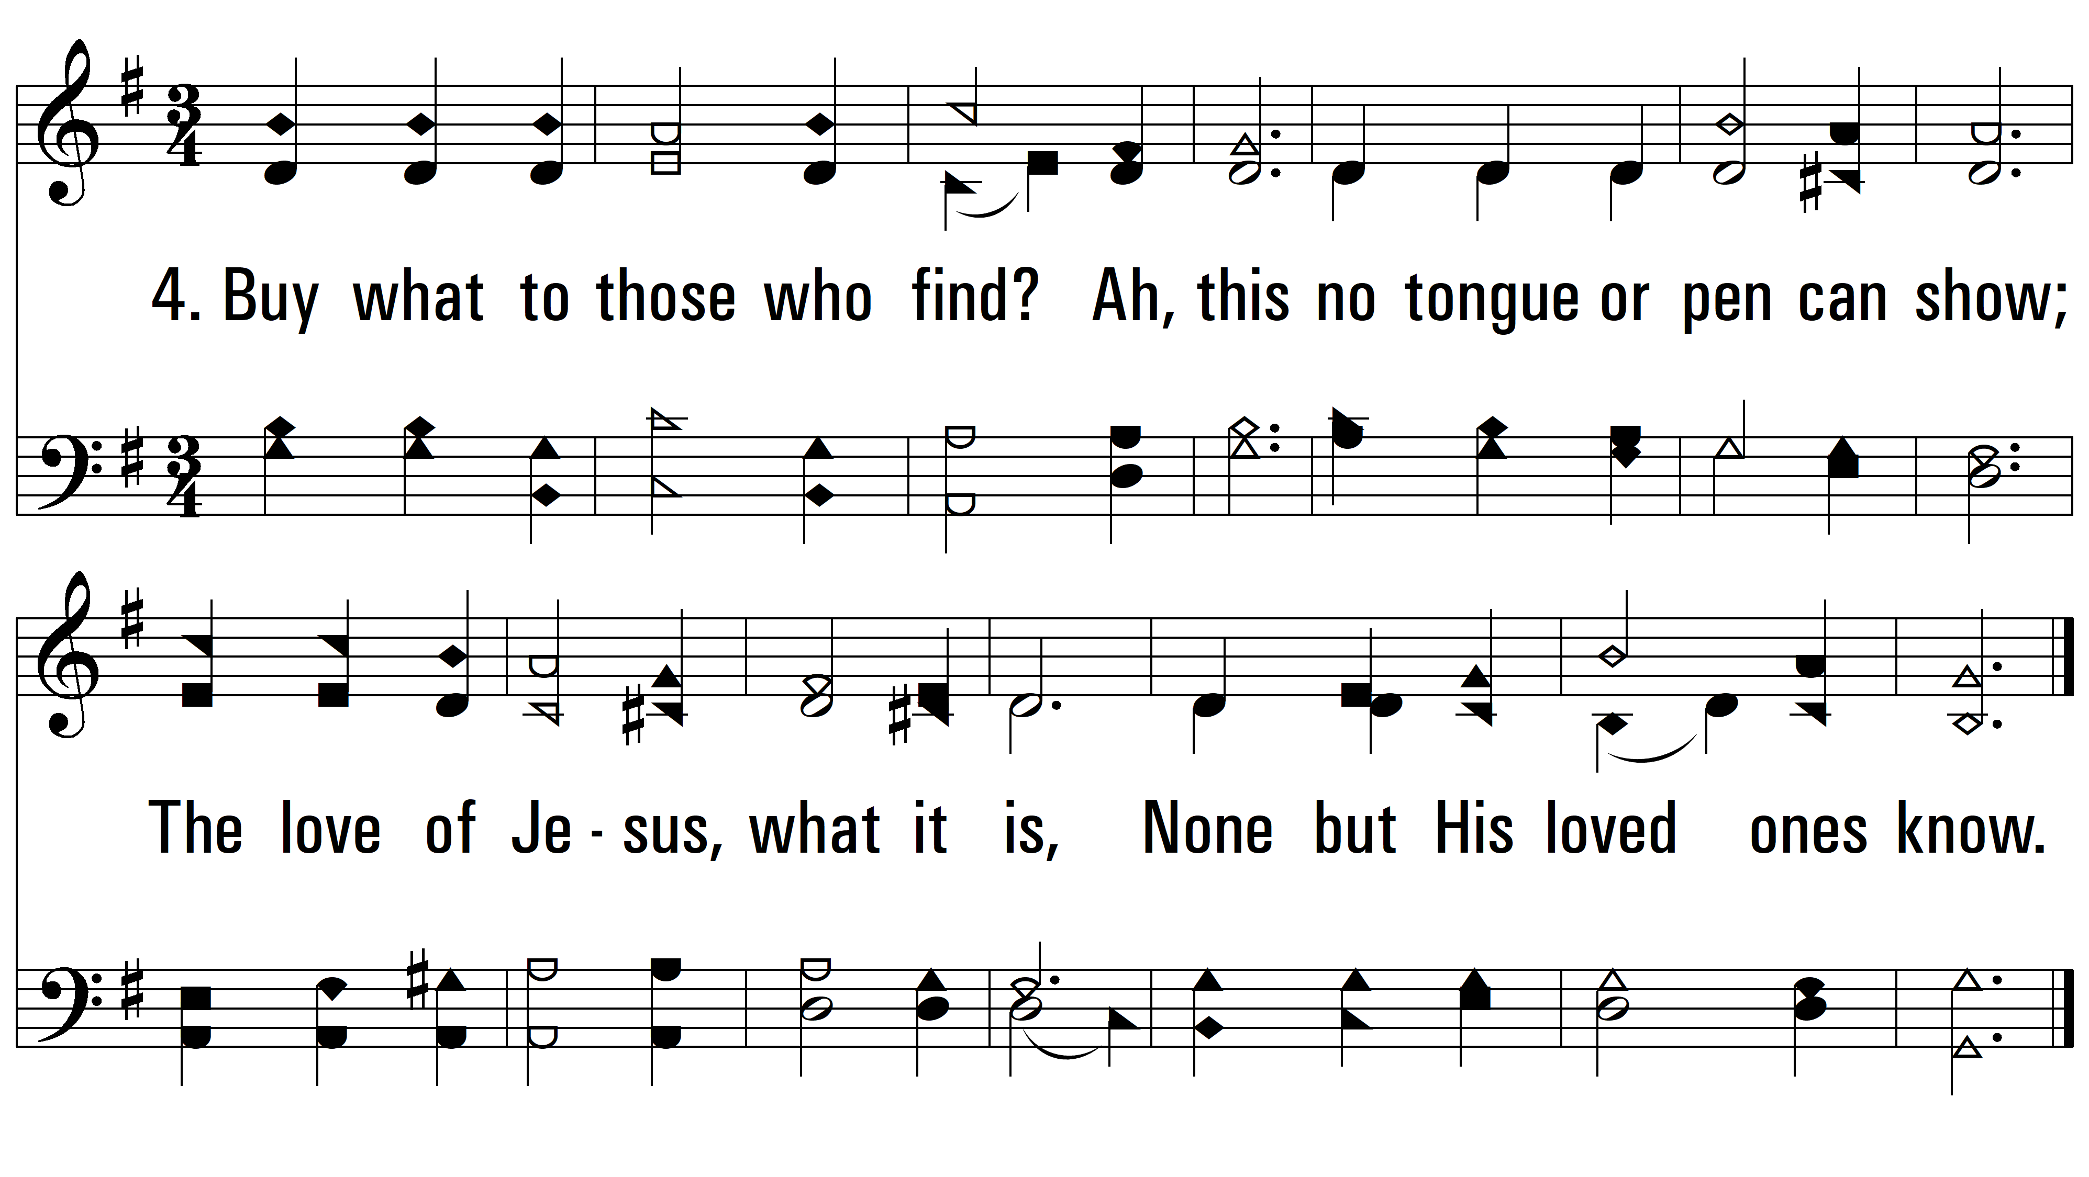
vs. 4 ~ Jesus, the Very Thought of Thee

Slide 6
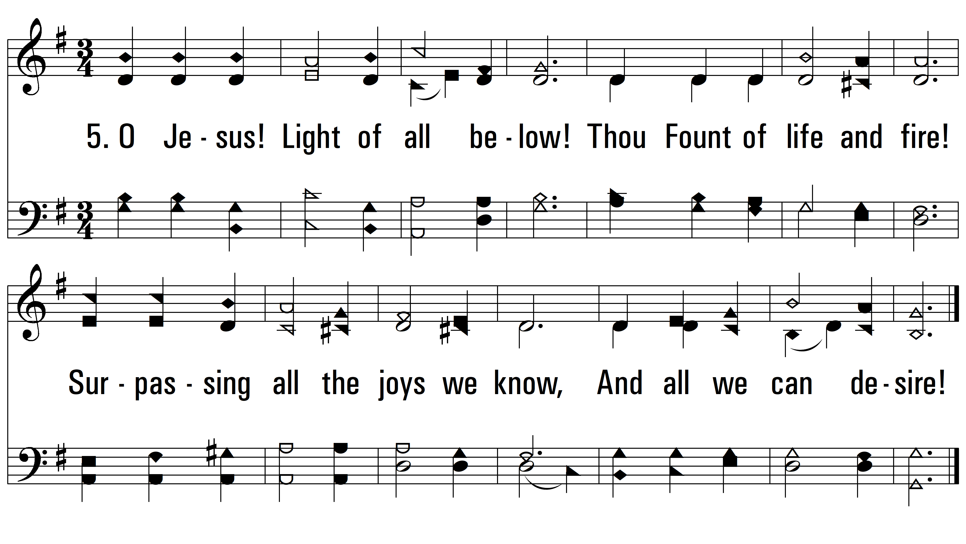
vs. 5 ~ Jesus, the Very Thought of Thee

Slide 7
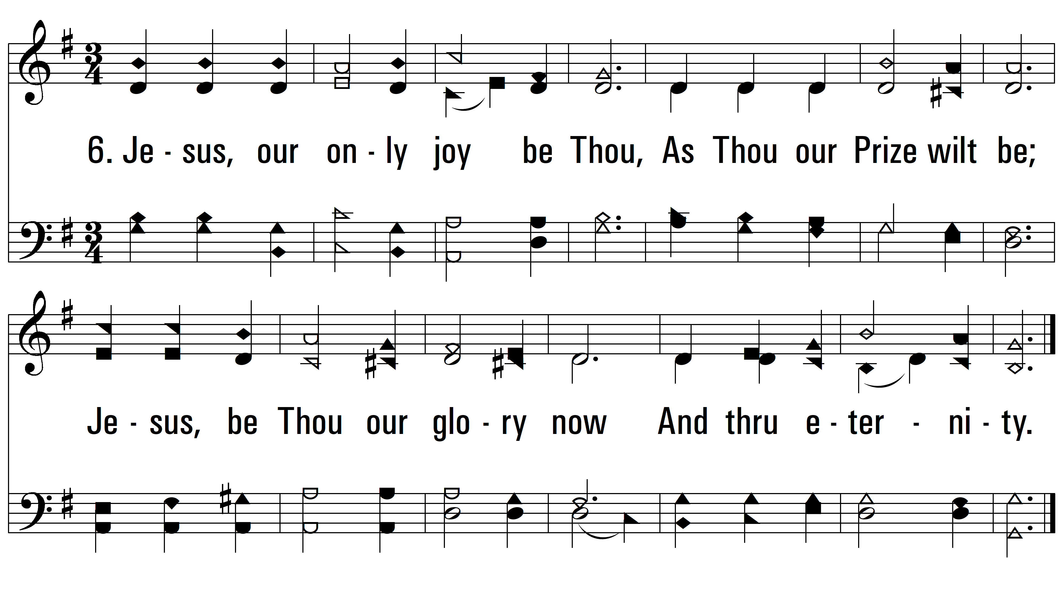
vs. 6 ~ Jesus, the Very Thought of Thee
PDHymns.com
END

