Slide 1
Jesus, The Loving Shepherd
Words: | W. A. Ogden (1885)
Music: | W. A. Ogden (1885)
6/8
F/F - DO
Verses: 3/Chorus
Lead - | DO
Alto - | SOL
Tenor - | MI
Bass - | DO
PDHymns.com

Slide 2
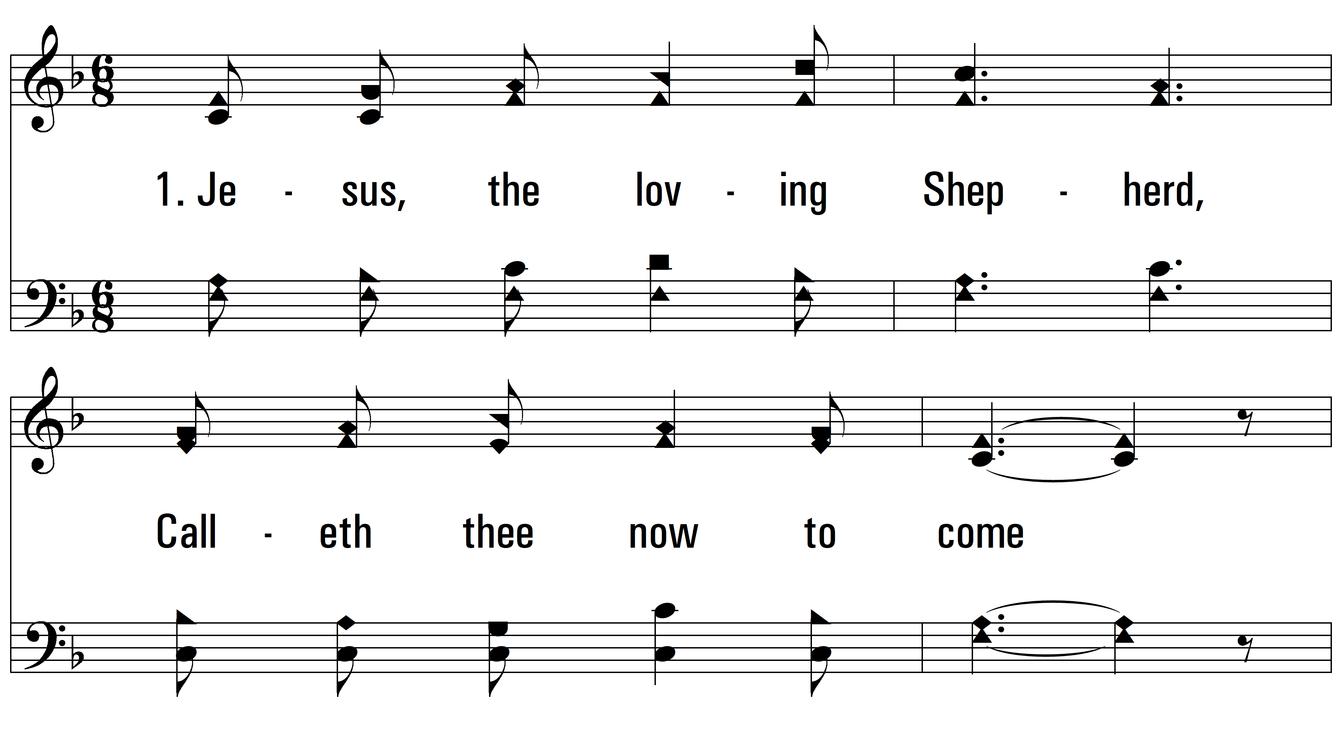
vs. 1 ~ Jesus, The Loving Shepherd

Slide 3
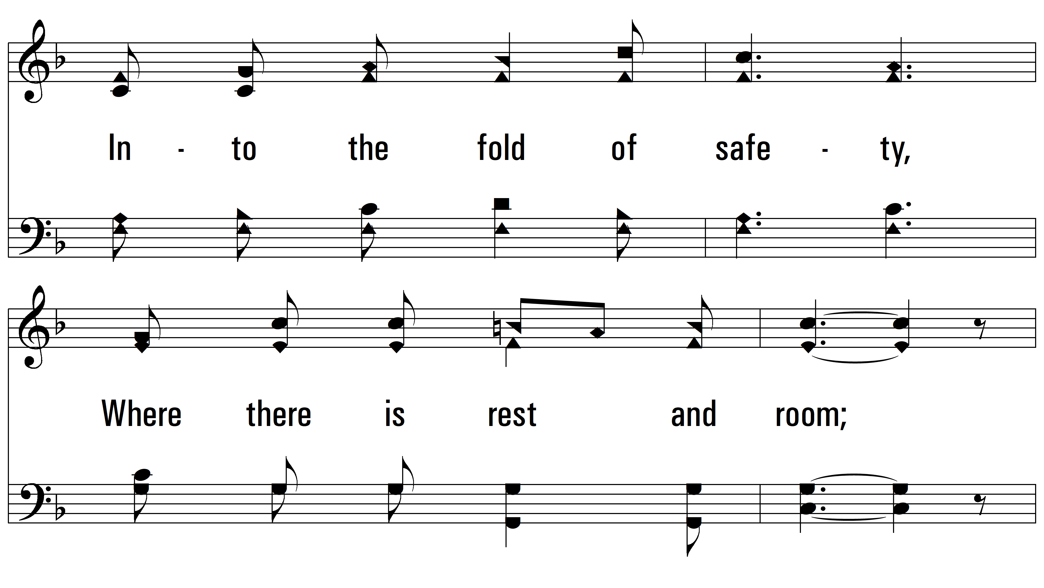
vs. 1

Slide 4
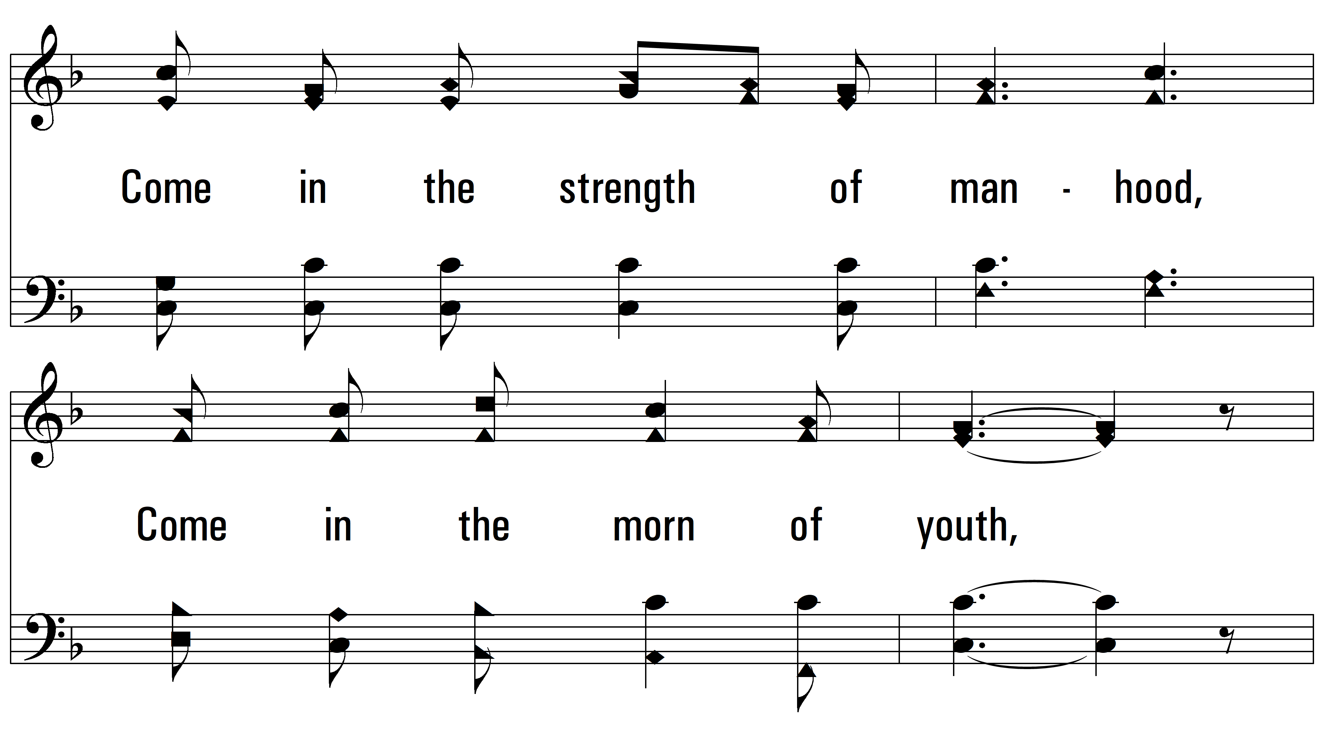
vs. 1

Slide 5
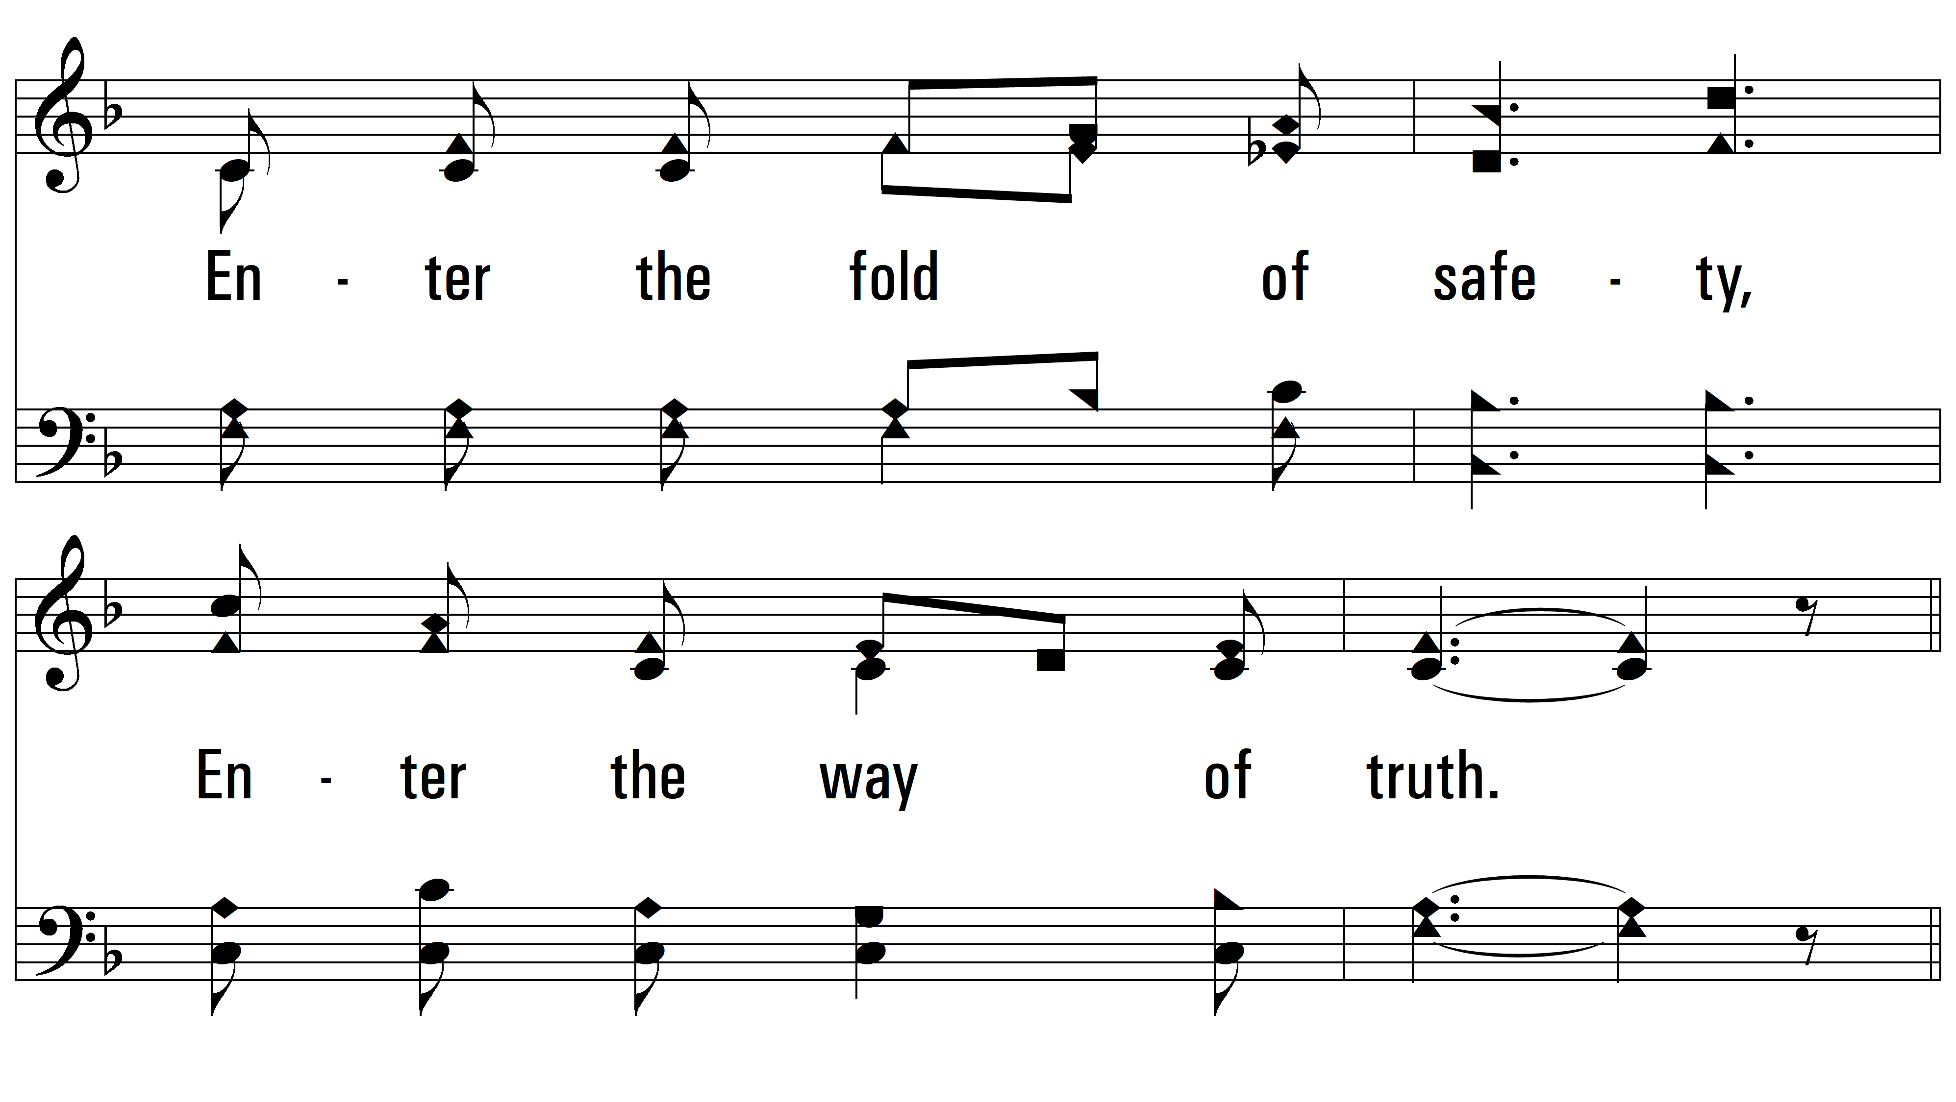
vs. 1

Slide 6
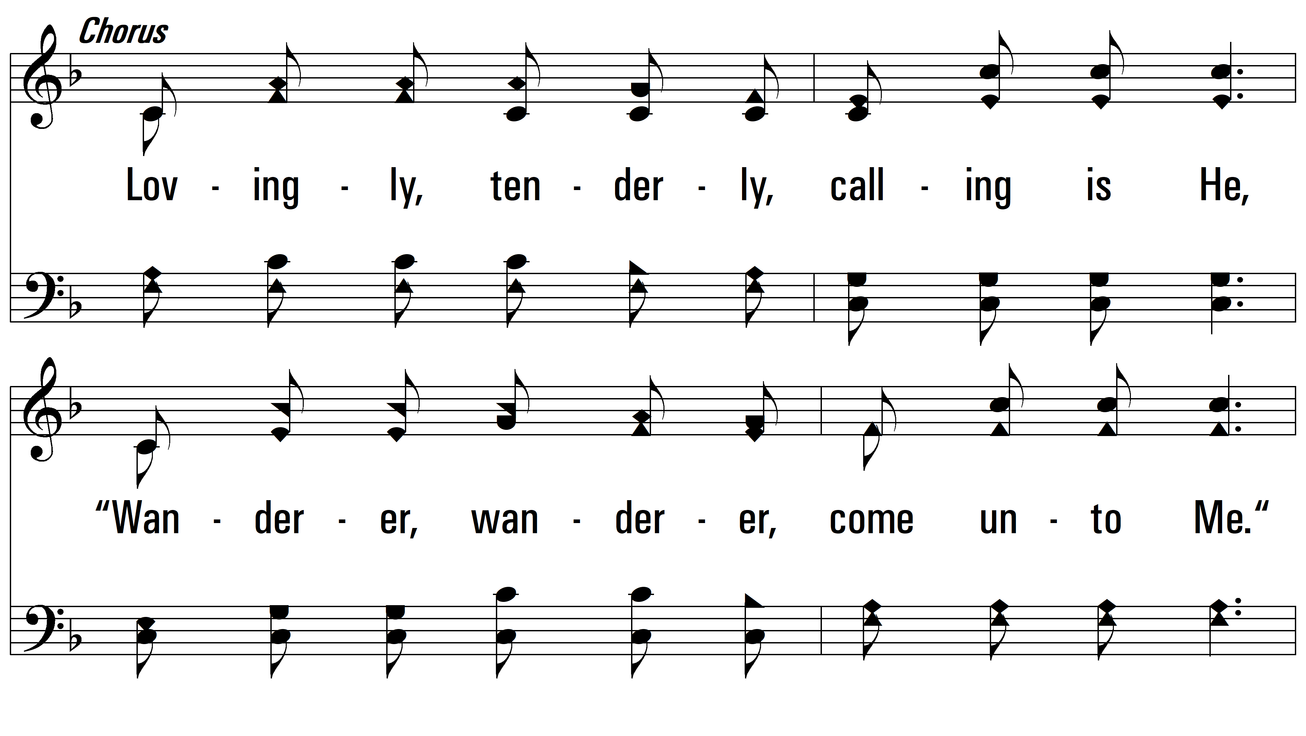
vs. 1

Slide 7
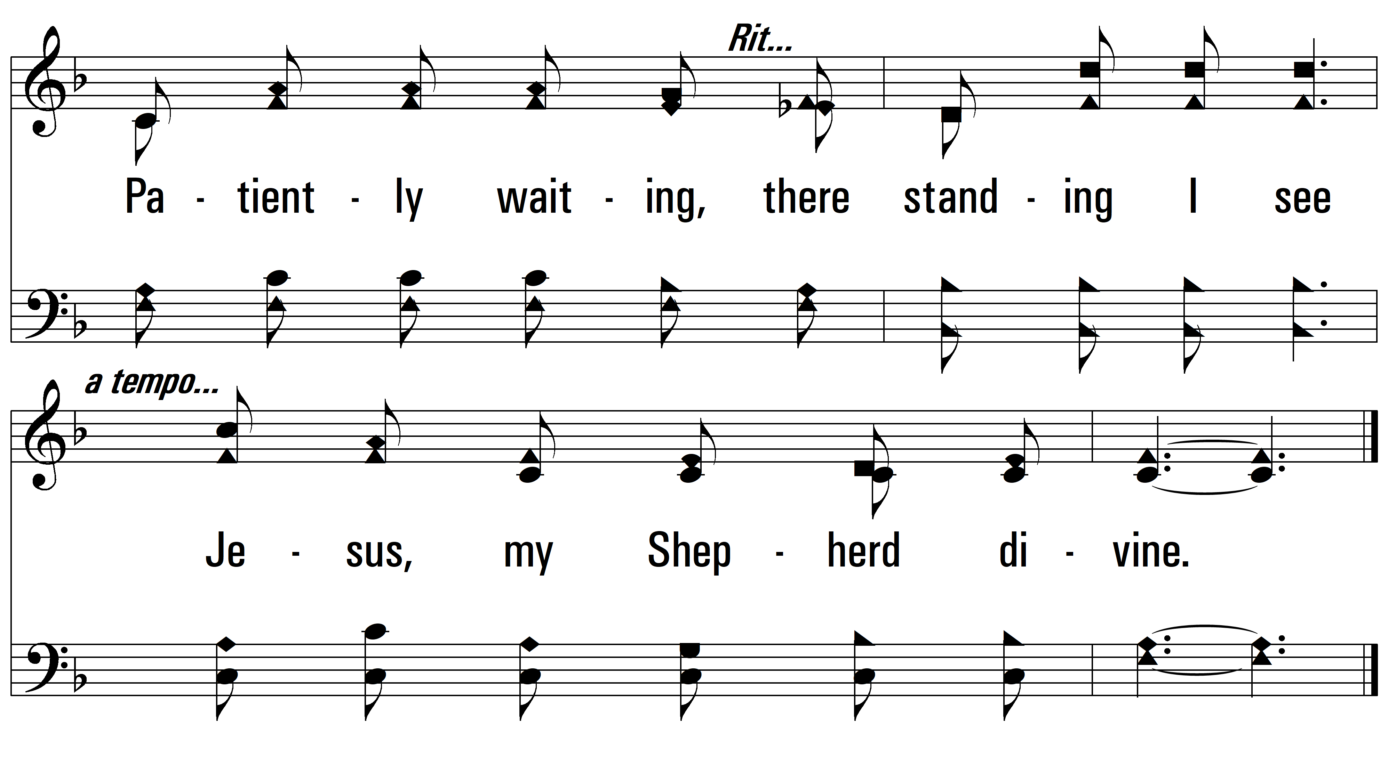
vs. 1

Slide 8
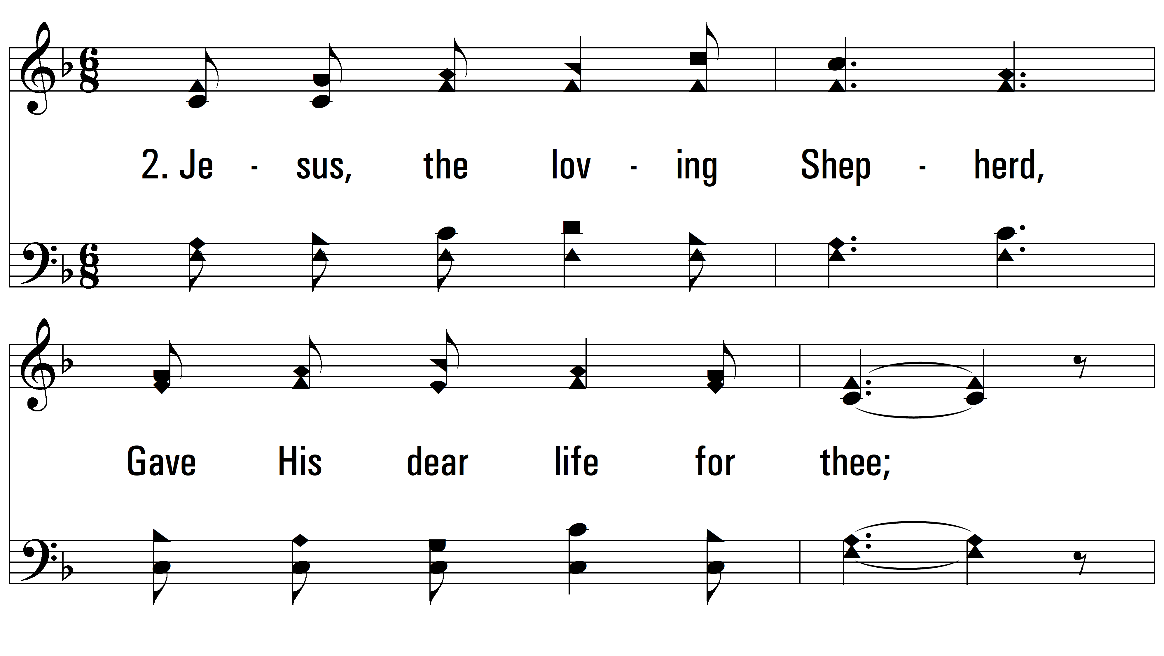
vs. 2 ~ Jesus, The Loving Shepherd

Slide 9
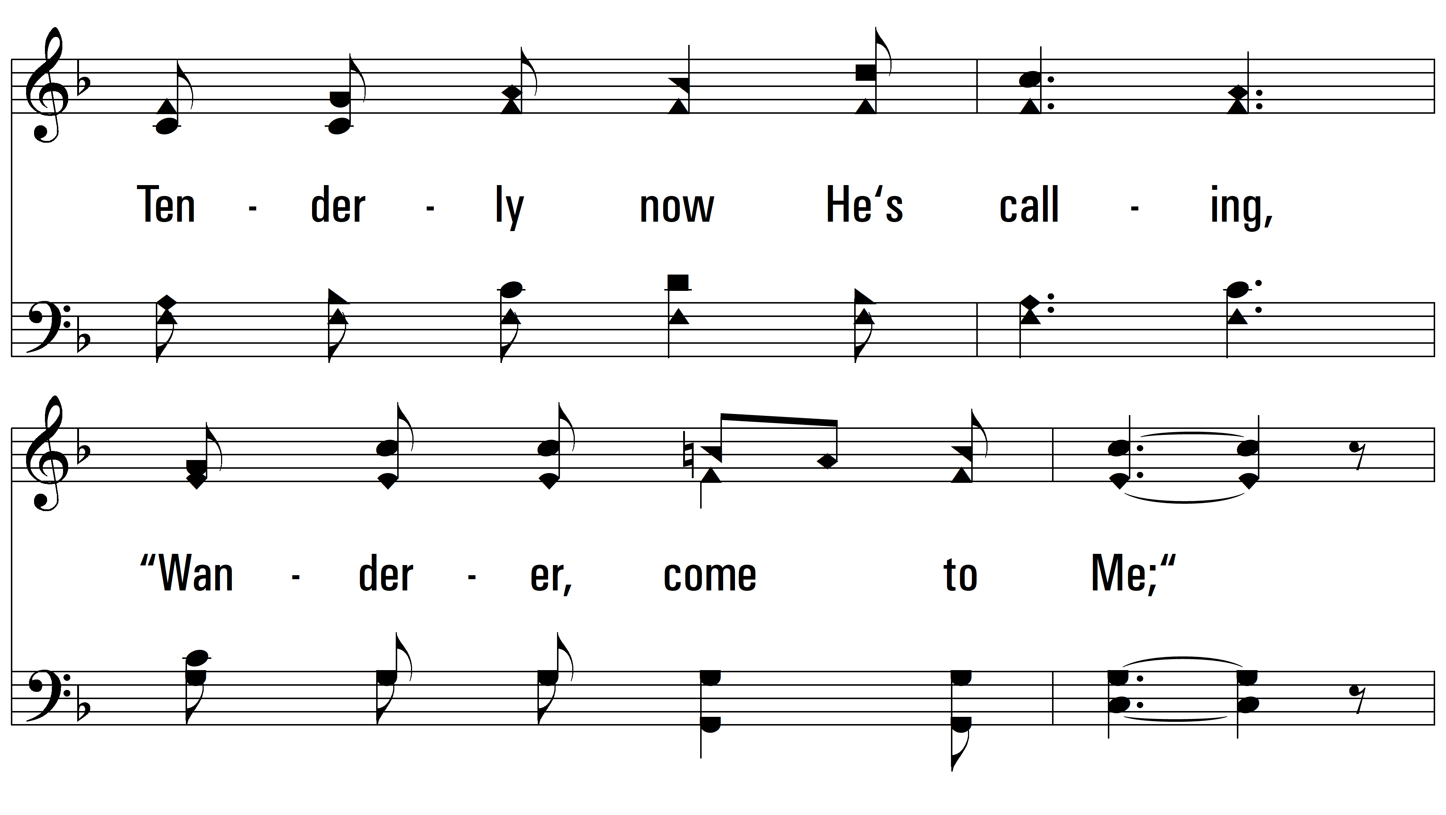
vs. 2

Slide 10
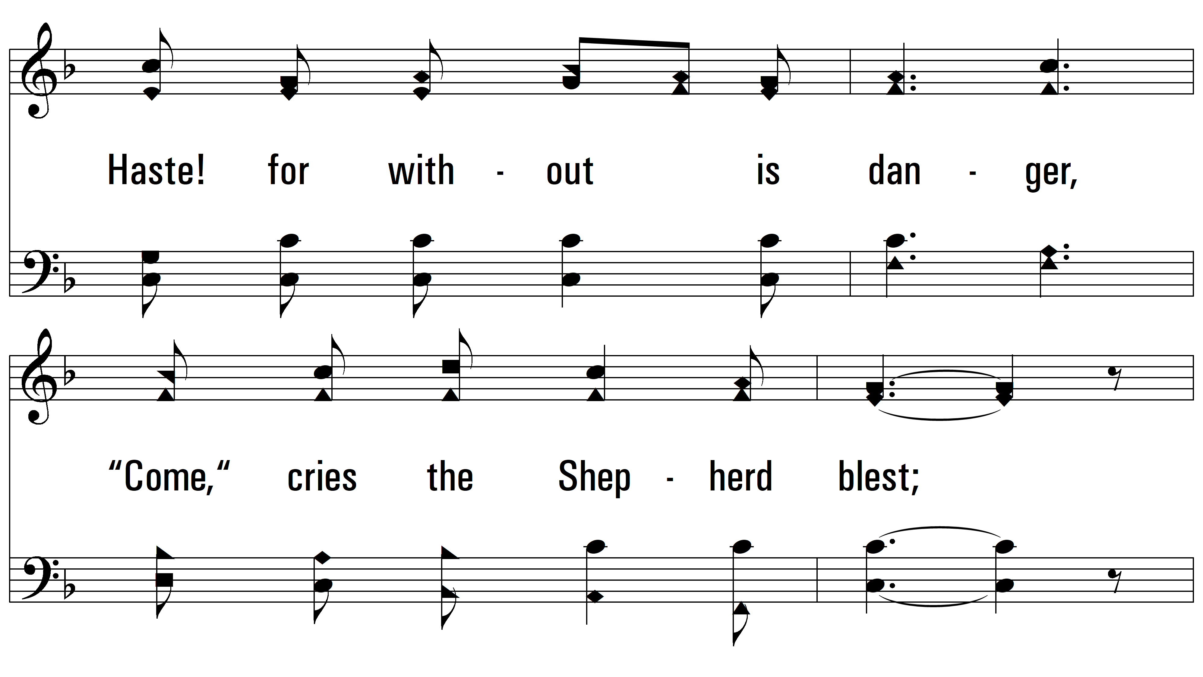
vs. 2

Slide 11
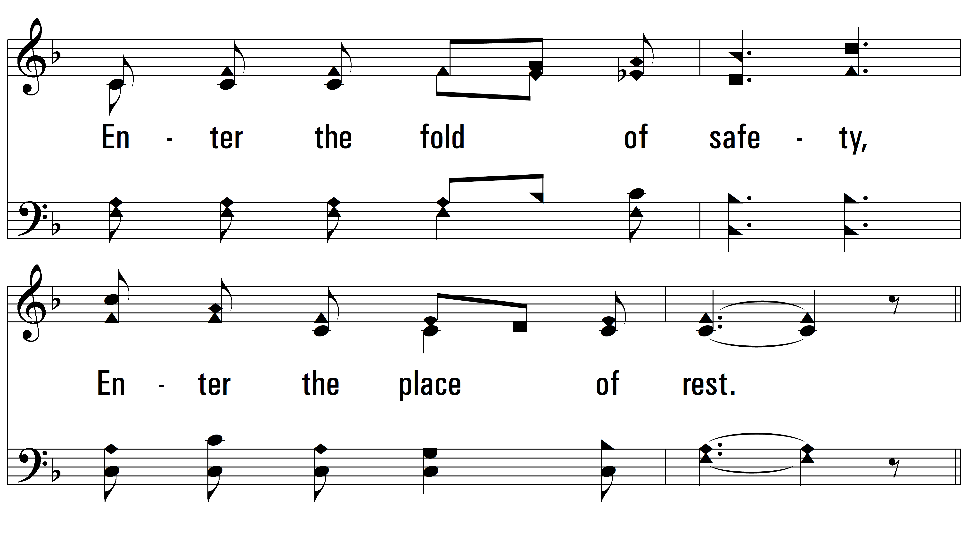
vs. 2

Slide 12
vs. 2

Slide 13
vs. 2

Slide 14
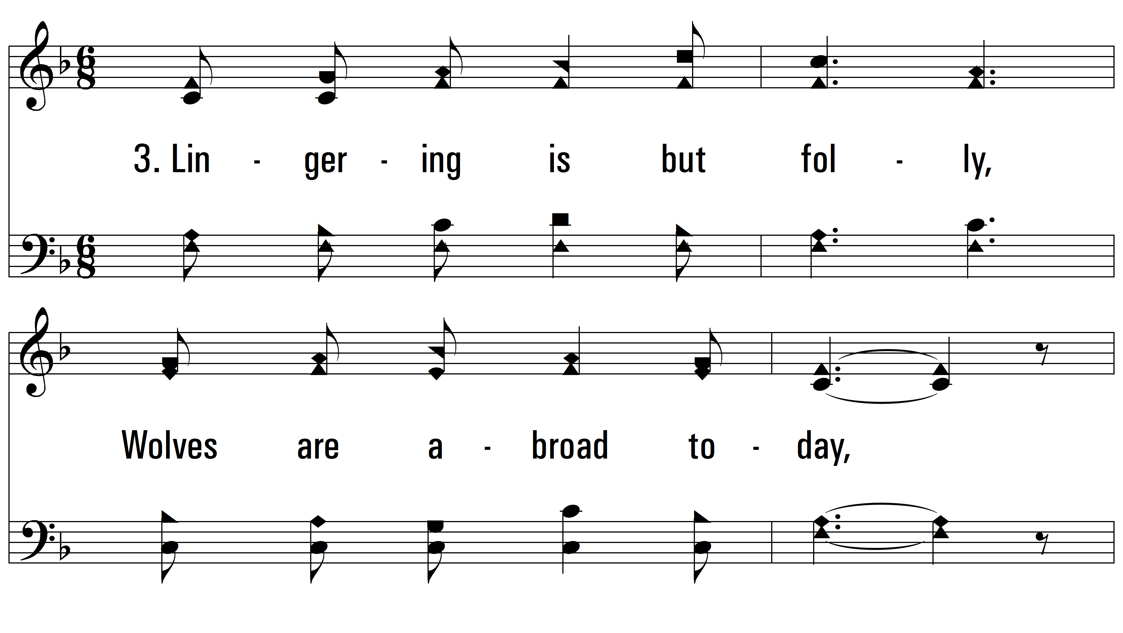
vs. 3 ~ Jesus, The Loving Shepherd

Slide 15
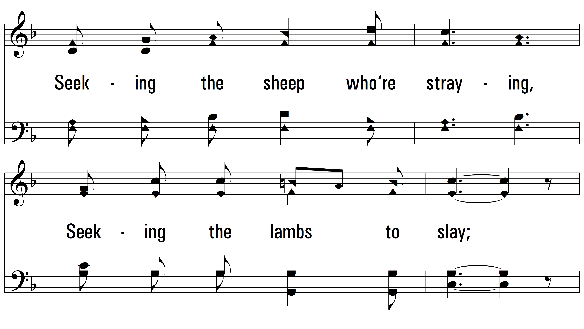
vs. 3

Slide 16
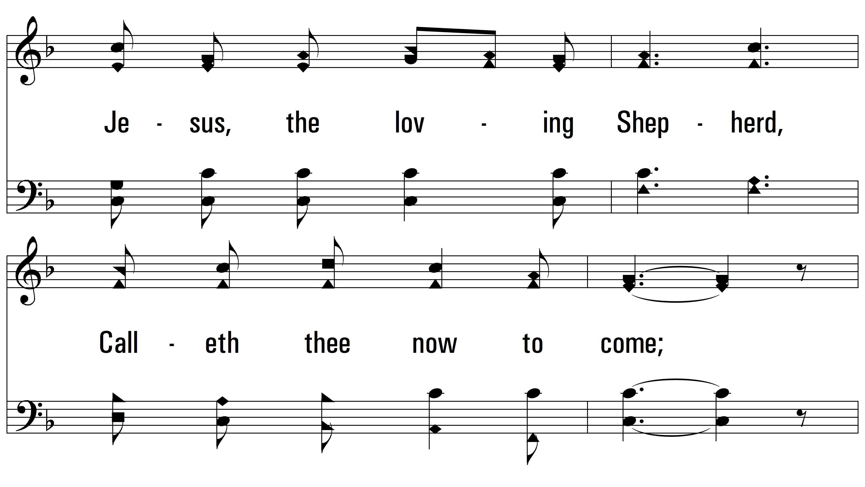
vs. 3

Slide 17
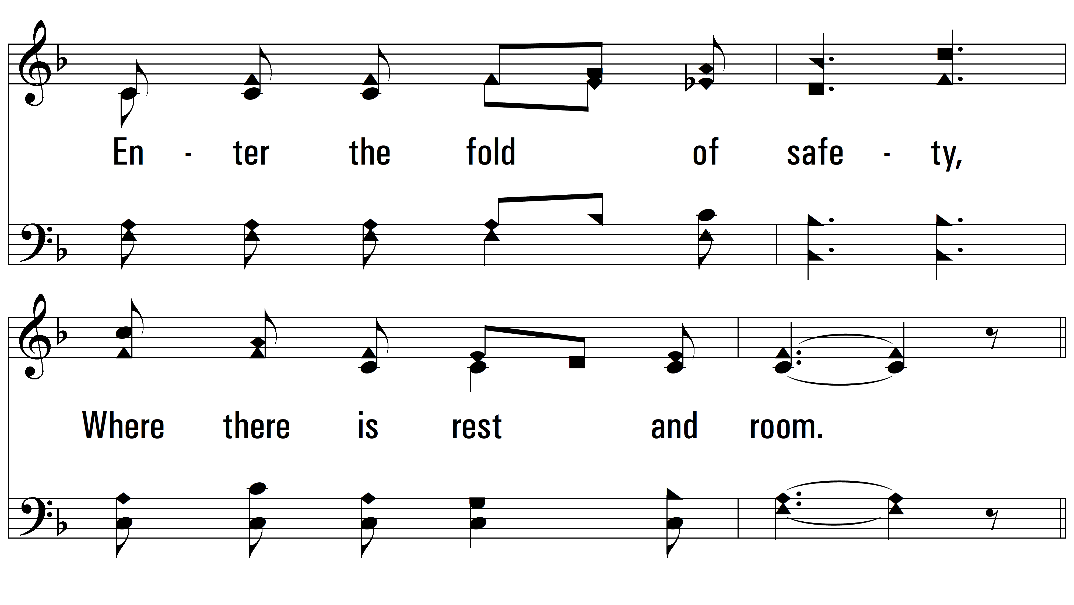
vs. 3

Slide 18
vs. 3

Slide 19
vs. 3
PDHymns.com
END

