Slide 1
Jesus, Savior Pilot Me
PILOT
Words: | Edward Hopper (1871)
Music: | John E. Gould (1871)
3/4
B^{b}/D - MI
Verses: 4
Lead - | MI
Alto - | SOL
Tenor - | DO
Bass - | DO
PDHymns.com

Slide 2
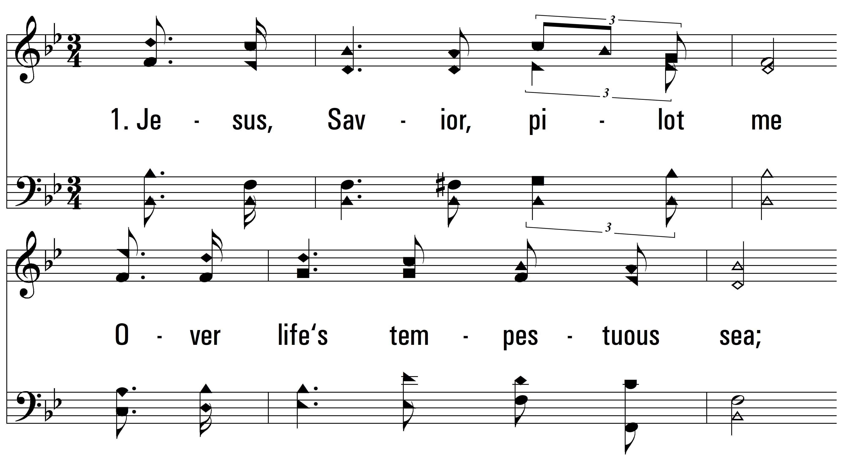
vs. 1 ~ Jesus, Savior Pilot Me

Slide 3
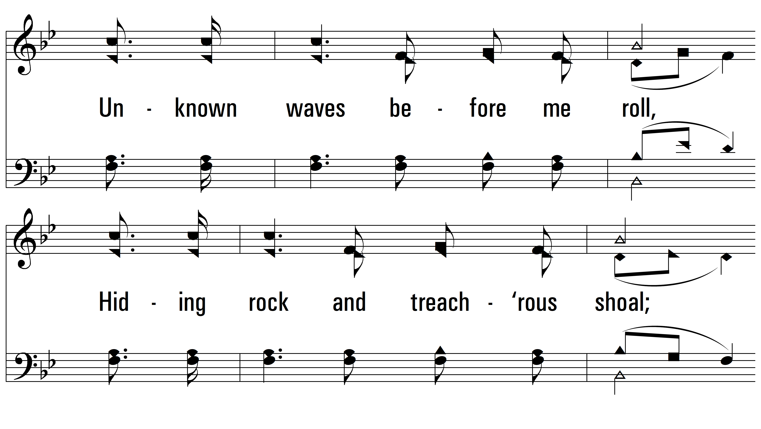
vs. 1

Slide 4
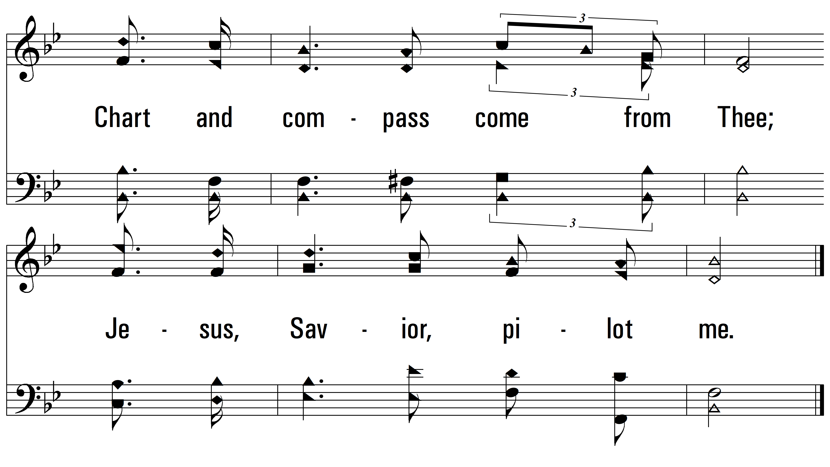
vs. 1

Slide 5
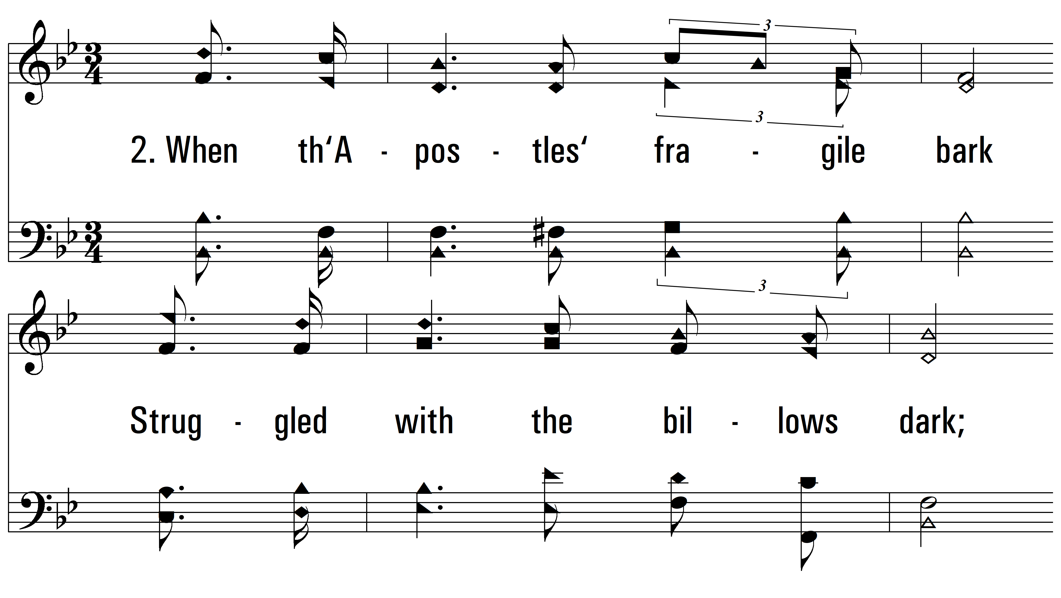
vs. 2 ~ Jesus, Savior Pilot Me

Slide 6
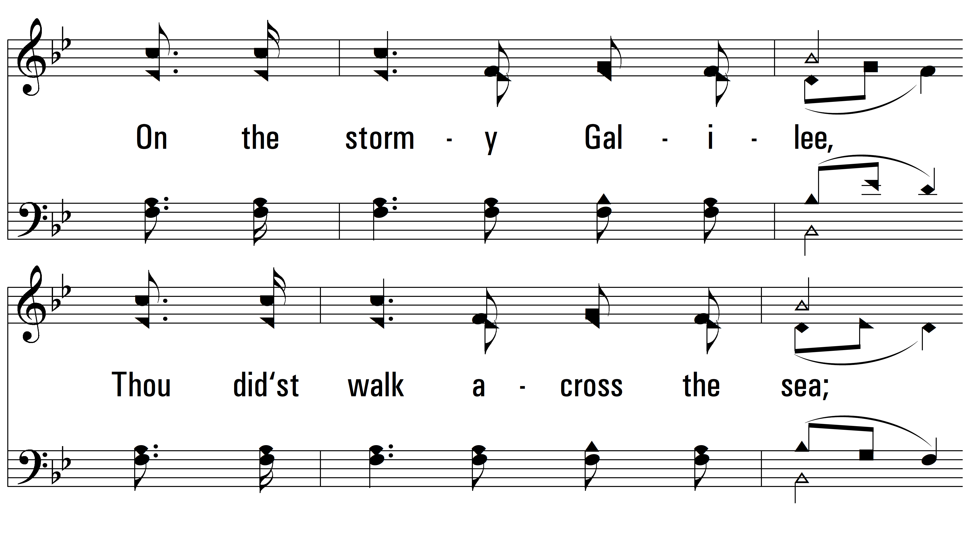
vs. 2

Slide 7
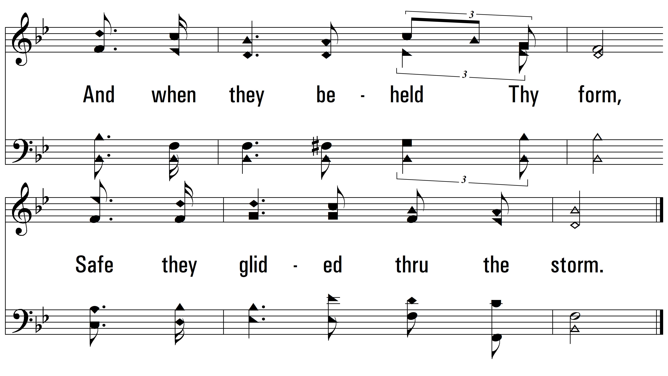
vs. 2

Slide 8
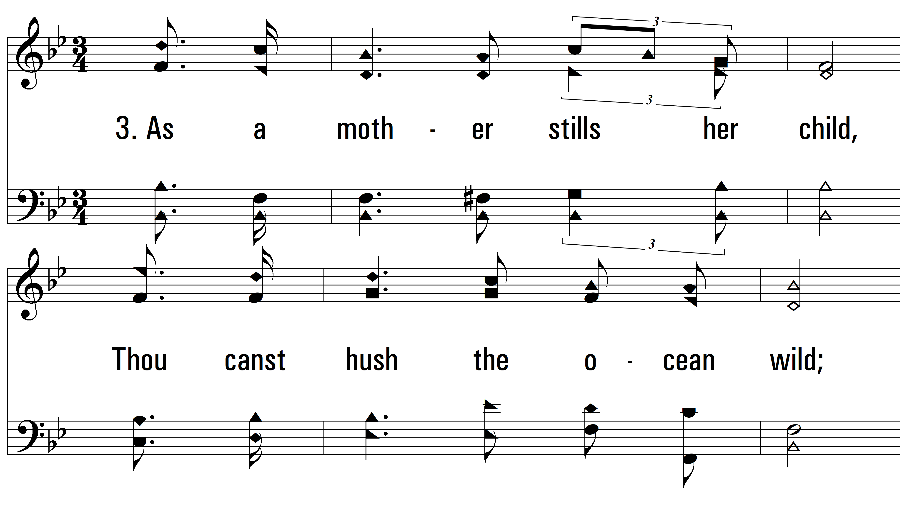
vs. 3 ~ Jesus, Savior Pilot Me

Slide 9
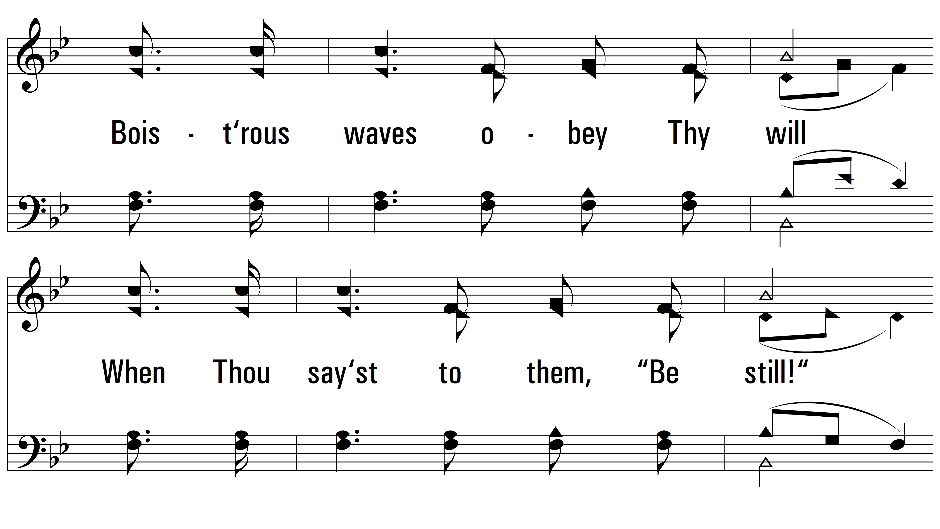
vs. 3

Slide 10
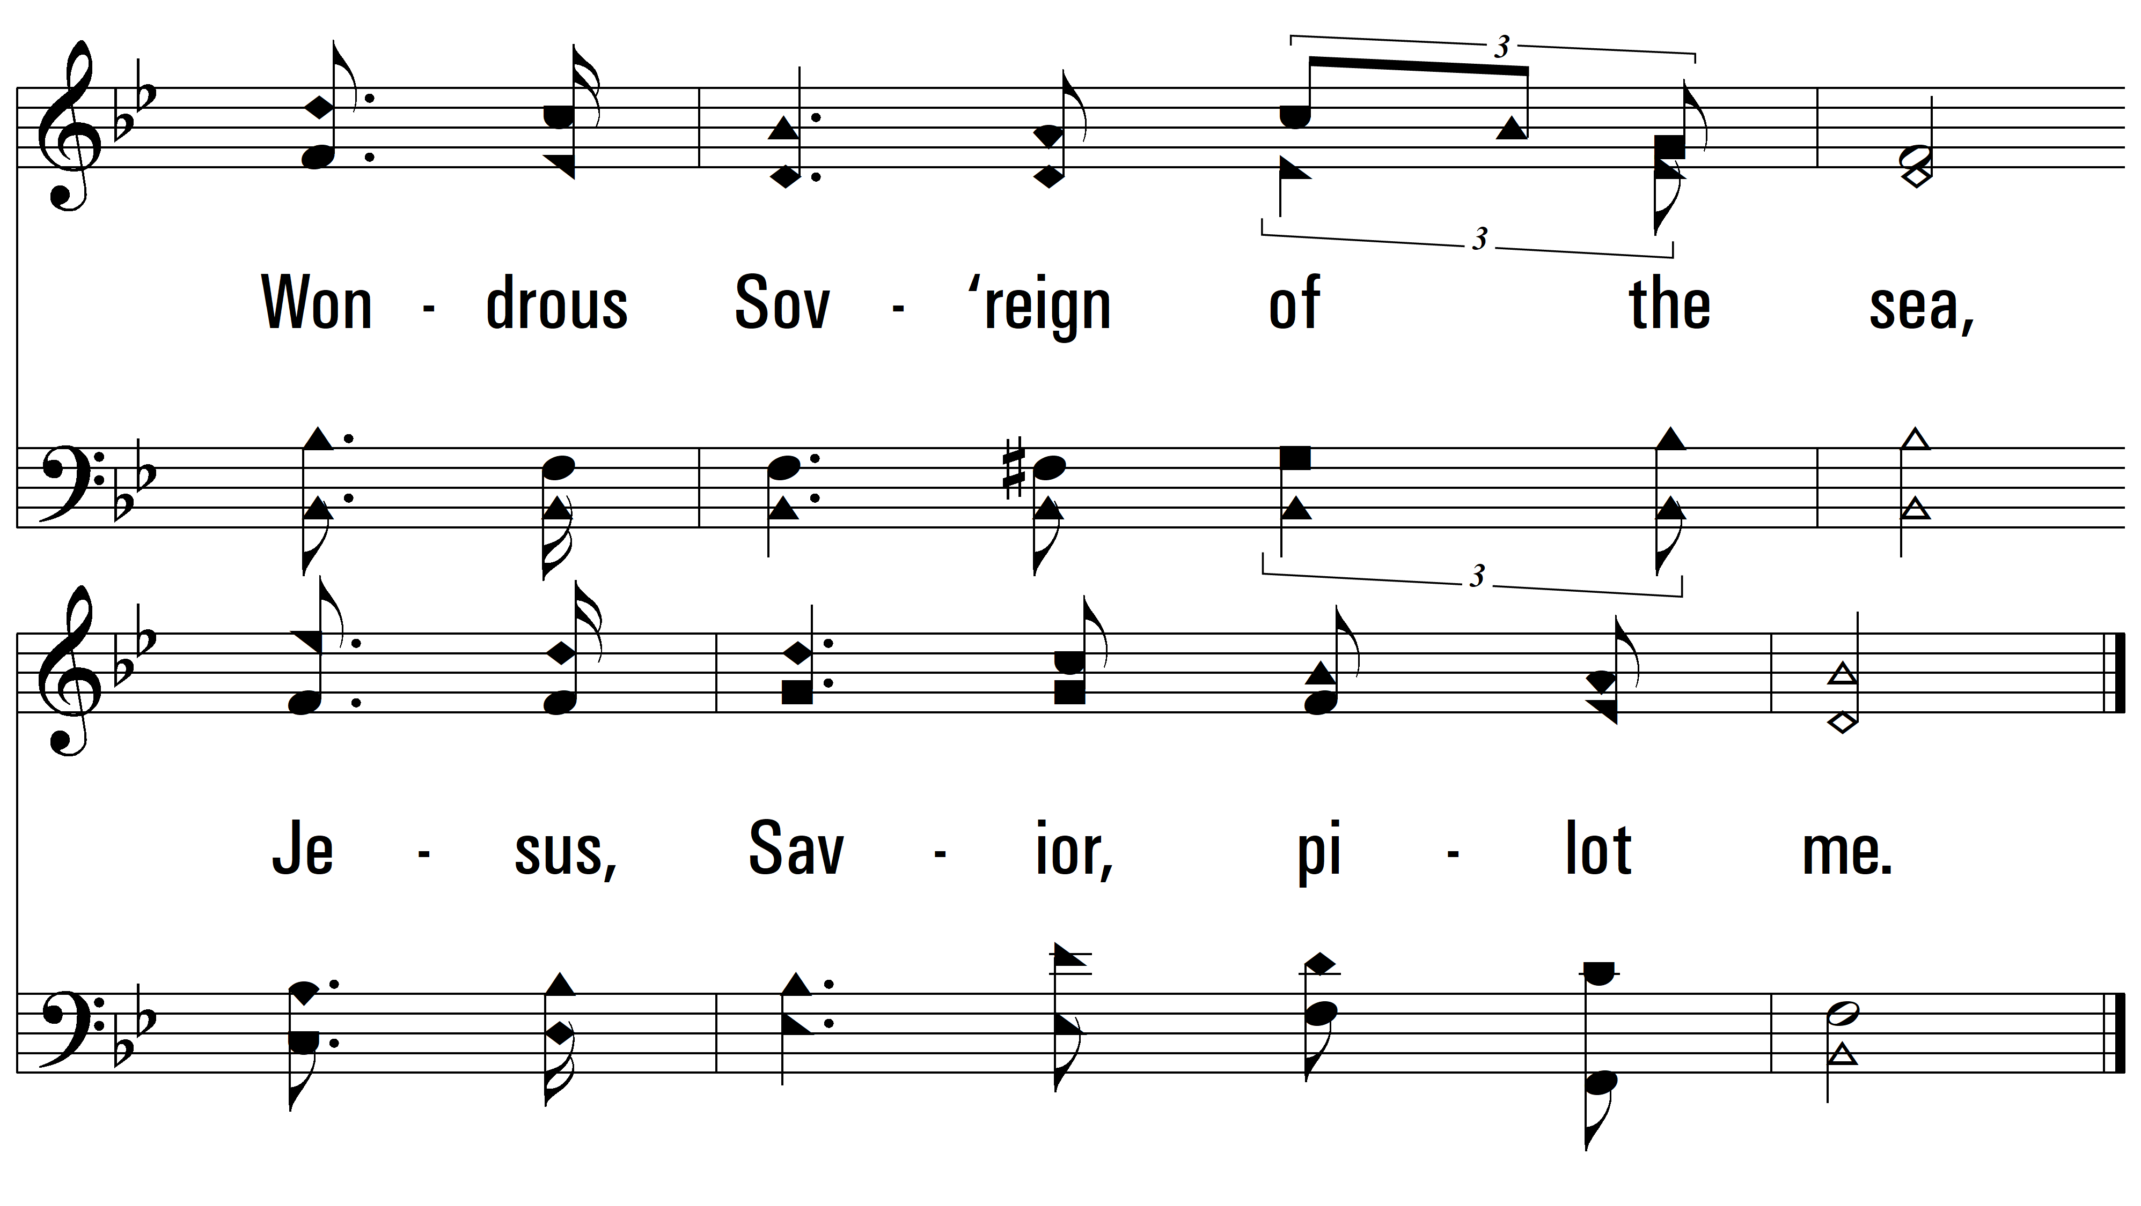
vs. 3

Slide 11
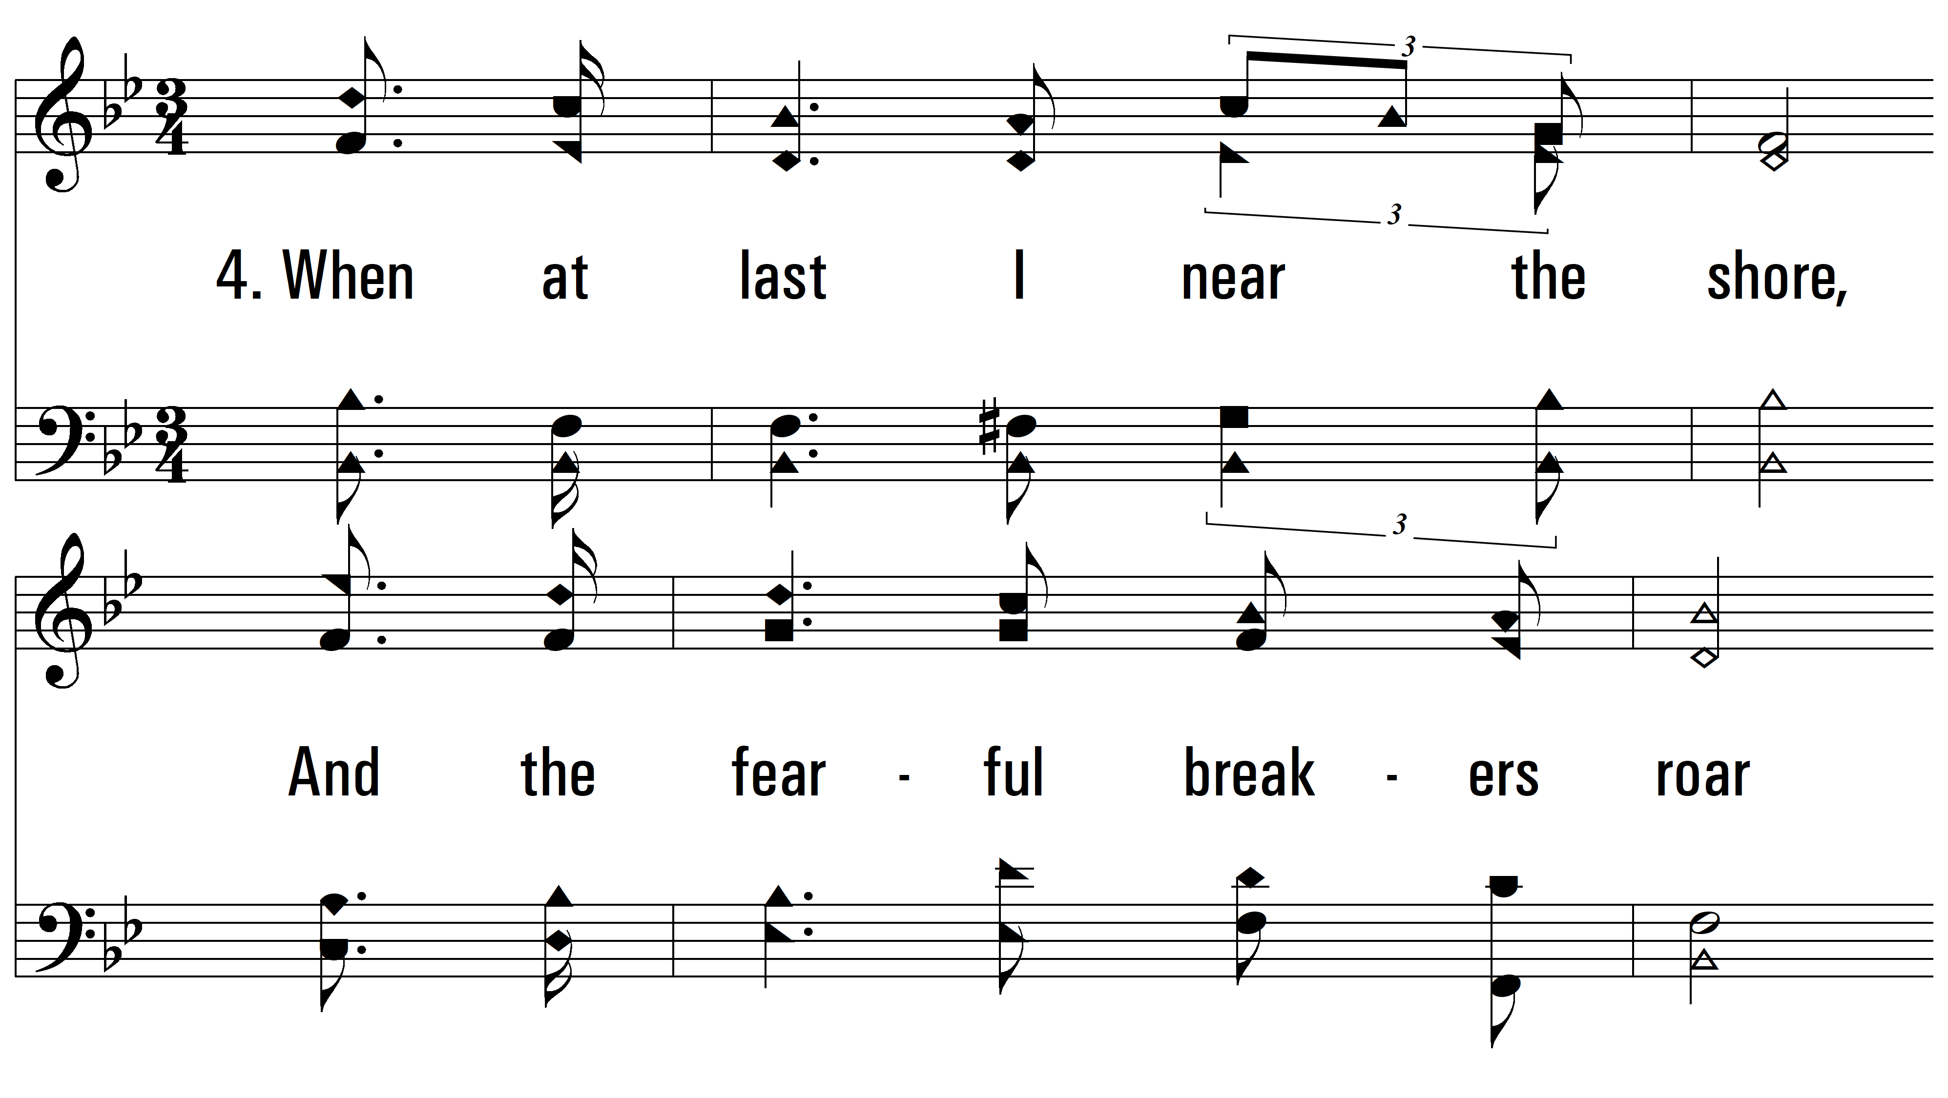
vs. 4 ~ Jesus, Savior Pilot Me

Slide 12
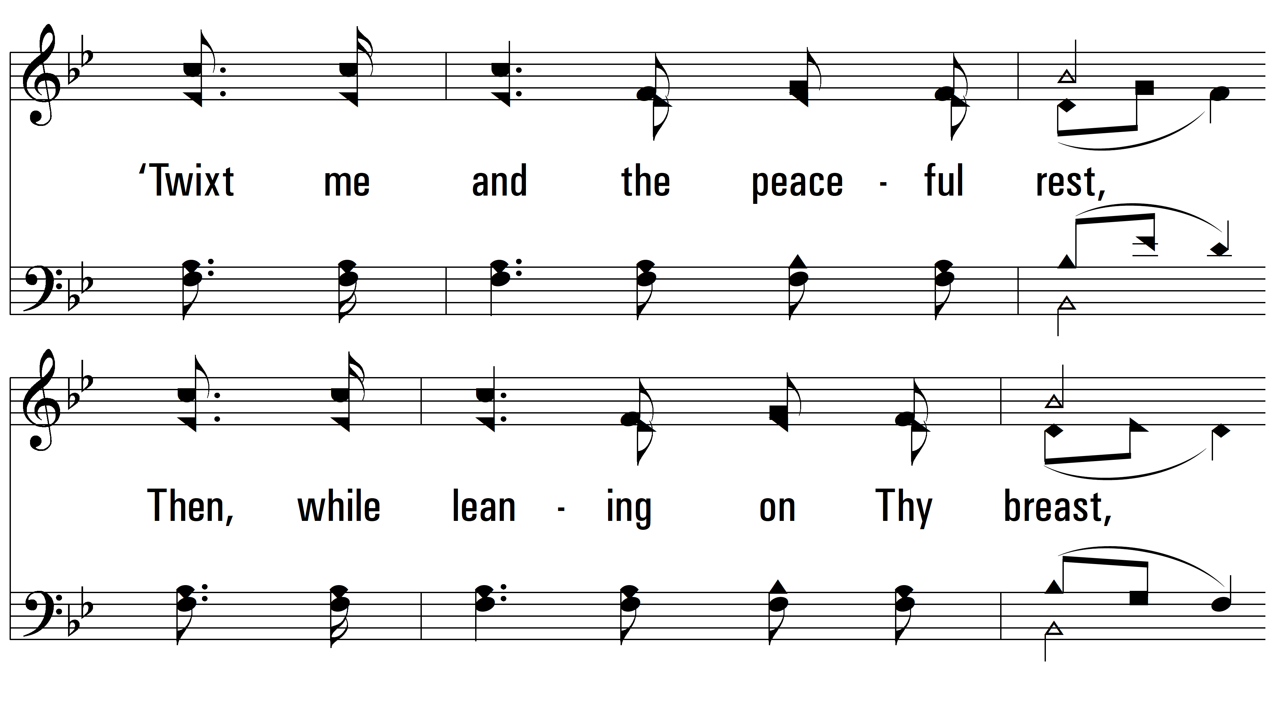
vs. 4

Slide 13
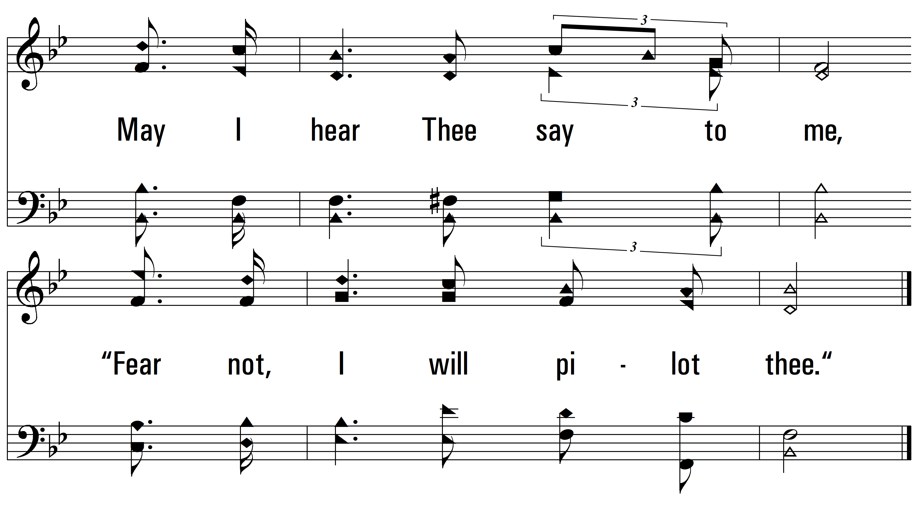
vs. 4
PDHymns.com
END

