Slide 1
Jesus Saves!
(We Have Heard The Joyful Sound)
Words: | Priscilla J. Owens (1882)
Music: | William J. Kirkpatrick (1882)
3/4
G/D - SOL
Verses: 4
Lead - | SOL
Alto - | MI
Tenor - | DO
Bass - | DO
PDHymns.com

Slide 2
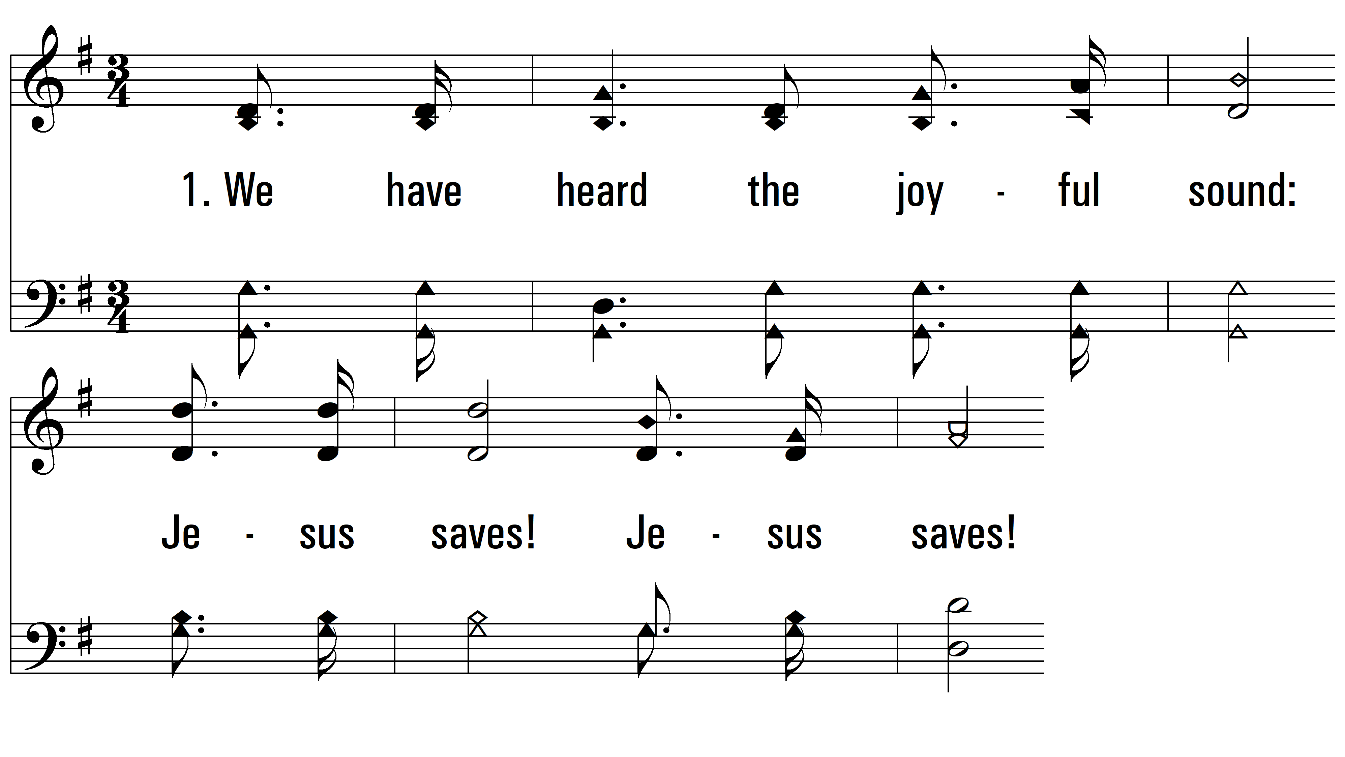
vs. 1 ~ Jesus Saves!

Slide 3
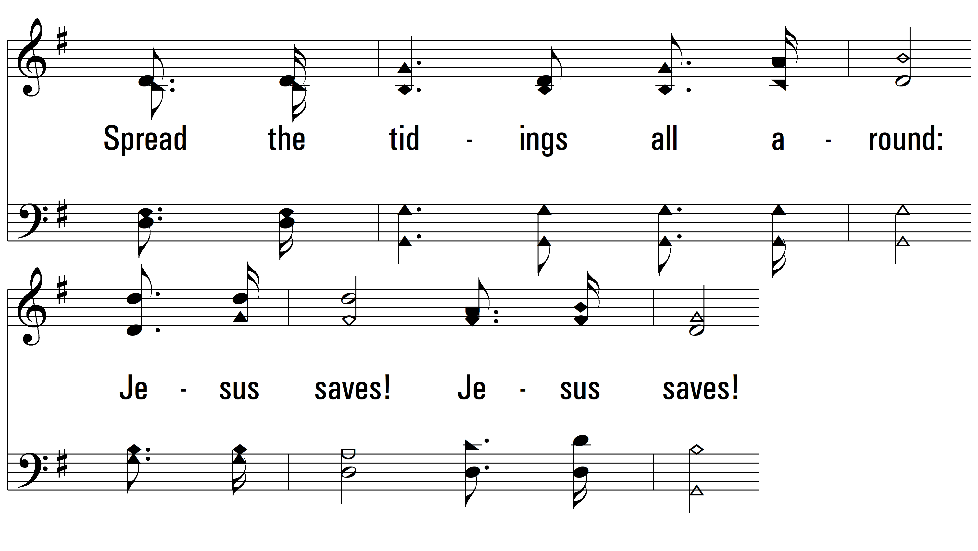
vs. 1

Slide 4
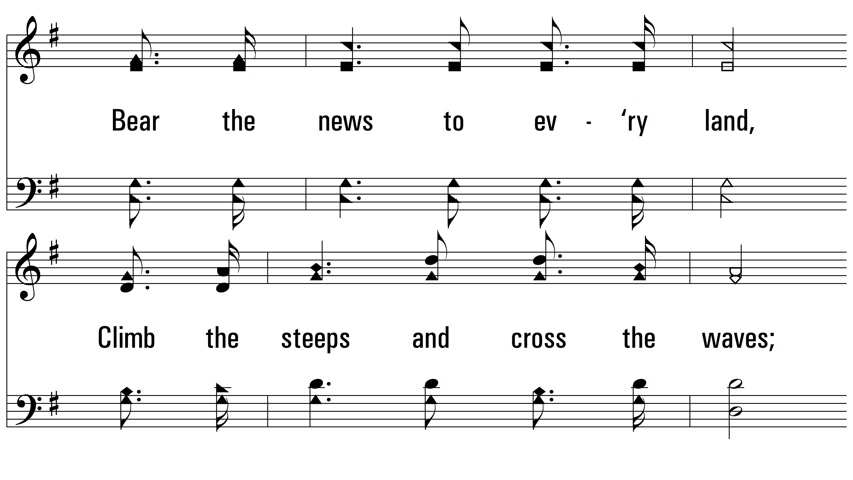
vs. 1

Slide 5
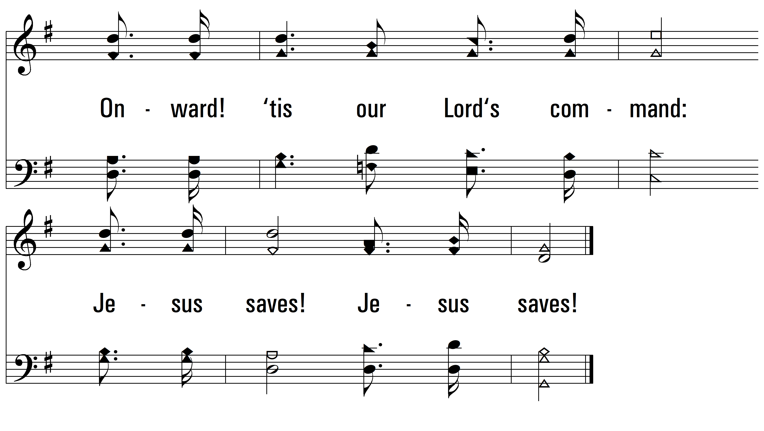
vs. 1

Slide 6
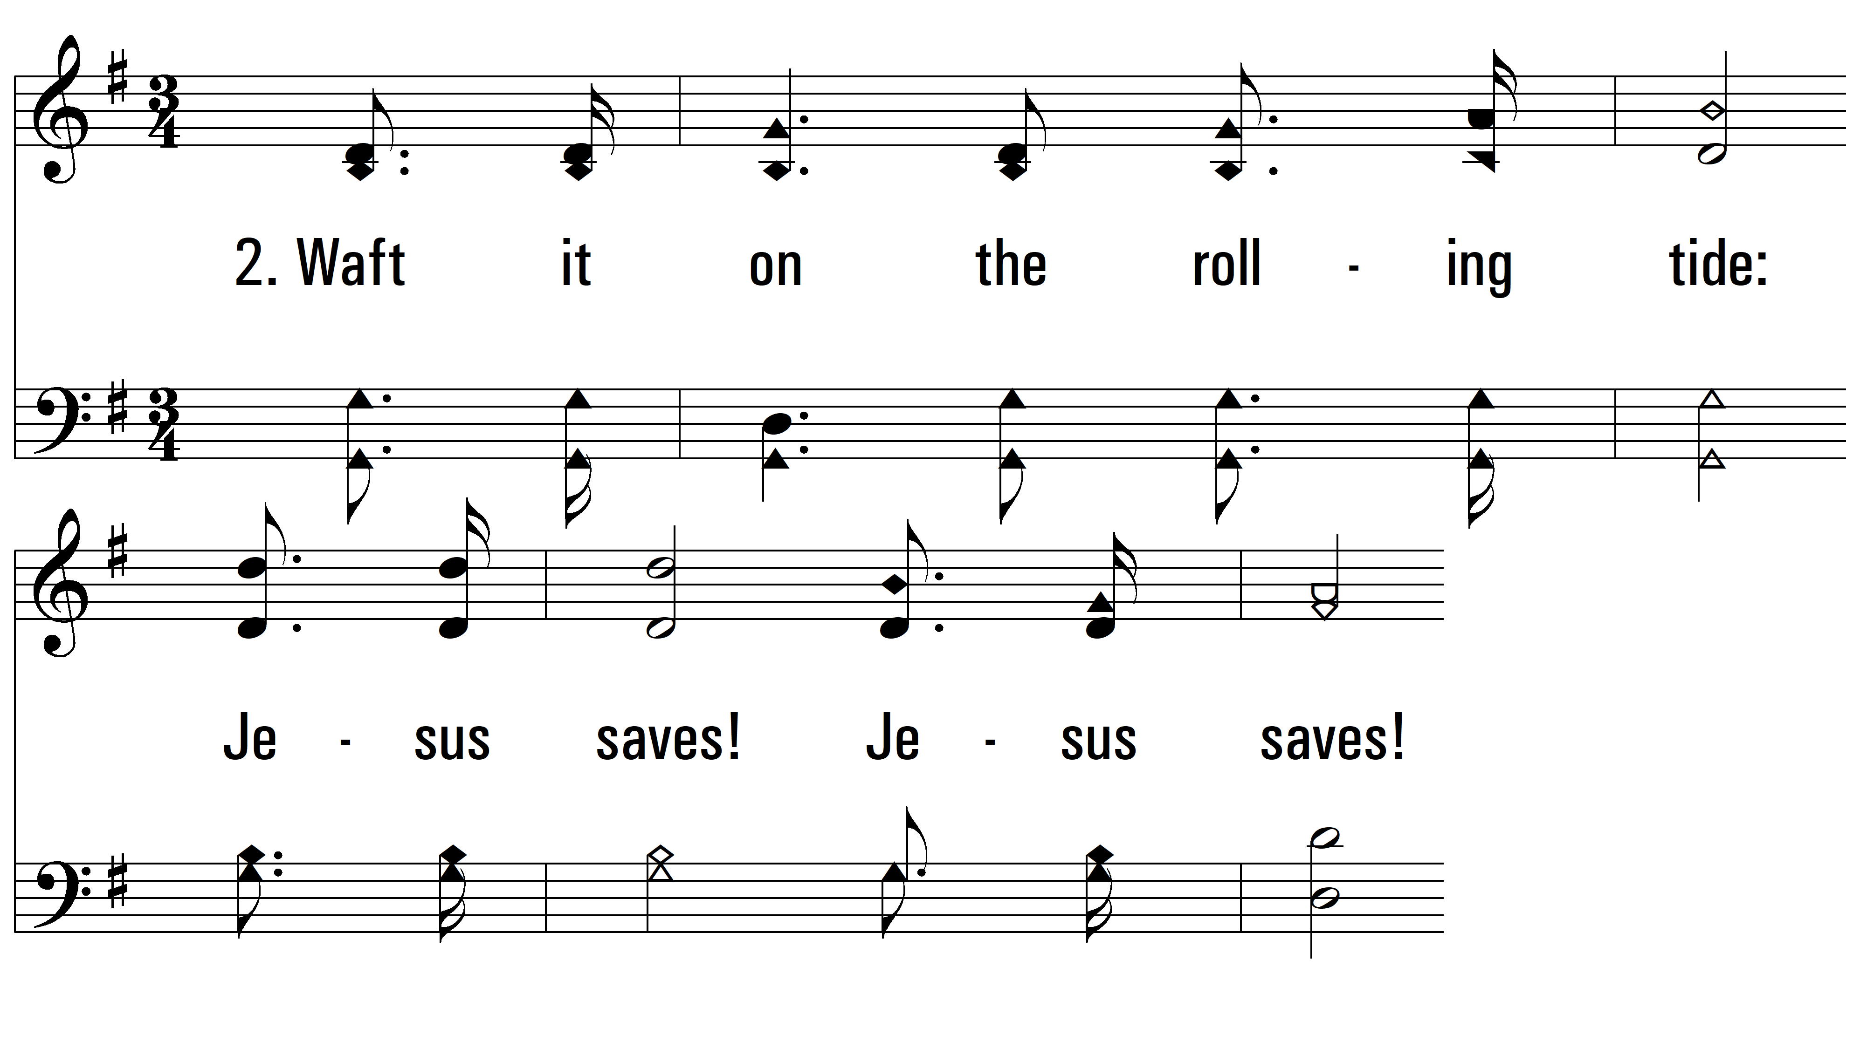
vs. 2 ~ Jesus Saves!

Slide 7
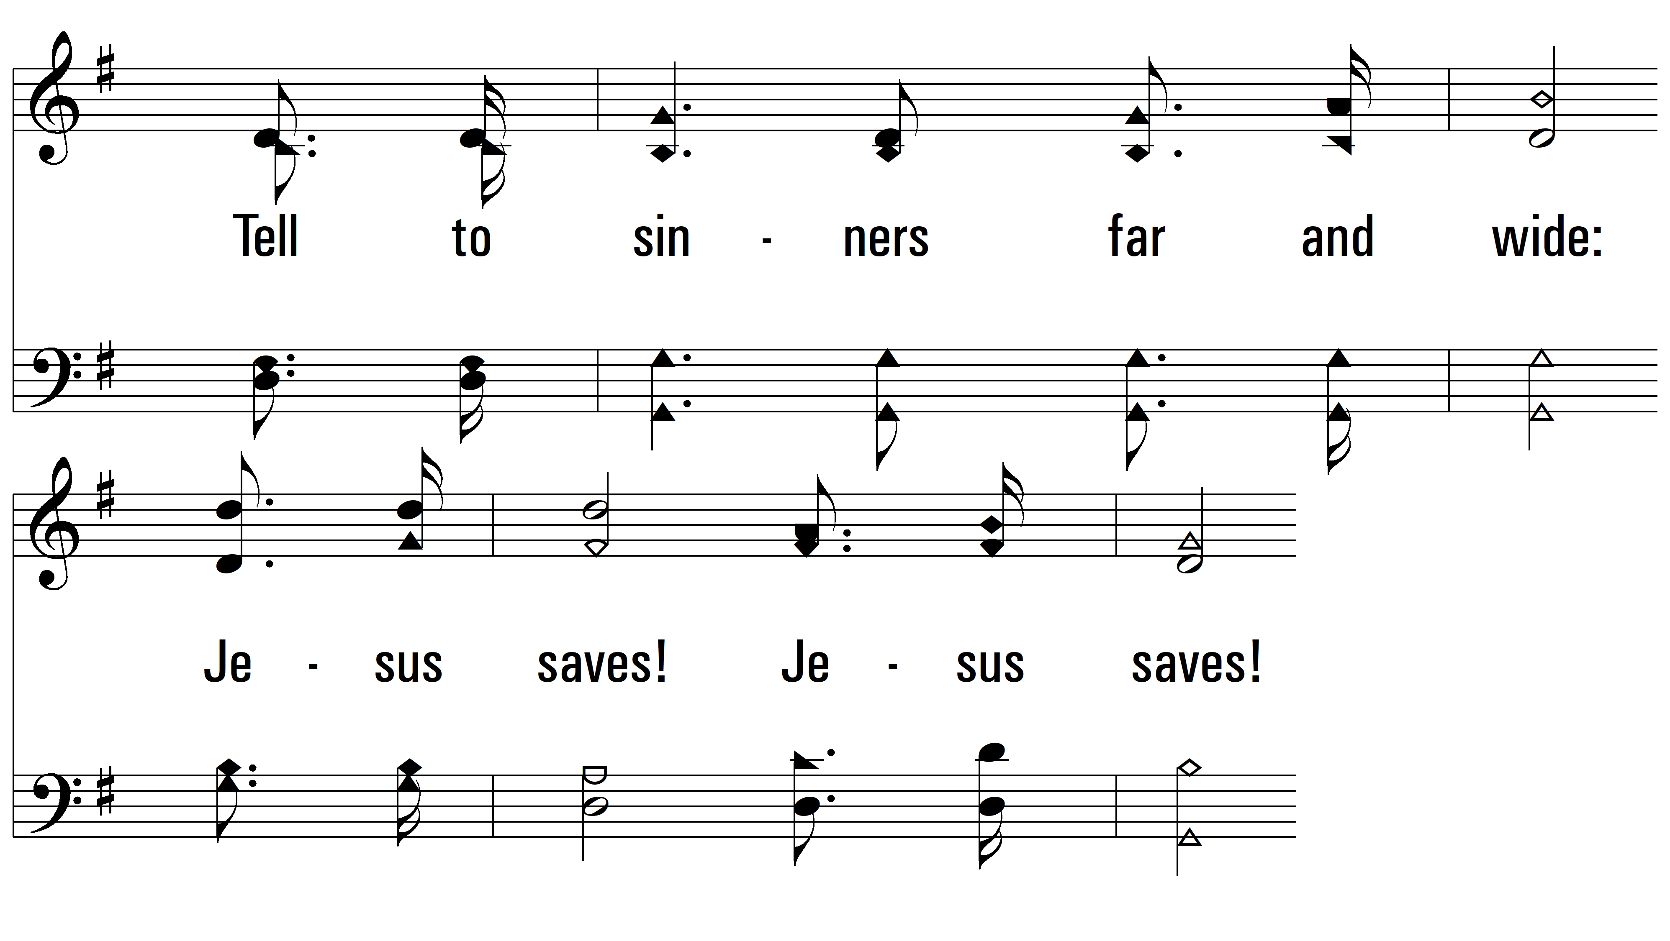
vs. 2

Slide 8
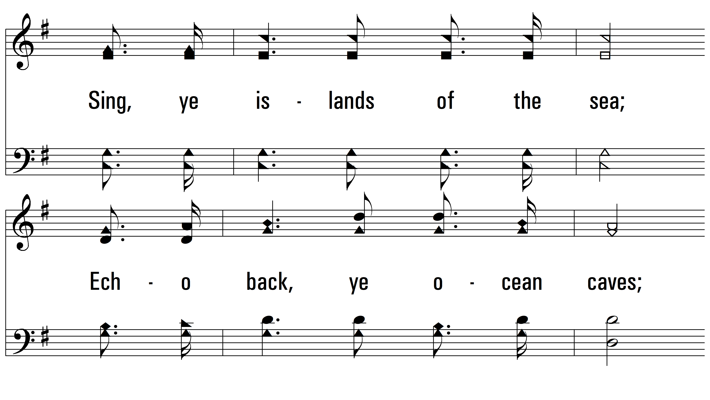
vs. 2

Slide 9
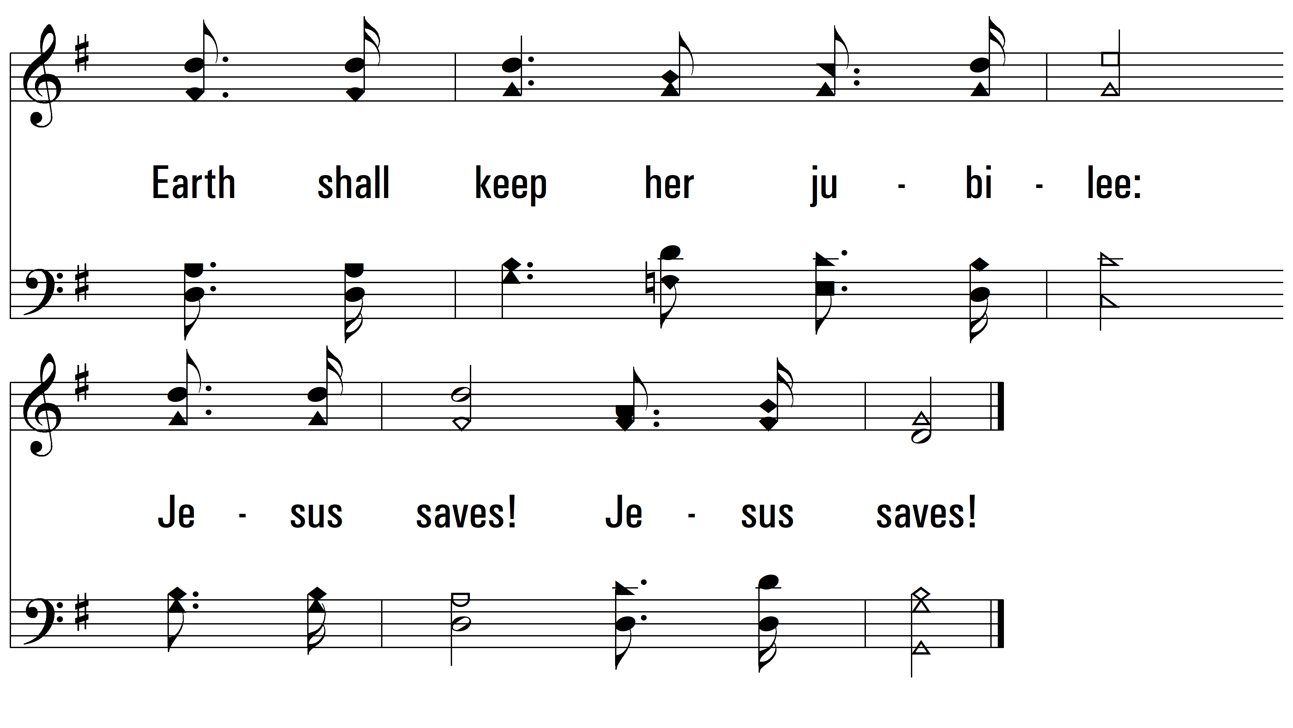
vs. 2

Slide 10
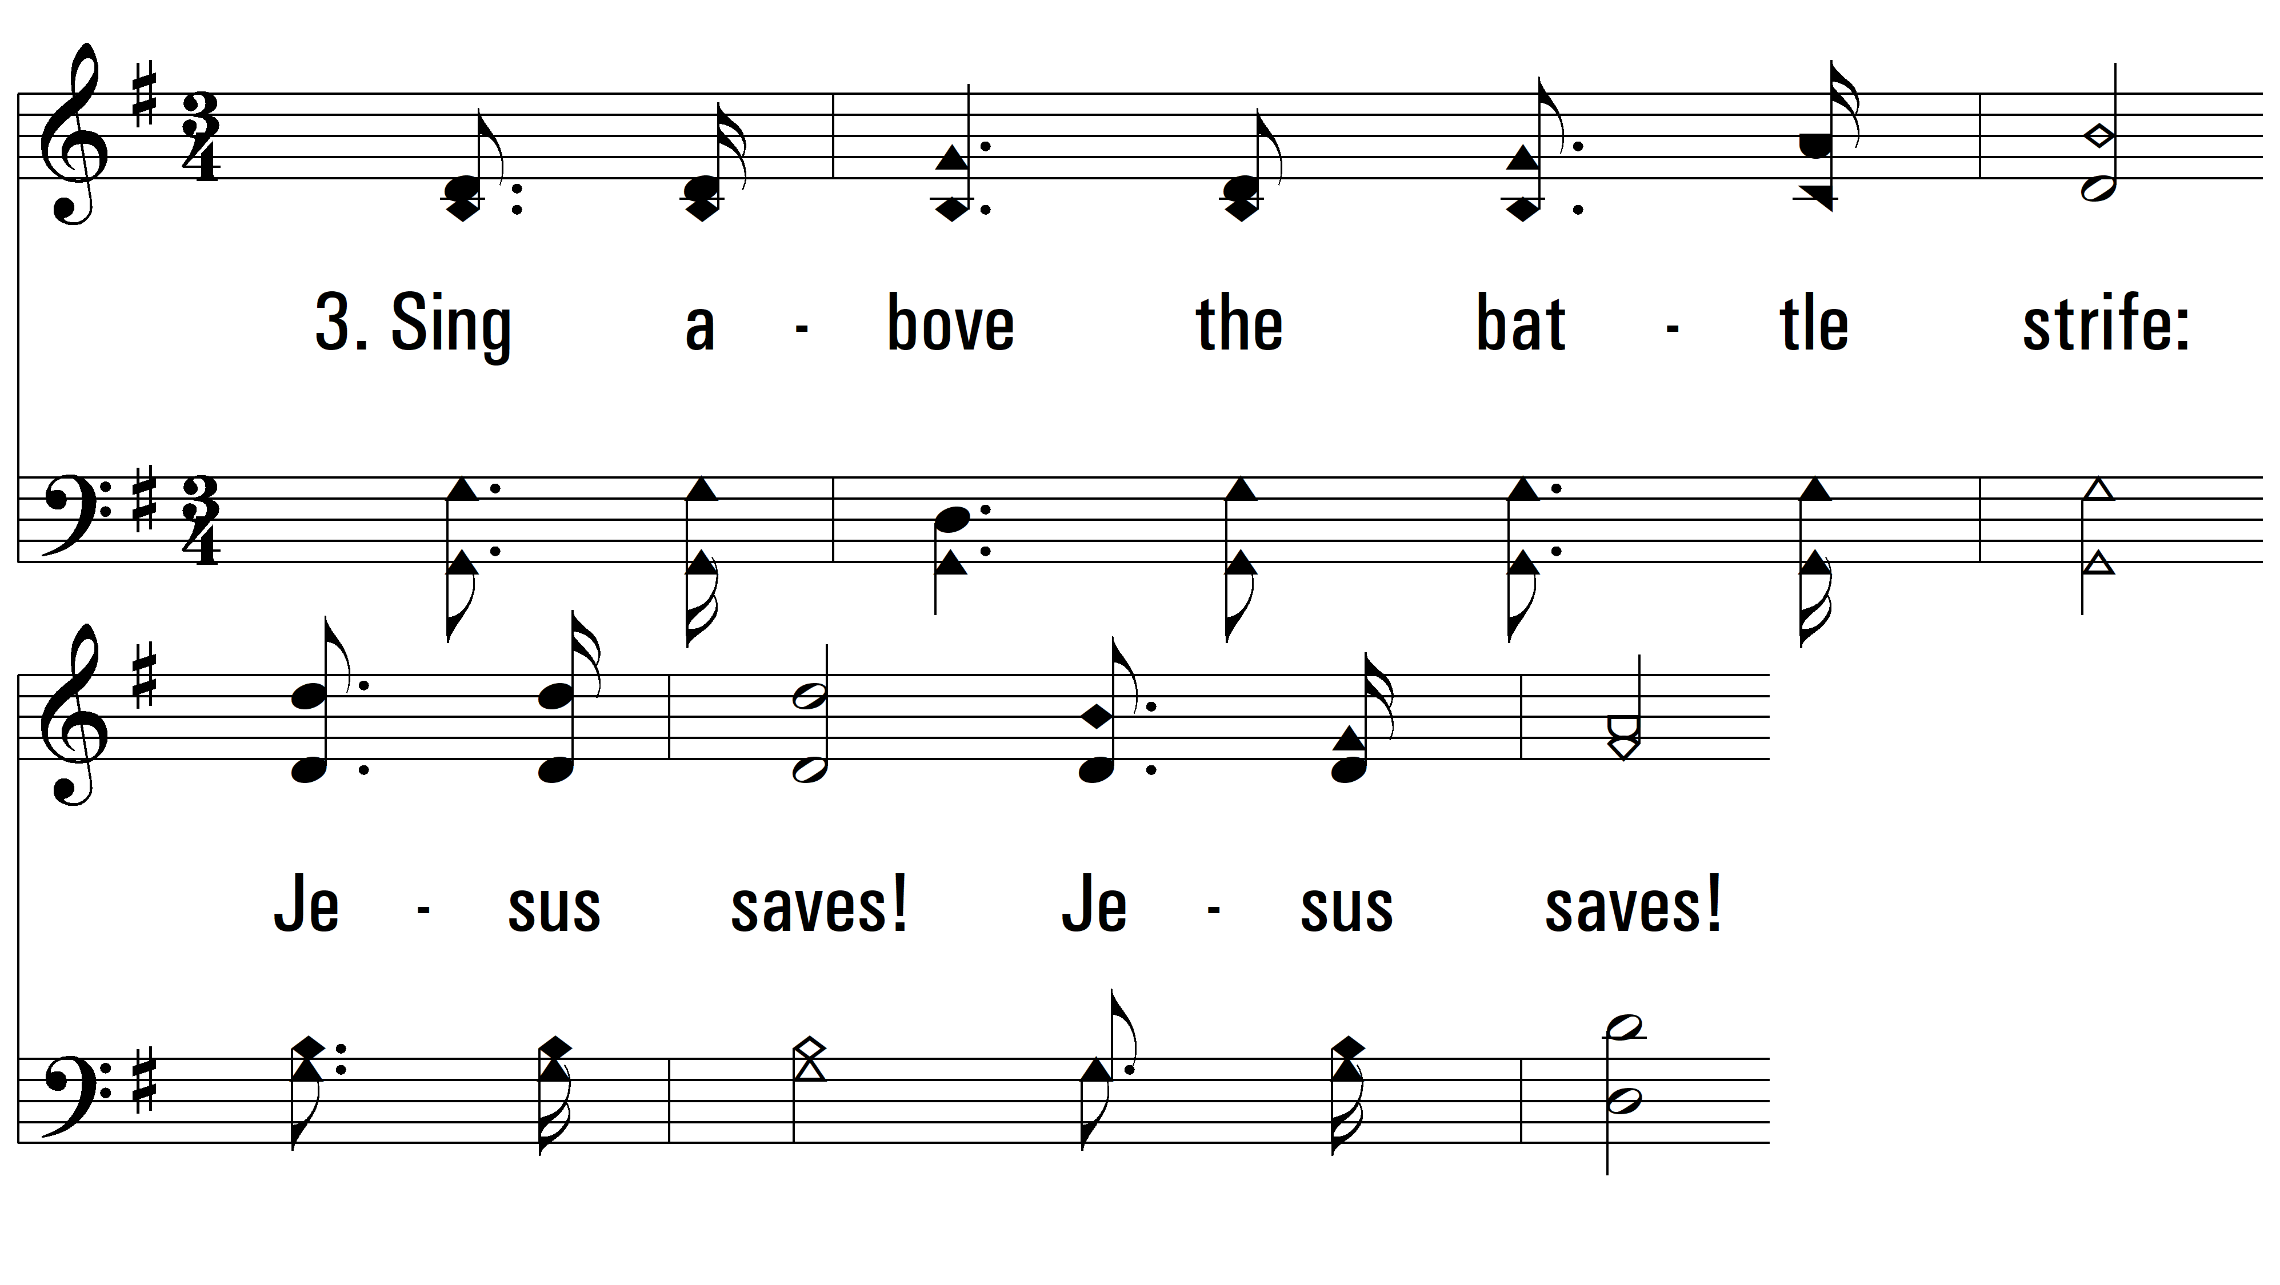
vs. 3 ~ Jesus Saves!

Slide 11
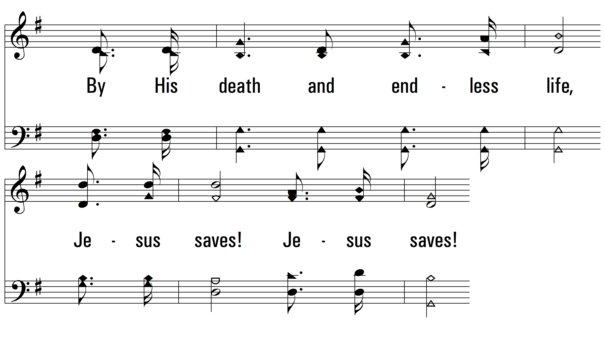
vs. 3

Slide 12
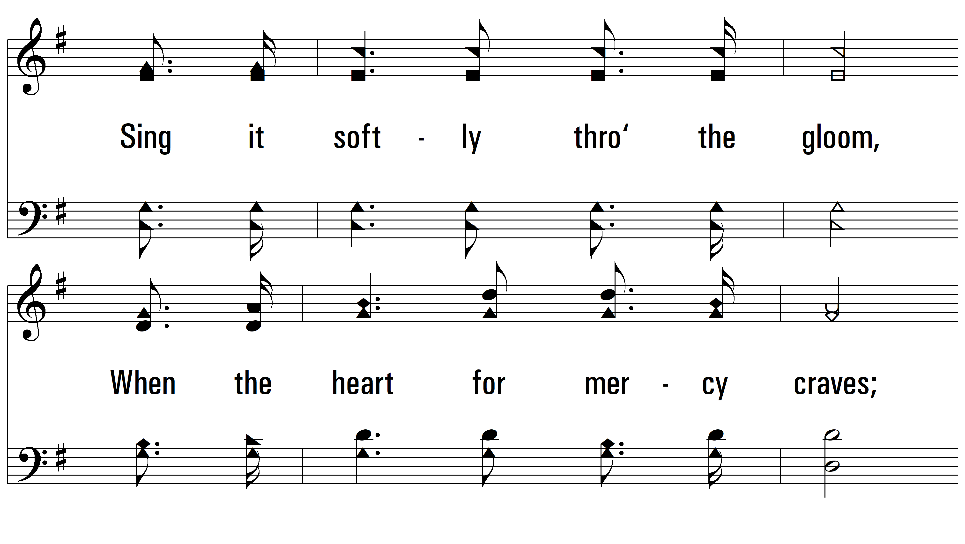
vs. 3

Slide 13
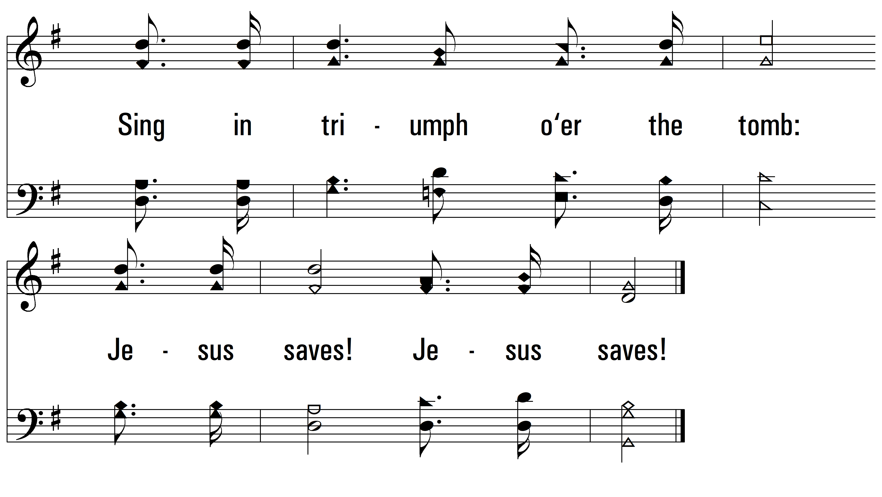
vs. 3

Slide 14
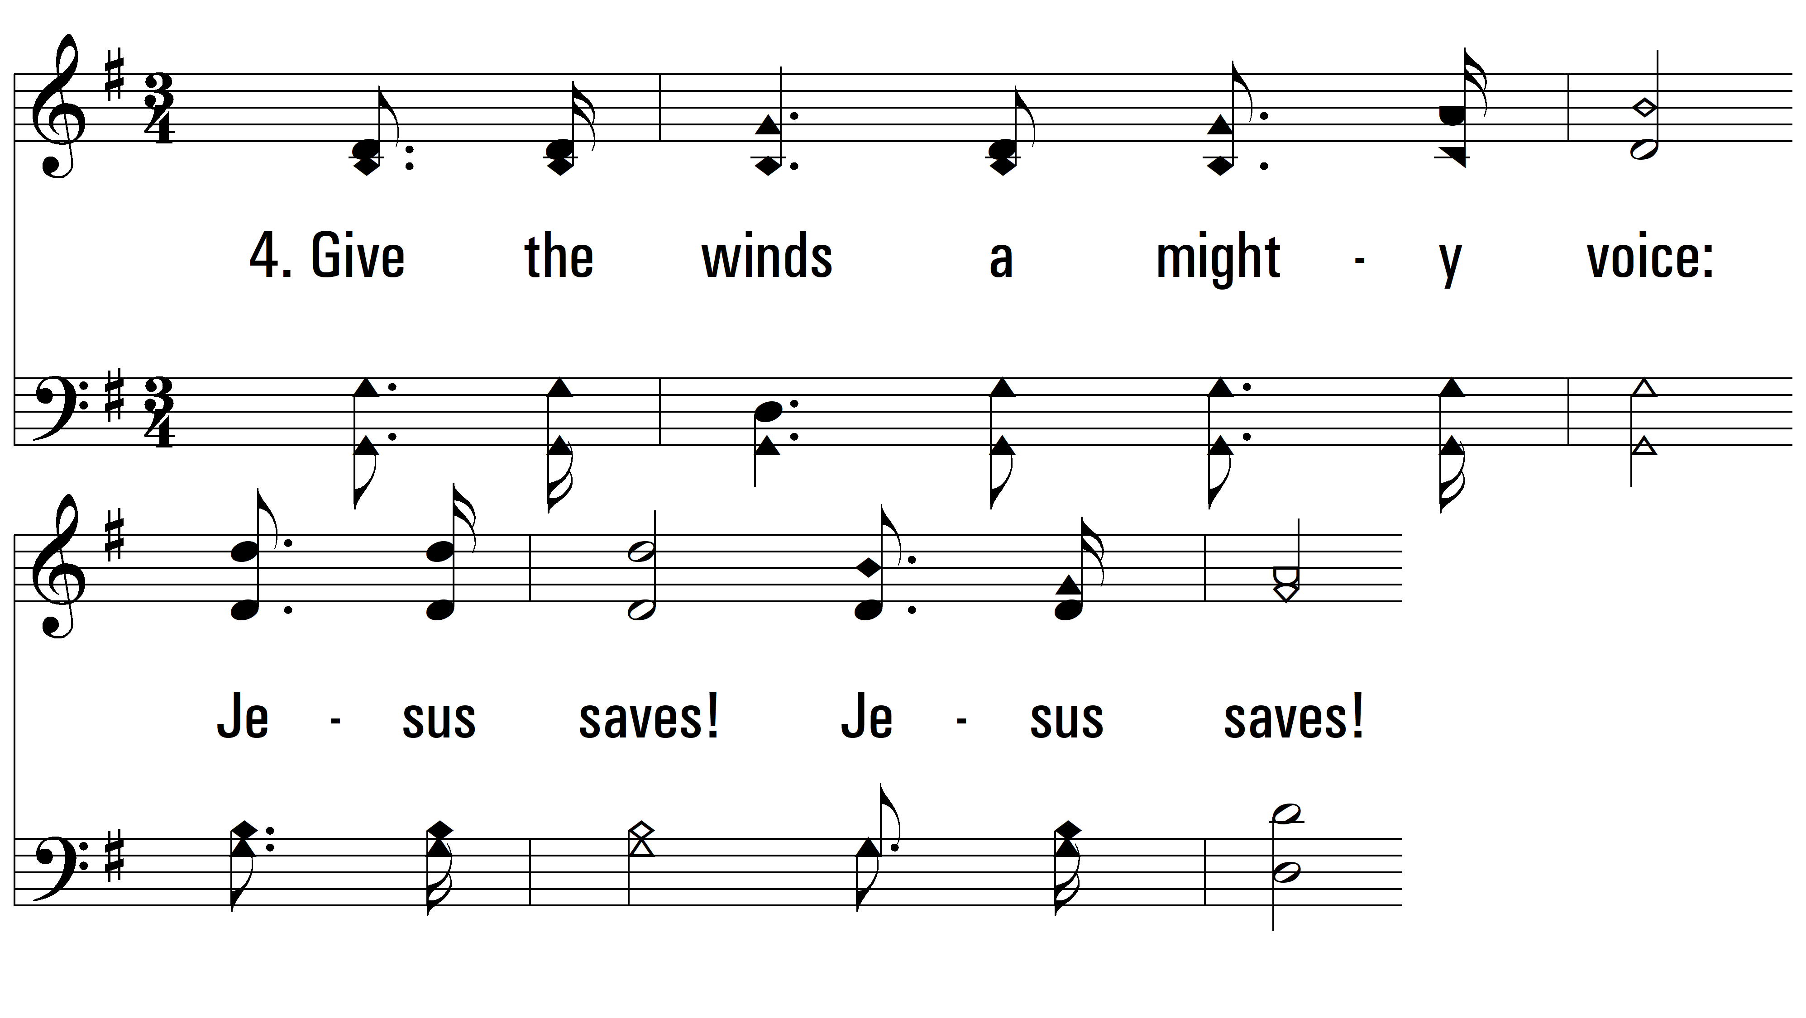
vs. 4 ~ Jesus Saves!

Slide 15
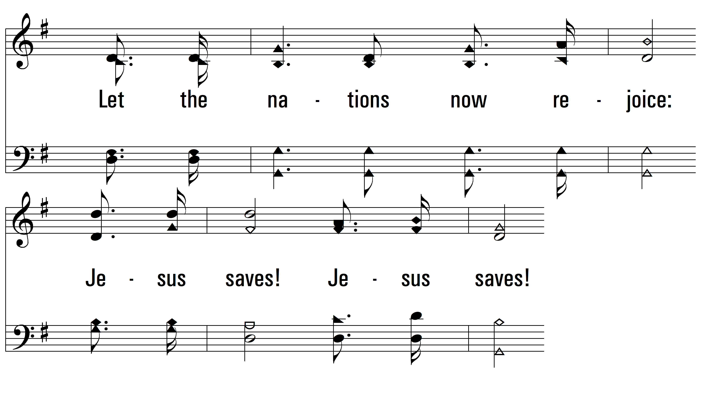
vs. 4

Slide 16
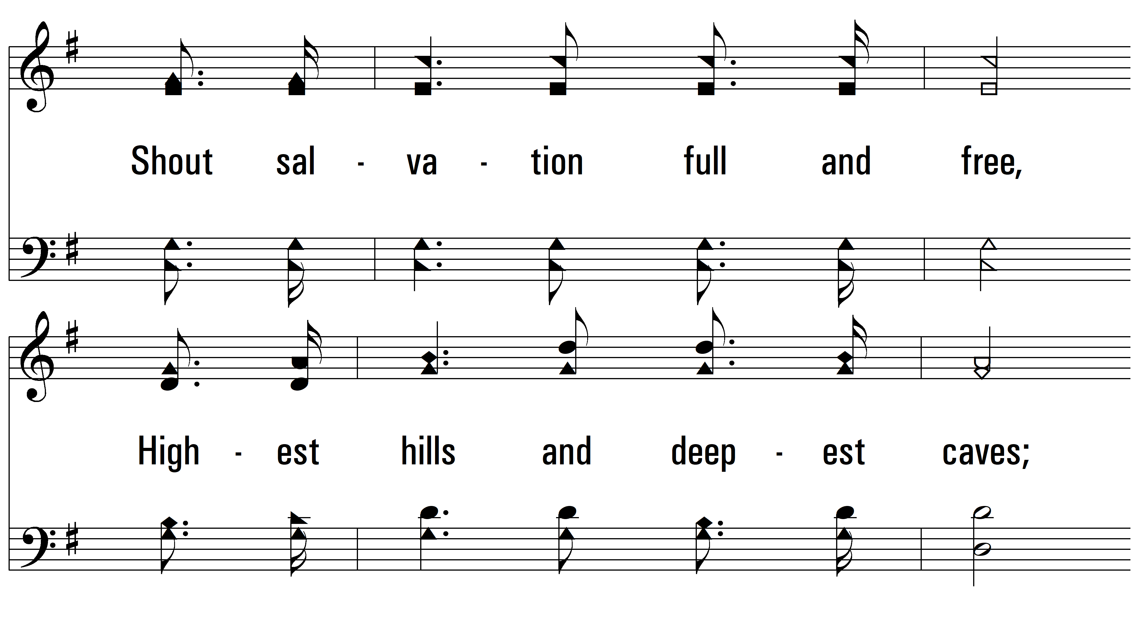
vs. 4

Slide 17
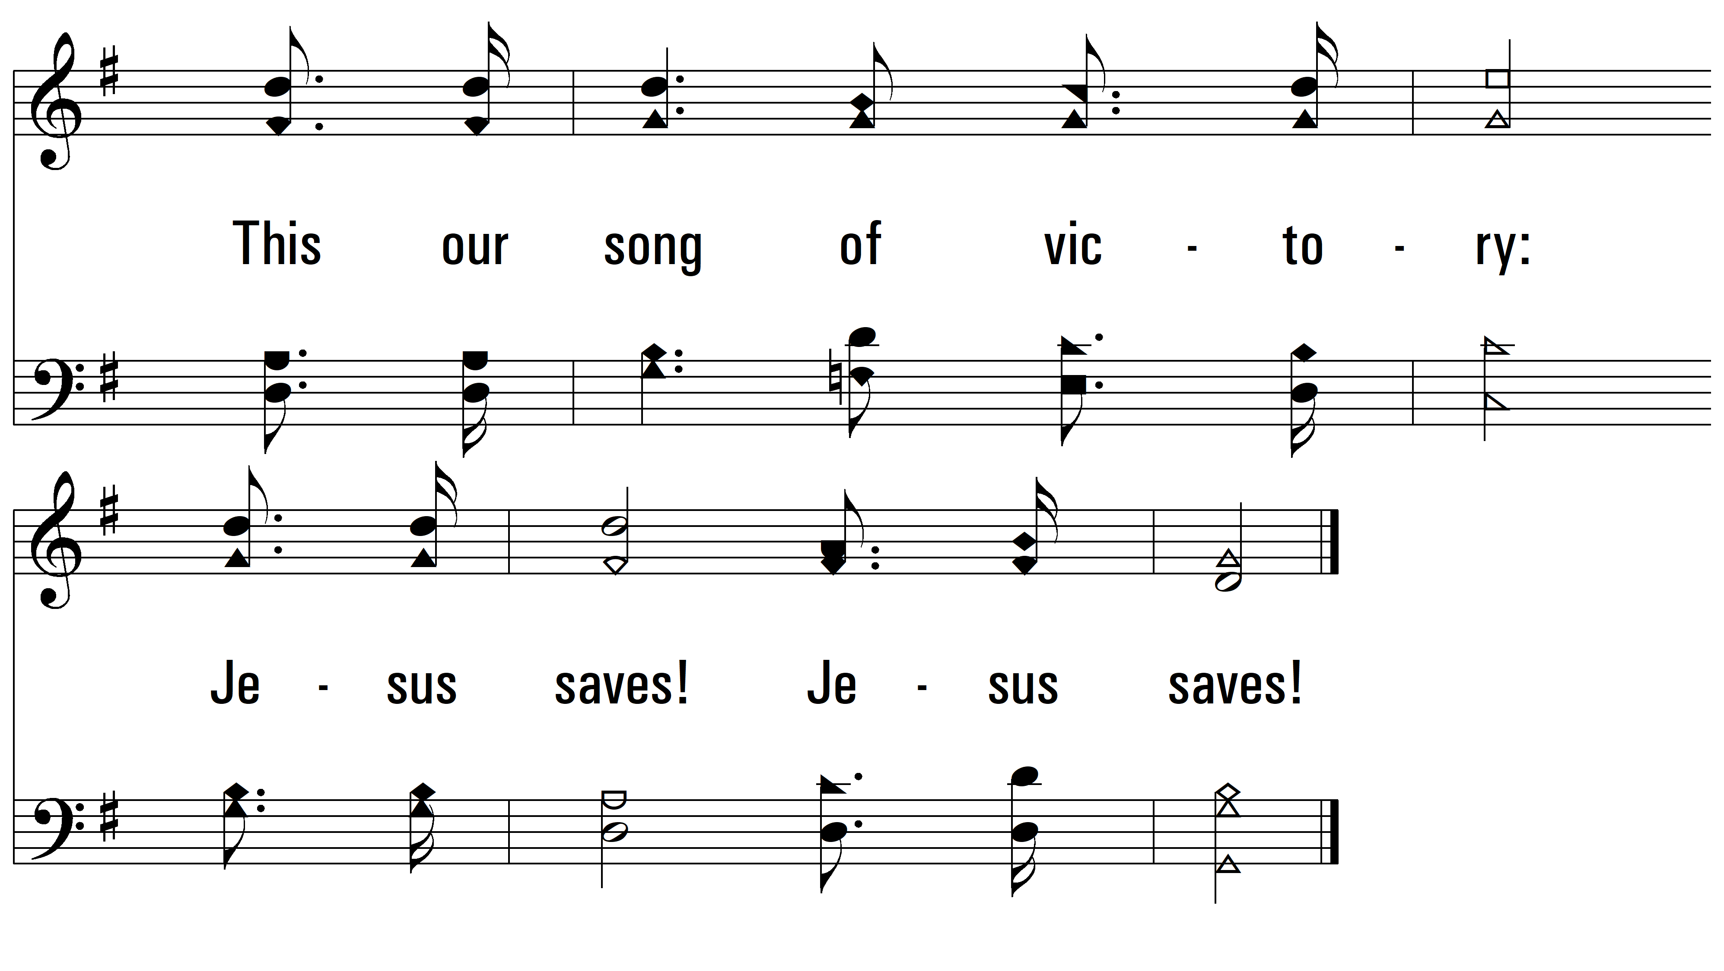
vs. 4
PDHymns.com
END

