Slide 1
Jesus, Rose Of Sharon
Words: | Ida A. Guirey
Music: | Charles H. Gabriel
3/4
E/G# - MI
Verses: 3/Chorus
Lead - | MI
Alto - | DO
Tenor - | SOL
Bass - | DO
PDHymns.com

Slide 2
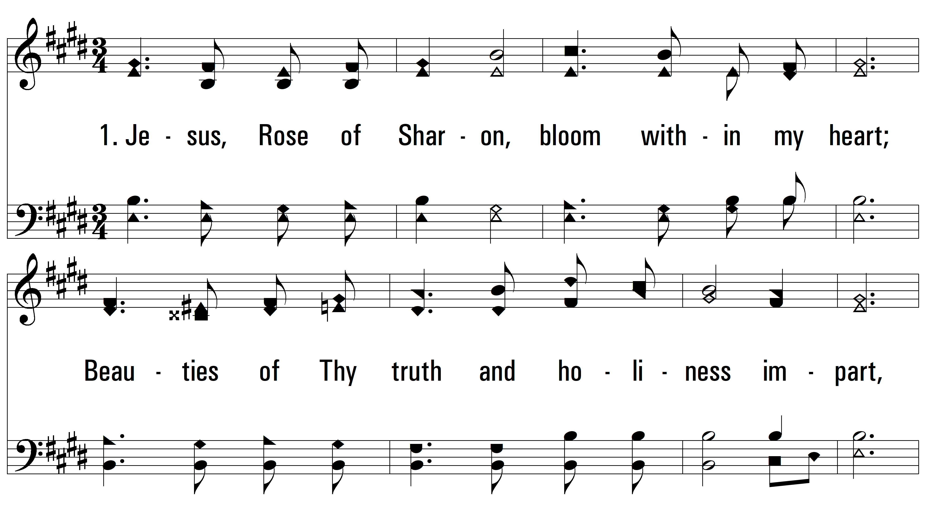
vs. 1 ~ Jesus, Rose Of Sharon

Slide 3
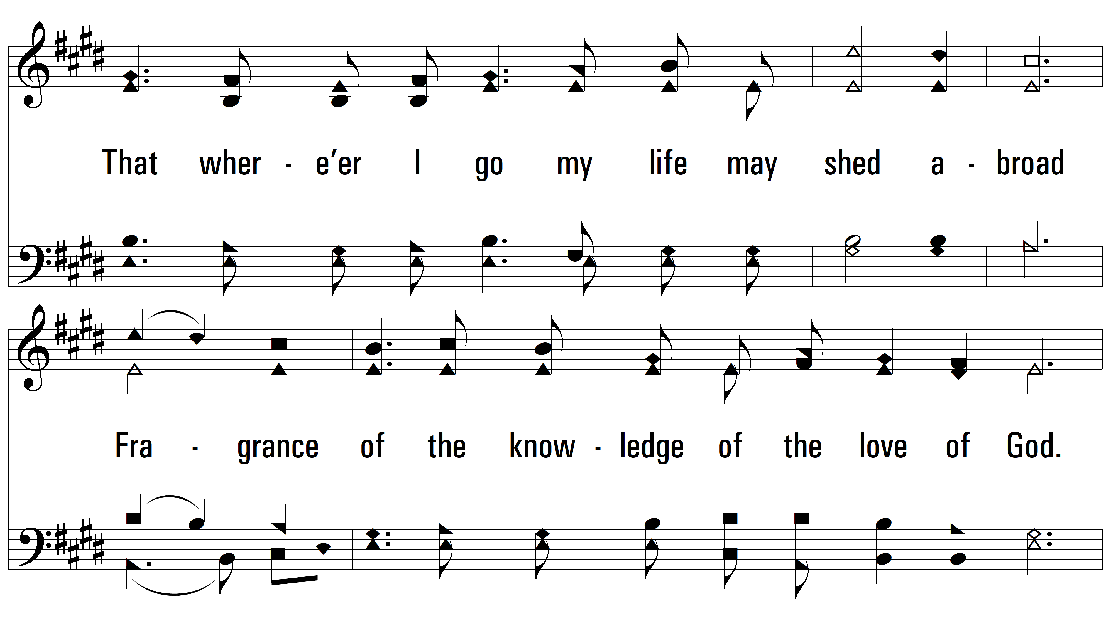
vs. 1

Slide 4
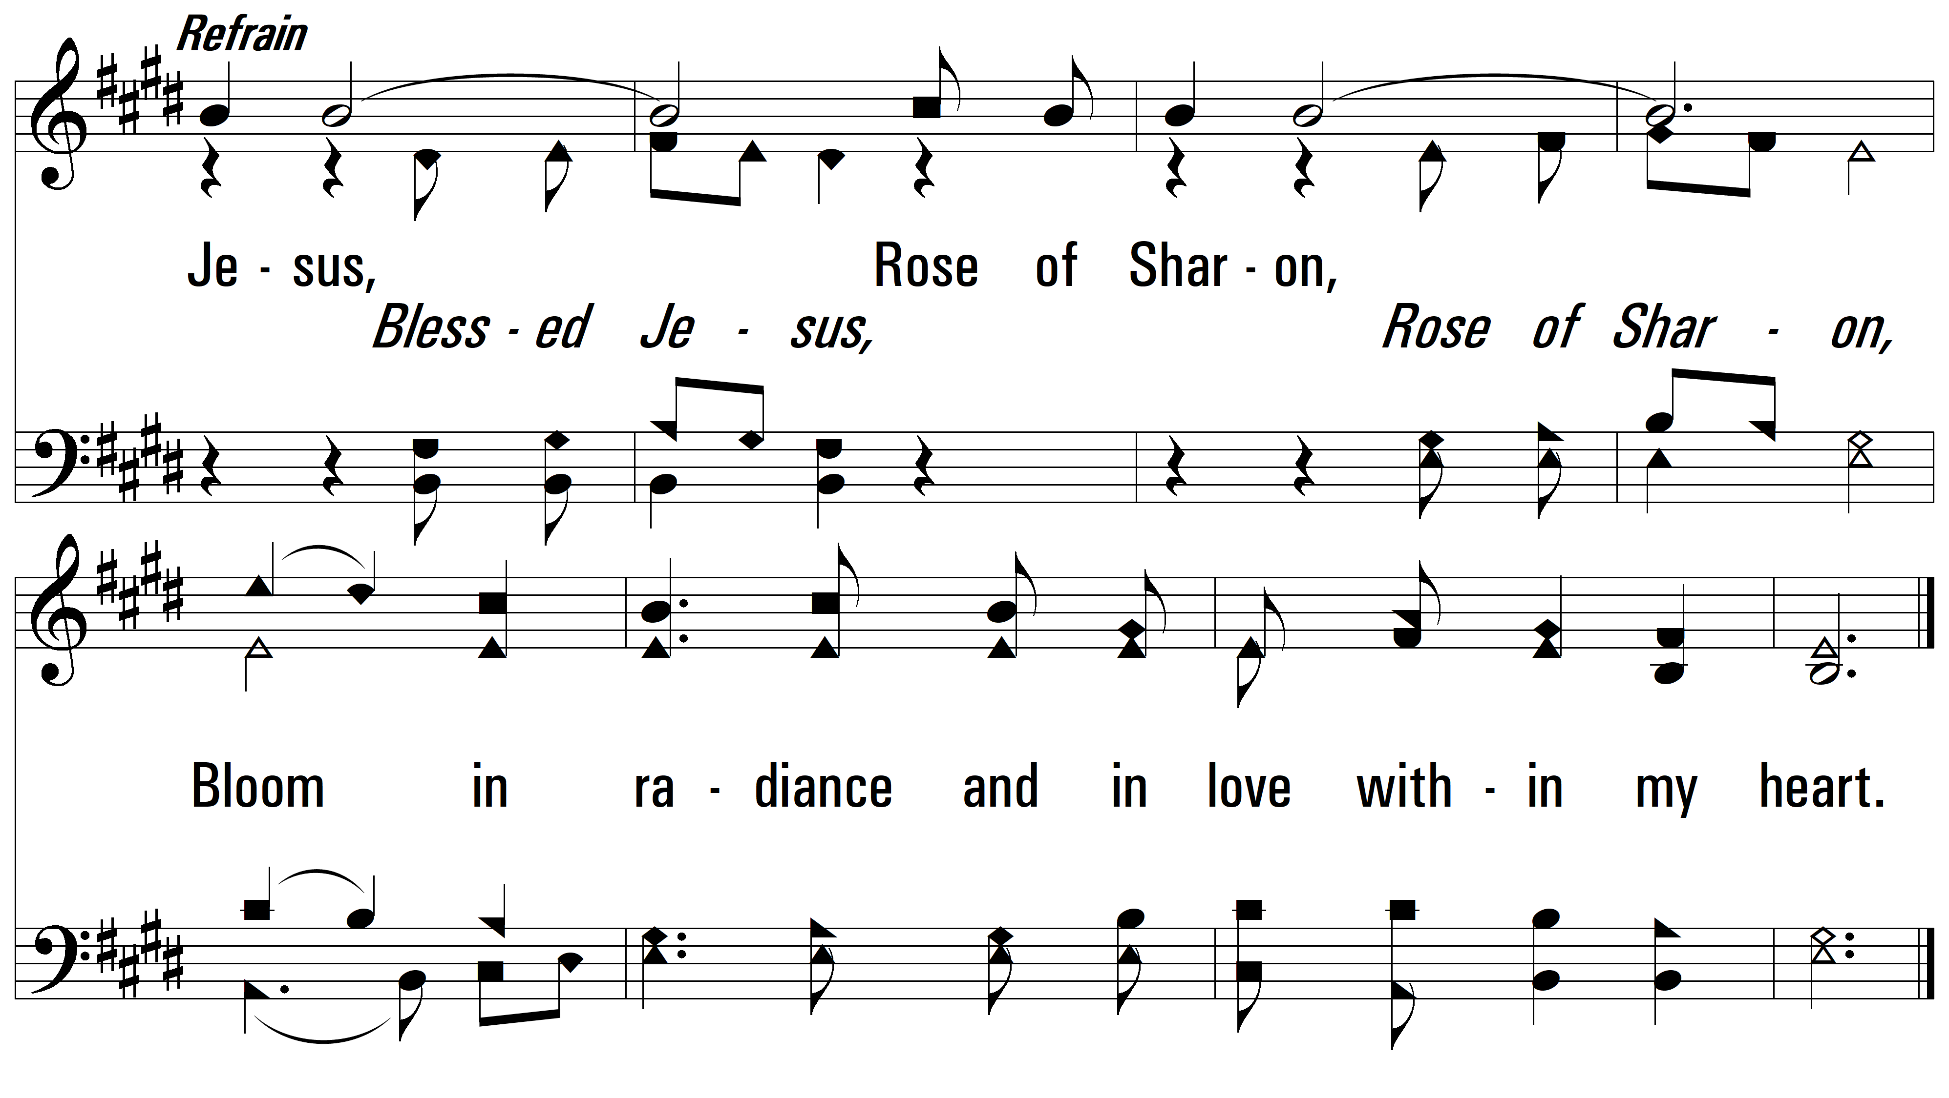
vs. 1

Slide 5
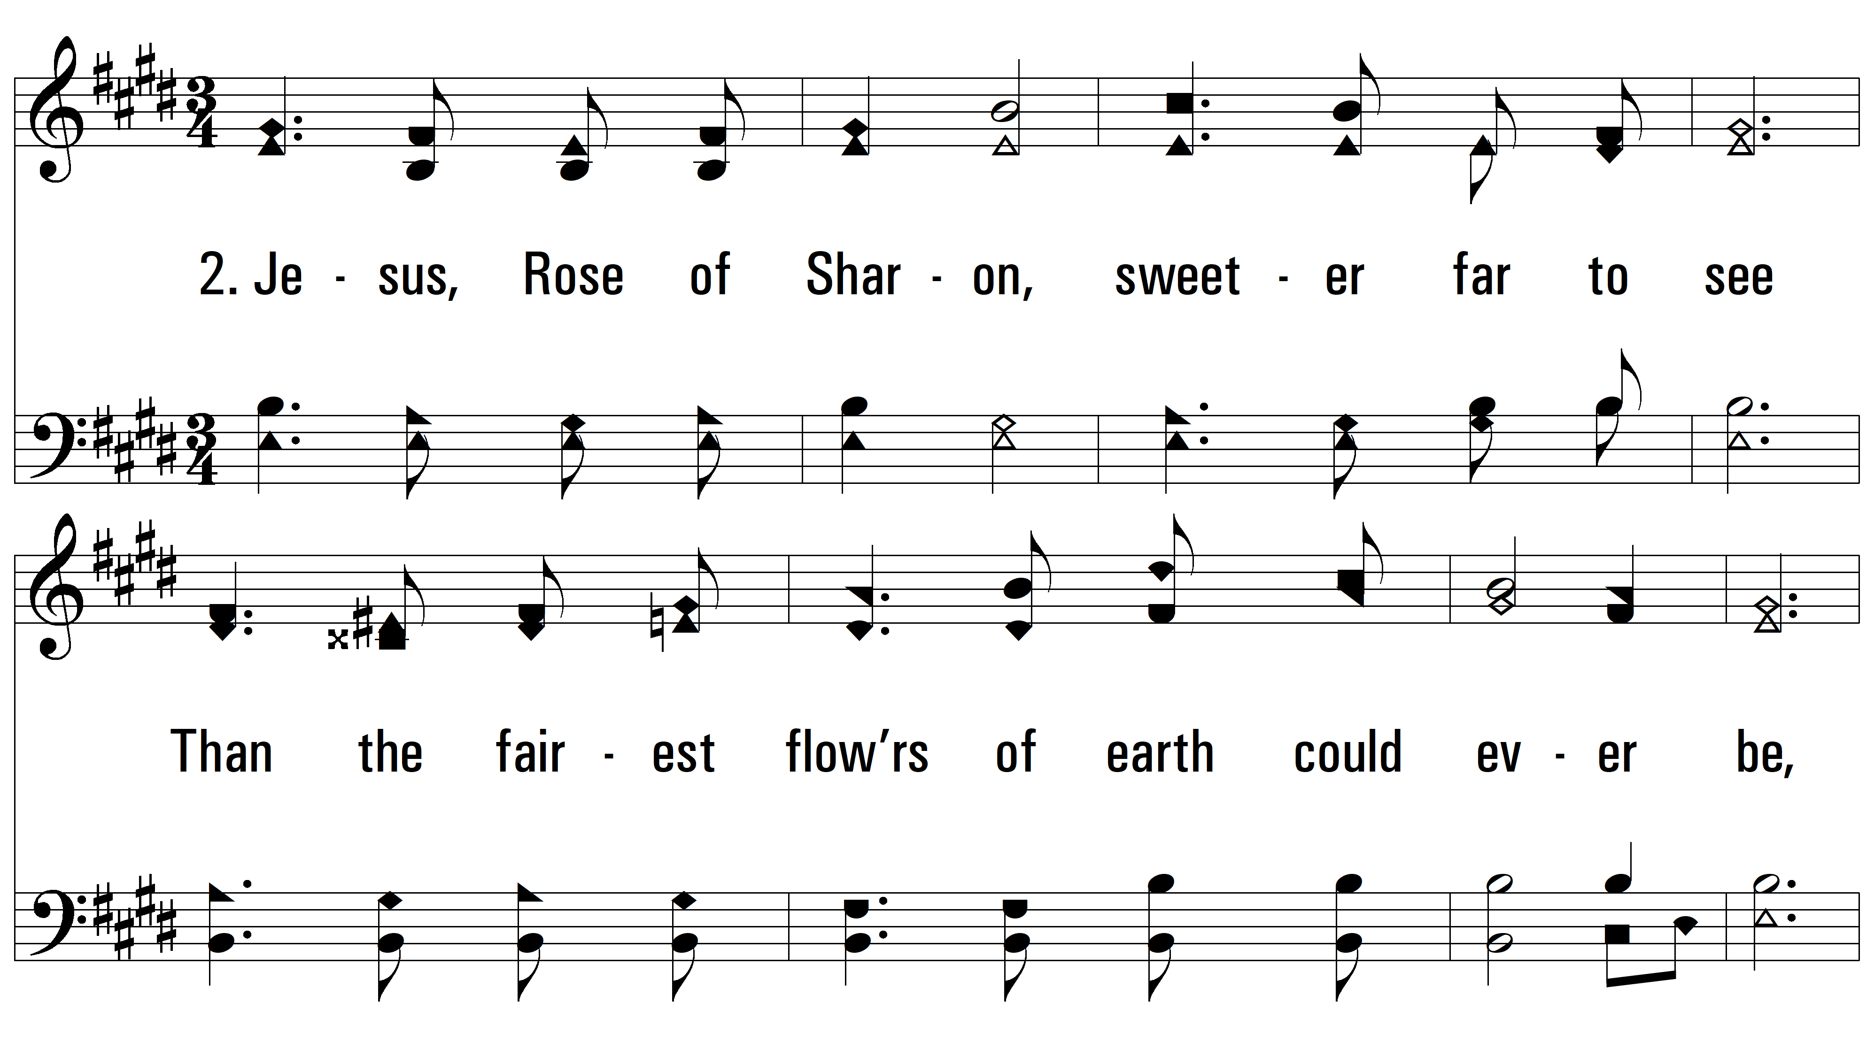
vs. 2 ~ Jesus, Rose Of Sharon

Slide 6
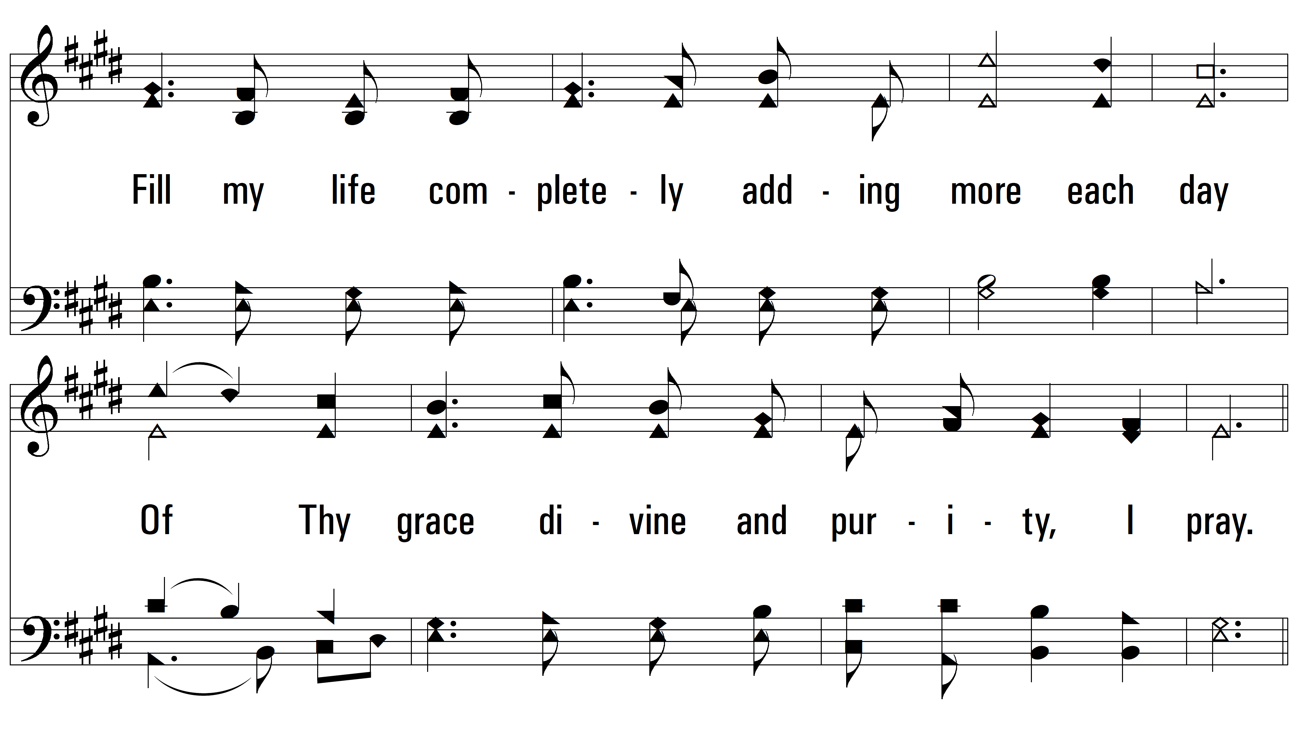
vs. 2

Slide 7
vs. 2

Slide 8
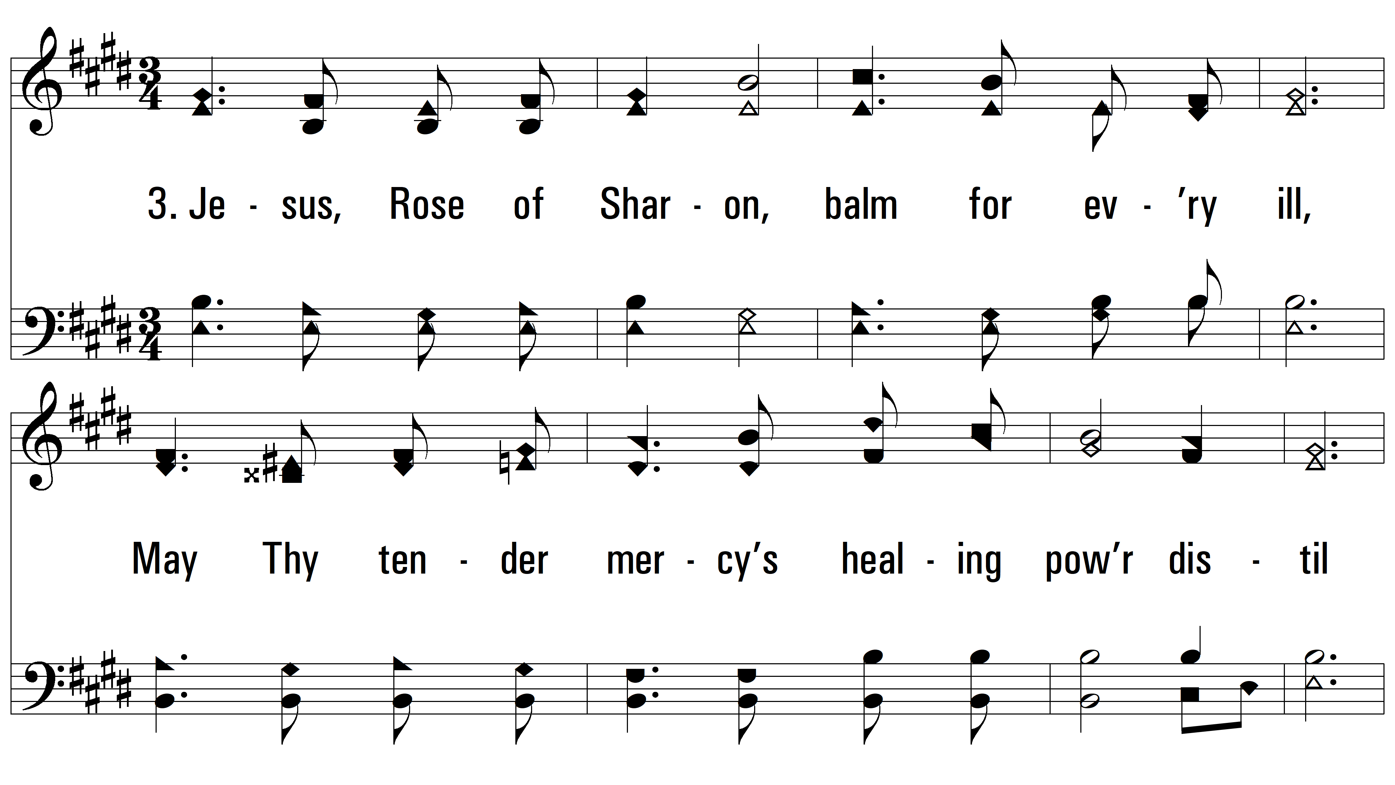
vs. 3 ~ Jesus, Rose Of Sharon

Slide 9
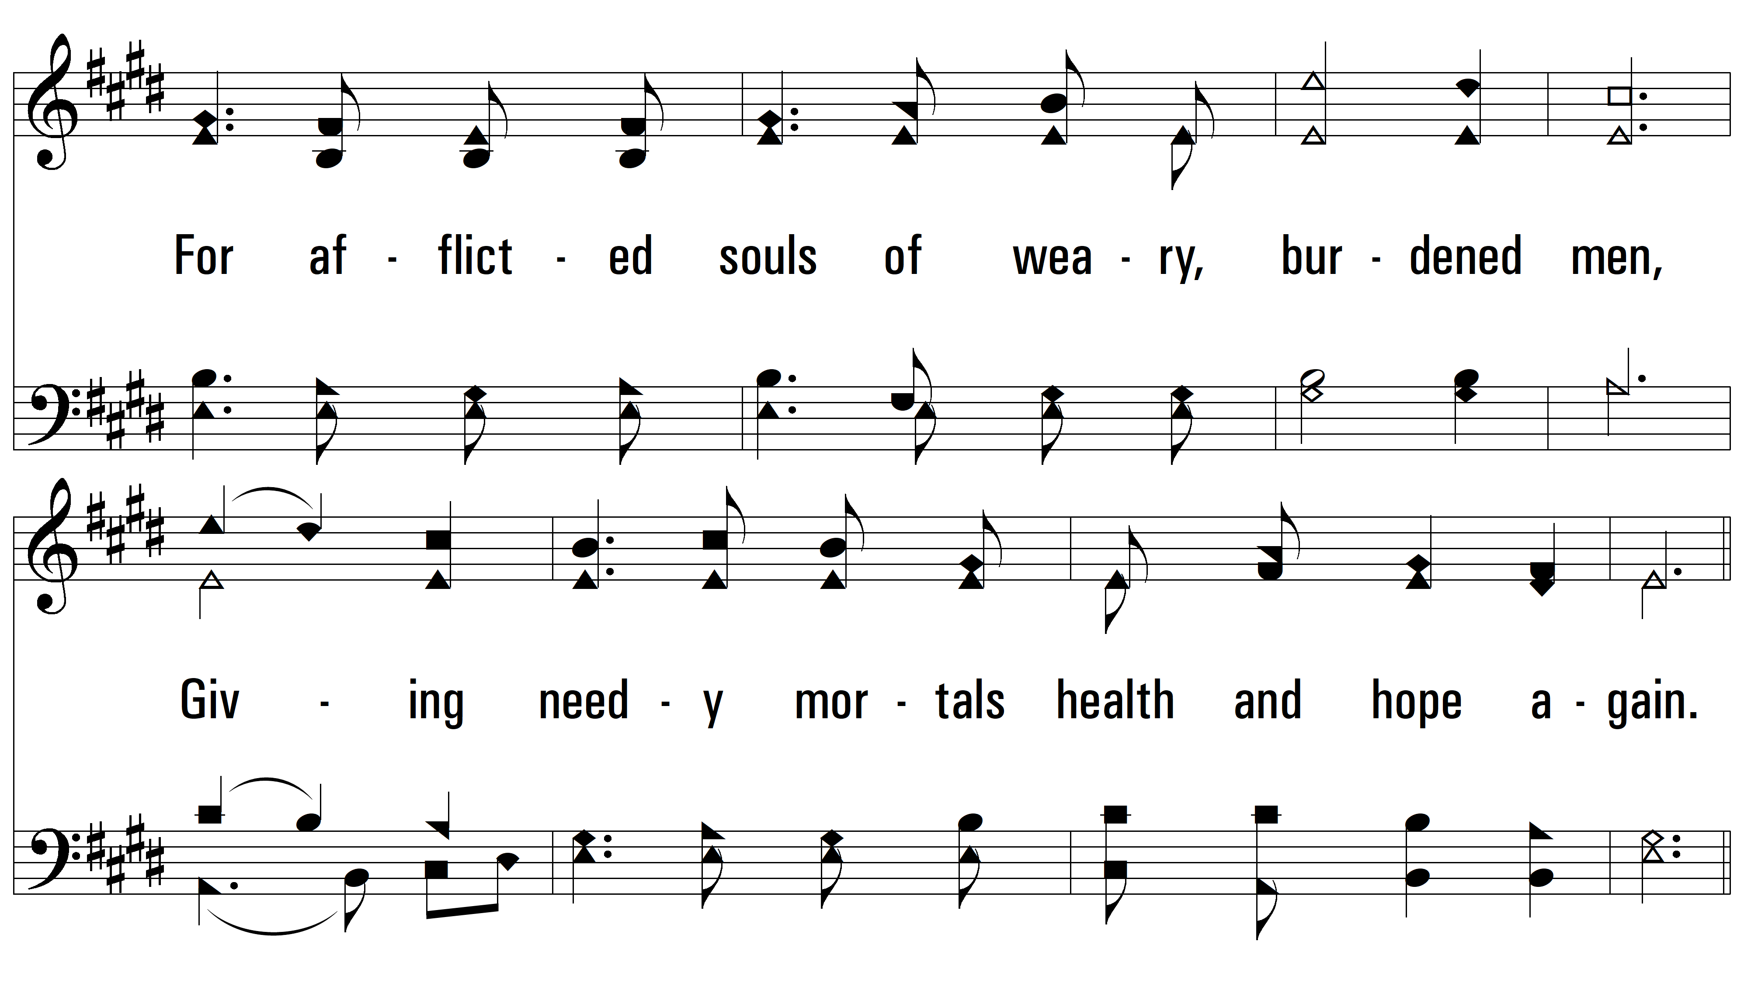
vs. 3

Slide 10
vs. 3
PDHymns.com
END

