Slide 1
Jesus Paid It All
Words: | M. S. Shaffer (1916)
Music: | Samuel W. Beazley (1916)
4/4
C/E - MI
Verses: 3/Chorus
Lead - | MI
Alto - | DO
Tenor - | SOL
Bass - | DO
PDHymns.com

Slide 2
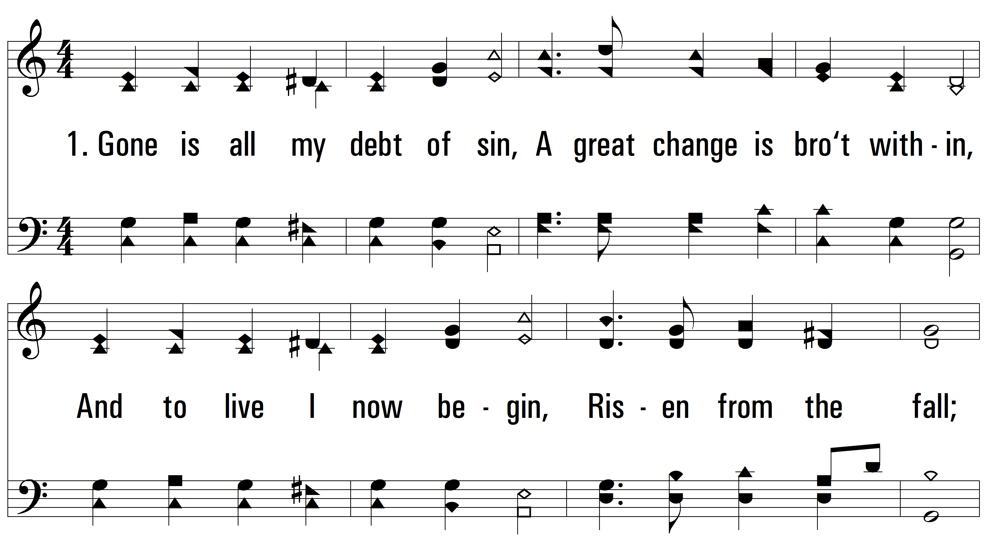
vs. 1 ~ Jesus Paid It All

Slide 3
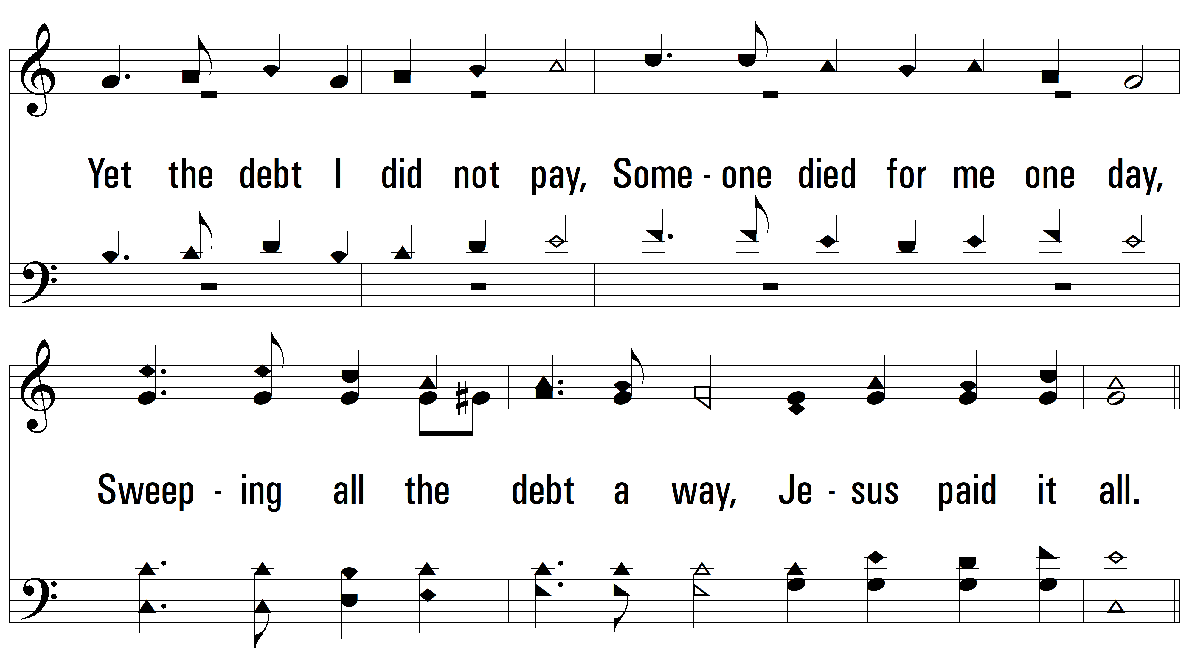
vs. 1

Slide 4
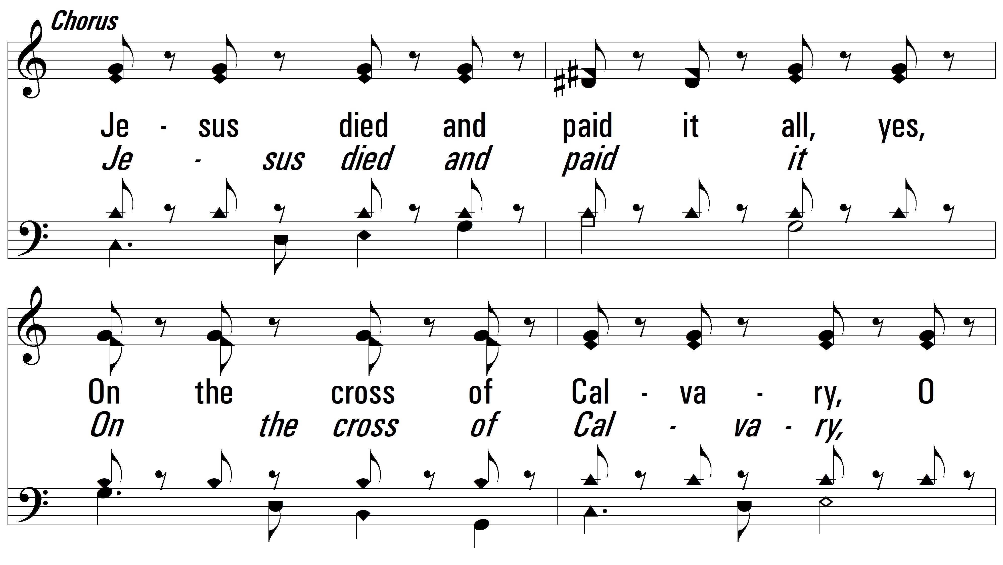
vs. 1

Slide 5
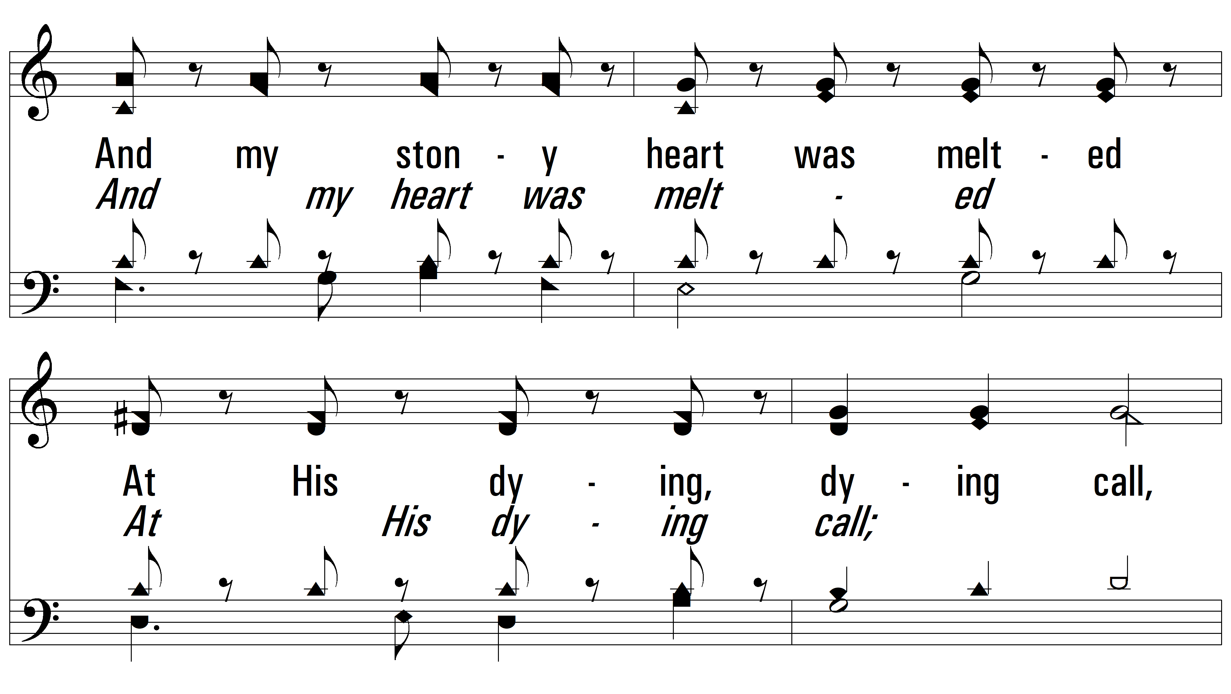
vs. 1

Slide 6
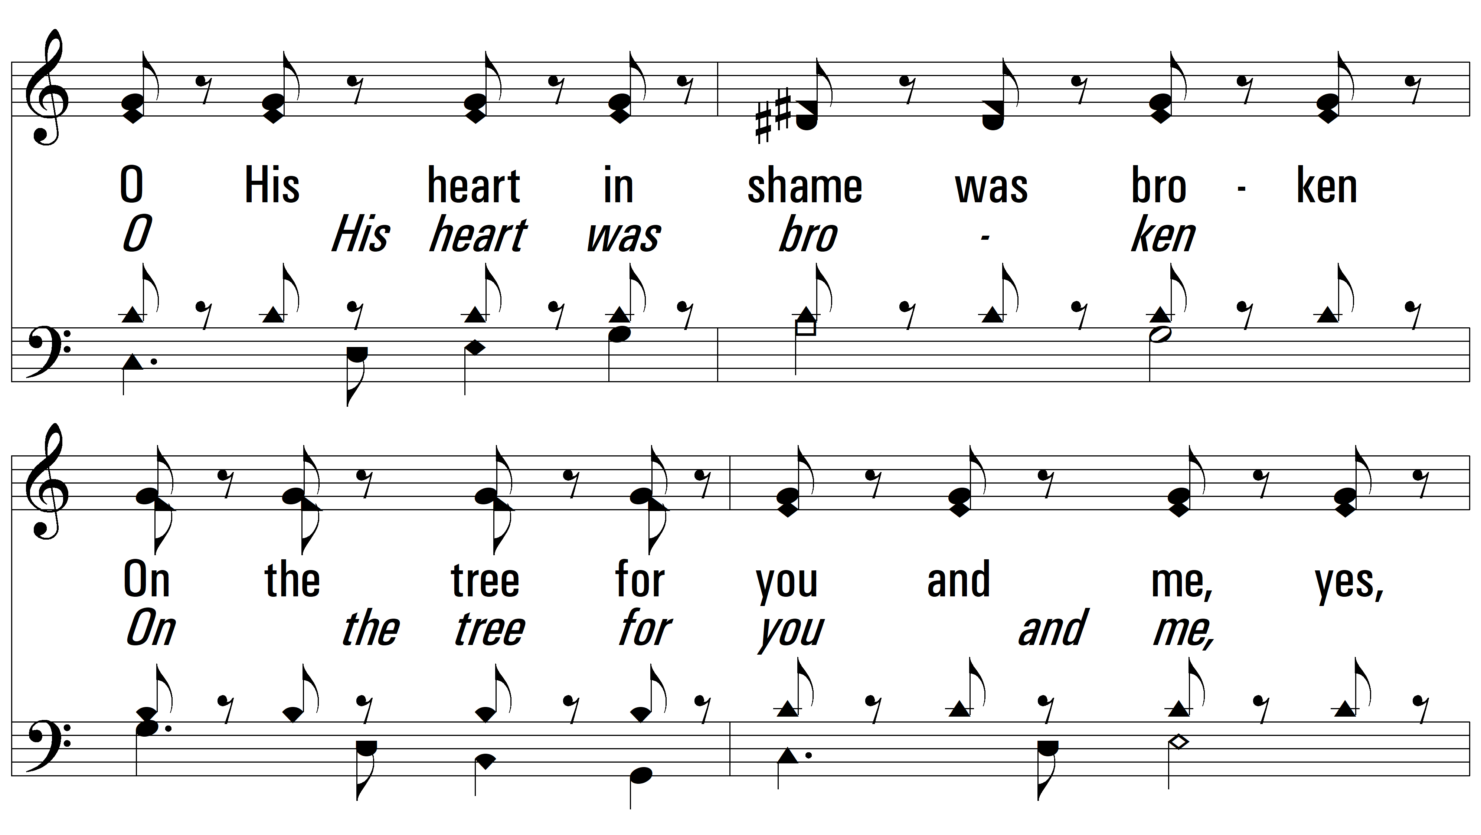
vs. 1

Slide 7
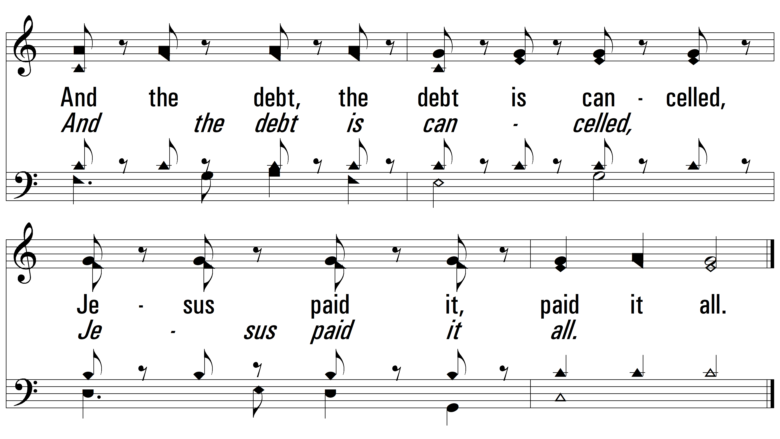
vs. 1

Slide 8
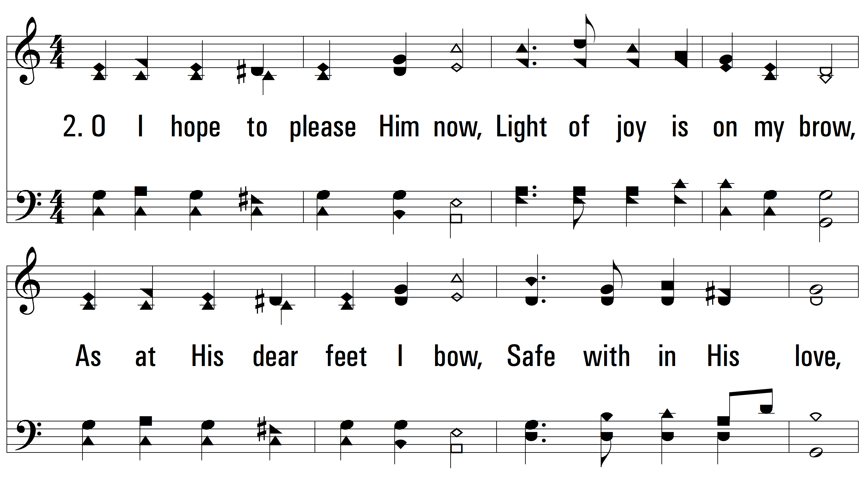
vs. 2 ~ Jesus Paid It All

Slide 9
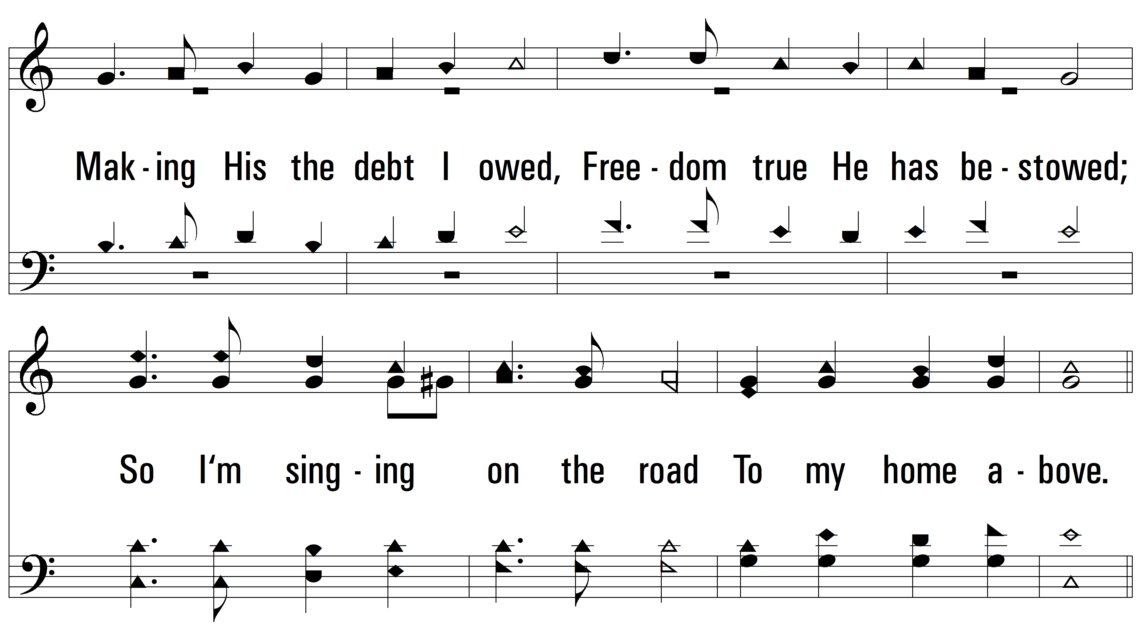
vs. 2

Slide 10
vs. 2

Slide 11
vs. 2

Slide 12
vs. 2

Slide 13
vs. 2

Slide 14
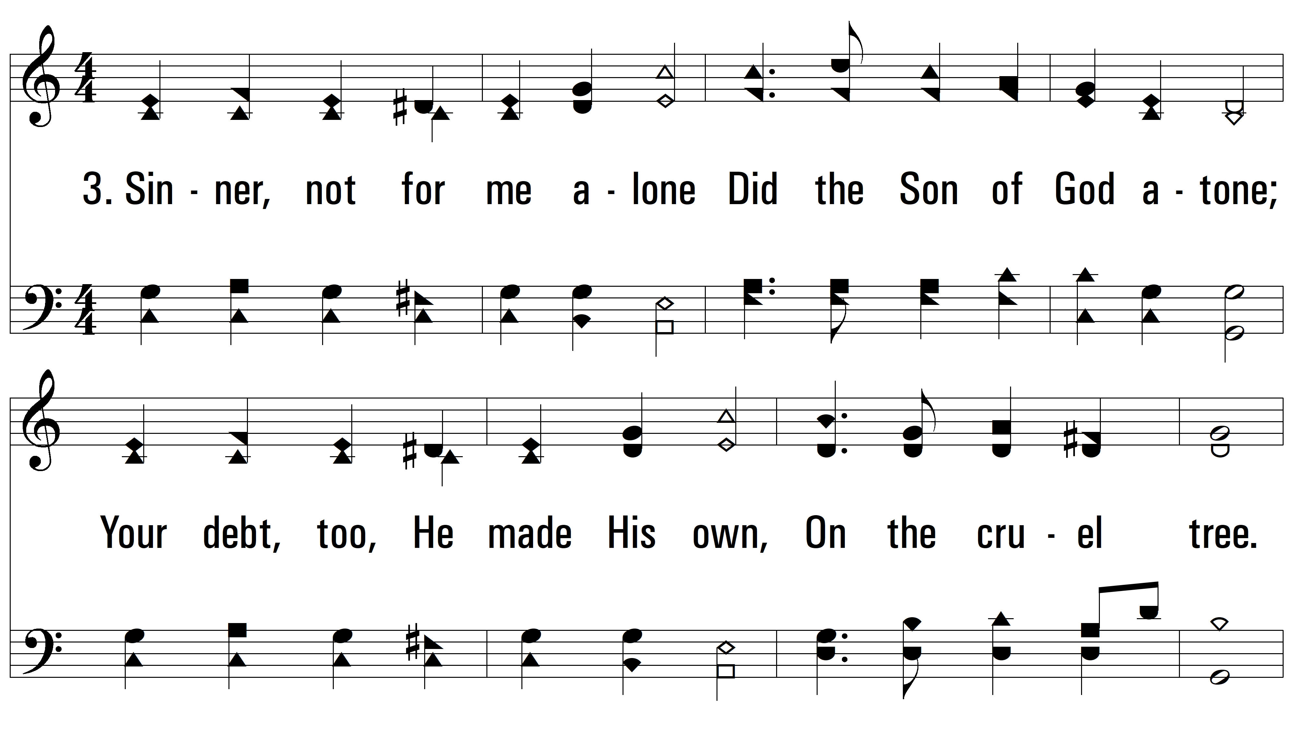
vs. 3 ~ Jesus Paid It All

Slide 15
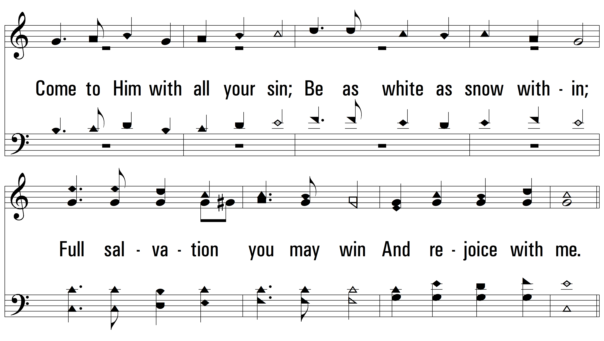
vs. 3

Slide 16
vs. 3

Slide 17
vs. 3

Slide 18
vs. 3

Slide 19
vs. 3
PDHymns.com
END

