Slide 1
Jesus Loves The Little Children
Words: | Clarence H. Woolston (1913)
Music: | George F. Root (1864)
4/4
A^{b}/C - MI
Verses: 1
Lead - | MI
Alto - | SOL
Tenor - | DO
Bass - | DO
PDHymns.com

Slide 2
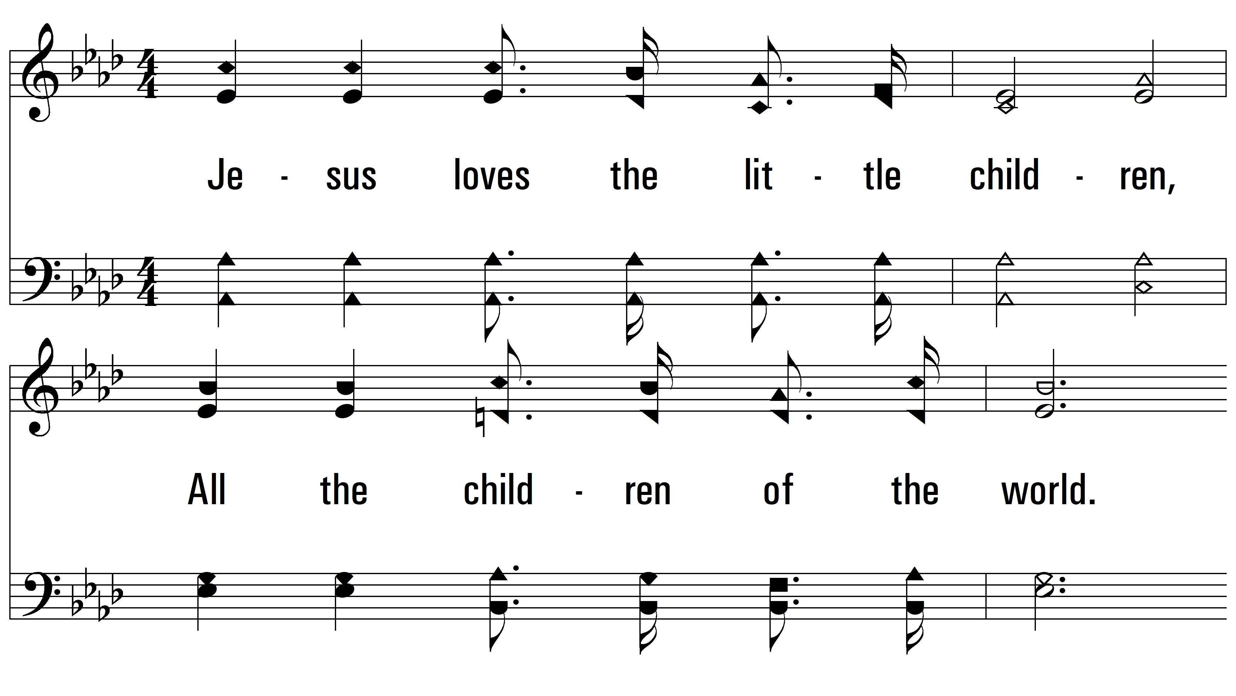
Jesus Loves The Little Children

Slide 3
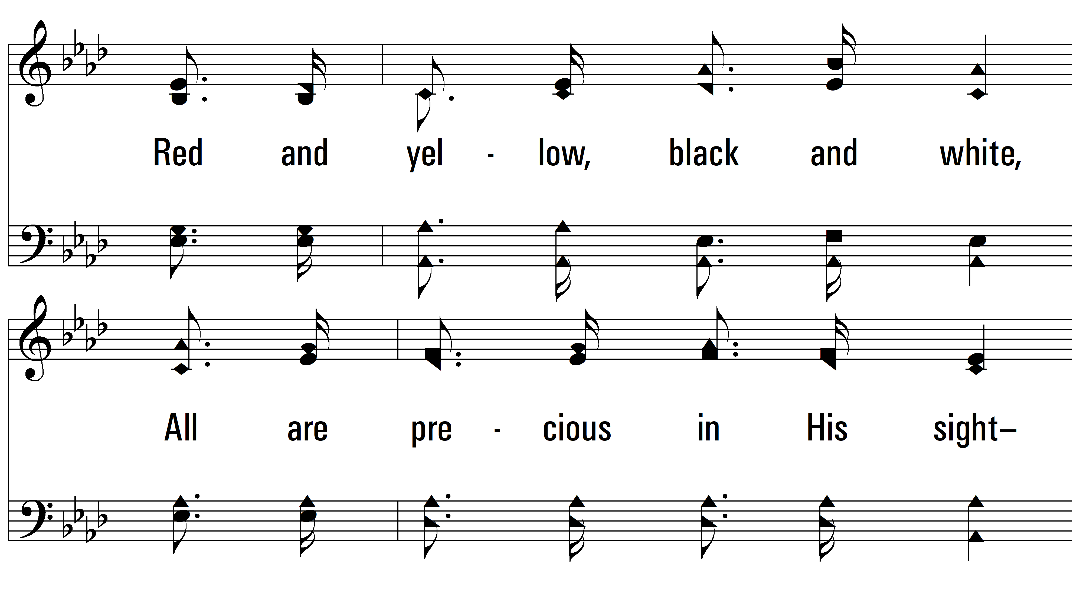

Slide 4
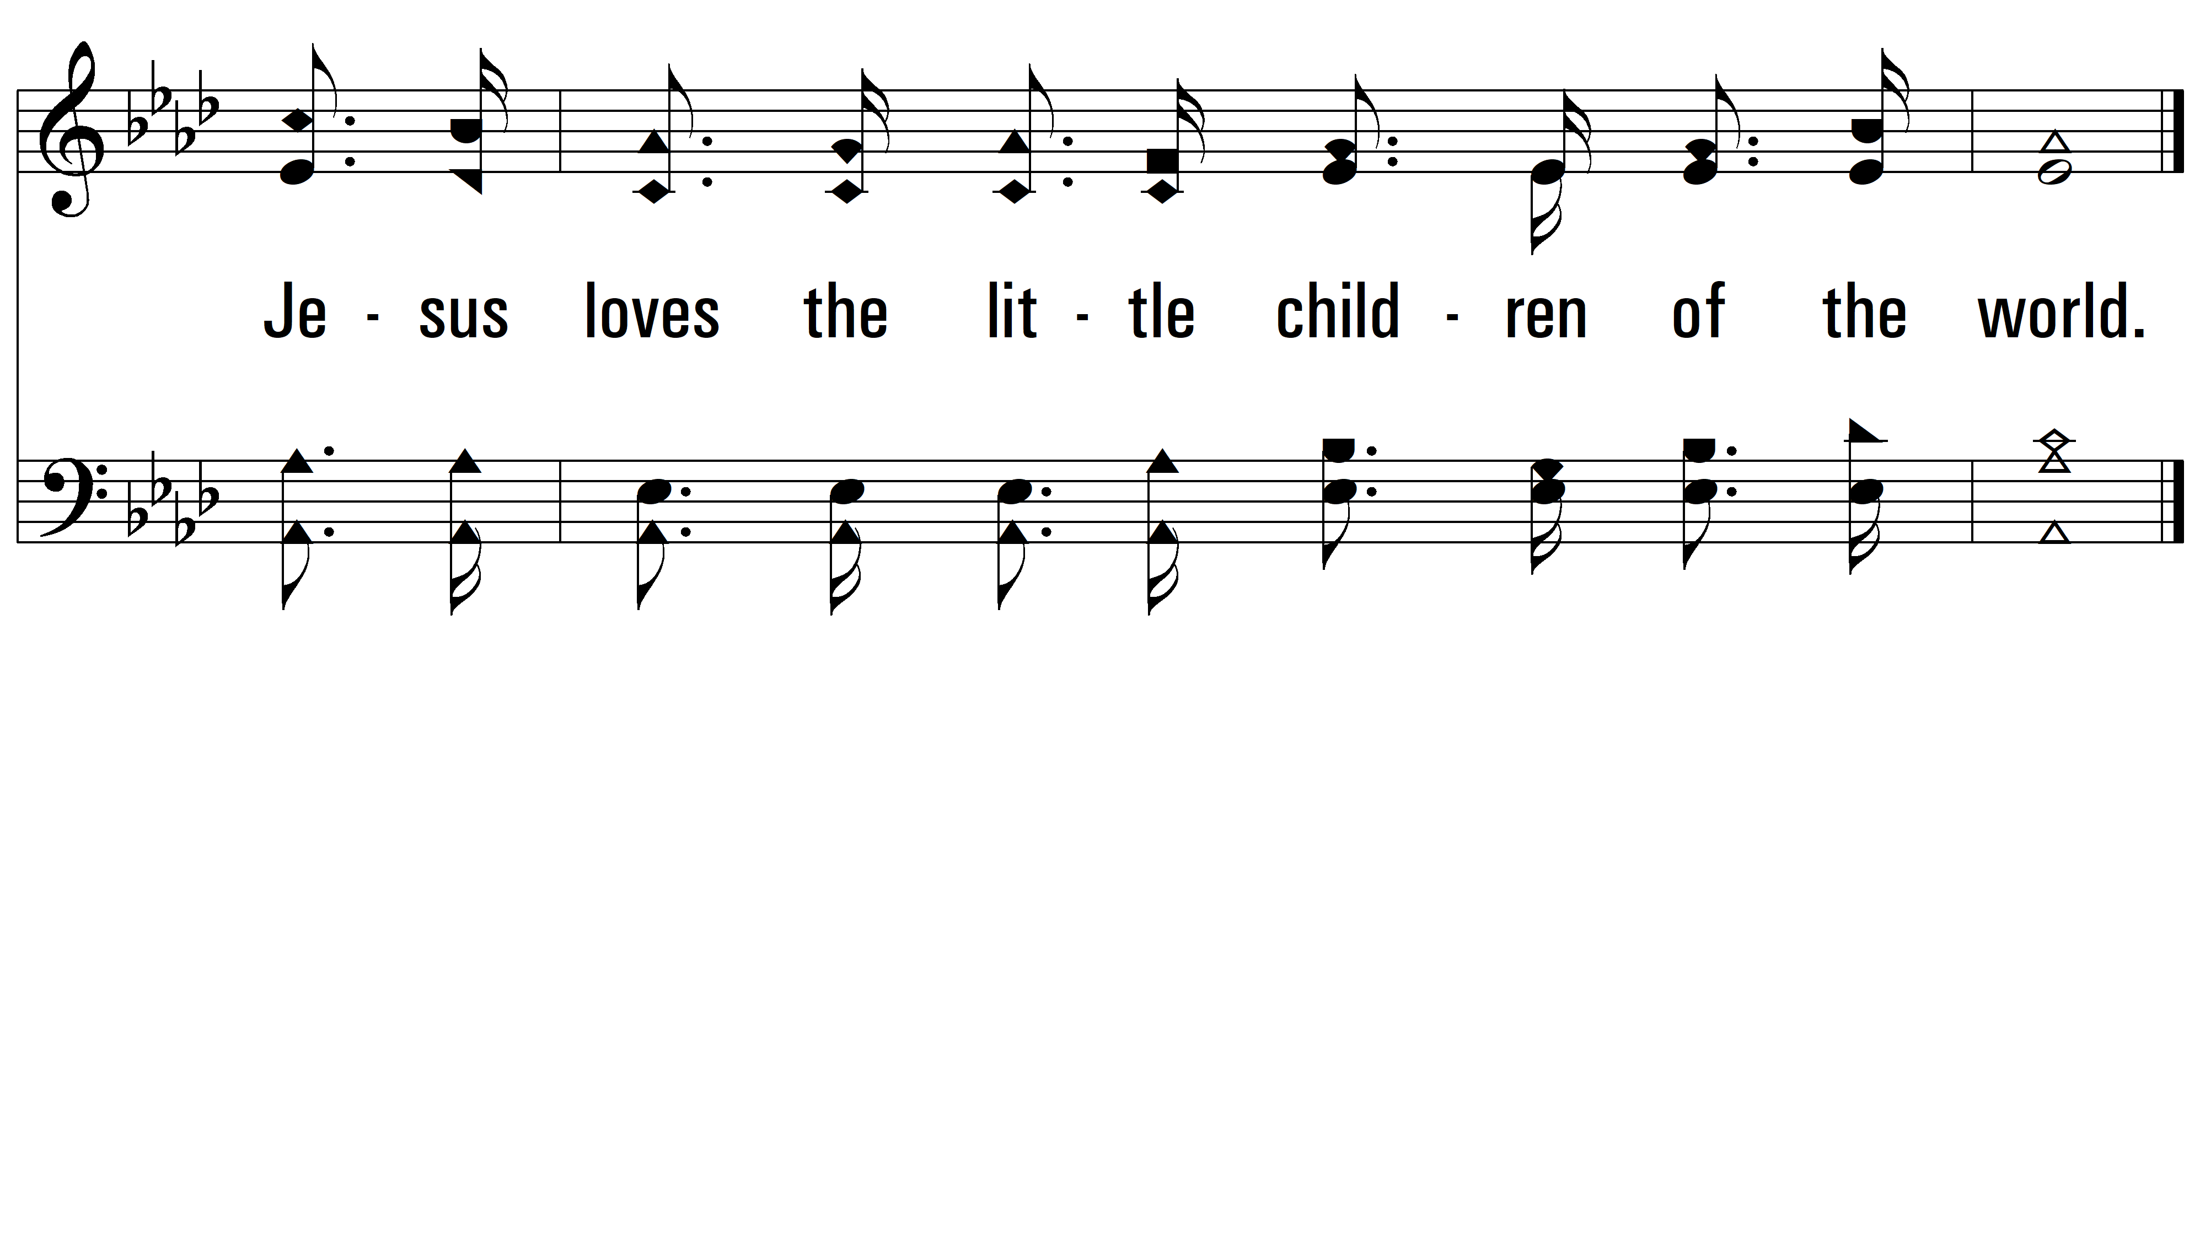
PDHymns.com
END

