Slide 1
Jesus Is Strong And Able To Save
Words: | Austin Taylor (1919)
Music: | Austin Taylor (1919)
9/8
A^{b}/E^{b} - SOL
Verses: 4/Chorus
Lead - | SOL
Alto - | SOL
Tenor - | SOL
Bass - | SOL
PDHymns.com

Slide 2
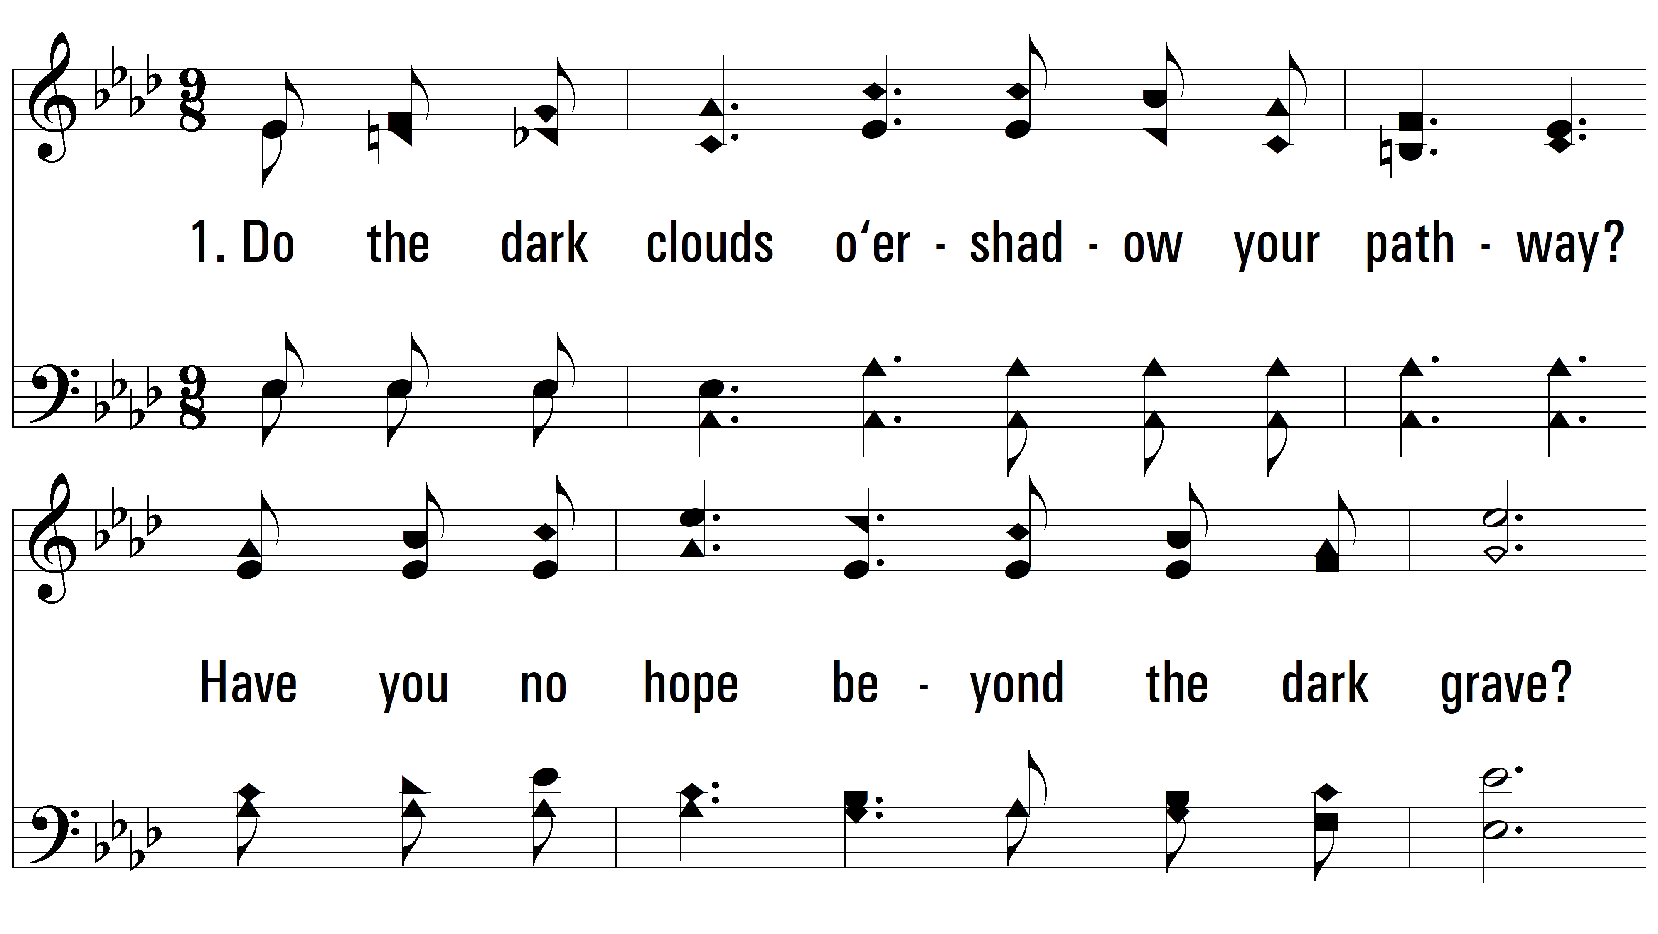
vs. 1 ~ Jesus Is Strong And Able To Save

Slide 3
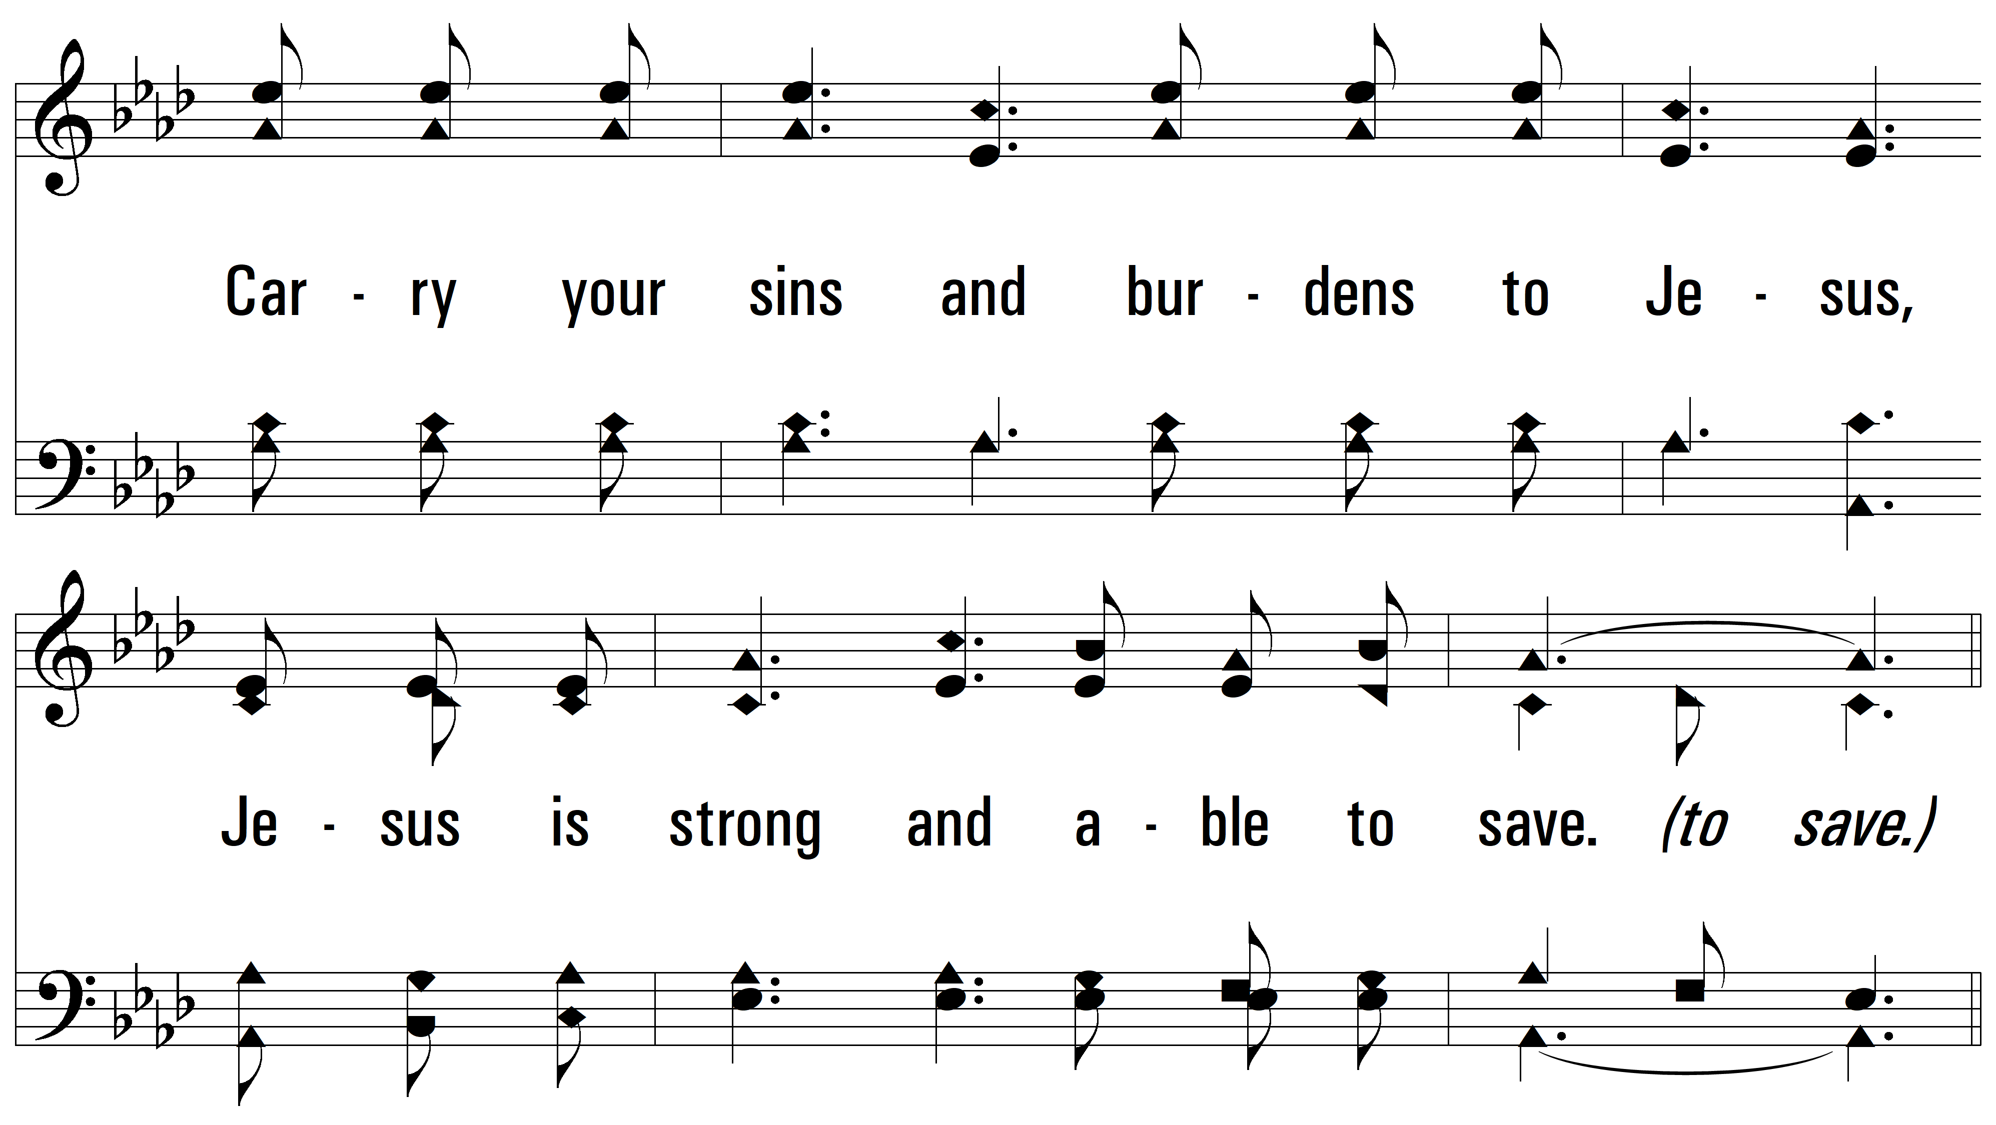
vs. 1

Slide 4
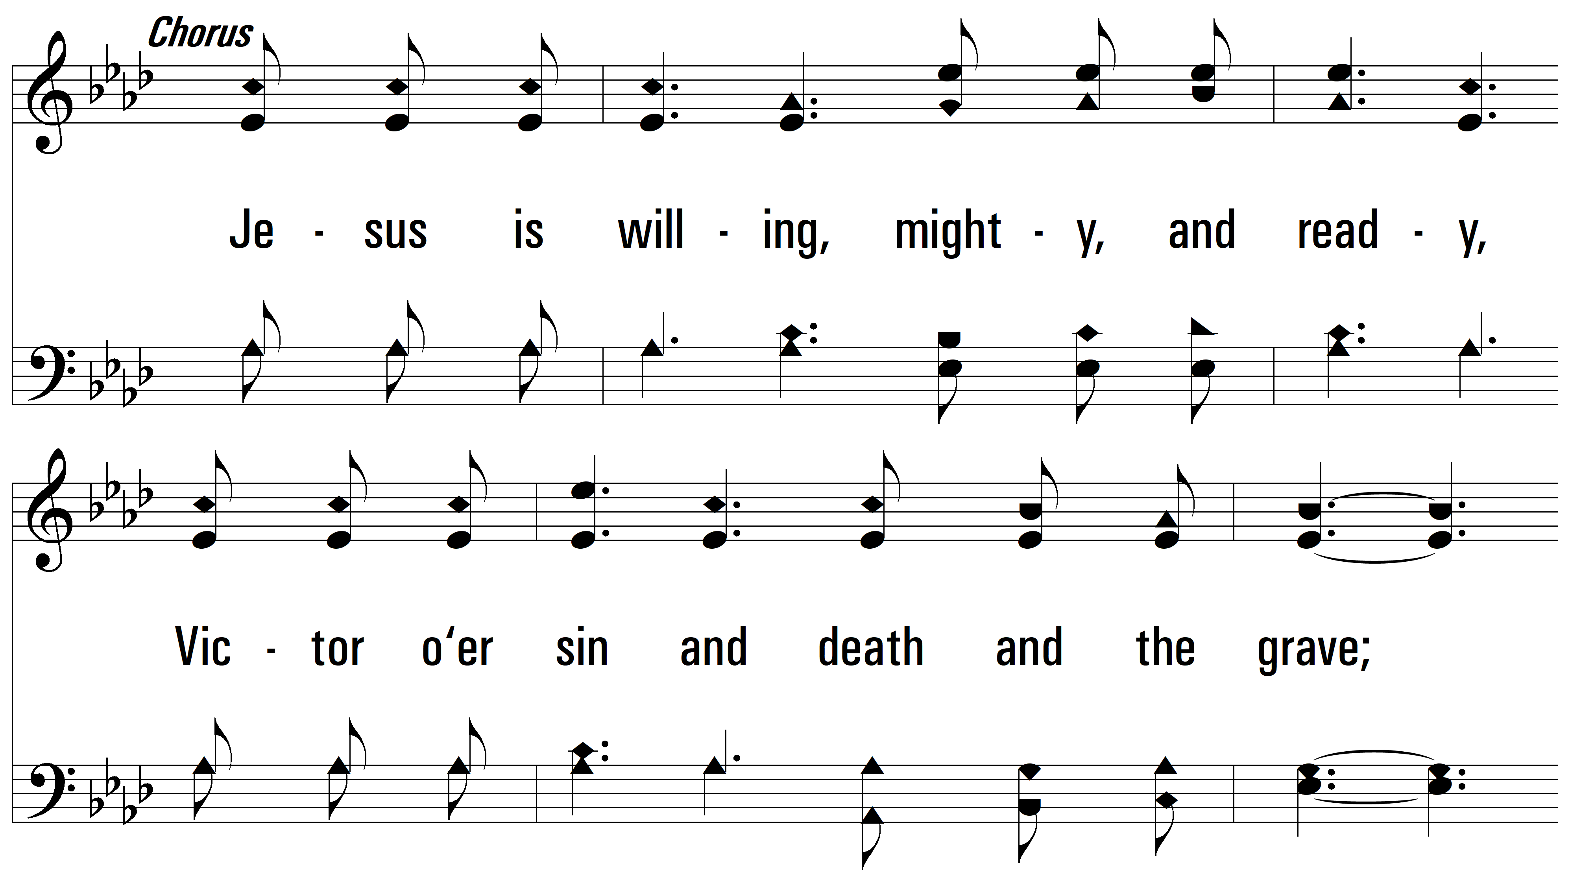
vs. 1

Slide 5
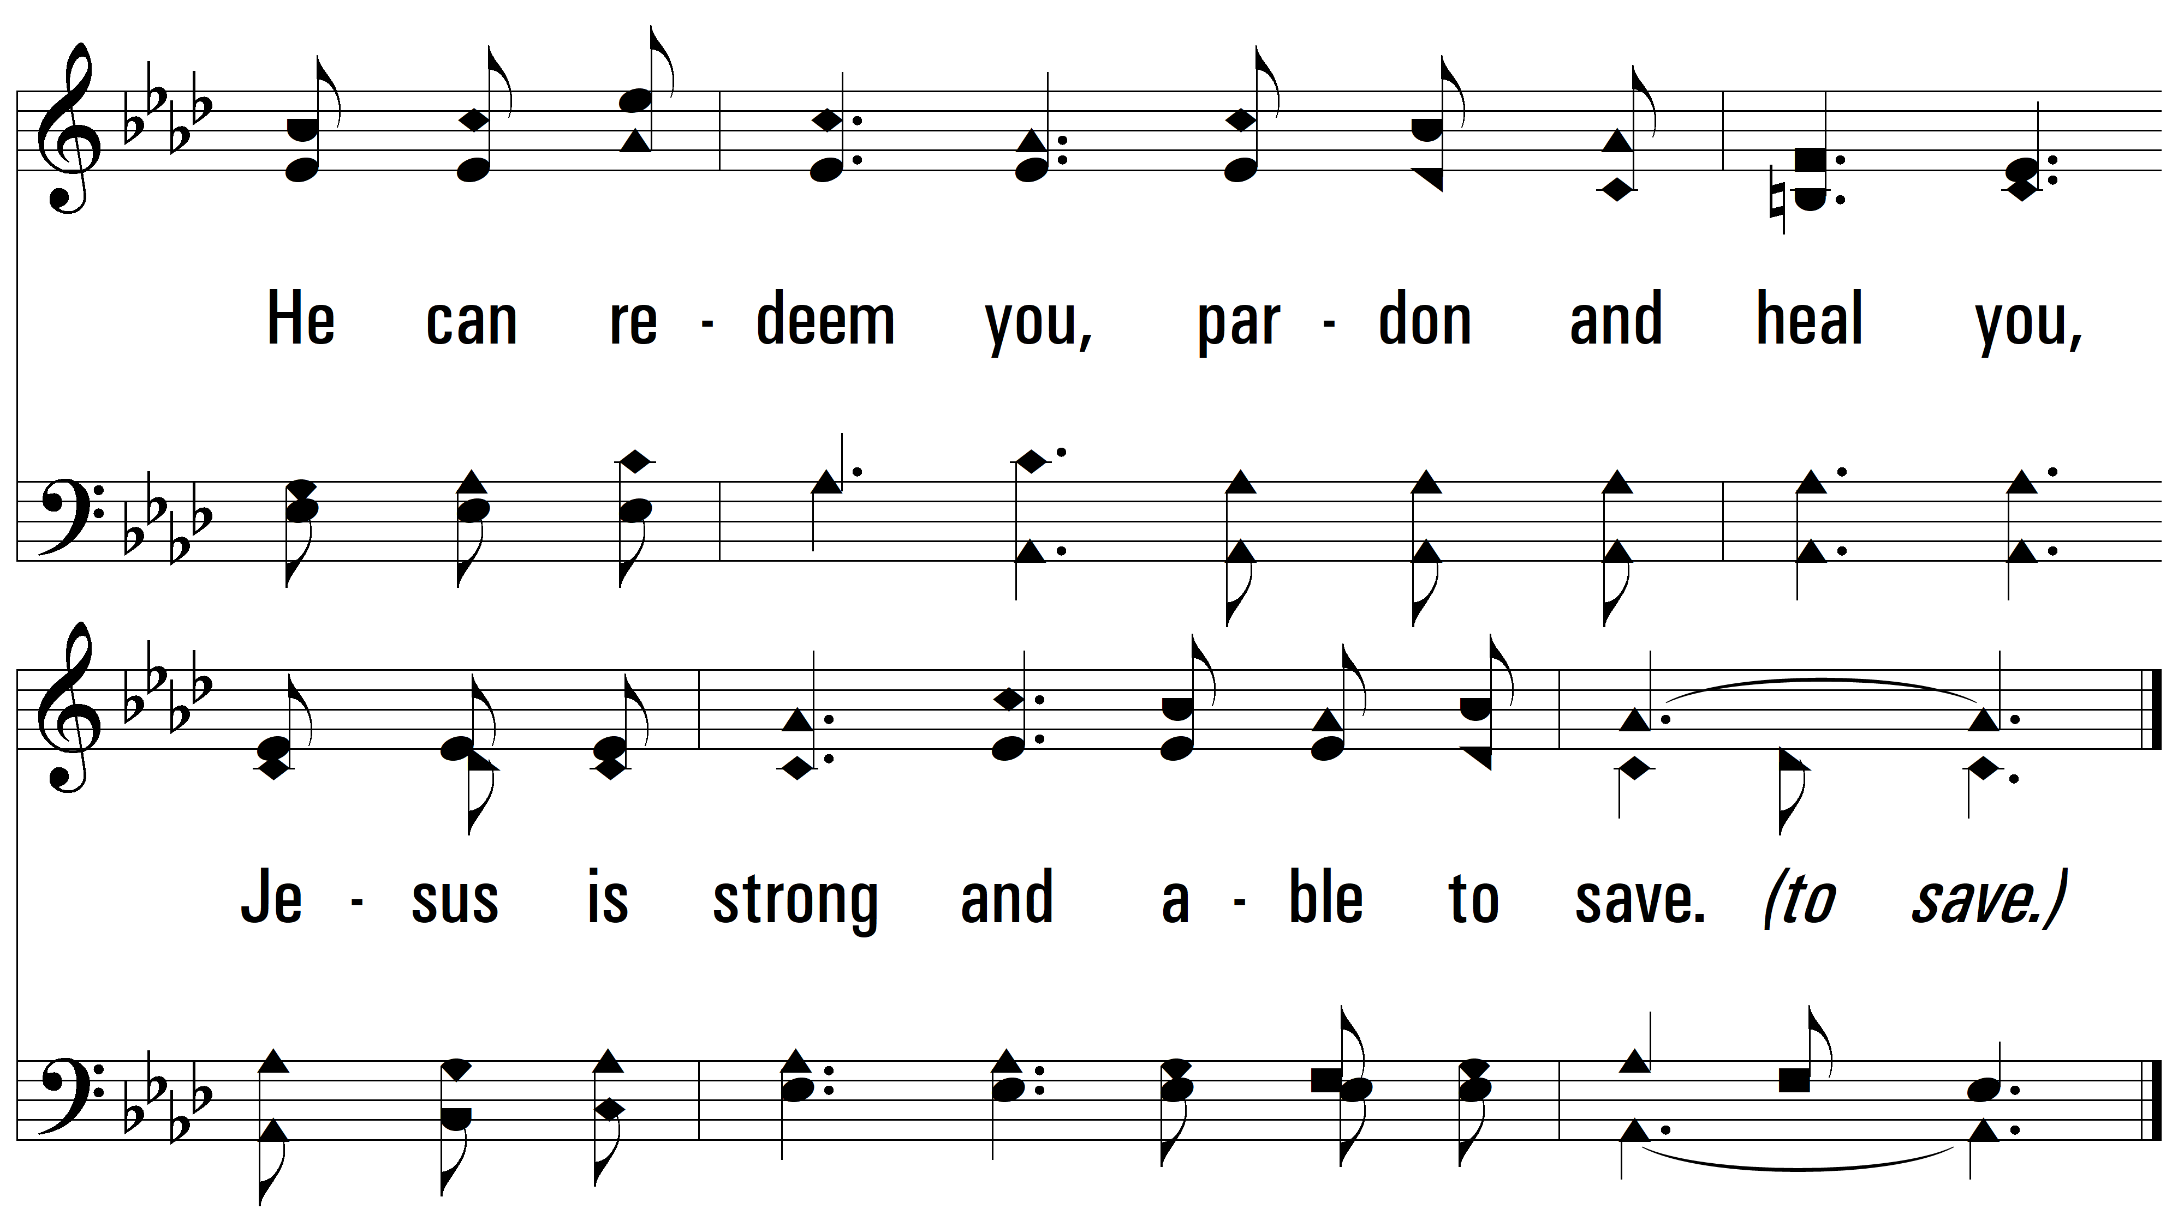
vs. 1

Slide 6
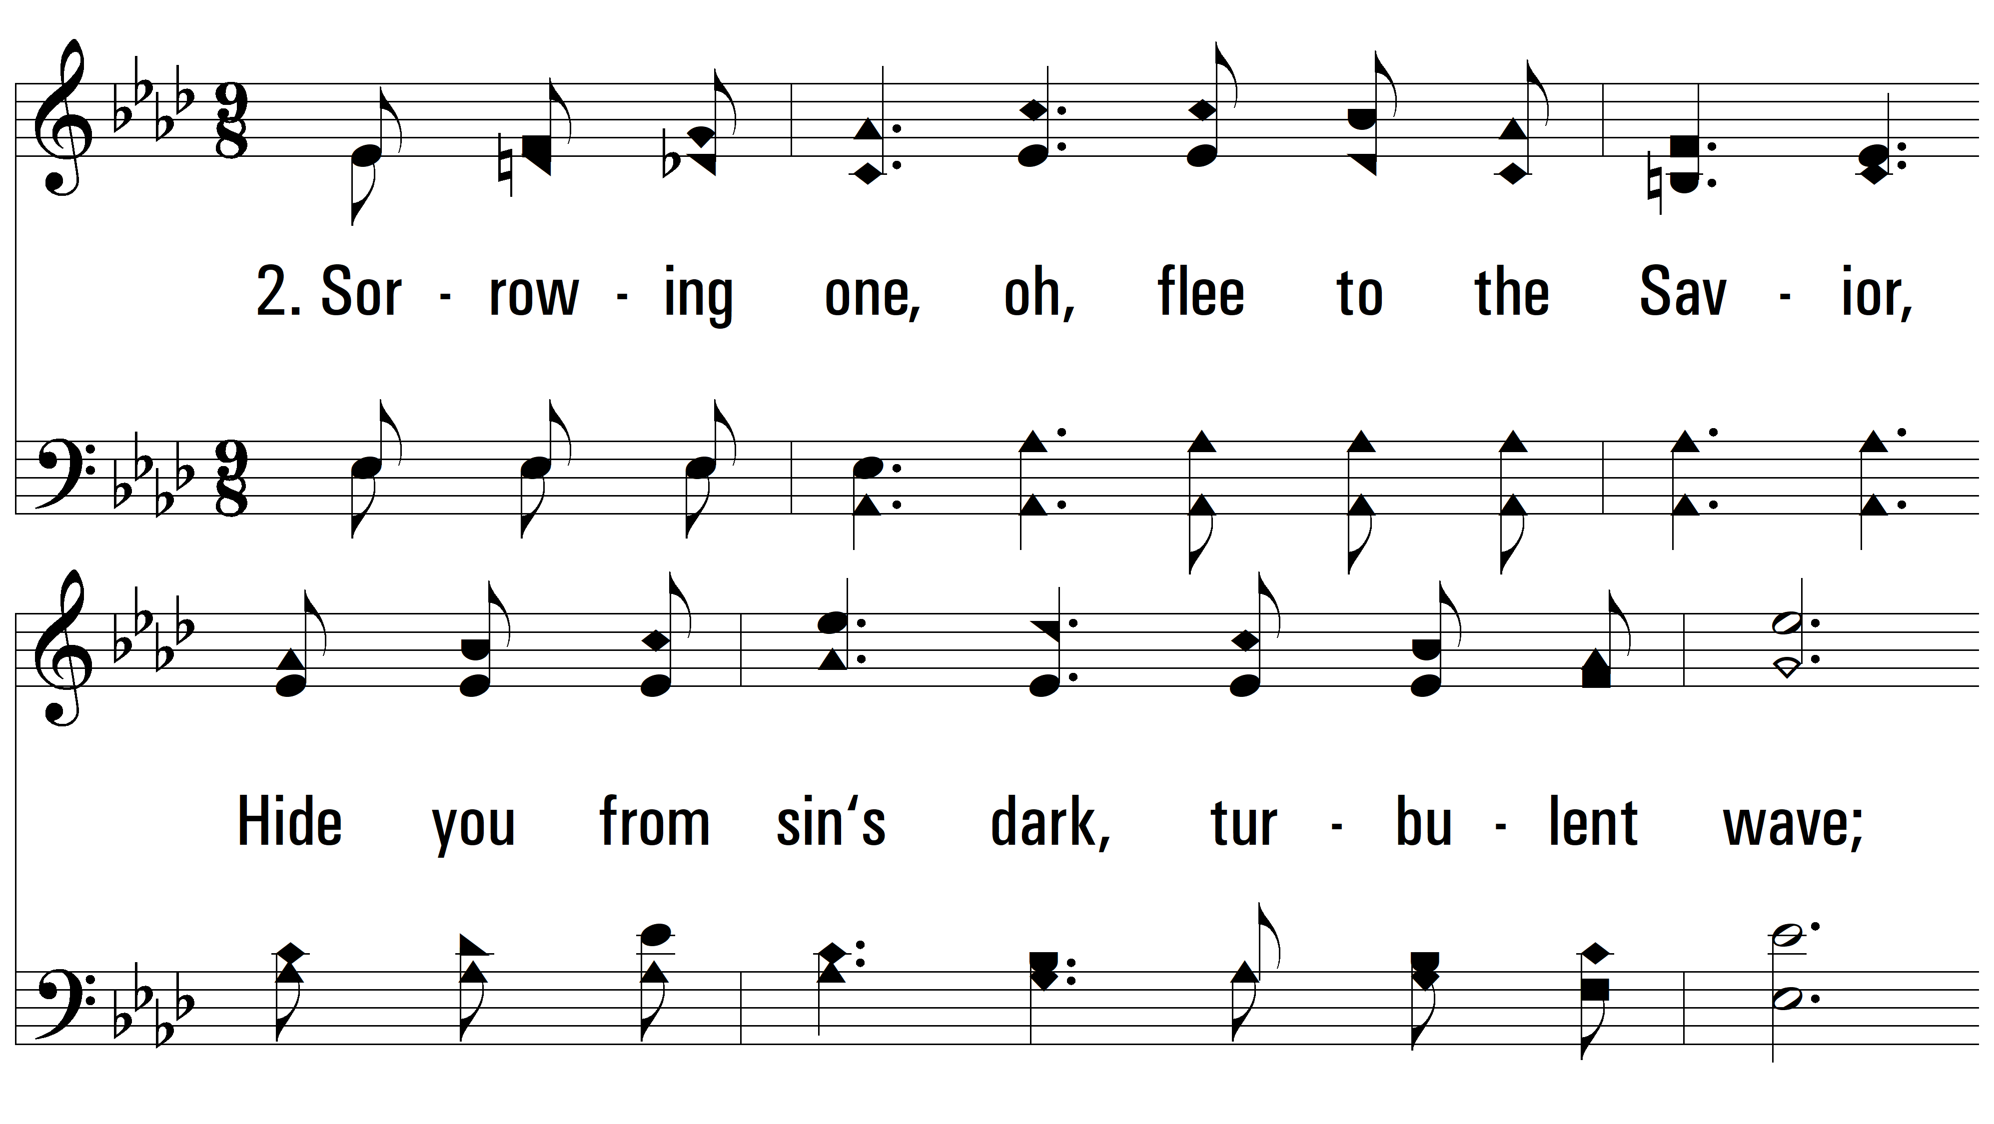
vs. 2 ~ Jesus Is Strong And Able To Save

Slide 7
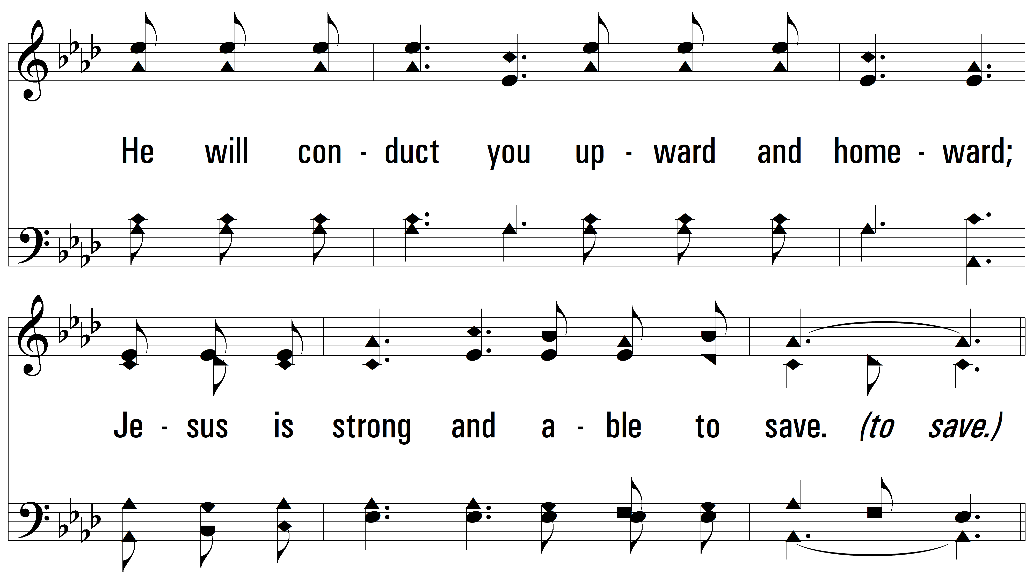
vs. 2

Slide 8
vs. 2

Slide 9
vs. 2

Slide 10
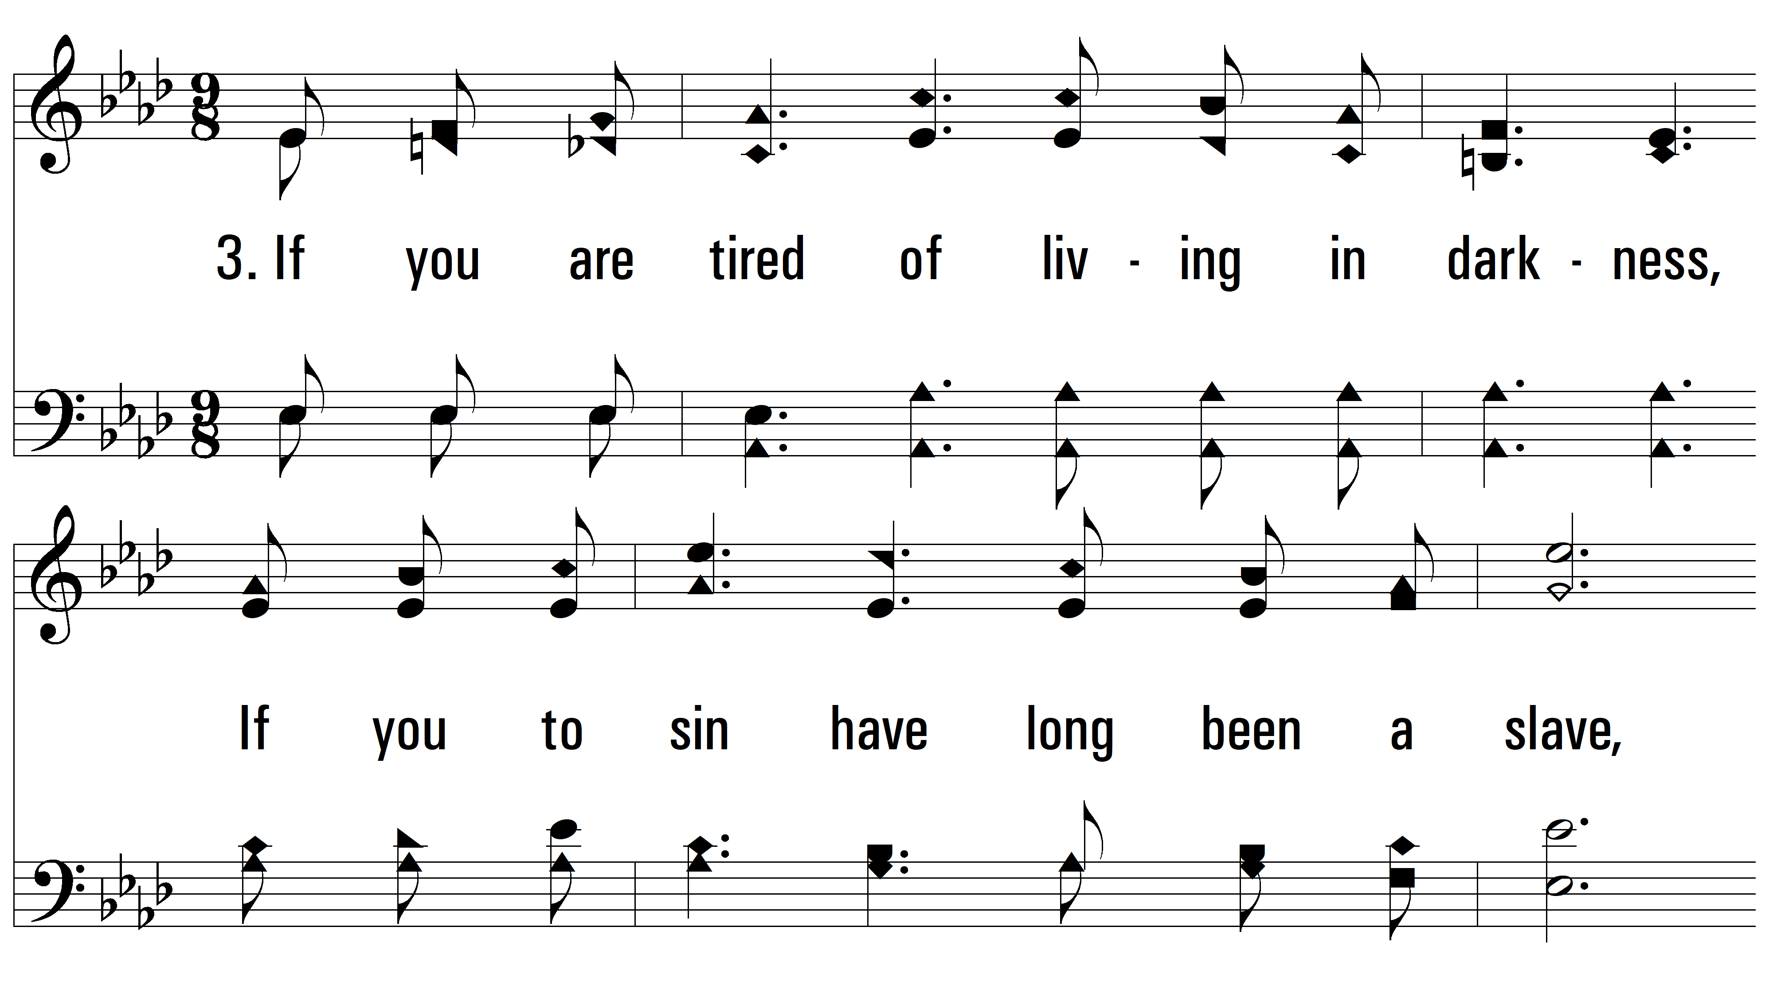
vs. 3 ~ Jesus Is Strong And Able To Save

Slide 11
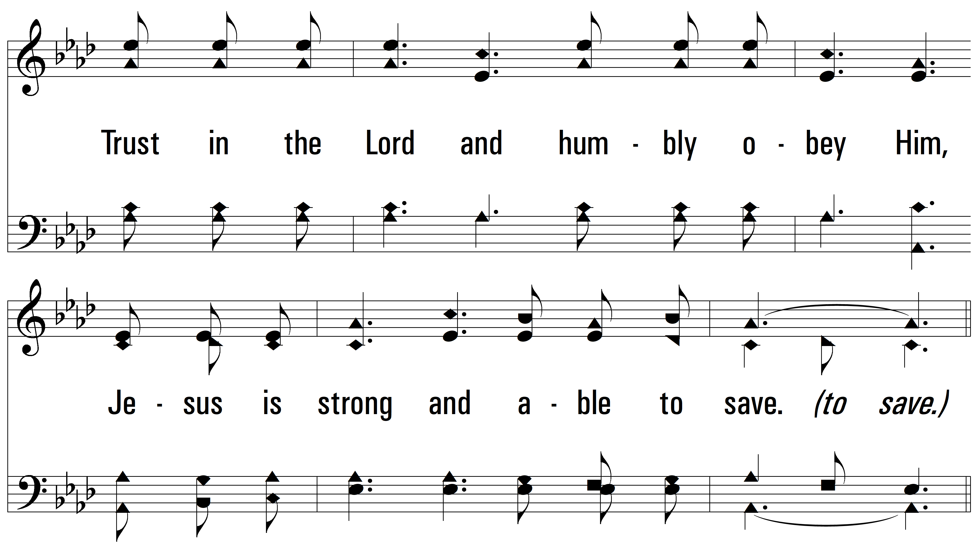
vs. 3

Slide 12
vs. 3

Slide 13
vs. 3

Slide 14
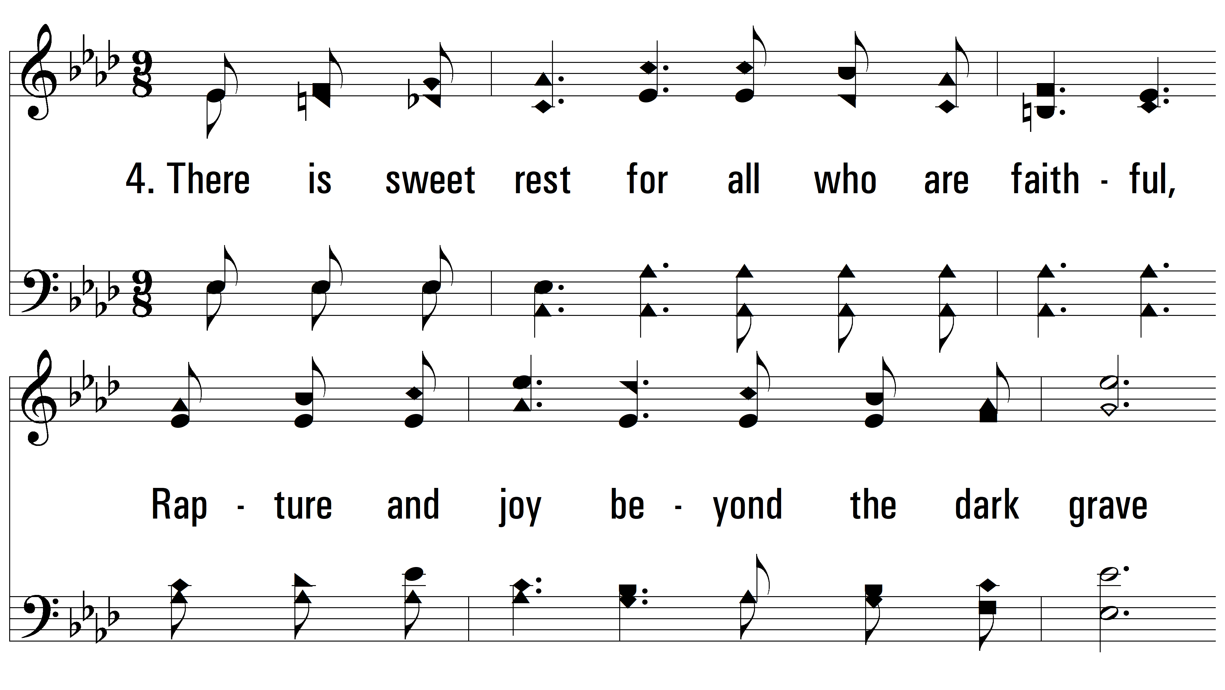
vs. 4 ~ Jesus Is Strong And Able To Save

Slide 15
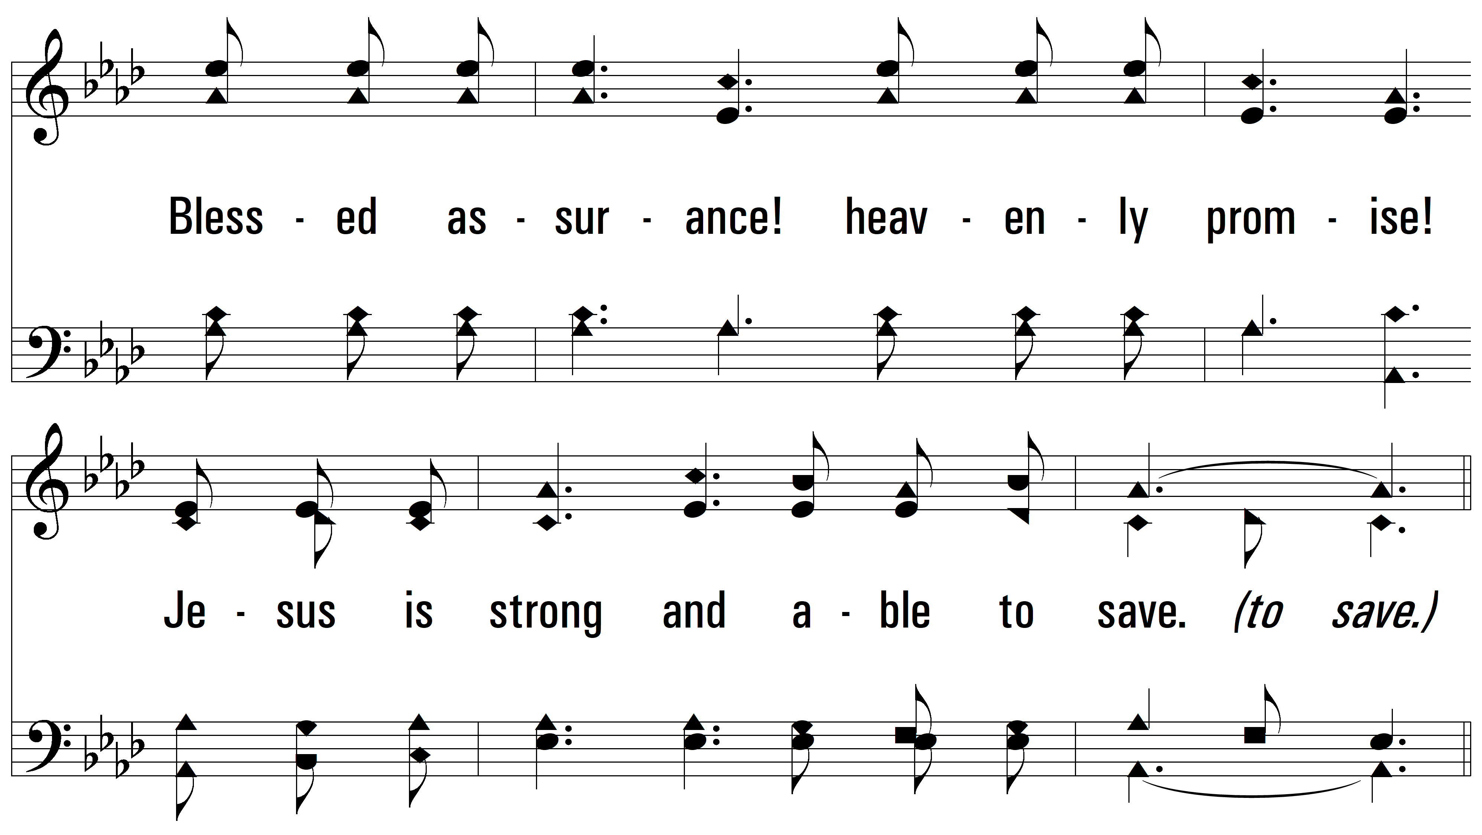
vs. 4

Slide 16
vs. 4

Slide 17
vs. 4
PDHymns.com
END

