Slide 1
Jesus Is Mine
Words: | James C. Bonar (1845)
Music: | Theodore E. Perkins (1858)
6/8
E^{b}/B^{b} - MI
Verses: 4
Lead - | SOL
Alto - | MI
Tenor - | DO
Bass - | DO
PDHymns.com

Slide 2
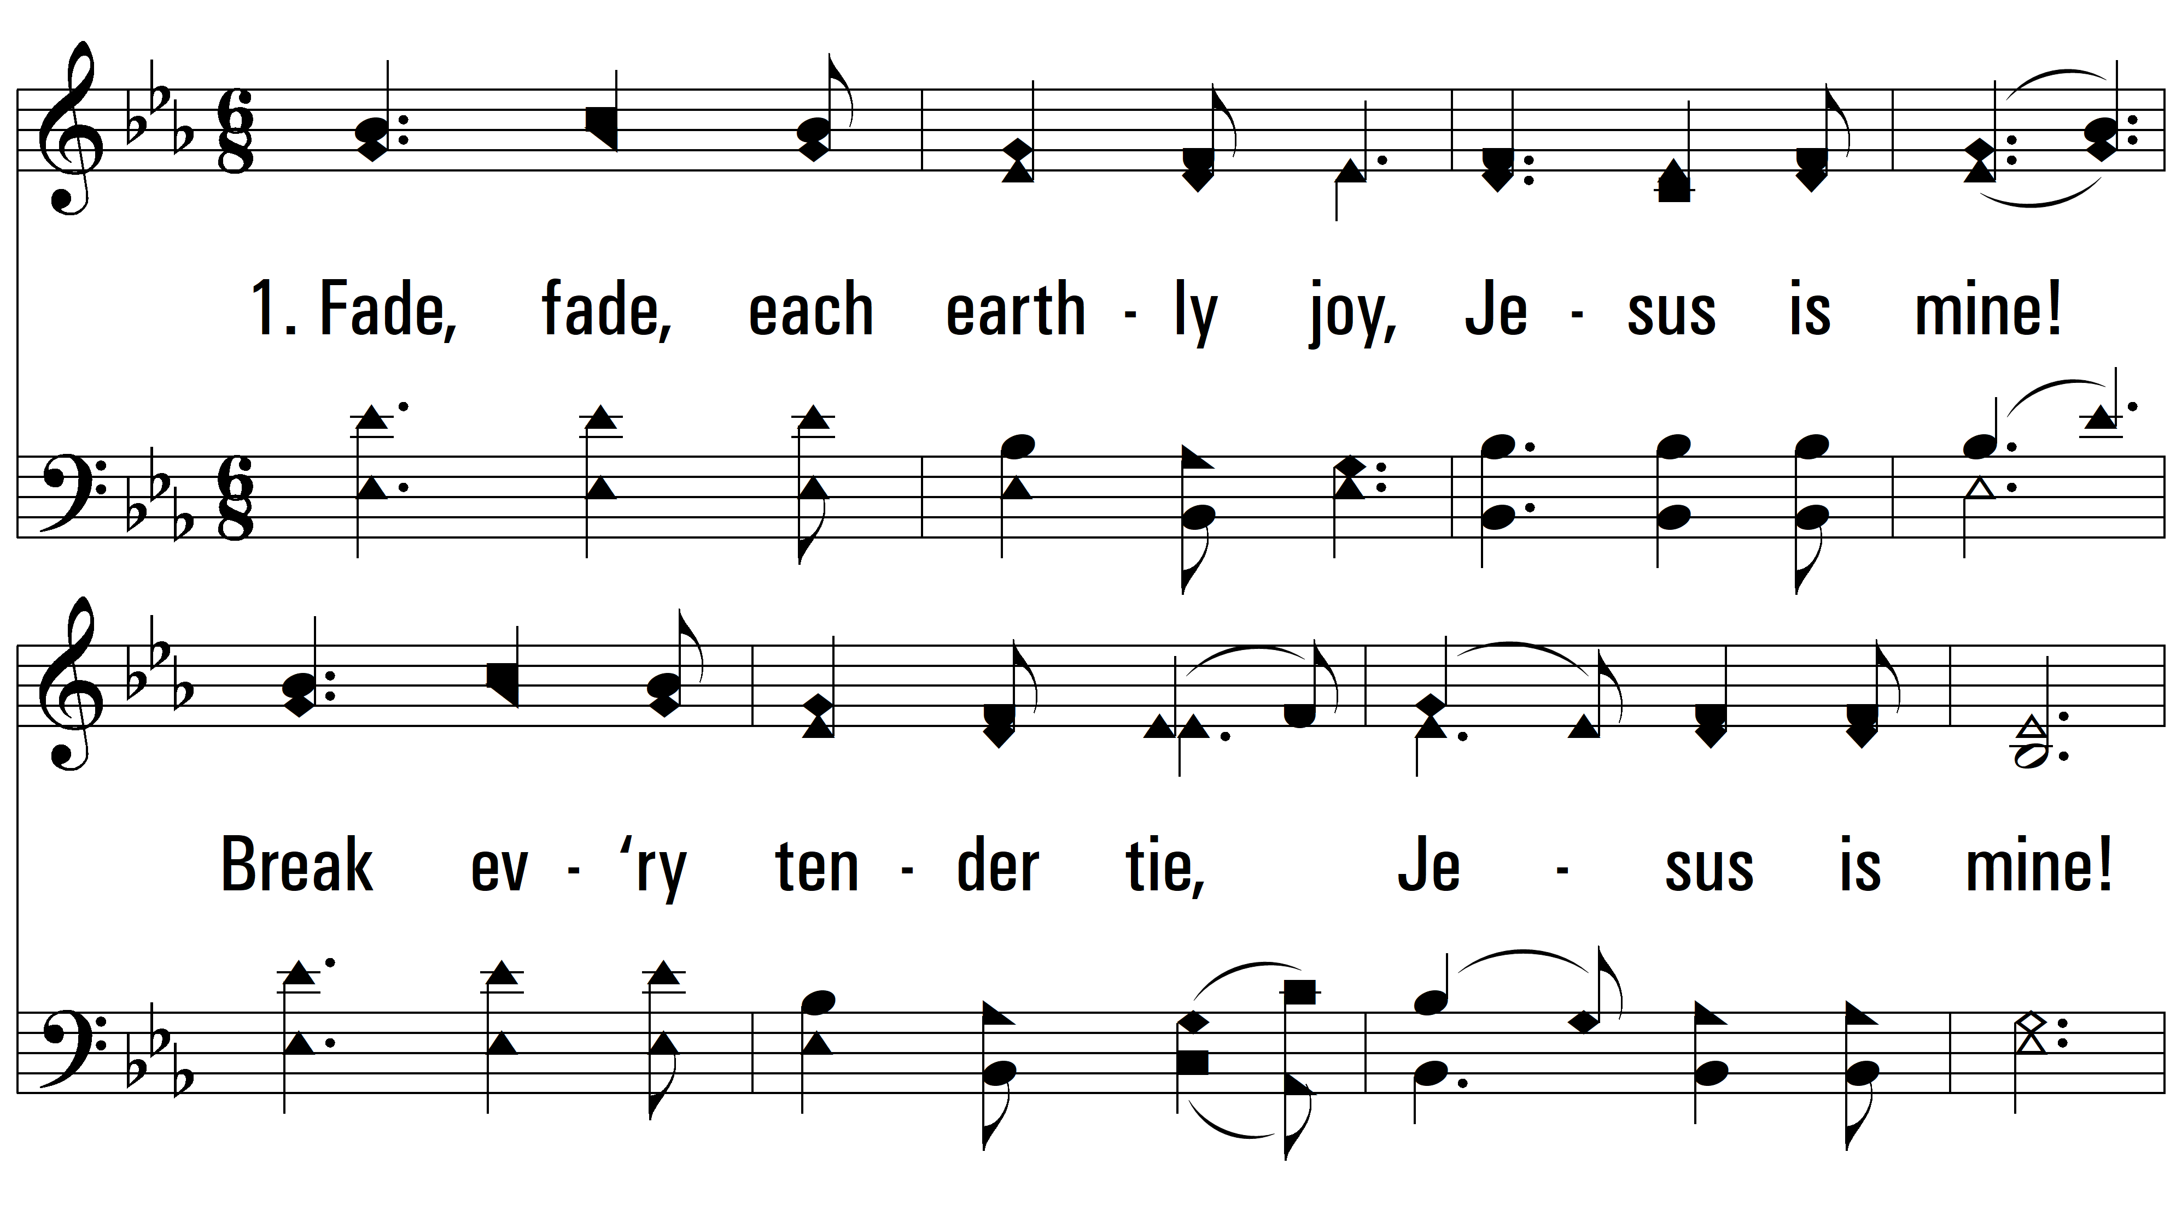
vs. 1 ~ Jesus Is Mine

Slide 3
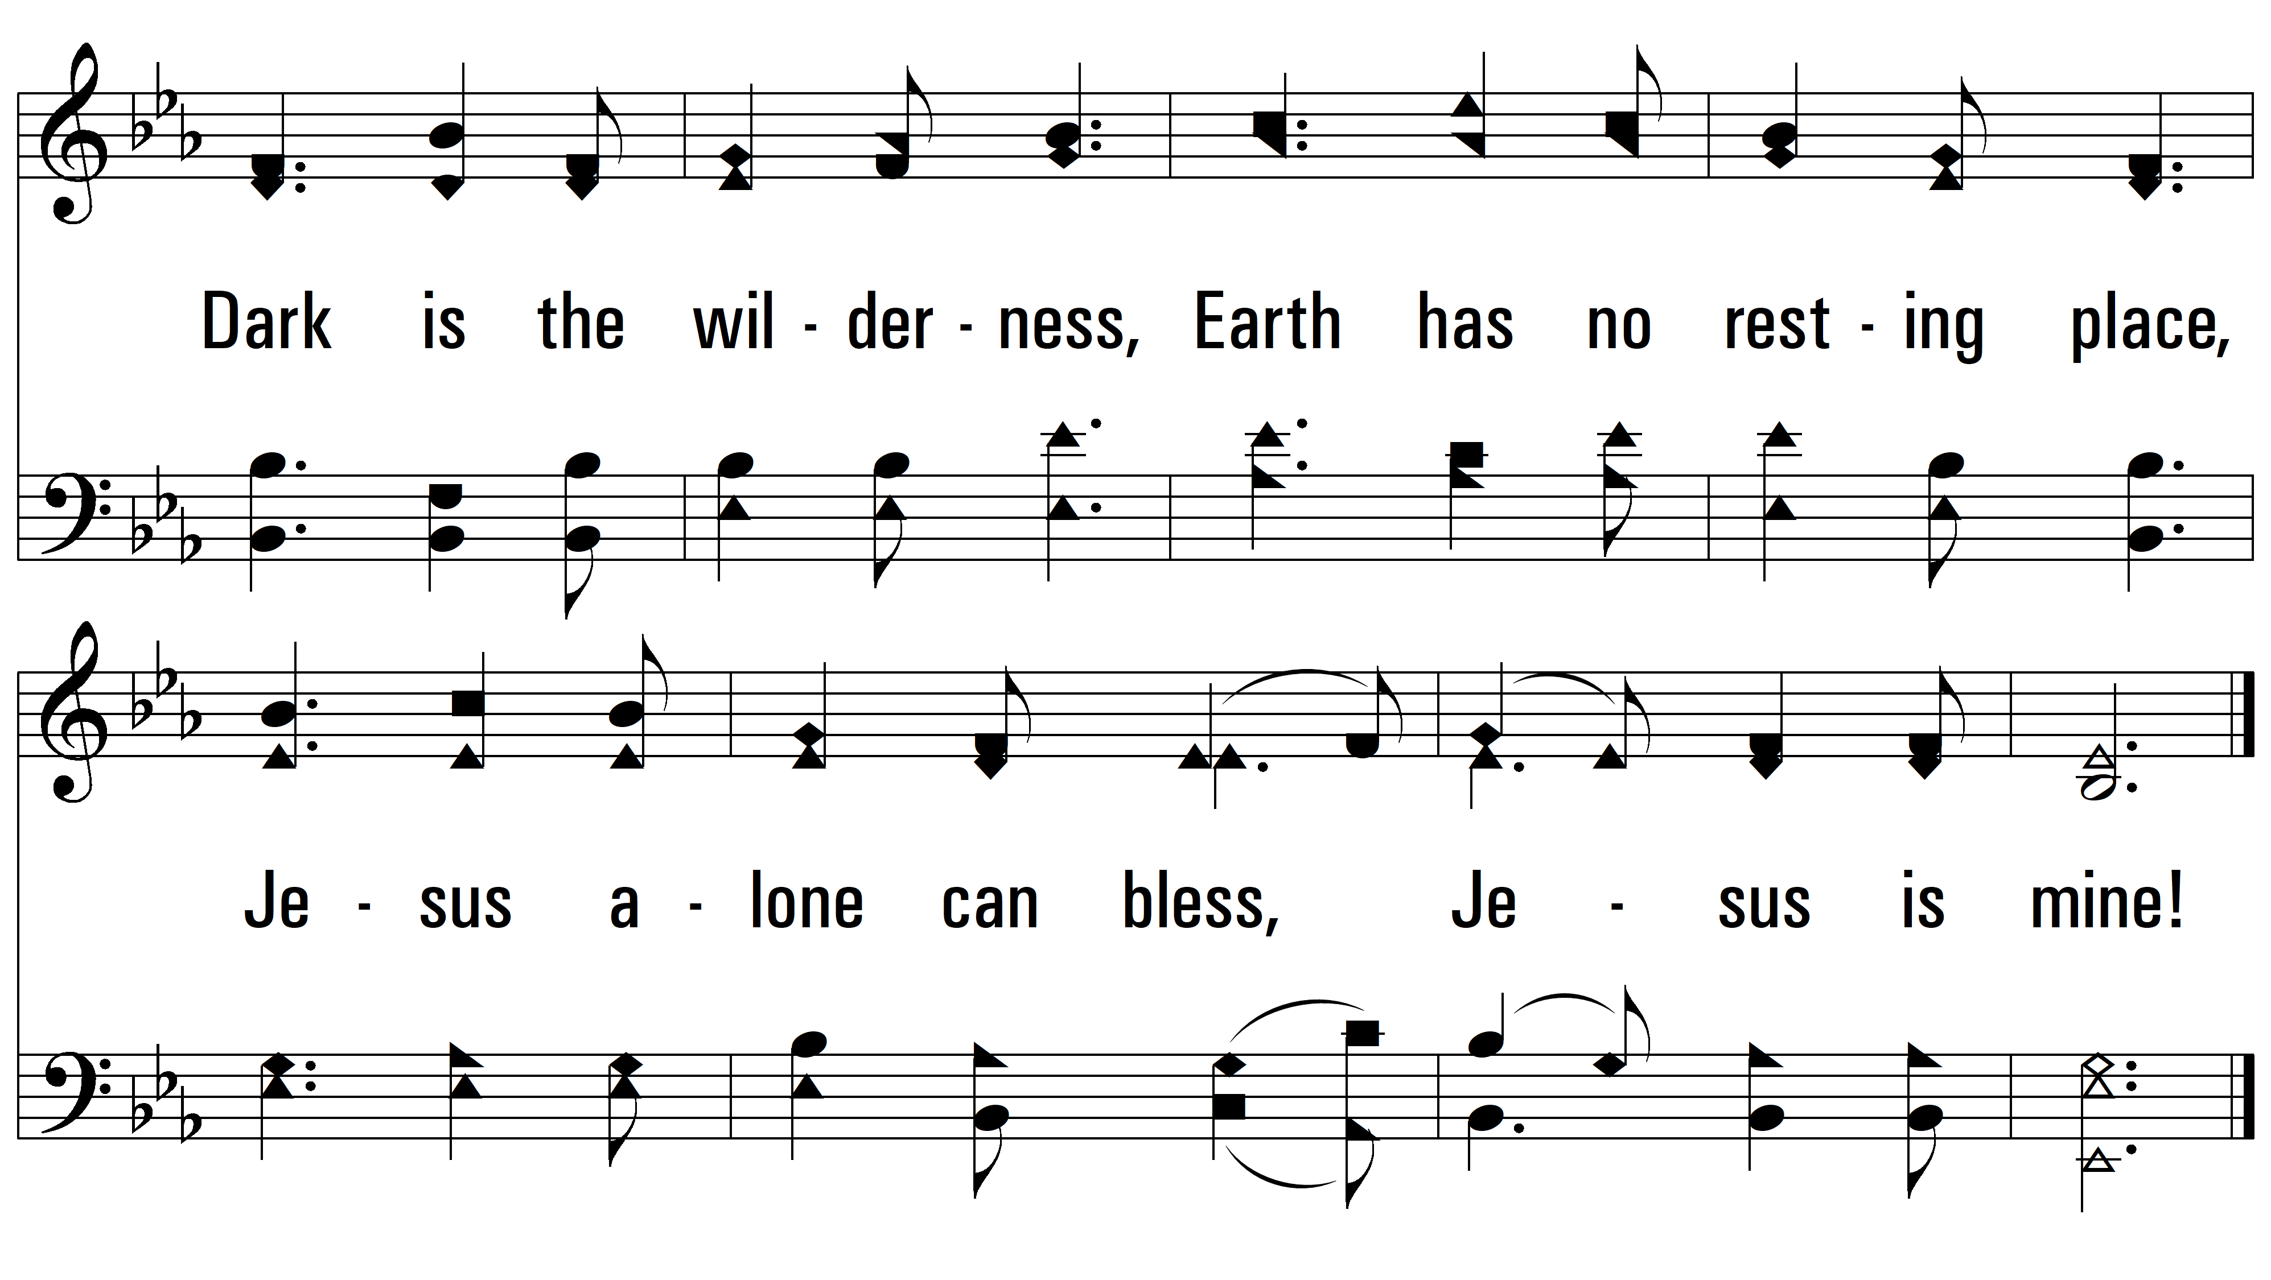
vs. 1

Slide 4
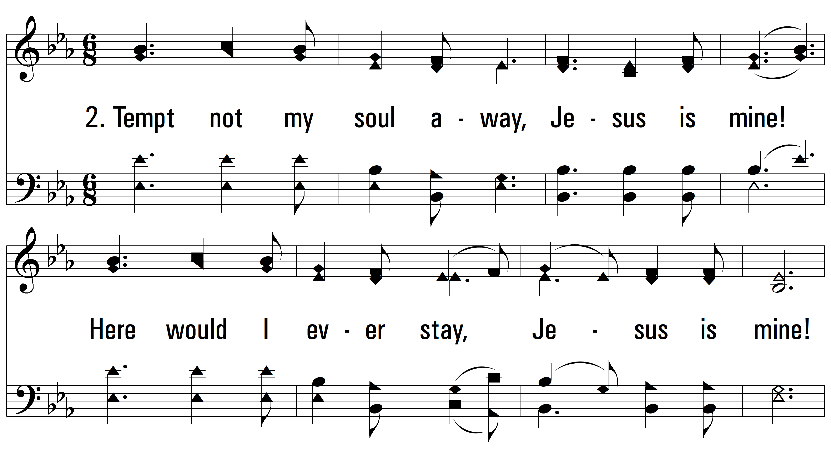
vs. 2 ~ Jesus Is Mine

Slide 5
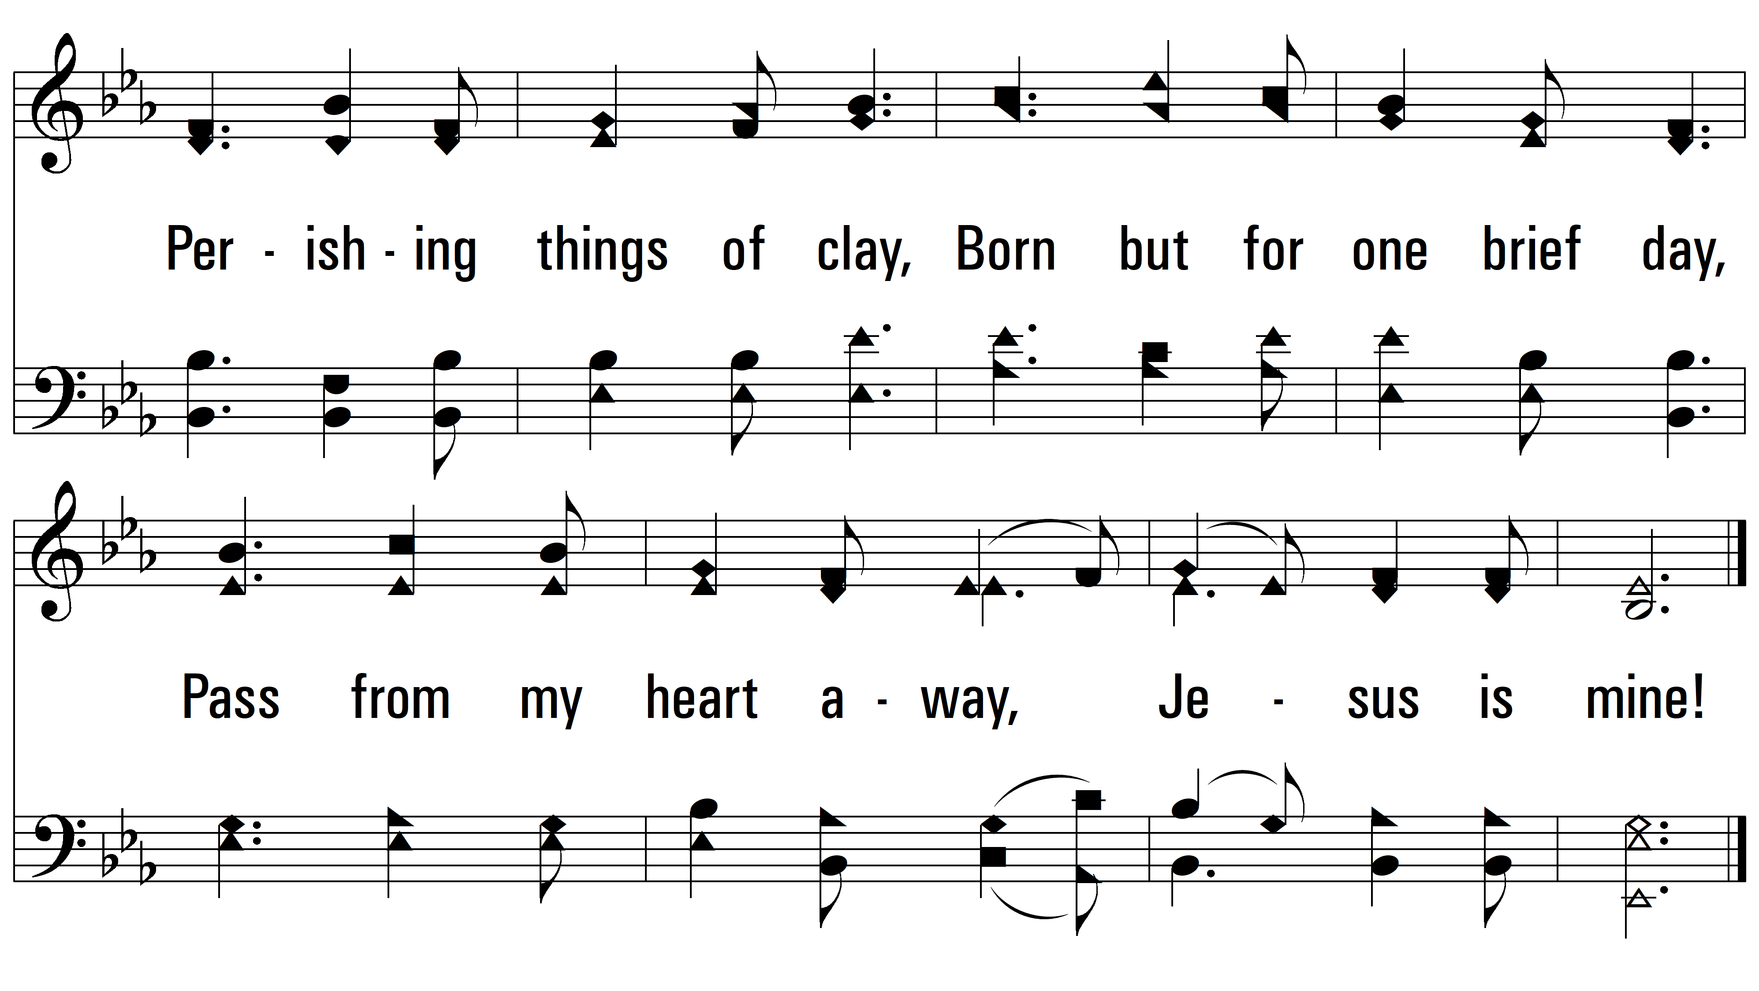
vs. 2

Slide 6
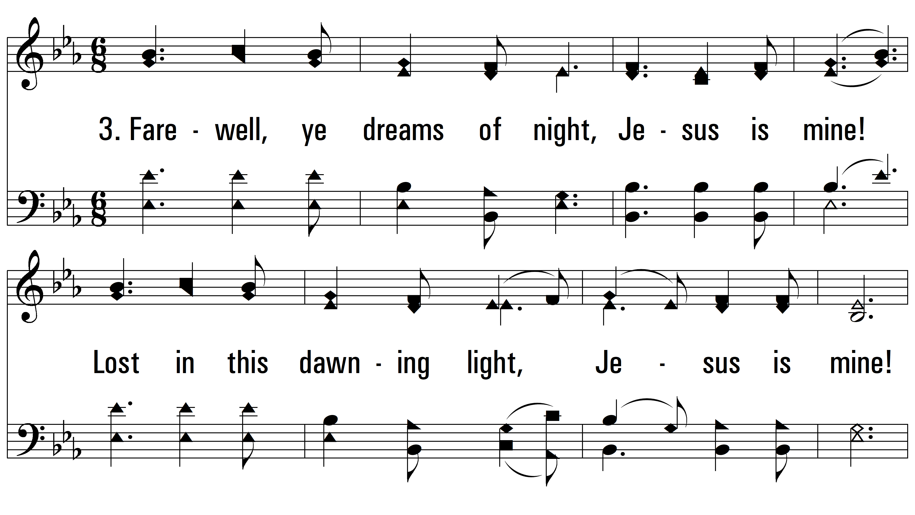
vs. 3 ~ Jesus Is Mine

Slide 7
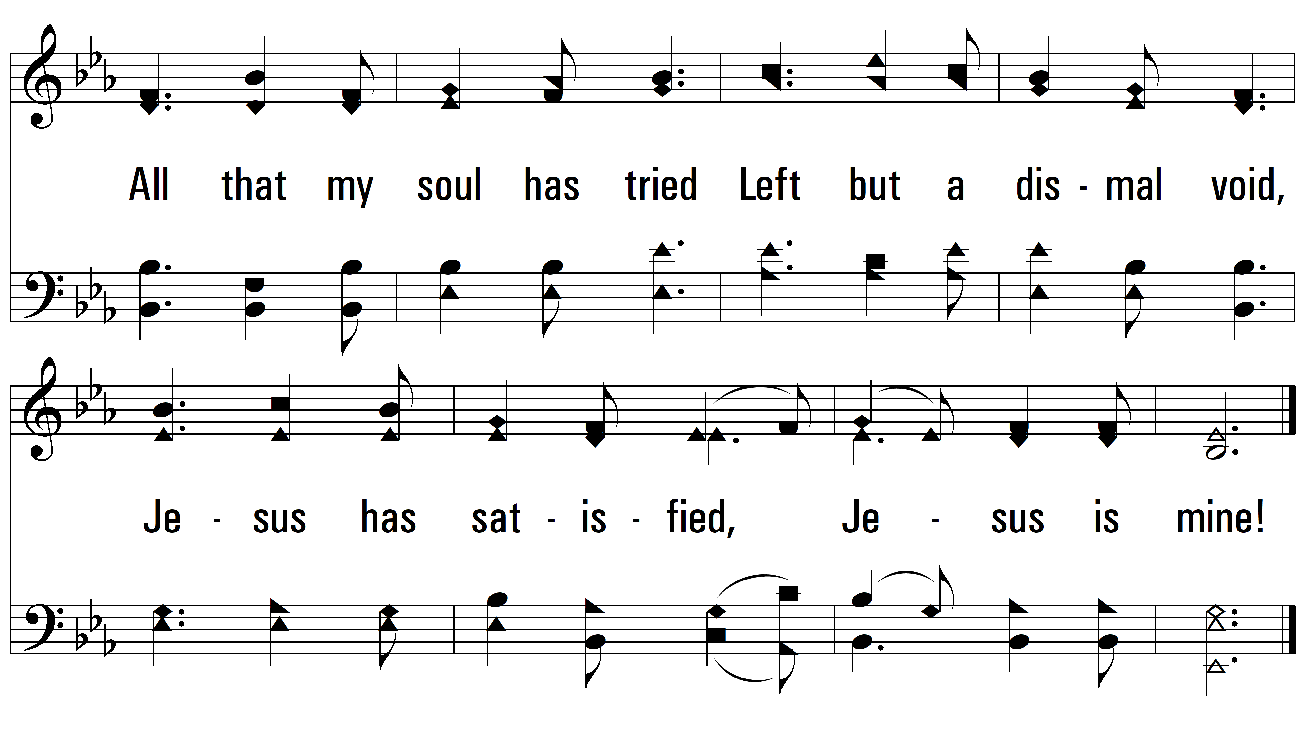
vs. 3

Slide 8
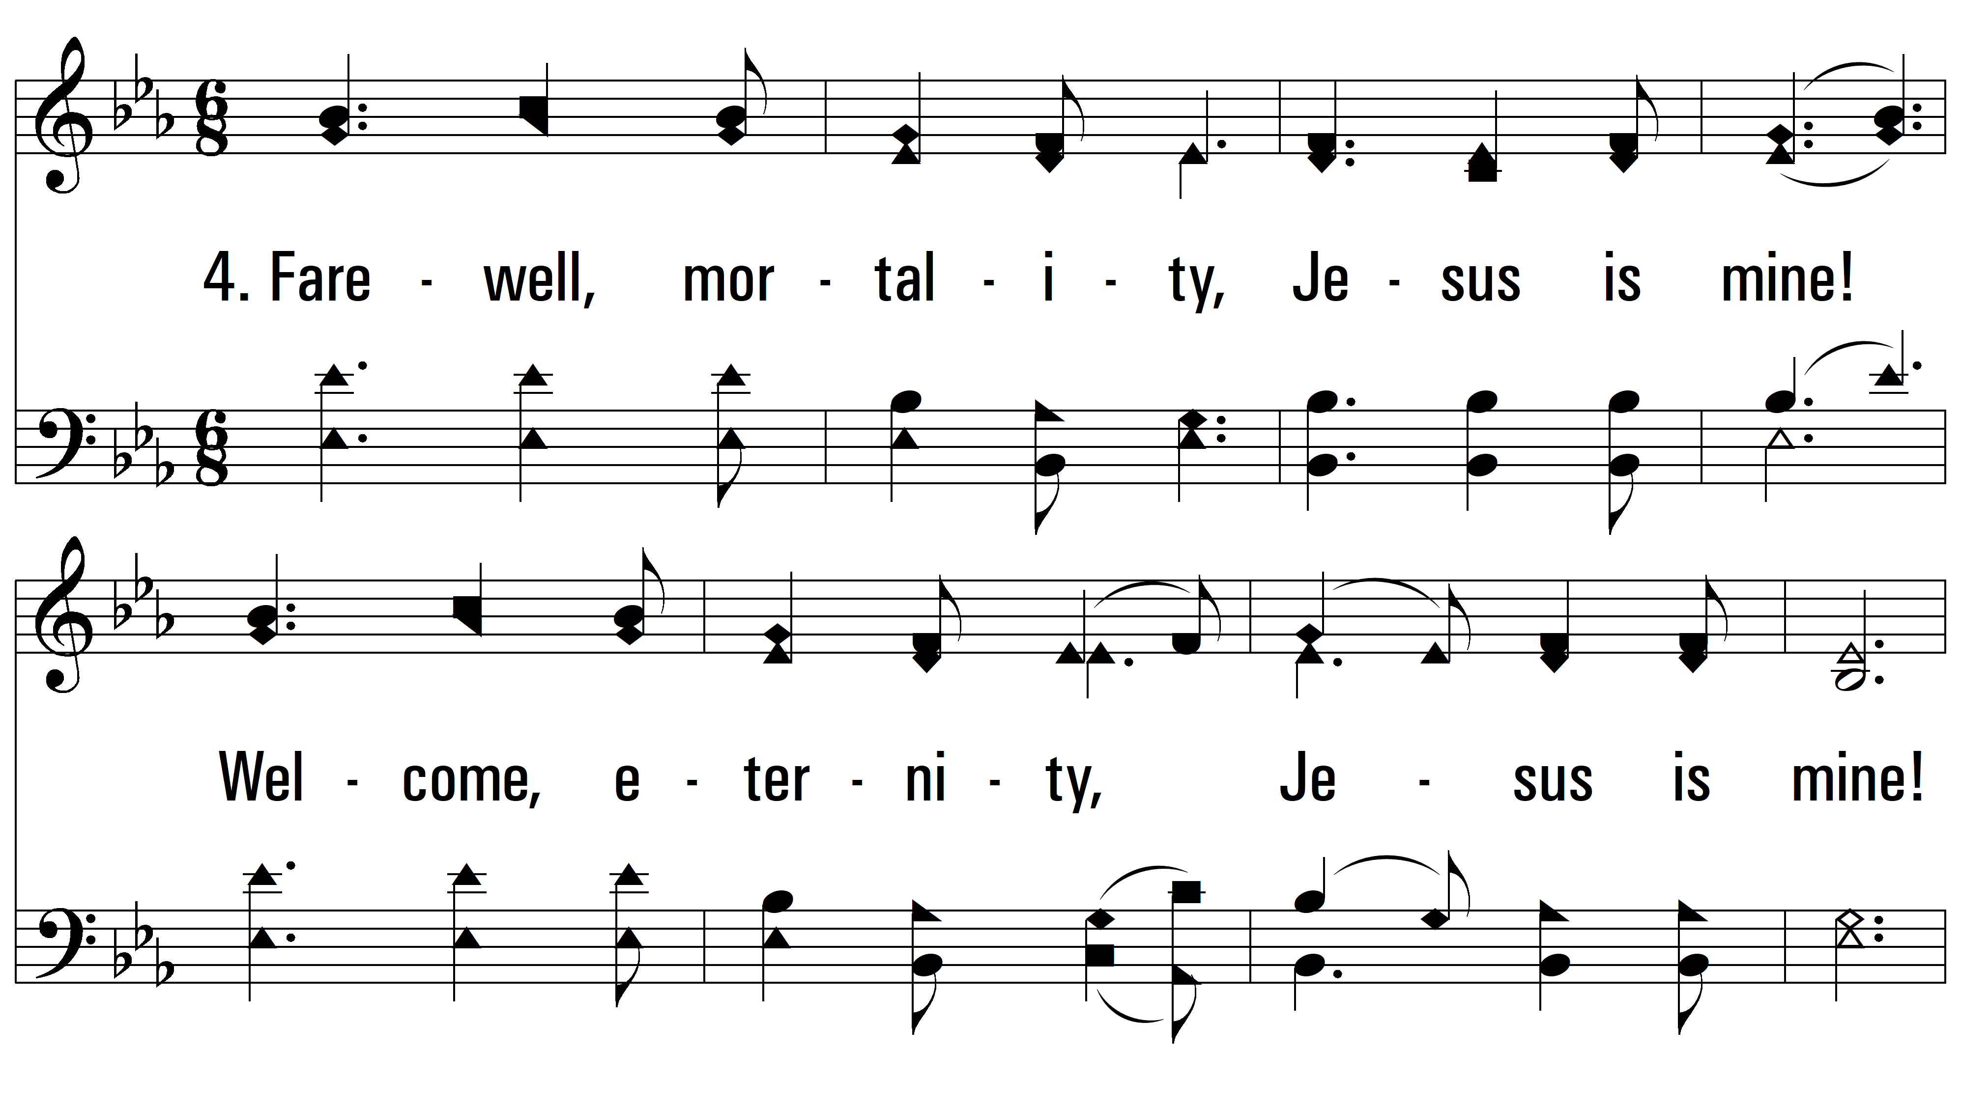
vs. 4 ~ Jesus Is Mine

Slide 9
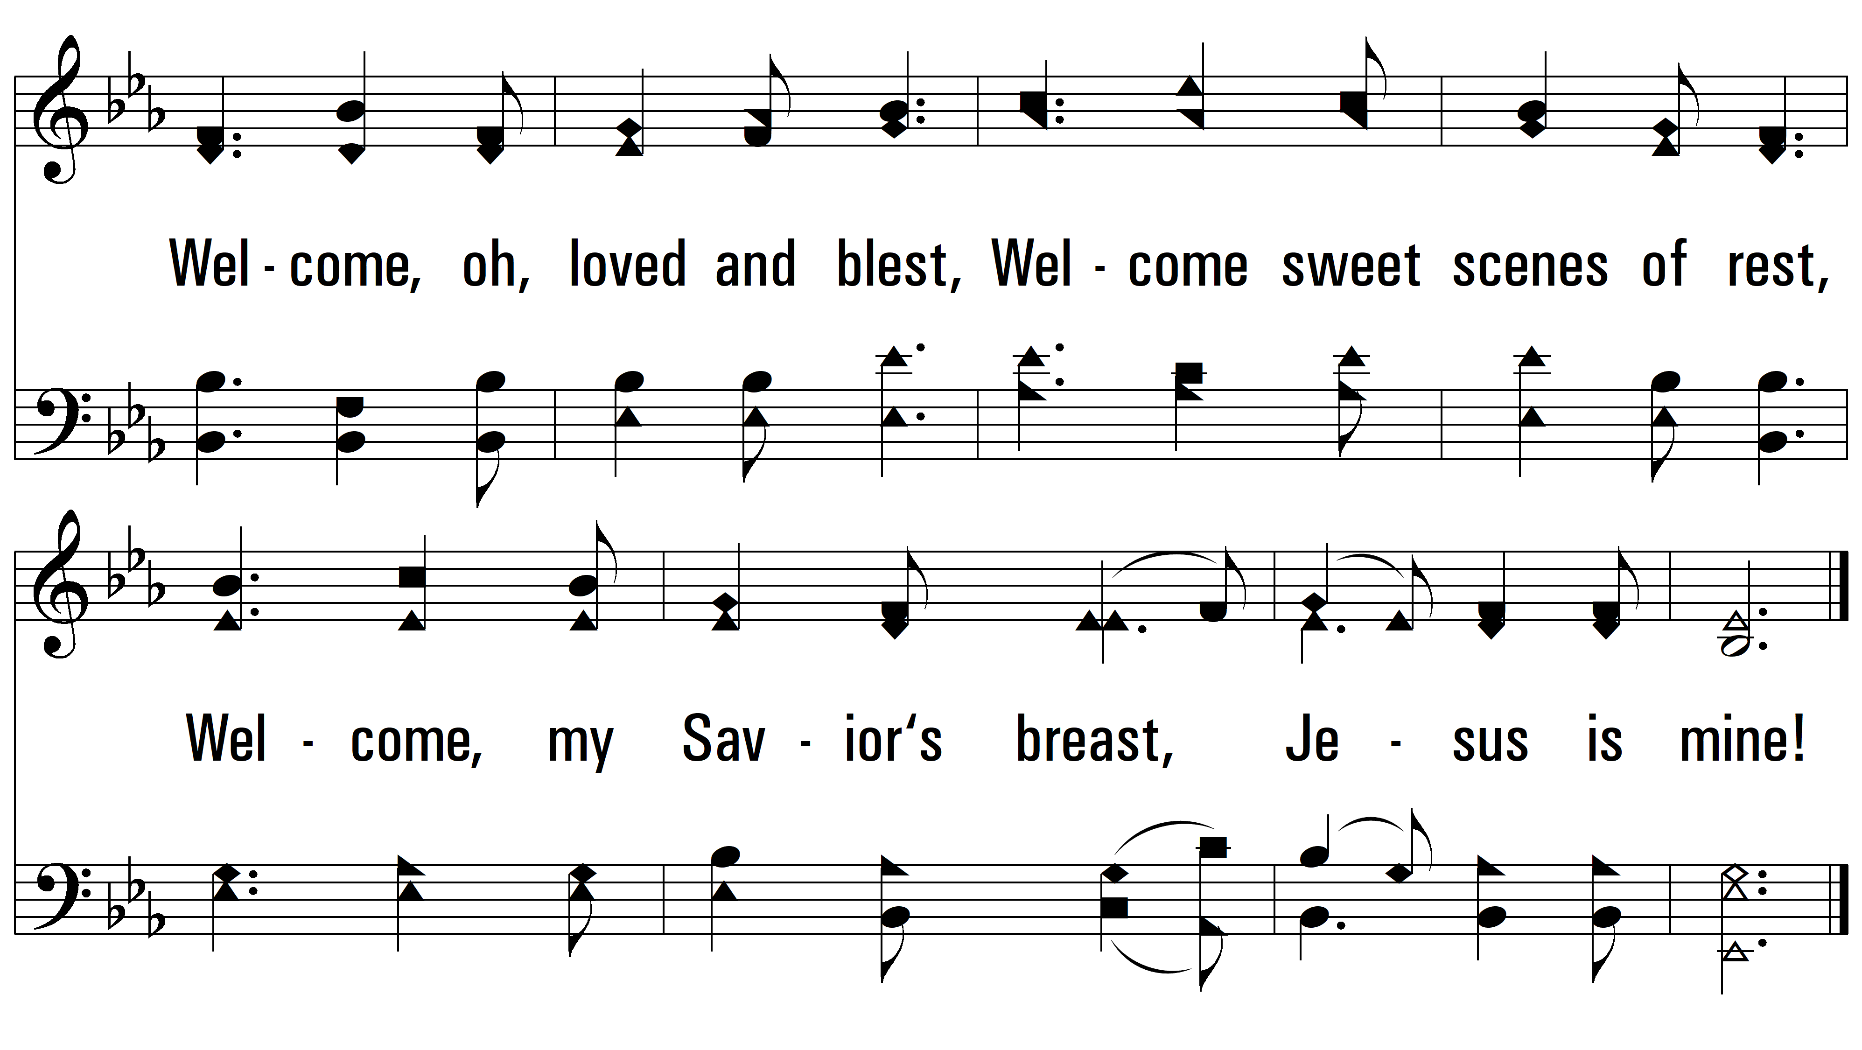
vs. 4
PDHymns.com
END

