Slide 1
Jesus Is All The World To Me
ELIZABETH
8.6.8.6.8.8.4.4.3
Words: | Will L. Thompson (1904)
Music: | Will L. Thompson (1904)
6/8
A^{b}/C - SOL
Verses: 4
Lead - | MI
Alto - | SOL
Tenor - | DO
Bass - | DO
PDHymns.com

Slide 2
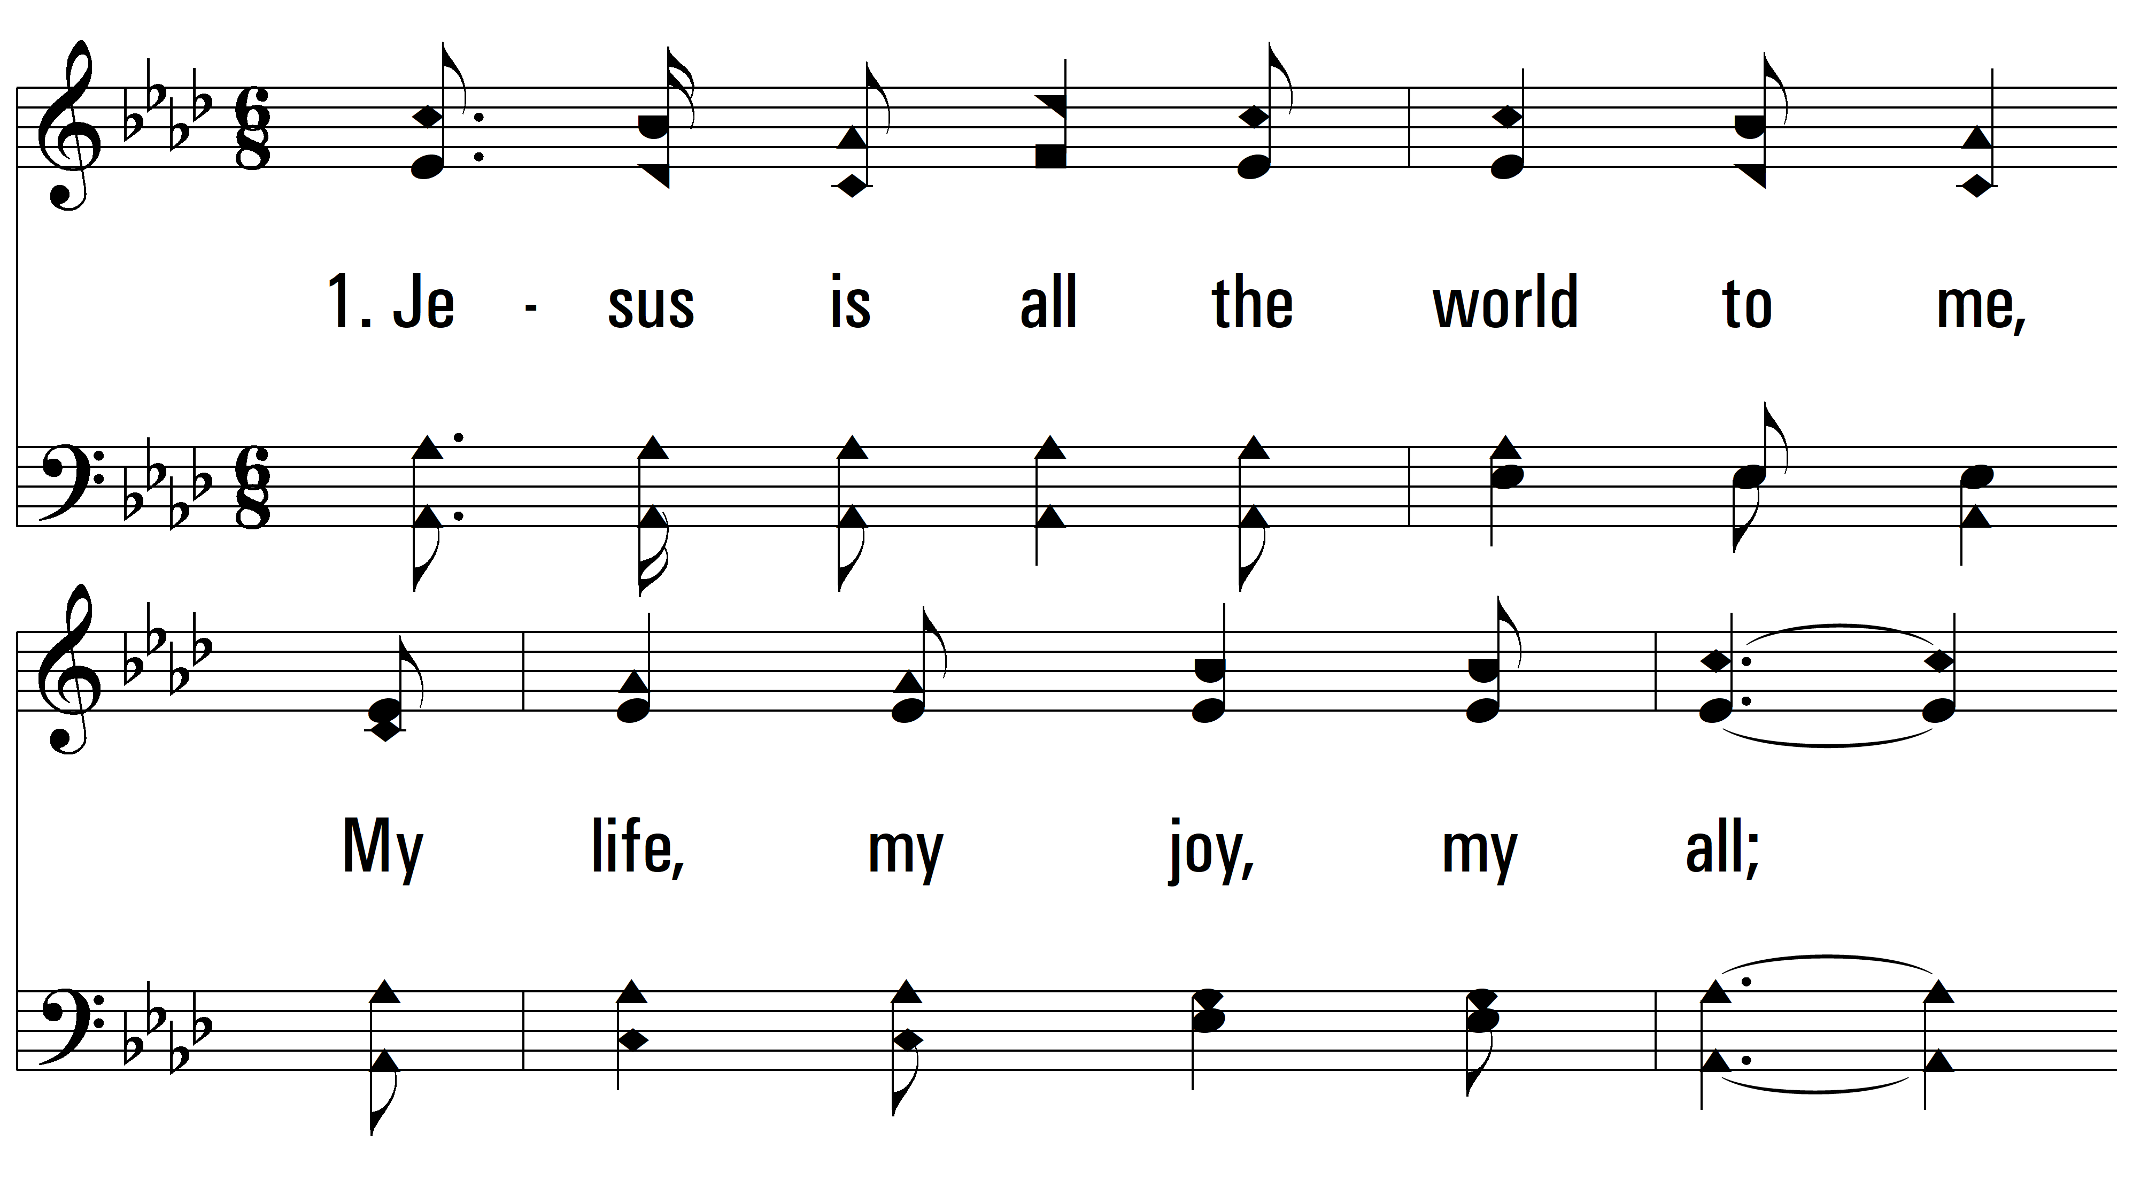
vs. 1 ~ Jesus Is All The World To Me

Slide 3
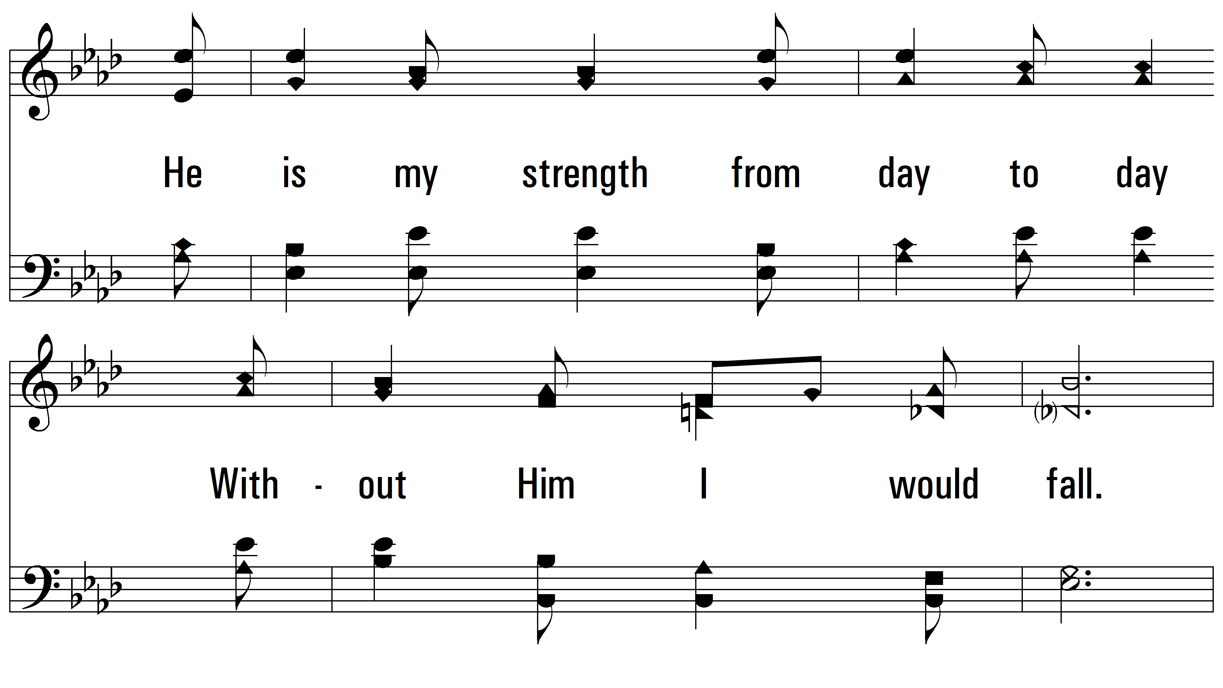
vs. 1

Slide 4
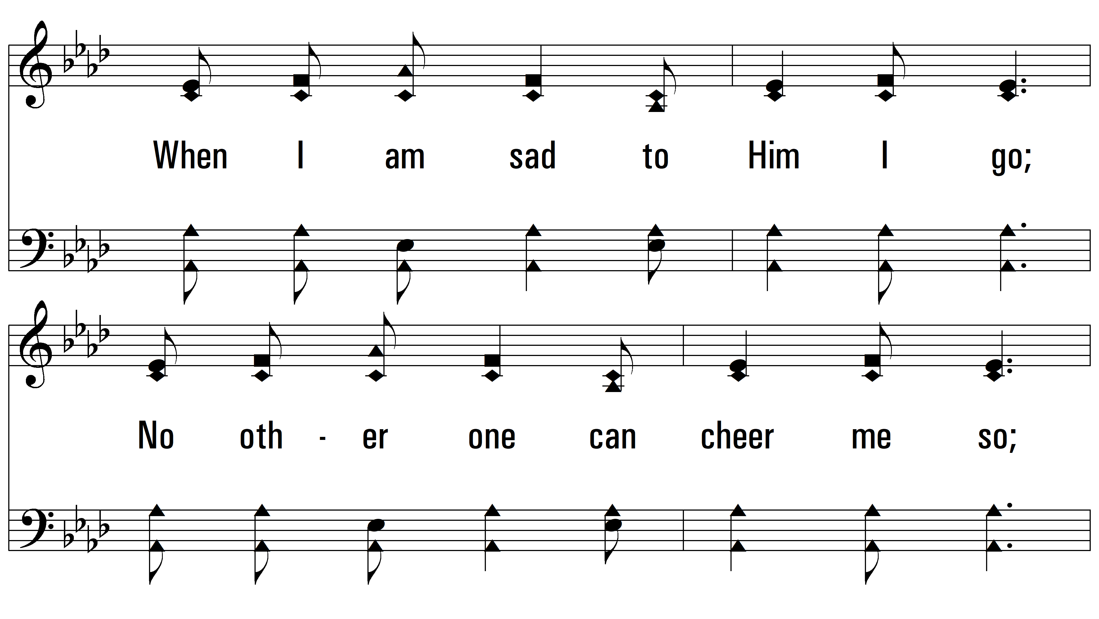
vs. 1

Slide 5
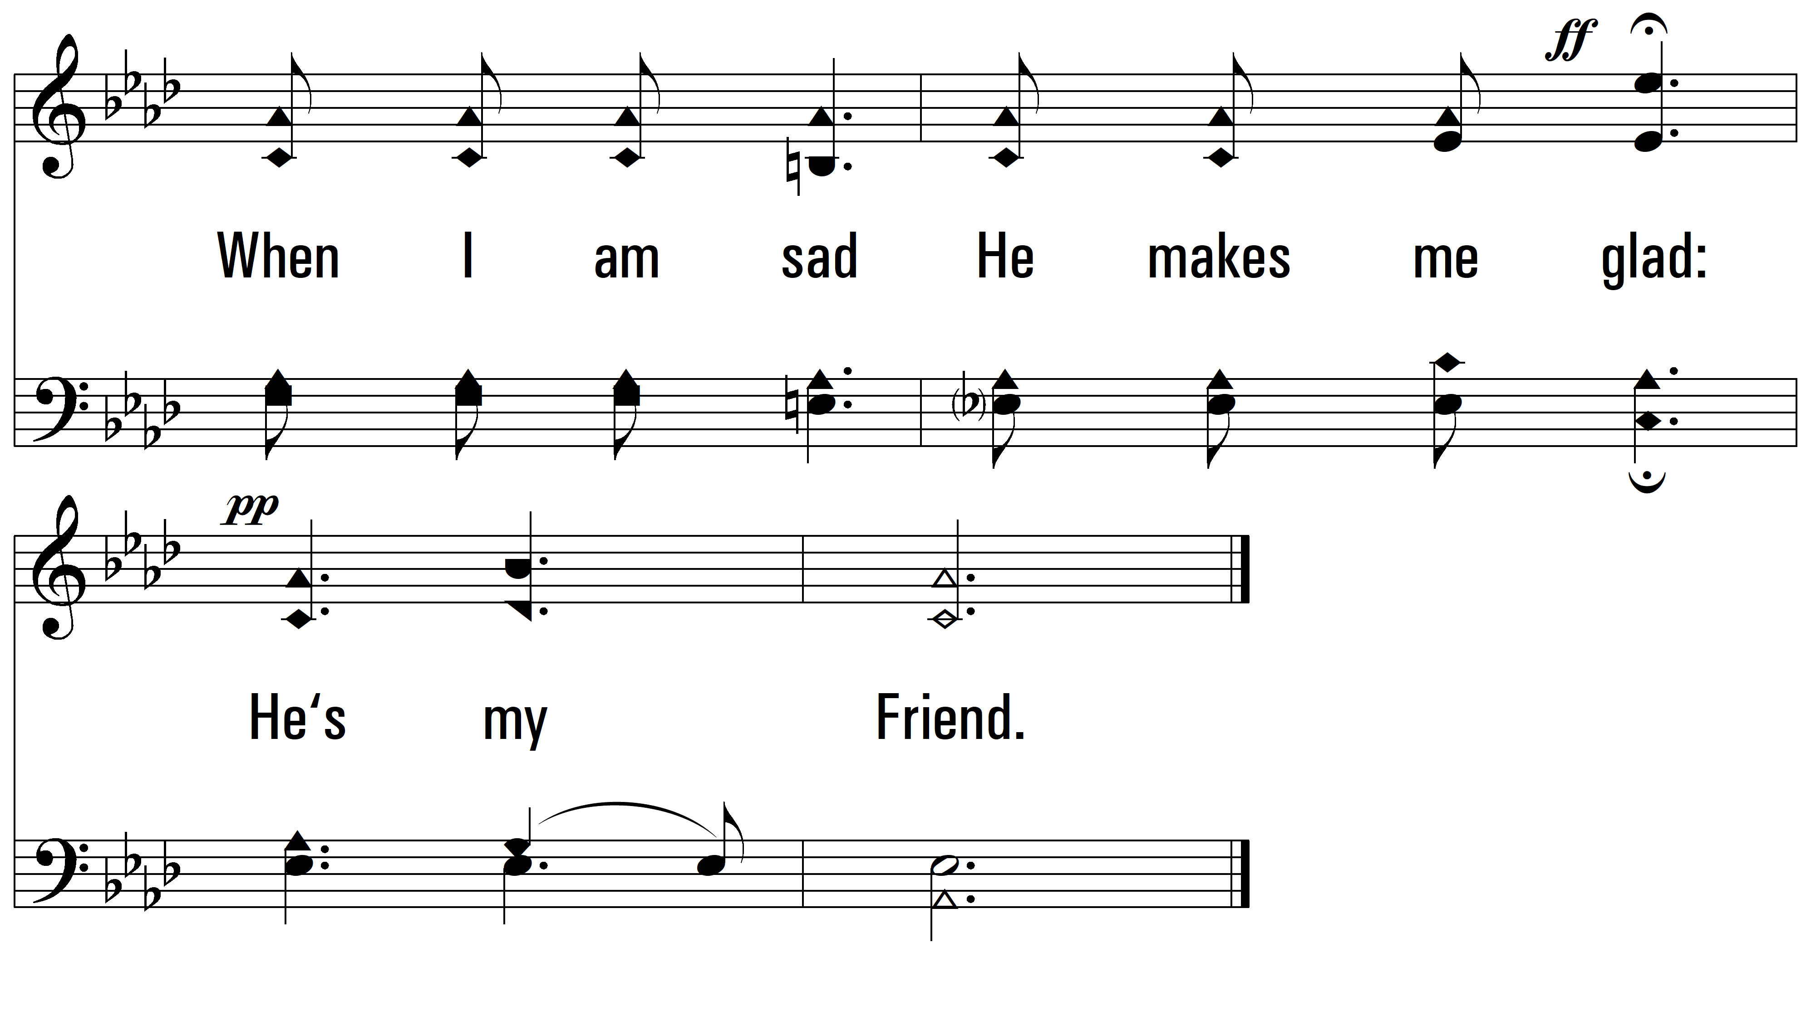
vs. 1

Slide 6
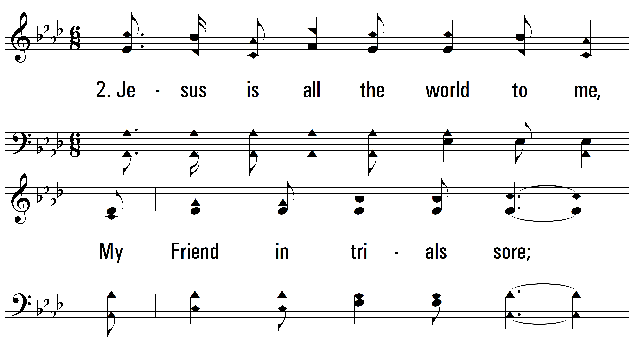
vs. 2 ~ Jesus Is All The World To Me

Slide 7
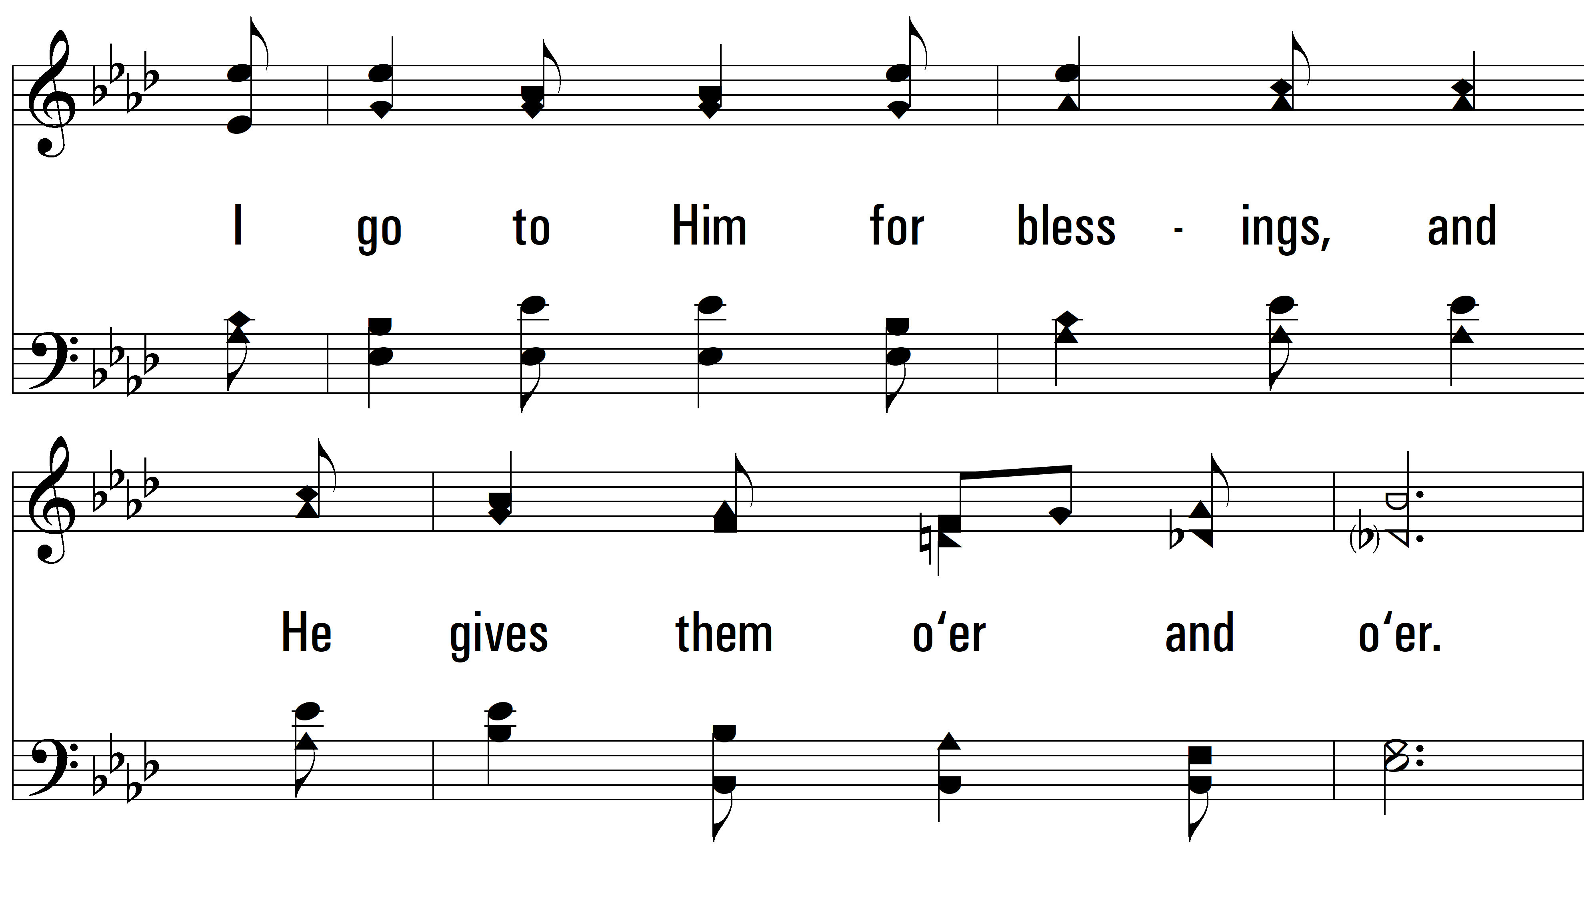
vs. 2

Slide 8
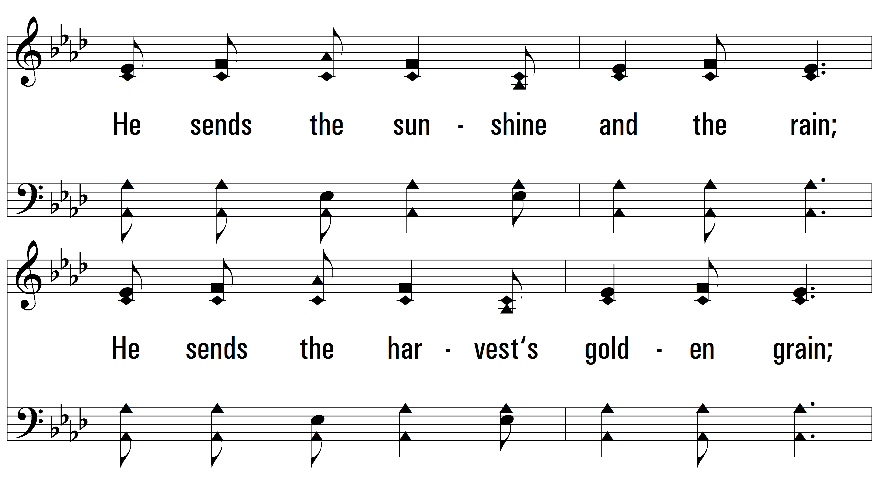
vs. 2

Slide 9
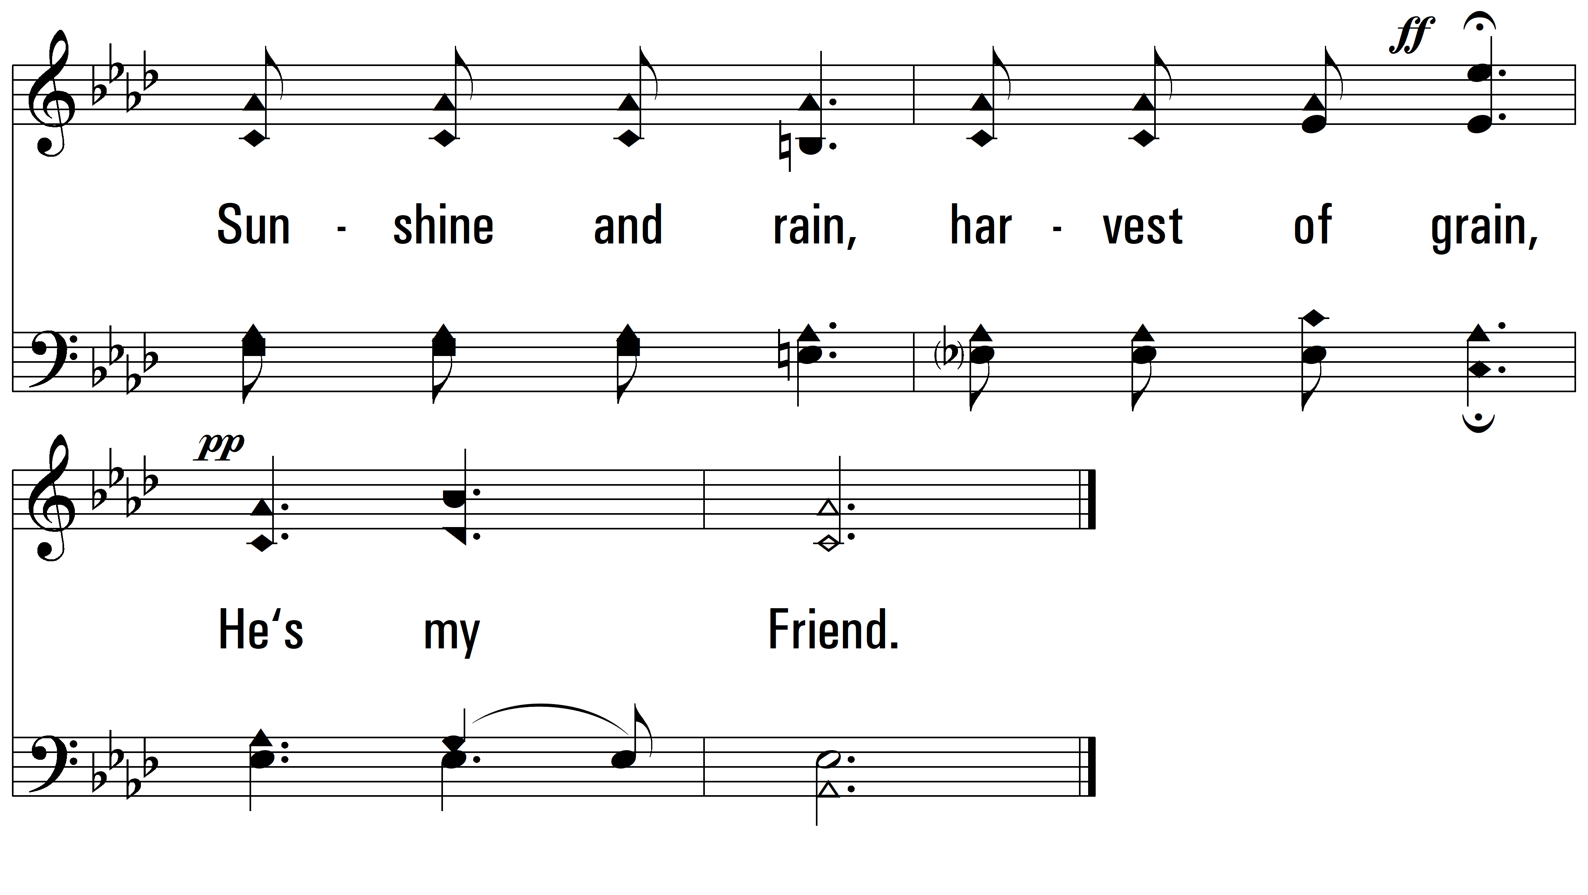
vs. 2

Slide 10
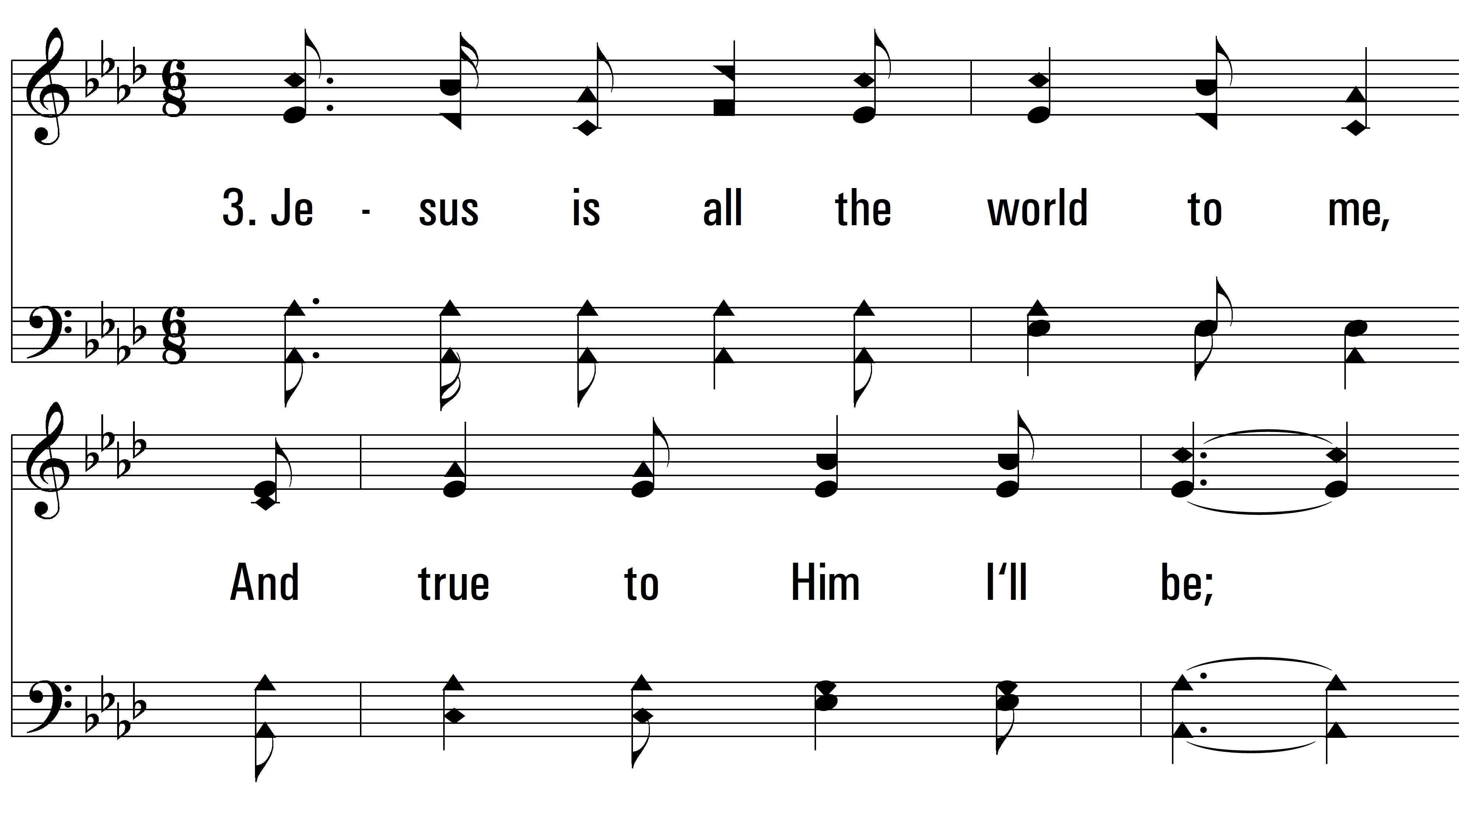
vs. 3 ~ Jesus Is All The World To Me

Slide 11
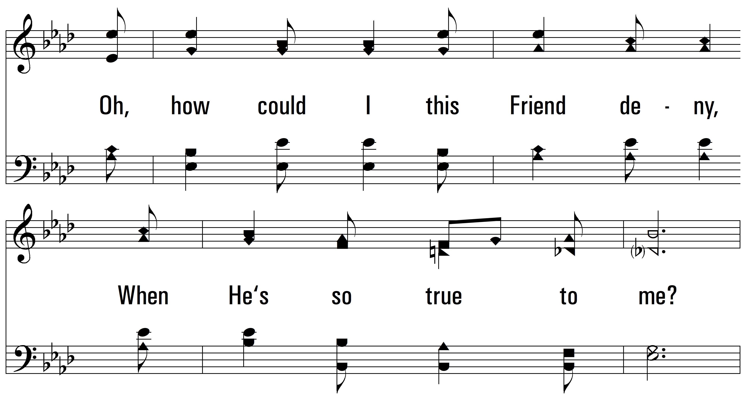
vs. 3

Slide 12
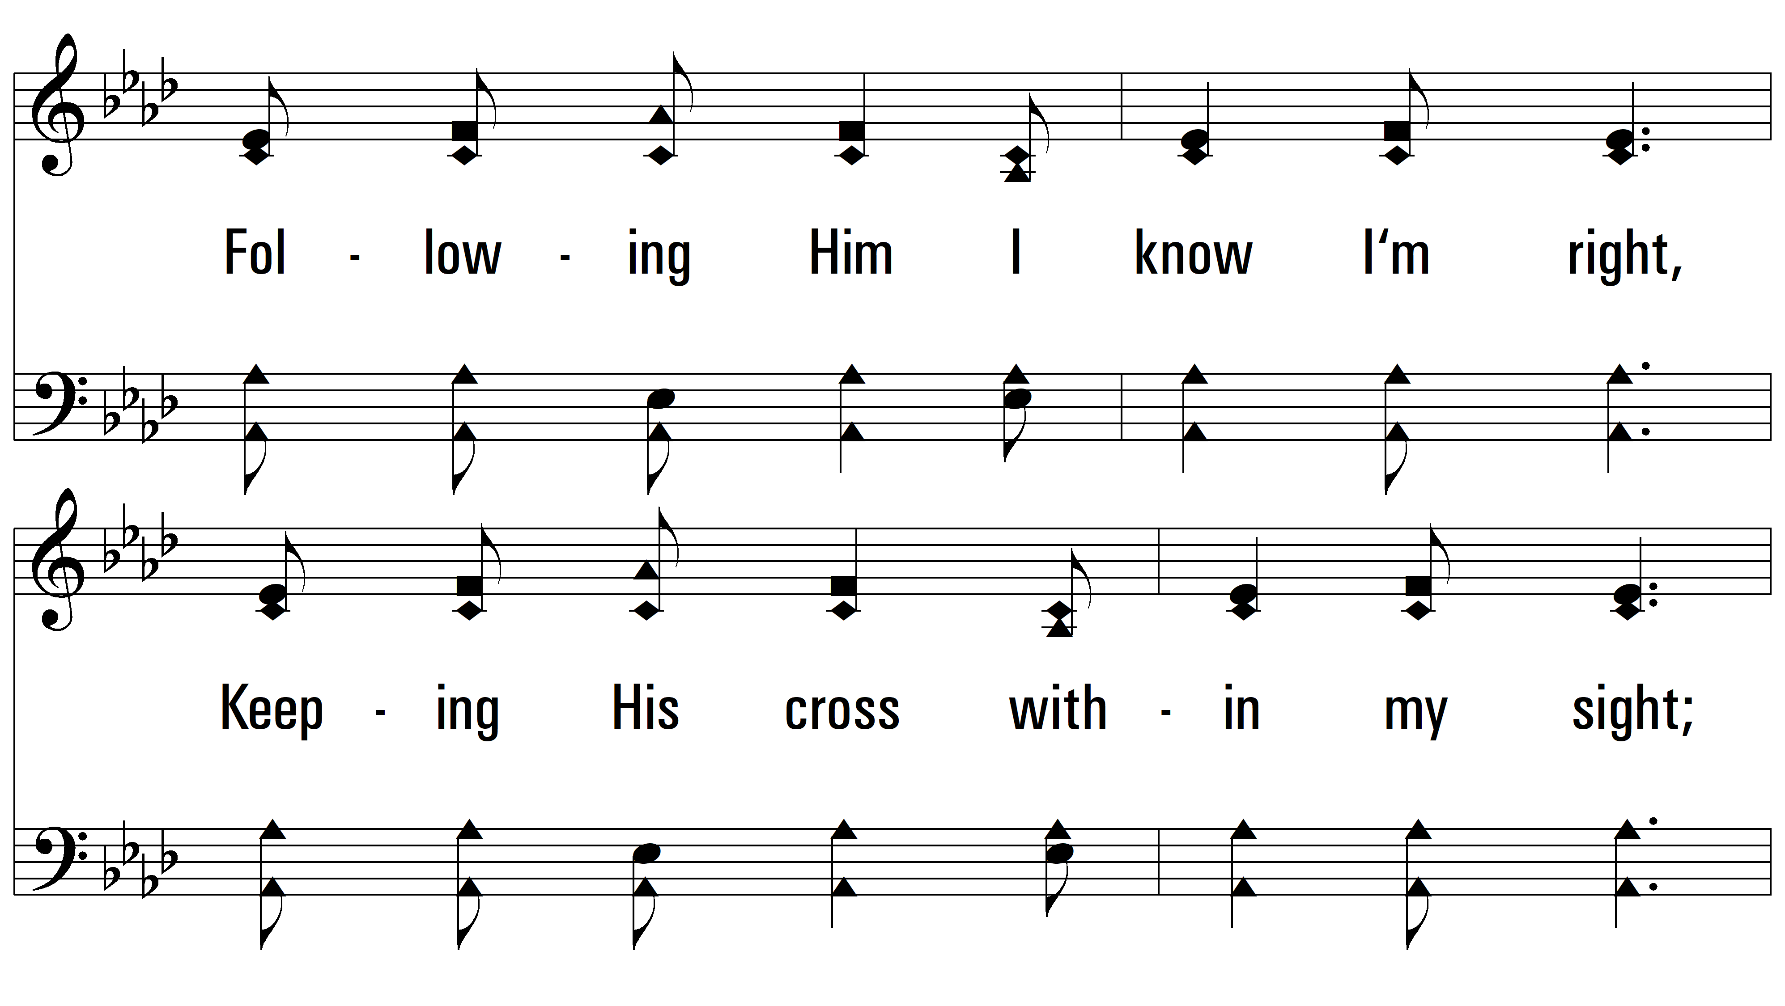
vs. 3

Slide 13
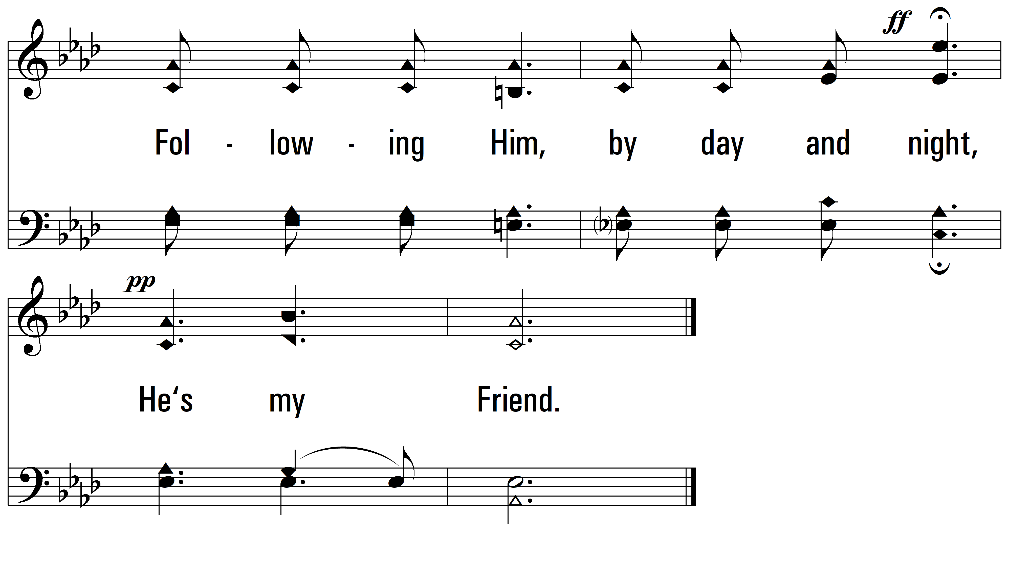
vs. 3

Slide 14
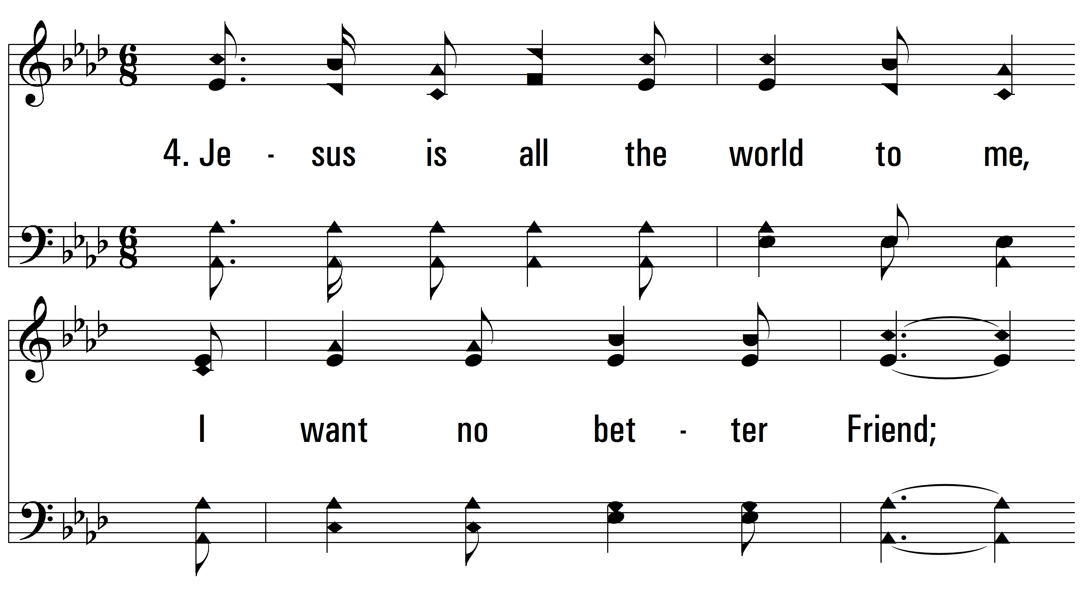
vs. 4 ~ Jesus Is All The World To Me

Slide 15
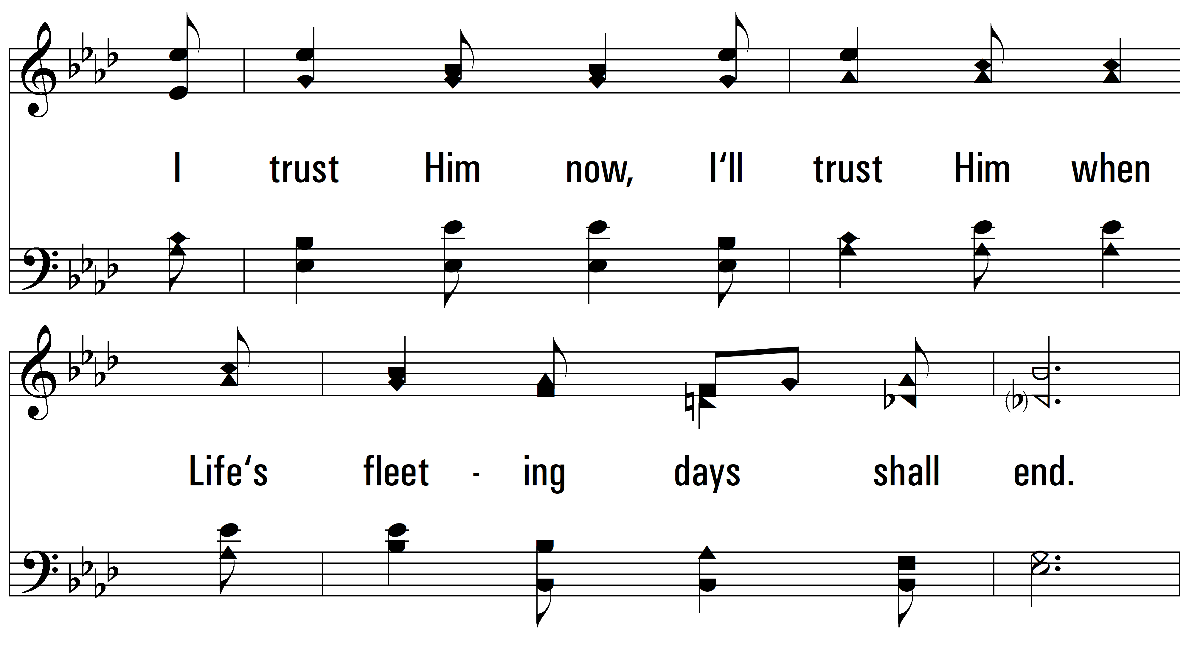
vs. 4

Slide 16
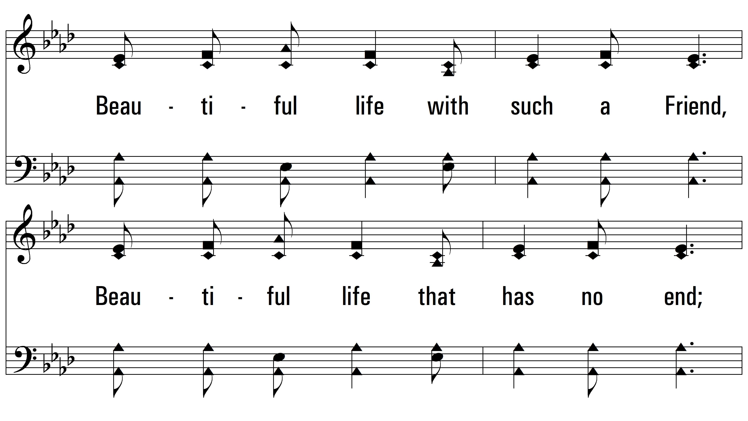
vs. 4

Slide 17
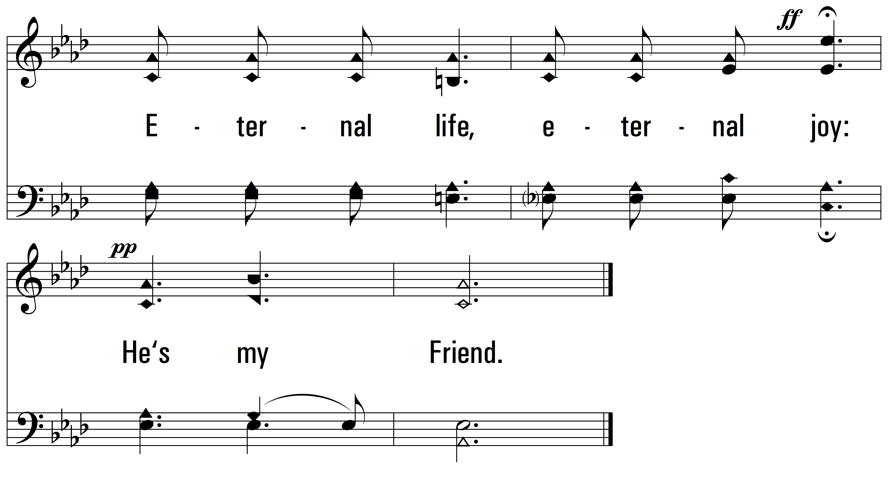
vs. 4
PDHymns.com
END

