Slide 1
Jesus Christ Is Risen Today
LLANFAIR
7.7.7.7.ALLELUIAS
Words: | Latin Hymn, 14th century, Tr. by Lyra Davidica (1708), alt. st. 4 by Charles Wesley (1740)
Music: | Robert Williams (1817)
4/4
F/F - DO
Verses: 4
Lead - | DO
Alto - | SOL
Tenor - | MI
Bass - | DO
PDHymns.com

Slide 2
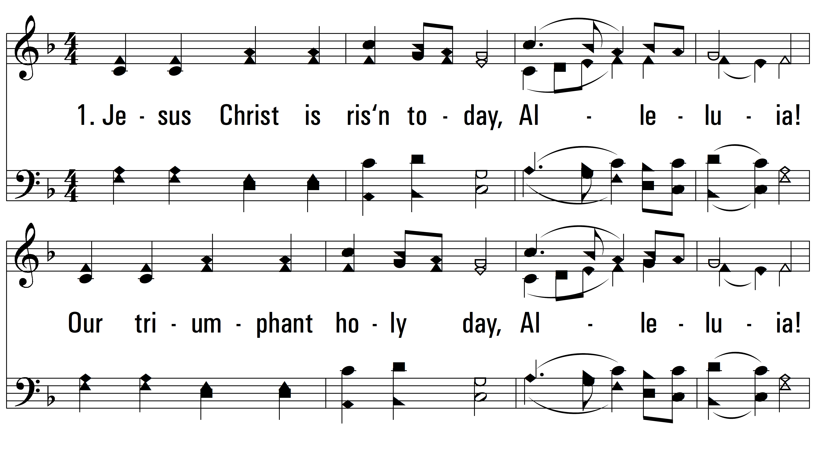
vs. 1 ~ Jesus Christ Is Risen Today

Slide 3
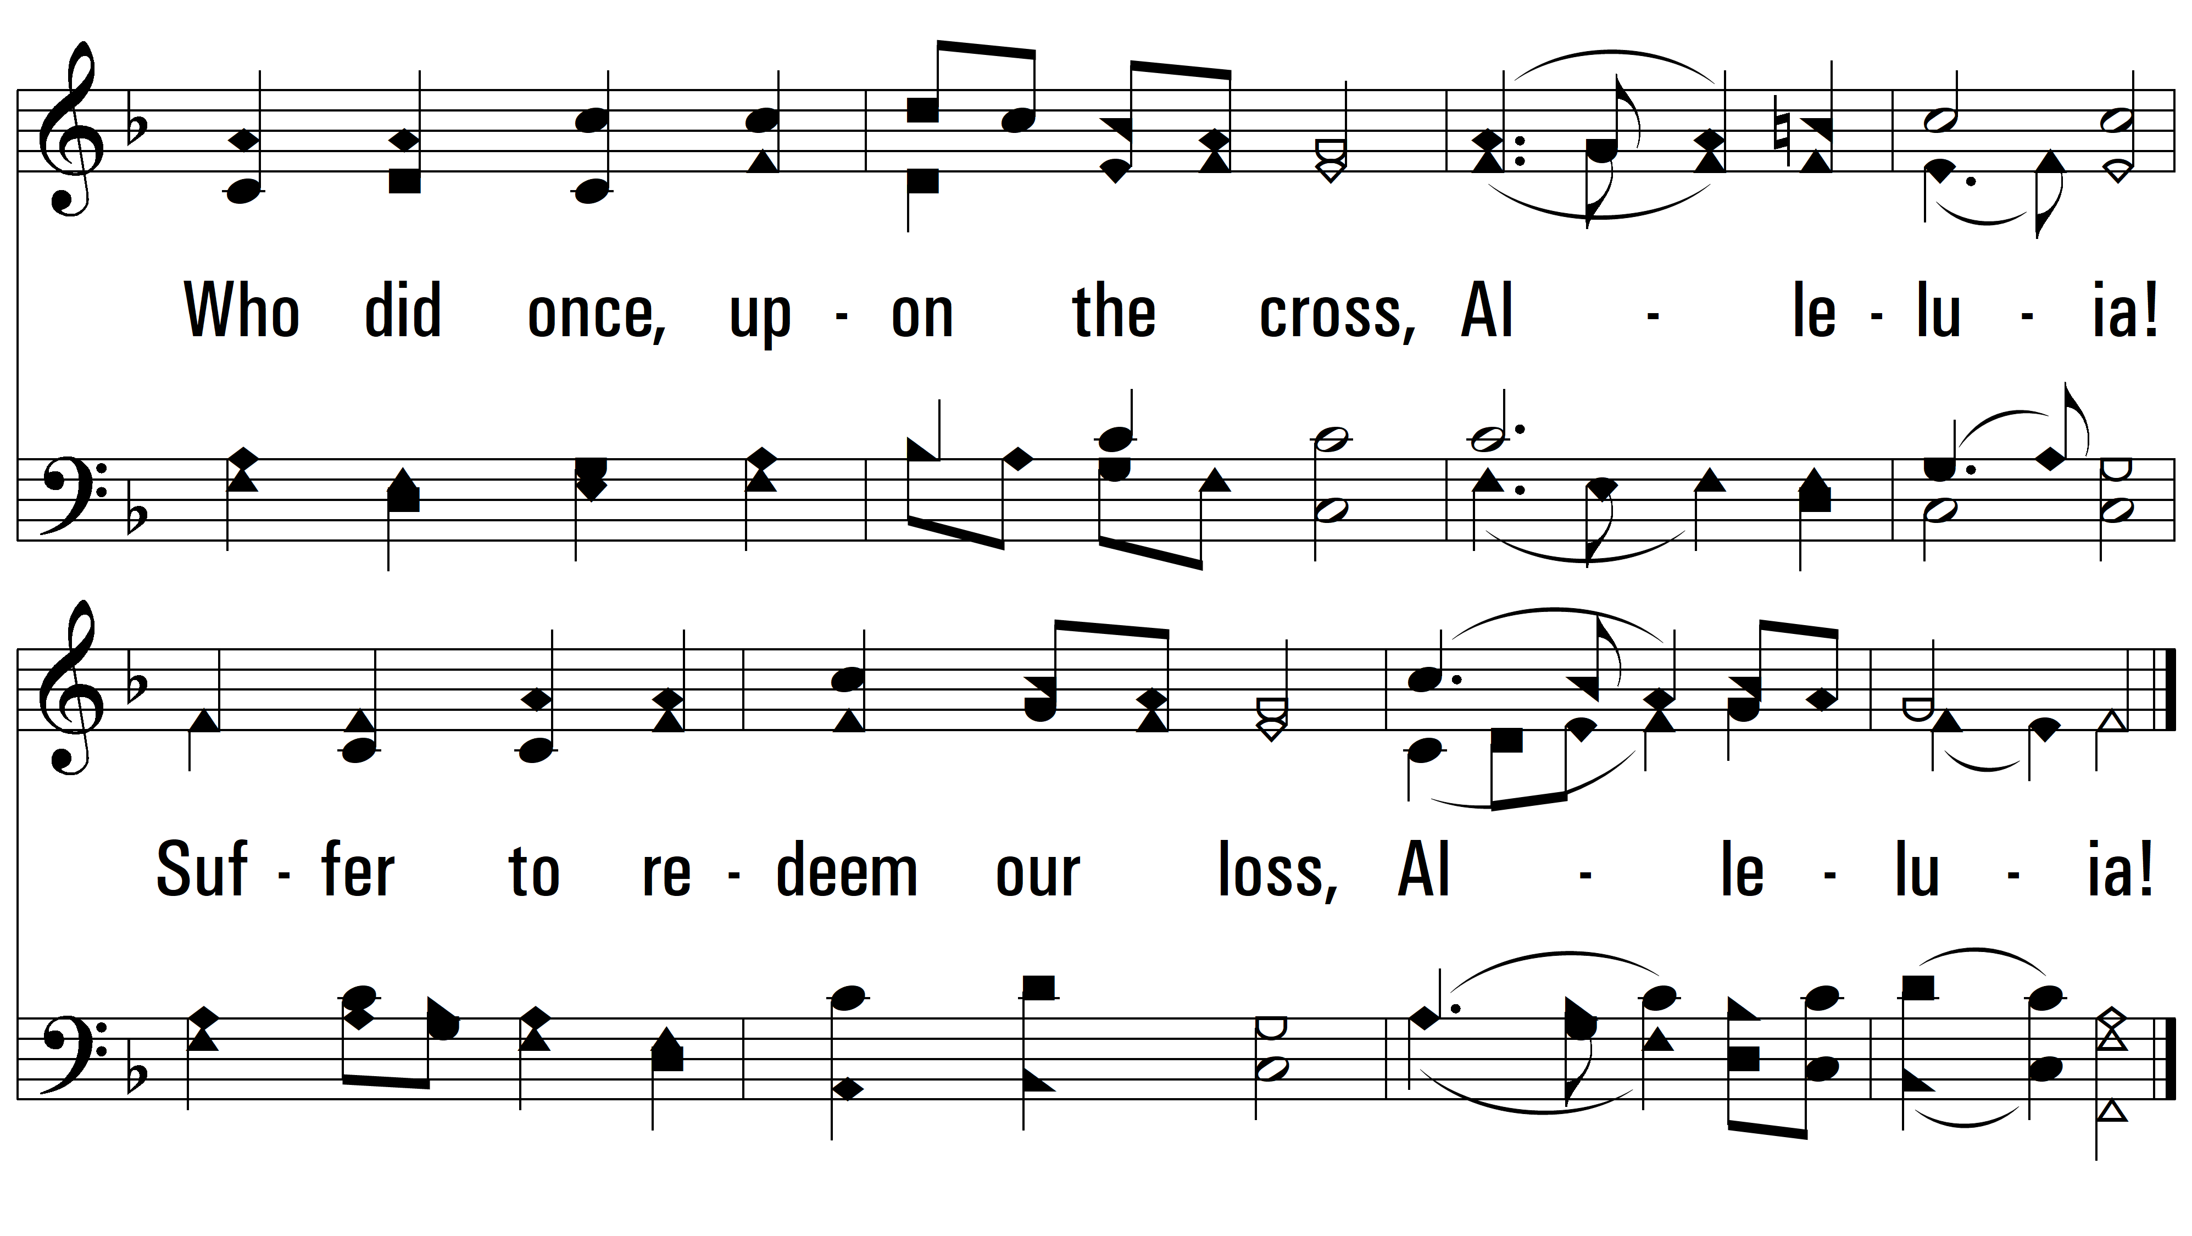
vs. 1

Slide 4
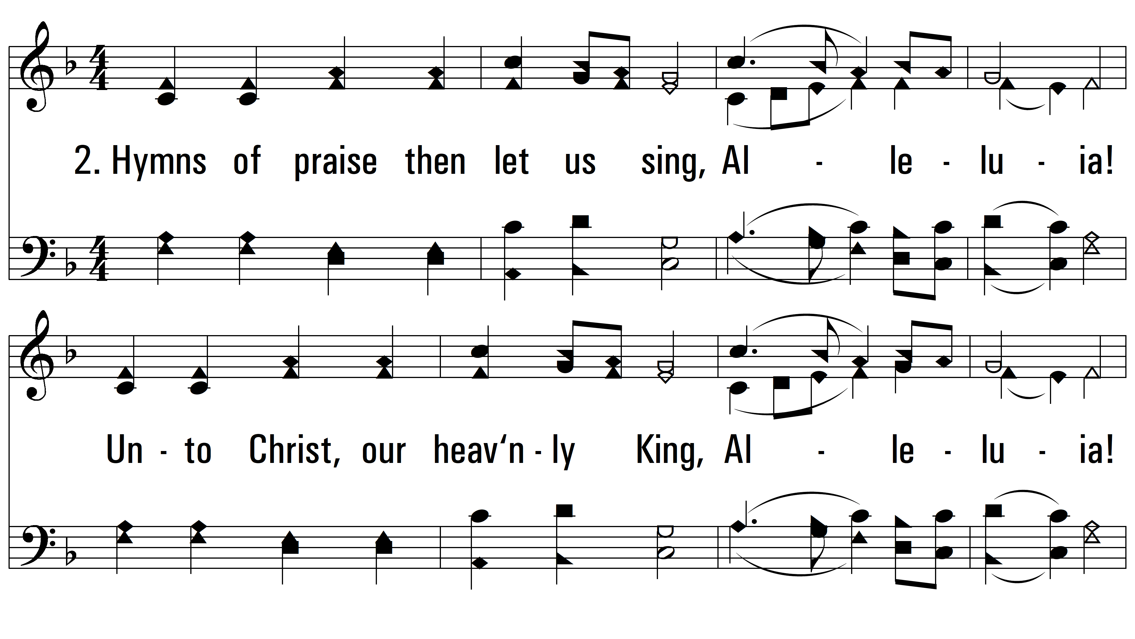
vs. 2 ~ Jesus Christ Is Risen Today

Slide 5
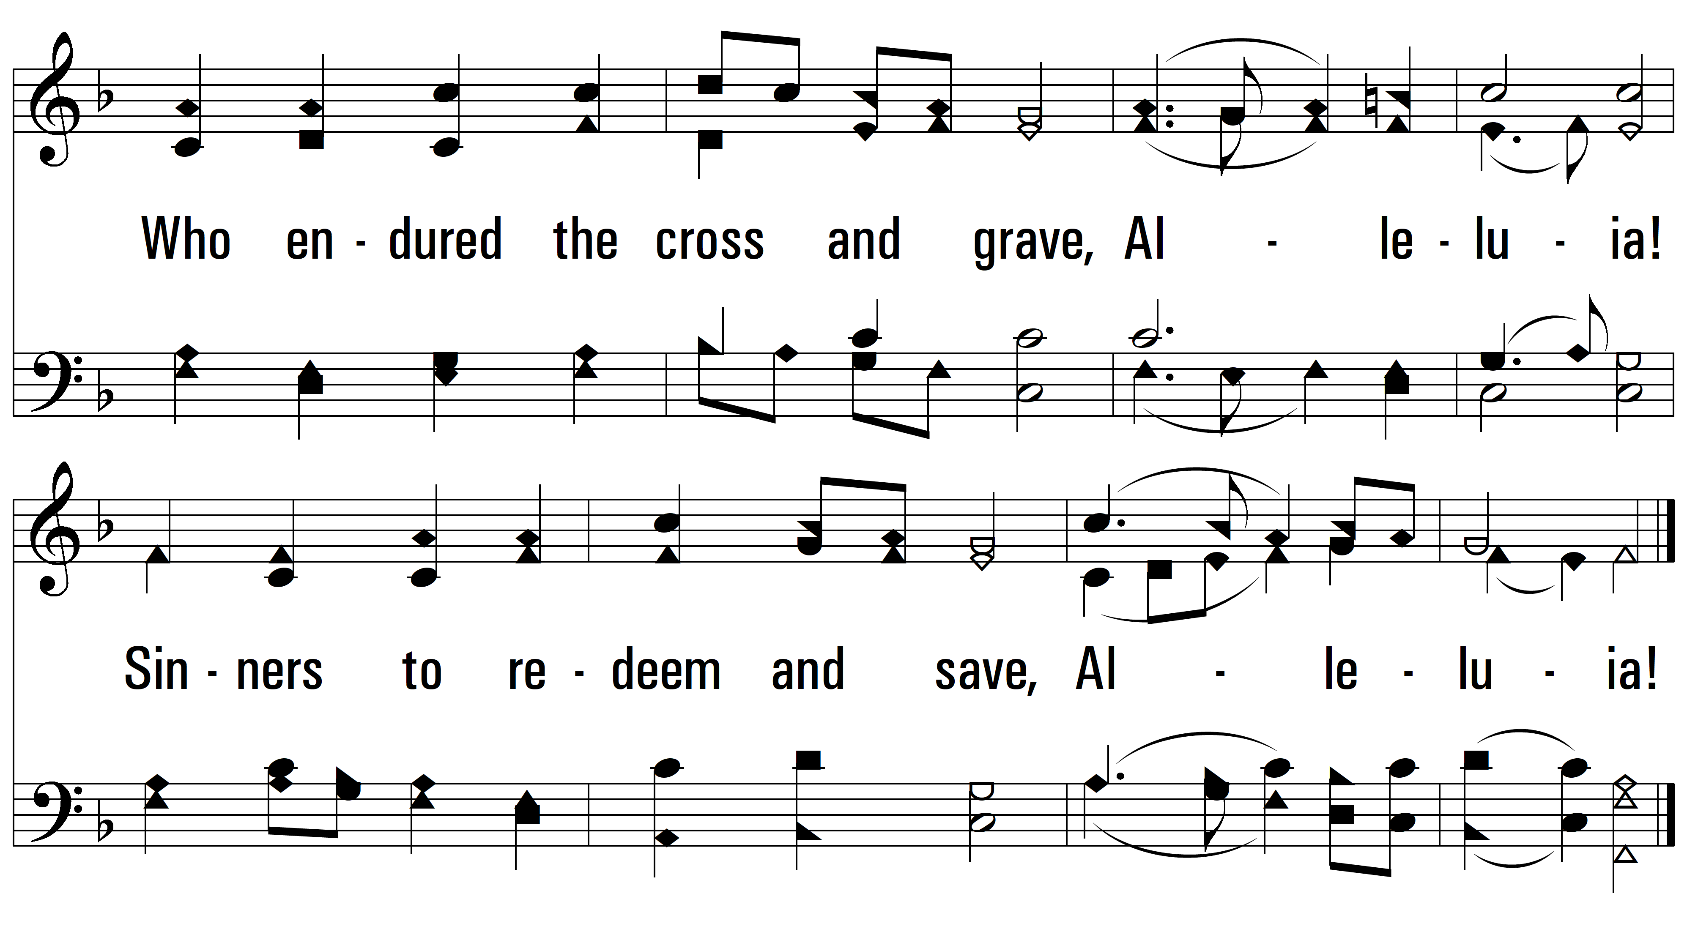
vs. 2

Slide 6
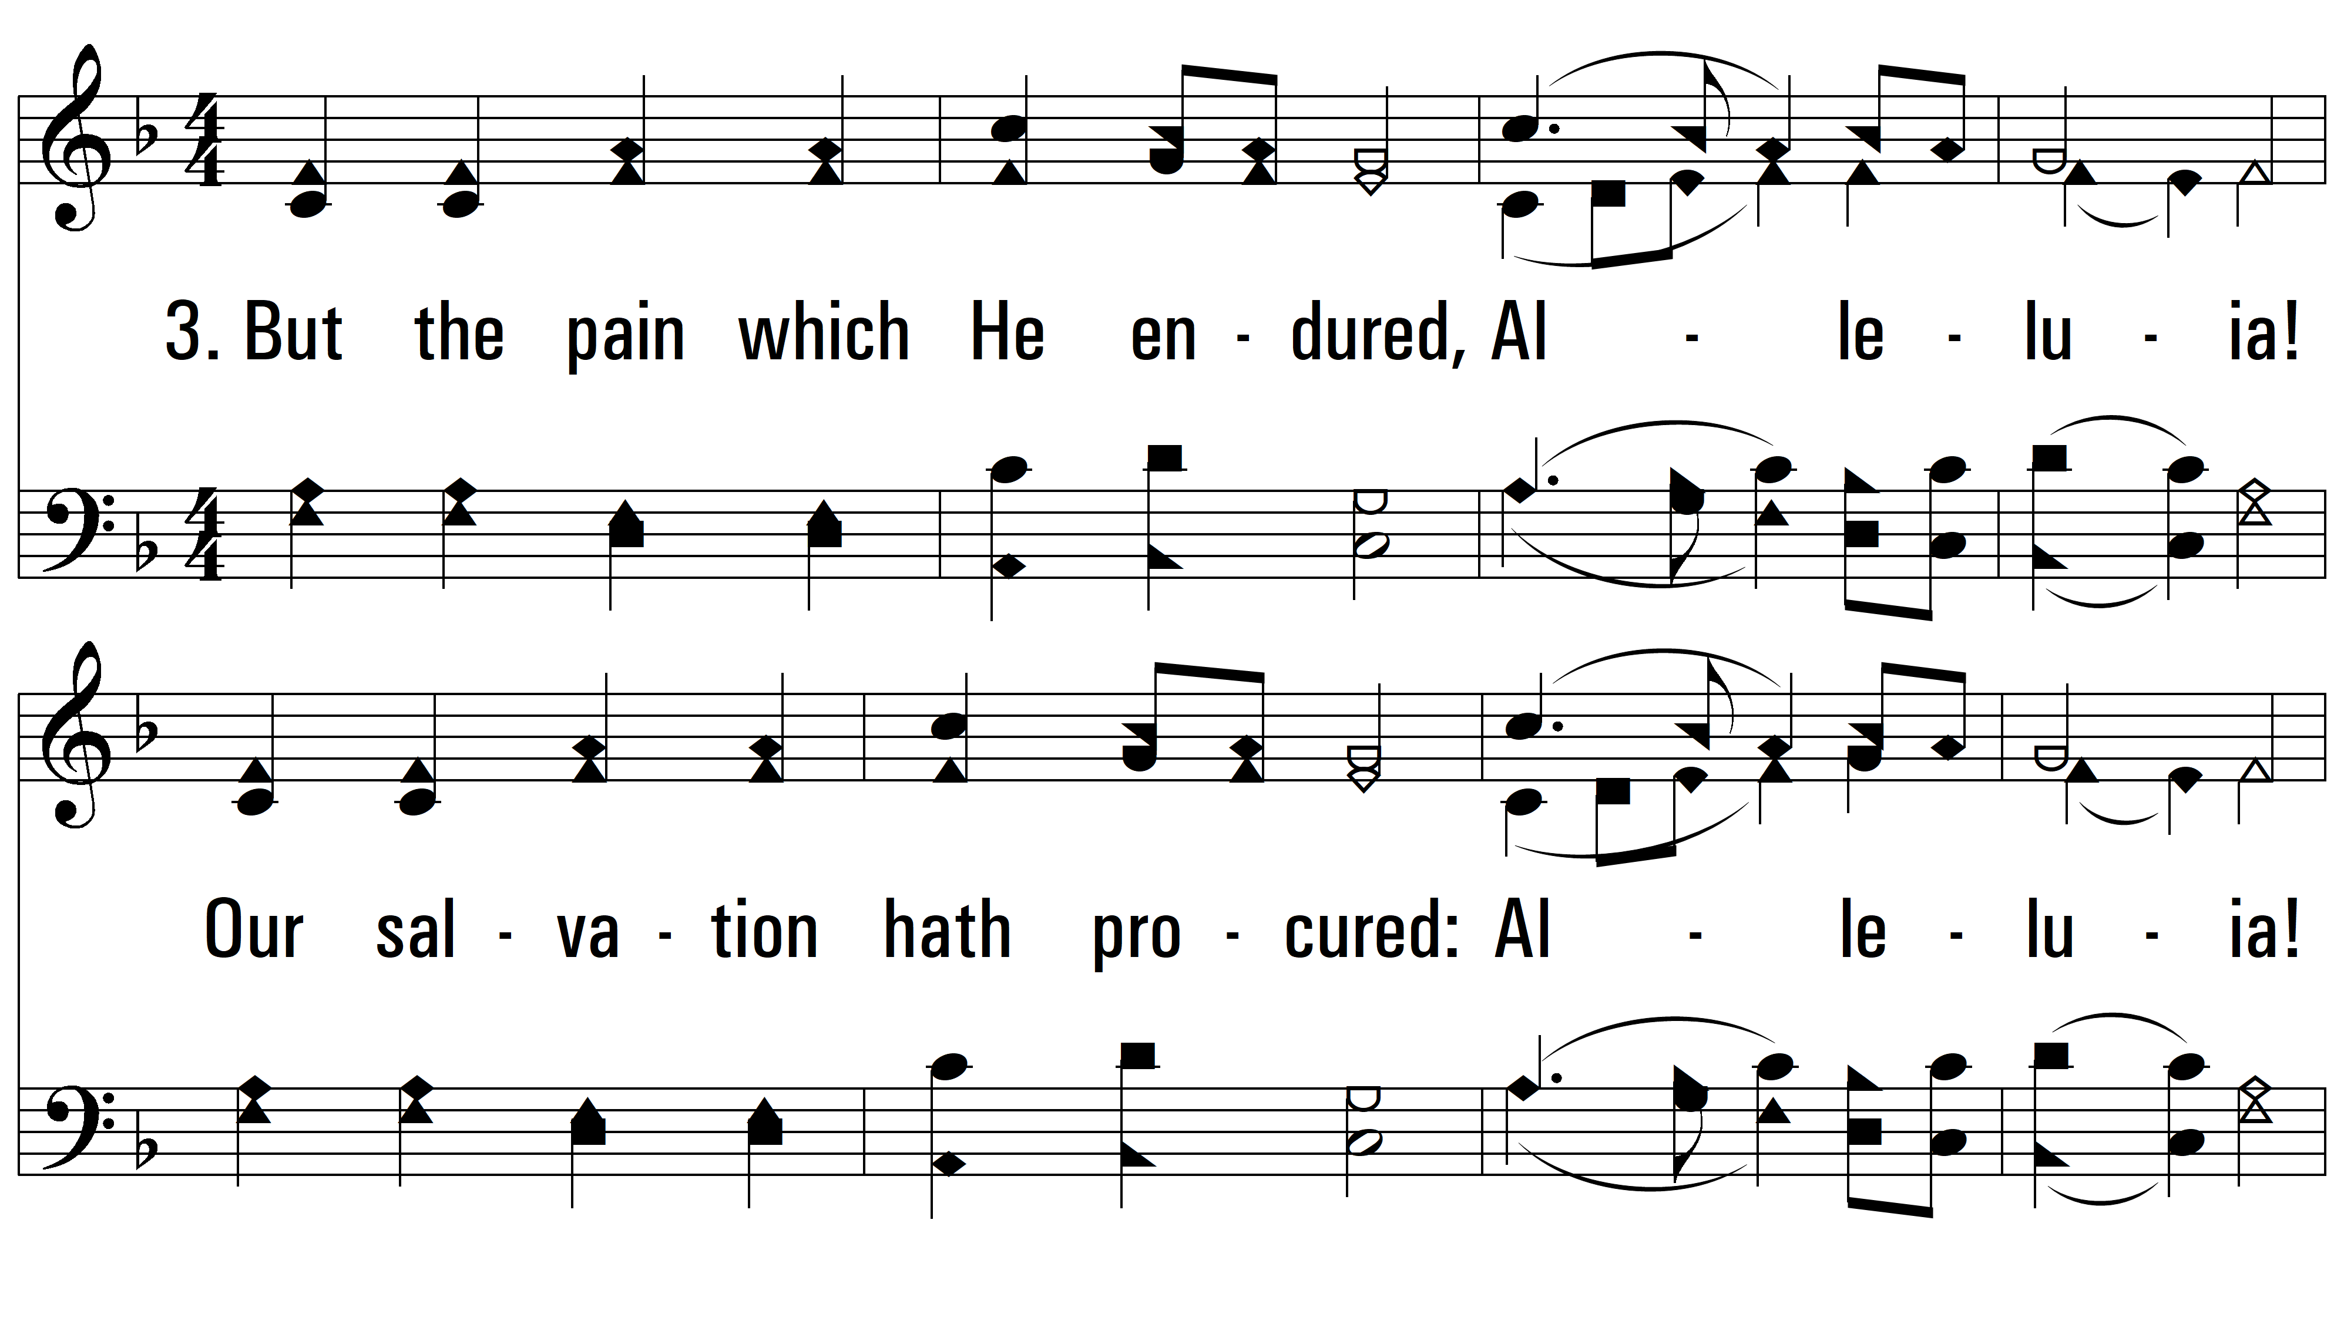
vs. 3 ~ Jesus Christ Is Risen Today

Slide 7
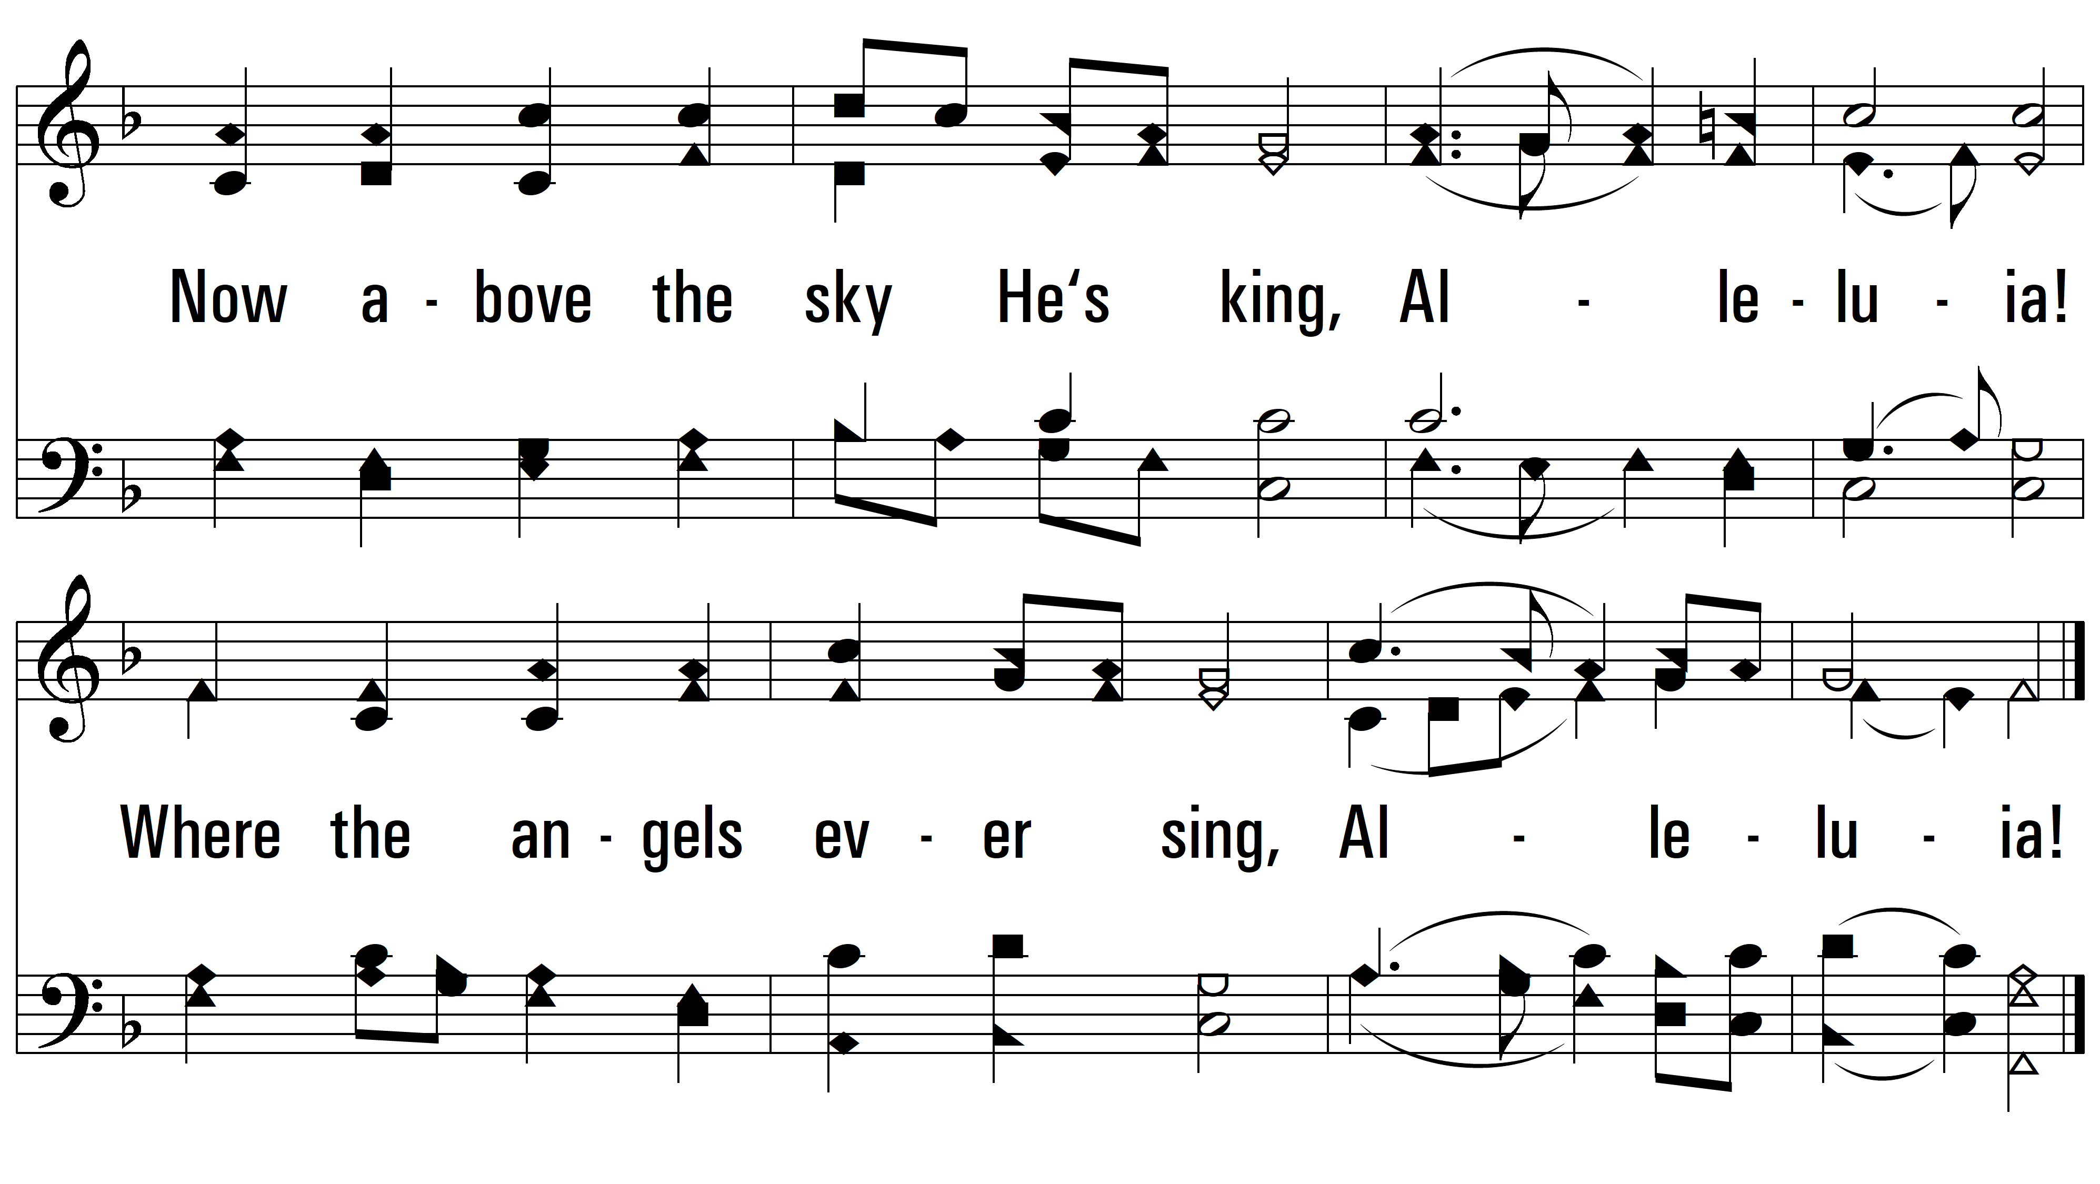
vs. 3

Slide 8
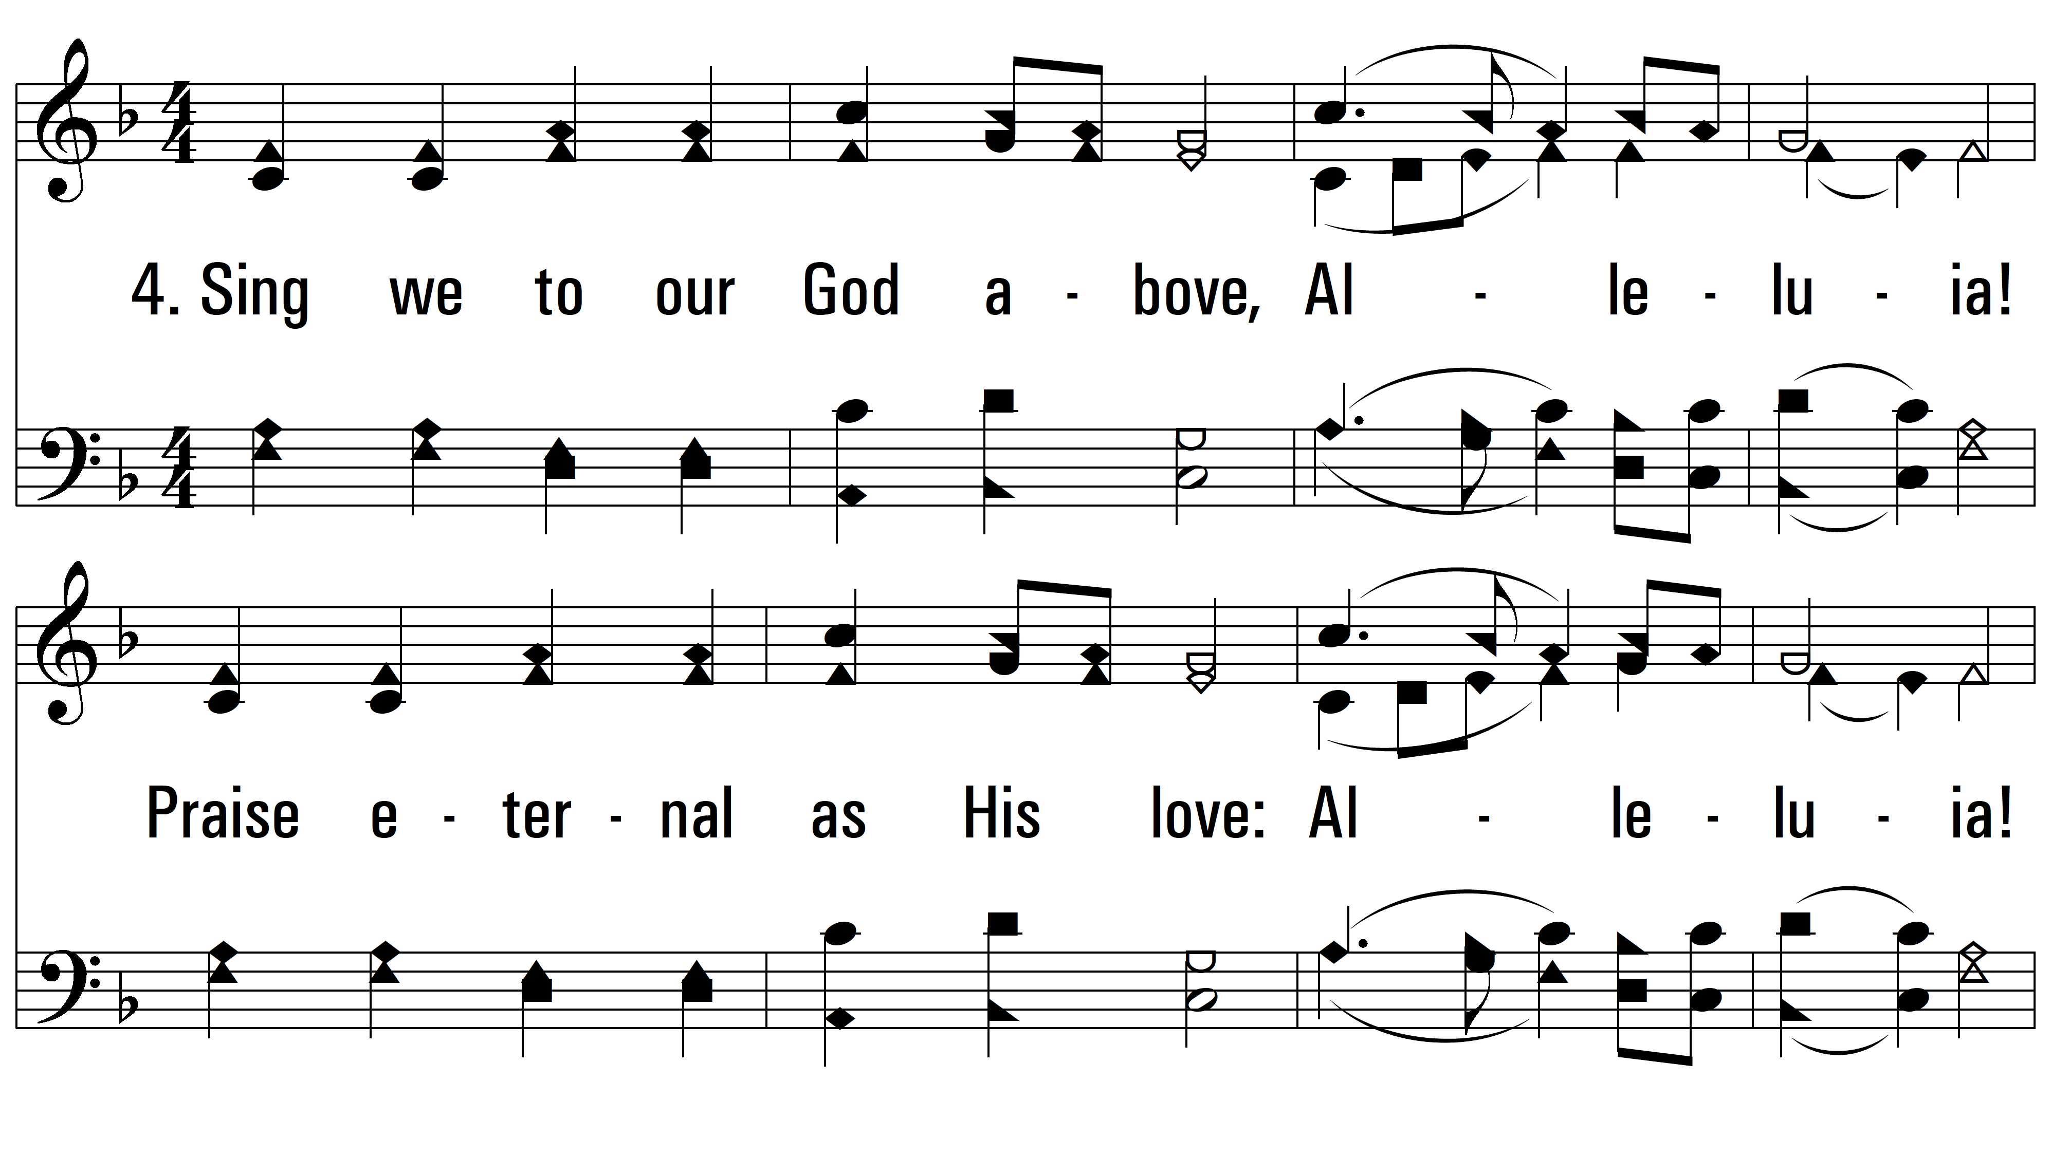
vs. 4 ~ Jesus Christ Is Risen Today

Slide 9
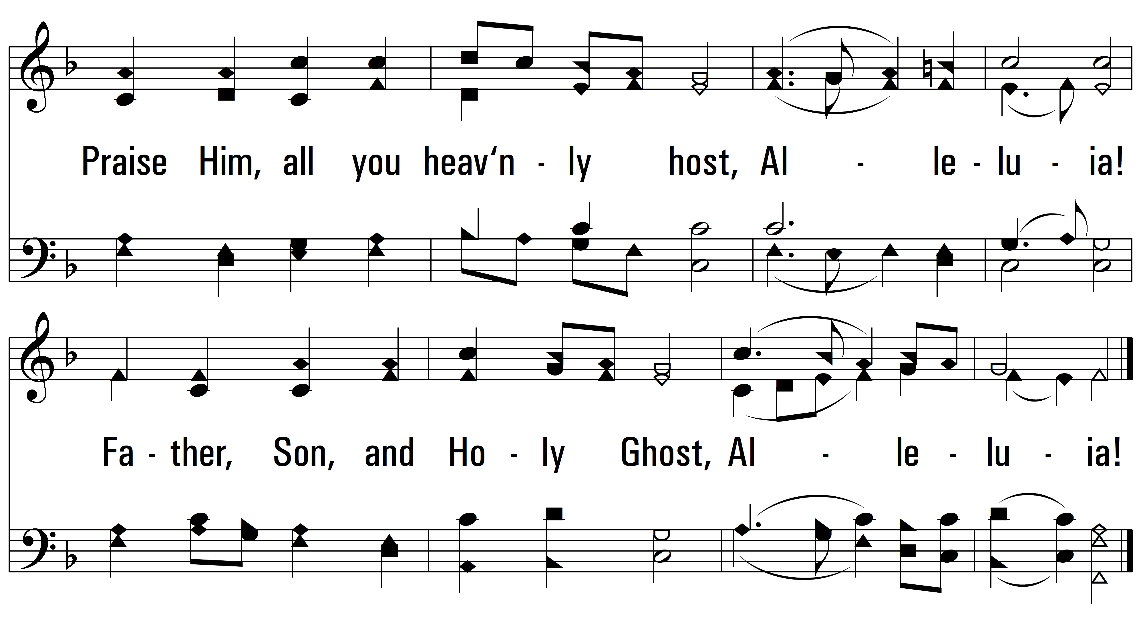
vs. 4
PDHymns.com
END

